Slide 1

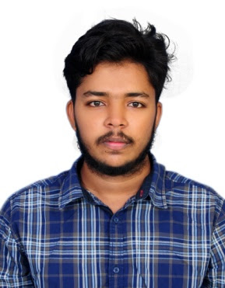




Aravindswamy Thoutam
Education and certificates
Bachelor of Technology
Mining Engineering : 2017 - 2021
Analyst/Software Engineer
Base Location:Bangalore
Skills
Mendix
Servicenow
Spring Boot Spring MVC
JPA CRUD
Bootstrap
Email ID:
xxxxxxxxxxx@capgemini.com
_{Mobile No:} +91 7993631908
Grade:
A4
Strengths
A self driven learner with Front-End and Back-End knowledge. Passionate about implementing and launching new projects.
Ready to learn new technologies/Frameworks and implement them to further improve my knowledge.
A team player with good communication skill always ready to work for the enrichment of knowledge.
Have done usecases using Mendix and Servicenow low code tools.Also done a flight reservation project using SpringBoot
Achivement
Flight Reservation Application
Backend
Spring Boot/Spring Security
REST-API
JavaScript
Completed end to end case study of Flight Reservationusing Springboot and PostgresSql for database.Created flight checkin application by using REST services provided by Flight Reservation application.
Database
SQL database – MySQL
Coded and designed Static Web Pages
Web Technologies
HTML5 CSS3
Javascript/TypeScript
Developed website with HTML5 and CSS3 to make website more interactive and dynamic.
Developed multiple usecases using mendix and servicenow
AddOns Github Maven Postman
Additional Details
Excellent Communication Skills
Team Player
Check out my work on GitHub
Presentation Title | Author | Date © Capgemini 2017. All rights reserved | 1

