Slide 1
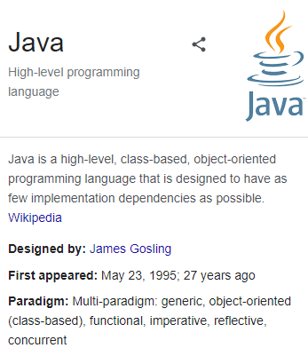

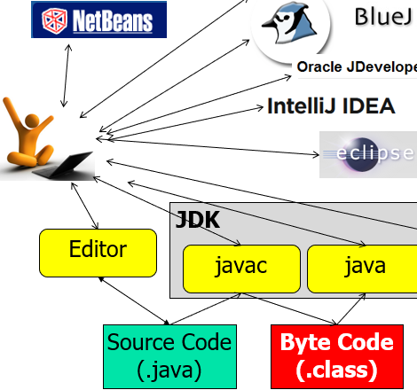
Αντικειμενοστρεφής Προγραμματισμός (Object-Oriented Programming)
Java Technology
Introduction
(CEID_NNY106)
Κύρια Πηγή
Κεφάλαιο: 3
3.1-3.5
Kleanthis Thramboulidis
Prof. of Software and System Engineering
University of Patras
https://sites.google.com/site/thramboulidiskleanthis/

Slide 2
Οργάνωση Διάλεξης
Java Technology
Απλά Προγράμματα σε Java
Hello World!
Echo
Java Development Kit (JDK)
Java Virtual Machine (JVM)
javac
java
javadoc
jar
jdb
© 2023 Κλεάνθης Θραμπουλίδης
Java Technology – Εισαγωγή
Διαφάνεια 2

Slide 3
Java Technology
Με τον όρο τεχνολογία Java αναφερόμαστε:
στη γλώσσα προγραμματισμού, και
στην πλατφόρμα λογισμικού που είναι η υποδομή για ανάπτυξη προγραμμάτων με χρήση της γλώσσας.
Java Development Kit (JDK)
Javac: O μεταγλωττιστής (compiler) της Java
Java: O διερμηνευτής (interpreter) της Java
Java Runtime Environment (JRE): Java Virtual Machine (JVM) + class libraries
© 2023 Κλεάνθης Θραμπουλίδης
Java Technology – Εισαγωγή
Διαφάνεια 3

Slide 4








Java Technology
Oracle JDeveloper is a free integrated development environment that simplifies the development of Java-based SOA and Java EE applications.
- a multi-language Integrated development environment (IDE) comprising a base workspace and an extensible plug-in system for customizing the environment.
- is written mostly in Java.
- can be used to develop applications in Java and, by means of various plug-ins, other programming languages including Ada, C, C++, COBOL, Fortran, Haskell, JavaScript, Perl, PHP, Python, R, Ruby (including Ruby on Rails framework), Scala, Clojure, Groovy, Scheme, and Erlang.
JDK
Editor
javac
java
jdb
…
JRE
Source Code
(.java)
Byte Code
(.class)
© 2023 Κλεάνθης Θραμπουλίδης
Java Technology – Εισαγωγή
Διαφάνεια 4

Slide 5
Οργάνωση Διάλεξης
Java Technology
Απλά Προγράμματα σε Java
Hello World!
Echo
Java Development Kit (JDK)
Java Virtual Machine (JVM)
javac
java
javadoc
jar
jdb
© 2023 Κλεάνθης Θραμπουλίδης
Java Technology – Εισαγωγή
Διαφάνεια 5

Slide 6
Hello World σε Java
/****************************************************************
* File name : HelloWorld.java
* Compile with javac: javac HelloWorld.java
* Execute with java: java HelloWorld
*
* Developer’s Comments
* The HelloWorld class implements an application that simply
* displays "Hello World!" to the standard output.
****************************************************************/
public class HelloWorld {
public static void main(String[] args) {
System.out.println("Hello, World!");
}
}
Δραστηριότητα 3.2
Το πρόγραμμα HelloWorld
Αναπτύξτε ένα πρόγραμμα σε Java που θα τυπώνει στην οθόνη τη φράση «Hello
World!».
© 2023 Κλεάνθης Θραμπουλίδης
Java Technology – Εισαγωγή
Διαφάνεια 6

Slide 7
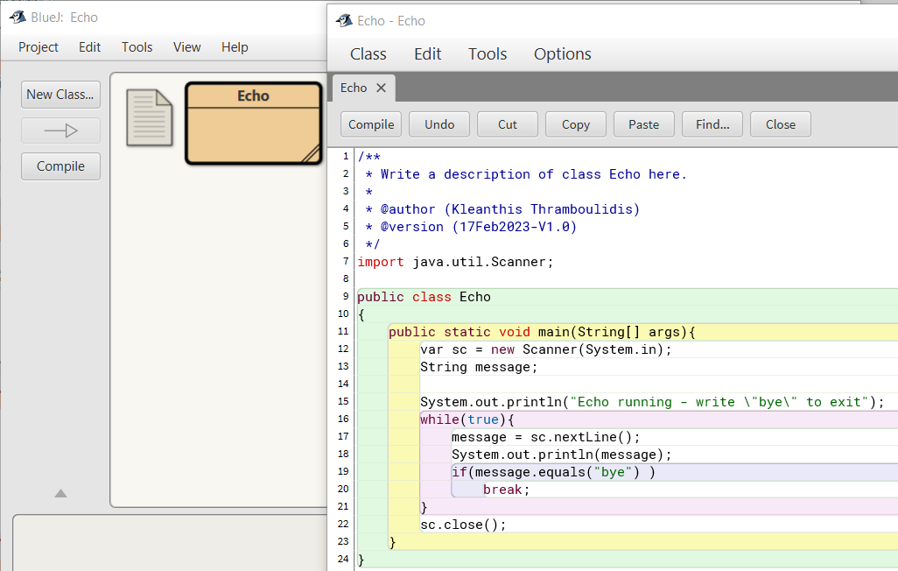
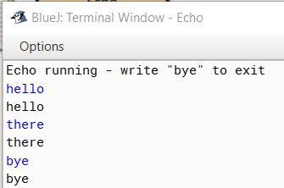
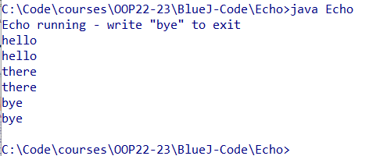
Echo example program
© 2023 Κλεάνθης Θραμπουλίδης
Java Technology – Εισαγωγή
Διαφάνεια 7

Slide 8
Οργάνωση Διάλεξης
Java Technology
Απλά Προγράμματα σε Java
Hello World!
Echo
Java Development Kit (JDK)
Java Virtual Machine (JVM)
javac
java
javadoc
jar
jdb
© 2023 Κλεάνθης Θραμπουλίδης
Java Technology – Εισαγωγή
Διαφάνεια 8

Slide 9
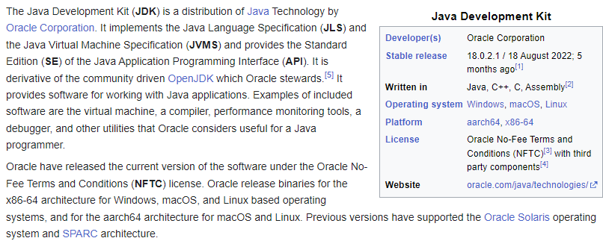
Java Development Kit (JDK)
Πηγή: Wikipedia
© 2023 Κλεάνθης Θραμπουλίδης
Java Technology – Εισαγωγή
Διαφάνεια 9

Slide 10
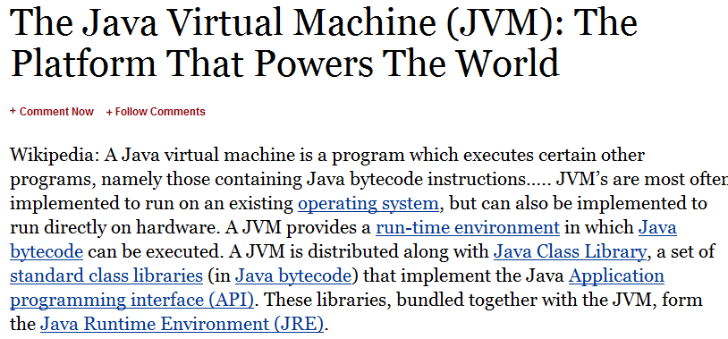
Java Development Kit (JDK)
Source: Forbes
© 2023 Κλεάνθης Θραμπουλίδης
Java Technology – Εισαγωγή
Διαφάνεια 10

Slide 11
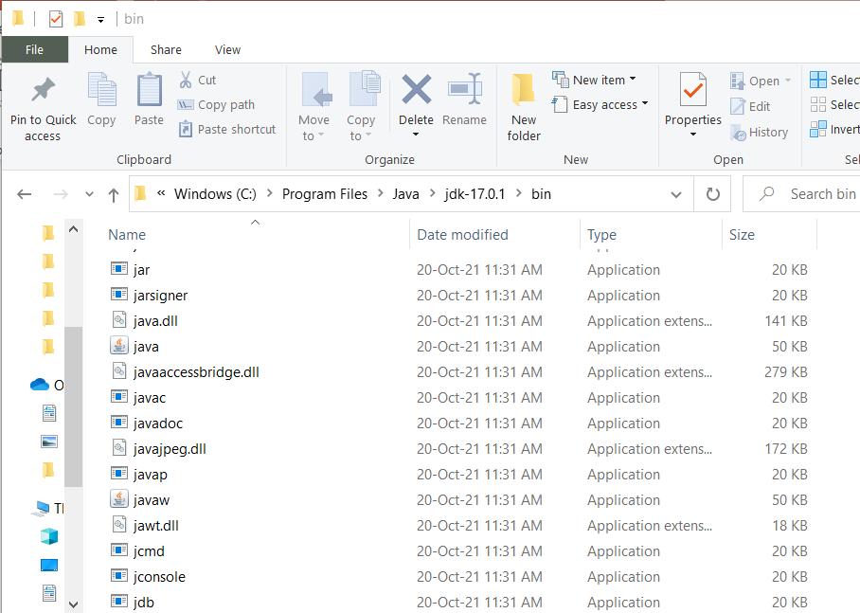
JDK Tools
Δραστηριότητα 3.1
Εγκατάσταση του JDK.
Κατεβάστε1 και εγκαταστήστε στον υπολογιστή σας το Java Development Kit (JDK).
© 2023 Κλεάνθης Θραμπουλίδης
Java Technology – Εισαγωγή
Διαφάνεια 11

Slide 12
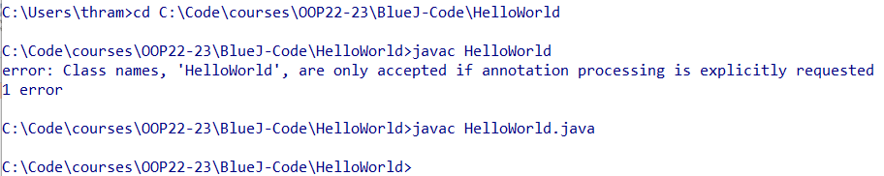
javac
The Java programming language compiler
The javac tool reads class and interface definitions, written in the Java programming language, and compiles them into bytecode class files.
javac HelloWorld.java
Editor
javac
Source code file names must have .java suffixes,
class file names must have .class suffixes, and both source and class files must have root names that identify the class.
For example, a class called MyClass would be written in a source file called MyClass.java and compiled into a bytecode class file called MyClass.class.
Source Code
(.java)
Byte Code
(.class)
© 2023 Κλεάνθης Θραμπουλίδης
Java Technology – Εισαγωγή
Διαφάνεια 12

Slide 13
Javac
javac [ options ] [ sourcefiles ] [ classes ] [ @argfiles ]
Arguments may be in any order.
options: Command-line options.
sourcefiles: One or more source files to be compiled (such as MyClass.java).
classes: One or more classes to be processed for annotations (such as MyPackage.MyClass).
@argfiles: One or more files that lists options and source files. The -J options are not allowed in these files.
The javac tool reads class and interface definitions, written in the Java programming language, and compiles them into bytecode class files. (…)
Source: https://docs.oracle.com/javase/7/docs/technotes/tools/windows/javac.html
© 2023 Κλεάνθης Θραμπουλίδης
Java Technology – Εισαγωγή
Διαφάνεια 13

Slide 14
Java
The Java application launcher
The java tool launches a Java application.
It does this by starting a Java runtime environment, loading a specified class, and invoking that class's main method.
java HelloWorld
The method declaration must look like the following:
public static void main(String args[])
The method must be declared public and static, it must not return any value, and it must accept a String array as a parameter.
Editor
javac
java
Source Code
(.java)
Byte Code
(.class)
Source: https://docs.oracle.com/javase/7/docs/technotes/tools/windows/java.html
© 2023 Κλεάνθης Θραμπουλίδης
Java Technology – Εισαγωγή
Διαφάνεια 14

Slide 15
Java
java [ options ] class [ arguments ]
java [ options ] -jar file.jar [ arguments ]
javaw [ options ] class [ arguments ]
javaw [ options ] -jar file.jar [ arguments ]
options
Command-line options.
class
Name of the class to be invoked.
file.jar
Name of the jar file to be invoked. Used only with -jar.
argument
Argument passed to the main function.
By default, the first argument without an option is the name of the class to be called.
Source: https://docs.oracle.com/javase/7/docs/technotes/tools/windows/java.html
© 2023 Κλεάνθης Θραμπουλίδης
Java Technology – Εισαγωγή
Διαφάνεια 15

Slide 16
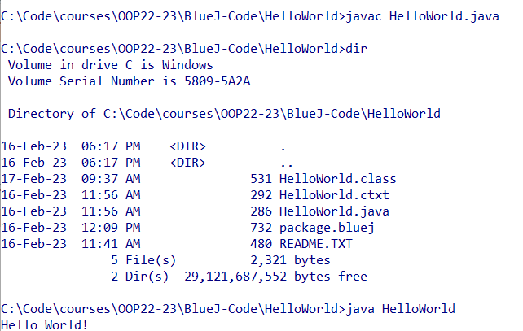
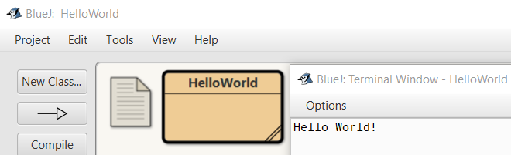
Java HelloWorld
© 2023 Κλεάνθης Θραμπουλίδης
Java Technology – Εισαγωγή
Διαφάνεια 16

Slide 17
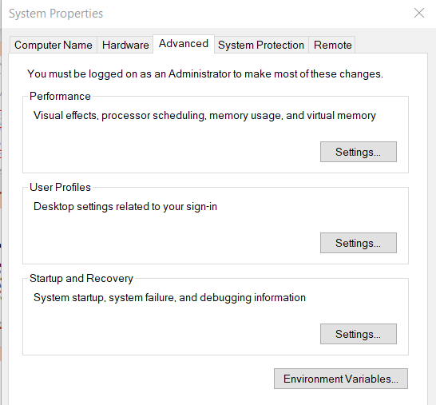
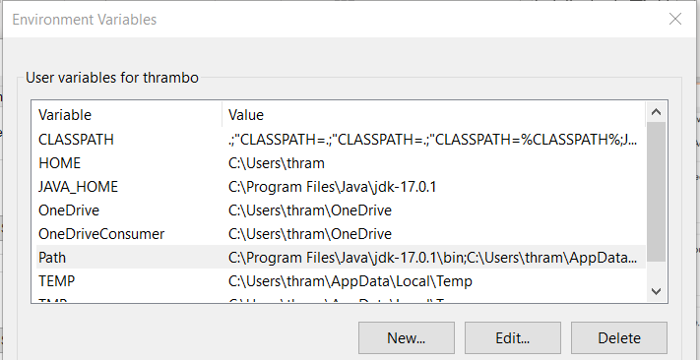
Set path
Windows
in the Environment Variables window (as shown below), highlight the Path variable in the Systems Variable section and click the Edit button. Add or modify the path lines with the paths you wish the computer to access.
Windows command prompt
path
set path=%PATH%;c:\bin;
© 2023 Κλεάνθης Θραμπουλίδης
Java Technology – Εισαγωγή
Διαφάνεια 17

Slide 18
Javadoc
The Java API Documentation Generator
Generates HTML pages of API documentation from Java source files.
The JavadocTM tool parses the declarations and documentation comments in a set of Java source files and produces a corresponding set of HTML pages describing (by default) the public and protected classes, nested classes (but not anonymous inner classes), interfaces, constructors, methods, and fields.
You can use it to generate the API (Application Programming Interface) documentation or the implementation documentation for a set of source files.
javadoc [ options ] [ packagenames ] [ sourcefilenames ][ -subpackages pkg1:pkg2:.. ] [ @argfiles ]
Source: https://docs.oracle.com/javase/7/docs/technotes/tools/windows/javadoc.html
© 2023 Κλεάνθης Θραμπουλίδης
Java Technology – Εισαγωγή
Διαφάνεια 18

Slide 19
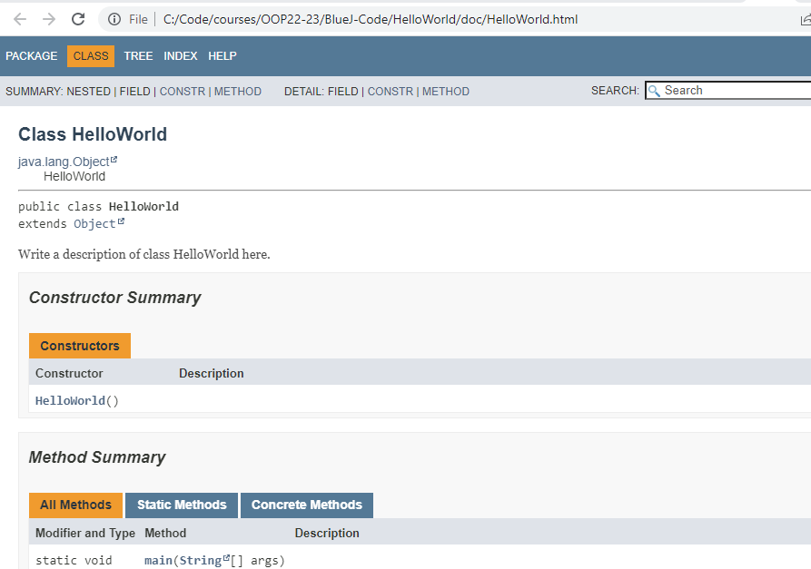
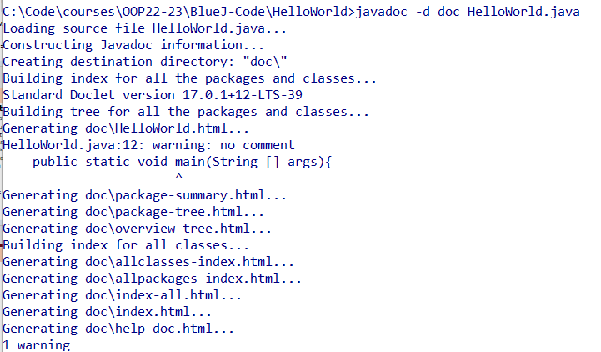
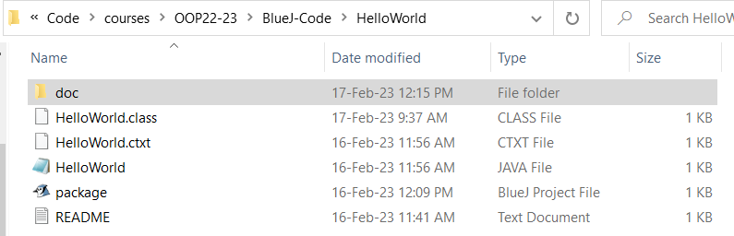
Javadoc for HelloWorld
javadoc -d doc HelloWorld.java
© 2023 Κλεάνθης Θραμπουλίδης
Java Technology – Εισαγωγή
Διαφάνεια 19

Slide 20
jar
The Java Archive Tool
Combines multiple files into a single JAR archive file.
jar is a general-purpose archiving and compression tool, based on ZIP and the ZLIB compression format.
However, jar was designed mainly to facilitate the packaging of java applets or applications into a single archive.
Create jar file
jar c[v0M]f jarfile [-C dir] inputfiles [-Joption]
Typical usage to combine files into a jar file is:
C:\Java> jar cf myFile.jar *.class
Source: https://docs.oracle.com/javase/7/docs/technotes/tools/windows/jar.html
© 2023 Κλεάνθης Θραμπουλίδης
Java Technology – Εισαγωγή
Διαφάνεια 20

Slide 21
jdb
The Java Debugger
jdb helps you find and fix bugs in Java language programs.
is a simple command-line debugger for Java classes.
jdb [ options ] [ class ] [ arguments ]
options
Command-line options.
class
Name of the class to begin debugging.
arguments
Arguments passed to the main() method of class.
© 2023 Κλεάνθης Θραμπουλίδης
Java Technology – Εισαγωγή
Διαφάνεια 21

