Slide 1
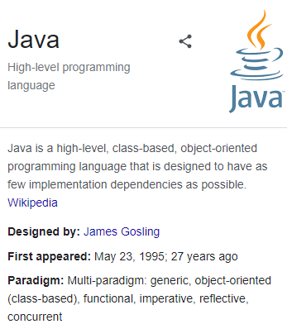

Αντικειμενοστρεφής Προγραμματισμός (Object-Oriented Programming)
Αλληλεπίδραση Ανθρώπου Μηχανής
Human Computer Interaction
(CEID_NNY106)
Κύρια Πηγή
Graphical User Interface (Gui)
Αbstract Window Τoolkit (awt)
RPN Calculator Gui
Κεφάλαιο: 8
8.1-8.3
Kleanthis Thramboulidis
Prof. of Software and System Engineering
University of Patras
https://sites.google.com/site/thramboulidiskleanthis/

Slide 2



Human – Computer Interaction
120 80 + 10 30 * + =
Machine
Human
RPN engine components
Operand
Stack
Adder
Multiplier
Subtractor
Divider
ResultPresenter
library Case study
© 2023 Κλεάνθης Θραμπουλίδης
Human Computer Interaction
Διαφάνεια 2

Slide 3
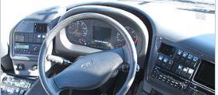

graphical user interface (GUI)
GUI: a type of computer human interface. It solves the blank screen problem that confronted early computer users.
At a conceptual level, a computer human interface is a "means by which people and computers communicate with each other”. One can make an analogy between a computer system's GUI and a car's steering wheel.
It is the look and feel of a program
In computer science terms, the GUI is a visual operating display that the computer presents on the monitor to the computer operator. More specifically, a GUI is a specification for the look and feel of the computer system.
Makes the program easier to use
A program interface that takes advantage of the computer's graphics capabilities to make the program easier to use. Well-designed graphical user interfaces can free the user from learning complex command languages. On the other hand, many users find that they work more effectively with a command-driven interface, especially if they already know the command language.
GUI usually have common characteristic such as windows, icons, menus, and push-buttons (WIMP).
© 2023 Κλεάνθης Θραμπουλίδης
Human Computer Interaction
Διαφάνεια 3

Slide 4
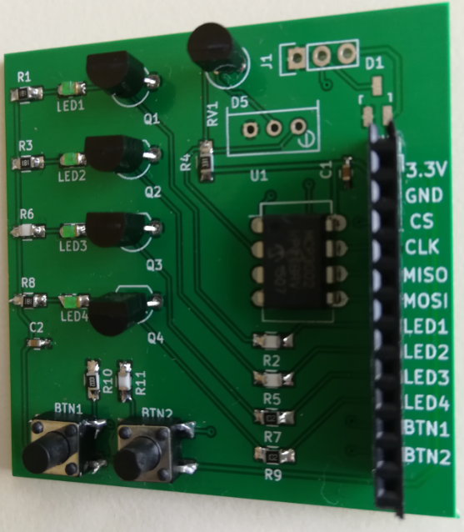
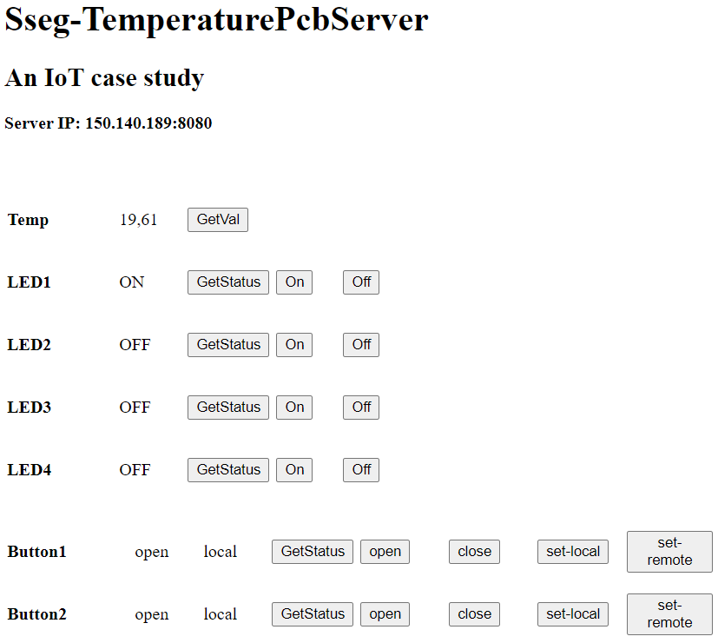
An IoT Gui
TemperaturePcb
Gui
Human
?
© 2023 Κλεάνθης Θραμπουλίδης
Human Computer Interaction
Διαφάνεια 4

Slide 5
Οργάνωση Διάλεξης
Internal vs. external messages
Abstract window toolkit (awt)
Frame
Button
TextField
GUIs στην Java
© 2023 Κλεάνθης Θραμπουλίδης
Human Computer Interaction
Διαφάνεια 5

Slide 6
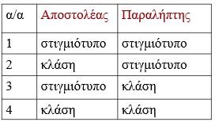
Internal vs. External messages
120 80 + 10 30 * + =
RPN engine components
Operand
Stack
Adder
Multiplier
Subtractor
Divider
ResultPresenter
ΕΣΩΤΕΡΙΚΑ ΜΗΝΥΜΑΤΑ Ανάλογα με την φύση των αντικειμένων αποστολέα και παραλήπτη σε μία ανταλλαγή μηνύματος διακρίνουμε
Human
Δες το παράδειγμα του φούρνου μικροκυμάτων
© 2023 Κλεάνθης Θραμπουλίδης
Human Computer Interaction
Διαφάνεια 6

Slide 7
Εξωτερικά μηνύματα
Θεωρείστε την αλληλεπίδραση της εφαρμογής σας με τον χρήστη.
Μπορείτε να υλοποιήσετε την αλληλεπίδραση αυτή χρησιμοποιώντας τους μηχανισμούς που προσφέρει η Java για αλληλεπίδραση μεταξύ των αντικειμένων που απαρτίζουν την εφαρμογή;
addDigit()
complete()
op:Operand
push()
ad:Adder
pop()
st:Stack
operate()
operate()
pop()
sub:Subtractor
© 2023 Κλεάνθης Θραμπουλίδης
Human Computer Interaction
Διαφάνεια 7

Slide 8
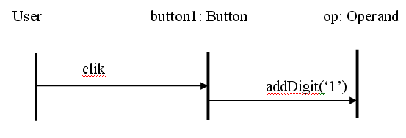
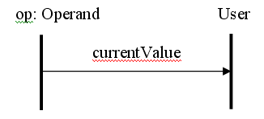
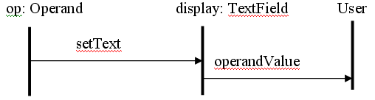
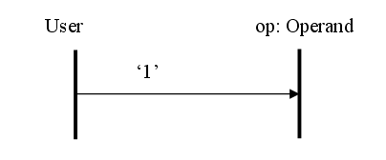
User interaction
Button
TextField
© 2023 Κλεάνθης Θραμπουλίδης
Human Computer Interaction
Διαφάνεια 8

Slide 9
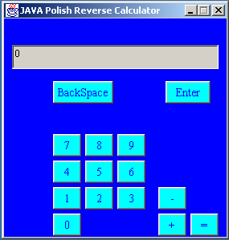
Gui responsibilities
120 80 + 10 30 * + =
Machine
Human
RPN engine components
Operand
Stack
Adder
Multiplier
Subtractor
Divider
ResultPresenter
© 2023 Κλεάνθης Θραμπουλίδης
Human Computer Interaction
Διαφάνεια 9

Slide 10
Οργάνωση Διάλεξης
Internal vs. external messages
Abstract window toolkit (awt)
Frame
Button
TextField
GUIs στην Java
© 2023 Κλεάνθης Θραμπουλίδης
Human Computer Interaction
Διαφάνεια 10

Slide 11
To πακέτο awt (abstract window toolkit)
παρέχει ένα σύνολο από αντικείμενα:
κλάσεις,
interfaces,
exceptions και
Errors.
τα αντικείμενα αυτά μας επιτρέπουν να υλοποιήσουμε την αλληλεπίδραση εφαρμογής-χρήστη.
Java 8: package java.awt
Java 9. module java.desktop
© 2023 Κλεάνθης Θραμπουλίδης
Human Computer Interaction
Διαφάνεια 11

Slide 12
Χαρακτηριστικές κλάσεις του awt
Classes AWTEvent Button Checkbox CheckboxMenuItem Choice Cursor Event Font Frame Label List | Classes Menu MenuBar MenuComponent MenuItem PopupMenu Rectangle Robot Scrollbar TextField Window | Interfaces ActiveEvent Composite MenuContainer Paint PrintGraphics Shape
© 2023 Κλεάνθης Θραμπουλίδης
Human Computer Interaction
Διαφάνεια 12

Slide 13
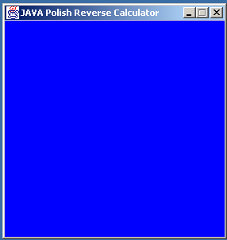
Example: RPN Calculator Gui
Χρησιμοποιήστε το awt για να δημιουργήσετε μία γραφική διεπαφή για την αριθμομηχανή αντίστροφης Πολωνικής σημειογραφίας
Iteration 1 – Build Frame
Αναπτύξτε ένα πρόγραμμα που θα εμφανίζει το παραπλεύρως πλαίσιο.
Αξιοποιήστε την κλάση Frame.
© 2023 Κλεάνθης Θραμπουλίδης
Human Computer Interaction
Διαφάνεια 13

Slide 14
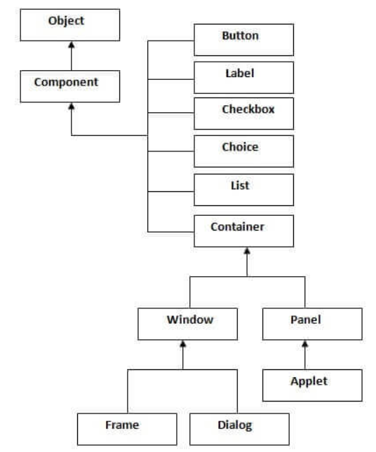
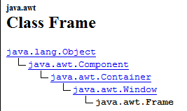
Class Frame
A Frame is a top-level window with a title and a border.
public class Frame extends Window implements MenuContainer
Frame(String title) Constructs a new, initially invisible Frame object with the specified title.
© 2023 Κλεάνθης Θραμπουλίδης
Human Computer Interaction
Διαφάνεια 14

Slide 15
CalculatorGui Class
import java.awt.*;
import java.awt.event.*;
public class CalculatorGui extends Frame{
public CalculatorGui(){
super("JAVA Polish Reverse Calculator");
this.setLayout(null);
// public void setFont(Font f) To set the font of this container.
// public void setBackground(Color c) To set the background color of this component.
// public void setSize(Dimension d) - w=283, h=297
// To resize this component so that it has width d.width and height d.height.
// public void setLocation(int x, int y) - x = 50, y =100
//Moves this component to a new location. The top-left corner of the new location is //specified by the x and y parameters in the coordinate space of this component's parent.
//public void setVisible(boolean b)
//To show this Window
// public void toFront()
//If this Window is visible, brings this Window to the front and may make it the focused Window.
//void setResizable(boolean resizable) //Sets whether this frame is resizable by the user.
this.addWindowListener(new CloseWindowAndExit());
}
}
class CloseWindowAndExit extends WindowAdapter {
public void windowClosing (WindowEvent closeWindowAndExit){
System.exit(0);
}
}
© 2023 Κλεάνθης Θραμπουλίδης
Human Computer Interaction
Διαφάνεια 15

Slide 16
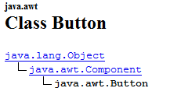
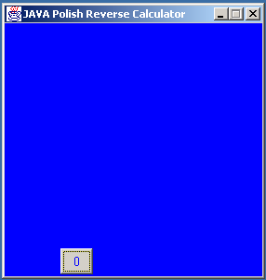
Iteration 2 – Add a Button
Προσθέστε στο πλαίσιο που αναπτύξατε το κουμπί 0
Χρησιμοποιήστε την κλάση Button
This class creates a labeled
button.
The application can cause some action to happen when the button is pushed.
public class Button extends Component implements Accessible
Button(String label) Constructs a button with the specified label.
© 2023 Κλεάνθης Θραμπουλίδης
Human Computer Interaction
Διαφάνεια 16

Slide 17
Appending a button
import java.awt.*;
import java.awt.event.*;
public class CalculatorGui extends Frame{
public CalculatorGui(){
super("JAVA Polish Reverse Calculator");
…
thιs.addWindowListener(new CloseWindowAndExit());
button0=new Button("0");
// public void setBounds(Rectangle r) - x=64, y=265, w=35, h=28
//Moves and resizes this component to conform to the new bounding rectangle r. This component's //new position is specified by r.x and r.y, and its new size is specified by r.width and r.height
button0.setFont(…);
button0.setBackground(…);
button0.setForeground(…);
// Append button0 to the end of this CalculatorGui container.
}
}
© 2023 Κλεάνθης Θραμπουλίδης
Human Computer Interaction
Διαφάνεια 17

Slide 18
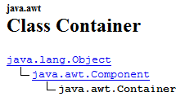
Class Container
public class Container extends
Component
A generic Abstract Window Toolkit(AWT) container object is a component that can contain other AWT components.
Components added to a container are tracked in a list. The order of the list will define the components' front-to-back stacking order within the container. If no index is specified when adding a component to a container, it will be added to the end of the list (and hence to the bottom of the stacking order).
public Component add(Component comp)
Appends the specified component to the end of this container.
Δώστε μια υλοποίηση της WindowsApp η οποία θα αξιοποιεί την παραπάνω λειτουργικότητα της Container.
example
© 2023 Κλεάνθης Θραμπουλίδης
Human Computer Interaction
Διαφάνεια 18

Slide 19
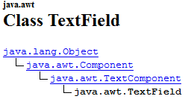
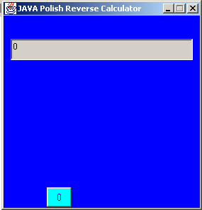
Iteration 3 - Add a TextField
Προσθέστε στο πλαίσιο που αναπτύξατε ένα instance της TextField όπως φαίνεται στο παρακάτω σχήμα.
A TextField object is a text
component that allows for the editing of a single line of text.
public class TextField extends TextComponent
TextField(String text, int columns) Constructs a new text field initialized with the specified text to be displayed, and wide enough to hold the specified number of columns.
© 2023 Κλεάνθης Θραμπουλίδης
Human Computer Interaction
Διαφάνεια 19

Slide 20
Appending a TextField
import java.awt.*;
import java.awt.event.*;
public class CalculatorGui extends Frame{
public CalculatorGui(){
super("JAVA Polish Reverse Calculator");
…
display = new TextField("0",14);
display.setEditable(false); //disable editing
// public void setBounds(Rectangle r) - x=13, y=55, w=257, h=30
//Moves and resizes this component to conform to the new bounding rectangle r. This component's //new position is specified by r.x and r.y, and its new size is specified by r.width and r.height
// Append display to the end of this CalculatorGui container.
}
}
© 2023 Κλεάνθης Θραμπουλίδης
Human Computer Interaction
Διαφάνεια 20

Slide 21
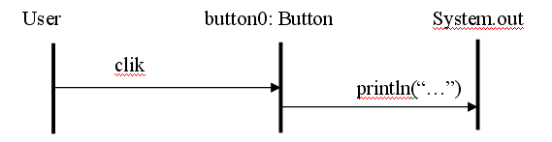
Iteration 4 – Define the Action of Button
Define the action to happen when the button is pushed
Τροποποιήστε την εφαρμογή ώστε πατώντας το κουμπί 0 να τυπώνεται στην οθόνη το μήνυμα “button 0 pressed”.
Event Handling
© 2023 Κλεάνθης Θραμπουλίδης
Human Computer Interaction
Διαφάνεια 21

Slide 22
Iteration 5 - Set “:Button” to display … a message to “:TextField”
Τροποποιήστε την εφαρμογή ώστε πατώντας το κουμπί 0 να τυπώνεται το μήνυμα “button 0 pressed” στο display της γραφικής διεπαφής.
Internal-object to user interaction
User to internal-object interaction
TextField
Button0:Button
setText(“button 0 pressed”)
button 0 pressed
© 2023 Κλεάνθης Θραμπουλίδης
Human Computer Interaction
Διαφάνεια 22

Slide 23
Οργάνωση Διάλεξης
Internal vs. external messages
Abstract window toolkit (awt)
Frame
Button
TextField
GUIs στην Java
awt
swing
swt
© 2023 Κλεάνθης Θραμπουλίδης
Human Computer Interaction
Διαφάνεια 23

Slide 24
Java’s GUI tool kits
AWT
Abstract Windows Toolkit (AWT) is the original Java GUI tool kit introduced with JDK 1.0.
Swing
Java Swing was an attempt to solve most of AWT's shortcomings. In Swing, Sun created a very well-engineered, flexible, powerful GUI tool kit. Unfortunately, this means Swing takes time to learn, and it is sometimes too complex for common situations. Was introduced by Sun in J2SE 1.2
SWT
Standard Widget Toolkit (SWT) is a low-level GUI tool kit comparable in concept to AWT. The builders of SWT learned from the AWT and Swing implementations and tried to build a system that had the advantages of both without their disadvantages.
Why is there more than one Java™ GUI tool kit? The best answer is that one size does not fit all,
nor is there a one-size-fits-all GUI tool kit to be invented soon. Each tool kit offers advantages and
disadvantages that make selecting one more appropriate, given your needs and intended audience.
Πηγή: SWT, Swing or AWT: Which is right for you? What to consider when choosing a GUI tool kit for new applications link
© 2023 Κλεάνθης Θραμπουλίδης
Human Computer Interaction
Διαφάνεια 24

Slide 25
AWT SWING
(Abstract Windows Toolkit)
is the original Java GUI tool kit.
AWT's main advantages are that
it comes standard with every version of Java technology, including Java implementations in old Web browsers, and
it is very stable.
This means
you do not need to install it,
you can depend on it being available everywhere you find a Java runtime environment, and
it will have the features you expect.
SWING
also known as a part of the Java Foundation Classes (JFC),
was an attempt to solve most of AWT's shortcomings.
In Swing, Sun created a very well-engineered, flexible, powerful GUI tool kit. Unfortunately, this means Swing takes time to learn, and it is sometimes too complex for common situations.
Swing is built on parts of AWT. All Swing parts are also AWT parts. Swing uses the AWT event model and support classes, such as Colors, Images, and Graphics.
far more extensive than that supplied by AWT and compares well to the SWT set.
© 2023 Κλεάνθης Θραμπουλίδης
Human Computer Interaction
Διαφάνεια 25

Slide 26
SWT
Low-level GUI
Standard Widget Toolkit (SWT) is a low-level GUI tool kit comparable in concept to AWT.
Makes building GUIs easier
JFace is a set of enhanced components and utility services to make building GUIs with SWT easier.
Was built on AWT and Swing advantages
The builders of SWT learned from the AWT and Swing implementations and tried to build a system that had the advantages of both without their disadvantages. In many ways, they succeeded.
Πηγή: SWT, Swing or AWT: Which is right for you? What to consider when choosing a GUI tool kit for new applications link
© 2023 Κλεάνθης Θραμπουλίδης
Human Computer Interaction
Διαφάνεια 26

Slide 27
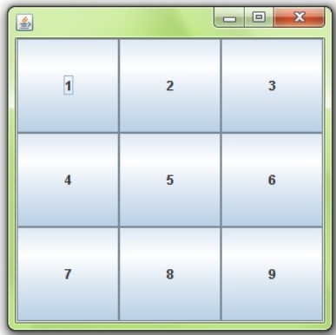
GridLayout class
is a layout manager that lays out a container's components in a rectangular grid.
The container is divided into equal-sized rectangles, and one component is placed in each rectangle.
GridLayout()
creates a grid layout with one column per component in a row.
GridLayout(int rows, int columns)
creates a grid layout with the given rows and columns but no gaps between the components.
GridLayout(int rows, int columns, int hgap, int vgap)
creates a grid layout with the given rows and columns alongwith given horizontal and vertical gaps.
See also the Panel class
© 2023 Κλεάνθης Θραμπουλίδης
Human Computer Interaction
Διαφάνεια 27

