Slide 1

SRI KRISHNA ARTS AND SCIENCE COLLEGE
Department of Software Systems and AIML
III M.Sc. SS
SEMESTER - VI
23SSI39- Mini Project
Title: Packwise
Guide Name: Dr. M. Raju M.Sc.,Ph.D.,
Assistant Professor
Student Roll number: 23MSS059
Student Name: THRANAESWANTH S

Slide 2
Abstract
• Packwise is a web-based AI-powered travel companion.
• The system helps users plan personalized travel itineraries seamlessly.
• Users can enter preferences and receive a detailed day-by-day plan.
• The project is developed using MongoDB, Express, React, Node.js, and GenAI.
• The main goal is to improve trip planning quality through an easy web
interface.
46f7qsxi

Slide 3
Introduction
46f7qsxi
• Trip planning is very complex and time-consuming in digital platforms.
• Many users find it difficult to organize flights, hotels, and activities.
• Traditional travel tools mostly focus on booking independent services.
• They do not effectively connect various aspects of a trip together.
• Packwise provides a simple solution to create and manage travel plans.

Slide 4
Existing Methodology
46f7qsxi
• Traditional travel planning requires browsing multiple websites.
• Most tools only offer generic location recommendations.
• Limited support for generating end-to-end itineraries.
• Some tools are complex and difficult to use for travelers.
Problems in existing systems:
• Time consuming • Limited personalization • Fragmented user experience

Slide 5
Proposed Methodology
46f7qsxi
• Packwise provides a simple web-based AI planning platform.
• Users can easily input travel preferences through the website.
• The system processes the input and creates an optimal travel plan.
FEATURES OF THE PROPOSED SYSTEM:
• Easy to use interface • Fast AI processing • Improved plan clarity
• Better personalization

Slide 6
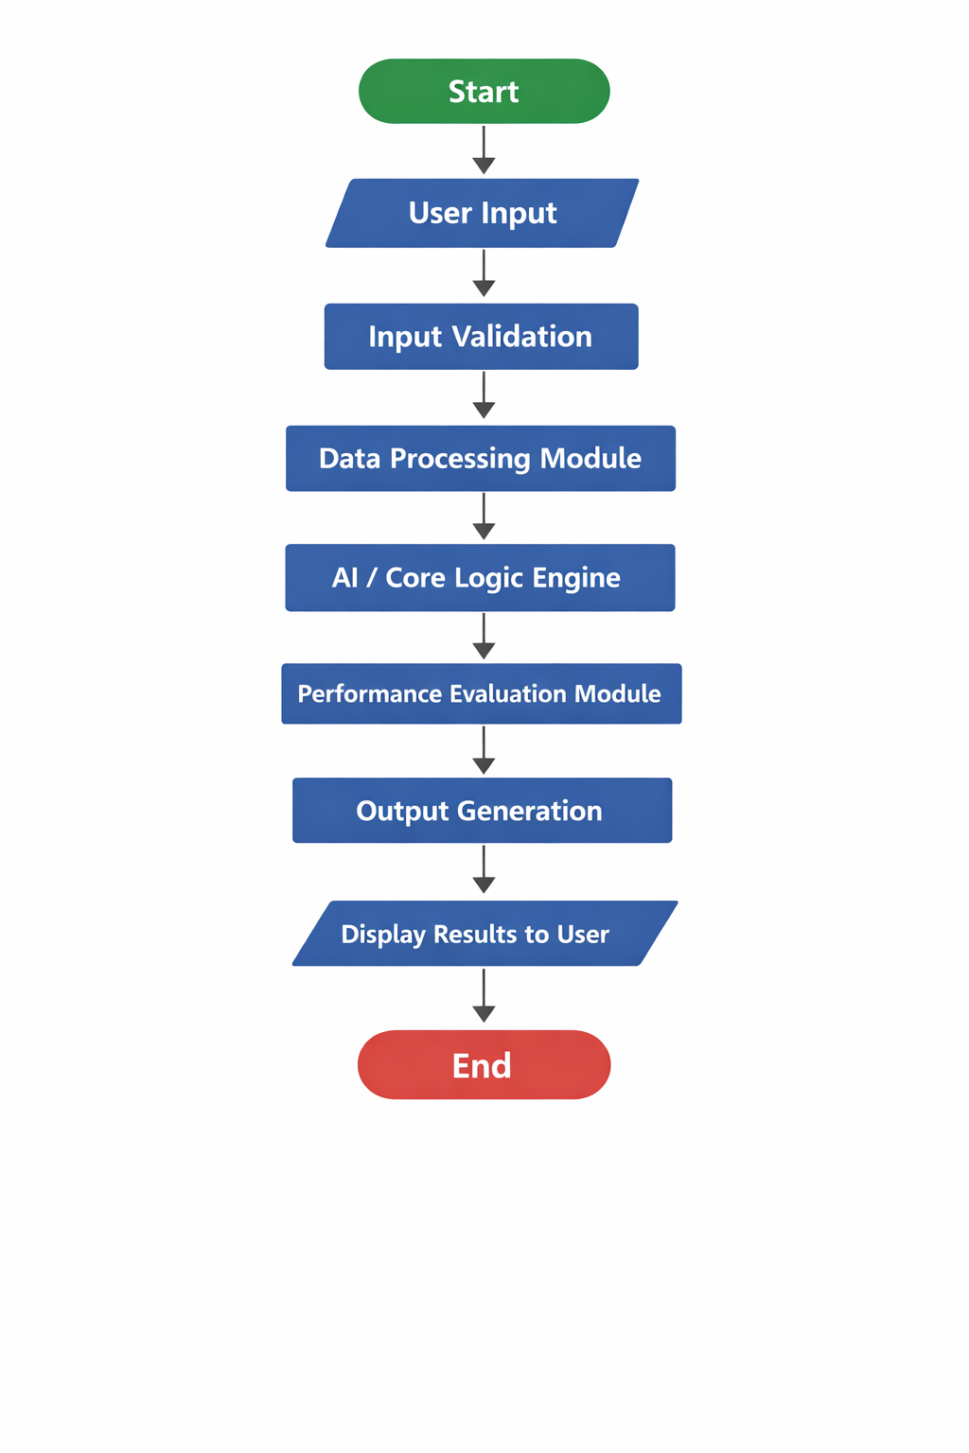
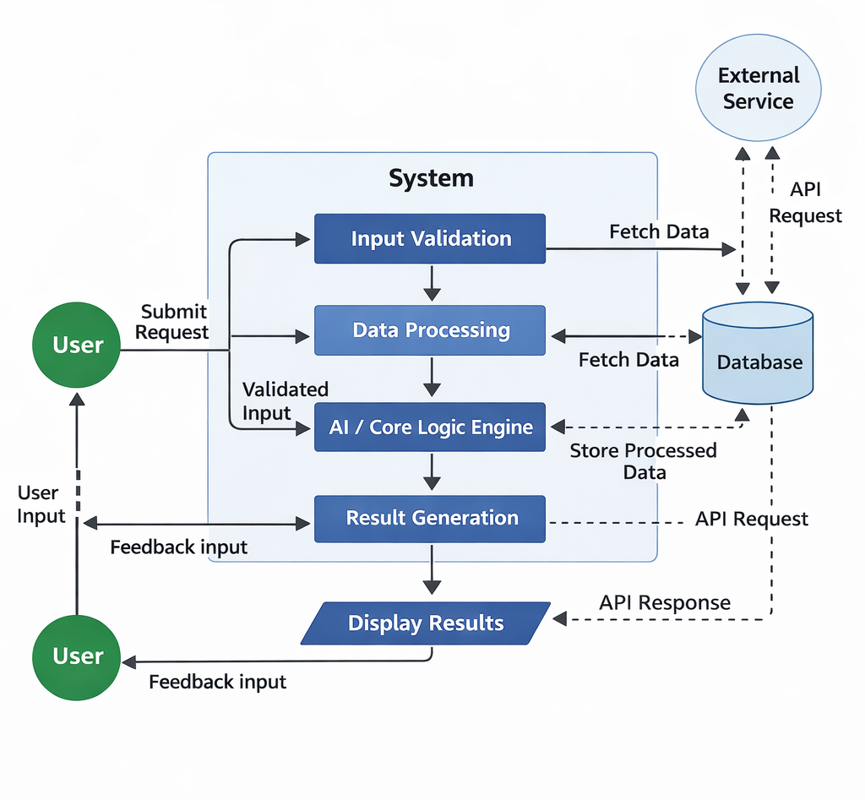
Flow of Process
46f7qsxi
SYSTEM FLOW DIAGRAM : DATA FLOW DIAGRAM :

Slide 7
Technical Method
packwise
Frontend Technologies
• React – Used to create the dynamic structure of web pages
• Tailwind CSS – Used for rapid styling and layout design
• GSAP / Motion – Used for fluid interaction and animations
Database
• MongoDB – Used to store user data, trips, and system info
Additional Technical Features
• Generative AI – Google Gemini processes preferences into detailed travel plans quickly.

Slide 8
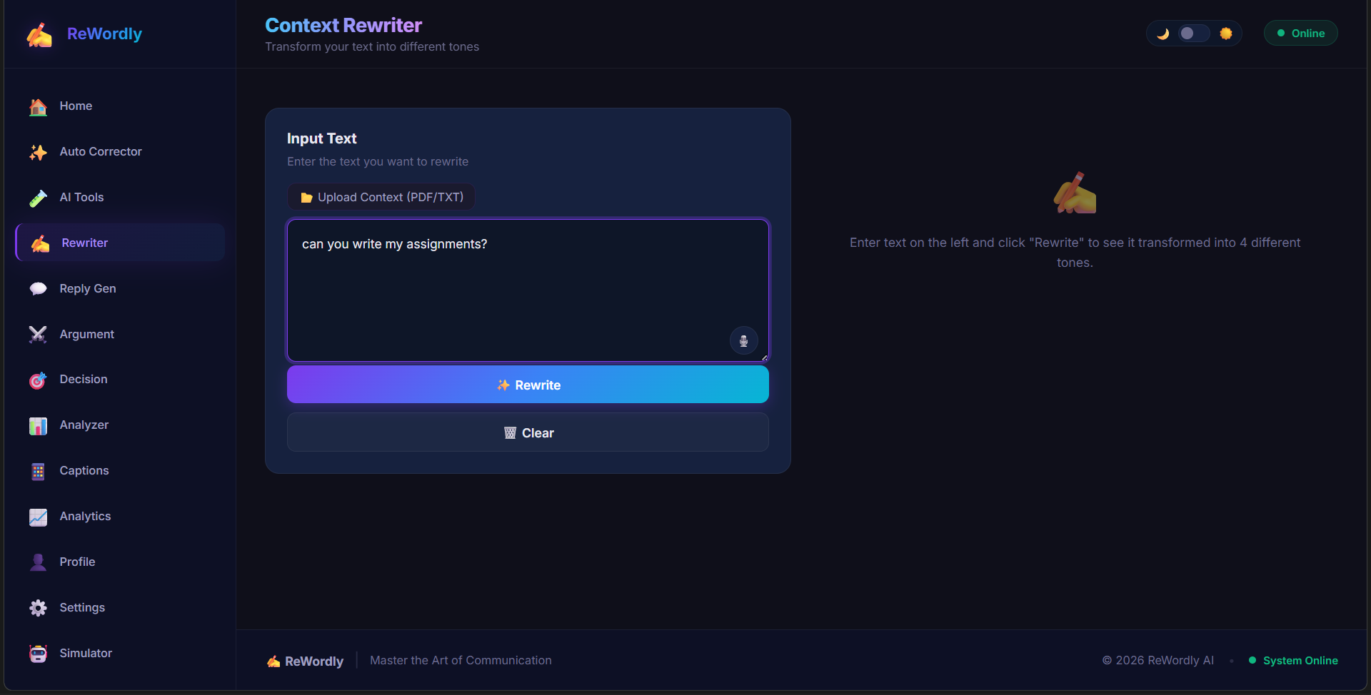
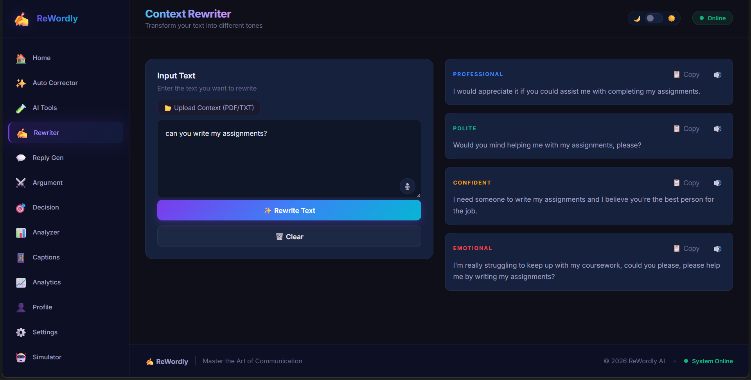
Input/Output Design
46f7qsxi
Input : User enters destination & dates Output : The planner, plans the trip
in detail day by day

Slide 9
46f7qsxi
Conclusion
• Packwise helps users plan their travels with clarity and ease.
• The system provides a centralized and intelligent trip planning platform.
• It uses modern web technologies like React, Node.js, and MongoDB.
• The platform improves the overall travel experience and management.
• Future improvements may include live bookings and collaboration.

Slide 10
_{Thank you}
46f7qsxi

