Slide 1
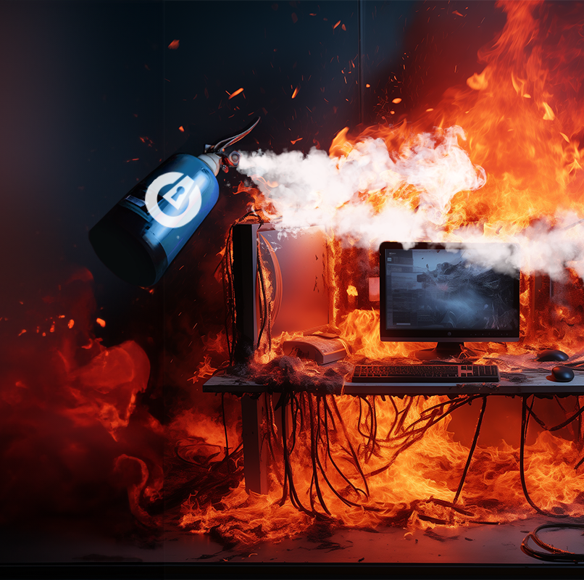

Incident Response

Slide 2

Follow Along on GitHub
We have a GitHub Repository with all the course content and payloads.
We encourage you to scan the QR code and follow along with the repository as we navigate through the course.

Slide 3
Overview
In our Incident Response Lab, we will go through a Scenario in which a client believes they have been breached.
We will do the following:
Gather Information
Run through a simple playbook
Using ThreatLocker® Ops
Generate a Report

Slide 4
Who We Are
We will be playing the role of a Jr Incident Responder/Threat Hunter at ThreatLocker®
Our main role is analyzing logs and the creation of a report

Slide 5
Scenario
REKT Corp. has been breached.
Frank Pint their Administrator has reached out to us in hope we can conduct an investigation and find out what happened.
He has left us an email, let’s check it out!

Slide 6
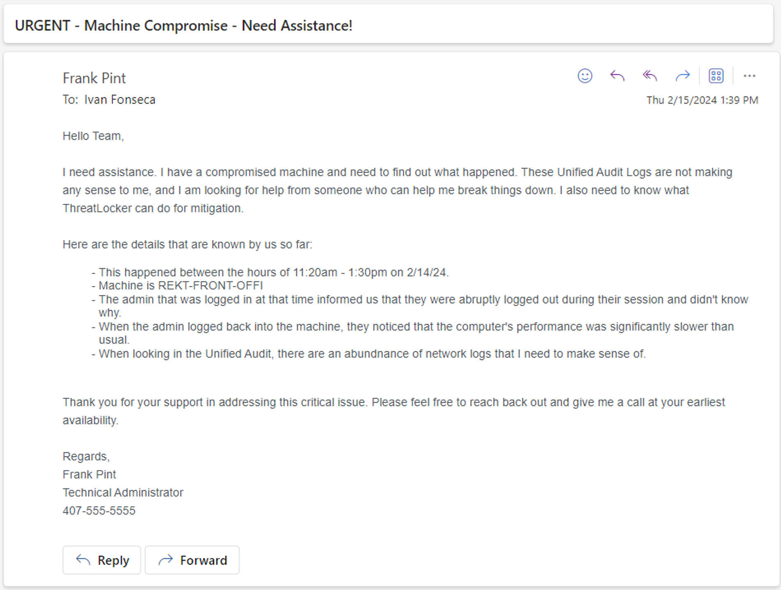
Email

Slide 7
Information Gathering
We will be going through our Initial Playbook, but we want to remember our main goal in this exercise is to gather information.
Let’s start!

Slide 8
Audience Collaboration
Question #1
What ThreatLocker® tool will help us view historical data on a machine? (Executions, Network Logs, Registry Changes, etc.)
Computers Page
Unified Audit
Storage Control
What ThreatLocker® tool will help us view historical data on a machine? (Executions, Network Logs, Registry Changes, etc.)
Computers Page
Unified Audit
Storage Control

Slide 9
Audience Collaboration
Answer #1
b) Unified Audit
The Unified Audit stores log data on almost all behaviour that occurs on a machine.
This tool is pivotal for Incident Response and many times the most crucial.

Slide 10
Playbook
A playbook acts as our blueprint or strategic guide when encountering incidents like the one described.
It outlines specific steps and procedures to be followed in response to various scenarios.
We have broken our playbook down into steps. Let’s start by step one!

Slide 11
Phase 1
Incident Scope
The Scope encapsulates the area affected and time of potential breach. This helps us focus on the assets that are in danger.
In some cases we won't have a clearly defined scope and that’s ok, writing down what we do know is extremely important.

Slide 12
Phase 1
Incident Scope
Let’s gather the information we do have:
Time of Attack: 11:20 - 13:30 2-14-24
Organization Name: REKT Corp.
Hostname(s): REKT-FRONT-OFFI

Slide 13
Phase 2
Machine State
Understanding the ThreatLocker® State or Mode of the endpoint is crucial as we can better understand how that machine is intended to behave.
Learning Mode: Automatically Catalogs Files based on users behaviour and runs those files
Monitor Mode: Does not take action on the End Point. This just monitors the behaviour on the machine to forward logs
Secure Mode: Only allows application previously trusted to run, everything else is blocked by default

Slide 14
Audience Collaboration
Question #2
Where can we check and manage an endpoints Mode in ThreatLocker®:
Response Center
Application Control
Computers Page
Where can we check and manage an endpoints Mode in ThreatLocker®:
Response Center
Application Control
Computers Page

Slide 15
Audience Collaboration
Answer #2
c) Computers Page
The Computers Page allows you to check and change the state or mode of an endpoint
Let’s find out what state the machine is via the Computers Page

Slide 16
Phase 3
Mystery
In this phase we will check how one our special tools makes our job easy by alerting on malicious behaviour.
We will come back to this at the end to see how much of an impact this tool makes

Slide 17
Phase 4
Network Activity
Let’s check network logs in the Unified Audit for any unusual behavior.
Red Flags indicators are external connection to common ports of entry (Ports that can are commonly used gain access to a device):
SSH 22
RDP 3389
FTP 21
SMB 445

Slide 18
Phase 5
Executions
In this phase we will be looking for signs of permitted execution, this lets us know what actually ran on the system.
Filter Unified Audit for:
Action = Permit
Action Type = Execute

Slide 19
Phase 6
Registry Changes
Let’s check logs for registry changes, in many occasions this can be a sign of a breach or persistence.
Filter Unified Audit for:
ActionType = Registry
Check GitHub for a list of maliciously used registry paths

Slide 20
Phase 7
Explicit Denies
This applies to machines in Secure Mode.
In these cases malware may be attempting to run against it but gets denied by our platform.
We still want to know about it and record the data so we can further understand where the attack is coming from and how to close that point of entry for the attacker

Slide 21
Phase 3
ThreatLocker® Ops
With ThreatLocker® Ops we can get alerts for known malicious behavior on an endpoint.
This can be a huge help as it can lead Incident Responder in the right direction.

Slide 22
Audience Collaboration
Question #3
Where can we access and manage ThreatLocker® Ops Alerts?
Response Center
Network Control
Unified Audit
Where can we access and manage ThreatLocker® Ops Alerts?
Response Center
Network Control
Unified Audit

Slide 23
Answer #3
Audience Collaboration
a) Response Center
The Response Center allows us to manage alerts from ThreatLocker® Ops
Let’s navigate to it!

Slide 24
Phase 8
Record Findings
In this Phase we will write down all the information we found on the machine in our Incident Response Report Template.

Slide 25



