Slide 1
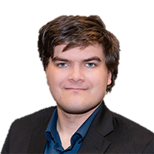
Obfuscating Your C2
Nick Cottrell
Threat Intelligence, ThreatLocker

Slide 2

What we will go over
What is a command and Control (C2)
Communication between the C2 and the endpoint
Problem: This is too obvious
Communicating in Pig Latin
This is too suspicious
Just act natural
The ultimate reverse shell: The beacon
I just don’t have time to write my own C2
Writing your own C2! (profile)
Place QR Code

Slide 3
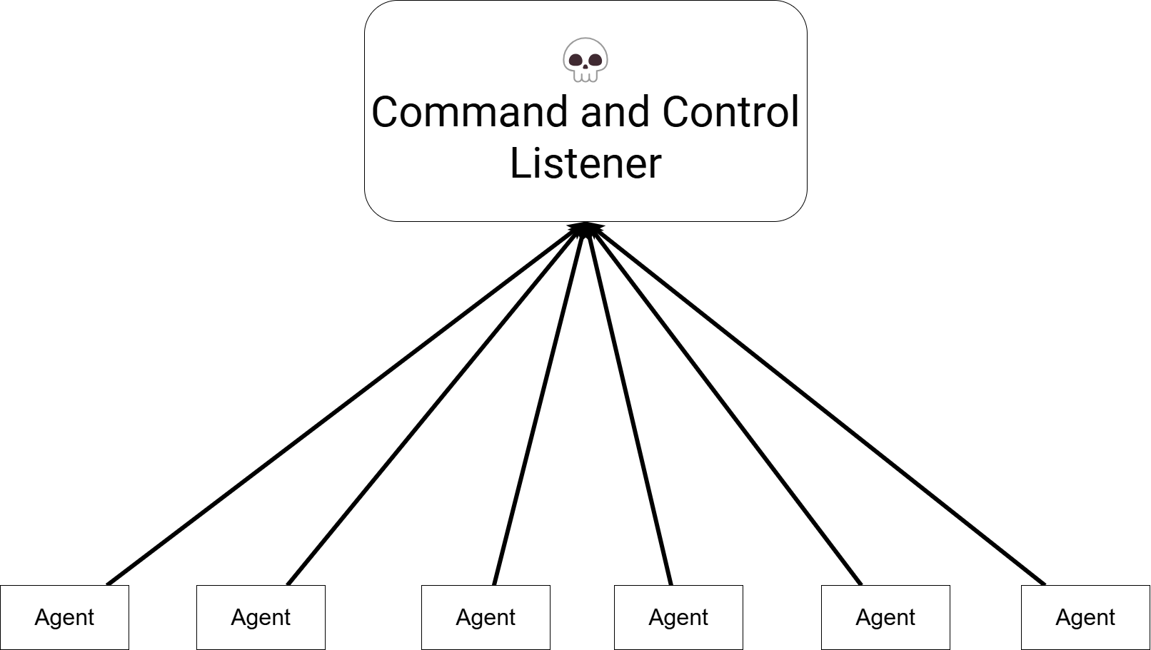
What is a Command and Control (C2)
Sends commands to an agent to act on and listens for responses
Contains a listener and at least one agent
Typically, agents talk back to listener
Example: netcat reverse shell

Slide 4
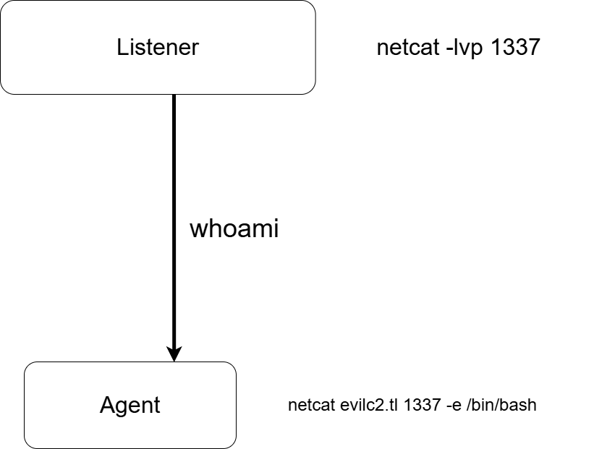
Communication between the C2 and the endpoint

Slide 5

Communication between the C2 and the endpoint

Slide 6
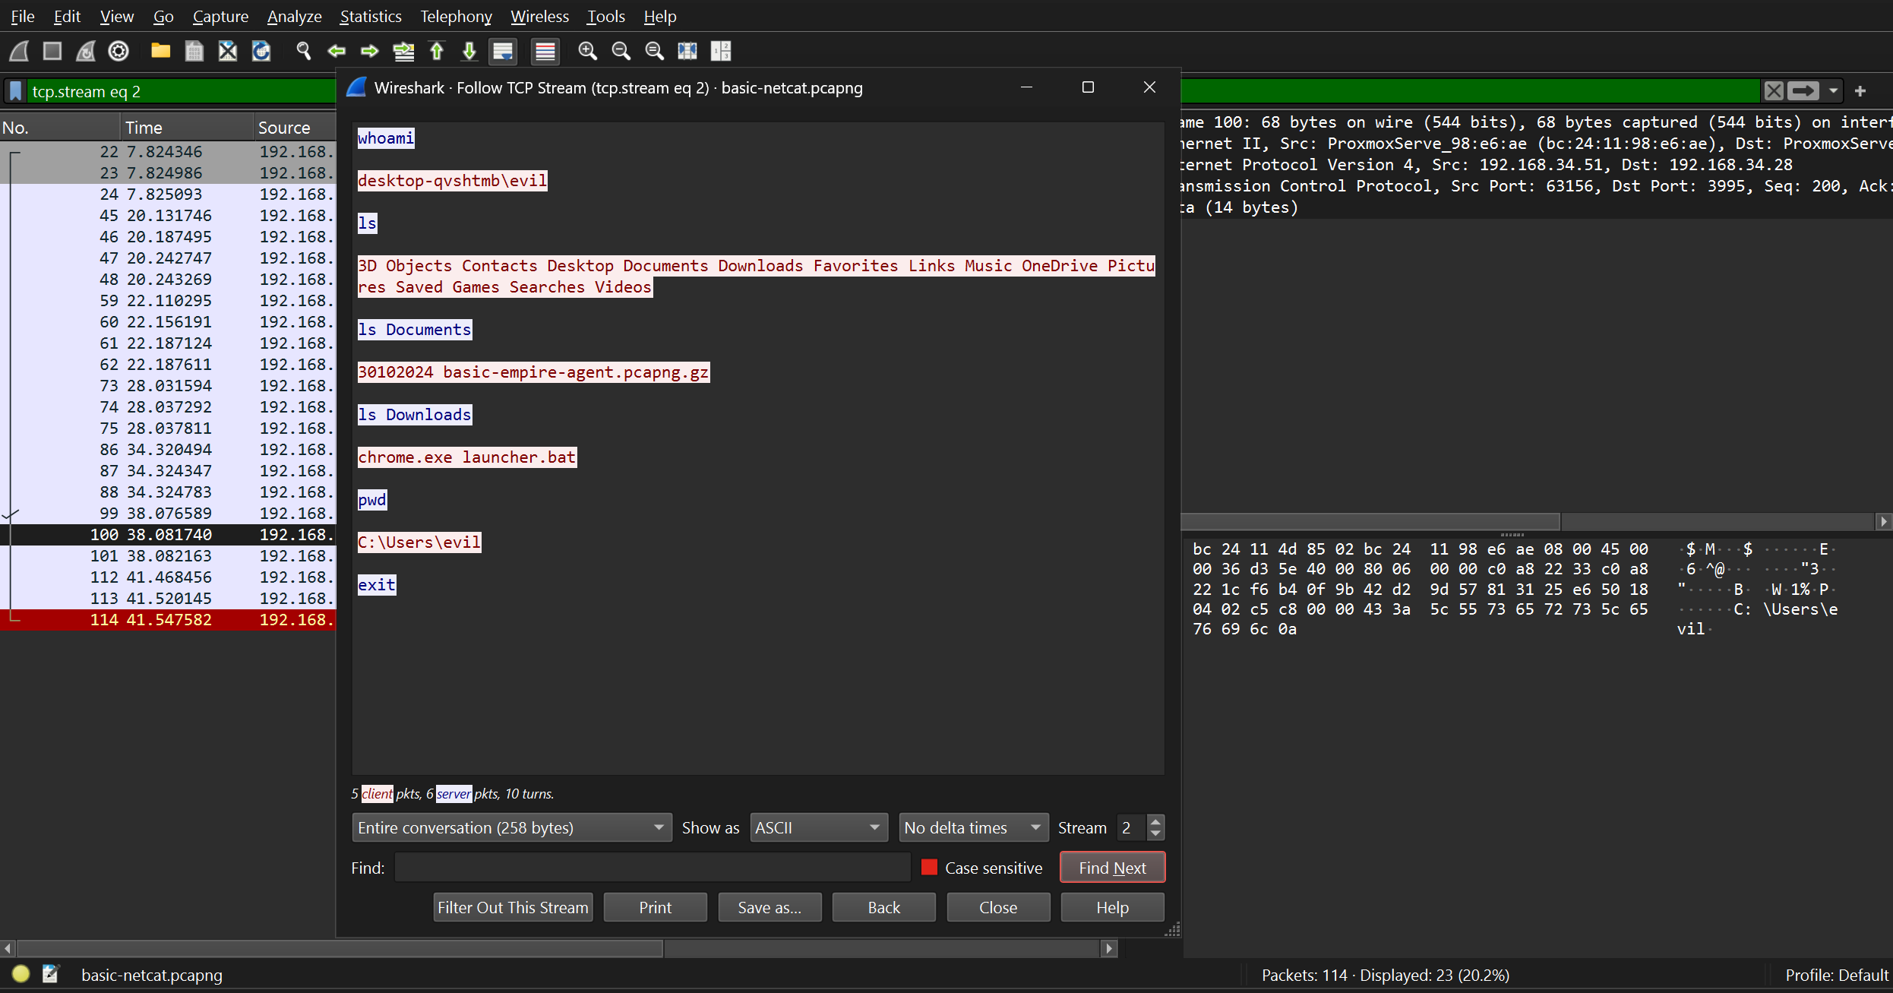
Problem: This is too obvious

Slide 7
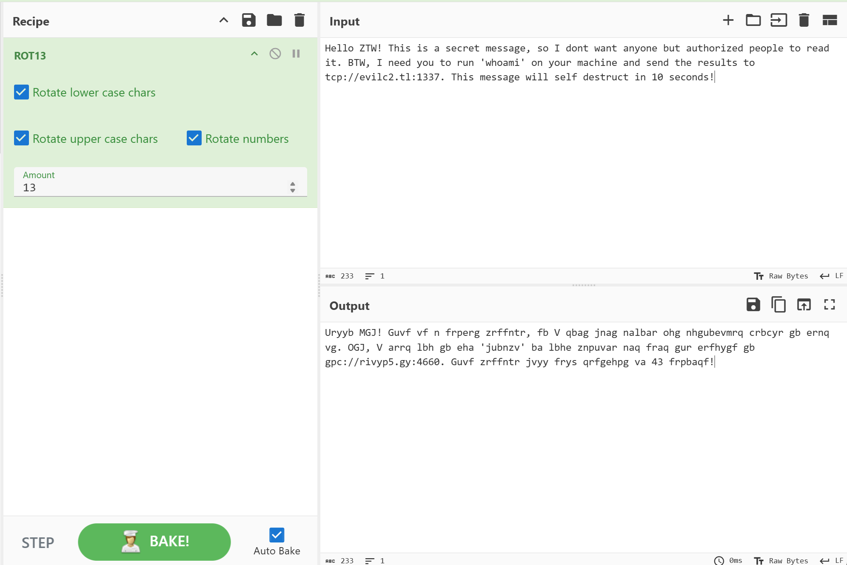
Communicating in pig latin
https://gchq.github.io/CyberChef/
Ciphers
Caesar cipher (aka ROT 13)
Rail Fence Cipher
Atbash Cipher
Bacon Cipher

Slide 8
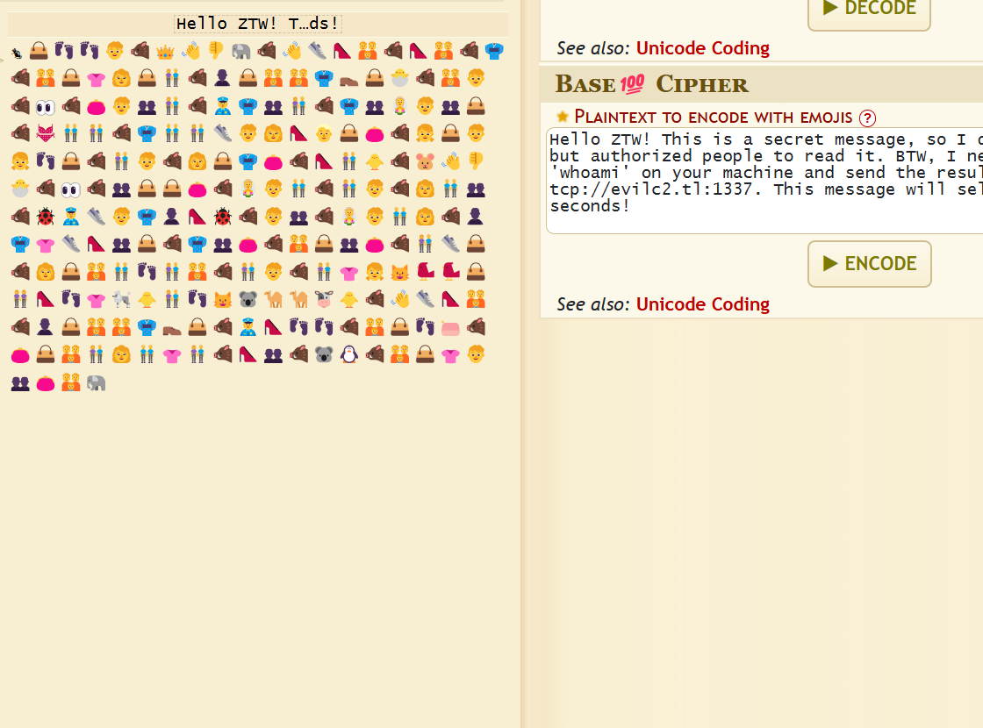
Communicating in pig latin
https://www.dcode.fr/base100-emoji-encoding
Encoding
Hex
Octal
binary
Base64
unicode

Slide 9
Communicating in pig latin
RSA
RC4
AES
HTTP -> HTTPS
DNS -> DNS Over HTTPS (DoH)

Slide 10
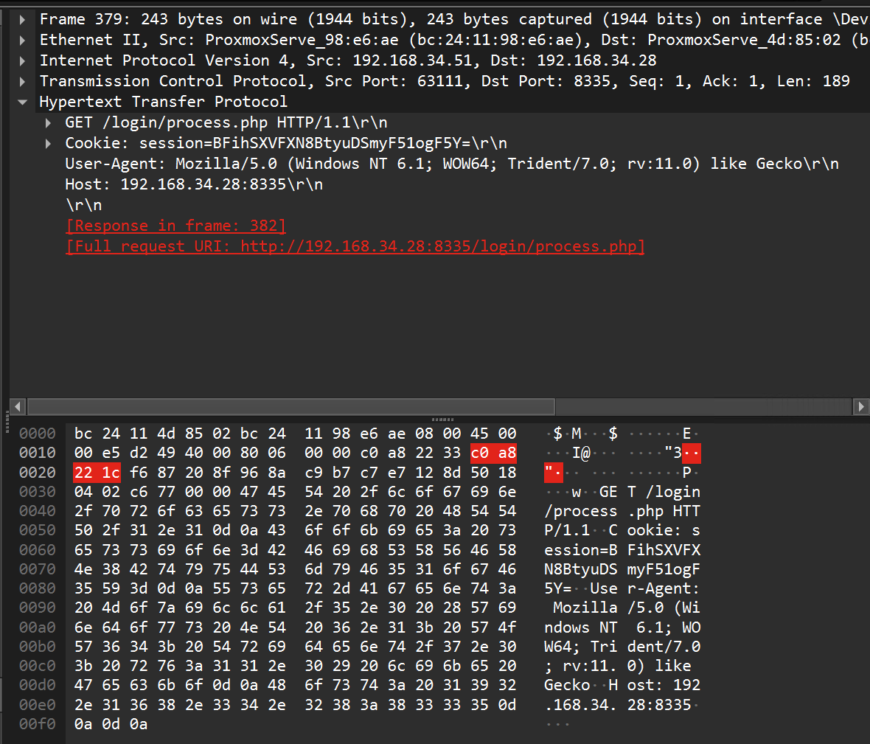
This is too suspicious…

Slide 11
Just act natural

Slide 12
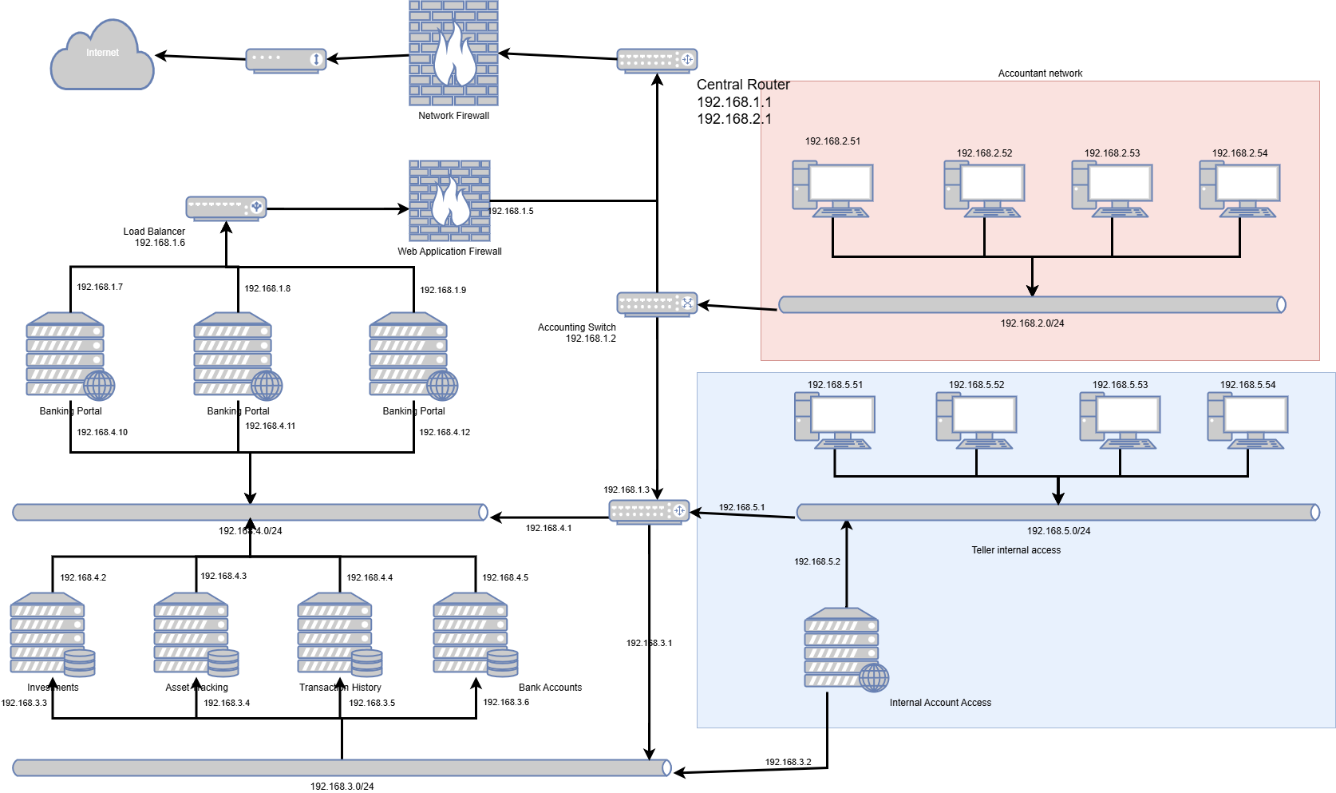
Just act natural: Know your target

Slide 13
Just act natural: Using common services
HTTPS
DNS
SMB
SSH
FTP
MYSQL
ARP

Slide 14

Just act natural: Checking in less
{{

Slide 15
The ultimate reverse shell: The beacon
Reverse Shell Traits
Beacon traits
Calls back to the listener
Waits for commands to be received
Can pivot through a middleman
Maintains connection through life of agent
Checks in periodically with listener
Waits for commands to be received
Can pivot through a middleman
Checks for new tasks from listener
Variable check-in rate

Slide 16

Beacons being sneaky
Beacons will check in once per sleep interval
Jitter provides random fluctuations in sleep interval
Counters patterns in check in time
$\text{Checkintime} \text{=} \text{sleep} \text{±} \text{x}$
$\text{x} \text{≤} \text{jitter}$

Slide 17

I just don’t have time to write my own C2

Slide 18

Writing your own C2! (profile)

Slide 19
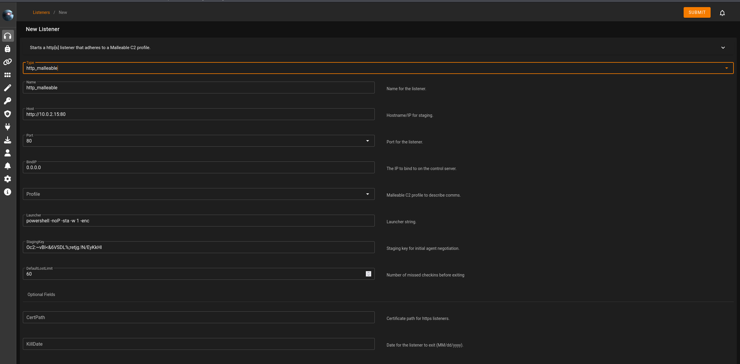
Writing your own C2! (profile)

Slide 20
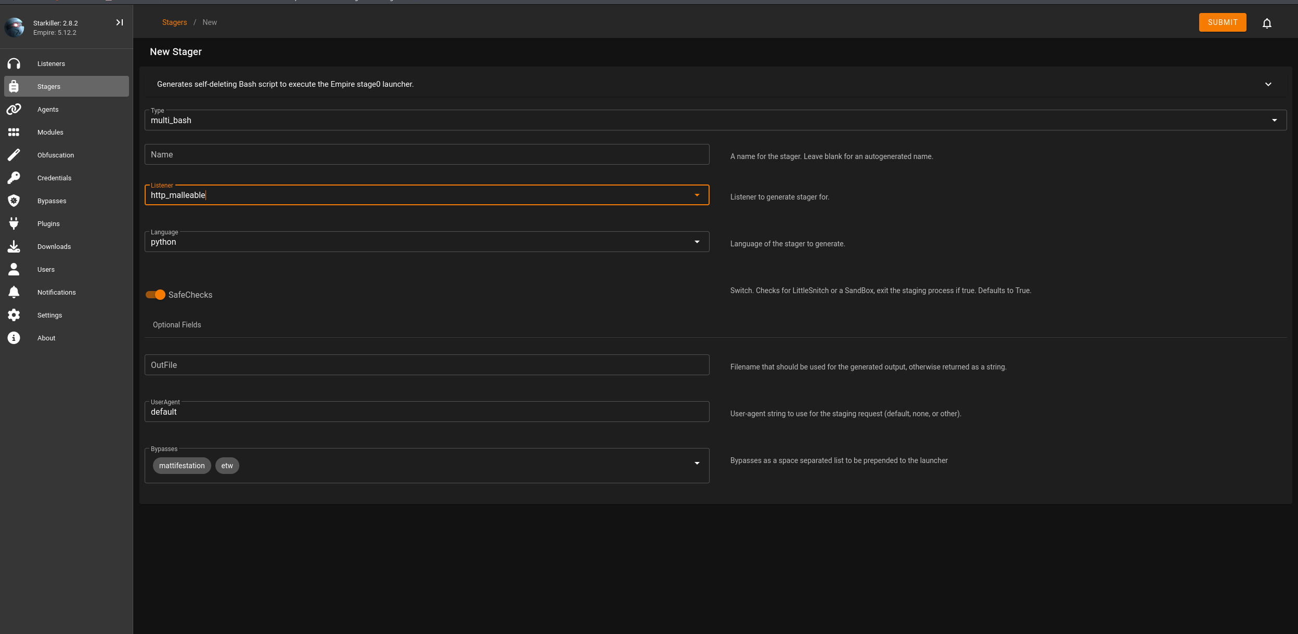
Writing your own C2! (profile)

Slide 21
Writing your own C2! (profile)
# this is a comment
set global_option "value";
protocol-transaction {
set local_option "value";
client {
# customize client indicators
}
server {
# customize server indicators
}
}
#
# Online Certificate Status Protocol (OCSP) Profile
# http://tools.ietf.org/html/rfc6960
#
# Author: @harmj0y
#
set sleeptime "20000"; # Use a 20s interval
set jitter "20"; # 20% jitter
set maxdns "255";
set useragent "Microsoft-CryptoAPI/6.1";
http-get {
set uri "/oscp/";
client {
header "Accept" "*/*";
header "Host" "ocsp.verisign.com";
metadata {
netbios;
uri-append;
}
}
server {
header "Content-Type" "application/ocsp-response";
header "content-transfer-encoding" "binary";
header "Cache-Control" "max-age=547738, public, no-transform, must-revalidate";
header "Connection" "keep-alive";
output {
print;
}
}
}

Slide 22
Writing your own C2! (profile)
Statement | Action | Inverse
append "string" | Append "string" | Remove last LEN(“string”) characters
base64 | Base64 Encode | Base64 Decode
base64url | URL-safe Base64 Encode | URL-safe Base64 Decode
mask | XOR mask w/ random key | XOR mask w/ same random key
netbios | NetBIOS Encode ‘a’ | NetBIOS Decode ‘a’
netbiosu | NetBIOS Encode ‘A’ | NetBIOS Decode ‘A’
prepend "string" | Prepend "string" | Remove first LEN(“string”) characters

Slide 23
Writing your own C2! (profile)
Statement | What
header “header” | Store data in an HTTP header
parameter “key” | Store data in a URI parameter
print | Send data as transaction body
uri-append | Append to URI

Slide 24
Writing your own C2! (profile)
option | Description
data_jitter | Provides random extra data to add to data randomness
Jitter | Variation in checkin times
Sleep | Interval for beacon checkins
tcp_port | The port for the client to listen on
Uri | Uri path to request
Useragent | Client useragent
tcp_frame_header | Additional data to add to tcp header
Verb | Option between get or post
sample_name | Name to describe profile in IoC report

Slide 25
The end
Go home

