Slide 1

Unit Testing in C#
Jason Fedler

Slide 2



Agenda
What Unit Testing Is & Is Not
Unit Test Benefits and Characteristics
What Should I Unit Test?
Why Do It?
Code Coverage & Demo
Resources

Slide 3
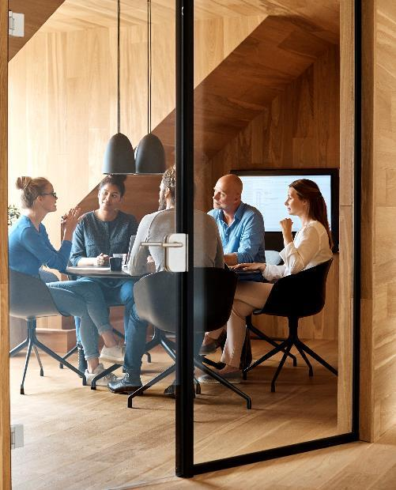



Introduction
Unit testing is an important part of delivering high quality software consistently over a long period of time. Like any engineering tool, though, there are trade-offs, and it becomes more of an art form rather than science.

Slide 4

What Unit Testing Is and Is Not

Slide 5
Unit Testing
What it is
What it is NOT
A unit test is a piece of code (usually a method) that invokes another piece of code and checks the correctness of some assumptions afterward. If the assumptions turn out to be wrong, the unit test has failed. A “unit” is a method or function. ~ The Art of Unit Testing, p. 4
Unit tests are NOT the same as automated tests
Unit tests are NOT integration tests
Unit tests are NOT silver bullets

Slide 6
Unit Testing Goals

Slide 7
Unit Testing
Goals
Overview
The primary goal of unit testing is to take the smallest piece of testable software in the application, isolate it from the remainder of the code, and determine whether it behaves exactly as you expect. Each unit is tested separately before integrating them into modules to test the interfaces between modules. Unit testing has proven its value in that a large percentage of defects are identified during its use. ~ MSDN
At a high-level, unit testing refers to the practice of testing certain functions and areas – or units – of our code. This gives us the ability to verify that our functions work as expected… ~ http://wp.tutsplus.com

Slide 8
Characteristics and Benefits

Slide 9
Characteristics of Unit Tests
Isolated from other code
Isolated from other developers
Targeted
Repeatable
Predictable
Fast
Professional Test Driven Development with C#, p 20

Slide 10
Benefits of Unit Tests
Implicit documentation of how to setup classes and objects
Passing tests show compliance with requirements
Failing tests show where requirements are not being met
Documents business rules by showing “correctness”
Helps guide the shape of classes that make them testable / flexible
Helps create a safety net for mild refactoring
Bugs found can be recreated in a test and then offending code updated to correct
Unit tests prove correctness

Slide 11
What Should I Unit Test

Slide 12
What Should I Unit Test?
Complex business logic
Find those edge cases before they make their way to production!
Should I unit test my repository layer?
A bit of a grey area here, but we are treading into integration testing

Slide 13

The way to get started is to quit talking and begin doing.
Walt Disney

Slide 14




Team
Name
Name
Name
Name
Title
Title
Title
Title

Slide 15
Timeline
Title
To start a presentation, go to the Slide Show tab, and select From Beginning.
Title
To display Presenter view, in Slide Show view, on the control bar at the bottom left select the three dots, and then Show Presenter View.
Title
During your presentation, the speaker notes are visible on your monitor, but aren't visible to the audience.
Title
Title
If you don’t see the Notes pane or it is completely minimized, click Notes on the task bar across the bottom of the PowerPoint window.
The Notes pane is a box that appears below each slide. Tap it to add notes.

Slide 16
Content 2
Subtitle
subtitle
subtitle
Add text, images, art, and videos.
Add transitions, animations, and motion.
Save to OneDrive, to get to your presentations from your computer, tablet, or phone.
Open the Design Ideas pane for instant slide makeovers.
When we have design ideas, we’ll show them to you right there.
Add text, images, art, and videos.
Add transitions, animations, and motion.
Save to OneDrive, to get to your presentations from your computer, tablet, or phone.
Open the Design Ideas pane for instant slide makeovers.
When we have design ideas, we’ll show them to you right there.
Add text, images, art, and videos.
Add transitions, animations, and motion.
Save to OneDrive, to get to your presentations from your computer, tablet, or phone.
Open the Design Ideas pane for instant slide makeovers.
When we have design ideas, we’ll show them to you right there.

Slide 17

Summary
With PowerPoint, you can create presentations and share your work with others, wherever they are. Type the text you want here to get started. You can also add images, art, and videos on this template. Save to OneDrive and access your presentations from your computer, tablet, or phone.

Slide 18


Thank You
Presenter name
Email address
Website address

