Slide 1
Introduction to Boolean Satisfiability

Slide 2
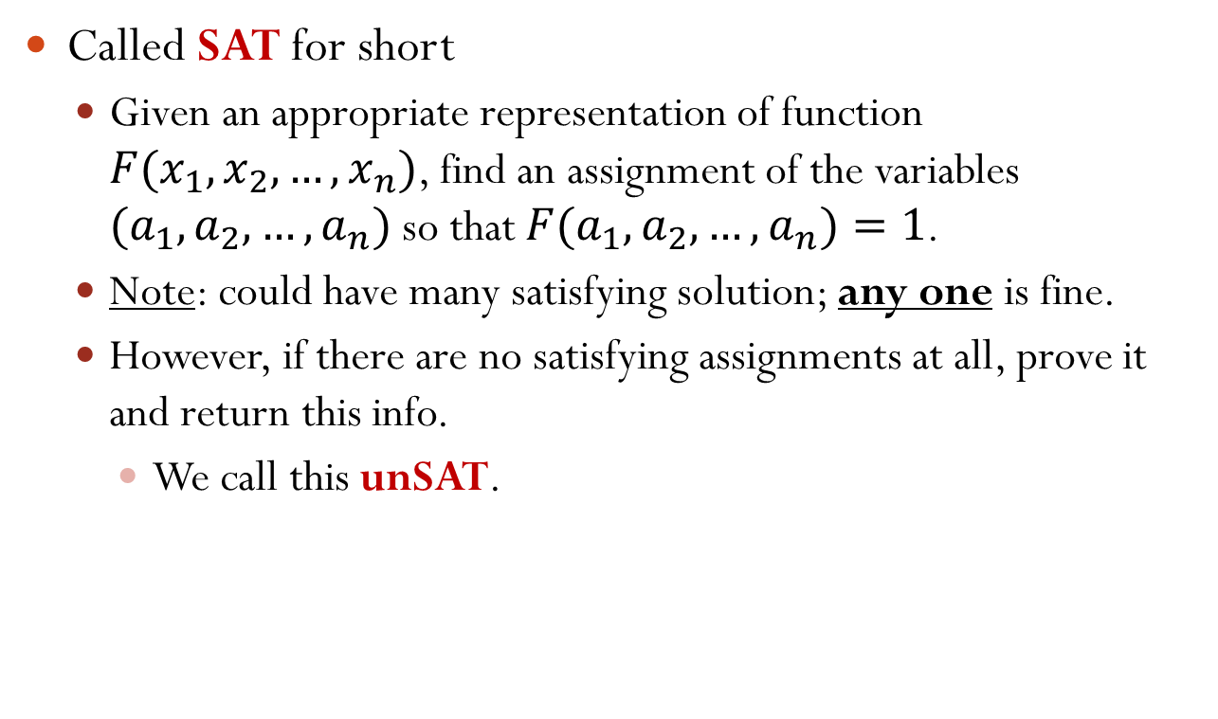
Satisfiability
Called SAT for short
Given an appropriate representation of function $F(x_{1},x_{2},…,x_{n})$, find an assignment of the variables $(a_{1},a_{2},…,a_{n})$ so that $F(a_{1},a_{2},…,a_{n})=1$.
Note: could have many satisfying solution; any one is fine.
However, if there are no satisfying assignments at all, prove it and return this info.
We call this unSAT.

Slide 3
Many Applications
One application: verify whether two digital circuits F and G are functionally equivalent
Build a circuit like below.
If unSAT for the final output, the two circuits are equivalent!
x1
x2
x3
x4
x1
x2
x3
x4
F
G
F1
G1
XOR

Slide 4
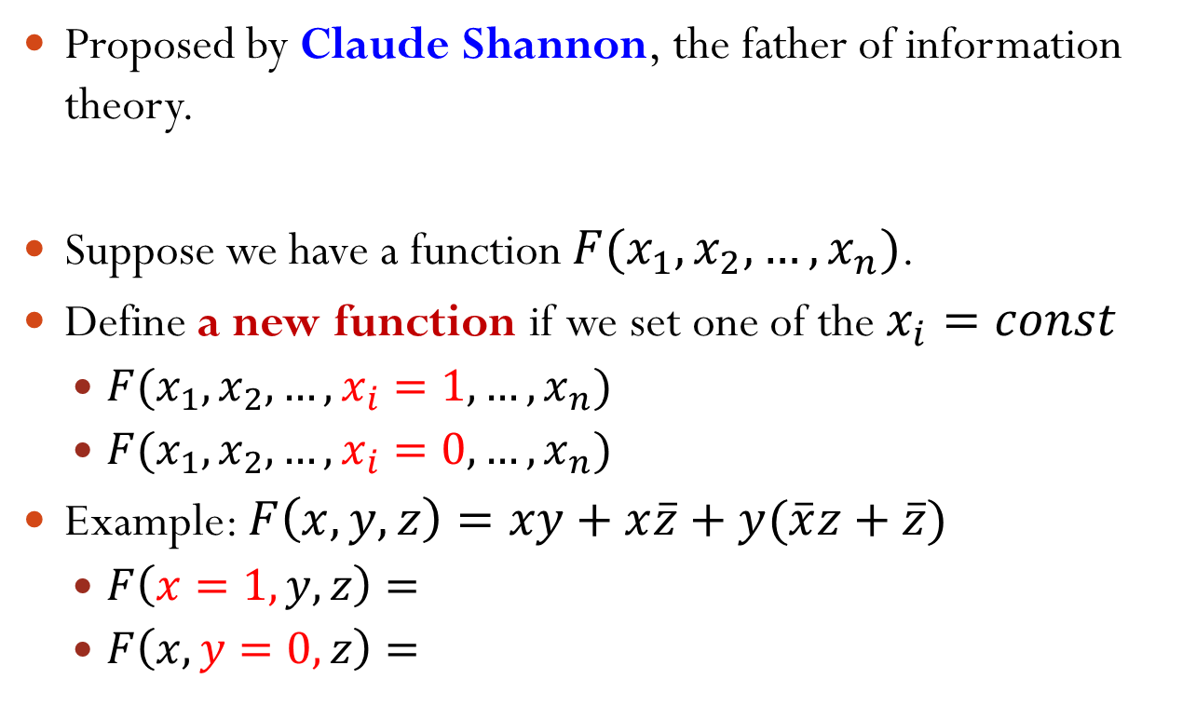
Standard SAT Form: CNF
Conjunctive Normal Form (CNF)
It is just standard Product-of-Sums form. $Φ=(a+c)(b+c)(\overline{a}+\overline{b}+\overline{c})$
Terminology
Each sum is called a clause.
Each variable in true form is called a positive literal.
Each variable in complement form is called a negative literal.
Why CNF is useful?
Need only determine that one clause evaluates to “0” to know whole formula = “0”.
Of course, to satisfy the whole formula, you must make all clauses identically “1”.
clause
positive literal
negative literal

Slide 5
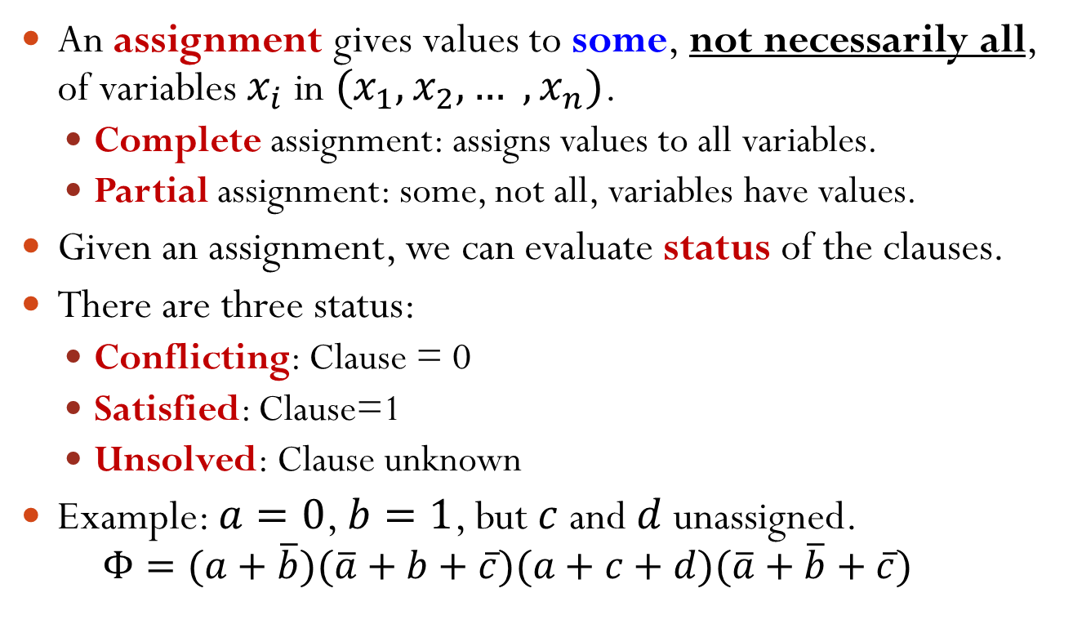
Assignment to a CNF Formula
An assignment gives values to some, not necessarily all, of variables $x_{i}$ in $(x_{1}, x_{2}, … , x_{n})$.
Complete assignment: assigns values to all variables.
Partial assignment: some, not all, variables have values.
Given an assignment, we can evaluate status of the clauses.
There are three status:
Conflicting: Clause = 0
Satisfied: Clause=1
Unsolved: Clause unknown
Example: $a=0$, $b=1$, but $c$ and $d$ unassigned.
$$Φ=(a+\overline{b})(\overline{a}+b+\overline{c})(a+c+d)(\overline{a}+\overline{b}+\overline{c})$$
Conflicting
Satisfied
Unsolved
Satisfied

Slide 6
How to Solve SAT Problem?
Idea #1: Decision
Select a variable and assign its value; simplify CNF formula as far as you can.
Hope you can decide if it is SAT or unSAT, without any further work.
If you cannot, pick another variable.

Slide 7














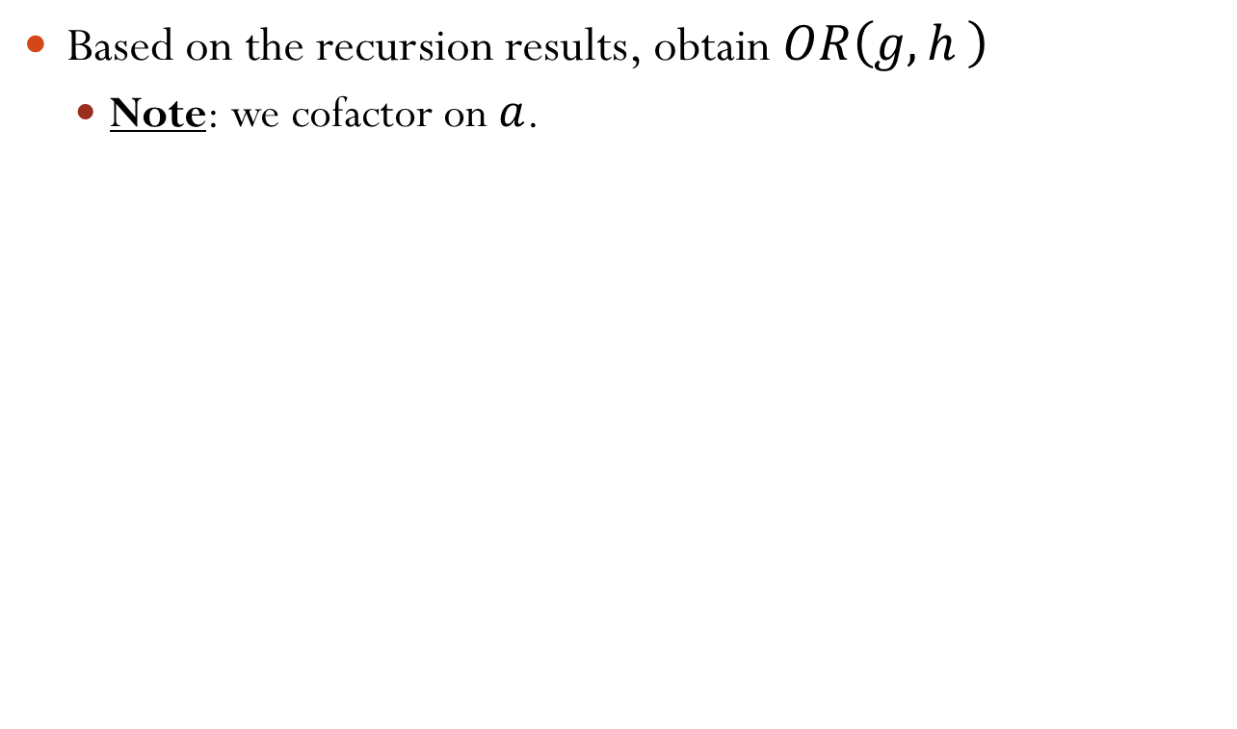

Decision: Example
Warning: this is just for illustration, which can be different from the actual steps in the project
$$Φ=(\overline{x}+\overline{y}+\overline{z})(x+\overline{y})(y+\overline{z})(x+y+z)$$
$$x=0$$
$$x=1$$
$$(1)(\overline{y})(y+\overline{z})(y+z)$$
$$(\overline{y}+\overline{z})(1)(y+\overline{z})(1)$$
$$y=0$$
$$y=1$$
$$y=0$$
$$(1)(\overline{z})(z)$$
$$0$$
$$(1)(1)(\overline{z})(1)$$
$$z=0$$
$$z=1$$
unSAT
$$z=0$$
$$0$$
$$0$$
$$1$$
SAT!!
Done!
unSAT
unSAT
However, with only decision, there could be a lot of work!
Notes:
With only decision, we can have a complete binary tree in the worst case.

Slide 8
How to Solve SAT Problem?
Idea #2: Deduction
Look at the newly simplified clauses.
Based on structure of clauses, and values of partial assignment, we can deduce the values of some unassigned variables so that SAT is possible.
With new values deducted, simplify the CNF as far as you can.
Do deduction and simplification iteratively until nothing simplifies. At this time,
If you can decide SAT, great!
If you decide unSAT, you have to backtrack to change a decision.
If you cannot say SAT/unSAT, you have to make decision again.

Slide 9
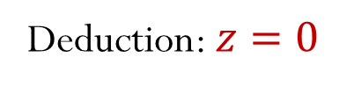



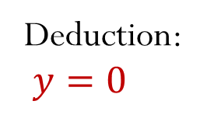






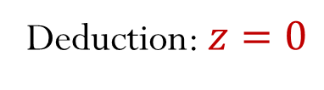
Deduction: Example
Warning: this is just for illustration, which can be different from the actual steps in the project
$$Φ=(\overline{x}+\overline{y}+\overline{z})(x+\overline{y})(y+\overline{z})(x+y+z)$$
$$x=0$$
$$x=1$$
Deduction: $y=0$
$$(1)(\overline{y})(y+\overline{z})(y+z)$$
$$(\overline{y}+\overline{z})(1)(y+\overline{z})(1)$$
Simplify
$$y=0$$
$$(1)(\overline{z})(z)$$
Deduction: $z=0$
$$(1)(1)(\overline{z})(1)$$
Simplify
Deduction: $z=0$
$$(1)(0)$$
$$1$$
SAT!!
Done!
unSAT
Notes:
In this example, we should further consider x=1, after we find x=0 is unSAT.

Slide 10
BCP: Boolean Constraint Propagation
To do “deduction”, use Boolean Constraint Propagation (BCP).
Given a set of fixed variable assignments, you “deduce” about other necessary assignments by “propagating constraints”.
What constraints? Each clause should be satisfied.
Most famous BCP strategy is “Unit Clause Rule”
A clause is said to be “unit” if it has exactly one unassigned literal.
Unit clause has exactly one way to be satisfied, i.e., pick polarity that makes clause=“1”.
This choice is called an “implication”.

Slide 11

Example: Unit Clause Rule
$$Φ=(a+c)(b+c)(\overline{a}+\overline{b}+\overline{c})(c+d+e)$$
Assume $a=1,b=1$
We can deduct that $c=0$.

Slide 12





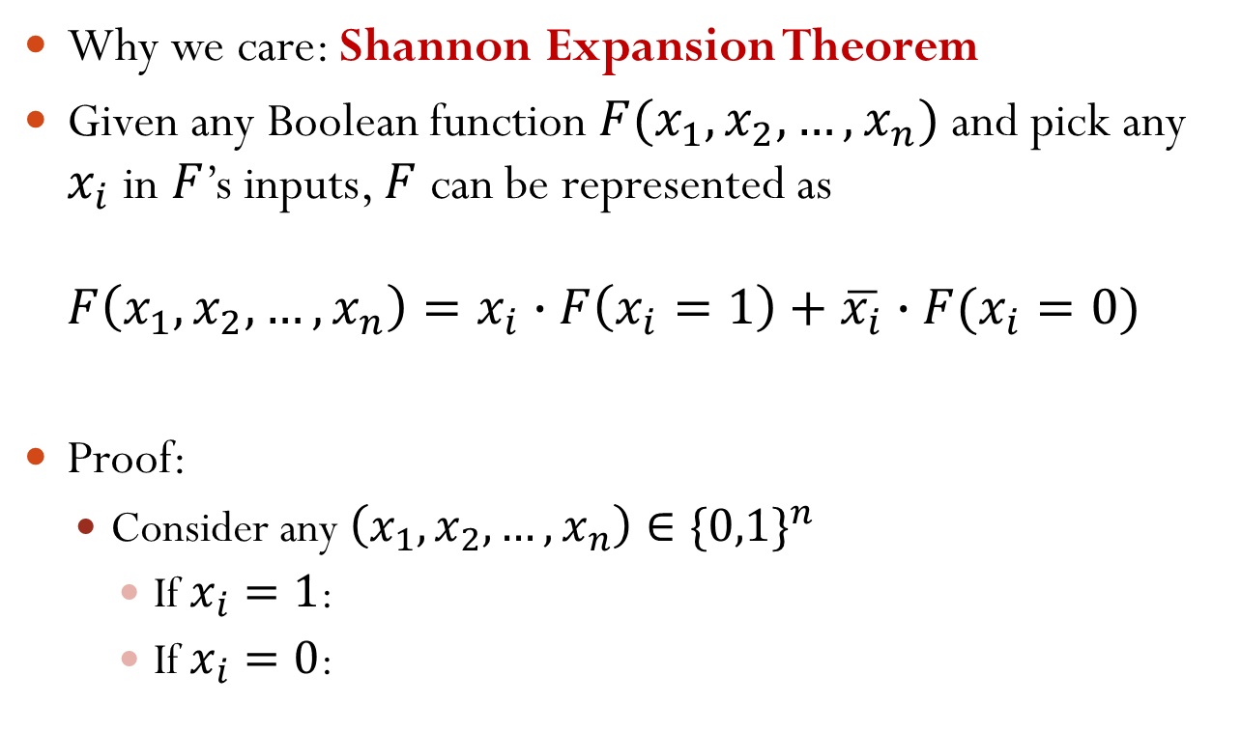



BCP Example
$$Φ=ω_{1}ω_{2}⋯ω_{9}$$
$$ω_{1}={\overline{x}}_{1}+x_{2}$$
$$ω_{2}={\overline{x}}_{1}+x_{3}$$
$$ω_{3}={\overline{x}}_{2}+{\overline{x}}_{3}+x_{4}$$
No SAT
No BCP
Now what?
$$ω_{4}={\overline{x}}_{4}+x_{5}$$
$$ω_{5}={\overline{x}}_{4}+x_{6}$$
$$ω_{6}={\overline{x}}_{5}+{\overline{x}}_{6}$$
$$ω_{7}=x_{1}+x_{7}$$
$$ω_{8}=x_{1}+x_{8}$$
$$ω_{9}={\overline{x}}_{7}+{\overline{x}}_{8}$$

Slide 13


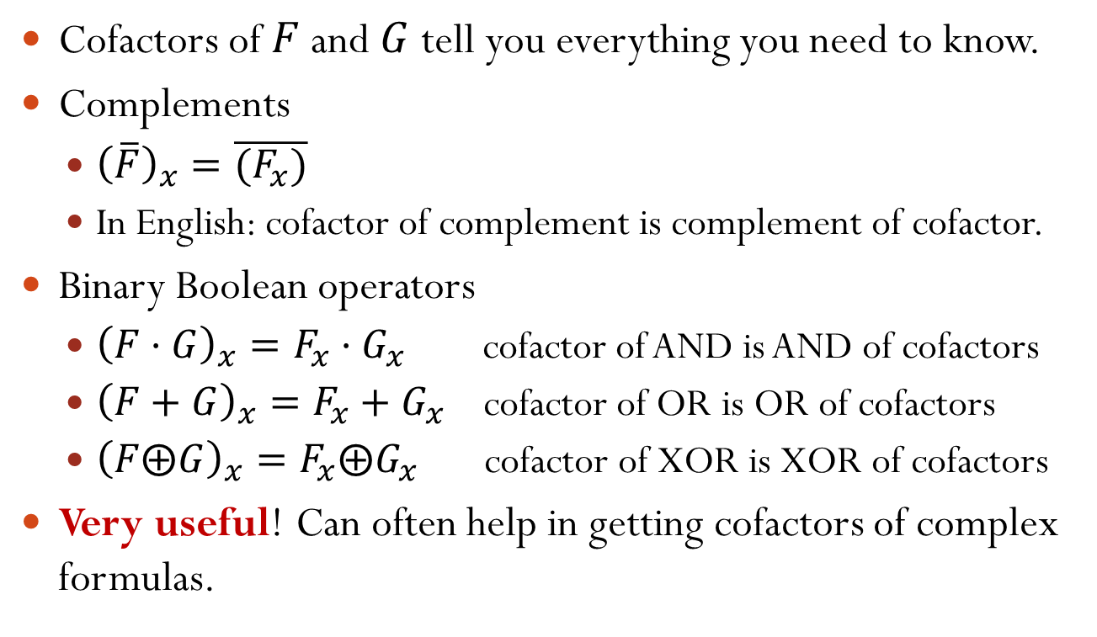
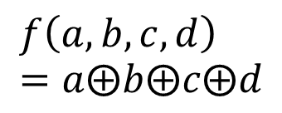


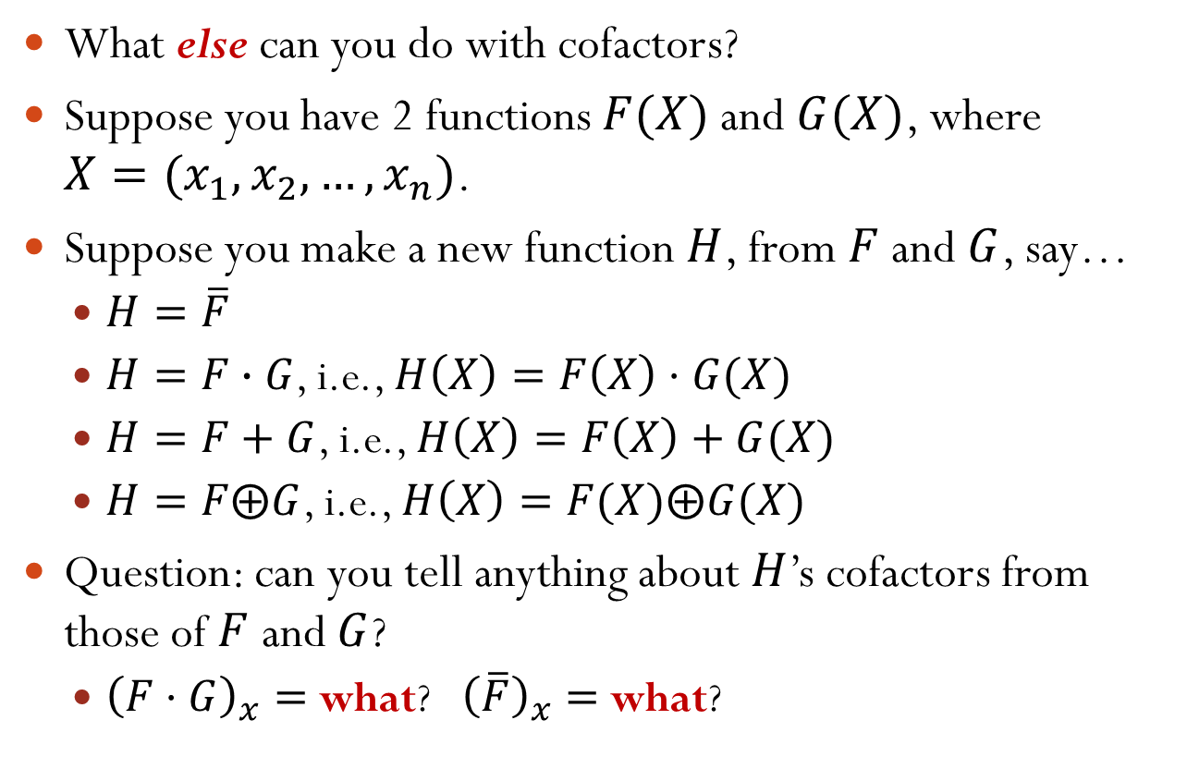


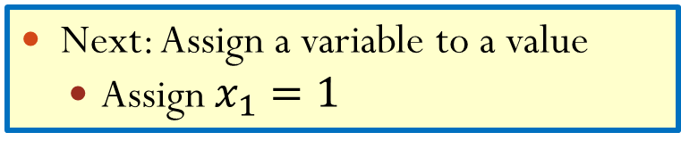
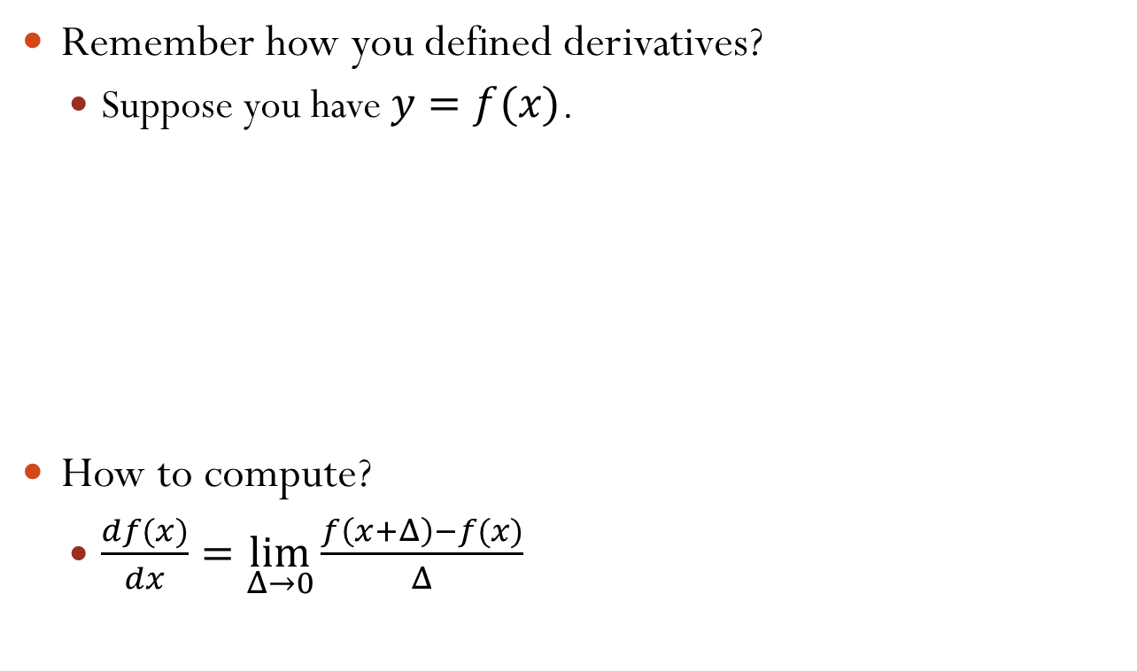


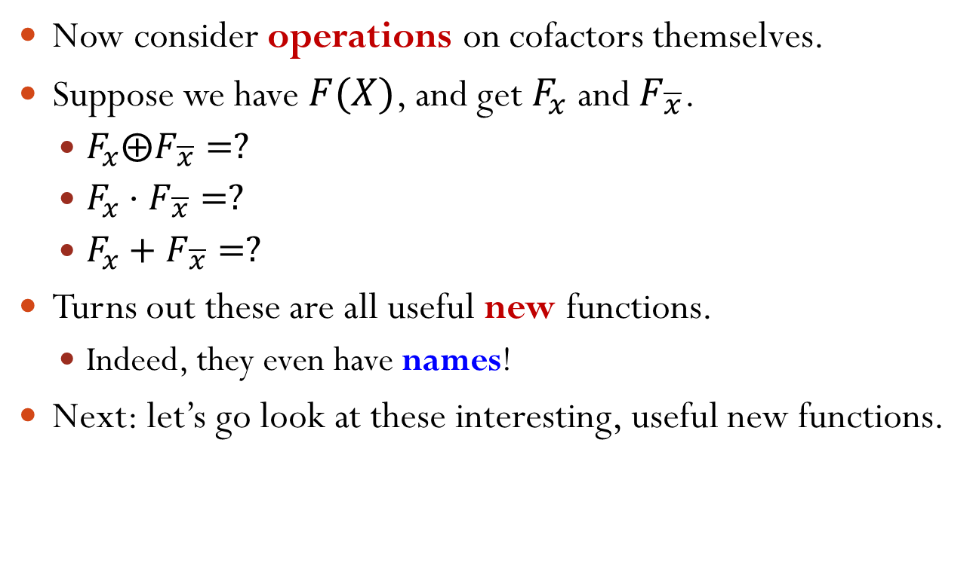


BCP Example (cont.)
Next: Assign a variable to a value
Assign $x_{1}=1$
$$ω_{1}={\overline{x}}_{1}+x_{2}$$
$$ω_{1}=x_{2}$$
Implication
$$x_{2}=1$$
$$ω_{2}={\overline{x}}_{1}+x_{3}$$
$$ω_{2}=x_{3}$$
$$x_{3}=1$$
Simplify
$$ω_{3}={\overline{x}}_{2}+{\overline{x}}_{3}+x_{4}$$
$$ω_{3}={\overline{x}}_{2}+{\overline{x}}_{3}+x_{4}$$
$$ω_{4}={\overline{x}}_{4}+x_{5}$$
$$ω_{4}={\overline{x}}_{4}+x_{5}$$
$$ω_{5}={\overline{x}}_{4}+x_{6}$$
$$ω_{5}={\overline{x}}_{4}+x_{6}$$
$$ω_{6}={\overline{x}}_{5}+{\overline{x}}_{6}$$
$$ω_{6}={\overline{x}}_{5}+{\overline{x}}_{6}$$
$$ω_{7}=x_{1}+x_{7}$$
$$ω_{7}=1$$
$$ω_{8}=x_{1}+x_{8}$$
$$ω_{8}=1$$
$$ω_{9}={\overline{x}}_{7}+{\overline{x}}_{8}$$
$$ω_{9}={\overline{x}}_{7}+{\overline{x}}_{8}$$

Slide 14










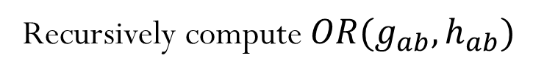

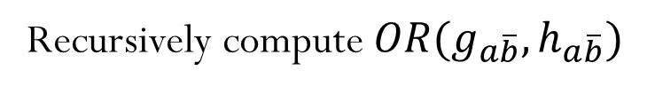

BCP Example (cont.)
Assign implied values
Assign $x_{2}=1,x_{3}=1$
$$ω_{1}=x_{2}$$
$$ω_{1}=1$$
$$ω_{2}=x_{3}$$
$$ω_{2}=1$$
Implication
Simplify
$$ω_{3}={\overline{x}}_{2}+{\overline{x}}_{3}+x_{4}$$
$$ω_{3}=x_{4}$$
$$x_{4}=1$$
$$ω_{4}={\overline{x}}_{4}+x_{5}$$
$$ω_{4}={\overline{x}}_{4}+x_{5}$$
$$ω_{5}={\overline{x}}_{4}+x_{6}$$
$$ω_{5}={\overline{x}}_{4}+x_{6}$$
$$ω_{6}={\overline{x}}_{5}+{\overline{x}}_{6}$$
$$ω_{6}={\overline{x}}_{5}+{\overline{x}}_{6}$$
$$ω_{7}=1$$
$$ω_{7}=1$$
$$ω_{8}=1$$
$$ω_{8}=1$$
$$ω_{9}={\overline{x}}_{7}+{\overline{x}}_{8}$$
$$ω_{9}={\overline{x}}_{7}+{\overline{x}}_{8}$$

Slide 15















BCP Example (cont.)
Assign implied values
Assign $x_{4}=1$
$$ω_{1}=1$$
$$ω_{1}=1$$
$$ω_{2}=1$$
$$ω_{2}=1$$
$$ω_{3}=x_{4}$$
Simplify
$$ω_{3}=1$$
$$ω_{4}={\overline{x}}_{4}+x_{5}$$
$$ω_{4}=x_{5}$$
Implication
$$x_{5}=1$$
$$ω_{5}={\overline{x}}_{4}+x_{6}$$
$$ω_{5}=x_{6}$$
$$x_{6}=1$$
$$ω_{6}={\overline{x}}_{5}+{\overline{x}}_{6}$$
$$ω_{6}={\overline{x}}_{5}+{\overline{x}}_{6}$$
$$ω_{7}=1$$
$$ω_{7}=1$$
$$ω_{8}=1$$
$$ω_{8}=1$$
$$ω_{9}={\overline{x}}_{7}+{\overline{x}}_{8}$$
$$ω_{9}={\overline{x}}_{7}+{\overline{x}}_{8}$$

Slide 16













BCP Example (cont.)
Assign implied values
Assign $x_{5}=1,x_{6}=1$
$$ω_{1}=1$$
$$ω_{1}=1$$
$$ω_{2}=1$$
$$ω_{2}=1$$
Simplify
$$ω_{3}=1$$
$$ω_{3}=1$$
$$ω_{4}=x_{5}$$
$$ω_{4}=1$$
$$ω_{5}=x_{6}$$
$$ω_{5}=1$$
$$ω_{6}={\overline{x}}_{5}+{\overline{x}}_{6}$$
$$ω_{6}=0$$
Conflicting!
$$ω_{7}=1$$
$$ω_{7}=1$$
unSAT
$$ω_{8}=1$$
$$ω_{8}=1$$
$$ω_{9}={\overline{x}}_{7}+{\overline{x}}_{8}$$
$$ω_{9}={\overline{x}}_{7}+{\overline{x}}_{8}$$

Slide 17






BCP Example: Summary
We start by assigning $x_{1}=1$.
After that, by BCP, we get implications: $x_{2}=1,x_{3}=1$ $x_{4}=1$ $x_{5}=1,x_{6}=1$
Finally, we obtain a conflicting clause → unSAT
$$Φ=ω_{1}ω_{2}⋯ω_{9}$$
$$ω_{1}={\overline{x}}_{1}+x_{2}$$
$$ω_{2}={\overline{x}}_{1}+x_{3}$$
$$ω_{3}={\overline{x}}_{2}+{\overline{x}}_{3}+x_{4}$$
$$ω_{4}={\overline{x}}_{4}+x_{5}$$
$$ω_{5}={\overline{x}}_{4}+x_{6}$$
$$ω_{6}={\overline{x}}_{5}+{\overline{x}}_{6}$$
$$ω_{7}=x_{1}+x_{7}$$
$$ω_{8}=x_{1}+x_{8}$$
$$ω_{9}={\overline{x}}_{7}+{\overline{x}}_{8}$$

Slide 18
When Does BCP Finish?
Three cases when BCP finishes:
SAT: Find a SAT assignment, all clauses resolve to “1”. Return the assignment.
Unresolved: One or more clauses unresolved.
What’s next? Pick another unassigned variable, and recurse more.
unSAT: Find conflict, one or more clauses evaluate to “0”.
What’s next? You need to undo one of the previous variable assignments, try again…

Slide 19
DPLL Algorithm
What we have covered is the basic idea behind the famous SAT-solving algorithm -- Davis-Putnam-Logemann-Loveland (DPLL) Algorithm.
Davis and Putnam published the basic recursive framework in 1960.
Davis, Logemann, and Loveland found smarter BCP, e.g., unit-clause rule, in 1962.
Big ideas
A complete, systematic search of variable assignments.
Use CNF form for efficiency.
BCP makes search stop earlier, “resolving” more assignments without recursing more.

