Slide 2
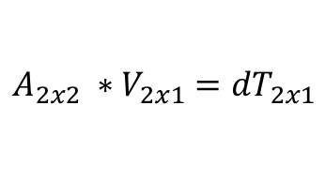
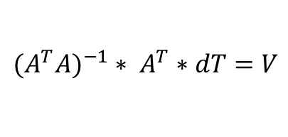
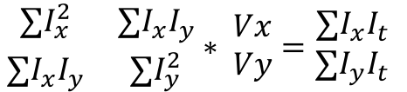
Lucas-Kanade Dense Optical Flow
Find dX, dY,
Solve for [VX, VY] at each pixel with window of size W
RGB Images
Gray Scale Images
RGB2Gray
Find dT
$\begin{matrix}∑I_{x}^{2} & ∑I_{x}I_{y} \\ ∑I_{x}I_{y} & ∑I_{y}^{2}\end{matrix}∗ \begin{matrix}Vx \\ Vy\end{matrix}=\begin{matrix}∑I_{x}I_{t} \\ ∑I_{y}I_{t}\end{matrix}$
$$A_{2x2} ∗V_{2x1}={dT}_{2x1}$$
$${{(A}^{T}A)}^{−1}∗ A^{T}∗dT=V$$

Slide 3
Building Gaussian Pyramid
Sample every other row/col to get ¼ image
Gray Scale Images
Apply Gaussian Blur
Repeat as many times as wanted (or until image becomes too small)

Slide 4
Scaling a Gaussian Pyramid
1
2
1
2
3
4
Interpolation
3
4
Fill empty spots with
Replication of values in surrounding neighborhood
Linear Interpolation
Gaussian Interpolation

Slide 5
Lucas-Kanade with Gaussian Pyramid
Find OF of top (smallest) level
RGB Images
Gray Scale Images
Build Pyramid
RGB2Gray
Interpolate OF down (to next pyramid level); Multiply magnitude by 4
Calculate OF of new level
Take Max OF
Repeat until at desired level

