Slide 1
Data Selection&Split
Data Selection
Task Definition
Data Split
Attribute&Link Prediction
Data Leakage - solve
Multi Labels - solve
Prediction Filter - solve

Slide 2
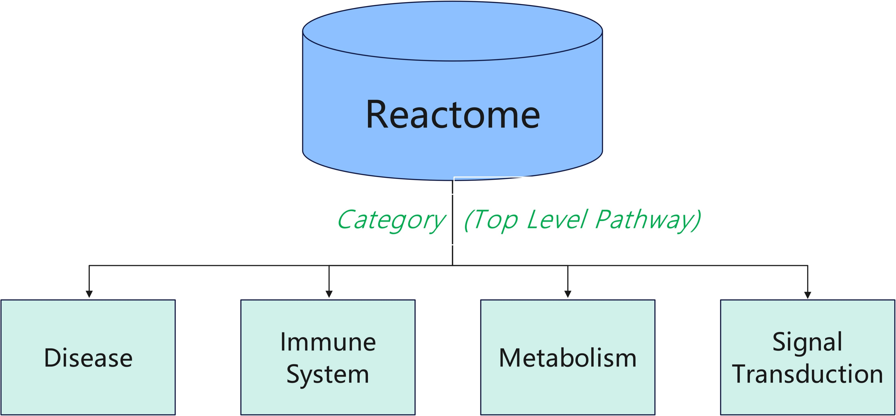
Data Selection
Home – Reactome
Pathway Database

Slide 3
Task Definition
For Single Category
multi reactions and entities
Category: Disease
A
…
…
D
…
B
…
…
E
…
Entity
C
…
…
………….

Slide 4
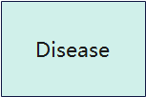
Task Definition
Node
A
Node
D
For Single Pathway
multi reactions and entities
Node
Hyper Edge
B
Reaction
Relationships
Node
A, R, -1
B, R, -1
C, R, -1
D, R, 1
E, R, 1
Node
E
C

Slide 5
Task Definition
X
Complex, Polymer,
Gene, Drug
x
Complex, protein,
Gene
For Single entity
multi components
1
Attributes Based on Reactome
A
2
3
Encode the Entity: 0010001000…..
Mappings
A, 1
A, 2
A, 3
…….
B
B
B

Slide 6
Task Definition
Reaction
Hyper Edges
Relationship(1&-1)
Entity
Nodes
mapping
Attributes
Node Attributes

Slide 7
Data Split
Attribute Level
Link Level
B
A
D
1
B
Reaction
A
E
2
C
3
Reaction
Based on the Nodes level
Based on the Edge level

Slide 8
Data Split
Attribute Level
B
Randomly pick a entity and check whether it contains more than 2 attributes
1
If so, randomly pick an attribute and check whether it associates with another entity
A
2
If so, we can mask this attribute
3
For each node, we only mask one attribute
So that, We guarantee the total number of entities and attributes won’t change and there will be no nodes without attributes.

Slide 9
Data Split
Attribute Level
Train
B
Input
Labels
1
A
A
A
2
2
2
3
3
3
Test/Validation
Num of Mappings
Train: 80%
Validation: 10%
Test: 10%
Input
Labels
1
A
A
2
3
The deal ratio is 8:1:1

Slide 10
Data Split
Link Level
A
Similar to node level splitting. Randomly pick a reaction and check whether it contains more than 2 entities
D
B
Reaction
E
If so, randomly pick an entity and check whether it associates with another reaction
C
If so, we can mask this entity
Reaction
For each reaction, we only mask one entity
So that, We guarantee the total number of reactions and attributes won’t change and there will be no nodes without attributes.

Slide 11
Attribute Prediction
Link Level
A
Train
D
A
Input
D
A
labels
B
Reaction
B
Reaction
B
Reaction
E
C
E
Reaction
Validation/Test
A
Input
D
labels
Num of Relationships
Train: 80%
Validation: 10%
Test: 10%
B
Reaction
Reaction
E
C
The ideal ratio is 8:1:1

Slide 12
Attribute Prediction
Attribute Level Prediction
Train Process
Input
Model:
GCN
HGNN
HGNN+
2
A
0
0
1
……..
0.1
0.2
1
….
3
encode
1
0
0
……..
input
output
0.8
0
0.3
….
………………
………………
……..
Cross-entropy
Loss Function
labels
2
0
0
1
……..
A
3
1
0
0
……..
encode
………………
……..

Slide 13
Attribute Prediction
Attribute Level Prediction
Validation/Test Process
Input
2
A
0
0
1
……..
0.1
0.2
0.9
….
0.1
0.2
….
0
3
Model
encode
1
0
0
……..
input
output
0.8
0
0.3
….
filter
0
0
0.3
….
………………
…………………
…………………
……..
labels
0
0
1
……..
A
encode
1
0
0
……..
NDCG@K
1
………………
Accuracy@K
……..

Slide 14
Link Prediction
Link Level Prediction
Train Process
Input
2
Node features N*K
……………………………
Model:
GCN
HGNN
HGNN+
MF
N*K
A
A
Reaction
3
0
0
1
……..
0.1
0.2
1
….
encode
1
0
0
……..
input
output
0.8
0
0.3
….
B
……..
……..
………………
………………
N
encode
multiply
Edge features E*K
Output E*N
Edge features E*N
A
D
0.3
0
0.5
….
0.8
0.6
0.5
….
1
1
0
……..
Reaction
multiply
Cross-entropy
Loss Function
readout
0.5
0
0
...
0.5
0
0
...
1
0
0
……..
B
E
……..
………………
………………
………………
E

Slide 15
Link Prediction
Link Level Prediction
Test/Validation Process
Input
2
Node features N*K
……………………………
labels
N*K
A
Reaction
3
0
0
1
……..
0.1
0.2
1
….
encode
1
0
0
……..
input
Model
output
0.8
0
0.3
….
C
……..
……..
………………
………………
N
encode
multiply
Edge features E*K
Output E*N
Edge features E*N
A
D
0.3
0
0.5
….
0.8
0.6
0.5
….
0
0
1
……..
Reaction
multiply
NDCG@K
filter
readout
0.5
0
0
...
0.5
0
0
...
1
0
0
……..
B
E
Accuracy@K
……..
………………
………………
………………
E

Slide 16
Data Leakage
Data Leakage
Train
A
Input
C
A
labels
Due to the mistake in DataLoader.
(We incorrectly used raw data for labels)
Some masked nodes are
exposed to the training process,
Result in extremely high performance.
B
Reaction
B
Reaction
D
C
Validation/Test
A
Input
C
labels
Reaction
Reaction
We Reconstructed DataLoader
And strictly cleared of these exposed nodes
B
D
C

Slide 17
Data Leakage
Data Leakage
Reconstructed DataLoader
And strictly cleared of these exposed nodes
Train
Train
A
Input
C
A
labels
A
Input
D
A
labels
B
Reaction
B
Reaction
B
Reaction
B
Reaction
D
C
E
Validation/Test
Validation/Test
A
Input
C
labels
A
Input
D
labels
B
Reaction
Reaction
B
Reaction
Reaction
D
C
E
C

Slide 18
Multi Labels
Multi Labels
Reaction
A
A
D
D
B
Reaction
B
Reaction
E
E
C
C
Reaction
Reaction
Some reactions will be masked more than one entity if we strictly obey to 8:1:1, which will make it more difficult to evaluate the prediction: We’ll need to rebuild the whole scoring system for multi-labels situation.

Slide 19
Multi Labels
Multi Labels
We have adapted the splitting algorithm by adding some compensation factors to mask as many as possible while ensuring that each edge will be only masked one node.
Num of Relationships
Train: 80%
Validation: 10%
Test: 10%
Num of Relationships
Train: 84%
Validation: 8%
Test: 8%
The deal ratio is 8:1:1
Actual ratio

Slide 20
Prediction Filter
A
For reaction’s edge embedding, we use its existing nodes: A, B, D, E to read it out. So in our final prediction. Those input nodes might have a higher score than C – the masked one.
D
B
Reaction-K
E
C
1
It’s similar when comes to attribute level prediction. The input attributes: 2, 3 might have higher scores in our final prediction than attribute 1 – the masked one.
A
2
3

Slide 21
Prediction Filter
We can filter those node/attribute’s score in final prediction to improve our validation/test performance
A
B
C
D
E
…………
Edge
0
0
masked
0
0
Evaluation

Slide 22
Thank You

