Slide 1
02 / SITE + BRIEF
The capacity baseline needs confirmation
WORKING TOTAL CAPACITY TARGET
RIT CAMPUS PLAN FIGURE
513
444
VERIFY BEFORE PROMISING
Current beds • units • occupancy
Building condition • closure dates
Swing housing • rate/utility rules
historic Riverknoll beds
beds listed in 2022
SITE: Riverknoll • 6000 Reynolds Drive • west campus near Kimball Drive
Keep 513 as a working total-capacity benchmark. Retain 516–536; subtract its verified beds from the net new-build count. RIT’s 444-bed figure is a material discrepancy to reconcile.
CONCEPT REVIEW • NOVEMBER 2026
01
Notes:
SPIRIT OF THE SLIDE
Lead with honesty about the number. This slide demonstrates that the proposal is careful with evidence.
TALK TRACK
I’m using 513 beds as a working total-capacity benchmark, not the number of new beds to build. The resident-identified 516–536 pilot building stays. Its current bed count must be verified and subtracted from the net replacement requirement. RIT’s 2022 plan says 444, so current inventory and the historic figures need reconciliation.
SOURCES
DASNY / RIT 2019 SEQR (516–536 renovation prototype): https://www.dasny.org/sites/default/files/inline-files/RIT%202019%20Financing%20Type%20I%2009.10.19%20SES.pdf
RIT 2022 Campus Plan: https://www.rit.edu/sites/rit.edu/files/docs/campus-plan/2022%20RIT%20Campus%20Plan%20Final.pdf

Slide 2
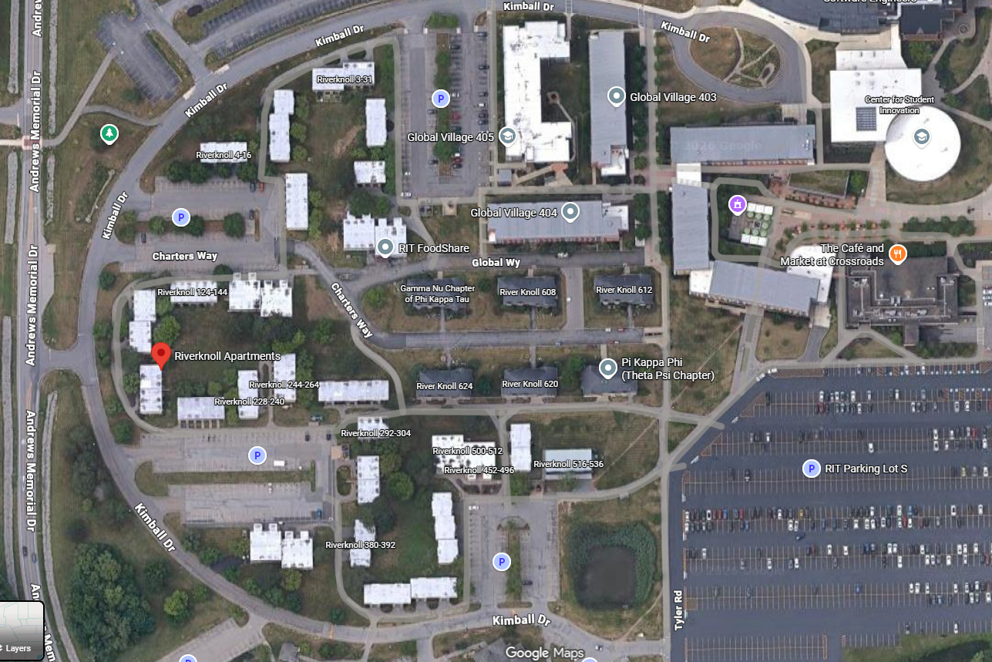
03 / SITE + CONSTRUCTION ACCESS
Build within Riverknoll’s real constraints
MUST STAY IN PLACE
Greek row houses along Charters Way
Riverknoll 516–536 • retain
Also retain mature trees and maintain existing resident, service and emergency access.
PHASE THE REMAINING CLUSTERS
Replace only confirmed legacy Riverknoll buildings. Coordinate truck routes, parking changes, work fencing and resident paths in each phase.
Student-supplied aerial; colored outlines are approximate. Confirm building/tree limits with RIT GIS, survey and arborist review.
CONCEPT REVIEW • NOVEMBER 2026
02
Notes:
SPIRIT OF THE SLIDE
The site isn’t empty. Greek houses, the renovated 516–536 pilot, mature trees and the roads between homes are fixed neighbors in the design.
TALK TRACK
This is the actual site context supplied by a Riverknoll resident. The red and teal marks are approximate discussion highlights, not legal limits. The proposal replaces only confirmed legacy Riverknoll clusters. Charters Way Greek houses and 516–536 remain; tree and road access are carried through the phasing plan. RIT’s 2019 SEQR document identifies 516–536 as a renovation prototype.
SOURCES
RIT campus map: https://www.rit.edu/facilitiesmanagement/sites/rit.edu.facilitiesmanagement/files/2024%20Campus%20Map.pdf
DASNY / RIT 2019 SEQR: https://www.dasny.org/sites/default/files/inline-files/RIT%202019%20Financing%20Type%20I%2009.10.19%20SES.pdf

Slide 3
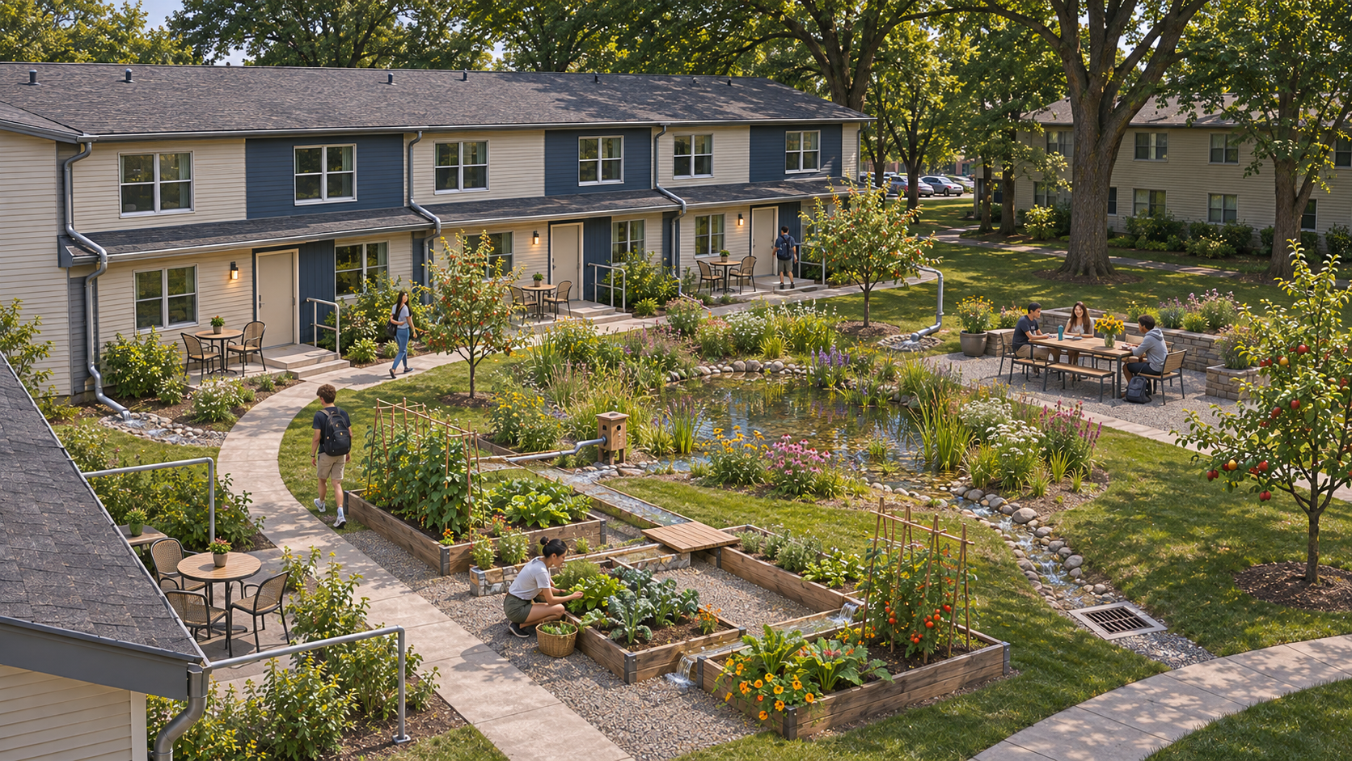
04 / COURTYARD + HYDROLOGY
Each courtyard can grow food and hold stormwater
BASE FORM
Two-story attached homes with private bedrooms, shared living, and a small rear patio per home.
WATER + COMMUNITY
Small private cafe patios lead to shared garden paths and seating. Roof gutters direct runoff to a shallow central rain garden pond that can feed beds by gravity.
Illustrative court concept. Grade, soils, overflow, freeze safety, access and site fit need civil design.
CONCEPT REVIEW • NOVEMBER 2026
03
Notes:
SPIRIT OF THE SLIDE
The courtyard is both a social room and a small water-management landscape.
TALK TRACK
Gutters and paths direct runoff toward a shallow, planted seasonal pond. Garden beds sit around it for shared tending and gravity-feed irrigation. Rochester freeze-thaw, soils, overflow capacity, standing-water control, universal access and foundation separation all need civil and landscape review. The render is illustrative, not surveyed or engineered.

Slide 4
05 / APARTMENT PLAN
Four residents, four private bedrooms
GROUND LEVEL • APPROX. 28 × 36 FT TEST
UPPER LEVEL • SAME FOOTPRINT TEST
KITCHEN
BEDROOM 3
BEDROOM 4
LIVING / DINING
~10 × 11 ft
~10 × 11 ft
shared student space
BATH / LAUNDRY
BATH 2
FLEX / STUDY
BEDROOM 1
BEDROOM 2
protected shared
common area
~10 × 11 ft
~10 × 11 ft
STAIR / STORAGE
~1,000–1,100 gross sq ft per level (early test)
No single-size double rooms. Test a 14 × 16 ft two-person room with two beds, desks and storage against private-room rates.
CONCEPT REVIEW • NOVEMBER 2026
04
Notes:
SPIRIT OF THE SLIDE
The room experience is the human center of the proposal.
TALK TRACK
The starting plan provides four private bedrooms and protects shared living space. It responds to a common concern at Riverknoll: the current double room can be no larger than a single. We need to test a truly larger double as an affordability alternative.
SOURCES
RIT Riverknoll unit descriptions and room dimensions: https://www.rit.edu/housing/riverknoll

Slide 5
06 / SECTION + SCALE
A two-story base can grow selectively
OPTIONAL 3RD STORY • +1 OR 2 ROOMS
SCALING RULE
Add stories only where daylight, privacy, shared space, accessibility, egress, fire protection and structure still work.
PRIVATE
COMMON
ENVELOPE EFFICIENCY
Rowhouse party walls reduce exposed wall area. Compare that geometry with both wall systems so System 3E’s material effect stays separate.
PRIVATE
KITCHEN
2-STORY SUITE SECTION
THIRD STORY IS A TEST, NOT A FIT DETERMINATION
CONCEPT REVIEW • NOVEMBER 2026
05
Notes:
SPIRIT OF THE SLIDE
Show a controlled path to growth rather than a blanket density increase.
TALK TRACK
The plan begins with two levels. Selectively adding a third can add bedrooms, but only if the building and site can safely support it and the apartment still feels livable.

Slide 6
07 / HABITAT + ENVELOPE
Wildlife belongs in the plan, outside the building cavities
GROUND EDGE • HABITAT / FOUNDATION SEPARATION
FAÇADE DETAIL • NEST BOX OUTSIDE SEALED ENVELOPE
ROOM
3E WALL
CAVITY
SHRUB /
MEADOW EDGE
BIRD BOX
HOME
No opening into wall, room or HVAC
Engineer a buried
foundation guard
Groundhog refuge zone
kept away from foundations
Building in unison with life: safe habitat outside a durable, serviceable envelope.
CONCEPT REVIEW • NOVEMBER 2026
06
Notes:
SPIRIT OF THE SLIDE
Honor the animals already using Riverknoll while protecting future homes. Building with life means planning safe habitat and durable boundaries together.
TALK TRACK
The site plan should retain and reconnect shrub habitat, create safe refuge away from footings and utilities, and provide maintainable nest features. Your façade idea is welcome as an architectural direction, but the nest enclosure should be independent of the building’s exhaust and interior envelope. The goal is for the building to last longer because we designed these relationships deliberately.
SOURCES
Audubon bird-friendly building design: https://www.audubon.org/news/building-continent-birds-cafs-northern-regional-hub-and-bird-friendly-architecture
EPA multifamily IAQ guidance on protecting vents from pest entry: https://nepis.epa.gov/Exe/ZyPURL.cgi?Dockey=P100NU5D.TXT

Slide 7
08 / SPEED + ENVELOPE
System 3E schedule claims are large enough to test
WALL INSTALLATION • 1,560 SF HOUSE
SHELL + CORE • SINGLE-HOUSE EXAMPLE
14 → 1
5 → 3
workdays • 13 days fewer (93% less wall-work time)
months • 2 months fewer (40% shorter)
System 3E: one dry-stacked wall trade; no mortar cure wait.
Manufacturer-reported single-house shell/core comparison.
Riverknoll test: require the same 4-bed plan, delivery scope, inspection and fall-ready turnover from both bidders. These manufacturer examples are not a guaranteed multifamily or summer completion schedule; confirm U.S./New York code path, supply lead time and trained crew capacity.
CONCEPT REVIEW • NOVEMBER 2026
07
Notes:
SPIRIT OF THE SLIDE
The reported wall-work reduction could make the difference between starting a replacement path and watching beds disappear without replacement. The numbers are vendor claims that RIT should challenge with an apples-to-apples pilot bid.
TALK TRACK
For a 1,560 SF single-house reference, System 3E USA reports 14 days for traditional masonry wall work and 1 day for 3E, and a 5-to-3-month shell/core comparison. Those figures do not establish whole-building construction time for attached student housing. Ask contractors to show crew-days, element delivery, training, foundations, inspections, weather, MEP and fall turnover. The system’s U.S. evaluation report remains part of its market-entry work, so code acceptance is a gating item.
SOURCES
SYSTEM 3E USA technical data and schedule claims: https://system3e.us/technology.html

Slide 8
09 / DELIVERY
Build in clean clusters. Finish each courtyard once.
READY BEFORE SUMMER
BUILD ONE CLUSTER
COMMISSION + FINISH
OPEN, THEN MOVE ON
Survey and permits
Order long-lead items
Pre-stage utilities
Protect active access
Bid 2 vs 4 buildings
Keep work contiguous
Foundations, utilities,
shell and MEP
Inspect and commission
Finish site utilities
Complete permanent paths,
pond and garden together
Open before fall
Keep other homes active
Residents bring furniture
Repeat at next cluster
Finish shared hardscape only after every building, utility tie-in and heavy delivery using that courtyard is complete.
Contractors must validate the 2- vs 4-building summer package, inspections and fall-ready turnover. Do not landscape early and reopen finished work.
CONCEPT REVIEW • NOVEMBER 2026
08
Notes:
SPIRIT OF THE SLIDE
A construction phase is a complete, finished zone—not a wave of buildings that forces crews to return and tear up new courtyards.
TALK TRACK
Preconstruction, permits, utility coordination and procurement must be ready before summer. The CM should bid a contiguous 2-building and 4-building summer package with a critical-path schedule, crew plan and fall turnover date. Complete foundations, utilities, every building, service access and heavy deliveries before installing permanent courtyard paths, drainage, pond and garden. Inspect, commission and open the cluster before moving residents or beginning the next isolated cluster. Apartments are unfurnished; fixed kitchen and bath fixtures and appliances are included, while residents supply beds, couches and movable furniture. Keep other safe housing active. System 3E can shorten wall work, but its published single-house claims do not establish how many Riverknoll buildings can be completed in one summer.
SOURCES
DASNY / RIT 2019 SEQR lists a historic three-phase renovation approach: https://www.dasny.org/sites/default/files/inline-files/RIT%202019%20Financing%20Type%20I%2009.10.19%20SES.pdf
SYSTEM 3E schedule claims: https://system3e.us/technology.html

Slide 9
11 / CAPACITY
Three capacity cases test density against student space
At four beds per suite, these cases require about 129 / 154 / 180 suites.
718 beds
616 beds
513 beds
HEIGHT TEST
Base: 2 stories.
Scale: add a third story to selected buildings only after technical review.
TOTAL TARGET
+20%
+40%
Gross targets include retained 516–536; subtract its verified beds to size new construction. Confirm site fit and access.
CONCEPT REVIEW • NOVEMBER 2026
09
Notes:
SPIRIT OF THE SLIDE
Make growth visible while keeping it conditional.
TALK TRACK
513 is the working total-capacity case. Keep the renovated 516–536 pilot and subtract its verified beds from the new-build quantity. 616 and 718 show denser total-capacity cases. The third story is a strategy to test, not proof of site capacity.

Slide 10
12 / OPERATING PERFORMANCE
Wall-energy savings are modest in this screen
513 NEW-BED SCREEN • BASE WALL COMPARISON
SENSITIVITY TO REFERENCE WALL R-VALUE
$4,628 / year
R-25 → $1,966 / yr
about $9 per bed-year • gas heat assumption
R-22 → $4,628 / yr
Approx. 325 MMBtu useful heating + 37 MMBtu cooling load saved per year across the 513-new-bed case.
R-20 → $6,846 / yr
This is an opaque-wall conduction estimate: System 3E published R-27.8 vs an assumed R-22 conventional whole wall, Rochester 6,624 HDD / 756 CDD, 90% gas heat, and statewide average utility rates. It excludes windows, roof, floor, leakage and actual RIT bills; enter retained beds to reduce the project result. Savings may be smaller against a stronger conventional wall.
CONCEPT REVIEW • NOVEMBER 2026
10
Notes:
SPIRIT OF THE SLIDE
Show both the promise and the limit. The more reliable economic case may be faster wall installation and removed material scope; the exact utility saving depends on a real comparison assembly and RIT data.
TALK TRACK
For a 513-new-bed upper-bound case, the transparent R-22-wall screen gives about $4,628/year of heating plus cooling savings. R-25 to R-20 references produce roughly $1,966 to $6,846/year. That is wall-only, not a whole-building forecast. It also uses statewide average prices; RIT’s actual fuel, tariff and bills are needed. The comparison does not count retained 516–536 beds.
SOURCES
SYSTEM 3E published R-27.8 wall value: https://system3e.us/technology.html
NOAA 1991–2020 Rochester KROC HDD65/CDD65 normals: https://www.ncei.noaa.gov/access/services/data/v1?dataset=normals-monthly-1991-2020&stations=USW00014768&format=pdf
NYSERDA/EIA commercial natural gas prices: https://www.nyserda.ny.gov/Energy-Prices/Natural-Gas/Monthly-Average-Price-of-Natural-Gas-Commercial
EIA New York electricity profile: https://www.eia.gov/electricity/state/newyork/

Slide 11
13 / FINANCIAL FEASIBILITY
Current rent cannot finance a full replacement alone
513-BED ALL-NEW PLANNING ALLOWANCE
ANNUAL RENT + OPERATING SCREEN
$103.9M – $254.6M
$3.30M gross rent
$158.9M base case • $309.7k per new bed
≈ $1.98M NOI after 40% operating allowance
ILLUSTRATIVE CAPITAL SUPPORT
WHAT THE GAP SAYS
$30.4M debt • $128.5M gap
RIT must pair student-rate goals with institutional capital or other subsidy. Gross rent is not NOI, and these are editable screening assumptions.
5% • 30 years. Before subsidies, fundraising or campus cross-subsidy.
These are 2026 planning allowances, not bids. The model prices all 513 target beds as new until retained 516–536 capacity is verified; System 3E is not yet priced or code-cleared for this project.
CONCEPT REVIEW • NOVEMBER 2026
11
Notes:
SPIRIT OF THE SLIDE
Be direct about the financing constraint and show what it means for affordability.
TALK TRACK
The planning-level 513-new-bed model has a $158.9M base cost, with a $103.9M–$254.6M range. At the current published room rate and 95% assumed occupancy, gross rent is about $3.30M and the illustrative 40% expense allowance leaves $1.98M NOI. Under 5%, 30-year level debt, that supports about $30.4M; the modeled capital gap is $128.5M. These estimates price all 513 target beds as new until retained 516–536 beds are entered and do not yet price System 3E separately.
SOURCES
RIT Riverknoll 2026–27 rates: https://www.rit.edu/housing/riverknoll
RIT 2022 Campus Plan bed count: https://www.rit.edu/sites/rit.edu/files/docs/campus-plan/2022%20RIT%20Campus%20Plan%20Final.pdf
RIT closure notice / public response via Reporter, Nov. 9, 2026: https://reporter.rit.edu/8904/showcase/riverknoll-to-be-permanently-closed-after-2027-academic-year/

Slide 12
PIN-UP / COURTYARD HYDROLOGY
A visible water cycle can make the garden work
ROOF + PATHS
PRE-TREAT
LIVING FILTER
COURTYARD POND
GARDEN USE
Gutters / downspouts
Graded walking surfaces
Leaf screen
Sediment / first flush
Planted rain garden
Soil + wetland planting
Seasonal basin
or engineered fish refuge
Gravity-fed beds
Controlled overflow
DEFAULT STUDY / SEASONAL RAIN GARDEN
OPTION / YEAR-ROUND FISH HABITAT
Capture snowmelt and roof runoff; store and infiltrate what soils allow; overflow safely when the basin fills.
Only if a deeper refuge, winter oxygen plan, verified water quality, safe access and a funded maintenance owner are designed.
Keep road-salt runoff and foundation drainage out of the fish refuge. Confirm grades, soils, utility conflicts, ice and overflow with civil + ecological review.
SUPPORTING ARCHITECTURAL PIN-UP • NOVEMBER 2026
12
Notes:
SPIRIT OF THE SLIDE
The water system is both infrastructure and a shared place. The reference is Shimabara’s clean spring-water channels, not fish used as drain cleaners.
TALK TRACK
The Japanese precedent likely in mind is Shimabara, where carp swim in abundant spring-fed watercourses. Riverknoll’s rainwater is different: roof and snowmelt runoff must be screened and tested. Start with a seasonal planted rain garden. If RIT wants year-round fish, make that a separately engineered option with deeper refuge volume and a winter dissolved-oxygen plan. Penn State Extension describes winterkill risk under long ice and snow cover; aquatic design must be reviewed locally.
SOURCES
Shimabara City, City of Abundant Spring Water: https://www.city.shimabara.lg.jp/page3136.html
Penn State Extension, Winterkill in Ponds: https://extension.psu.edu/winterkill-in-ponds

