Slide 1
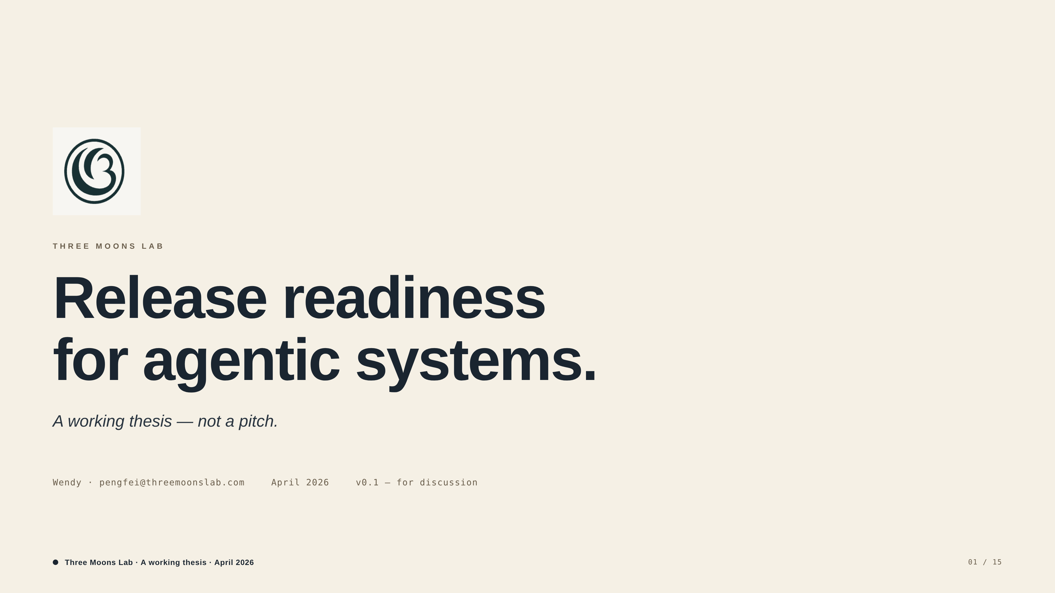
Notes:
Subtitle: 'A working thesis — not a pitch.' Set this expectation up front so the room reads correctly: I'm not raising; I'm pressure-testing whether this can become a venture-scale infrastructure company.

Slide 2
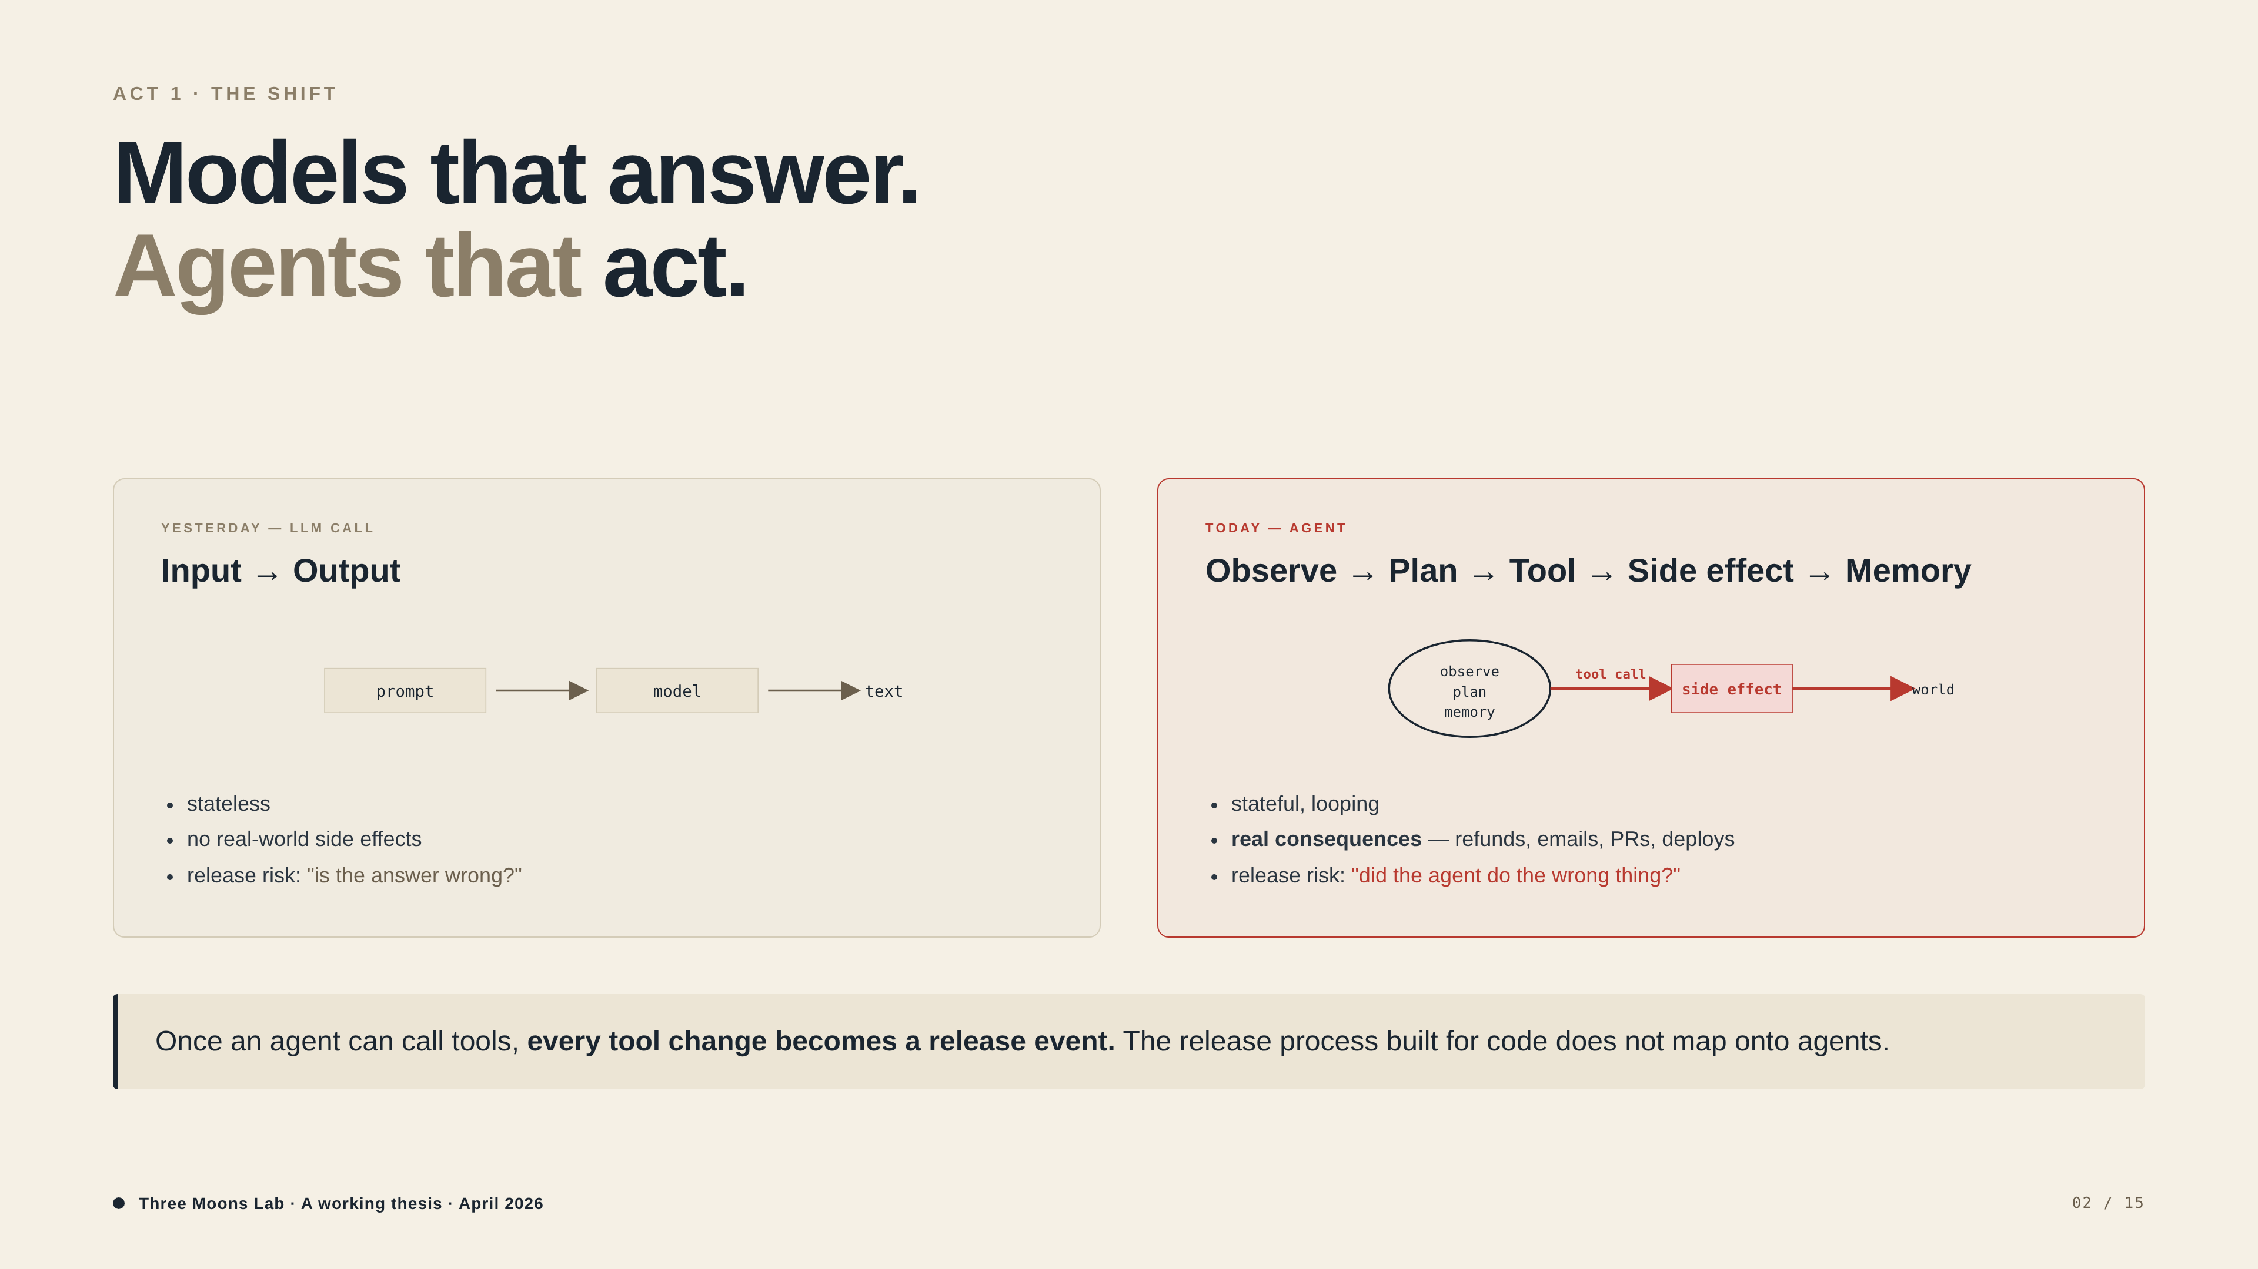
Notes:
Highest-leverage slide for category creation. The bottom callout — 'every tool change becomes a release event' — is the entire wedge in one line. If they read past this and don't update their model of agents, the rest of the deck won't land.

Slide 3
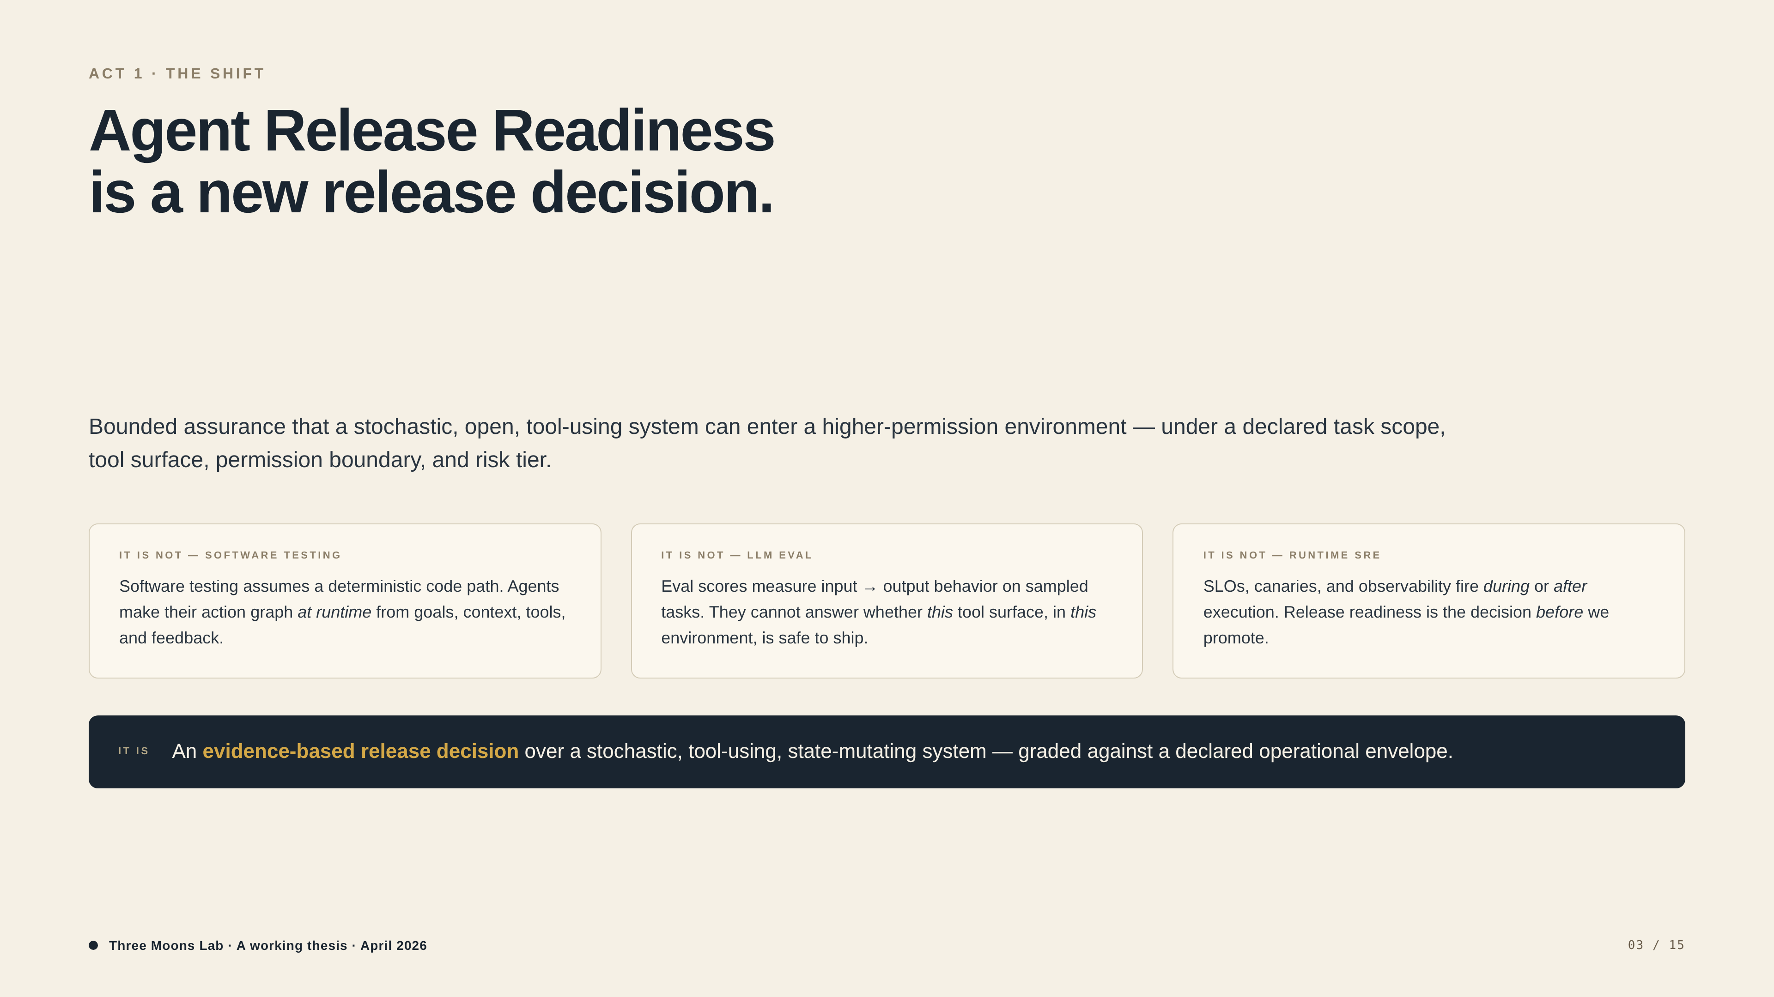
Notes:
Three negative-space cards (it is not — software testing / LLM eval / runtime SRE) before the positive definition. Defending the category claim by what it isn't is more honest than a TAM slide.

Slide 4
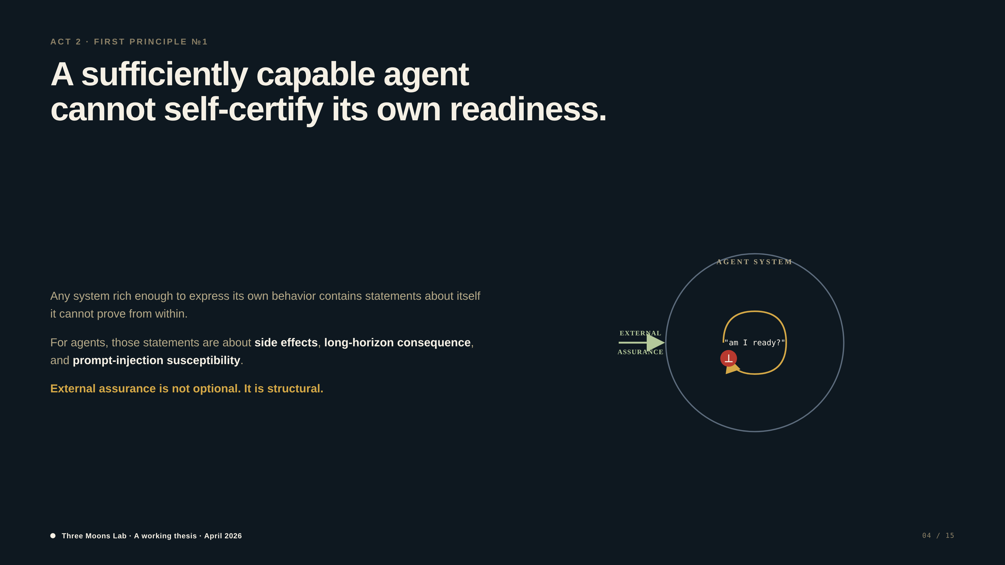
Notes:
Gödel — *why* this category must exist. External assurance is structural, not a 'nice to have'. This slide closes off two competitors before they're raised: foundation labs ('we'll add this') and agent self-certification ('the agent can check itself'). Skip this slide if the audience is allergic to philosophy.

Slide 5
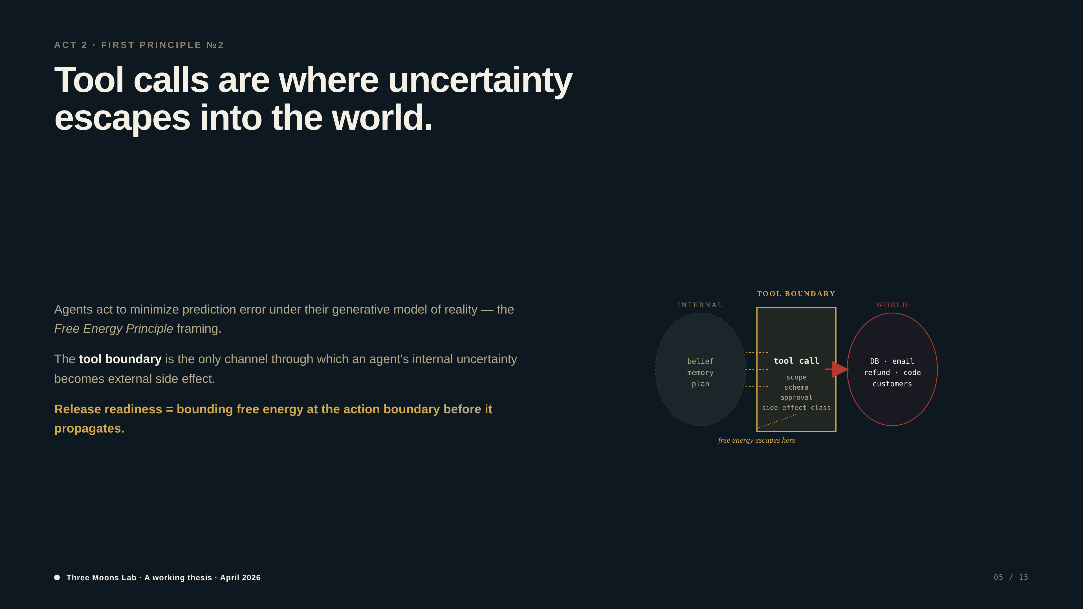
Notes:
Free Energy — *where* the wedge intervenes. Tool calls are the only channel through which internal uncertainty becomes external side effect. Pivots naturally into Slide 7's tool-use argument. Skip if you skipped Slide 4.

Slide 6
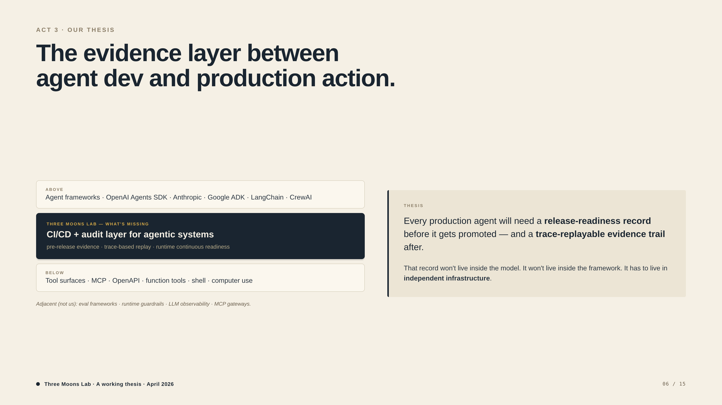
Notes:
Stack diagram positions us between agent frameworks (above) and tool surfaces (below), distinct from adjacent infra (eval, observability, MCP gateways). Right side: thesis stated plainly. If they push on 'why not LangSmith / Patronus / Galileo', point at the adjacency footer.

Slide 7
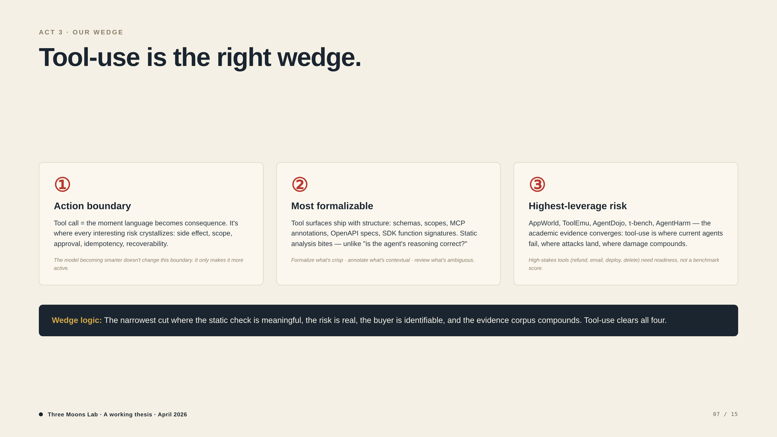
Notes:
Three reasons tool-use is the right cut. Academic backup (AppWorld, ToolEmu, AgentDojo, τ-bench) shows this isn't a hunch. Wedge logic in the dark callout: any miss and tool-use isn't the right cut.

Slide 8
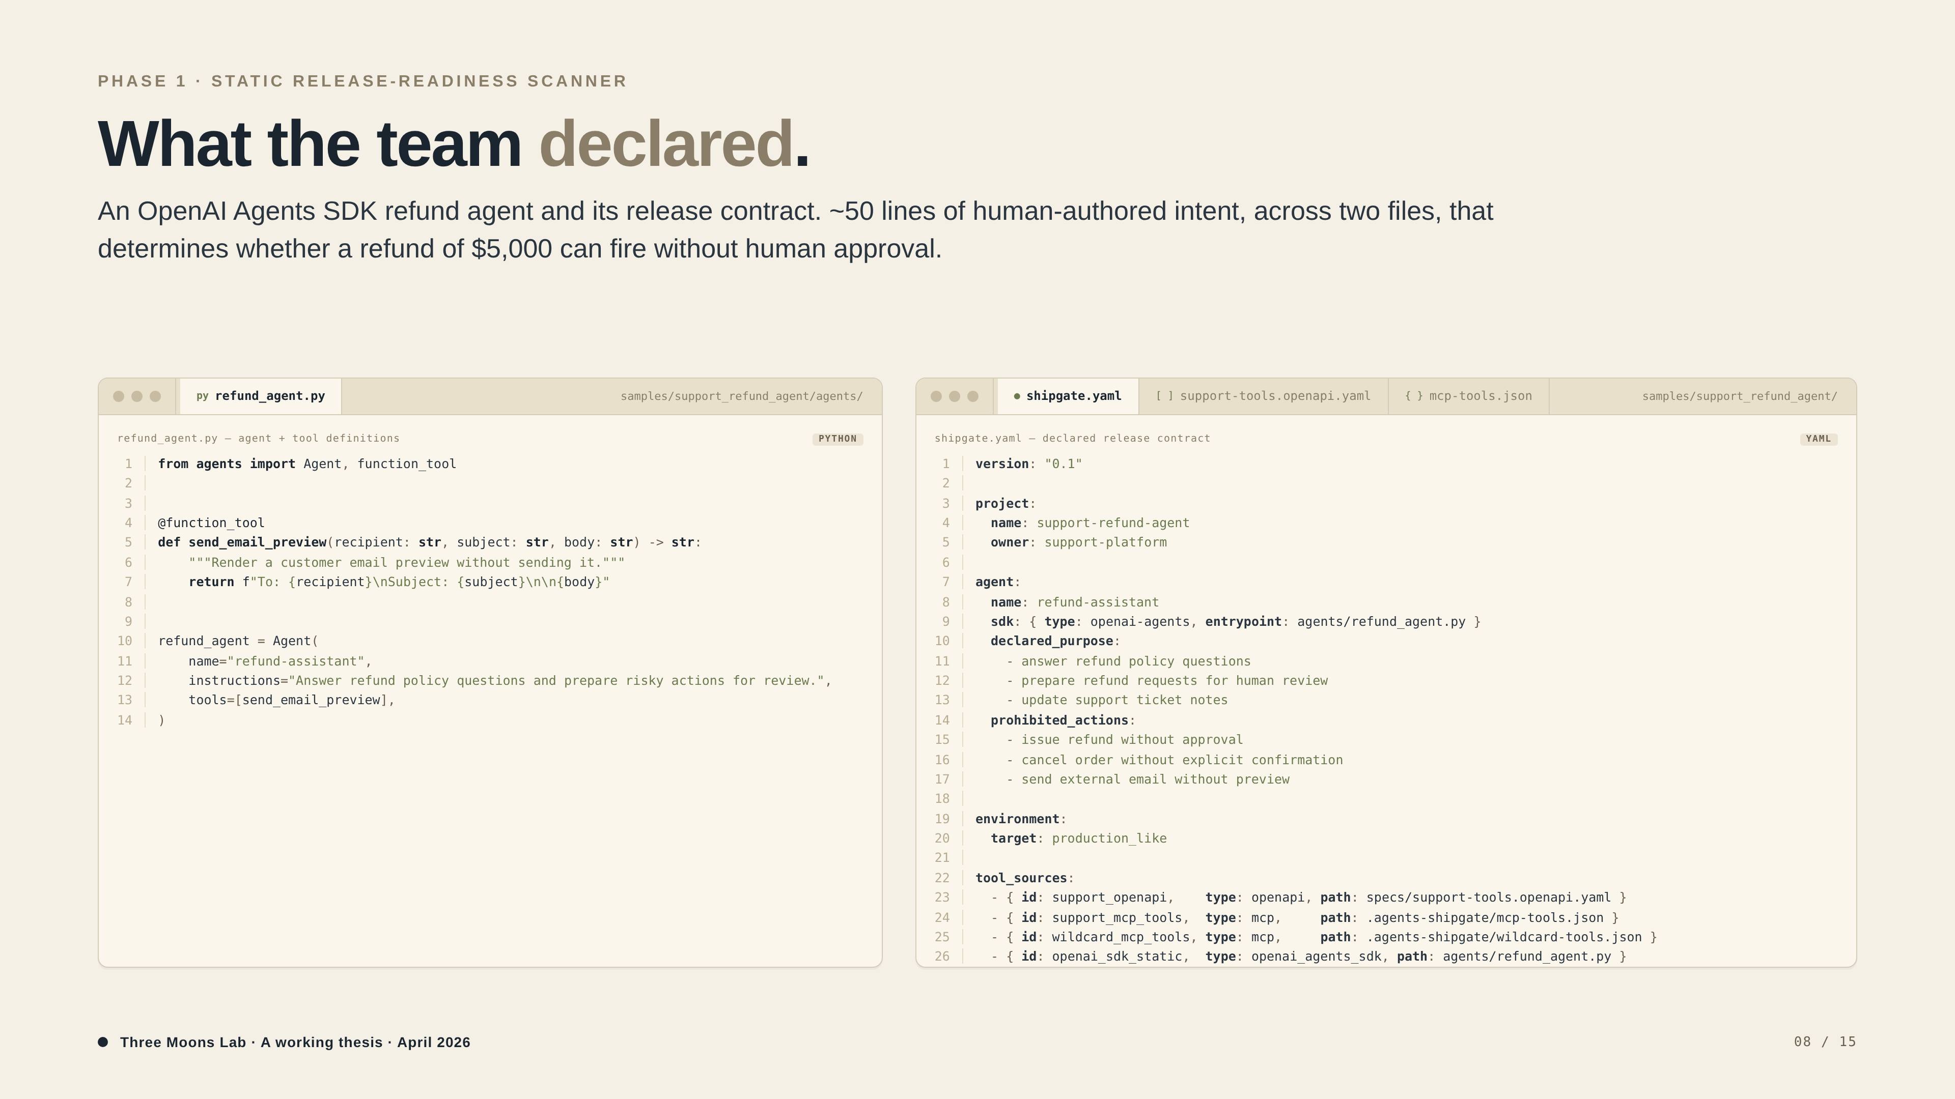
Notes:
DECLARED — what the team built. Python (refund_agent.py) on the left shows the actual OpenAI Agents SDK wiring. YAML (shipgate.yaml) on the right shows the release contract. Read prohibited_actions out loud — 'issue refund without approval'. Hold that thought.

Slide 9
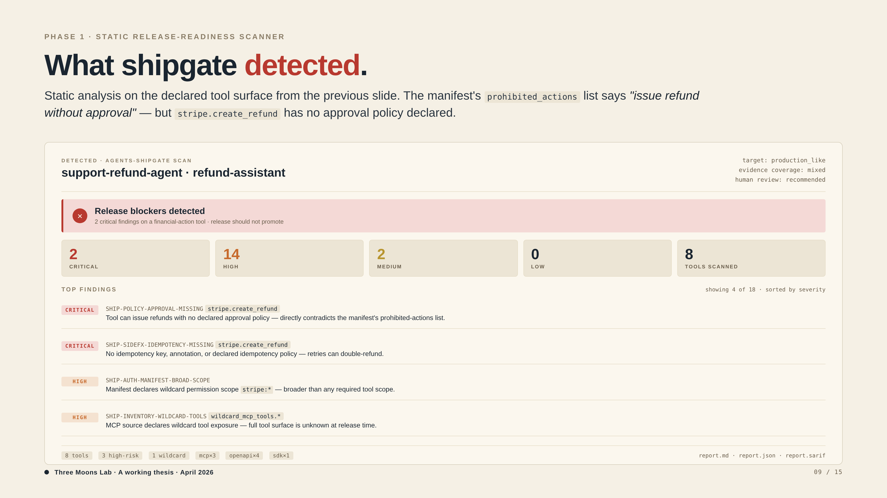
Notes:
DETECTED — what shipgate found. Same tool surface, scanned. BLOCKED. 2 critical, 14 high. First finding: stripe.create_refund has no approval policy declared. That's the contradiction with the previous slide's prohibited_actions list. Let the audience connect Slide 8 ↔ Slide 9 themselves.

Slide 10
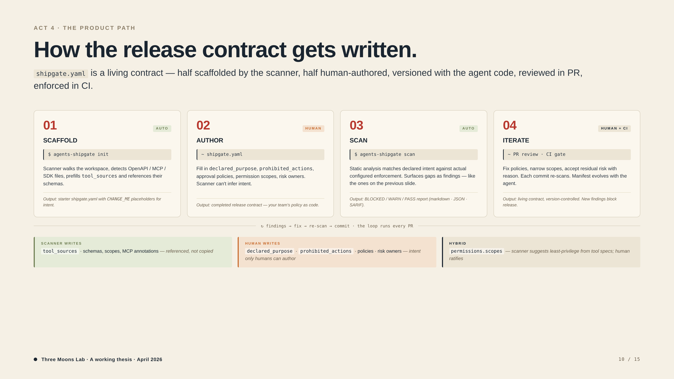
Notes:
How the contract gets written. Anticipates the question 'wait, where does shipgate.yaml come from?' Four steps: scaffold (auto) → author (human) → scan (auto) → iterate (human + CI). Bottom row makes the auto-vs-human split explicit — scanner can detect tools, only humans can write intent. The Terraform analogy works well here if they push: prose policy → policy as code.

Slide 11
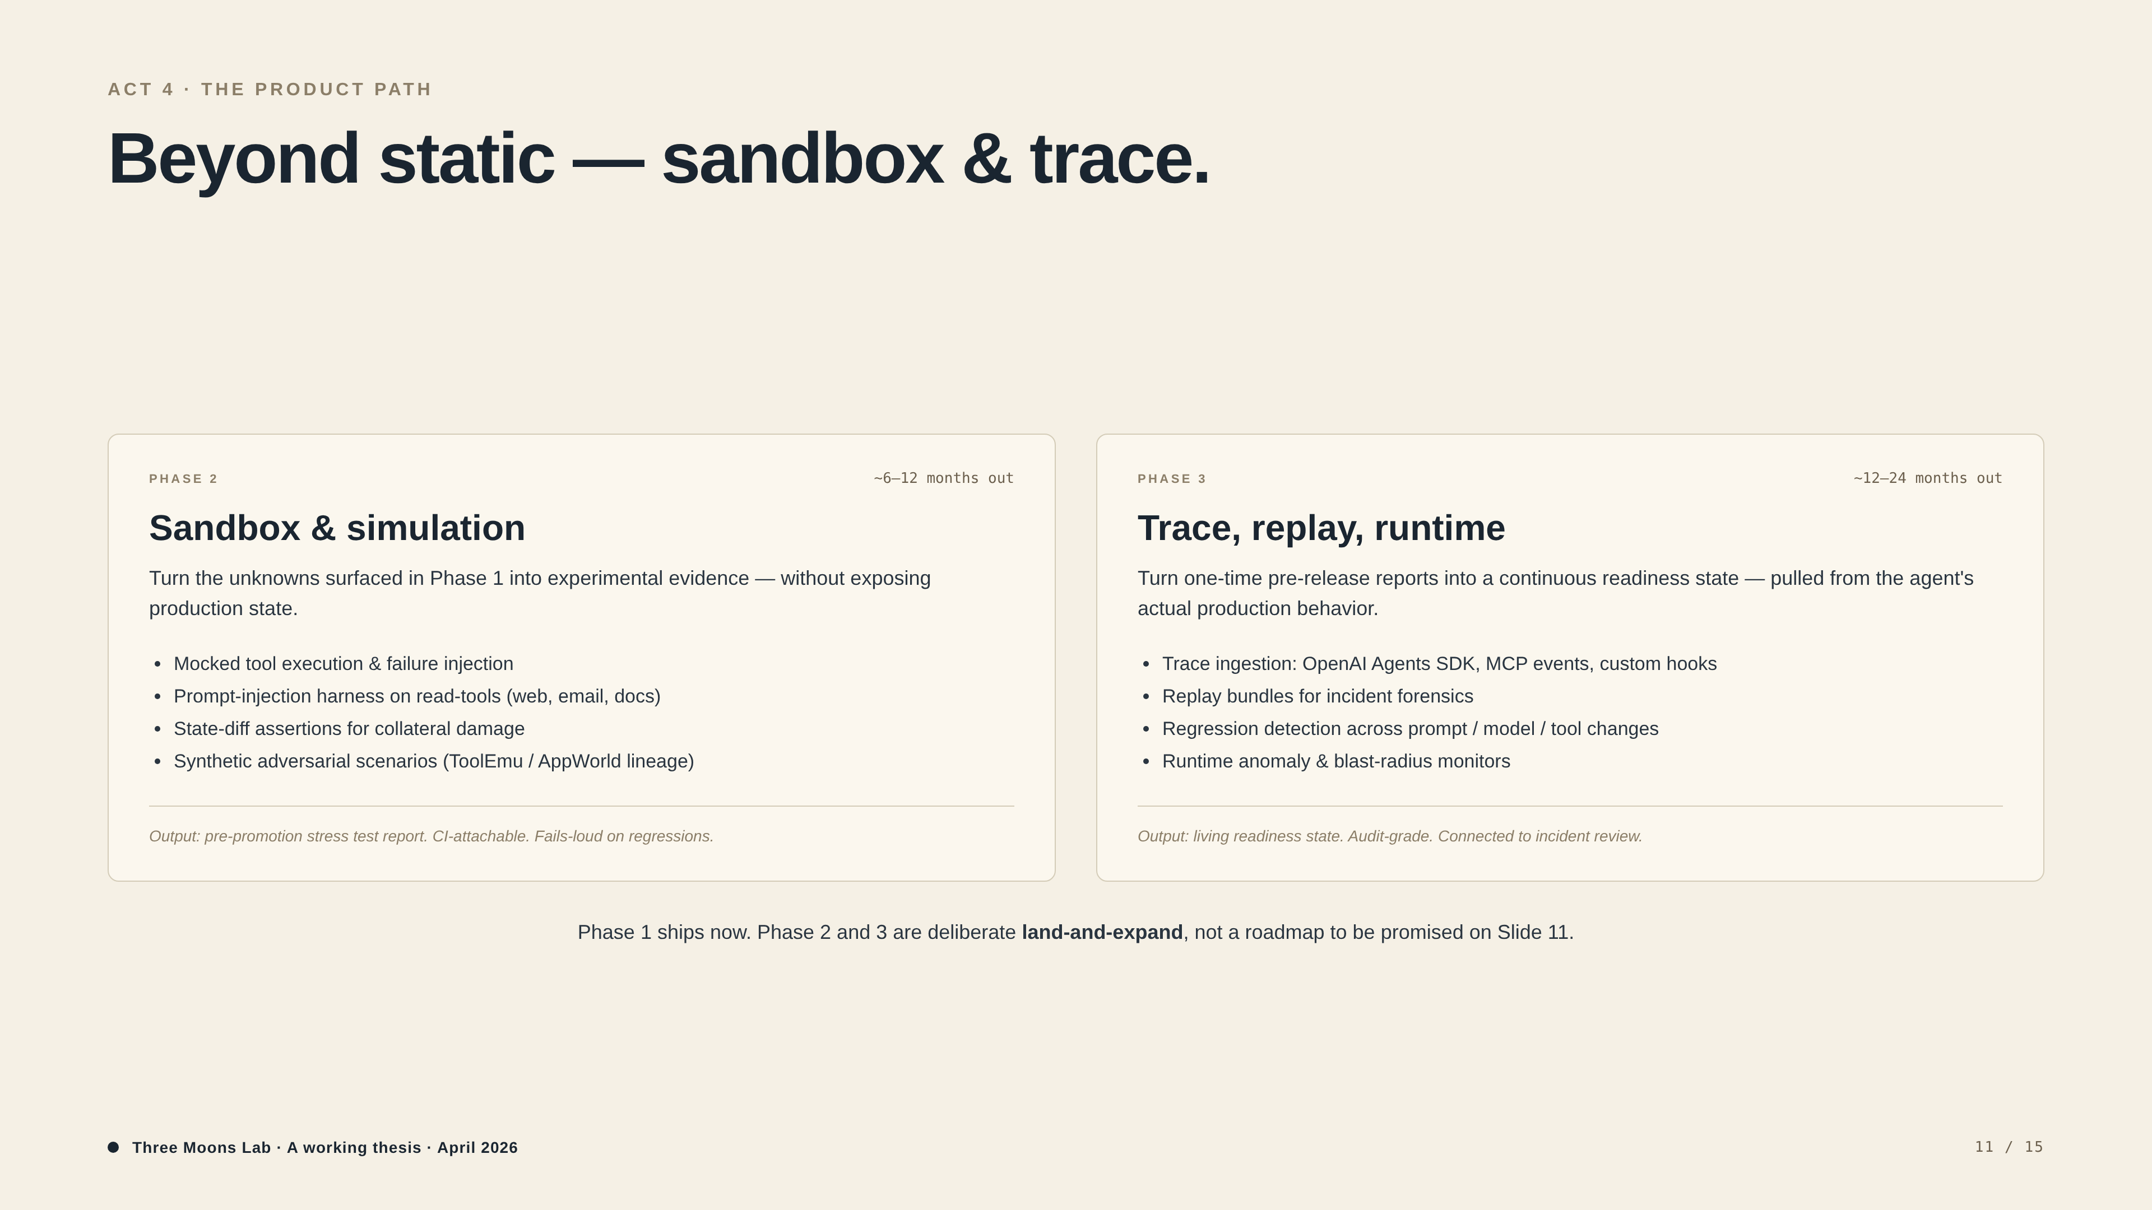
Notes:
Sandbox turns Phase 1 unknowns into experimental evidence. Trace turns one-time reports into a continuous readiness state. Footer line is deliberate humility: 'Phase 1 ships now. Phase 2 and 3 are land-and-expand.'

Slide 12
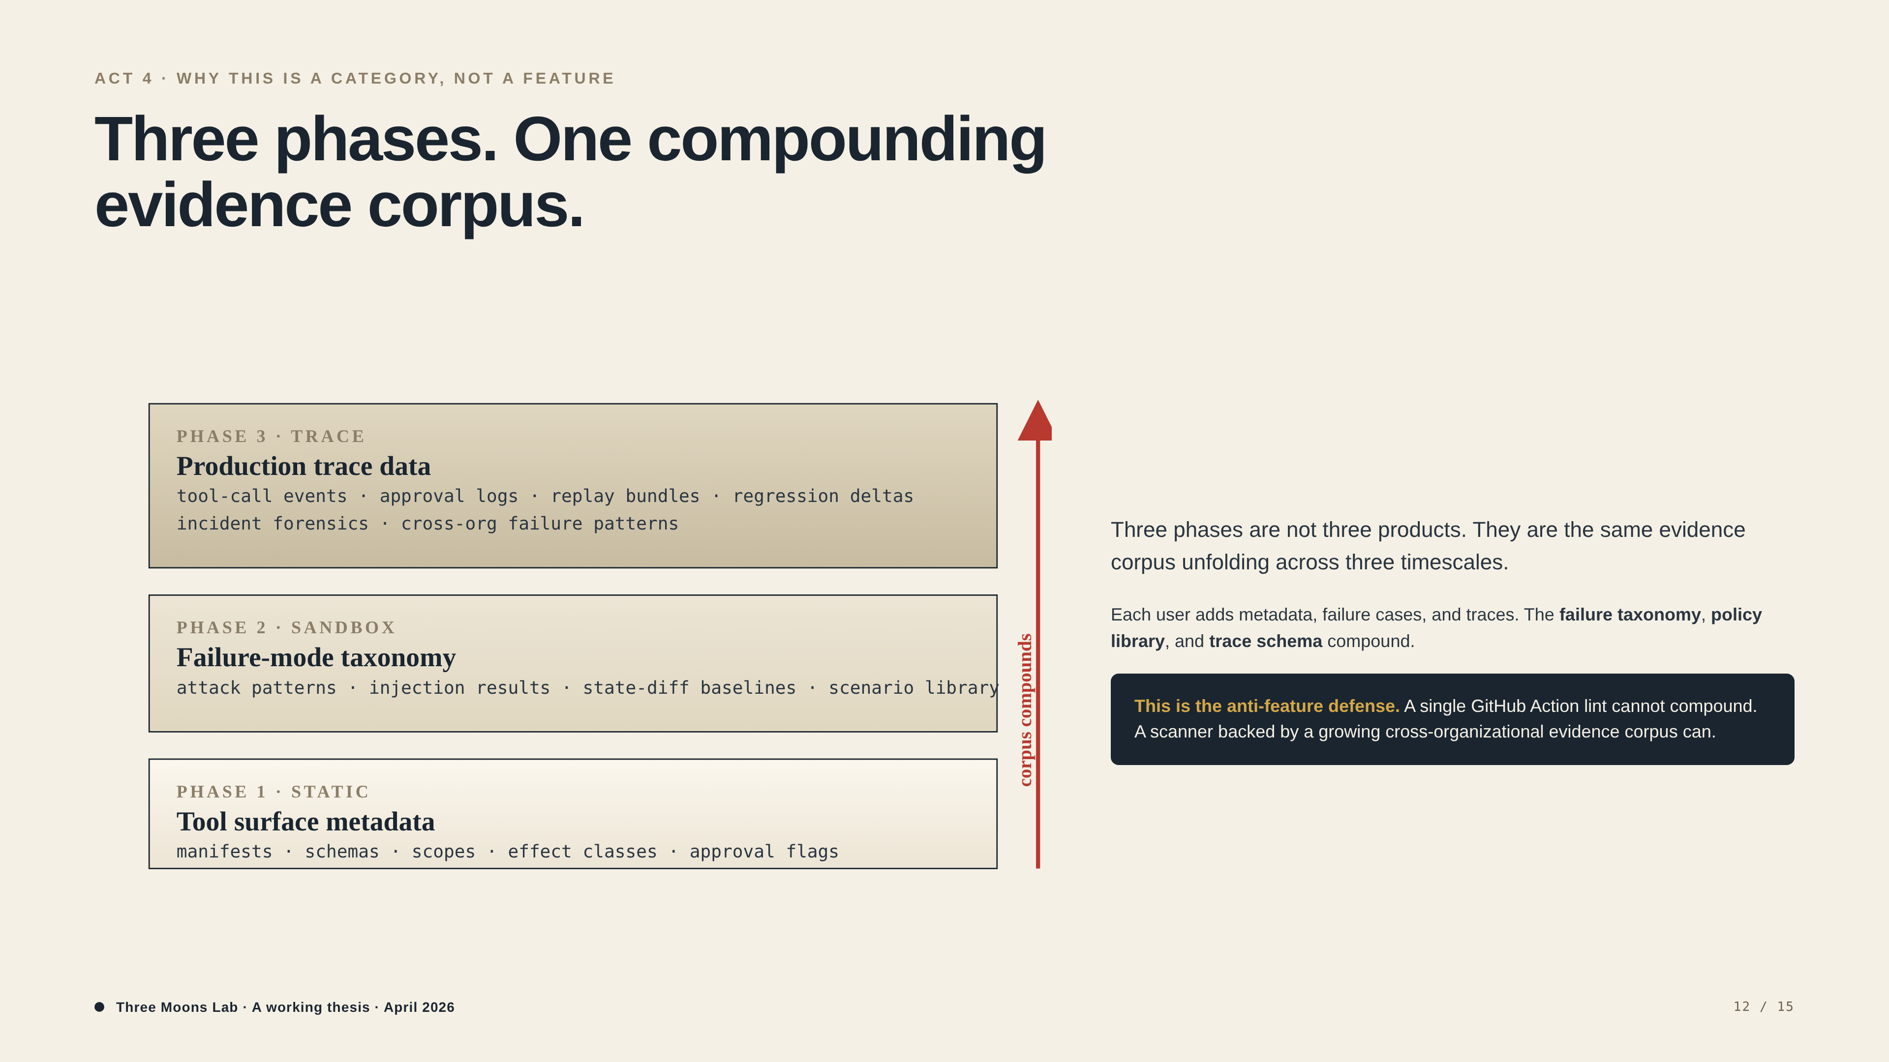
Notes:
Most important slide for category vs feature framing. Three phases = same evidence corpus unfolding across timescales. Failure taxonomy / policy library / trace schema all compound with every user. If they say 'this could be a feature in [LangSmith / GitHub / Snyk]', this is the slide that pushes back.

Slide 13
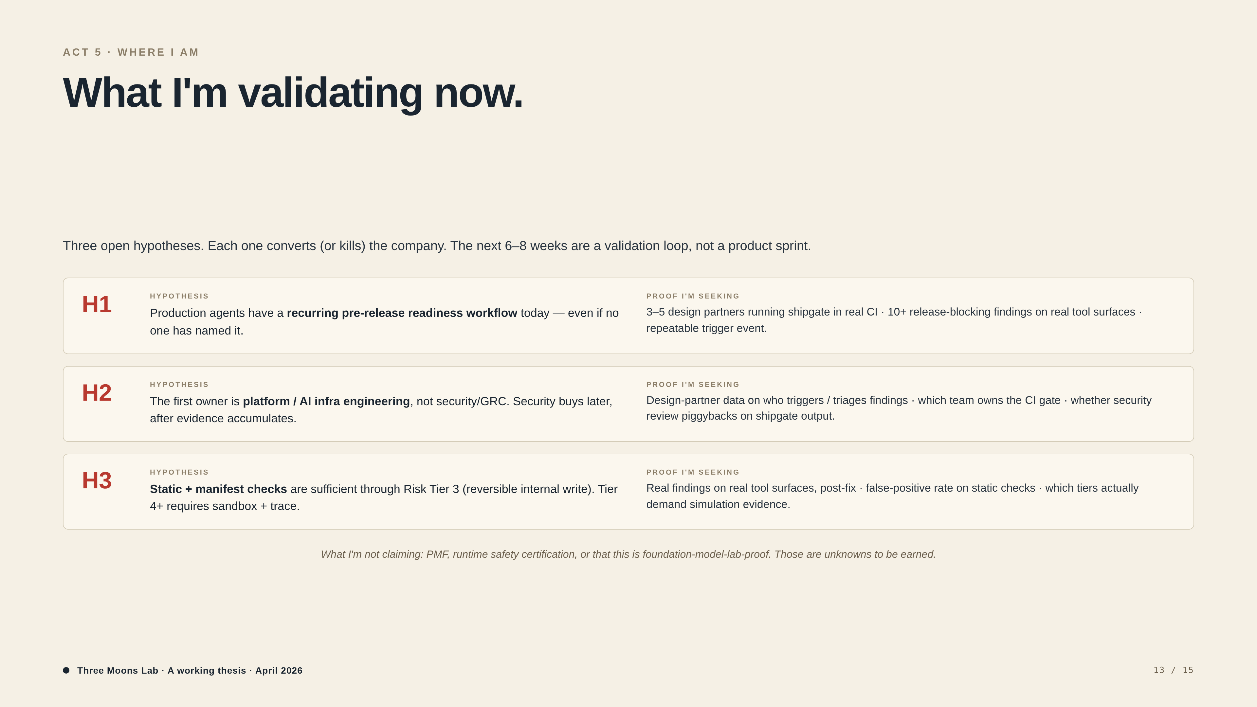
Notes:
Three open hypotheses, each paired with proof being sought. Closes with what I'm NOT claiming — PMF, runtime safety certification, foundation-model-lab proof. The 'what I'm not claiming' line is the strongest credibility signal in the deck.

Slide 14
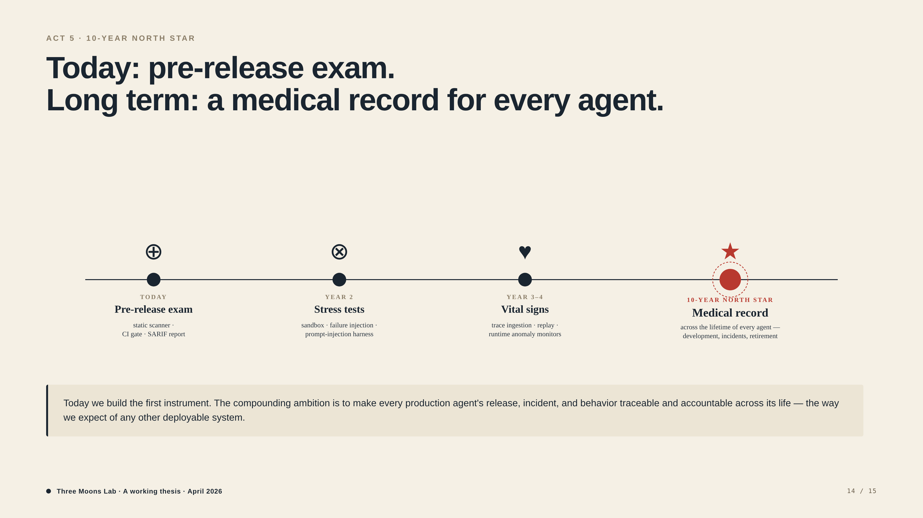
Notes:
Healthcare metaphor placed deliberately late so it doesn't dominate framing. Today: first instrument. Long-term: medical record across every agent's life. Skip this slide if the audience is too transactional for vision.

Slide 15
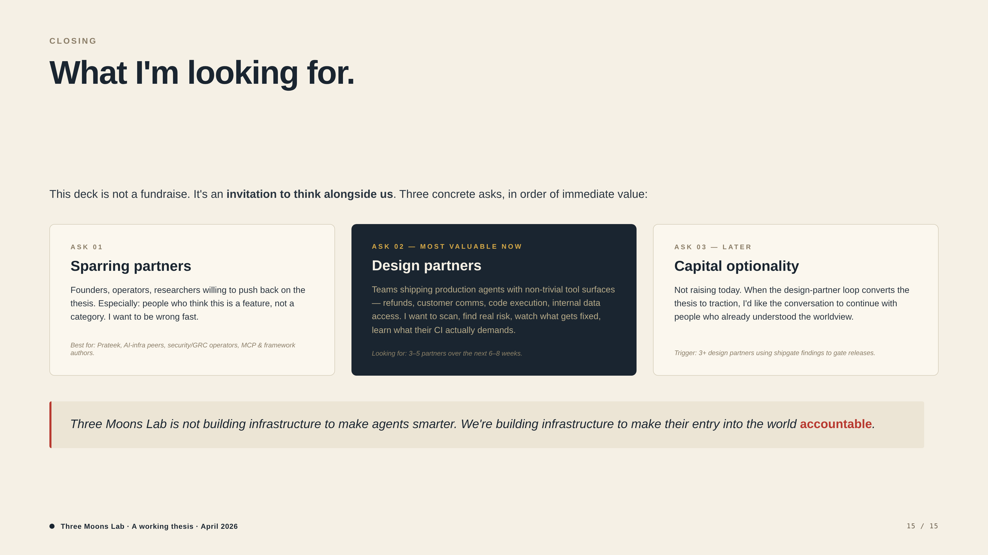
Notes:
Three asks in order of immediate value: sparring partners → design partners (most valuable now) → capital optionality. Closing italic line is the only place the deck declares philosophy directly: 'infrastructure to make their entry into the world accountable.' End on this beat.

