Slide 1

Knowledge sharing
gstreamer
Thao luong
February 28, 2017
Gstreamer prj., multimedia fw team
R-Car Software Solution 2 group
Renesas design vietnam co., ltd.

Slide 2
Agenda
GStreamer and RVC Gstreamer project 3
Knowledge for user of GStreamer 15
Knowledge for developer of GStreamer 19
Q & A 34

Slide 3

Project overview
Piture got from: https://twitter.com/gstreamer

Slide 4






Project overview
Full HD/60fps
GStreamer Framework (v.1.6.3)
Full HD/60fps
v4l2src
gst-omx
vspfilter
waylandsink
alsasink
H264 (enc/dec)
H265 (dec)
MPEG4 (dec)
VC1 (dec)
VP8 (dec)
AAC (dec)
MP3 (dec)
WMA (dec)
Target of dev.
Video Capture driver
OMX
Video
OMX
Audio
vsp2driver
Wayland/
Weston
Alsa
Target of test
RCarGen3
We support audio & video playback, capture and encode on RCarGen3 platform using GStreamer framework

Slide 5
RVC gstreamer project
In-charge of:
Development of v4l2src (capture plugin) which use Renesas BSP
Development gst-omx (audio/video decode & video encode plugins) which use Renesas OMX IL library
Ensure v4l2src and all supported elements of gst-omx can run without error on RCarGen3
Verify GStreamer framework on RCarGen3

Slide 6
RVC gstreamer project
GStreamer framework have 5 main packages and some other packages like gst-omx or gstlibav
GStreamer: the core package
gst-plugins-base: an essential exemplary set of elements
gst-plugins-good: a set of good-quality plug-ins under LGPL
gst-plugins-ugly: a set of good-quality plug-ins that might pose distribution problems
gst-plugins-bad: a set of plug-ins that need more quality
We only care for gst-omx and gst-plugins-good

Slide 7

Knowledge for user of GStreamer

Slide 8
Knowledge for user of GStreamer
What is knowledge which user of GStreamer need to know?
What is GStreamer?
Basic concepts of GStreamer
How to create pipeline using gst-launch tool
How to build GStreamer in yocto
How to Install built packages into filesystem

Slide 9
What is gstreamer ?
Is a framework for creating streaming media applications
The fundamental design comes from the video pipeline at Oregon Graduate Institute, as well as some ideas from DirectShow
Possible to write any type of streaming multimedia application
Advantage:
The pluggable components can be mixed and matched into arbitrary pipelines. This pipeline defines the flow of the data

Slide 10
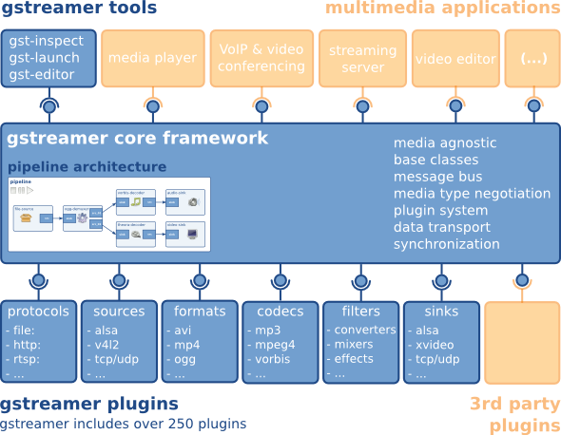
Gstreamer framework
Applications and tools
GStreamer core provided gst-inspect to query information of plugins; gst-launch to create pipeline from elements of plugins
Core:
Provide framework for plugins, data flow and media type handling/negotiation
Provide API for application
Plugins:
There are many types of plugins, basic plugins and plugins from 3rd party
Plugins and their elements can be found at: https://gstreamer.freedesktop.org/documentation/plugins.html
Picture got from: https://gstreamer.freedesktop.org/documentation/application-development/introduction/gstreamer.html

Slide 11
Basic conceps of gstreamer
Elements
On GStreamer, each element has one specific function, for example, read data from file, decode, encode and so on.
Element linked together and let data go through them
Chaining several element together, a pipeline for a specific task is created.
Input and out put of element are called pads.
Sink pad is input of element, where receive data from other element
Source pad is output element, where send data to other element
Element
Data
Sink
Source
Data

Slide 12
Basic conceps of gstreamer
The element type can be classified depend on number of pads:
Element
Source
Data
Source elements: only have source pad
Filter and filter-like elements:
have both source and sink pad
Element
Data
Sink
Source
Data
Element
Sink elements: only have sink pad
Data
Sink

Slide 13
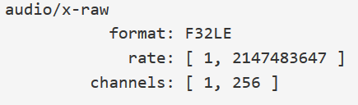

Basic conceps of gstreamer
Capabilities of pads (caps)
Describe the type of data that is streamed between two pads, or that one pad (template) supports
Example of caps of sink pad and src pad of one audio decoder:
Can get information of caps via gst-inspect and it will show as information of next page
Element
Sink
Source

Slide 14
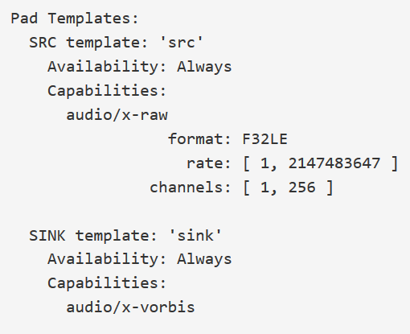
Basic conceps of gstreamer
Capabilities of pad (caps)
Direction of pads: source pad
Caps of source pad
Direction of pads: sink pad
Caps of sink pad

Slide 15
Basic conceps of gstreamer
Caps negotiation
Capabilities of 2 pads are compatible each other
Ex:
video/x-h264
parsed: true
stream-format: { avc, avc3, byte-stream }
alignment: { au, nal }
video/x-h264
alignment: au
stream-format: byte-stream
width: [ 1, 2147483647 ]
height: [ 1, 2147483647 ]
h264parse
Negotiate
video/x-raw
format: { NV12, I420 }
width: [ 1, 2147483647 ]
height: [ 1, 2147483647 ]
omxh264dec
Sink
Source
Sink
Source
Caps negotiation

Slide 16
How to create pipeline
Pipeline can be created by using gst-launch tool to connect for elements on system:
Elements will connect each other by “!”. Element before “!”, we call upstream element. Element after “!”, we call downstream element.
Elements on pipeline will decide for data flow.
Ex: Pipeline decode, convert and show video on screen:
# gst-launch-1.0 filesrc location=file.mp4 ! qtdemux ! h264parse ! omxh264dec ! vspfilter ! waylandsink
FileSystem
(NFS)
filesrc
qtdemux
h264parse
omxh264dec
vspfilter
waylandsink
File.mp4
NV12
BGRA
Sink pad
element
Src pad

Slide 17
How to create pipeline
Besides, we can assign type for negotiation by using capsfilter element in case element have many types.
Ex: omxh264dec can sent data with format is NV12 and I420, normally it will use NV12 as default for caps negotiation with other element.
But we can choose I420 to make negotiation:
# gst-launch-1.0 filesrc location=file.264 ! h264parse ! omxh264dec ! capsfilter caps=video/x-raw,format=I420 ! vspfilter ! waylandsink
shorten pipeline:
# gst-launch-1.0 filesrc location=file.264 ! h264parse ! omxh264dec ! video/x-raw,format=I420 ! vspfilter ! waylandsink
FileSystem
(NFS)
filesrc
h264parse
omxh264dec
vspfilter
waylandsink
File.264
I420
BGRA

Slide 18
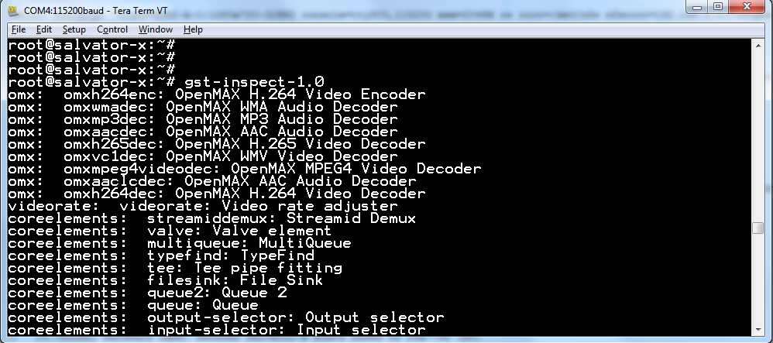
How to create pipeline
So to create pipeline for audio and video, you should have basic knowledge about audio and video, such as:
Container (Mp4, mv4, …), codec (H264, H265, VC1, AAC, MP3, …), video format (NV12, NV16, BGRA, …)
Base on these information, we will choose a suitable demuxer, parser and decoders corresponding to video stream (please refer to Appendix for example)
Can specify supported elements on system by gst-inspect tool:

Slide 19
How to create pipeline
In case you don’t have knowledge about the video file, can use playbin:
# gst-launch-1.0 -v playbin uri=file:///path/to/somefile.mp4
Playbin will detect suitable elements in filesystem for playback automatically.
For more information, can refer to: https://gstreamer.freedesktop.org/data/doc/gstreamer/head/gst-plugins-base-plugins/html/gst-plugins-base-plugins-playbin.html

Slide 20
How to build gst in yocto
Normally, GStreamer will be built with yocto in case BSP + 3D Graphics + Multimedia package. Please refer to 3.1 RENESAS_RCH3M3_YoctoStartupGuide_UME_vx.xx.x.pdf
But we can rebuilt packages of GStreamer by following command line:
#bitbake gstreamer1.0xxx –C configure
(Please refer to yocto team for more knowledge about building)
After building, libraries and configure installed in filesystem will locate at:
$build/tmp/work/aarch64-poky-linux/gstreamer1.0xxx/<version>/image/
gstreamer1.0xxx: gstreamer1.0
gstreamer1.0-plugins-base
gstreamer1.0-omx
…

Slide 21
How to Install built packages into filesystem
Besides libraries at $build/tmp/work/aarch64-poky-linux/gstreamer1.0xxx/<version>/image/, there are some plugins were built but they didn’t install into filesystem.
Can find them on $build/tmp/work/aarch64-poky-linux/gstreamer1.0xxx/<version>/deploy-ipks/aarch64/
To install for these plugins use “opkg install” plugin.ipk
Ex: To install for ivfparse element, go to https://gstreamer.freedesktop.org/documentation/plugins.html to check which plugin and module (package) that ivfparse element belongs to. In this case, ivfparse element belongs to gst-plugins-bad package and ivfparse plugin.
Step1: Go to $build/tmp/work/aarch64-poky-linux/gstreamer1.0-plugins-bad/1.6.3-r0/deploy-ipks/aarch64
Step2: Copy gstreamer1.0-plugins-bad-ivfparse_1.6.3-r0_aarch64.ipk into filesystem
Step 3: Install it into filesystem by:
# opkg install gstreamer1.0-plugins-bad-ivfparse_1.6.3-r0_aarch64.ipk

Slide 22
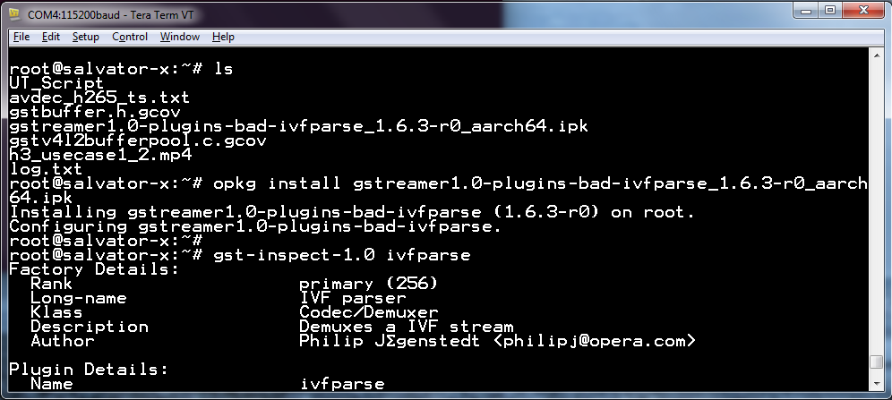
Install built packages into filesystem

Slide 23

Knowledge for developer of GStreamer

Slide 24
Knowledge for developer of GStreamer
Writing a new plugin is not easy, this document only share knowledge for reading source code of existence plugins and how to debug
First, there are some knowledge which developer of GStreamer need to know:
Basic understanding of C language (please self study)
Some knowledge about GObject (you will be OK if you have knowledge of object-oriented and C language. For further study, please refer to http://library.gnome.org/devel/gobject/stable/
Basic concepts of GStreamer
Important points when reading source code of GStreamer
How to debug

Slide 25
Basic concepts of GStreamer
Elements and Plugins
Elements:
At the core of GStreamer. An element is an object derived from the GstElement class
Elements provide some sort of functionality when linked with other elements.
Filter element: processes a stream of data
Source and sink element: producers and consumers of data
After being created, an element will not actually perform any actions yet. It is necessary to change state to make it do something
source
filter
sink
src
Data
sink
src
Data
sink

Slide 26
Basic concepts of GStreamer
+ Use gst_element_set_state () to change state for element
+ Element class will be in-charge for change state.
+ In case setting an element from NULL to PLAYING, element will internally change to READY -> PAUSE before PLAYING
Elements and Plugins
Elements:
Change state in Upward:
NULL (default state)
No resources are allocated
Transitioning to it will free all resources
NULL
READY
READY
Allocated global resources
But the stream is not opened, the stream positions is automatically zero
PAUSE
Opened the stream, but is not actively processing it.
Allowed to modify a stream's position, read and process data but it is not allowed to play the data (without a running clock)
PLAYING
The stream is actively processing
(Same as PAUSE with a running clock)
PLAYING
PAUSE

Slide 27
Basic concepts of GStreamer
+ Use gst_element_set_state () to change state for element
+ Element class will be in-charge for change state.
+ In case setting an element from PLAYING to NULL, element will internally change to PAUSE -> READY before NULL
Elements and Plugins
Elements:
Change state in Downward:
NULL (default state)
No resources are allocated
Transitioning to it will free all resources
NULL
READY
READY
Allocated global resources
But the stream is not opened, the stream positions is automatically zero
PAUSE
Opened the stream, but is not actively processing it.
Allowed to modify a stream's position, read and process data but it is not allowed to play the data (without a running clock)
PLAYING
The stream is actively processing
(Same as PAUSE with a running clock)
PLAYING
PAUSE

Slide 28
Basic concepts of GStreamer
Elements and Plugins
Elements:
Bin elements: contain other elements. There are 2 types:
responsible for synchronization of the elements that they contain so that data flows smoothly
automatically add other elements to the bin and links them together
Can refer to https://gstreamer.freedesktop.org/data/doc/gstreamer/head/gstreamer/html/GstElement.html or $build/tmp/work/aarch64-poky-linux/gstreamer1.0/1.6.3-r0/gstreamer-1.6.3/gst/gstelement.c
Bin
Element 1
Element 2
Element 3
src
Data
sink
src
Data
sink

Slide 29
Basic concepts of GStreamer
Elements and Plugins
Plugins:
A plugin is essentially a loadable block of code (shared object file or a dynamically linked library)
A single plugin may contain the implementation of several elements, or just a single one
The plugin mechanism is used everywhere in GStreamer
Can refer to https://gstreamer.freedesktop.org/data/doc/gstreamer/head/gstreamer/html/GstPlugin.html or $build/tmp/work/aarch64-poky-linux/gstreamer1.0/1.6.3-r0/gstreamer-1.6.3/gst/gstplugin.c

Slide 30
Basic concepts of GStreamer
Pads
Pads are used to negotiate links and data flow between elements in GStreamer
Pads have specific data handling capabilities: A pad can restrict the type of data that flows through it. Links are only allowed between two pads when the allowed data types of the two pads are compatible
All data in GStreamer flows one way through a link between elements
Data flows out of one element through one or more source pads, and elements accept incoming data through one or more sink pads
Can refer to https://gstreamer.freedesktop.org/data/doc/gstreamer/head/gstreamer/html/GstPad.html or $build/tmp/work/aarch64-poky-linux/gstreamer1.0/1.6.3-r0/gstreamer-1.6.3/gst/gstpad.c
Element
Element
Source
Data
Sink
Source
Data

Slide 31
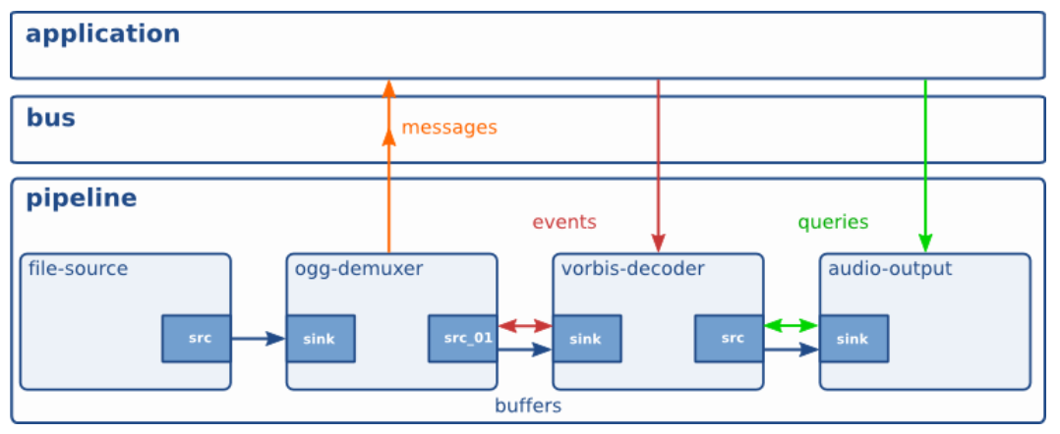
Basic concepts of GStreamer
Communication on GStreamer

Slide 32
Basic concepts of GStreamer
Communication on GStreamer
buffers are objects for passing streaming data between elements in the pipeline. Buffers always travel from sources to sinks
events are objects sent between elements or from the application to elements. Events can travel upstream and downstream.
messages are objects posted by elements on the pipeline's message bus, where they will be held for collection by the application. Messages are used to transmit information such as errors, tags, state changes, buffering state, redirects etc. from elements to the application in a thread-safe way.
queries allow applications to request information such as duration or current playback position from the pipeline. Queries are always answered synchronously. Elements can also use queries to request information from their peer elements

Slide 33
Basic concepts of GStreamer
GstMiniObject, Buffers and Events
GstMiniObject
GstBuffer
GstEvent

Slide 34
Basic concepts of GStreamer
GstMiniObject, Buffers and Events
GstMiniObject
is the structure used to hold chunks of data (all streams of data in GStreamer)
contains:
An exact type indicating what type of data (event, buffer, ...)
A reference count (refcount) indicating the number of elements currently holding this miniobject.
When the reference count falls to zero, the miniobject will be disposed, and its memory will be freed
Can refer to https://gstreamer.freedesktop.org/data/doc/gstreamer/head/gstreamer/html/gstreamer-GstMiniObject.html or $build/tmp/work/aarch64-poky-linux/gstreamer1.0/1.6.3-r0/gstreamer-1.6.3/gst/gstminiobject.c

Slide 35
Basic concepts of GStreamer
GstMiniObject, Buffers and Events
Buffers
contains a chunk of audio or video data that flows from one element to another
contain metadata describing the buffer's contents include:
Pointers to one or more GstMemory objects.
A timestamp indicating the preferred display timestamp of the content in the buffer.
Can refer to https://gstreamer.freedesktop.org/data/doc/gstreamer/head/gstreamer/html/GstBuffer.html or $build/tmp/work/aarch64-poky-linux/gstreamer1.0/1.6.3-r0/gstreamer-1.6.3/gst/gstbuffer.c

Slide 36
Basic concepts of GStreamer
GstMiniObject, Buffers and Events
Events
contain information on the state of the stream flowing between the two linked pads
Events are used to indicate: a media type, the end of a media stream, seeking and so on.
Event can contain:
A subtype indicating the type of the event.
The other contents of the event depend on the specific event type.
Can refer to https://developer.gnome.org/gstreamer/stable/gstreamer-GstEvent.html or $build/tmp/work/aarch64-poky-linux/gstreamer1.0/1.6.3-r0/gstreamer-1.6.3/gst/gstevent.c

Slide 37
Basic concepts of GStreamer
Buffer allocation
Can contains memory allocated by malloc()
Elements create buffers that point to special memory. Can create via GstBufferPool or GstAllocator. Elements can ask a GstBufferPool or GstAllocator from the downstream. If downstream is able to provide these objects, upstream can use them to allocate buffers

Slide 38
Important points when reading source code of GStreamer
When reading source code of a element on GStreamer, to understand it we should care:
Parent class of element
Methods of element and initialization value
Data processing flow

Slide 39
Important points when reading source code of GStreamer
Parent class of element
How to detect?: it is the first field in struct of element/plugin
Ex: gstomxh264dec
struct _GstOMXH264Dec
{
GstOMXVideoDec parent;
};
struct _GstOMXVideoDec
{
GstVideoDecoder parent;
…
}
gstobject
gstelement
gstomxvideodec is parent class of gstomxh264dec
gstvideodecoder
gstomxvideodec
gstvideodecoder is parent class of
gstomxvideodec
Continue this identifying, we will have inheritance:
gstomxh264dec

Slide 40
Important points when reading source code of GStreamer
Parent class of element
Purpose: Trace for source code and understand operation flow
For example, source code of gstomxh264dec.c only have some functions and it does not show a completely operation flow, it only handle for format. It doesn’t show how is data handled.
To understand how is data handled, we must trace on source code of gstomxvideodec.c:
input data will be handled in gst_omx_video_dec_handle_frame ()
output data is handle in gst_omx_video_dec_loop ()
gstobject
gstelement
gstvideodecoder
gstomxvideodec
gstomxh264dec

Slide 41
Important points when reading source code of GStreamer
Methods of element and initialization value
Methods is defined on Xxx_class_init() and _class structure (defined on header (.h))
In class_init() we can specify which methods of parent class will be overridden by element
And it also defines methods for itself
Initialization value is defined on Xxx_init():
initialize object’s instances
(Xxx will be named base on name of file.)
Ex: gstomxh264dec.c
gst_omx_h264_dec_class_init() and gst_omx_h264_dec_init ()
_class_init() will be loaded before _init()

Slide 42
Important points when reading source code of GStreamer
Data processing flow
On GStreamer, the chain function (_chain ()) is the function in which all data processing takes place
If there is no _chain() function on element source code, it is implemented on parent class of element.
Can investigate from this function to understand data processing flow.
For example, in case gstomxh264dec, chain() function is defined on gstvideodecoder class, and it will let children’s class make specific handling via handle_frame() method.
gstomxvideodec will implement for handle_frame() to make specific handling for OMX data.
Besides, should care about event handling and query handling. It should be implement as _sink_event(), src_event(), sink_query() or src_query.

Slide 43
Important points when reading source code of GStreamer
Comment:
GStreamer framework only provide mechanism for transfer data, to handle for data must have specific knowledge of that data
For example, to understand gst-omx, must have knowledge of OMX; to understand v4l2src and vspfilter, must have knowledge of v4l2 framework; to understand waylandsink, must have knowledge of wayland/Weston.

Slide 44
How to debug
GStreamer provide many level for debugging, can enable it by export GST_DEBUG=# (#=0,1, ..8)
# | Name | Description
0 | none | No debug information is output.
1 | ERROR | Logs all fatal errors.
2 | WARNING | Logs all warnings.
3 | FIXME | Logs all "fixme" messages
4 | INFO | Logs all informational messages.
5 | DEBUG | Logs all debug messages.
6 | LOG | Logs all log messages.
7 | TRACE | Logs all trace messages.
8 | MEMDUMP | Logs all memory dump messages.

Slide 45
How to debug
Or can enable debug by using --gst-debug=# in gst-launch
Ex:
gst-launch-1.0 filesrc location=file.mp4 ! qtdemux ! h264parse ! omxh264dec ! vspfilter ! waylandsink --gst-debug=2
Can debug base on name of element
Ex:
gst-launch-1.0 filesrc location=file.mp4 ! qtdemux ! h264parse ! omxh264dec ! vspfilter ! waylandsink --gst-debug=*omx*:9
=> It will show all debug log of gst-omx packages (gstomxh264dec, gstomxvideodec, gstomx,…)

Slide 46
Reference
For more information please refer to following link:
https://gstreamer.freedesktop.org/documentation/application-development/index.html
https://gstreamer.freedesktop.org/documentation/plugin-development/index.html
https://gstreamer.freedesktop.org/documentation/plugins.html

Slide 47
Renesas.com

Slide 48
Appendix – reference for making pipeline
General order of GST pipeline with Video and Audio
# gst-launch-1.0 filesrc location=file.extension ! demuxer name=d d. ! queue ! video_parser ! video_decoder ! video_filter ! video_converter ! waylandsink d. ! queue ! audio_parser ! audio_decoder ! audio_filter ! audio_converter ! alsasink device=hw:0,0
Note: Filter (vspfilter, audioresample, etc.) and Converter (videoconvert, audioconvert, etc.) are optional.
Rule: choose demuxer follows extension; choose decoder follows standard
Similar for pipeline for Video or Audio only:
# gst-launch-1.0 filesrc location=file.extension ! demuxer ! video_parser ! video_decoder ! waylandsink
# gst-launch-1.0 filesrc location=file.extension ! demuxer ! audio_parser ! audio_decoder ! alsasink device=hw:0,0
extension | Video parser - decoder | Audio parser - decoder
qtdemux : mp4,3gp,mov,m4a matroskademux : mkv,webm tsdemux : trp, ts asfdemux : wmv, wma avidemux : avi | H264 : h264parse - omxh264dec H265 : h265parse -omxh265dec MPEG4 : mpeg4videoparse - omxmpeg4videodec VC-1 : none - omxvp8dec VP8 : none - omxvc1dec | AAC : aacparse - omxaacdec MP3 : mpegaudioparse - omxmp3dec WMA : none - omxwmadec VORBIS : none - vorbisdec

