Slide 1
Open source platform
linux
Date: 28/10/2016
Name: Group 2
Position, Department: 24g software
Renesas Electronics Corporation

Slide 2
Agenda
LINUX Page 03
LINUX KERNEL Page 06
USERS SPACE AND LINUX KERNEL Page 23
EMBEDDED LINUX Page 30

Slide 3
LINUX WHAT IS LINUX?
Linux is an operating system, a software program that controls your computer.
Linux is a Unix-like and mostly POSIX-compliant computer operating system (OS) assembled under the model of free and open-source software development and distribution.
Linux was originally developed as a free operating system for personal computers based on the Intel x86 architecture, but has since been ported to more computer hardware platforms than any other operating system.

Slide 4
LINUX history
Year | Version | Users | Kernel size (Bytes) | Milestone(s)
1991 | 0.01 | 100 | 63,362 | Linus Torvalds writes Linux kernel
1992 | 0.99 | 1000 | 431,591 | GNU software integrated with Linux kernel, producing a fully functional operating system
1993 | 0.99 | 20,000 | 937,917 | High rate of code contributions prompts Linus to delegate code review responsibility
1994 | 1.0 | 100,000 | 1,016,601 | First production release
1995 | 1.2 | 500,000 | 1,850,182 | Linux adapted to non-Intel processors
1996 | 2.0 | 1,500,000 | 4,718,270 | Linux supports multiple processors, IP masquerading, and Java
1999 | 2.2 | 7,500,000 | 10,600,000 | Linux growth rate exceeds that of Microsoft Windows NT

Slide 5
linux Linux distribution
A Linux distribution (often abbreviated as distro) is an operating system made from a software collection, which is based upon the Linux kernel and, often, a package management system.
A typical Linux distribution comprises a Linux kernel, GNU tools and libraries, additional software, documentation, a window system, a window manager, and a desktop environment.

Slide 6
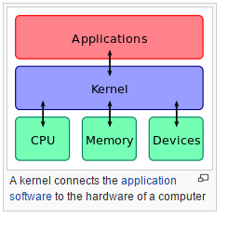
What is kernel? definition
The kernel (also called nucleus) is a computer program that constitutes the central core of a computer's operating system.
A kernel is the lowest level of easily replaceable software that interfaces with the hardware in your computer. It is responsible for interfacing all of your applications that are running in “user mode” down to the physical hardware

Slide 7
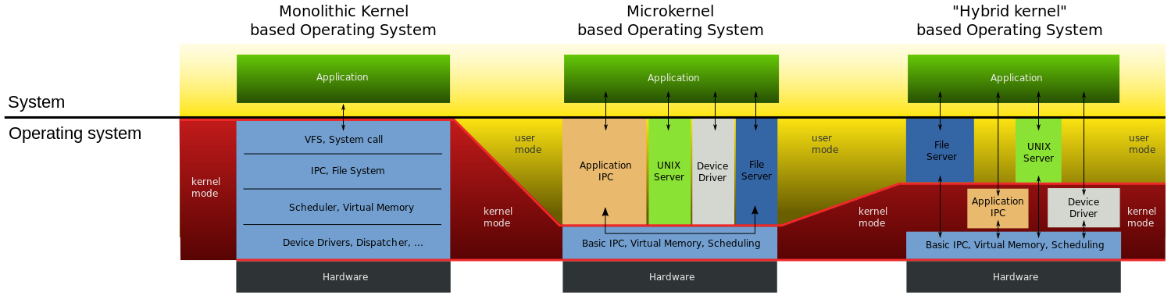
What is kernel? Classification

Slide 8
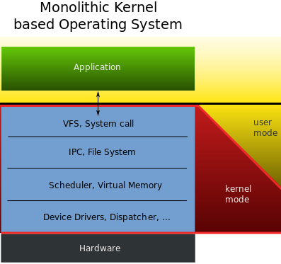
What is kernel? classification
Microkernel
A microkernel takes the approach of only managing what it has to: CPU, memory, and IPC.
Pretty much everything else in a computer can be seen as an accessory and can be handled in user mode.

Slide 9
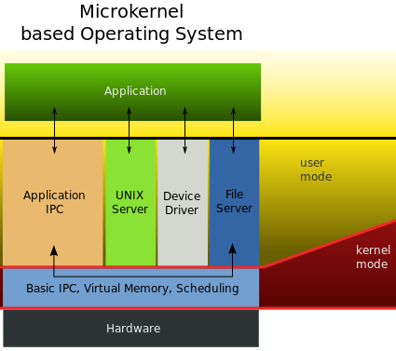
What is kernel? classification
Monolithic Kernel
Monolithic kernels are the opposite of microkernels because they encompass not only the CPU, memory, and IPC, but they also include things like device drivers, file system management, and system server calls.

Slide 10
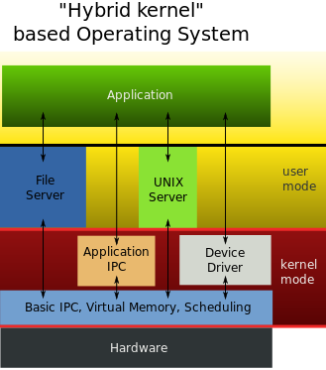
What is kernel? classification
Hybrid Kernel
Hybrid kernels have the ability to pick and choose what they want to run in user mode and what they want to run in supervisor mode.

Slide 11
What is linux kernel?
The Linux kernel is a computer operating system kernel.
The Linux kernel was created as a hobby in 1991 by a Finnish student, Linus Torvalds. Then Linux quickly started to be used as the kernel for free software operating systems.
The Linux kernel is one component of a system, which also requires libraries and applications to provide features to end users.

Slide 12
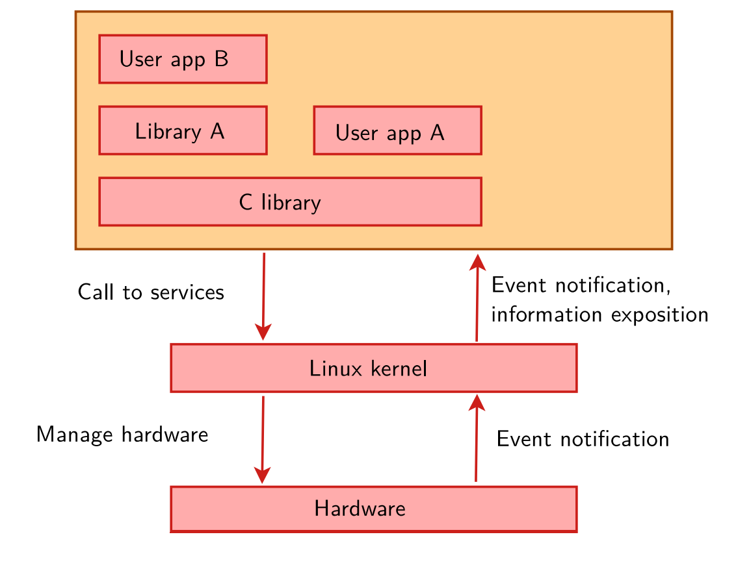
Role of linux kernel?
Manage all the hardware resources: CPU, memory, I/O.
Provide a set of portable, architecture and hardware independent APIs (Application Programming Interface) to allow user space applications and libraries to use the hardware resources
Handle concurrent accesses and usage of hardware resources from different applications. Example: a single network interface is used by multiple user space applications through various network connections. The kernel is responsible to ‘multiplex’ the hardware resource.

Slide 13
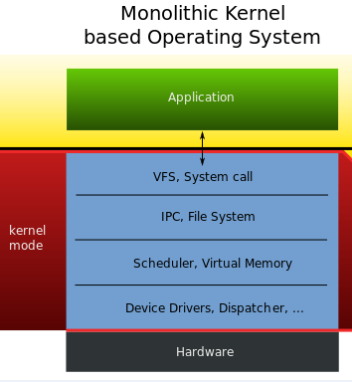
Description of linux kernel architecture
The Linux kernel is a monolithic kernel
It supports:
True preemptive multitasking (both in user mode and, since the 2.6 series, in kernel mode)
Virtual memory
Shared libraries
Demand loading
Shared copy-on-write executables (via KSM)
Memory management
The Internet protocol suite
Threading

Slide 14
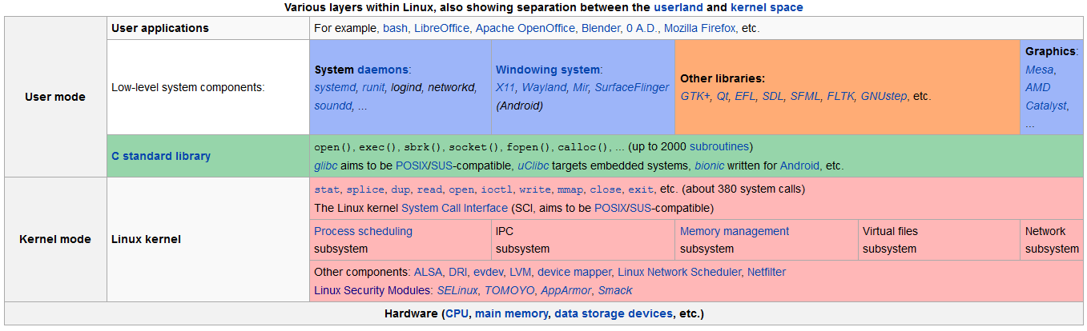
Description of linux kernel architecture

Slide 15
Linux kernel function
Portability and hardware support: Run on most architectures
Scalability: Can run on super computer as well as tiny devices (4MB RAM)
Compliance to standards and interoperability
Exhausive networking support
Stability and reliability
Modularity: Can include only what a system needs even at run time.
Security: Its code is reviewed by many experts

Slide 16
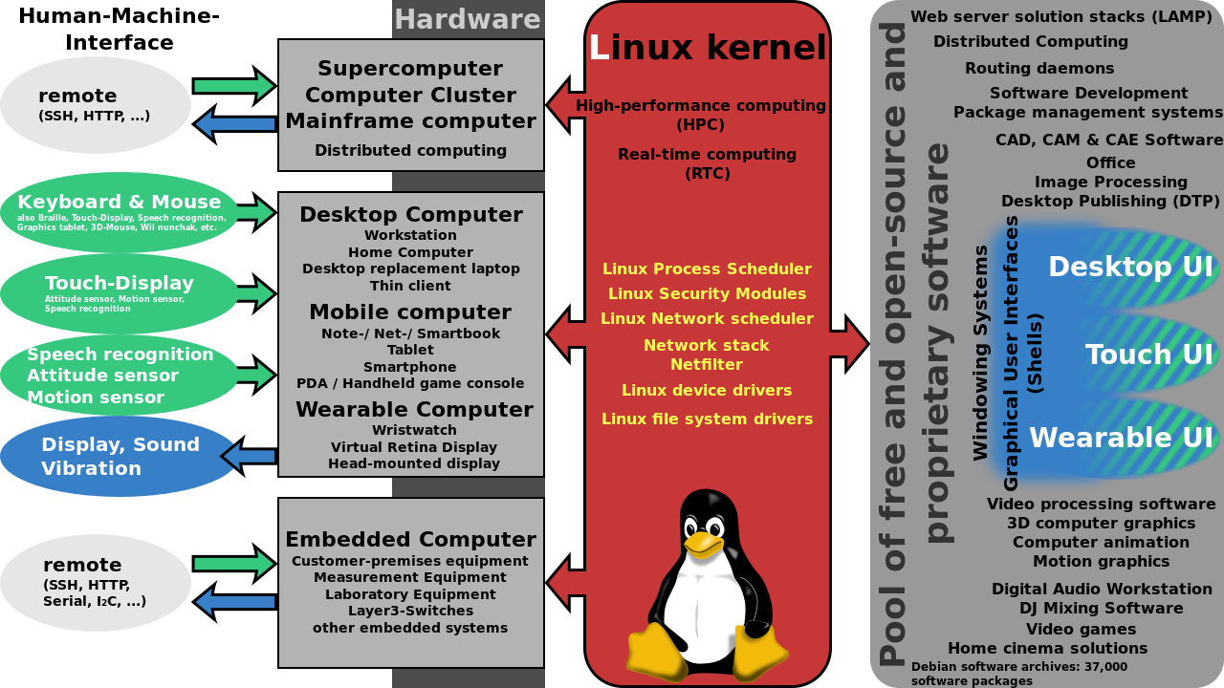
Relationship between linux kernel and hardware
Linux kernel can be installed on different computer architectures
Linux is now one of the most widely ported operating system kernels, running on a diverse range of systems from the ARM architecture to IBM Z/Architecture mainframe computers
Linux can run on super computers as well as on tiny devices (4 MB of RAM is enough)

Slide 17
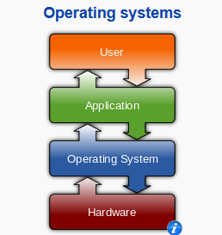
Relationship between linux kernel and application
Kernel helps application to access to hardware correctly and safely (using device drivers):
Processes need access to the peripherals connected to the computer, which are controlled by the kernel through device drivers
A device driver is a computer program that enables the operating system to interact with a hardware device

Slide 18
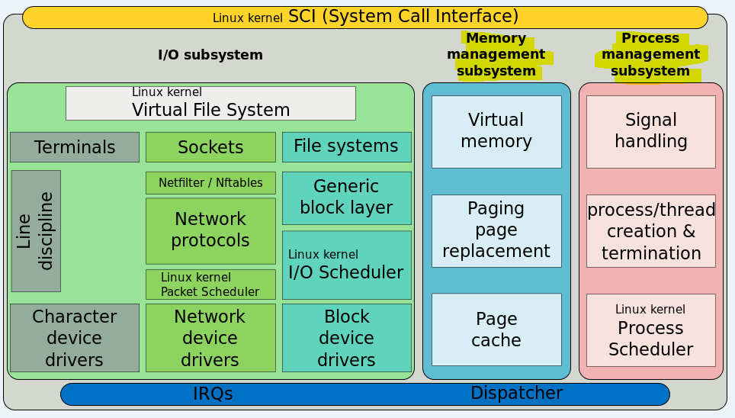
Relationship between linux kernel and application (con’t)
Kernel helps applications schedule running time:
The kernel takes responsibility for deciding at any time which of the many running programs should be allocated to the processor
Kernel helps store multiple programs in RAM efficiently:
The kernel is responsible for deciding which memory each process can use, and determining what to do when not enough memory is available.
Kernel helps applications communicate with I/O devices:
The kernel allocates requests from applications to perform I/O to an appropriate device
Provides convenient methods for using the device (typically abstracted to the point where the application does not need to know implementation details of the device)

Slide 19
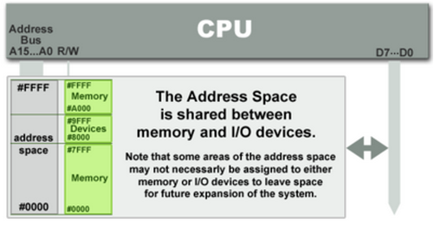
Memory-mapped i/o? definition
The method to access I/O memory and I/O register with the same address space with memory. So it increase cost if adding more I/O.
The CPU instructions used to access the memory can also be used for accessing devices by address

Slide 20
Memory-mapped i/o? method to access
Can access by address of memory because they have the same address bus. ioread and iowrite instruction usually to access memory

Slide 21
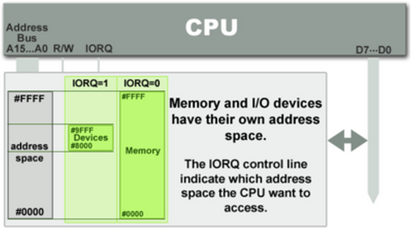
port-mapped i/o? definition
I/O devices have a separate address space from general memory.
The address space for I/O is isolated from that for main memory, this is sometimes referred to as isolated I/O

Slide 22
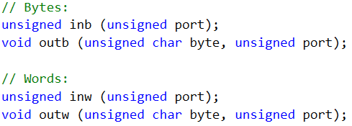
port-mapped i/o? method to access
Port - mapped I/O often uses a special class of CPU instructions designed specifically for performing I/O, such as in and out.(use in intel x86-64 architectures)
To access: with port is the base address of access port. It control all address of port.

Slide 23
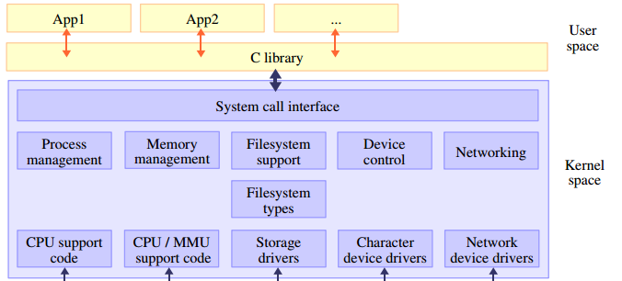
Users Space and linux kernel Overview

Slide 24
Users space and linux kernel
System call
Definition
System call is the programmatic way in which a computer program requests a service from the kernel of the operating system it is executed on. This may include hardware-related services (for example, accessing a hard disk drive), creation and execution of new processes, and communication with integral kernel services such as process scheduling. System calls provide an essential interface between a process and the operating system.
→ A system call is an interface between a user-space application and a service that the kernel provides.

Slide 25
Users space and linux kernel
System call
Services
About 380 system calls that provide the main kernel services:
Services
File and device operations
Process management
Networking operations
Inter-process communication
Memory mapping
Synchronization primitives
Timers
Threads
Etc

Slide 26
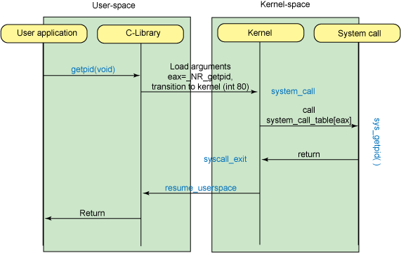
Users space and linux kernel
Interaction between linux kernel and users
By the way Linux maintain a directory called proc as interface between user space and kernel.
Notes:
The proc filesystem provides a method of communication between kernel space and user space. For example, the GNU version of the process reporting utility process status uses the proc file system to obtain its data, without using any specialized system calls.

Slide 27
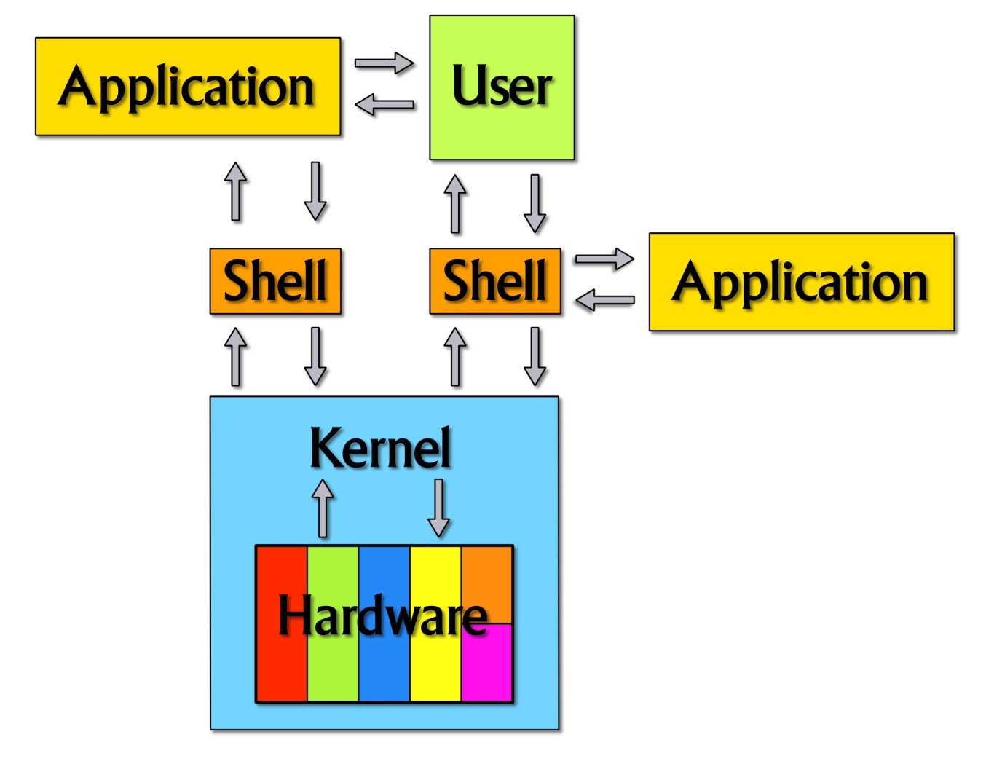
Users space and linux kernel
Interaction between linux kernel and users
Shell accepts user’s instruction or commands in English and translate it into computers native binary language. So kernel can understand requests from users
Notes:
The proc filesystem provides a method of communication between kernel space and user space. For example, the GNU version of the process reporting utility process status uses the proc file system to obtain its data, without using any specialized system calls.

Slide 28
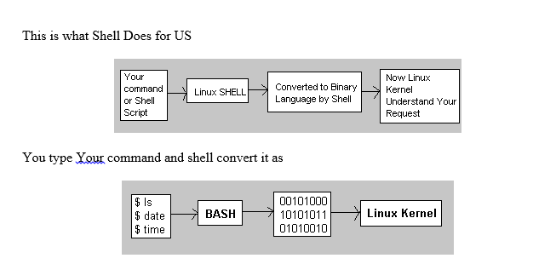
Users space and linux kernel
Interaction between linux kernel and users
Notes:
The proc filesystem provides a method of communication between kernel space and user space. For example, the GNU version of the process reporting utility process status uses the proc file system to obtain its data, without using any specialized system calls.

Slide 29
Users space and linux kernel
Strace (System call trace):
The Linux kernel provides a useful way to trace the system calls that a process invokes (as well as those signals that the process receives). The utility is called strace and is executed from the command line, using the application you want to trace as its argument. This tracing is accomplished in the kernel when the current system call request has a special field set called syscall_trace, which causes the function do_syscall_trace to be invoked.
System call tracer: http://sourceforge.net/projects/strace/

Slide 30
What is embedded linux?
Embedded Linux is the usage of the Linux kernel and various open-source components in embedded systems.

Slide 31
Why is embedded linux?
Advantages
Re-using components
Low cost
Full control
Eases testing of new features
Quality
Community support
Taking part into the community

Slide 32
Advantages
Re-using components
Low cost
Full control
Quality
Eases testing of new features
Community support
Allows to focus on the added value of your product
Allows to have a higher budget for the hardware or to increase the company’s skills and knowledge
Allows to have full control over the software part of your system.
Allows to design your system with high-quality components at the foundations
Allows to easily explore new possibilities and solutions
Allows to speed up the resolution of problems when developing your system

Slide 33
Overview about Boot process of Embedded Linux
1
Software components Involved in E.L.B.P
2
Steps during Booting process of a conventional PC
3
The Primary boot loader
4
Secondary boot loader
5
Kernel Invocation

Slide 34
Overview about Boot process of Embedded Linux
1) Software components Involved in Embedded Linux Boot Process
Bootloader
kernel Image
root file system

Slide 35
Overview about Boot process of Embedded Linux
2) Steps during Booting process of a conventional PC
System Startup
Stage 1 bootloader – MBR
Stage 2 bootloader - LILO,GRUB etc
Call Kernel Linux
Init The User Space

Slide 36
Overview about Boot process of Embedded Linux
3) The Primary boot loader
Performs few optional initializations
Its main job is to load the secondary boot loader
4) Secondary boot loader
The Second Stage boot loader loads the Linux & an optional initial RAM disk in to the memory.

Slide 37
Overview about Boot process of Embedded Linux
5) Kernel Invocation
As the kernel is invoked, it performs the checks on system hardware, enumerates the attached hardware devices, mounts the root device

Slide 38
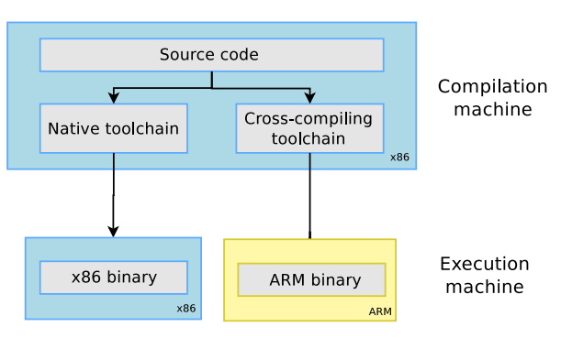
toolchains definition
The usual development tools available on a GNU/Linux workstation is a native toolchain.
Cross-compiling toolchains are generally used. They run on your workstation but generate code for your target.

Slide 39
toolchains machines in build proceduce
Three machines must be distinguished when discussing toolchain creation:
The build machine, where the toolchain is built.
The host machine, where the toolchain will be executed.
The target machine, where the binaries created by the tool chain are executed.
Four common build types are possible for toolchains.

Slide 40
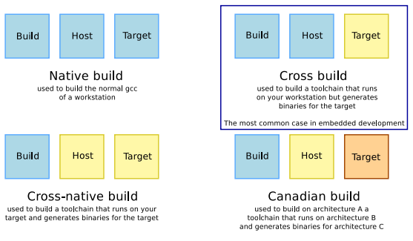
toolchains machines in build procedure

Slide 41
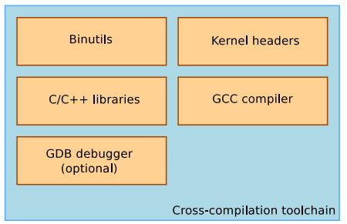
toolchains components

Slide 42
www.renesas.com

