Slide 1

PoolManager

Slide 2

PoolManager
创建C#脚本PoolManagerEditor
[MenuItem("Manager/Create GameobjectPoolConfig")]
static void CreateObjectPoolList()
{
GameObjectPoolList poolList = ScriptableObject.CreateInstance<GameObjectPoolList>();
//string path = PoolManager.PoolConfigPath;
string path = "Assets/Framework/Resources/gameobjectpool.asset";
AssetDatabase.CreateAsset(poolList, path);//创建资源
}
点击Manager下的Create GameobjectPoolConfig，在Assets/Framework/Resources/路径下创建一个可配置的gameobjectpool文件。后续可直接配置池子

Slide 3
PoolManager
创建C#脚本GameObjectPool—— prefabs池
并包含三个公用的可序列化变量，可在前端配置，分别为name,prefab和maxAmount
private List<GameObject> goList = new List<GameObject>();
public GameObject GetInst() //从资源池中获取实例
{
foreach (GameObject go in goList)
{
if (go.activeInHierarchy == false)//被禁用
{go.SetActive(true);
return go; }
}
if (goList.Count >= maxAmount)
{
GameObject.Destroy(goList[0]);
goList.RemoveAt(0);
}
GameObject temp = GameObject.Instantiate(prefab) as GameObject;
goList.Add(temp);
return temp;
}
从单个资源池中获取实例化的gameobject，若超过最大数量，则按照先进先出的原则，删除第一个

Slide 4
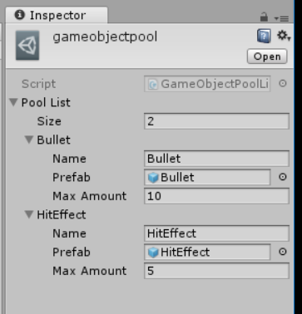
PoolManager
创建C#脚本GameObjectPoolList
并继承自ScriptableObject，表示把类GameObjectPoolList变成可以自定义资源配置的文件（不用挂在gameobject就可以编辑）
public List<GameObjectPool> poolList;
只包含一个GameObjectPool的List
可设计多个prefab，往gameobjectpool编辑，设计预制体池

Slide 5
PoolManager
创建C#脚本PoolManager，并设置单例模式
private static string poolConfigPathPrefix = Application.dataPath + "/Framework/Resources/";
private const string poolConfigPathMiddle = "gameobjectpool";
private const string poolConfigPathPostfix = ".asset";
public static string PoolConfigPath
{
get
{
return poolConfigPathPrefix + poolConfigPathMiddle + poolConfigPathPostfix;
}
}
全局变量获取gameobjectpool路径

Slide 6
PoolManager
private Dictionary<string, GameObjectPool> poolDict;
private PoolManager()
{
GameObjectPoolList poolList = Resources.Load<GameObjectPoolList>(poolConfigPathMiddle);
poolDict = new Dictionary<string, GameObjectPool>();
foreach (GameObjectPool pool in poolList.poolList)
{
poolDict.Add(pool.name, pool);加载配置文件池中的数据并存到字典中
}
}
public GameObject GetInst(string poolName)
{
GameObjectPool pool;
if (poolDict.TryGetValue(poolName, out pool))
{
return pool.GetInst();
}
Debug.Log("pool+" + poolName + " is not exists");
return null;
} //根据名称从池子中取出想要加载的对象

Slide 7
PoolManager
创建代码DeActiveForTime，定时清理生成的prefabs对象
private void OnEnable() //每次SetActive(true)都会响应
{
Invoke(“Deactive”, 3f); //3S后不显示
}
void Deactive()
{
this.gameObject.SetActive(false);
}
把该脚本挂载到prefab上

Slide 8
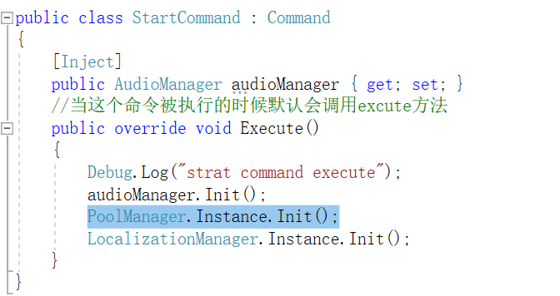
PoolManager
调用：
在框架的StartCommand中调用PoolManager.Instance.Init();
即调用poolManager的构造函数从池子中获取数据

Slide 9
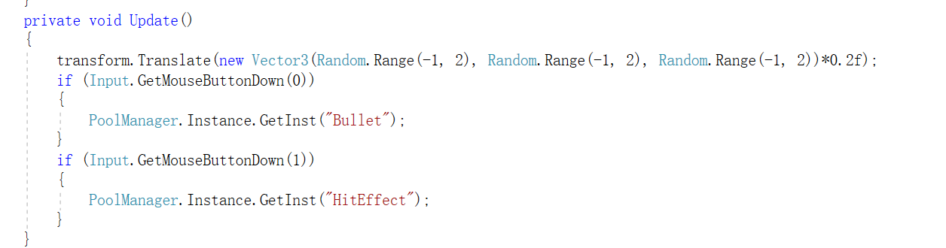
PoolManager
调用：
在CubeView中调用生成prefab

