Slide 1
AudioManager和LocalizationManager

Slide 2
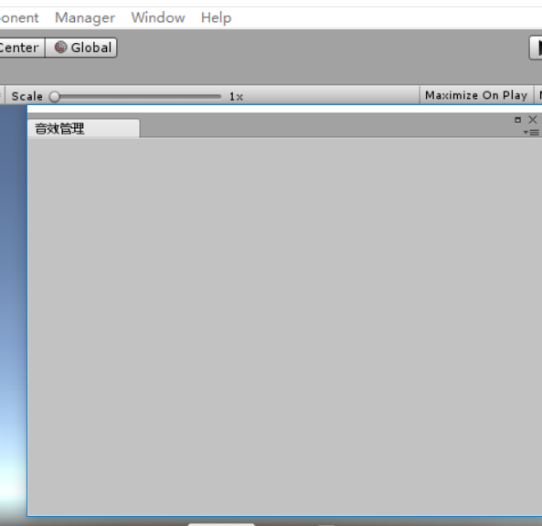
AudioManager
创建C#脚本AudioWindowEditor，并使用unity编辑器扩展菜单
则点击工具栏Manager->AudioManager 则生成一个空的窗口，命名‘音效管理’
[MenuItem("Manager/AudioManager")]
static void CreateWindow()
{
AudioWindowEditor window = EditorWindow.GetWindow<AudioWindowEditor>("音效管理"); //可以缩放
window.Show();
}

Slide 3
AudioManager
private void LoadAudioList()
{
if (File.Exists(AudioManager.AudioTextPath) == false) return;
audioDict = new Dictionary<string, string>();
string[] lines = File.ReadAllLines(AudioManager.AudioTextPath);
foreach (string line in lines)
{
if (string.IsNullOrEmpty(line)) continue;
string[] keyvalue = line.Split(',');
audioDict.Add(keyvalue[0], keyvalue[1]);
}
}
添加方法LoadAudioList()，在Awake中调用，读取当前目录下audiolist.txt已经存在的记录，并存到字典audioDict中

Slide 4
AudioManager
private void SaveAudioList()
{
StringBuilder sb = new StringBuilder();
foreach (string key in audioDict.Keys)
{
string value;
audioDict.TryGetValue(key, out value);
sb.Append(key + "," + value + "\n"); //
}
File.WriteAllText(AudioManager.AudioTextPath, sb.ToString());
// File.AppendAllText(savePath, sb.ToString());
}
添加方法SaveAudioList() ，在删除和新增时调用，即把已经删除/新增的字典记录，转成名称和路径，中间‘，’隔开的格式保存到audiolist.txt

Slide 5
AudioManager
添加方法OnGUI()，系统会自动调用
GUILayout.BeginHorizontal；
GUILayout.Label("音效名称");
GUILayout.Label("音效路径");
GUILayout.Label("操作");
EditorGUILayout.EndHorizontal();
使用后三个标签成水平一列。
foreach (string key in audioDict.Keys) //读取字典,已经操作后的audiolist.txt音效记录
{
string value;
audioDict.TryGetValue(key, out value);
GUILayout.BeginHorizontal();
GUILayout.Label(key);
GUILayout.Label(value);
if (GUILayout.Button(“删除”)) //遇到删除，则把该记录从字典中去除
{
audioDict.Remove(key);
SaveAudioList();
return;
}
EditorGUILayout.EndHorizontal();
}

Slide 6
AudioManager
audioName = EditorGUILayout.TextField(“名字”, audioName); //存入输入的音效名称
audioPath = EditorGUILayout.TextField(“音效路径”, audioPath);//存输入的音效路径
if (GUILayout.Button("添加音效"))
{
var o = Resources.Load(audioPath);
if (o == null)
{
Debug.LogWarning("音效不存在于" + audioPath + " 添加不成功");
audioPath = “ ”; //不能添加Resources资源中不存在的音效
}
else
{
if (audioDict.ContainsKey(audioName))
{
Debug.LogWarning(“名字已经存在，请修改”);//不能重复存
}
else
{
audioDict.Add(audioName, audioPath); //添加到字典
SaveAudioList();//保存记录到audiolist.txt
}
}
}

Slide 7
AudioManager
//窗口面板更新的时候调用
private void OnInspectorUpdate()
{
LoadAudioList();
}
无论做了删除还是新增，保证界面更新不延时

Slide 8
AudioManager
创建C#脚本AudioWindowEditor，控制音乐的加载和播放
private static string audioTextPathPrefix = Application.dataPath + "\\Framework\\Resources";
private const string audioTextPathMiddle = "audiolist";
private const string audioTextPathPostfix = ".txt";
public static string AudioTextPath
{
get { return audioTextPathPrefix + audioTextPathMiddle + audioTextPathPostfix; }
}
AudioTextPath做成全局变量，在AudioWindowEditor中加载audiolist时只需取该方法
private Dictionary<string, AudioClip> audioClipDict = new Dictionary<string, AudioClip>();

Slide 9
AudioManager
创建加载音效的方法，直接加载audiolist，遇到空跳过，加载ketvalue[1]即音效地址取得音效，在字典中存入音效名称和音效。初始化时加载LoadAudioClip()
public void LoadAudioClip()
{
audioClipDict = new Dictionary<string, AudioClip>();
TextAsset ta = Resources.Load<TextAsset>(audioTextPathMiddle);
string[] lines = ta.text.Split('\n');
foreach (string line in lines)
{
if (string.IsNullOrEmpty(line)) continue;//空就跳过
string[] keyvalue = line.Split(',');
string key = keyvalue[0];
AudioClip value = Resources.Load<AudioClip>(keyvalue[1]);
audioClipDict.Add(key, value);
}
}

Slide 10
AudioManager
创建加载音效的方法，直接加载audiolist，遇到空跳过，加载ketvalue[1]即音效地址取得音效， public void Play(string name)//播放
{
if (isMute) return; //isMute是控制是否需要屏蔽音效的布尔值，默认为false
AudioClip ac;
audioClipDict.TryGetValue(name, out ac);
if (ac != null)
{
AudioSource.PlayClipAtPoint(ac, Vector3.zero);//默认位置播放
}
}//这两个播放 效果类似，但第二个可以控制位置
public void Play(string name, Vector3 position)
{
if (isMute) return;
AudioClip ac;
audioClipDict.TryGetValue(name, out ac);
if (ac != null)
{
AudioSource.PlayClipAtPoint(ac, position);//默认位置播放
}
}

Slide 11
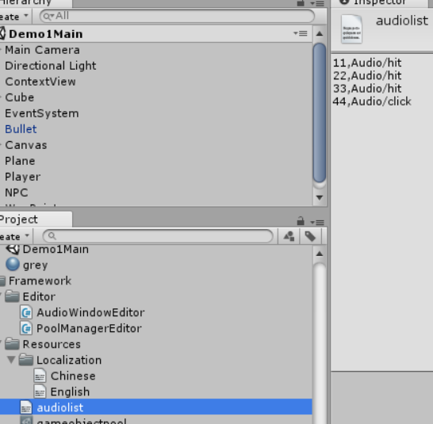
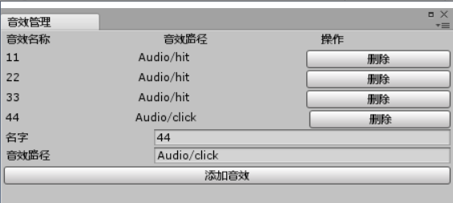
AudioManager

Slide 12
LocalizationManager
创建两个button分别命名startButton和exitButton
创建c#脚本LocalizationManager
使用单例模式，并在Resources/ Localization下创建两个txt文档
private const string Chinese = "Localization/Chinese";
private const string English = “Localization/English”;
public const string Language = Chinese; //默认为中文
private Dictionary<string, string> dict;
public LocalizationManager()
{
dict = new Dictionary<string, string>();
TextAsset ta = Resources.Load<TextAsset>(Language); //加载资源
string[] lines = ta.text.Split('\n');
foreach (string line in lines)
{
if (string.IsNullOrEmpty(line) == false)
{
string[] keyValues = line.Split(‘=‘); //通过等号分割 分割成key与value存入字典
dict.Add(keyValues[0], keyValues[1]);
}
}
}

Slide 13
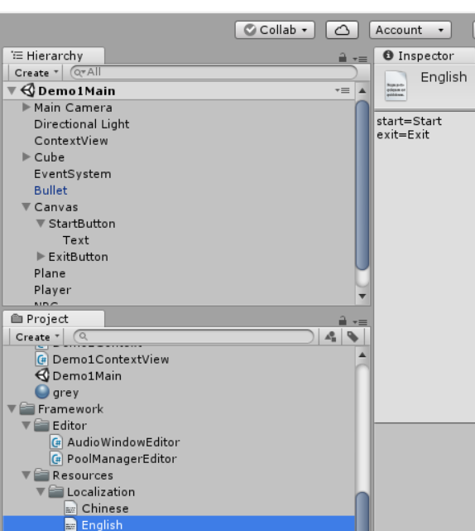
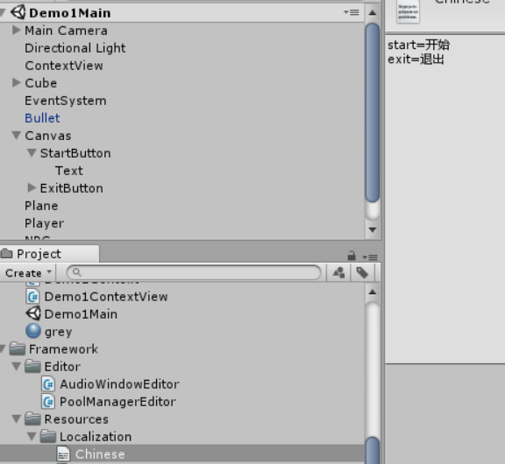
LocalizationManager

Slide 14
LocalizationManager
创建两个button分别命名startButton和exitButton
创建c#脚本LocalizationManager
使用单例模式，并在Resources/ Localization下创建两个txt文档
private const string Chinese = "Localization/Chinese";
private const string English = “Localization/English”;
public const string Language = Chinese; //默认为中文
private Dictionary<string, string> dict;
public LocalizationManager()
{
dict = new Dictionary<string, string>();
TextAsset ta = Resources.Load<TextAsset>(Language); //加载资源
string[] lines = ta.text.Split('\n');
foreach (string line in lines)
{
if (string.IsNullOrEmpty(line) == false)
{
string[] keyValues = line.Split(‘=‘); //通过等号分割 分割成key与value存入字典
dict.Add(keyValues[0], keyValues[1]);
}
}
}

Slide 15
LocalizationManager
public string GetValue(string key)
{
string value;
dict.TryGetValue(key, out value);
return value;
}
获取文本文档里key对应的value并返回，显示到前台UI按钮上

Slide 16
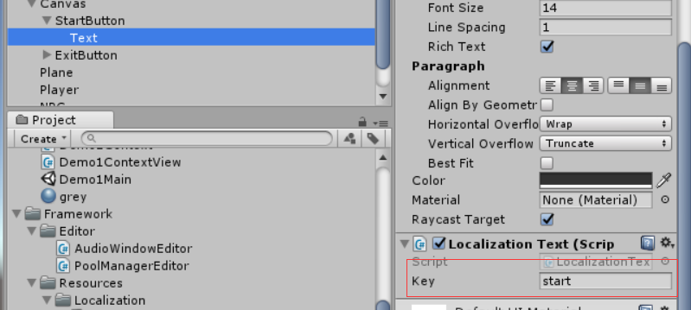
LocalizationManager
public string key;
void Start ()
{
string value = LocalizationManager.Instance.GetValue(key);
GetComponent<Text>().text = value;
}
创建脚本LocalizationText，挂载到两个button的text上 通过修改public const string Language = Chinese或者English判断text显示的是哪个值

