Slide 1
End-to-end predictive and prescriptive system for HIV: integrated risk assessment, early detection, and treatment optimization
Group ID - 25-26J-147
12/09/2025

Slide 2




Our Research Team
Ms. Gaya Thamali Dassanayake
Supervisor
Rupasinghe R.A.D.N.
IT22907066
Team member
Thrimanna A.
IT22585530
Team member
Jayarathna J.V.D.
IT22577610
Team member
12/09/2025

Slide 3
INTRODUCTION TO OVERALL PROJECT
HIV patients face high vulnerability to opportunistic infections due to weakened immunity, limited access to radiologists, and delays in diagnosis in resource-constrained clinical settings. This project develops a unified AI-driven early-screening system with three core components:
1. Behavioral risk prediction using publicly available datasets with raw columns capturing individual risky behaviors, and preventive practices.
2. Deep-learning chest X-ray analysis for detecting TB and Pneumonia—two of the most fatal HIV-related infections.
3. Treatment Optimization and Adherence Prediction for HIV Patients
The system enables faster, more reliable early detection of HIV-associated lung complications, reduces diagnostic delays, and supports clinical decision-making where specialist resources are limited.
12/09/2025

Slide 4
Research impact of the solution in Sri Lanka
Early diagnosis: Faster detection of TB and pneumonia reduces HIV-related complications and mortality.
Clinical efficiency: AI-assisted screening supports doctors and reduces diagnostic workload in busy or low-resource clinics.
Healthcare accessibility: Mobile/Web deployment brings reliable screening to rural areas lacking radiologists.
National benefit: Strengthens public health response, improves patient outcomes, and supports early intervention in HIV care programs.
12/09/2025

Slide 5
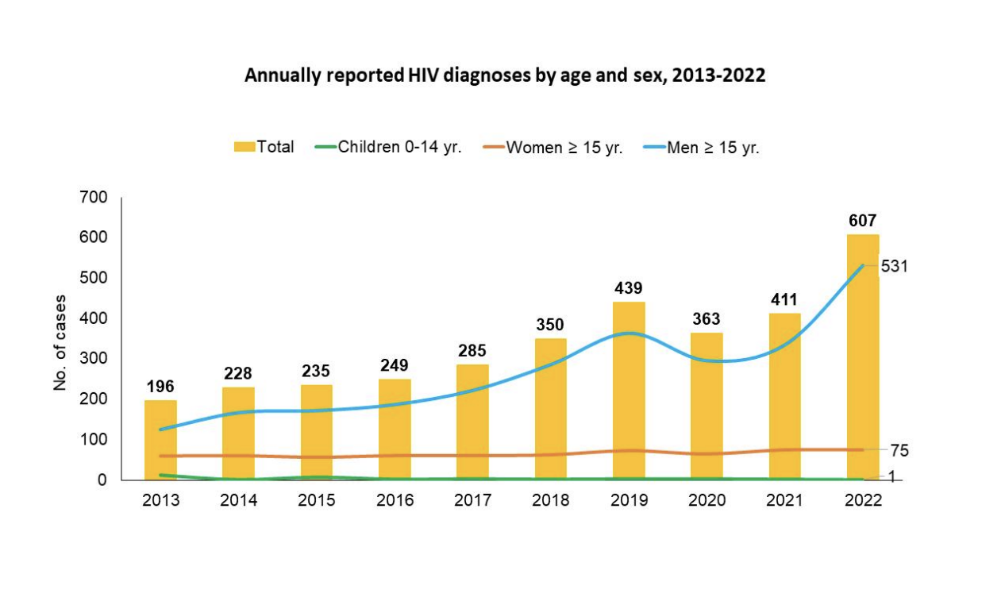
cycle of late diagnosis → severe infection → treatment failure, which our project aims to break using AI-driven early screening and prediction
12/09/2025

Slide 6
Previous research and its shortcomings
Done before: CNN-based TB detectors, pneumonia classifiers, standalone HIV risk scoring models, and traditional radiology-based diagnosis methods.
Limitations: Disease models trained on general populations (not HIV-specific), limited use of clinical biomarkers, poor performance on mixed opportunistic infections, lack of explainability validation, and absence of integrated, real-time mobile or web-based screening tools.
12/09/2025

Slide 7
Constraints and Limitations
Data: Reliance on publicly available X-ray and HIV clinical datasets; limited HIV-specific imaging data may affect model accuracy.
Uncertainty: Variations in X-ray quality, equipment differences, and atypical patterns in advanced HIV cases can reduce consistency.
Integration: Real-time deployment with mobile/web apps and ensuring reliable backend performance in low-resource clinics can be challenging.
Scope: This is a research prototype; clinical validation and larger hospital-level trials are required for widespread adoption.
12/09/2025

Slide 8
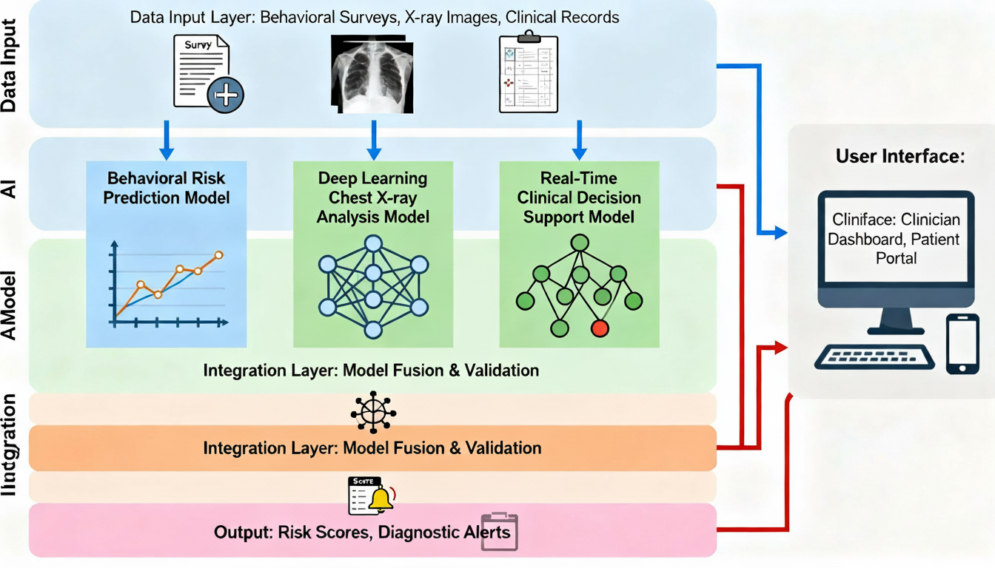
Overall System Diagram
12/09/2025

Slide 9

Deep Learning X-ray Model for HIV-related Lung Infection Detection
IT22907066 – Rupasinghe R.A.D.N
Specialization : Data Science
IT22907066 | Rupasinghe R.A.D.N | 25-26J-147
12/09/2025

Slide 10
Deep Learning X-ray Model for HIV-related Lung Infection Detection
Knowledge Gap / Problem Definition
HIV-positive patients have unique, a typical lung X-ray patterns, making TB/Pneumonia detection harder compared to normal patients.
Existing AI TB/Pneumonia models are trained on general populations, not HIV-immunocompromised individuals.
No integrated system combines clinical factors (CD4 count, viral load) with chest X-ray image analysis.
Shortcomings of Existing Systems
Manual X-ray reading is slow, depends on radiologist availability.
Current AI TB detectors don’t work well for HIV patients.
No clinical + image integration.
No real deployments (mobile/web) for HIV clinics.
Proven Gap / Creative Solution
Proven Gap: Existing TB/Pneumonia detection models are not optimized for HIV-positive patients, lack clinical data integration, and are rarely deployed as real-time tools in low-resource clinics.
Creative Solution: A hybrid AI system combining deep-learning X-ray analysis (CNN/ResNet) with clinical risk factors (CD4 count, symptoms), delivered through a web/mobile app for fast, reliable early detection of HIV-related lung infections in real-world healthcare settings.
IT22907066 | Rupasinghe R.A.D.N | 25-26J-147
12/09/2025

Slide 11


Deep Learning X-ray Model for HIV-related Lung Infection Detection
Key Domains of Specialization
Deep Learning (CNNs)
Medical Imaging
Predictive Analytics
Explainable AI
Web/Mobile App Development
Latest Technologies Utilized
AI: PyTorch/TensorFlow, ResNet, MobileNet, GradCAM
Backend: FastAPI / Flask
Frontend: React / Flutter
Cloud: AWS / Docker Database: MongoDB / Firebase
IT22907066 | Rupasinghe R.A.D.N | 25-26J-147
12/09/2025

Slide 12
Deep Learning X-ray Model for HIV-related Lung Infection Detection
Research Gap
Research Area | Existing Status | Gap Identified | Your Contribution
HIV-specific chest X-ray data | Very limited datasets | Poor performance for HIV cases | Create HIV-focused model using augmented or mixed datasets
Opportunistic infection detection | AI confuses TB vs Pneumonia | Atypical patterns in HIV not studied | Multi-class classifier tuned for HIV OIs
Clinical + image integration | Rarely used | Clinical fusion benefits unexplored | Combine CD4, viral load with CNN output
Generalizability | Poor across devices/hospitals | No framework for diverse data | Domain adaptation + normalization
Explainability | GradCAM not validated | Clinicians don’t trust AI outputs | HIV-specific explainability layer
Deployment | Almost no mobile/web systems | Lack of real-world applicability | Create actual working application
IT22907066 | Rupasinghe R.A.D.N | 25-26J-147
12/09/2025

Slide 13
Deep Learning X-ray Model for HIV-related Lung Infection Detection
How to Evaluate / Prove Success
Model metrics: Accuracy, Precision, Recall, F1, ROC-AUC
Confusion Matrix for error analysis
GradCAM heatmap validation for explainability
System tests: speed, usability (SUS score), and integration stability
Data Availability & Ethical Clearance
Uses public, de-identified datasets (NIH, Montgomery, Shenzhen, UCI ACTG)
No personal patient data → no ethical approval needed
Research-only tool with secure data handling and privacy protection
IT22907066 | Rupasinghe R.A.D.N | 25-26J-147
12/09/2025

Slide 14
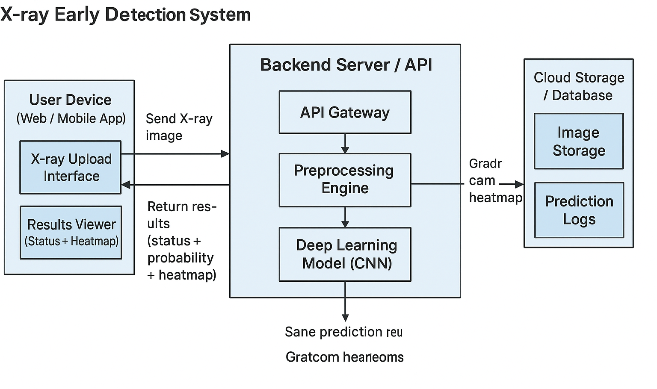
System Diagram
IT22907066 | Rupasinghe R.A.D.N | 25-26J-147
12/09/2025

Slide 15

HIV Risk Identification and Personalized Intervention Sequencing for Risk Reduction
IT22585530 – Thrimanna A.
Specialization : Data Science
11/19/2025

Slide 16
HIV Risk Identification and Personalized Intervention Sequencing for Risk Reduction
Knowledge Gap or Problem Definition
Research | Automated Detection of Individual’s Risky Behaviors (from raw columns) | Personalized Behavioral Intervention Sequencing & Priority Weighting (Ordered & Prioritized Personal Recommendations) | Time-Phased Implementation Roadmap (Week 1– Phase 1: 3 actions; Phase 2: Weeks 5–12)
ML Risk -Prediction[2] | ❌ | ❌ | ❌
MyPEEPS Mobile App[3] | ✔ | ✔ (partial - tailored modules) | ❌
MyChoices PrEP/HIV [4] | ✔ | ❌(recommends frequency) | ❌
CDC HIV Risk Reduction [5] | ✔ | ❌(generic tips) | ❌
Our Research | ✔ | ✔ | ✔
Shortcomings and Proposed Solution
Current Shortcomings:
🚫 Traditional - Detect some risky behaviors with generic recommendation - But no real priority ordering recommendation
🚫 No personalized, time phased plan delivered in the person’s own language
Our Proposed Solution:
✅ Detects exact risky behaviors for each person
✅ Prioritized sequence recommendations
✅ Time-phased plan in the person’s own language
IT22585530 | Thrimanna A. | 25-26J-147 11/19/2025

Slide 17
HIV Risk Identification and Personalized Intervention Sequencing for Risk Reduction
​
Key Domains of Specialization-based Knowledge Utilized to Fabricate the Solution
✔Data Science: Analyzed 18,000+ records to extract behavioral risk features for HIV risk prediction
✔AI (Machine Learning): Built a model to generate personalized HIV risk scores
✔Natural Language Processing: Generated multilingual, user-friendly guidance using an LLM
✔Explainable AI: For clear explanations showing which behaviors influence each person’s score(SHAP method))
✔Software Engineering: Developed an interactive web application for real-time risk assessment and planning
Specific Latest Technology/Technologies in that Domain are Utilized
⮚XGBOOST - HIV risk classification and predictive modeling
⮚SHAP - Identifying individual-level behavioral risk factors
⮚Streamlit - dashboard development
⮚Python – Programming language
⮚Gemini-2.5-Flash API - Multilingual translation
⮚Google Colab - GPU environment for model training
⮚GitHub – Version Control
IT22585530 | Thrimanna A. | 25-26J-147 11/19/2025

Slide 18
HIV Risk Identification and Personalized Intervention Sequencing for Risk Reduction
Evaluation Methods
Model Performance Testing: Validate HIV risk predictions against CDC historical data Personalization Accuracy Verification: Confirm different users receive appropriately sequenced intervention plans
Multilingual Output Quality Testing: Assess accuracy across all language outputs. System Integration Tests: Verify end-to-end functionality from dataset to automated roadmap generation
Expected Accuracy
Data Availability and Ethical Clearance
Key Performance Indicator | Project Goal
Risk Prediction Accuracy | > 90%
Personalization Relevance | > 90%
Multilingual Output Quality | > 90%
Primary Data Source:
⮚CDC Youth Risk Behavior Survey (YRBS) ⮚YRBS Data Summary & Trends Report Ethical Clearance – Data handled with strict confidentiality following CDC public health research guidelines.
Metrics Models - Precision, recall, and F1-score
User Experience - Usability Surveys
IT22585530 | Thrimanna A. | 25-26J-147 11/19/2025

Slide 19
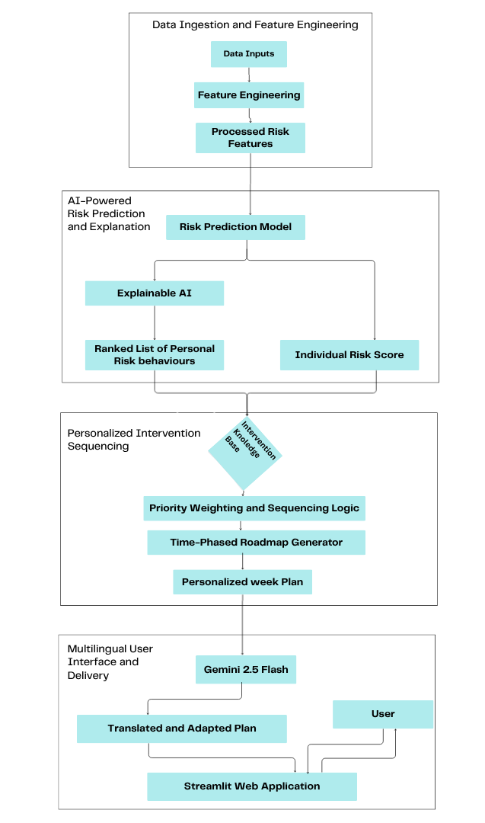
HIV Risk Identification and Personalized Intervention Sequencing for Risk Reduction
System Overview and How to Use It in a Real-World Scenario
Step 1: Enter User Data
user fills in behavior-related information in the web application.
Step 2: View Risk Score and Factors
The system analyses the data, predicts the individual’s HIV risk level, and lists the specific behaviors contributing to that risk.
Step 3: Receive Personalized Action Plan
The user is given a prioritized week intervention plan Step 4: Deliver Guidance in Preferred Language
The plan is translated into the user’s chosen language. Benefit
Improves early HIV risk detection, Guidance for each individual with more effectively
IT22585530 | Thrimanna A. | 25-26J-147 11/19/2025

Slide 20
Treatment Optimization and Adherence Prediction for HIV Patients
IT22577610 – Jayarathna J. V. D
Specialization : Data Science
IT22577610 | Jayarathna J.V.D | 25-26J-147
12/09/2025

Slide 21
Treatment Optimization and Adherence Prediction for HIV Patients
Knowledge Gap / Problem Definition
Existing research predicts treatment failure or LTFU, not early adherence.
Models are often not explainable to healthcare staff.
No clear recommendations or treatment optimization after prediction.
Shortcomings of Existing Systems
Focus only on outcomes (failure, dropout) → too late for intervention.
Black-box models make clinicians mistrust results.
Limited generalizability across clinics/regions.
No simple dashboard or tool to support real decision-making.
Proven Gap / Creative Solution
Build early adherence prediction model (before interruption happens).
Provide interpretable insights (SHAP, feature importance).
Add actionable recommendations for treatment optimization.
Ensure fairness and generalizability by testing across subgroups.
Deliver a lightweight, easy-to-use decision-support system.
IT22577610 | Jayarathna J.V.D | 25-26J-147
12/09/2025

Slide 22
Research Gap
Treatment Optimization and Adherence Prediction for HIV Patients
Study | Focus | Limitation | Gap You Address
Mamo et al., 2023 | Predict virologic failure | Not about adherence | I focus on early adherence prediction
Stockman et al., 2022 | Identify LTFU risk | Not explainable | I provide interpretable ML
Ogbechie et al., 2023 | Predict 30-day interruption | Only short-term | I use multiple prediction horizons
Endebu et al., 2025 | Predict LTFU | No external validation | I test generalizability
Ijaiya et al., 2025 | Multi-state IIT prediction | Varies by region | I address fairness across groups
IT22577610 | Jayarathna J.V.D | 25-26J-147
12/09/2025

Slide 23
Treatment Optimization and Adherence Prediction for HIV Patients
Key Domains of Data Science
Data Collection & Preparation – Gather and clean patient data..
Machine Learning & Modeling – Predict adherence and treatment risk.
Interpretability & Explainable AI – Explain predictions for clinicians.
Visualization & Decision Support – Show insights and recommendations via dashboards.
Big Data / Scalable Systems – Handle large or multi-clinic datasets efficiently.
Latest Technologies Utilized
Python & ML Libraries – Scikit-learn, XGBoost, TensorFlow for predictive modeling
Explainable AI – SHAP, LIME to interpret model predictions
Data Management – SQL/NoSQL, EMR systems for patient data
Visualization & Dashboards – Tableau, Power BI, Plotly for insights
Cloud & MLOps – AWS/GCP, Git, MLflow for scalable, reproducible models
IT22577610 | Jayarathna J.V.D | 25-26J-147
12/09/2025

Slide 24
Treatment Optimization and Adherence Prediction for HIV Patients
Evaluation Methods
Model Accuracy Testing: Validate adherence and risk predictions against historical patient records.
Early Warning Effectiveness: Confirm high-risk patients are detected before treatment interruption occurs.
Interpretability Verification: Ensure clinicians can understand and act on model explanations (SHAP/LIME).
Dashboard & Decision Support Testing: Verify recommendations and visualizations are clear and actionable.
Data Availability & Ethical Clearance
Data Sources: Use public datasets ( Kaggle ) and clinic records.
Data Collected: Age, medical history, treatment records, visit patterns.
Patient privacy is protected.: No names stored, follows data protection rules.
Responsible Use: The system is designed to support doctors in treatment decisions without exposing any sensitive patient information.
IT22577610 | Jayarathna J.V.D | 25-26J-147
12/09/2025

Slide 25
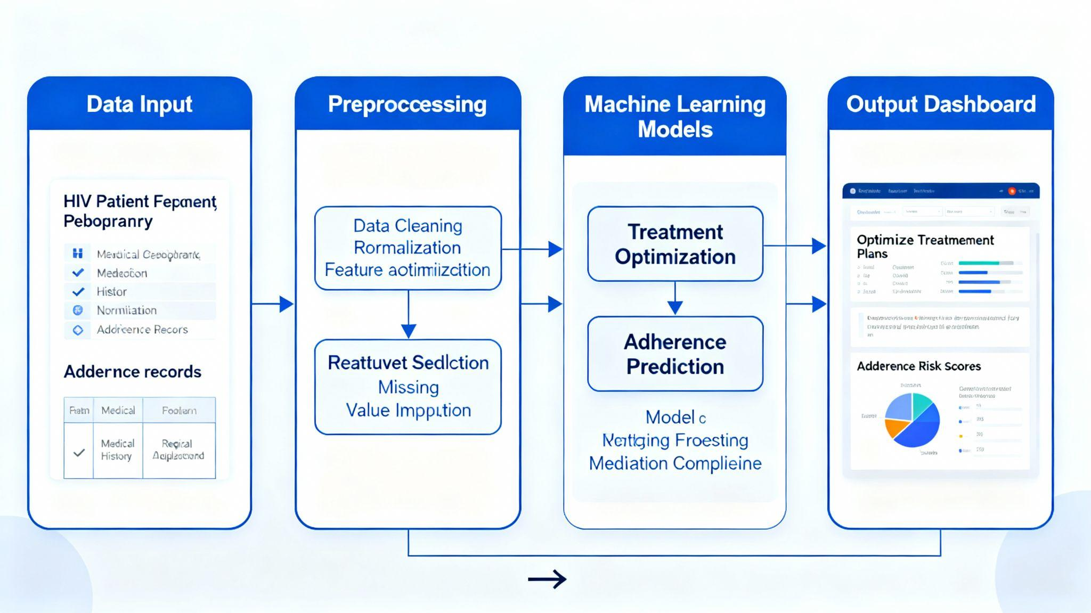
System Diagram
Treatment Optimization and Adherence Prediction for HIV Patients
Real-World Usage
Helps patients follow their HIV treatment correctly.
Sends personalized reminders and schedules for taking medication.
Works without constant supervision, supporting patients in daily life.
Improves adherence and reduces risk of treatment failure.
Helps doctors monitor patient adherence and adjust treatment plans.
IT22577610 | Jayarathna J.V.D | 25-26J-147
12/09/2025

Slide 26
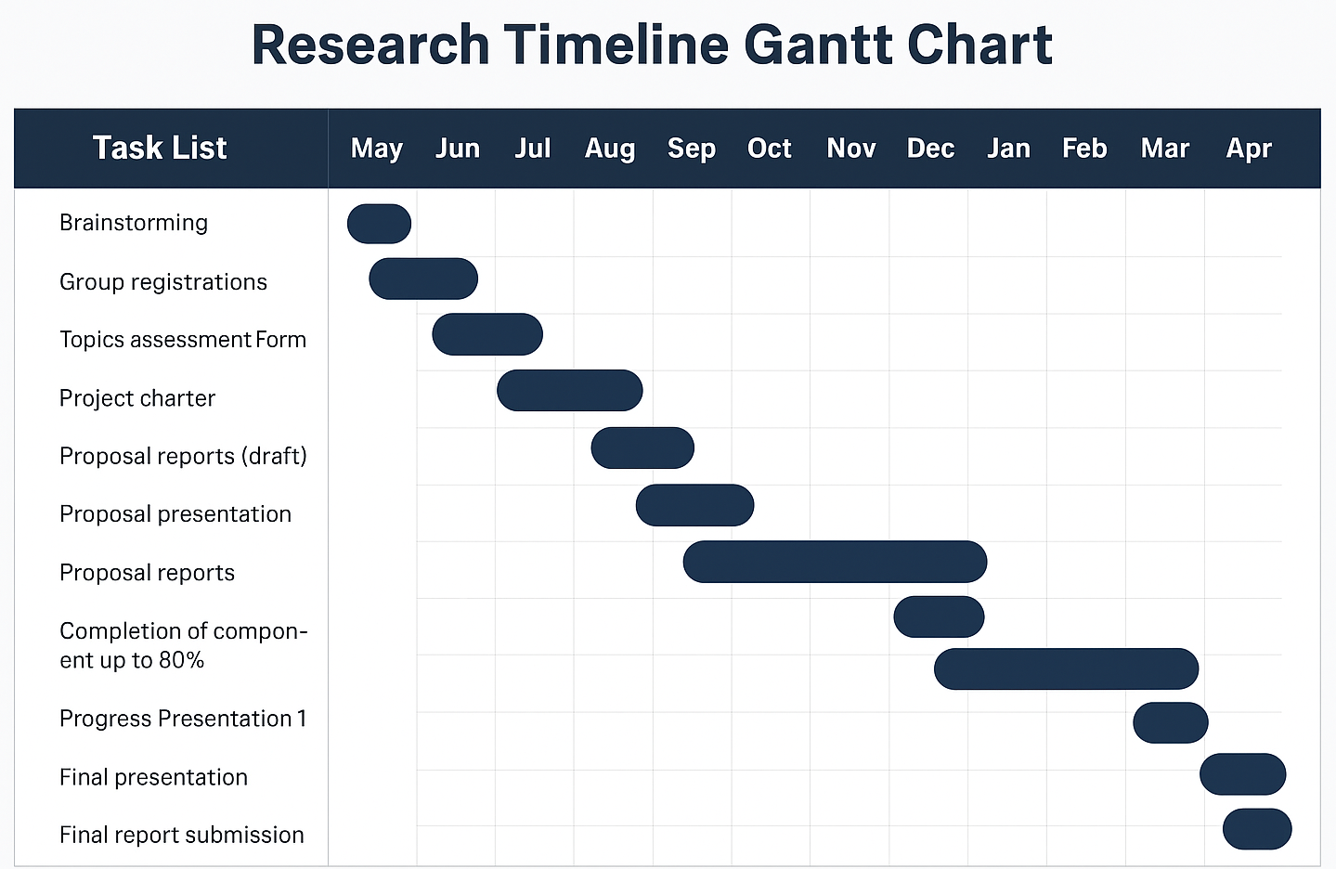
Gantt Chart
12/09/2025

Slide 27
End-to-end predictive and prescriptive system for HIV: integrated risk assessment, early detection, and
treatment optimization
Pricing & Licensing Model
Licensing Model → Provide the system to government hospitals and clinics as a subscription or one-time license.
Customization → Charge for adapting the system to local workflows, languages, and treatment guidelines.
Consultancy Package → Offer training for healthcare staff and advice on using the system for HIV programs.
12/09/2025

Slide 28
End-to-end predictive and prescriptive system for HIV: integrated risk assessment, early detection, and treatment optimization
Target Market
Government hospitals, public clinics, and national HIV programs
Customer Profile
Healthcare staff and program managers who need early HIV risk detection, guidance, and actionable insights.
HIV patients
Value Proposition
Quickly detects HIV risk, suggests personalized actions, and provides easy-to-use dashboards for better patient care.
12/09/2025

Slide 29
Budget
Expense | Amount (Rs.)
Computing/Storage (monthly, avg.) | 8000.00
Software/Tools (one-time) | 15000.00
Data Preparation & Annotation (one-time) | 6000.00
Model Training & Evaluation (one-time) | 10000.00
Maintenance/Testing (monthly, avg.) | 5000.00
Transportation Charges | 5000.00
Total | 49,000.00
12/09/2025

Slide 30
THANK YOU!
Any questions?
12/09/2025

