Slide 1
End-to-end predictive and prescriptive system for HIV: integrated risk assessment, early detection, and treatment optimization
Group ID - 25-26J-147​
​

Slide 2
An Intelligent IoT and AI-Based Decision Support System for HIV Risk Assessment, Monitoring, and Treatment Optimization
Design Excellence of the Overall Solution
Who Has This Problem? (Who Will Benefit)
End-to-end integrated system combining:
HIV risk prediction
IoT-based real-time health monitoring & portable CD4 estimation
AI-based treatment optimization
Low-cost and portable design, suitable for low-resource settings
Continuous monitoring instead of infrequent testing
Modular and scalable architecture
Designed to support clinical decision-making, not replace doctors
HIV Patients
Especially those in rural or remote areas
Need affordable, frequent, and accessible monitoring
Doctors & Healthcare Providers
Need continuous, reliable data for better treatment decisions
Hospitals & Clinics
Face resource and infrastructure limitations
Public Health Systems & NGOs
Need scalable, low-cost solutions for HIV care and monitoring

Slide 3

IoT-Based Physiological Monitoring for HIV Stage Identification (CD4 – Prototype Phase)
Specialization: Data Science
IT22907066 | Rupasinghe R a D N
IT22907066 Rupasinghe R A D N | 25-26J-147

Slide 4
IoT-Based Physiological Monitoring for HIV Stage Identification (CD4 – Prototype Phase)
How the Solution will address the Sub-Problem
Addresses the challenge of continuous health monitoring for HIV patients.
Uses an IoT device to capture real-time physiological parameters: Heart Rate (BPM)Blood Oxygen Saturation (SpO₂), Body Temperature, Patient Movement (activity level)
These parameters act as indirect indicators of immune system stress.
CD4 Cell Count is planned as a future module (Coming Soon).
Data is transmitted wirelessly to a mobile application dashboard for visualization.
The collected data will later support HIV stage classification (Stage 1, 2, or 3) using ML.
User Requirements addressed by the solution
✔ Need for non-invasive, continuous monitoring
✔ Real-time access to patient health data
✔ Remote monitoring for doctors and healthcare providers
✔ Easy-to-understand health indicators for patients
✔ Integration capability with future AI/ML models
IT22907066 Rupasinghe R A D N | 25-26J-147

Slide 5
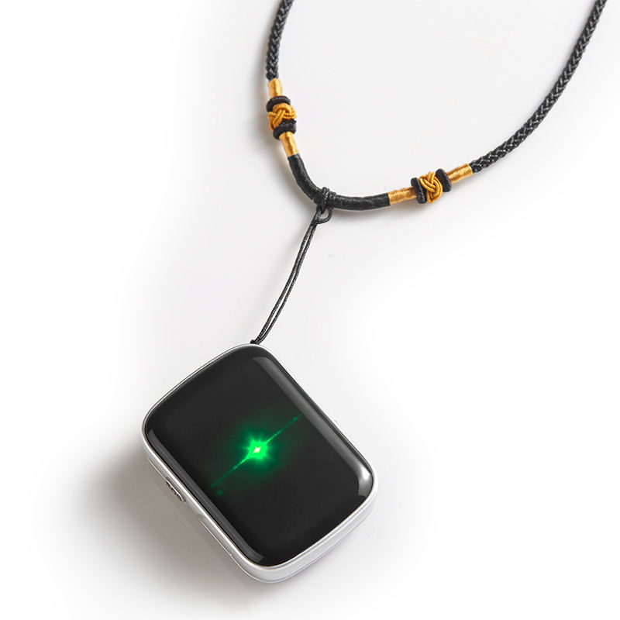
IoT-Based Physiological Monitoring for HIV Stage Identification (CD4 – Prototype Phase)
Design Excellence/Contribution
Modular IoT architecture allowing easy sensor expansion
Real-time data updates using local IoT network
Low-cost hardware design suitable for resource-limited settings
Seamless integration with mobile application
Designed to support future CD4 estimation + ML-based HIV stage detection
User Feedback on Prototype
Patients found the system easy to use and non-intrusive
Doctors appreciated real-time vitals visibility
Positive feedback on:
Live heart rate & temperature updates
Simple mobile dashboard interface
Suggested improvements:
Direct CD4 count integration
Cloud data storage for long-term tracking
Feedback validated the feasibility and usefulness of the prototype
IT22907066 Rupasinghe R A D N | 25-26J-147

Slide 6

HIV Behavioral Risk Identification and Personalized Intervention Sequencing for Risk Reduction
Specialization: Data Science
IT22585530 | Thrimanna a
IT22585530 THRIMANNA A | 25-26J-147

Slide 7
HIV Behavioral Risk Identification and Personalized Intervention Sequencing for Risk Reduction
How the Solution Addresses the Sub-Problem
User Requirements
Existing Prevention Tools | Our Behavioral Sequencing Approach
Same recommendations for everyone at same risk level | Different sequencing plans for individuals with identical risk levels
No Personalized Recommendation | AI-driven personalized risk reduction roadmap
No Time-based Sequencing plan | Weekly based sequenced intervention phases
One-time static recommendations | Progressive, Step-by-Step Risk Reduction
Generic for everyone | Will be Available in English, Sinhala, Tamil language intervention plan in the next phase
Requirement 1: Clear starting point for correct behaviors
✅ Feature: Clear weekly phased roadmap
Requirement 2: Personalized, relevant recommendations based on their individual behaviors ✅ Feature: Personalized Behavioral intervention
Requirement 3: Motivation Support
✅ Feature: Progress tracking visualization dashboard
Requirement 4 : Progress measurement
✅Feature: Risk trend timeline
Requirement 5: Fit into daily routine
✅ Feature: Simple weekly action steps
IT22585530 THRIMANNA A | 25-26J-147​

Slide 8
HIV Behavioral Risk Identification and Personalized Intervention Sequencing for Risk Reduction
Design Excellence & Technical Contribution
Frontend
React Native (simple, guided user flow)
Algorithm
AI-driven – personalized intervention sequencing
Backend
FastAPI (for assessment & planning)
Dashboard
Live tracking – visual risk trends & progress
Database
Firebase Firestore (stores user history & progress)
Languages
English, Sinhala, Tamil – multi-language plans
Infrastructure
Ngrok Tunneling
(Secure External Access)
Architecture
Scalable and maintainable
Strengths and user Feedback on Prototype
Output is easy to understand and useful
Personalized weekly action plan is clear and best fit into daily routine
Step-by-step intervention flow is easy to follow
Progress via the risk trend visualization is effective
Will implement multi-language support
IT22585530 THRIMANNA A | 25-26J-147​

Slide 9

Machine Learning-Based Predictive Framework for HIV Drug Resistance and Personalized Treatment Optimization System
Specialization: Data Science
IT22577610 | Jayarathna J V D
IT22577610 Jayarathna J V D | 25-26J-147

Slide 10
Machine Learning-Based Predictive Framework for HIV Drug Resistance and Personalized Treatment Optimization System
How the Solution will address the Sub-Problem
Identifies HIV drug resistance early using Machine Learning
Reduces delay in treatment decisions (no need to wait weeks for lab tests)
Predicts whether current treatment will fail or succeed
Provides real-time results through a mobile application
User Requirements addressed by the solution
Fast predictions – results in seconds
High accuracy – reliable ML models used
Easy to use – simple interface for clinicians
Explainable results – shows why a prediction was made
Cost-effective – reduces expensive resistance testing
Secure – protects patient data
IT22577610 Jayarathna J V D | 25-26J-147

Slide 11
Machine Learning-Based Predictive Framework for HIV Drug Resistance and Personalized Treatment Optimization System
Design Excellence/Contribution
Used Ensemble Machine Learning for better performance
Integrated medical knowledge into feature engineering
Prevented overfitting using proper validation techniques
Designed an interpretable model, not a black box
Connected ML model with a real-world mobile system
User Feedback on Prototype
Clinicians found the system easy and fast to use
Early resistance detection helped improve patient outcomes
Explanation of predictions increased trust in the system
Reduced unnecessary laboratory testing
Useful for complex HIV treatment cases
IT22577610 Jayarathna J V D | 25-26J-147

Slide 12
End-to-end predictive and prescriptive system for HIV: integrated risk assessment, early detection, and treatment optimization
Commercialization Model
IoT Device
Market price (existing devices): Rs. 15,000–25,000
Our device cost: ~Rs. 5,000
Selling price: Rs. 10,000–12,000
Affordable + strong profit margin
As of 2024–2025, there are an estimated ~40.8 million people worldwide living with HIV
Mobile Application
Subscription-based model
This is life-critical, not an optional app → high willingness to subscribe
What Makes Our Solution Unique
Portable CD4 estimation concept
End-to-end system: Risk → Monitoring → Treatment
Designed for low-resource and rural settings
Continuous monitoring instead of infrequent testing
Scalable, modular, and future-ready

