Slide 1
IoT and AI Based Decision Support System for HIV: Integrated Risk Assessment, Monitoring, and Treatment Optimization
Group ID - 25-26J-147​
​

Slide 2
Problem Statement and Stakeholders
Context
HIV risk assessment, monitoring, and treatment support in low-resource healthcare environments.
Stakeholders
Primary users: HIV patients and HIV-unsure individuals, especially those in rural or remote areas.
Secondary users: doctors and healthcare providers
Decision makers: hospitals, clinics, public health systems, and NGOs
Observed Issue and its impact
HIV-unsure individuals lack tools to understand their risk and the need for testing.
Diagnosed patients depend on infrequent clinical tests.
Continuous health monitoring is limited.
25-26J-147

Slide 3
Research Gap and Objectives
Research Gap
Existing solutions are infrequent and non-personalized
Lack continuous monitoring
Do not integrate behavioral risk, physiological monitoring, and AI treatment optimization
Main Objective
Develop a low-cost, portable IoT & AI system
Enable continuous HIV risk assessment for patients and HIV-unsure individuals
Provide real-time monitoring and personalized treatment optimization
25-26J-147

Slide 4
Solution Overview
Solution Summary
An integrated IoT and AI system for continuous HIV risk assessment, real-time health monitoring, and personalized treatment optimization
Key Features
FR1 : Behavioral risk assessment and personalized intervention sequencing, and Analytics-Driven Progress Tracking
FR2 : IoT-based real-time physiological monitoring (CD4 prototype-based)
FR3 : AI-driven predictive framework for drug resistance, treatment optimization, and adherence
Non-functional focus -
Performance | security | usability | reliability
Current Completion Status - ~90%+ complete
25-26J-147

Slide 5
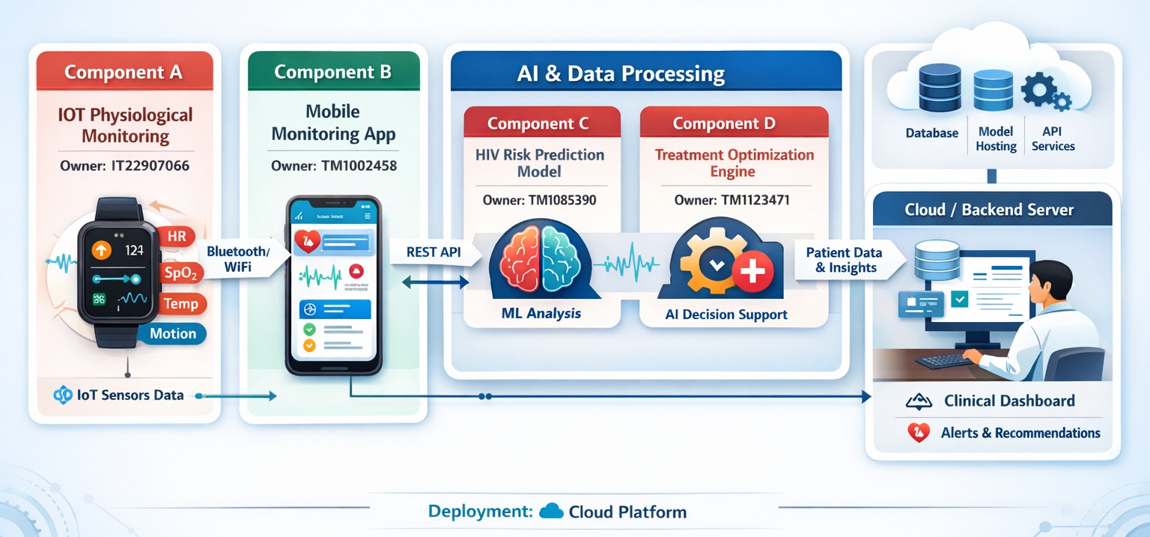
System Architecture and Integration
IT2290706
IT2290706 / IT2258553
IT22577610
IT2258553
IT2257761
25-26J-147

Slide 6
Commercialization / Impact
Target Users/ Market
HIV patients, HIV-unsure individuals, doctors, clinics, and public health systems, especially in low-resource or rural areas
Value Proposition
Low-cost, portable, and personalized HIV monitoring and treatment solution
faster risk detection and decision-making than current alternatives
Cost and feasibility
IoT device: ~Rs. 5,000 Mobile app: Low-cost and scalable for public use
Adoption plan/ next steps
Pilot test in a few clinics → Collect feedback and make improvements → Expand to more hospitals and public health programs
25-26J-147

Slide 7
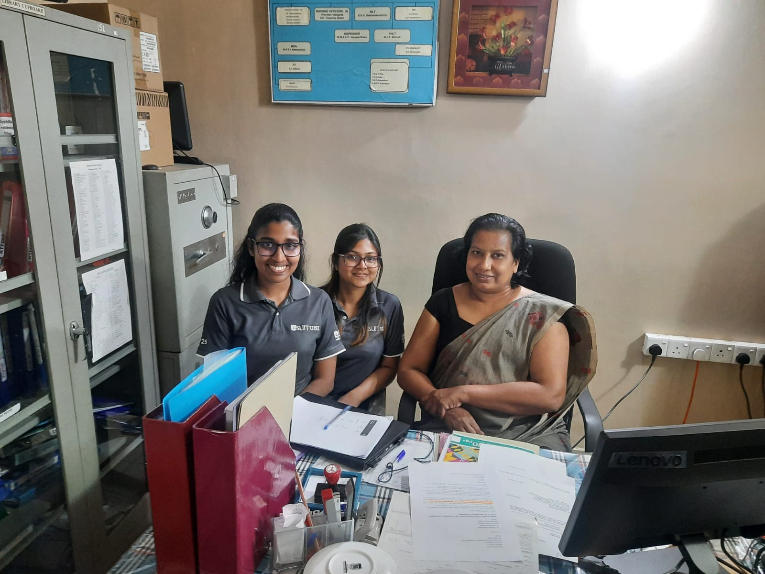
Clinical Validation by Dr. Kokilanthi Dharmarathne (Venereologist), Teaching Hospital Kalutara
25-26J-147

Slide 8
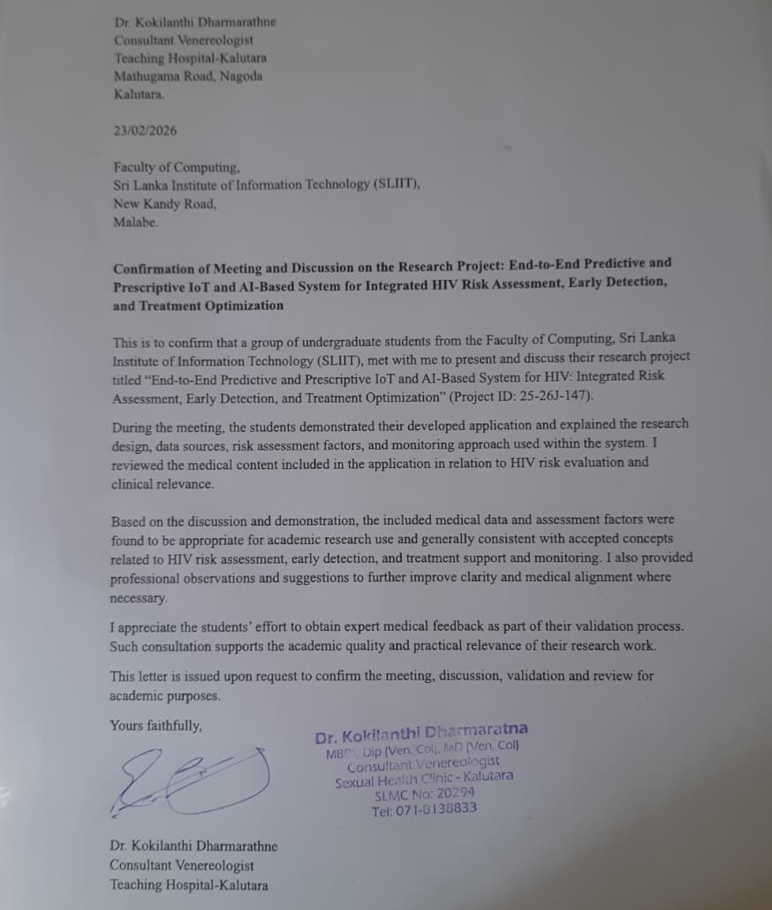
Letter of Clinical Validation
25-26J-147

