Slide 1



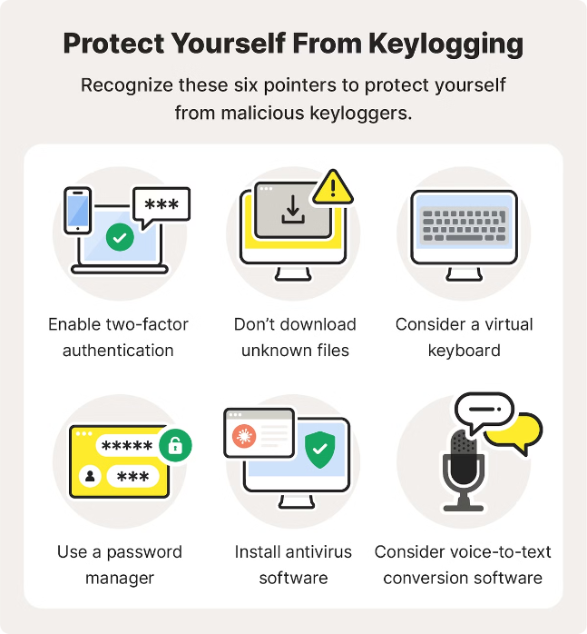

by Thrinadh Kakarla
What is a Keylogger?
A keylogger is a software application that records the user's keystrokes, including passwords, credit card numbers, and other sensitive information. Keyloggers are often used by cybercriminals to steal personal data, but they can also be employed for legitimate purposes, such as monitoring employee computer usage or troubleshooting technical issues.

Slide 2

Why use Python?
Python is a popular choice for building keyloggers due to its simplicity, cross-platform compatibility, and extensive library of tools and modules. Its high-level syntax and easy-to-learn nature make it an accessible language for both novice and experienced programmers.

Slide 3

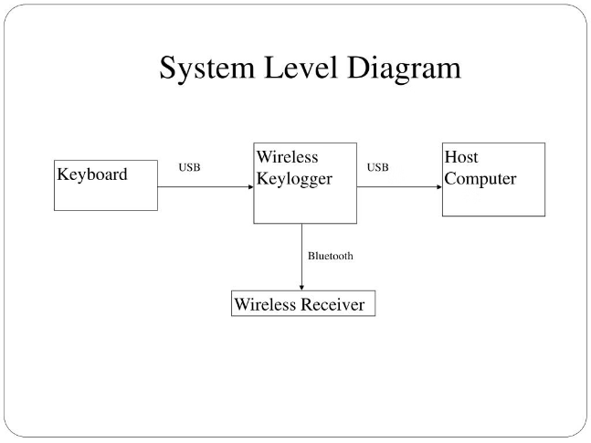
Basic Keylogger Structure
A keylogger, at its core, is a program that records keyboard input on a computer. The basic structure of a Python keylogger includes event listeners, input processing, and output mechanisms to capture and store the user's keystrokes.

Slide 4

Input Methods
A keylogger needs to capture user input, which can be done through various methods. The two main approaches are keyboard input and file input.

Slide 5



Keyboard Input
Real-Time Monitoring
Comprehensive Logging
Stealth Operation
The keylogger captures all keyboard inputs in real-time, including every keystroke, as the user types.
All recorded keyboard input is stored in a log file or database, providing a complete history of the user's activities.
The keylogger can run silently in the background without the user's knowledge, making it difficult to detect and remove.

Slide 6
File Input
Advantages
Implementation
Reading input from a file allows for more robust and dynamic data handling. It enables you to load pre-recorded keystrokes or actions, making the keylogger more flexible and versatile.
To implement file input, you'll need to open the file, read its contents, and process the data accordingly. This could involve parsing the file for specific patterns or events to log.

Slide 7
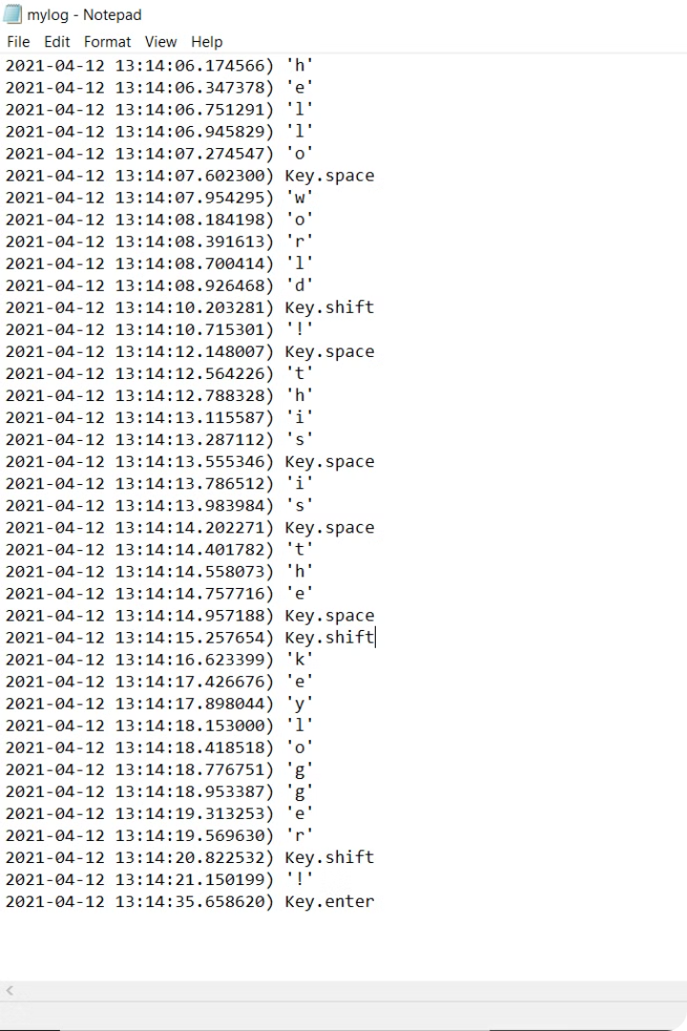
Output Methods
Once the keylogger has captured user input, it needs to store or transmit the data. There are two main output methods to consider: console output and file output.

Slide 8



Console Output
Real-Time Monitoring
Convenient Debugging
Immediate Feedback
The keylogger can continuously display the captured keyboard input on the console, providing real-time visibility into the user's actions.
Console output makes it easy to debug the keylogger and ensure it's functioning correctly, by allowing you to inspect the data as it is being collected.
Displaying the keystrokes on the console gives the user immediate feedback, which can be useful for testing and demonstration purposes.

Slide 9
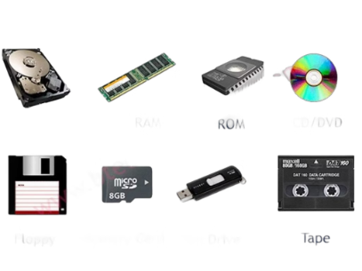
File Output
Logging to a File
Append vs. Overwrite
Write the captured keystrokes to a text file for later analysis. This allows the keylogger to operate discreetly without displaying output on the screen.
Decide whether to append new data to an existing log file or overwrite the file each time. Appending is useful for long-term monitoring.
Obfuscation
Consider encrypting or encoding the log file contents to prevent easy detection and reading by the user.

Slide 10
File Output
Write captured keystrokes to a text file for later analysis, allowing the keylogger to operate discreetly without displaying output on the screen.
Decide whether to append new data to an existing log file or overwrite the file each time. Appending is useful for long-term monitoring.
Consider encrypting or encoding the log file contents to prevent easy detection and reading by the user.

Slide 11

Conclusion
In conclusion, Python is an excellent choice for creating a robust keylogger application. Its simplicity, flexibility, and extensive libraries make it a powerful tool for capturing user input discreetly and effectively.

