Slide 1

Bank marketing campaign—Data Science
13-Aug-2021

Slide 2
Project details
Group Name: Thrinesh
Name: Thrinesh Duvvuru
Email: duvvuruthrinesh@gmail.com
Country: Germany
College/Company: Rosenheim university of applied sciences
Specialization: Data Science

Slide 3
Problem description
ABC Bank wants to sell its term deposit product to customers and before launching the product they want to develop a model which help them in understanding whether a particular customer will buy their product or not (based on customer's past interaction with bank or other Financial Institution).
GitHub repo : https://github.com/Thrinesh1200/EDA_presentation

Slide 4
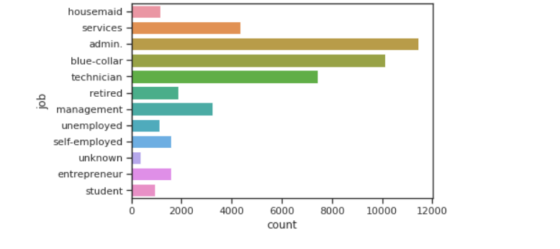
Exploratory Data Analysis
Admin jobs are more compared to all other jobs, blue-collar jobs being second highest.

Slide 5
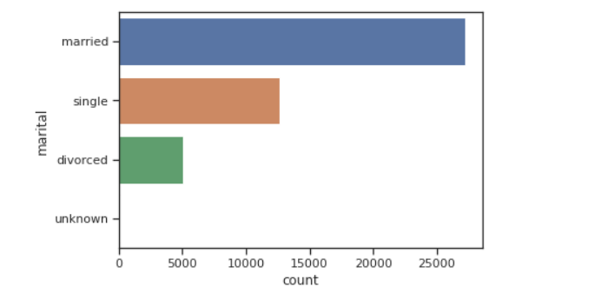
Exploratory Data Analysis
Married customers are more compared to others.

Slide 6
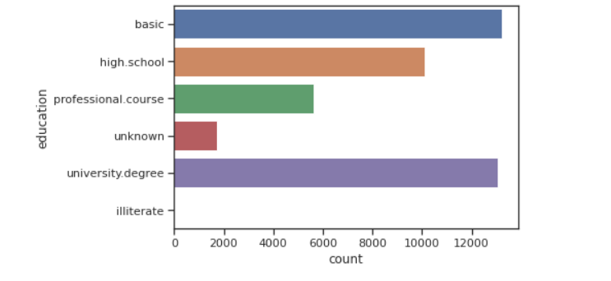
Exploratory Data Analysis

Slide 7
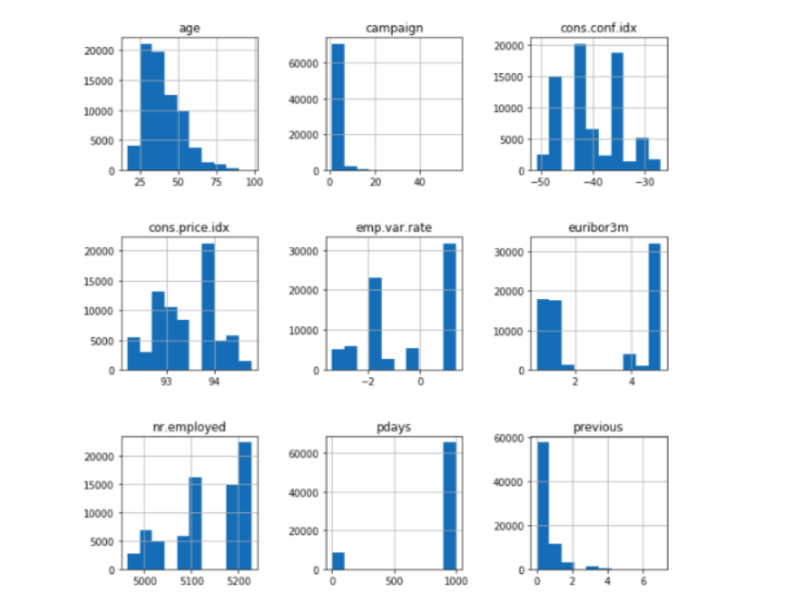
Exploratory Data Analysis

Slide 8
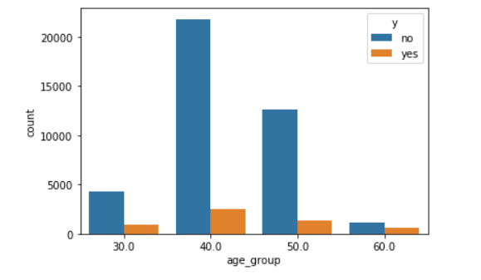
Exploratory Data Analysis

Slide 9
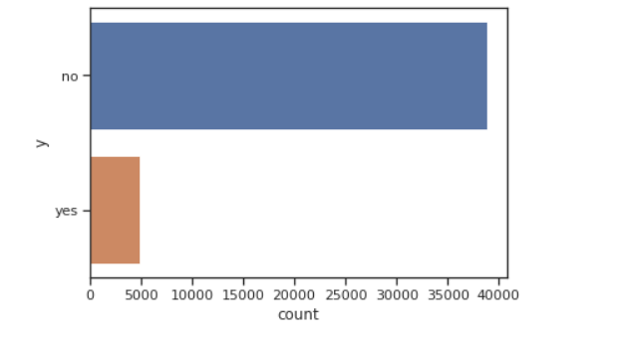
Exploratory Data Analysis
It is clear that , people who deposited in the bank is very less compared to those who did not.

Slide 10
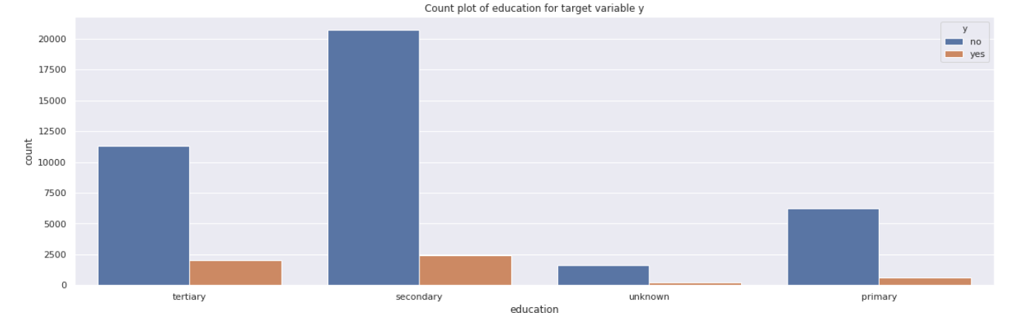
Exploratory Data Analysis
Most of the people who are contacted have tertiary or secondary education.

Slide 11
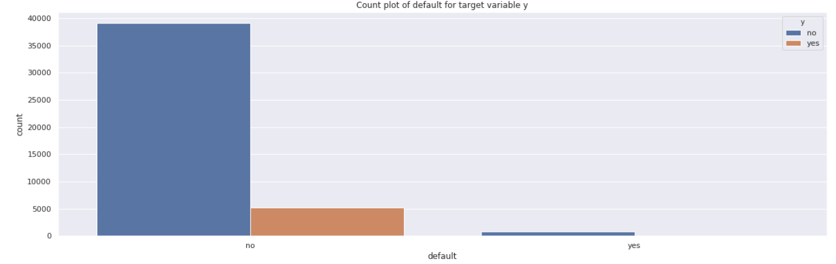
Exploratory Data Analysis
Very few clients are contacted who are defaulter.

Slide 12
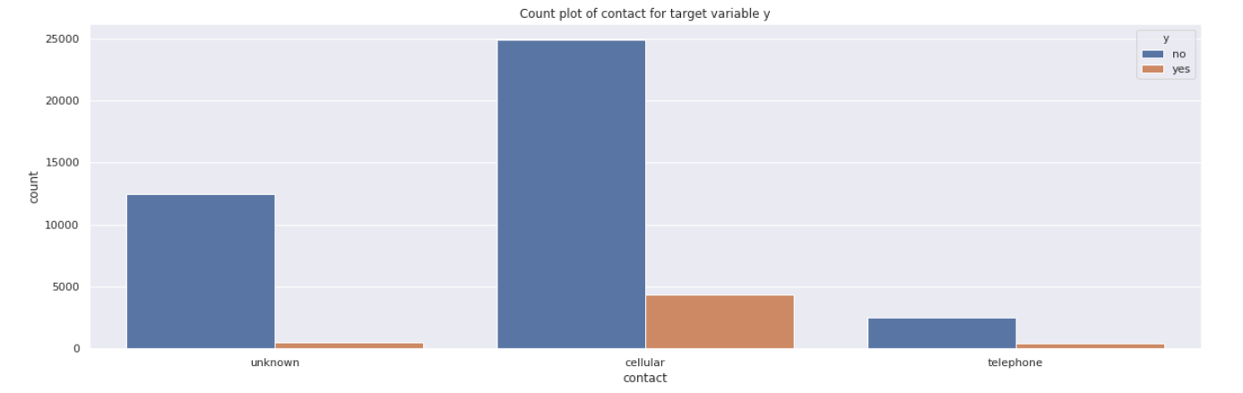
Exploratory Data Analysis
Most of the people are contacted through cellular.

Slide 13
Recommended Models
LogisticRegression
KNeighborsClassifier
DecisionTreeClassifier
GaussianNB
Support vector machine
RandomForestClassifier
AdaBoostClassifier

Slide 14
Accuracy for Training Data
MODEL | ACCURACY (%)
LogisticRegression | 90.35
KNeighborsClassifier | 89.59
DecisionTreeClassifier | 87.59
GaussianNB | 89.76
Support vector machine | 90.23
RandomForestClassifier | 90.43
AdaBoostClassifier | 89.90
Logistic Regression obtained the highest accuracy with lesser runtime and is more stable in the results. Even SVM and Random Forest obtained the similar accuracy but have higher runtime compared to Logistic Regession.

Slide 15
Confusion matrix
1. Logistic Regression
Actual Values
 | Positive | Negative
Positive | 9611 | 126
Negative | 954 | 246
Predicted Values
Accuracy: 90.12%

Slide 16
Confusion matrix
2. Random Forest Classifier
Actual Values
 | Positive | Negative
Positive | 9624 | 113
Negative | 957 | 243
Predicted Values
Accuracy: 90.21%

Slide 17
Conclusion
The objective of this case study was to predict whether a customer will subscribe to a term deposit or not given the data of the customer.
There are lot of categorical variables and some numerical variables which capture various information about the customer and the bank-customer relationship.
There are no null values for the data, and the data is imbalanced, where “no” is the majority class.
After implementing all the models, Logistic Regression obtained the highest accuracy with lesser runtime and is more stable in the results.
Random Forest obtained the similar accuracy but have higher runtime compared to Logistic Regession.

Slide 18
Thank You

