Slide 1

G2M INSIGHT FOR
CAB INSVESTMENT FIRM
Virtual Internship
26-Jun-2021

Slide 2
Background
Overview
XYZ is a private firm in US. Due to remarkable growth in the Cab Industry in last few years and multiple key players in the market, it is planning for an investment in Cab industry and as per their Go-to-Market(G2M) strategy they want to understand the market before taking final decision.
Project delivery:
We have been provided with multiple data sets that contains information on 2 cab companies. Each file (data set) provided represents different aspects of the customer profile. XYZ is interested in using your actionable insights to help them identify the right company to make their investment.
Data Set:
We have been provided 4 individual data sets. Time period of data is from 31/01/2016 to 31/12/2018.Below are the list of datasets which are provided for the analysis:
Cab_Data.csv – this file includes details of transaction for 2 cab companies
Customer_ID.csv – this is a mapping table that contains a unique identifier which links the customer’s demographic details
Transaction_ID.csv – this is a mapping table that contains transaction to customer mapping and payment mode
City.csv – this file contains list of US cities, their population and number of cab users

Slide 3
Data Exploration
All 4 files are in .csv format.
Data cleaning and Exploratory data analysis has been done in Jupyter Notebook.
All four files are merged according to their references.
The feature “Date of Travel” in Cab_data.csv was in Epoch format and has been converted into “Date time format”
It is assumed that Time period of data is from 31/01/2016 to 31/12/2018 and analysis has been done to recommend
XYZ firm to invest on best cab company.
Cab_Data.csv
Customer_ID.csv
Transaction_ID.csv
City.csv
Final cab data

Slide 4
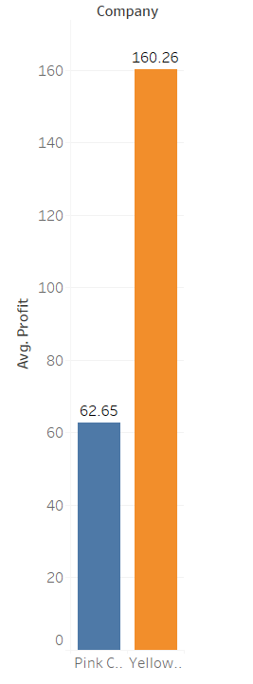
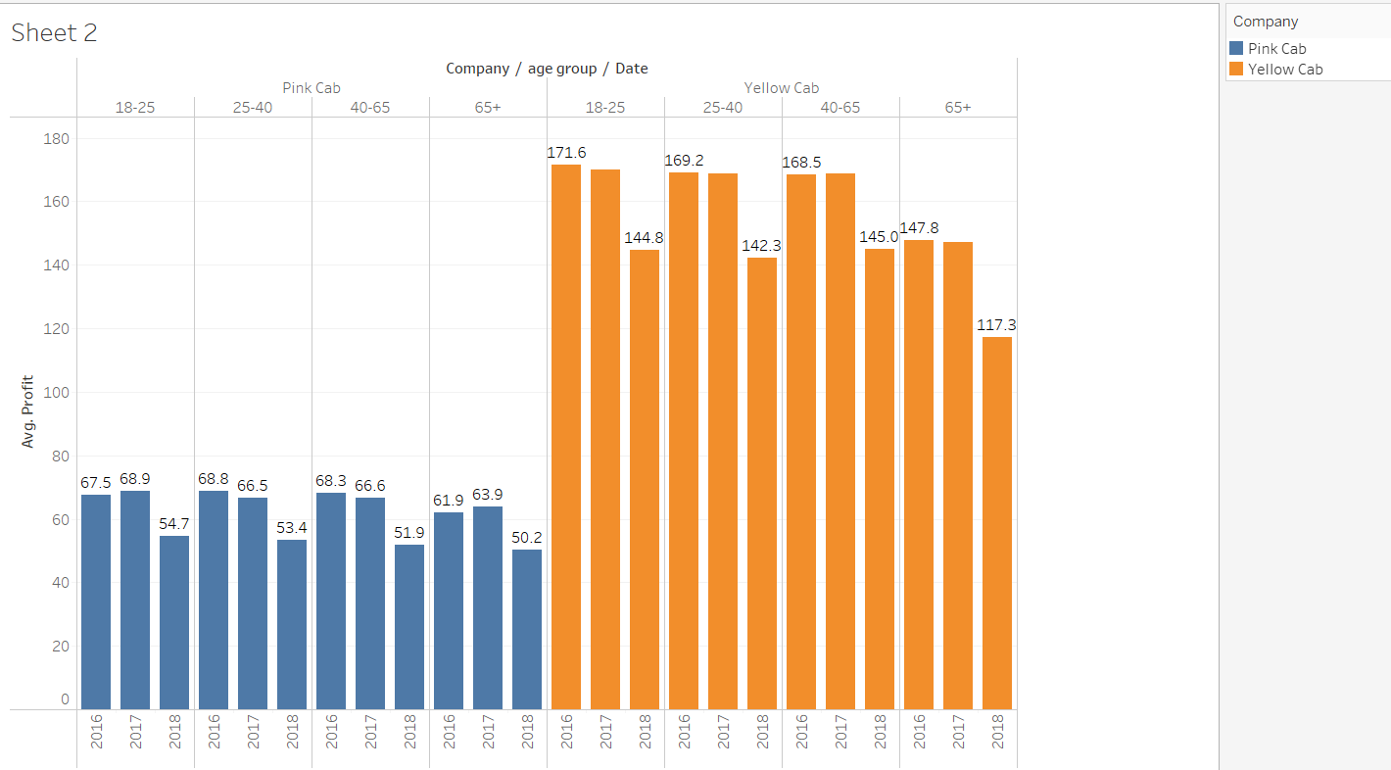
Profit Analysis
Profit Analysis
The average profit value for Yellow cab is more than that of Pink cab.
Cab name | Average profit(M USD)
Pink Cab | 62.65
Yellow Cab | 160.26

Slide 5

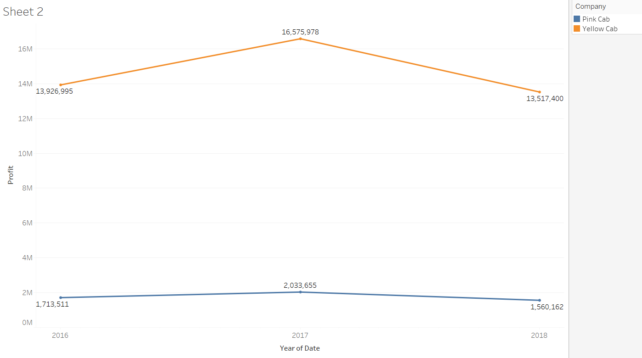
Profit Analysis
Yearly Profit Analysis
Both companies recorded highest
profit in the year 2017.
In all the three years, Yellow cab has more profit than pink cab.

Slide 6
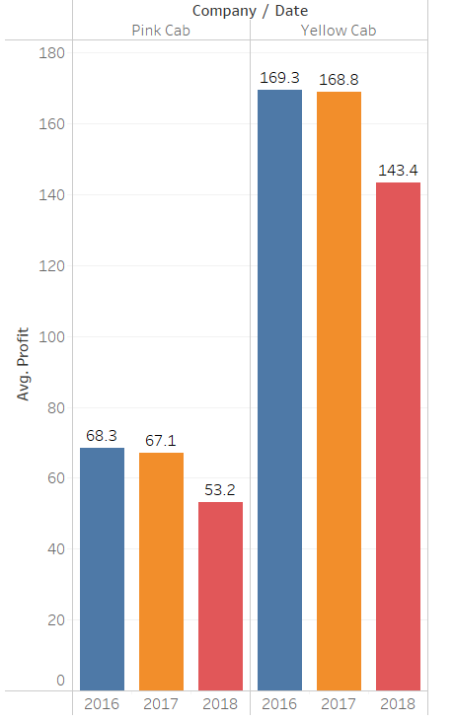
Profit Analysis
Average yearly Profit per ride
There is a decrease in average profit per ride year by year in both cab companies.
In all the three years, Yellow cab has more average profit value than pink cab.

Slide 7
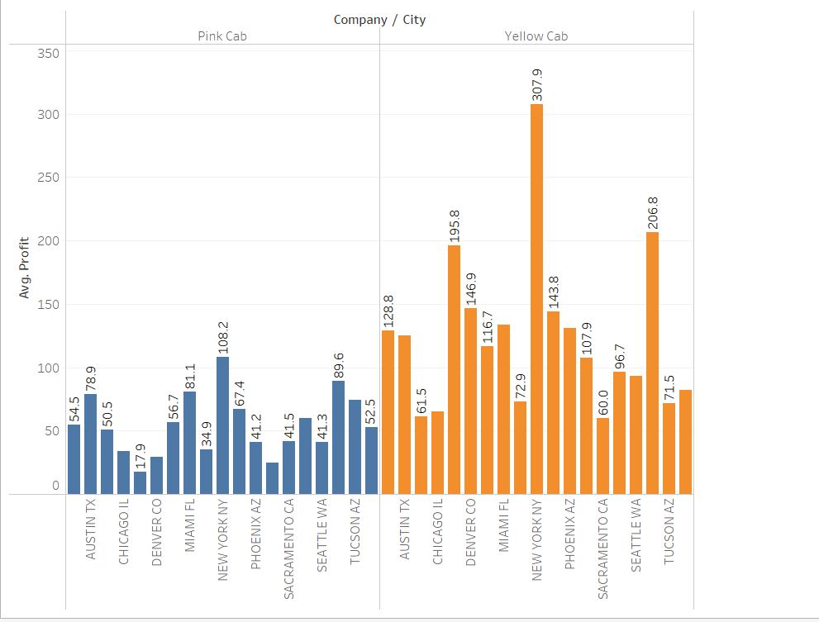
Profit Analysis
City Wise Profit Analysis
The average profit value of Yellow cab is more in almost every city than that of Pink cab.
For both the companies the highest average profit value is in New York city.

Slide 8
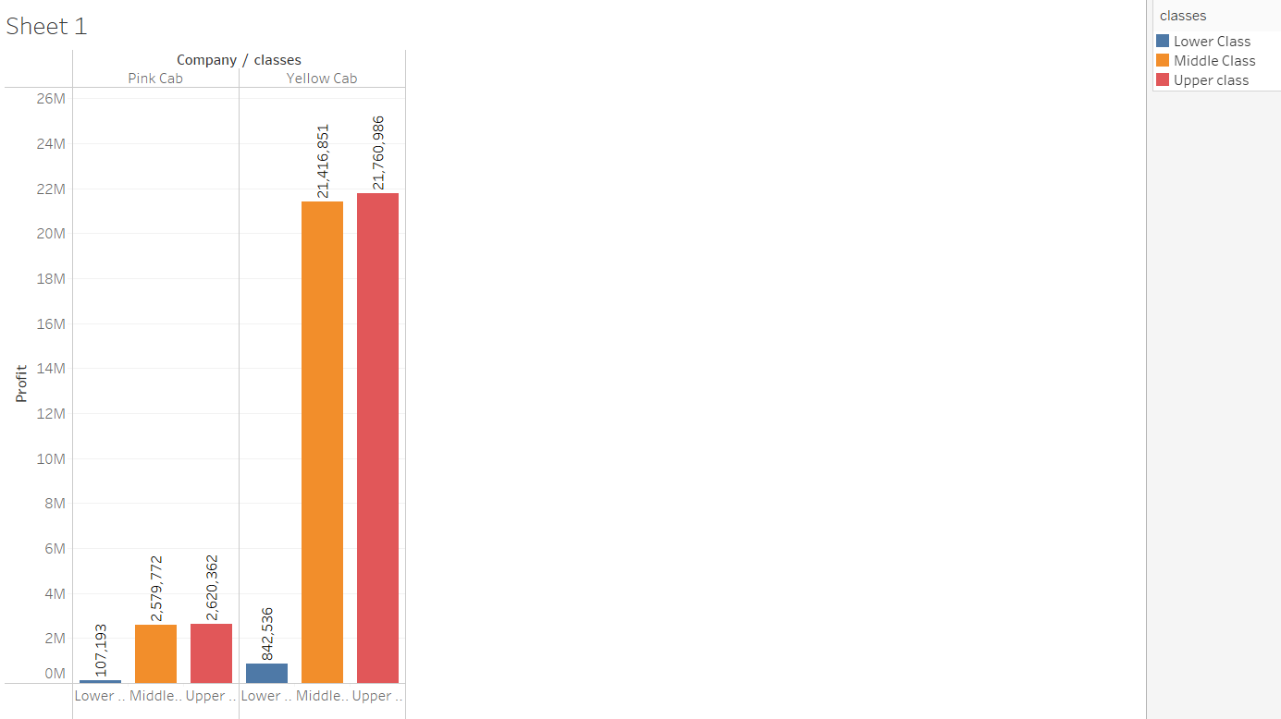
Profit Analysis
Profit Analysis based on Income
Middle and upper classes contributed more to the profit compared to lower class for both the companies.
Total profit by Middle and Upper classes is more in Yellow cab compared to Pink cab.

Slide 9
Profit Analysis
Profit Analysis based on age group
Every year , average profit based on age groups is almost same in both the companies except for 65+ age group in Yellow Cab.
On the whole, the average profit based on age group is more in Yellow Cab.

Slide 10
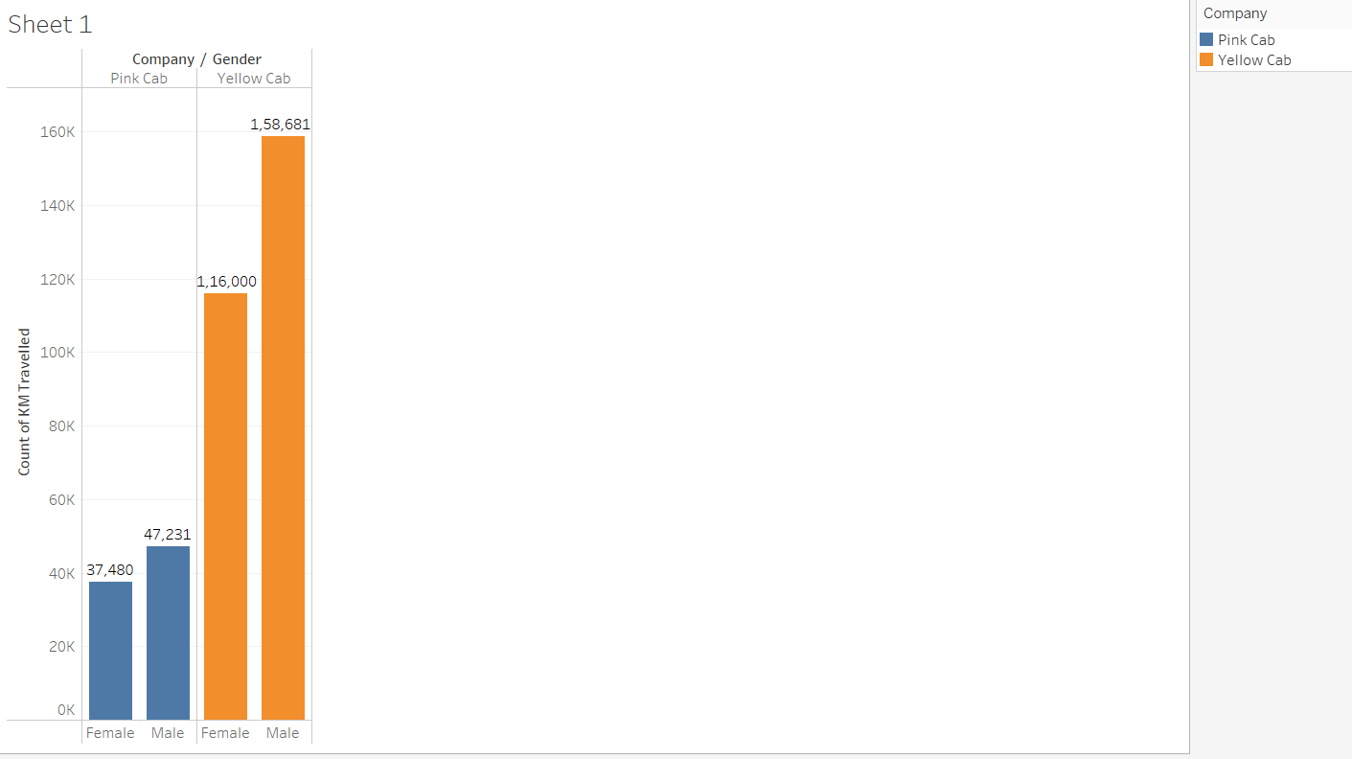
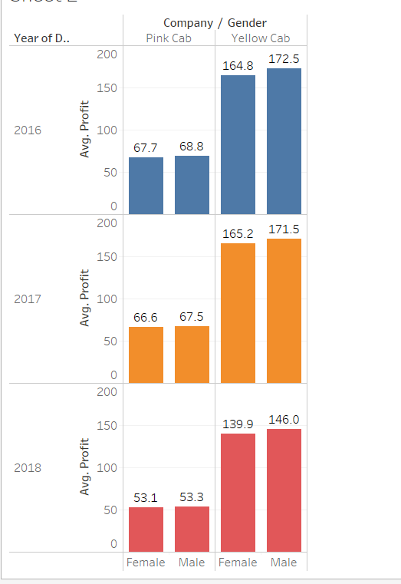
Profit Analysis
Profit Analysis based on gender
In both the companies, Male users are higher.
In every year, the average profit based on gender is almost similar for both the genders in each company.
Overall, Yellow Cab has higher average profit compared to Pink Cab.

Slide 11
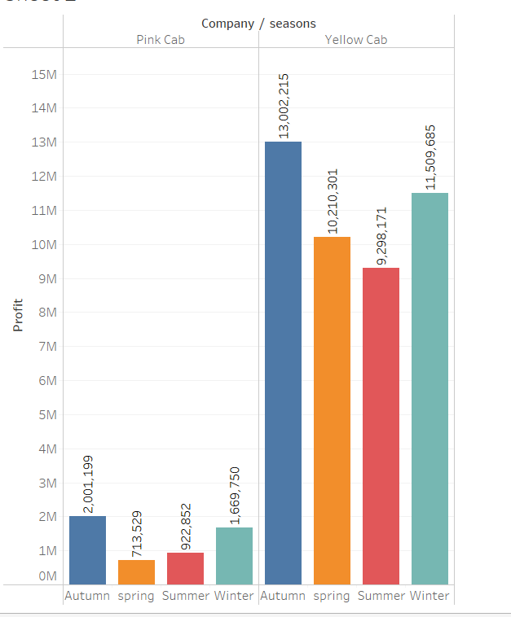
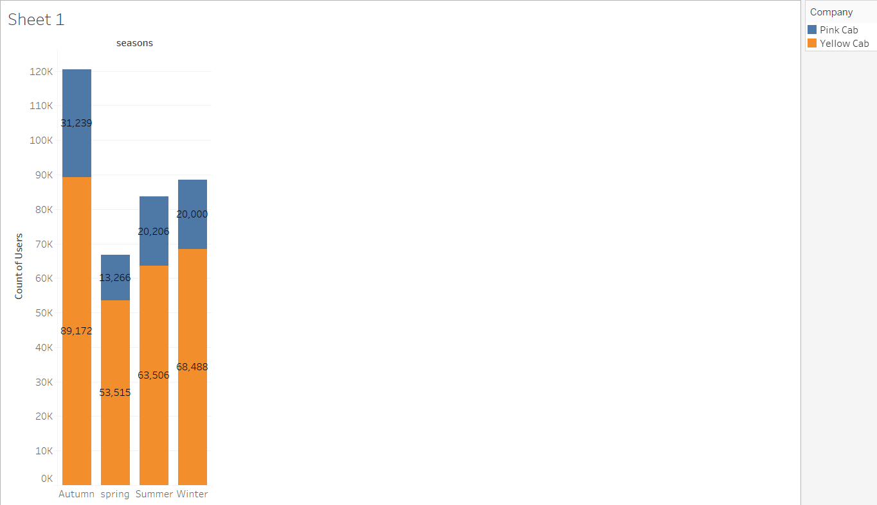
Profit Analysis
Season wise Profit Analysis
In all the four seasons, Yellow Cab users are more than Pink Cab users.
In both the companies, there are higher number of users in Autumn season.
Both the companies have the maximum profit in Autumn season.
Yellow Cab out numbered Pink Cab in terms of profit in all the four seasons.

Slide 12
Recommendations
From the above analysis it is very clear that "YELLOW CAB" outperformed "PINK CAB" in almost every aspects, and it is strongly recommended to XYZ company to invest on "YELLOW CAB“.

Slide 13
Thank You

