Slide 1





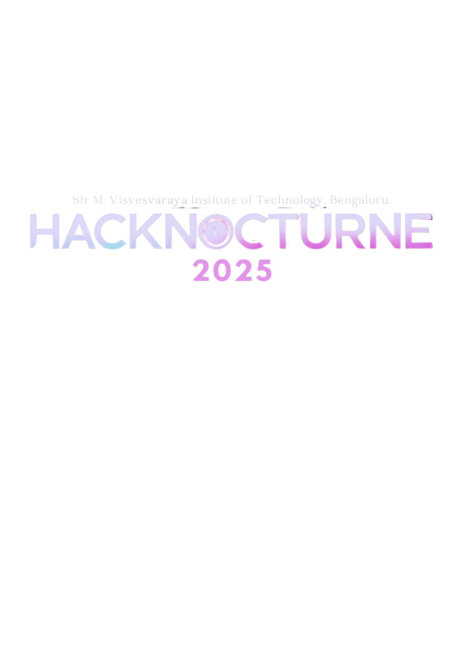
SRI KRISHNADEVARAYA EDUCATIONAL TRUST
SIR M. VISVESVARAYA INSTITUTE OF TECHNOLOGY
(Affiliated to VTU-Belagavi, Recognized by AICTE and Accredited by NAAC)
Krishnadevarayanagar, Off Kempegowda International Airport Road, Hunasamaranahalli, Bengaluru – 562 157
PROJECT PRESENTATION
28&29 TH MARCH 2025
PROBLEM STATEMENT: Teenagers often struggle with managing their finances, lacking tools tailored to their unique needs, such as tracking allowances, part-time income, and educational expenses
TEAM ID : 418
TEAM NAME : CodeTechieJ (Reboot_Rebels)

Slide 2

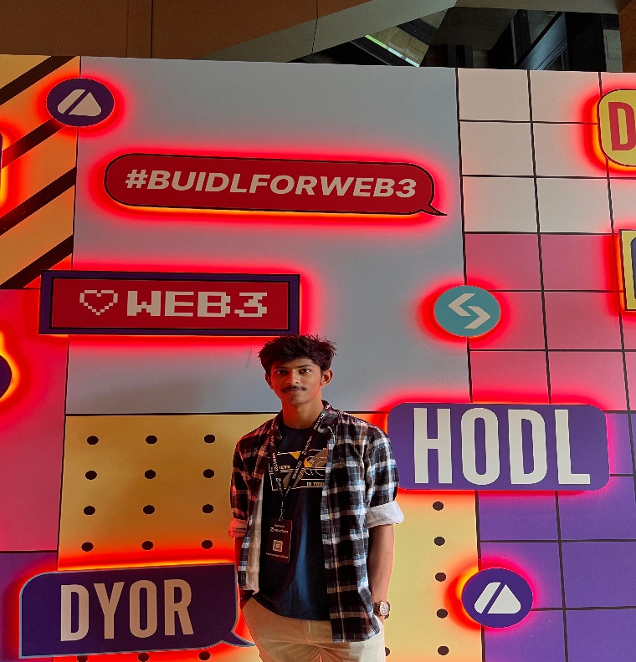

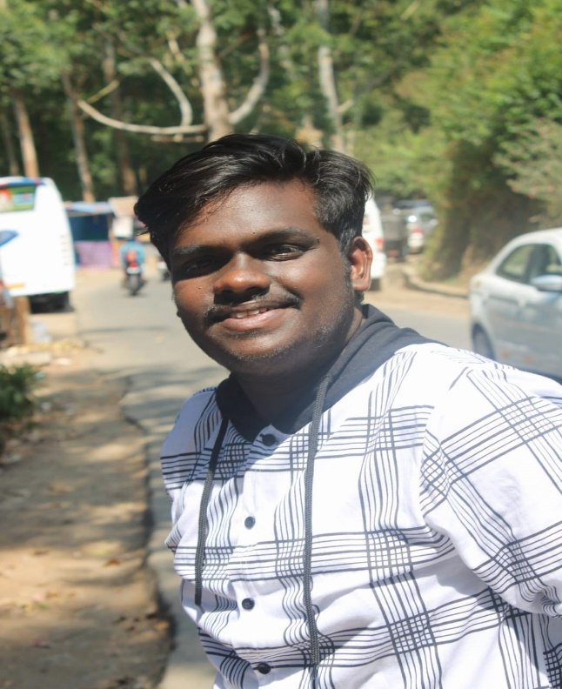
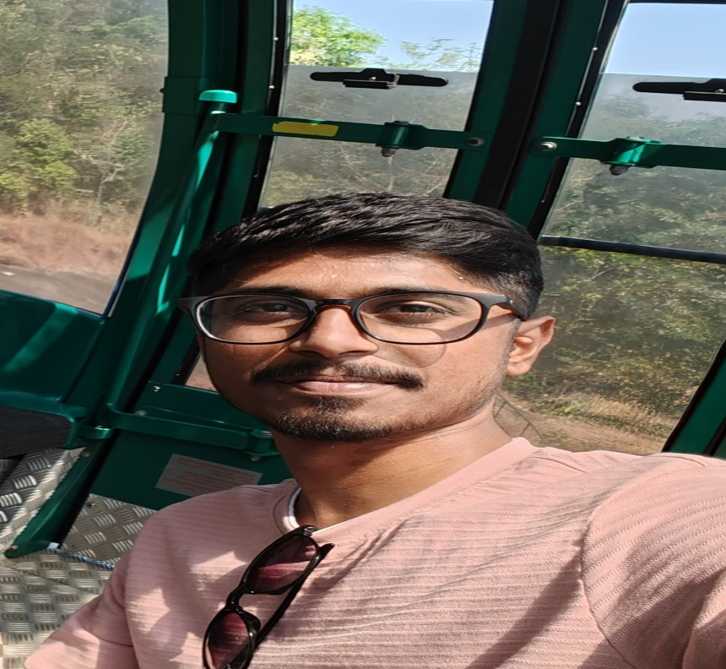
Our Team
AV Thrinesh
Vinay Sai
Suraj Nayaka H M
GJ Goutham

Slide 3


IDEA TITLE
Problem Statement (Idea/Solution):
Detailed Explanation :
How It Addresses the Problem:
Teenagers often struggle with managing their finances, lacking tools tailored to their unique needs, such as tracking allowances, part-time income, and educational expenses. This project aims to develop a budgeting dashboard designed specifically for teenagers, enabling them to build healthy financial habits from a young age.
Our budgeting tool provides an intuitive platform for teenagers to manage their finances, set savings goals, and track expenses. Key features include:
Recurring Transactions & Bill Reminders
Savings Goals & Progress Tracking
Expense Trends & Analysis
Income Prediction & Budget Forecasting
Expense Categorization & Filtering
The tool simplifies financial management by automating recurring expenses, visualizing spending patterns, and setting savings targets. It empowers teenagers to make informed financial decisions and plan for the future.
Innovation and Uniqueness of the Solution: Unlike generic budgeting apps, our solution tailors features specifically for teenagers, using interactive visual indicators, personalized insights, and easy-to-understand interfaces. This approach encourages responsible financial habits from a young age, preparing them for real-world financial management.

Slide 4

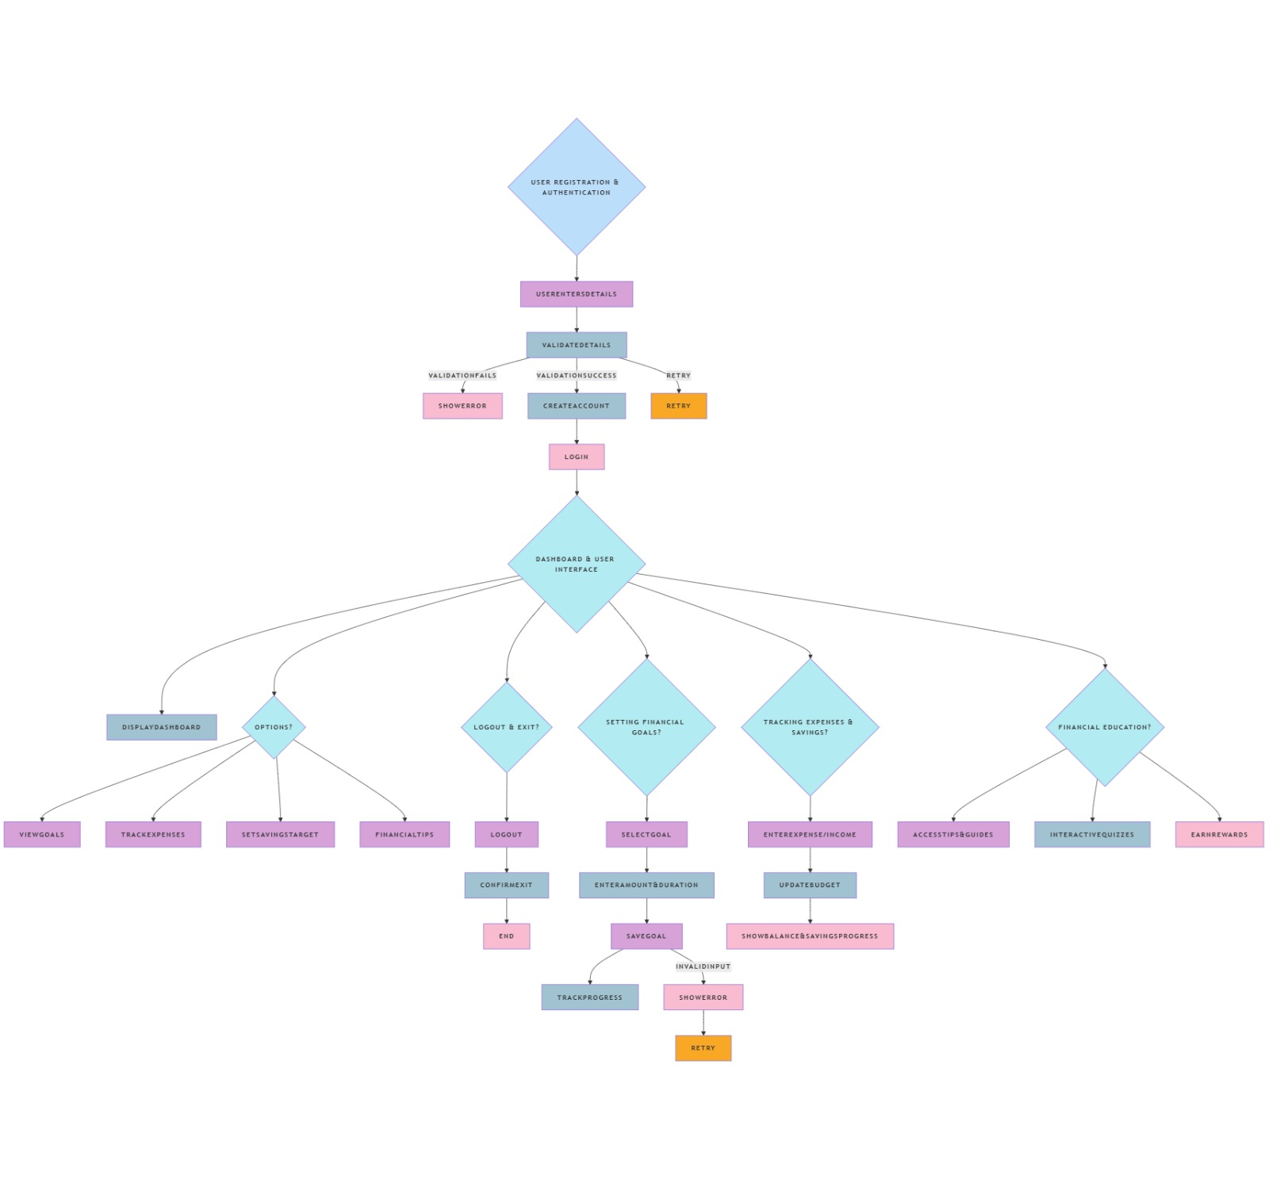
TECHNICAL APPROACH
01
TECHNOLOGIES USED
Software: Python, Django, React Native, Firebase
Programming Languages: Python, JavaScript, HTML, CSS
Frameworks: Django, React Native, Tailwind CSS
02
METHODOLOGY
Start ➡️ User Login/Registration
User selects the role: Farmer or Buyer
Farmers can:
Create contract offers
Set prices and conditions
View ongoing contracts
Buyers can:
Browse contract offers
Negotiate terms
Confirm contracts
Contract Agreement:
Digital signing
Store contract details in the database
Notifications and Reminders:
Payment due alerts
Contract renewal notifications
End

Slide 5

FEASABILITY & VIABILITY
Feasibility & Viability Analysis
Assessing the feasibility of the idea
Analyzing potential challenges and risks
Developing strategies to overcome challenges
Potential Challenges & Risks
Lack of financial literacy among teens
Privacy and security concerns
Resistance to adopting financial habits
Strategies to Overcome Challenges
Interactive and engaging financial education
Robust data security measures
Incentives for consistent usage

Slide 6
POTENTIAL BENEFITS AND IMPACTS
SOCIAL
ECONOMICAL
ENVIRONMENTAL
Promotes financial literacy and responsibility among teens.
Builds confidence in managing personal finances.
Reduces financial stress and enhances decision-making skills.
Encourages saving habits from a young age.
Increases financial independence and future stability.
Supports long-term economic growth by fostering responsible spending.
Promotes digital payments and reduces paper usage.
Supports sustainable finance initiatives.
Encourages eco-friendly financial habits.

Slide 7


RESEARCH AND REFERENCES
DEATAILS AND LINKS OF REFERENCES AND RESEARCH WORK
Research Papers and Articles:
1. National Strategy for Financial Education 2023
Published by: Ministry of Finance, India
Link: www.finmin.gov.in/national-financial-education
2.Financial Literacy and Education for Teens: A Global Perspective:
Author(s): John Doe, Emily Smith
Published in: Journal of Youth Studies
Link: www.examplejournal.com/financial-literacy-teens
3.Empowering the Next Generation: The Importance of Financial Literacy for Teens:
Author(s): David Miller, Sarah Lee
Published in: International Journal of Finance
Link: www.financejournal.com/teen-financial-literacy

Slide 8
CONCLUSION
Enhanced Financial Awareness: The project successfully raised awareness among teenagers about the importance of financial literacy, enabling them to make informed financial decisions and manage their money effectively.
Practical Money Management Skills: It provided practical skills such as budgeting, saving, and investing, fostering responsible financial behavior and empowering teens to secure their financial future.
Long-term Financial Success: By equipping teens with essential financial skills, the project ensured they are better prepared to handle real-world financial challenges, paving the way for a financially stable and prosperous future.

Slide 9
THANK
YOU

