Slide 1




NEXT GEN EMPLOYABILITY PROGRAM
Creating a future-ready workforce
Team Members
Shanmuganathan engineering college
Student Name :THRISHA K
Student ID :au912421104052
SEC -9124
ARASAMPATTI,PUDUKKOTTAI

Slide 2

CAPSTONE PROJECT SHOWCASE
Project Title
Voting Web Application using Django Framework
Abstract | Problem Statement | Project Overview | Proposed Solution | Technology Used | Modelling & Results | Conclusion

Slide 3
Abstract: Django Online Voting System
Casting a ballot is a fundamental concept in our democratic structure. We consider voting to be one of the most essential rights in our society. The proposed e-voting system facilitates users in making their choices without physically visiting voting stations. This system leverages the power of the internet to enable eligible voters to cast their votes remotely.
Source :

Slide 4
Problem Statement
Develop a user-friendly voting application that allows users to create, share, and participate in polls on various topics. The application should provide features for creating multiple-choice questions, setting voting deadlines, and generating real-time results. It should prioritize accessibility, simplicity, and security to ensure a seamless voting experience for both creators and participants while safeguarding the integrity of the voting process.
Source :

Slide 5
Project Overview
Application name : Voting Application
Category :Web application
Features :
1)conduct polls with questions and multiple choices
2)Allow user to vote for their preferred choice
3)Display the votes for each questions
4)admin panel for adding and managing questions
Technologies Used:
Django Framework to create a backend and handle database :
SQLite Database Django come with sqlite by default
Source :

Slide 6
Proposed Solution
Project Setup:
Start a new Django project: django-admin startproject voting_app.
Create a new Django app for the voting functionality: python manage.py startapp vote.
Models:
Define models for your voting system. For example, you might have a Poll model to represent each poll and a Choice model to represent the choices for each poll.
.
Source :

Slide 7
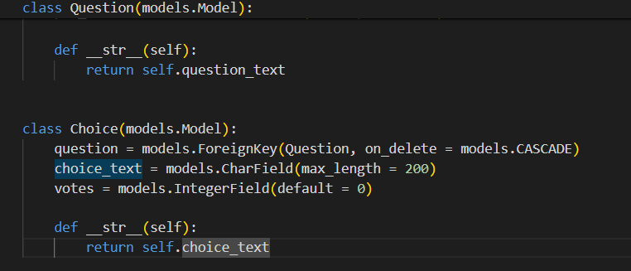
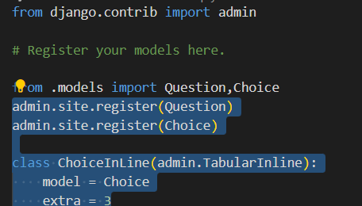
Models.py
Admin.py
Source :

Slide 8
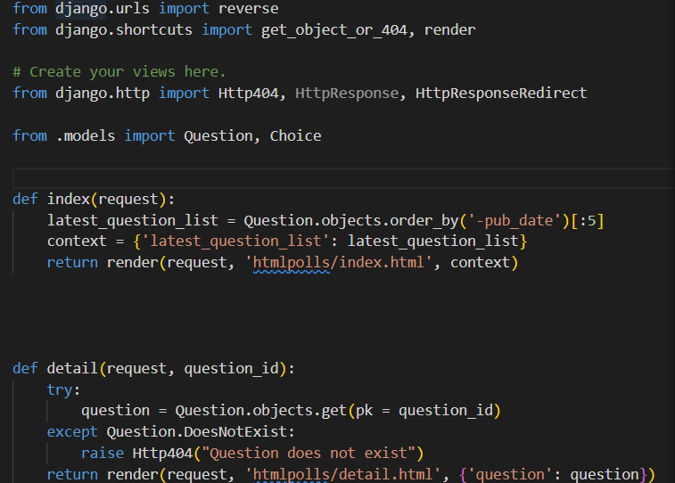
Views.py
Create view to handle displaying polls and submitting
votes
Source :

Slide 9


Technology Used
Front-end
Back-end
Source :

Slide 10
Modelling & Results
Project Setup:
Start a new Django project: django-admin startproject voting_app.
Create a new Django app for the voting functionality: python manage.py startapp vote.
Models:
Define models for your voting system. For example, you might have a Poll model to represent each poll and a Choice model to represent the choices for each poll.
Source :

Slide 11
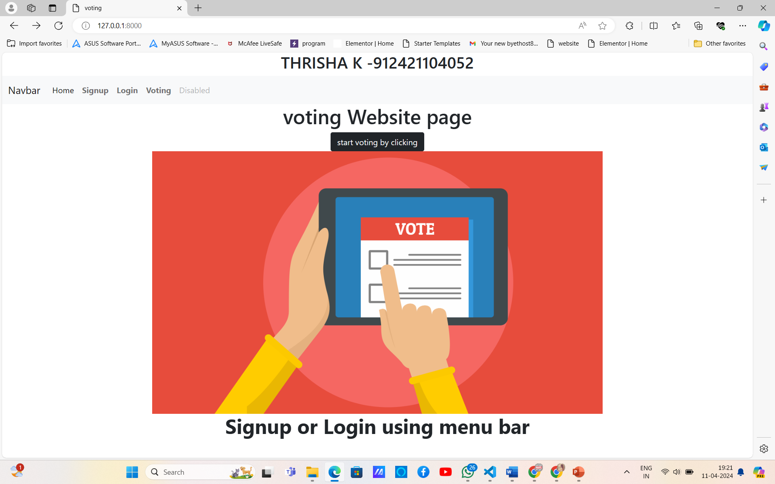
Homepage

Slide 12
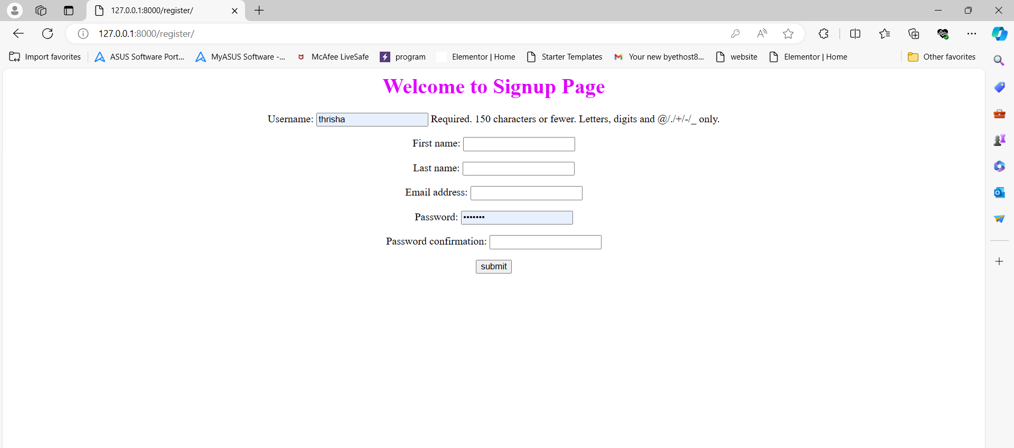
Signup Page

Slide 13
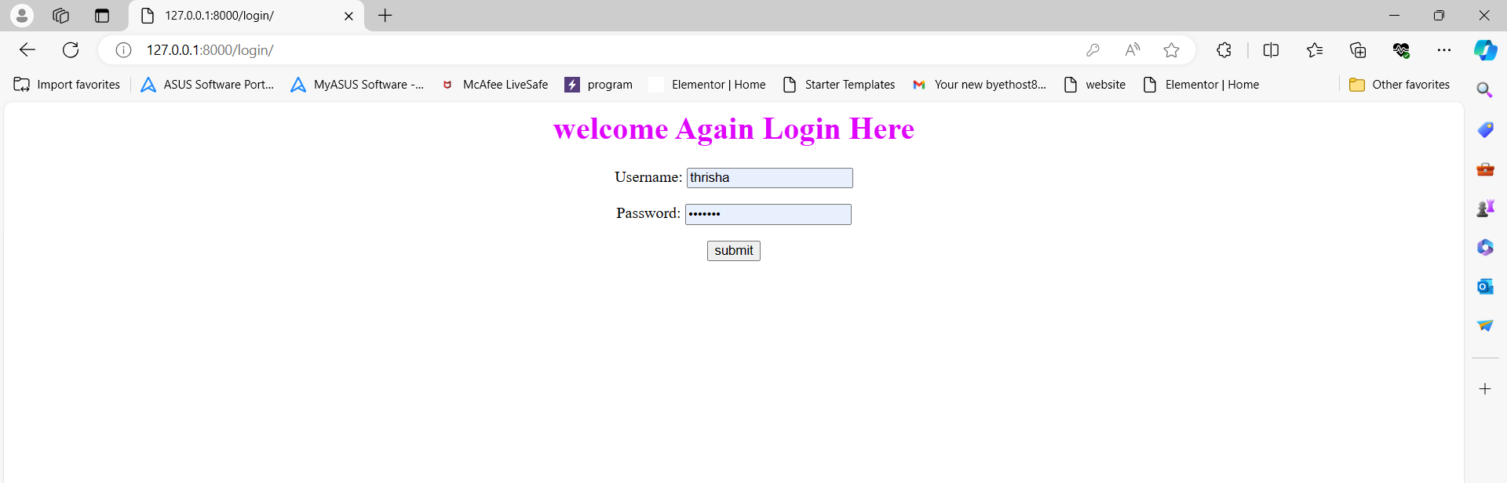
Login-Page

Slide 14
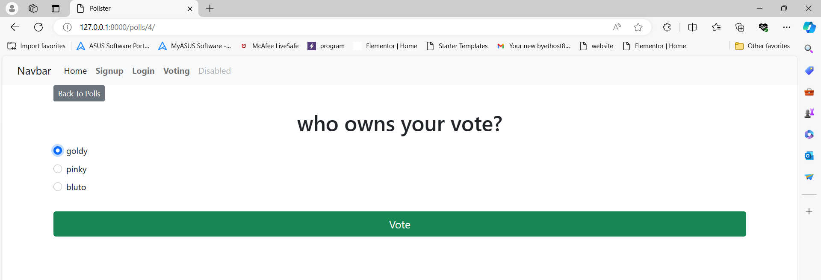
Voting-Page

Slide 15
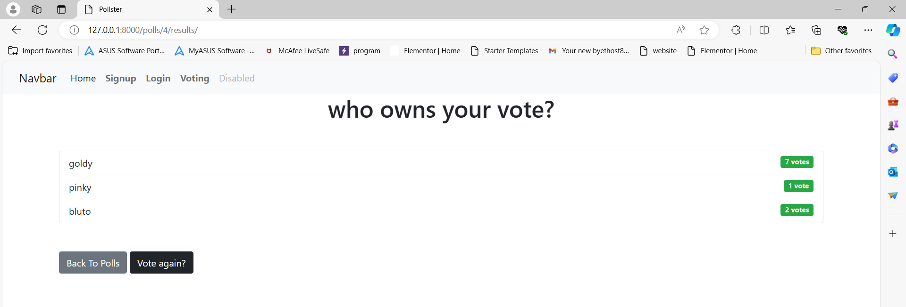
Voting-Result-Page

Slide 16
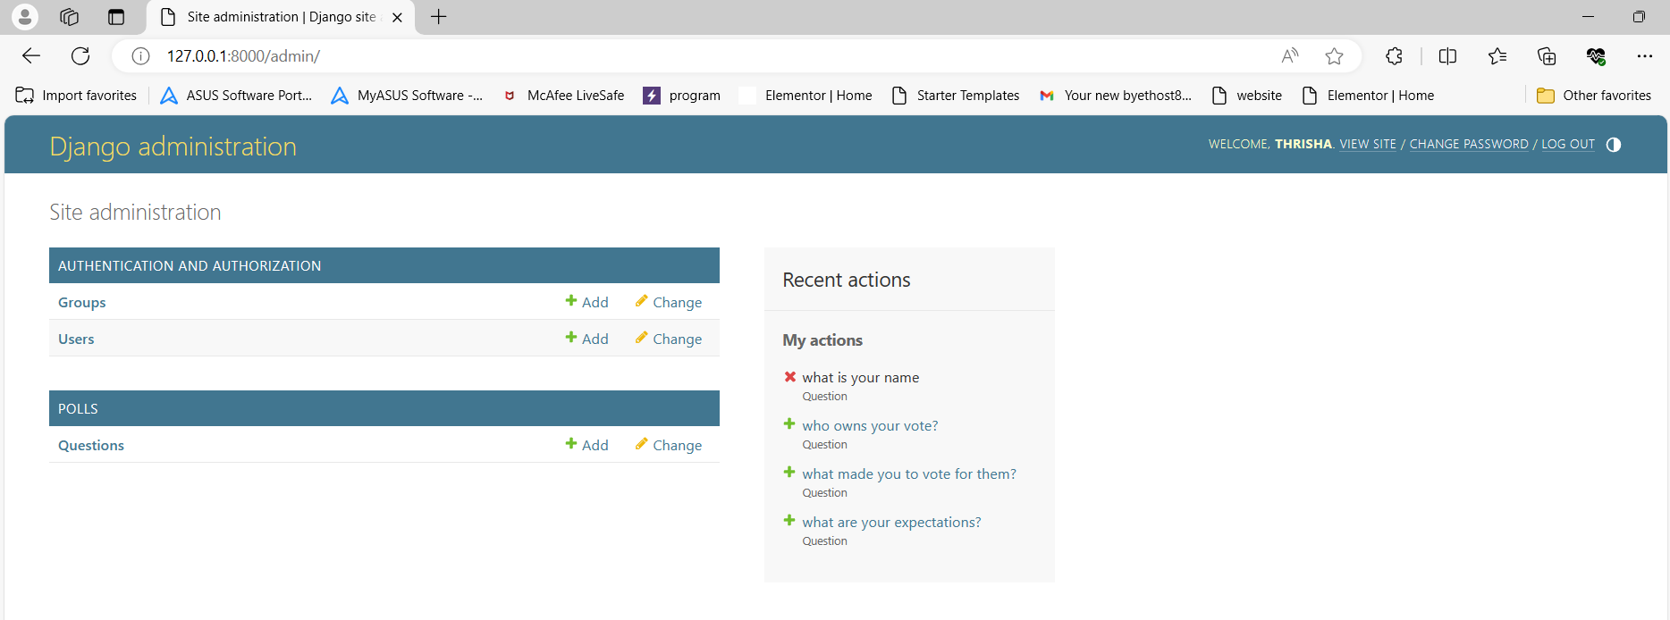
Admin-Page

Slide 17
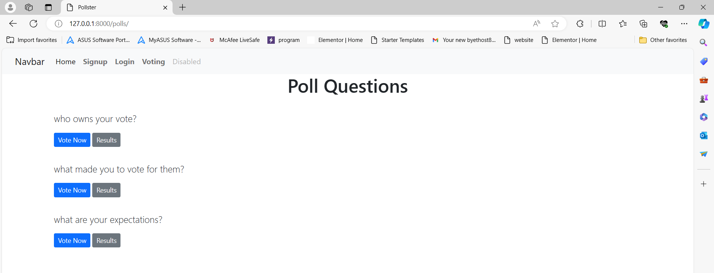
Voting-Polls-Page

Slide 18
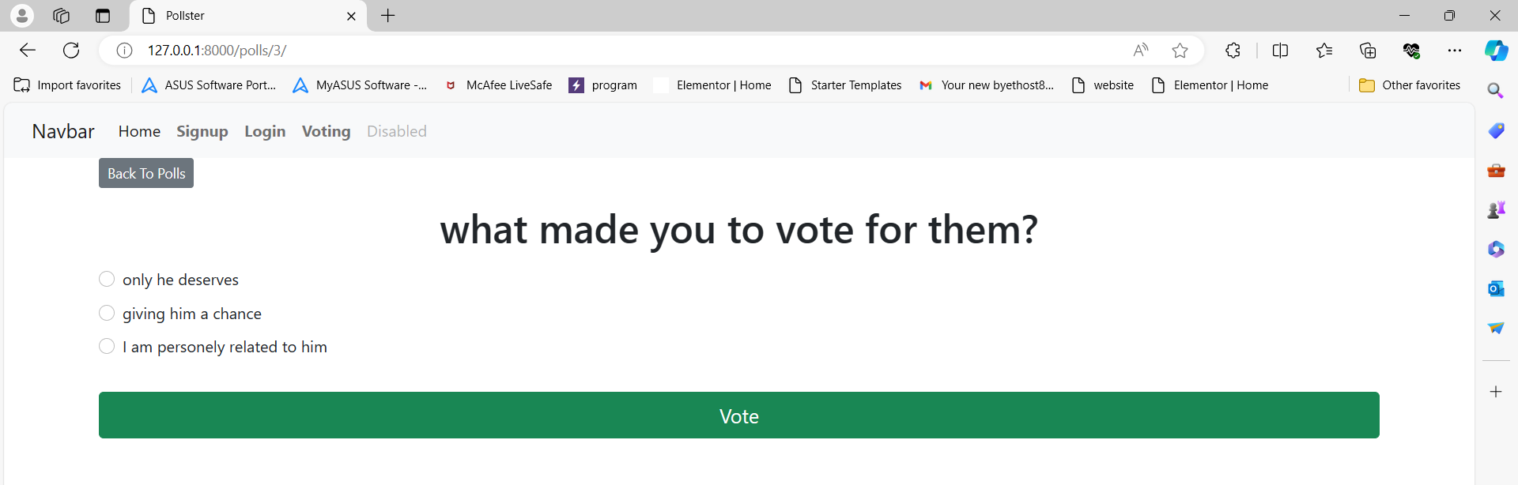
Options-Page

Slide 19
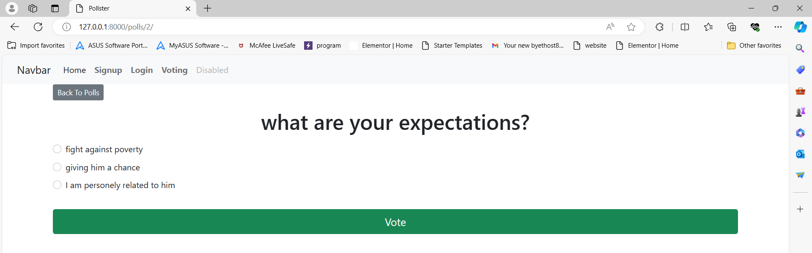
Options-Page

Slide 20
.
Future Enhancements:
User Authentication:
Implement user authentication to allow only registered users to vote.
Associate each vote with a user to prevent duplicate voting.
Multiple Choice Options:
Allow users to select multiple choices for a single poll.
Implement validation to ensure users do not exceed the allowed number of choices.
Real-Time Updates:
Use WebSockets or server-sent events to provide real-time updates of poll results without requiring page refreshes.
Improved UI/UX:
Enhance the user interface with modern design principles and responsive layouts.
Implement client-side validation for a smoother user experience. polls.

Slide 21
Conclusion
In conclusion, the Django voting application offers a comprehensive solution for conducting polls with various advanced features to enhance user experience and functionality. By leveraging Django's powerful framework, along with modern frontend technologies and third-party services, we've created a robust platform for managing polls and engaging users.
With user authentication in place, only registered users can vote, and each vote is associated with a specific user, preventing duplicate voting. The application allows users to select multiple choices for a single poll, with validation ensuring they do not exceed the allowed number of choices. Real-time updates are facilitated through WebSockets or server-sent events, providing users with instant feedback on poll results without requiring page refreshes.
Source :

Slide 22
Thank You!
Notes:
Thank You !!

