Slide 1


Marimuthu Thrisha Devi
NMID: BBCF024501D292398974443CE44E87F9
Madras Institute of Technology campus, Anna University
1

Slide 2

PROJECT TITLE
Attendance Automation using CNN
3/21/2024 Annual Review
2

Slide 3



AGENDA
Develop and integrate a facial recognition system using CNN to accurately identify individuals from a database of facial images.
Implement a system to log attendance based on facial recognition results and add the attendance to a csv file with timeframe.
3/21/2024 Annual Review
3

Slide 4
PROBLEM STATEMENT
In many educational and organizational settings, manual attendance tracking processes are labor-intensive, time-consuming, and prone to errors.
To address these challenges, we propose the development of an Automated Attendance System using Convolutional Neural Networks (CNNs).
Tackling the shortcomings of traditional attendance systems through the creation of an Automated Attendance System powered by (CNN), aimed at enhancing accuracy, efficiency, and security in monitoring attendance.
3/21/2024 Annual Review
4

Slide 5



PROJECT OVERVIEW
STEP 1
STEP 2
STEP 3
STEP 4
FINDING ALL THE FACES
POSING AND PROJECTING FACES
ENCODING FACES
FINDING THE PERSON’S NAME
To find faces in an image, we’ll start by making our image black and white. Then we’ll look at every single pixel in our image one at a time.
We are going to use an algorithm called face landmark estimation. The basic idea is we will come up with 68 specific points (called landmarks) that exist on every face.
This process of training a convolutional neural network to output face embedding requires a lot of data and computer power. So we run our face images through their pre-trained network to get the 128 measurements for each face.
Now we have to do is find the person in our database of known people who has the closest measurements to our test image. We can do that by using any basic classification algorithm.
3/21/2024 Annual Review
5

Slide 6


WHO ARE THE END USERS?
01
02
03
Educational Institutions
Organizations
Event Organizers
HR Personnel: to manage employee attendance records and generate reports.
Managers/Supervisors: to track attendance of team members.
Event Staff: to monitor attendance at conferences, seminars, or workshops.
Event Planners: to manage attendee lists , ensure accurate participation records.
Teachers: to take attendance in classrooms.
School Administrators: to monitor attendance trends and manage student records.
3/21/2024 Annual Review
6

Slide 7

YOUR SOLUTION AND ITS VALUE PROPOSITION
Automated Attendance System using CNN
Accuracy and Reliability
Implement a facial recognition-based attendance system using Convolutional Neural Networks (CNN) to automate the attendance tracking process.
Utilize advanced facial recognition algorithms to accurately identify individuals from a database of facial images.
Integrate the system with existing attendance management systems or databases for seamless operation.
Ensure accurate attendance tracking through advanced facial recognition technology, minimizing errors associated with manual methods.
Provide a reliable solution for monitoring attendance in various environments, including classrooms, offices, and events.
Efficiency and Time Savings
Streamline the attendance tracking process, saving time for both administrators and users.
Reduce administrative workload by automating attendance logging and management tasks.
Real-time Processing and Logging
Enable real-time processing of video streams or static images to ensure timely attendance updates.
Log attendance data automatically, eliminating the need for manual recording and reducing administrative workload.
Provide a user-friendly interface for administrators to access and manage attendance records efficiently.
Enhanced Security
Implement robust security measures to protect facial data and prevent unauthorized access or misuse.
Ensure compliance with privacy regulations, safeguarding the privacy of individuals' facial information.
3/21/2024 Annual Review
7

Slide 8

THE WOW IN YOUR SOLUTION
Real-Time Accuracy
01
With facial recognition technology powered by CNN, the system can accurately identify individuals in real-time, eliminating the need for manual input and reducing errors to an unprecedented level.
Effortless Efficiency
02
Imagine walking into a classroom or office space and being automatically logged in within seconds, without any effort on your part. That's the power of this automated attendance system
Cutting-Edge Innovation
03
It's not just about automating attendance – it's about pushing the boundaries of what's possible with facial recognition technology.
3/21/2024 Annual Review
8

Slide 9
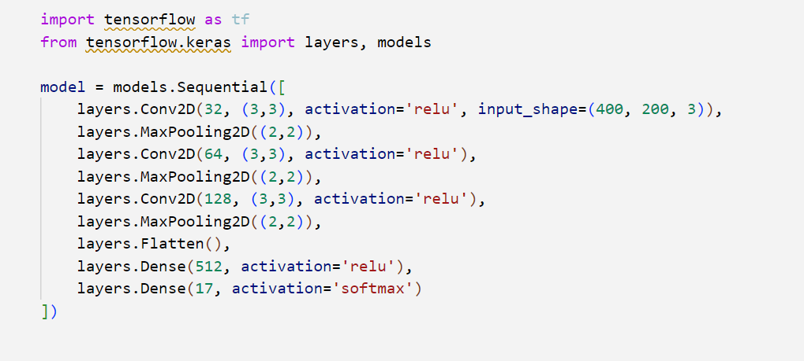
MODELLING
Building the neural network model:
Using Tensorflow and keras
3/21/2024 Annual Review
9

Slide 10
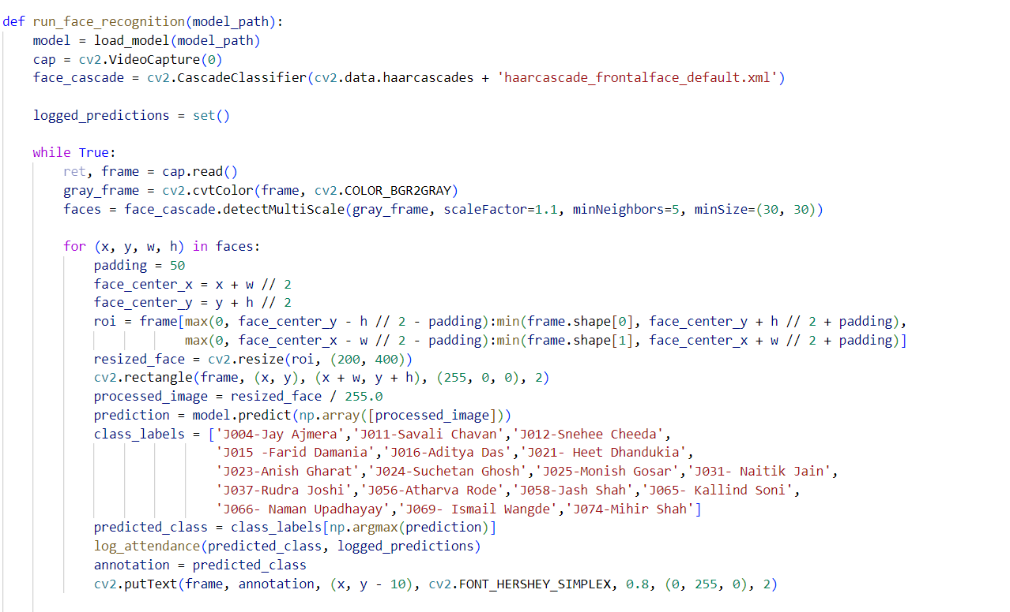
MODELLING
9

Slide 11
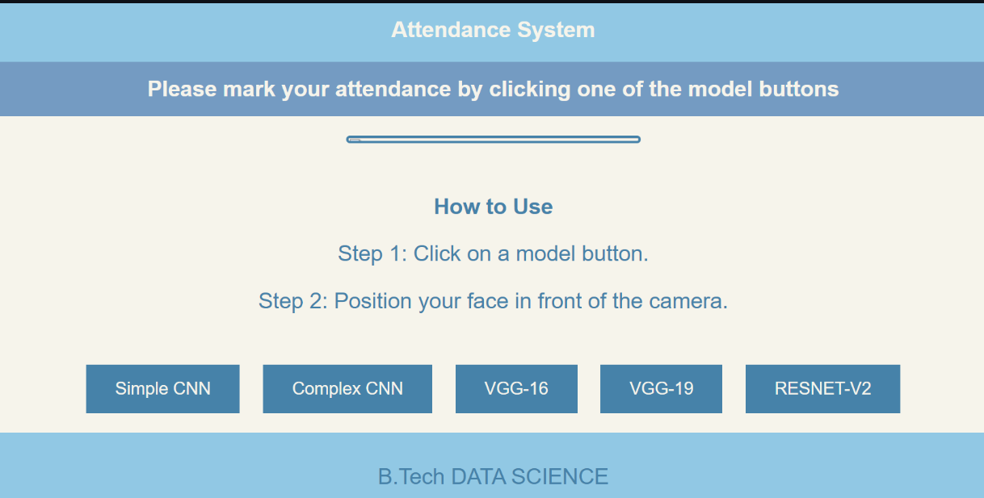
RESULT
Link :
https://github.com/Thrisha17/NM_GEN_AI
11

