Slide 1

SMART INDIA HACKATHON 2026
JalRakshak
Your Water. Your Village. Your Voice.
Problem Statement ID - SIH26255
Problem Statement Title - Development of a solution using AI and ML to monitor the functionality of FHTC in real time at both the Gram Panchayat and household levels. This solution should provide alerts on water quality issues, allow village members to give feedback through mobile devices, and automatically sync data with IMIS/Sujal Gaon IDs.
Organization - Ministry of Jal Shakti (MoJS)
Department - National Jal Jeevan Mission (NJJM), Department of Drinking Water & Sanitation (DDWS)
Theme - Clean & Green Technology
PS Category - Hardware
Team ID - 158724
Team Name - Team Vistaar

Slide 2






THE PROBLEM & OUR SOLUTION
Team Vistaar
THE PROBLEM
OUR SOLUTION: JALRAKSHAK
Found out too late
Problems surface through periodic reports and field inspections, by which time a tap may be dry for days
1
Continuous FHTC monitoring
sensor nodes on the pipeline + a daily villager tap check give household-level status, analysed with AI/ML
2
Real-time alerts
for supply disruption, water quality deterioration, low pressure, leakages and infrastructure failure
Disruptions nobody sees
Non-functional taps, intermittent supply, poor water quality, low pressure and failing pipes show up only when someone complains
3
Villagers speak up
feedback, complaints, photographs and geo-tagged observations from a phone, in local languages
Villagers have no easy voice
No quick way to report a dry tap, share a photo, or confirm that the water really came back
4
Early detection and prediction
AI/ML spots abnormal service patterns early, predicts failures and ranks maintenance
Data sits in separate places
Sensors, mobile apps, water-quality results and citizen feedback are rarely seen together in one village view
5
Ready to sync
records keyed to Sujal Gaon IDs; IMIS / JJM adapters built, official API access needed
6
Dashboards for every level
GIS maps, service status indicators and analytics from VWSC to State
A tap is not a service
98.1% of surveyed homes had a tap, yet only 76.0% were assessed as functional [1]
7
What is new
Beyond sensor-only IoT pilots: HIGH alerts need sensor + villager evidence; repairs close only when readings recover and villagers confirm
SENSE
Nodes + villagers
UNDERSTAND
Rules + AI/ML
ALERT
Alert Center
REPORT
IMIS / JJM platforms
FIX
Task + repair
VERIFY
Readings recover
DEMO VIDEO (YouTube)
youtu.be/LYlQtrBbpes
For: Village Water & Sanitation Committees (VWSCs), Gram Panchayats, implementing agencies and State authorities.
[1] DDWS, Functionality Assessment of Household Tap Connection, National Report 2024 (weighted sample estimates).

Slide 3










TECHNICAL APPROACH
Team Vistaar
Proposed hardware and how it connects (firmware tested in simulation; bench build next; circuit on the next slide)
ESP32 node
LoRa SX1276
Pi gateway
Acoustic sensor
Chlorine sensor
Pressure x2
Flow meter x2
Ultrasonic level
Solar + battery
Reads sensors through ADC, I2C and GPIO; sleeps between samples
SPI radio, 865-867 MHz, node to village gateway
Buffers readings, sends over 4G MQTT to the ingestion API
Piezo clamp at critical points; leak-noise indicator, confirmed by flow and pressure
4-20 mA probe in a flow cell at the tail end; measured mg/L, low-chlorine alert
4-20 mA transmitters, head and tail; low-pressure alert
Pulse output, head and tail; a gap above its normal baseline flags a possible leak
JSN-SR04T on the tank; supply and tank health
12 V 10 W panel, 7 Ah battery, IP65 box; buck and boost rails

Slide 4
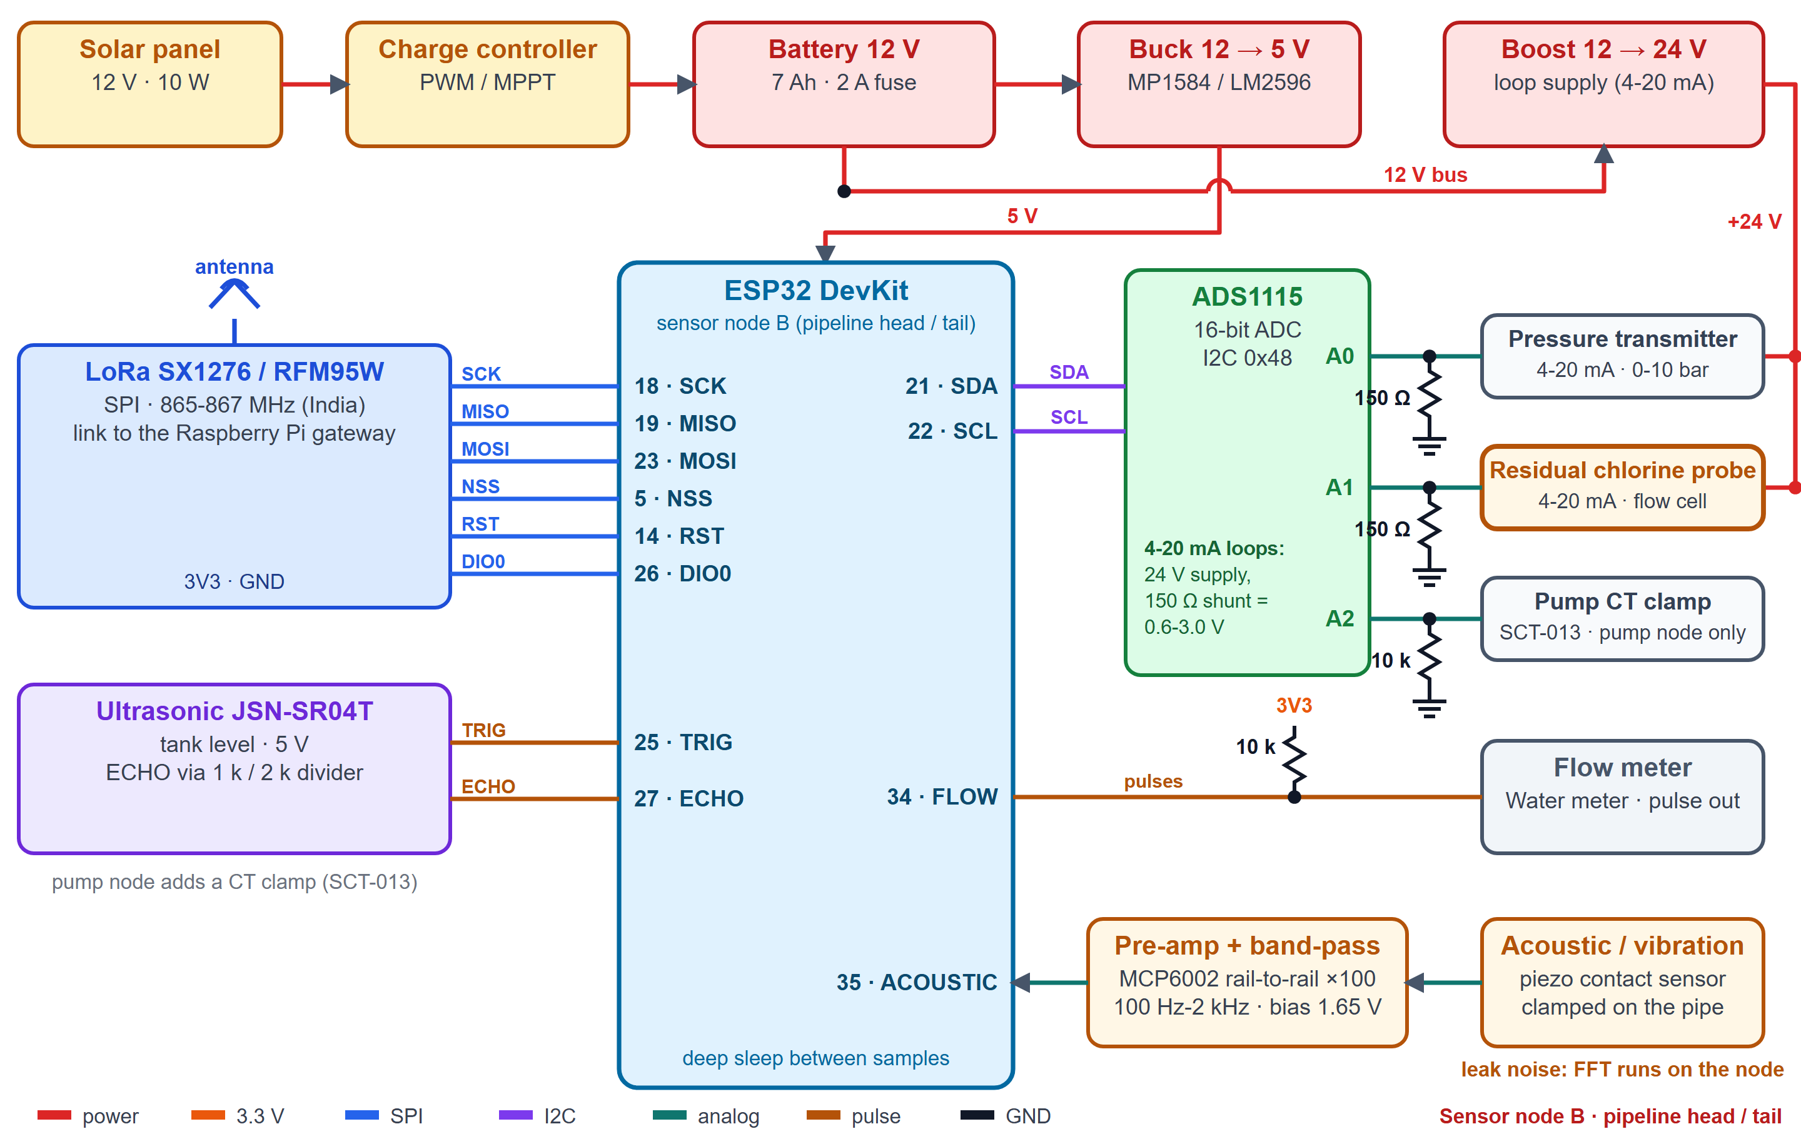

FEASIBILITY AND VIABILITY
Team Vistaar
Scalability
Interoperability
One village, then a cluster per gateway, block, district, state
Stateless APIs; PostgreSQL + PostGIS
Same node design in every village
Keyed to Sujal Gaon and Sujalam Bharat IDs
Sync adapters built and mock-tested; live IMIS / JJM / WQMIS sync needs official API access
Open formats: REST/OpenAPI, GeoJSON, CSV
Data security
Ease of deployment
Role-based access by village; hashed passwords
Photo location data stripped; location shared separately by opt-in
No personal data sent to other platforms
Solar node, plug-in LoRa gateway, no grid cabling
Mobile web app: nothing to install
Docker deployment, one configuration file
Node installation concept
Solar-powered pole node with an IP65 box
Clamp-on acoustic sensor: no digging
Chlorine flow cell at the tail end
LoRa to the Panchayat gateway
Circuit of sensor node B (pipeline head / tail): ESP32 with LoRa, ADS1115, 4-20 mA loops, flow, acoustic and tank-level inputs.
Feasibility analysis
Potential challenges and strategies to overcome them
Off-the-shelf parts: ESP32, ADS1115, LoRa, Raspberry Pi
Platform on demo data; 278 tests incl. firmware on a simulated board
AI/ML runs on demo data now; to be validated on pilot data
False alarms: persistence windows; HIGH needs two kinds of evidence
Sensor fault or drift: health gate; chlorine probe checked with a DPD kit
Rural network: gateway buffers readings, sends when online
Trust in AI: every score shows its reasons
Leak vs noise: per-pipe acoustic baseline plus flow gap
Platform access: adapters ready; official access and specifications needed

Slide 5



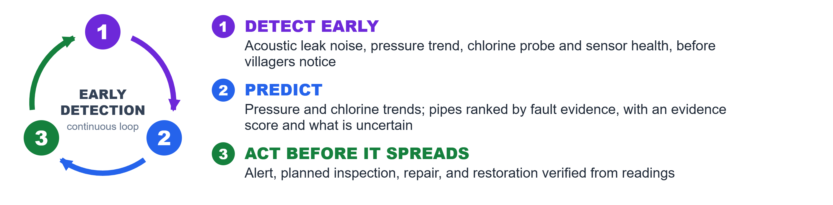
IMPACT AND BENEFITS
Team Vistaar
USERS INVOLVED
Villagers
VWSC and Gram Panchayat
Technicians and operators
Implementing agencies
District and State authorities
Report problems with a photo, check their tap daily, and get alerts and advisories in their own language
See alerts, household tap status and a ranked repair list; confirm that water is really restored
Receive tasks with the pipeline, evidence and location; close them when readings recover
Plan preventive maintenance from risk scores and fault history instead of waiting for breakdowns
Multi-level analytics and GIS; data prepared for IMIS, Sujal Gaon IDs and the JJM platforms
SOCIAL BENEFITS
ECONOMIC BENEFITS
ENVIRONMENTAL BENEFITS
Dry taps get fixed sooner, and the villager is told when water is restored
A voice for every household, in local languages
Boil-water advisory to homes when a field test fails, plus a confirmatory lab test request
Tail-end homes stop being invisible
Inspect the riskiest pipes first: fewer repeat repairs and wasted visits
Leaks near monitored points are flagged earlier
Less treated water lost to unseen leaks
Evidence replaces guesswork in planning and budgets
Early leak detection saves treated water and pumping energy
Solar-powered nodes: no grid cabling
Low-power LoRa links and sleep cycles
Measured chlorine helps avoid both under- and over-dosing
WHAT A PILOT WILL MEASURE
1
Time from fault to alert, vs complaint-led detection
2
Time from alert to verified restoration
3
Share of days each household reports water
4
False-alarm rate under the two-evidence rule
5
Low-chlorine events caught before a kit test
6
Repairs planned from the ranked risk list
FUTURE SCOPE
Public village water report card (share of working taps, repair time, last quality test; no personal data) WhatsApp / SMS task alerts to linemen and pump operators
ROADMAP
Idea submission
Working software platform
Bench rig with real nodes
Finale demo
Field pilot

Slide 6




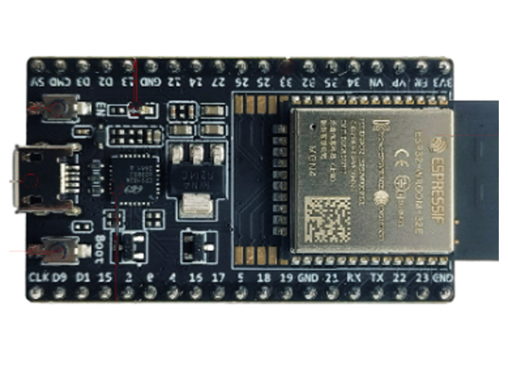
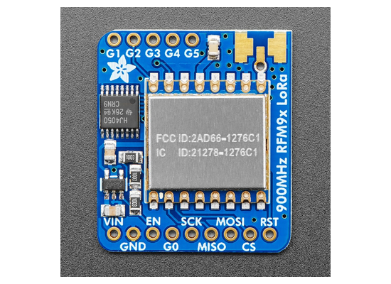
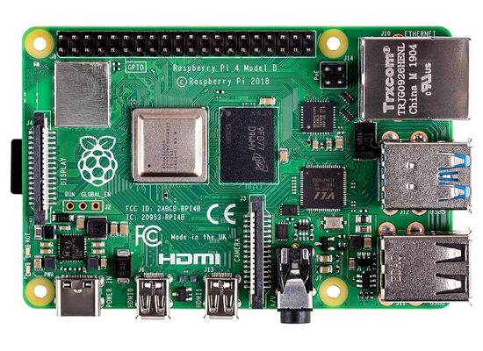
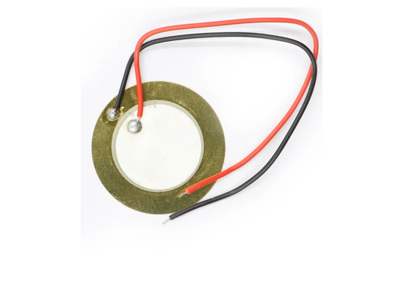
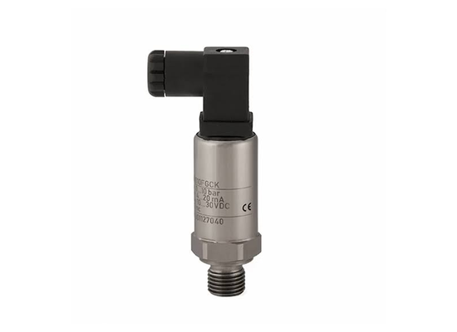
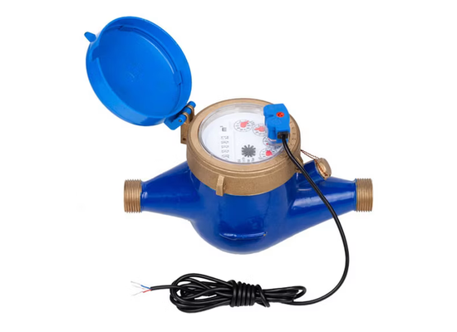
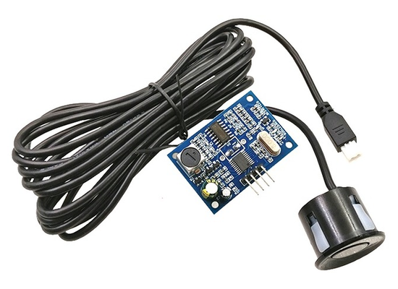

RESEARCH AND REFERENCES
Team Vistaar
Details / links of the reference and research work
Working platform screens
[1] DDWS, Functionality Assessment of Household Tap Connection, National Report 2024
jaljeevanmission.gov.in/sites/default/files/2025-12/FHTC_Na...
[2] PIB, 13 Aug 2026: 75% of rural habitations covered with Sujal Gaon IDs
pib.gov.in/PressReleasePage.aspx?PRID=2298959
[3] PIB, 30 Dec 2025: Jal Seva Aankalan launched
pib.gov.in/PressReleasePage.aspx?PRID=2209798
[4] Cabinet, 10 Mar 2026: JJM extended to Dec 2028, service-delivery focus
pmindia.gov.in/en/news_updates/cabinet-approves-extension-of-jal-jeevan-mission...
[5] JJM Dashboard (coverage, GIS, IoT pilot view)
ejalshakti.gov.in/JJMReport/JJMIndia.aspx
[6] JJM-WQMIS (laboratory and FTK water-quality testing)
ejalshakti.gov.in/WQMIS/
[7] PIB, 31 Mar 2021: JJM deploys sensor-based IoT devices (off-grid pilot)
pib.gov.in/PressReleaseIframePage.aspx?PRID=1708701
[8] Jal Jeevan Samvad, Oct 2023: IoT water-quality monitoring with complaint tracking
jaljeevanmission.gov.in/sites/default/files/2025-05/JalJeev...
[9] Systematic review: ML for anomaly detection in smart water metering networks (2024)
sciencedirect.com/science/article/pii/S1474706524000160
Villager app: tap status and water quality (left); report a problem with photo and opt-in location (right)
[10] SIH 2026 problem statement SIH26255, Ministry of Jal Shakti
sih.gov.in/sih2026PS
Gram Panchayat: AI Early Warning with measured chlorine (top right) and Water Status with acoustic leak alerts (bottom right).
Demo video: youtu.be/LYlQtrBbpes
Source code: github.com/Thrisha236/JalRakshak (platform, node firmware, gateway, circuit and architecture files)
Proposed sensor-node hardware (not yet assembled)
ESP32
LoRa
Pi gateway
Acoustic
Chlorine
Pressure
Flow
Tank level
Solar
ESP32-DevKitC + ADS1115, RFM95W LoRa, 4-20 mA pressure and chlorine probes, pulse water meter, piezo clamp, JSN-SR04T. Vendor photos of single parts, not a built prototype; bench build next.
pH, TDS and turbidity come from field-test-kit entries: screening indicators that trigger confirmatory laboratory testing, not a safety certification.

