Slide 1

SMART INDIA HACKATHON 2026
JalRakshak
Your Water. Your Village. Your Voice.
Problem Statement ID – SIH26255
Problem Statement Title – AI/ML solution to monitor the functionality of FHTC in real time at Gram Panchayat and household levels, with water-quality alerts, citizen feedback and IMIS/Sujal Gaon ID sync
Theme – Clean & Green Technology
PS Category – Hardware
Team ID – [enter from portal]
Team Name – Team Vistaar

Slide 2
JalRakshak: Closed-Loop Water-Service Assurance
Team Vistaar
98.1%
76.0%
A tap is not the same as a working water service.
JJM already has dashboards, WQMIS, Jal Seva Aankalan, Sujalam Bharat IDs and IoT pilots. We did not find a public system that links sensor warnings, citizen complaints and pipeline records into one prioritised repair that is verified after restoration.
Source: DDWS, Functionality Assessment of Household Tap Connection – National Report 2024 (weighted sample estimates) [1]
surveyed households in Har Ghar Jal villages had a tap
assessed functionality status of household tap connections
Proposed Solution
How it addresses the problem
Innovation and uniqueness
Sensor nodes at pump, tank, pipeline head and tail – not at every house
Citizen app (English / తెలుగు / हिंदी): report no, low or dirty water or leakage with a photo; track status
Pipeline records: age, material, repairs, corrosion findings → explainable risk score
Gram Panchayat console: evidence, maintenance tasks, restoration check
Detects supply failures continuously, between periodic surveys
Separates a faulty sensor from a real supply fault
Links each complaint to a pipe and zone, so the right asset is repaired first
Closes an incident only when readings recover – measures service, not just assets
Evidence fusion: sensors + complaints + photos + pipe history + supply schedule → one explainable incident
Preventive maintenance: inspect high-risk pipes before visible failure
Verified restoration, not self-declared closure
Complements JJM systems; Sujal Gaon / Sujalam Bharat-ready IDs (mock in prototype)
Predict
Report
Review
Prioritise
Maintain
Verify
Inform
Closed loop: early warning → citizen report → official review → prioritised task → repair → sensor-verified restoration → villager informed

Slide 3
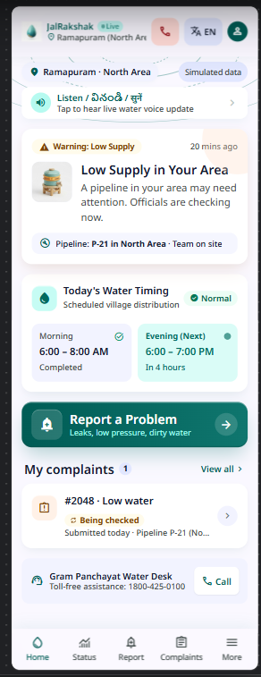
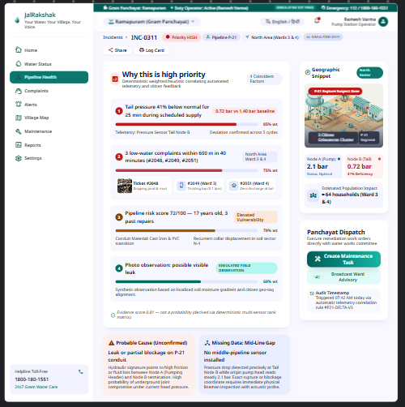
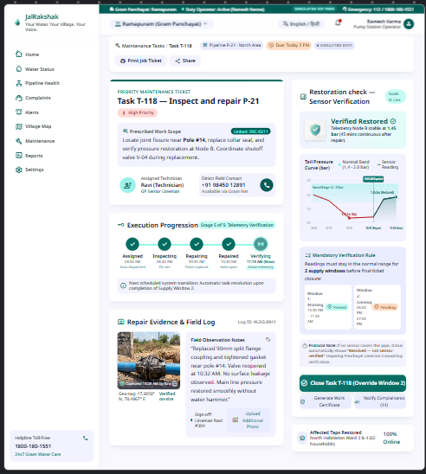
TECHNICAL APPROACH
Team Vistaar
FIELD
Pump · current
Tank · level
Pipeline head · flow + pressure
Pipeline tail · flow + pressure
Citizens · photo, voice, location
Technologies to be used
Hardware: ESP32 + LoRa, hall-type flow ×2, pressure transducer ×2, ultrasonic level, CT pump-current sensor, Raspberry Pi gateway, solar + battery, IP65 enclosures
Software: React + Vite + Tailwind (mobile-first PWA), Leaflet + OpenStreetMap, Python FastAPI, SQLite → PostgreSQL/PostGIS, MQTT (Mosquitto)
AI/ML: Python, pandas, scikit-learn: rules, robust z-score, Isolation Forest trained on normal runs; explainable risk and fusion scores
Image triage: simulated in prototype; a vision model only after labelled-data evaluation
EDGE
Node A: ESP32 + LoRa (pump/tank)
Node B: ESP32 + LoRa, solar (tail)
Raspberry Pi gateway · offline buffer
4G · MQTT
CLOUD
FastAPI ingest + APIs
SQLite → PostgreSQL / PostGIS
Photo store · role-based access
Mock Sujal Gaon / Sujalam Bharat IDs
Methodology: clickable prototype (Google Stitch)
AI / ML
Rules
Sensor-health gate
Anomaly: z-score → Isolation Forest
Pipeline risk score
Evidence fusion
ACTION
Incident + evidence
GP maintenance task
Repair
Verification window
Citizen notified
Build path: Google Stitch prototype → React PWA · sensor simulator → bench rig on the same ingest API · rules first, ML added as data grows
Prototype screens use simulated data · link in reference [11]

Slide 4
FEASIBILITY AND VIABILITY
Team Vistaar
Worked example: Pipeline P-21 (illustrative, simulated data)
Analysis of the feasibility of the idea
North Area · iron (record) · 17 years underground (record) · 3 past repairs · corrosion 67/100 (visual inspection of an exposed section)
Commodity, student-buildable hardware; open-source software
Works from day one with rules; ML added as real data accumulates
A few nodes per scheme + citizens as observers: far cheaper than per-house meters
JJM pilots already ran off-grid (solar + battery) sensor monitoring with RF + cellular links [7]
Age
20 / 25
Prior failures
20 / 25
Corrosion observation
12 / 20
Pressure-per-flow trend
12 / 20
Potential challenges and risks → Strategies for overcoming these challenges
Material susceptibility
8 / 10
False alarms
Persistence windows, schedule-aware rules; HIGH needs ≥ 2 evidence types
Risk score 72 / 100 · HIGH · Inspect soon
Sensor fault or drift
Heartbeat, stuck/out-of-range checks; "node offline" ≠ "no water"
Complaint #2048: "Low water" + photo
Low-cost sensor accuracy
Bench calibration; deployment-grade EM flow, 4–20 mA pressure
Water-quality limits
pH / TDS / turbidity are indicators only → FTK / lab confirmation
Simulated image check: "possible visible leak – inspection recommended"
Rural connectivity
Gateway store-and-forward; replay when the network returns
Citizen privacy
Coarse location, role-based photo access, audit log
Fused with tail pressure −41% for 25 min + 2 nearby complaints → HIGH incident
Government integration
Mock IDs + adapter; live IMIS / Sujalam Bharat sync needs authorisation
GP assigns maintenance task → repair logged with photo
Prototype status (as of submission)
Clickable UI (Google Stitch)
IN PROGRESS
Readings normal for 2 supply windows → Verified Restored → villager notified
Sensor readings
SIMULATED · bench rig planned
Risk score, fusion, verification logic
DESIGNED · code after submission
The risk score ranks inspection priority; it is not a failure probability. A photo cannot show buried-pipe condition.
Image analysis
SIMULATED · clearly labelled
IMIS / Sujal Gaon sync
NOT IMPLEMENTED · needs authorisation

Slide 5
IMPACT AND BENEFITS
Team Vistaar
Potential impact on the target audience
Villagers
Gram Panchayat / VWSC
District / State officers
Before: Complaint disappears; no update
After: Report in their own language with a photo; told when water is actually restored
Before: Learns of failures late; no priority order
After: Ranked inspection list with evidence; proof that a repair worked. Only 55.2% of villages had a VWSC and 58.1% skilled O&M manpower [1]
Before: Coverage numbers, not service
After: Repeat-failure hotspots, overdue repairs, verified resolution trends
Benefits of the solution (social, economic, environmental, etc.)
Social
Less time lost to outages; quality-indicator anomalies trigger earlier testing
Economic
Inspect the riskiest pipes first; fewer repeat repairs and wasted visits
Environmental
Earlier leak detection reduces water and pumping-energy loss
Governance
Verifiable service records aligned with JJM 2.0's service-delivery focus [4]
Scalability
Roadmap
1 village → cluster per gateway → block → district → state
Keyed to service-area (Sujal Gaon) and scheme (Sujalam Bharat) identities [2]
Stateless APIs; PostgreSQL/PostGIS; LoRaWAN for multi-gateway networks
Rules transfer to new villages on day one; models retrain per region as data grows
Idea + Stitch prototype
Working app on simulated data
Bench-rig integration
Finale demo (proposed Dec 2026)
Field pilot (needs authorisation)
Limitations: bench-scale validation only; no field data yet; risk weights are expert judgement until real failure records exist.

Slide 6
RESEARCH AND REFERENCES
Team Vistaar
Details / Links of the reference and research work
How to read our claims
[1] DDWS – Functionality Assessment of Household Tap Connection, National Report 2024
jaljeevanmission.gov.in/sites/default/files/2025-12/FHTC_National%2…
VERIFIED
[2] PIB, 13 Aug 2026 – 75% of rural habitations covered with Sujal Gaon IDs
pib.gov.in/PressReleasePage.aspx?PRID=2298959
Figures with a [n] citation, checked against official sources on 16 Oct 2026
[3] PIB, 30 Dec 2025 – Jal Seva Aankalan launched
pib.gov.in/PressReleasePage.aspx?PRID=2209798
PROPOSED
[4] Cabinet, Mar 2026 – JJM extended to Dec 2028 (₹8.69 lakh crore, service-delivery focus)
pmindia.gov.in/en/news_updates/cabinet-approves-extension-of-jal-je…
Architecture, risk scoring, evidence fusion and verification: our design
[5] JJM Dashboard (coverage, GIS, IoT pilot view)
ejalshakti.gov.in/JJMReport/JJMIndia.aspx
[6] JJM-WQMIS (laboratory and FTK water-quality testing)
ejalshakti.gov.in/WQMIS/
SIMULATED
Village, Pipeline P-21, Complaint #2048, sensor readings, image analysis and scores: demo data, labelled on screen
[7] PIB, 31 Mar 2021 – JJM deploys sensor-based IoT devices (off-grid solar + battery pilot)
pib.gov.in/PressReleaseIframePage.aspx?PRID=1708701
[8] Jal Jeevan Samvad, Oct 2023 – IoT water-quality monitoring with complaint tracking
jaljeevanmission.gov.in/sites/default/files/2025-05/JalJeevanSamvad…
NOT YET IMPLEMENTED
Field deployment, trained vision model, IMIS / Sujalam Bharat / JJM API integration
[9] Systematic review: ML for anomaly detection in smart water metering networks (2024)
sciencedirect.com/science/article/pii/S1474706524000160
[10] SIH 2026 problem statement SIH26255, Ministry of Jal Shakti
sih.gov.in/sih2026PS
No model accuracy, field results or supplier prices are claimed. pH, TDS and turbidity readings are indicators that trigger confirmatory testing, not a safety certification.
[11] JalRakshak clickable prototype – Google Stitch (simulated data)
stitch.google.com/projects/5969310015179761668

