Slide 1

SMART INDIA HACKATHON 2026
JalRakshak
Your Water. Your Village. Your Voice.
Problem Statement ID - SIH26255
Problem Statement Title - Development of a solution using AI and ML to monitor the functionality of FHTC in real time at both the Gram Panchayat and household levels. This solution should provide alerts on water quality issues, allow village members to give feedback through mobile devices, and automatically sync data with IMIS/Sujal Gaon IDs.
Organization - Ministry of Jal Shakti (MoJS)
Department - National Jal Jeevan Mission (NJJM), Department of Drinking Water & Sanitation (DDWS)
Theme - Clean & Green Technology
PS Category - Hardware
Team ID - [enter from portal]
Team Name - Team Vistaar

Slide 2






THE PROBLEM & OUR SOLUTION
Team Vistaar
THE PROBLEM
OUR SOLUTION: JALRAKSHAK
Periodic reporting only
Monitoring relies on periodic reports and field inspections, so disruptions are found late
1
Continuous FHTC monitoring
at Gram Panchayat and household levels using AI/ML
2
Real-time alerts
water supply disruption, water quality deterioration, low pressure, leakages, infrastructure failure
Disruptions go unseen
Non-functional taps, intermittent supply, poor water quality, inadequate pressure, infrastructure failures
3
Community feedback
complaints, photographs and geo-tagged observations from mobile devices, in local languages
Limited community feedback
No real-time way for villagers to report, or to validate service
4
AI/ML analytics
abnormal service patterns, failure prediction, maintenance prioritisation
No unified platform
Sensors, mobile apps, water-quality systems and citizen feedback are not brought together
5
Automatic sync
monitoring data, alerts and feedback to IMIS, Sujal Gaon IDs and other JJM platforms
6
Interactive dashboards
GIS visualisation, service status indicators, analytics for multiple administrative levels
Taps installed, service uncertain
98.1% of surveyed households had a tap, but only 76.0% were assessed as functional [1]
7
Scalable, interoperable, secure
data security and ease of deployment
SENSE
Nodes + villagers
UNDERSTAND
Rules + AI/ML
ALERT
Alert Center
REPORT
IMIS / JJM platforms
FIX
Task + repair
VERIFY
Readings recover
DEMO VIDEO (YouTube)
[add link after upload]
For: Village Water & Sanitation Committees (VWSCs), Gram Panchayats, implementing agencies and State authorities.
[1] DDWS, Functionality Assessment of Household Tap Connection, National Report 2024 (weighted sample estimates).

Slide 3
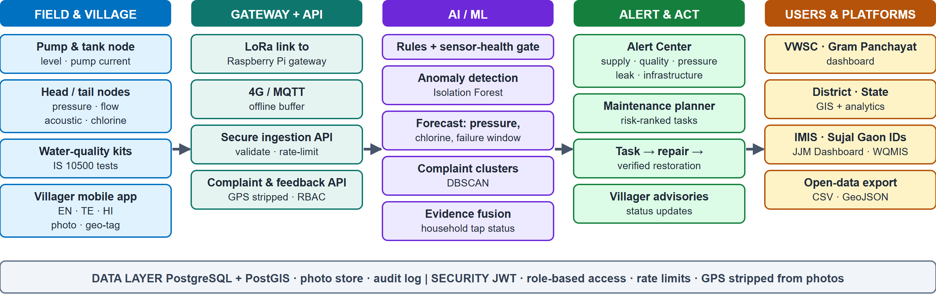









TECHNICAL APPROACH
Team Vistaar
Technology stack
App: React, Vite, Tailwind CSS, MapLibre, i18next (EN / TE / HI)
Backend: Python, FastAPI, SQLAlchemy, JWT
Database: PostgreSQL + PostGIS (SQLite for development)
AI/ML: scikit-learn, NumPy: Isolation Forest, DBSCAN, Theil-Sen trend
IoT: ESP32 (MicroPython firmware), ADS1115, LoRa SX1276, Raspberry Pi gateway, MQTT
Interfaces: REST + OpenAPI, GeoJSON, CSV
Deployment: Docker, Nginx
Hardware we use and how it connects (circuit diagram on the next slide)
ESP32 node
LoRa SX1276
Pi gateway
Acoustic sensor
Chlorine sensor
Pressure x2
Flow meter x2
Ultrasonic level
Solar + battery
Reads sensors through ADC, I2C and GPIO; deep sleep between samples
SPI radio, 865-867 MHz, node to village gateway
Buffers readings, sends over 4G MQTT to the ingestion API
Piezo clamp on the pipe; leak noise is amplified, filtered and analysed on the node
4-20 mA probe in a flow cell at the tail end; measured mg/L, low-chlorine alert
4-20 mA transmitters, head and tail; low-pressure alert
Pulse output, head and tail; head-to-tail gap means a leak
JSN-SR04T on the tank; supply and tank health
12 V 10 W panel, 7 Ah battery, IP65 box; buck and boost rails

Slide 4
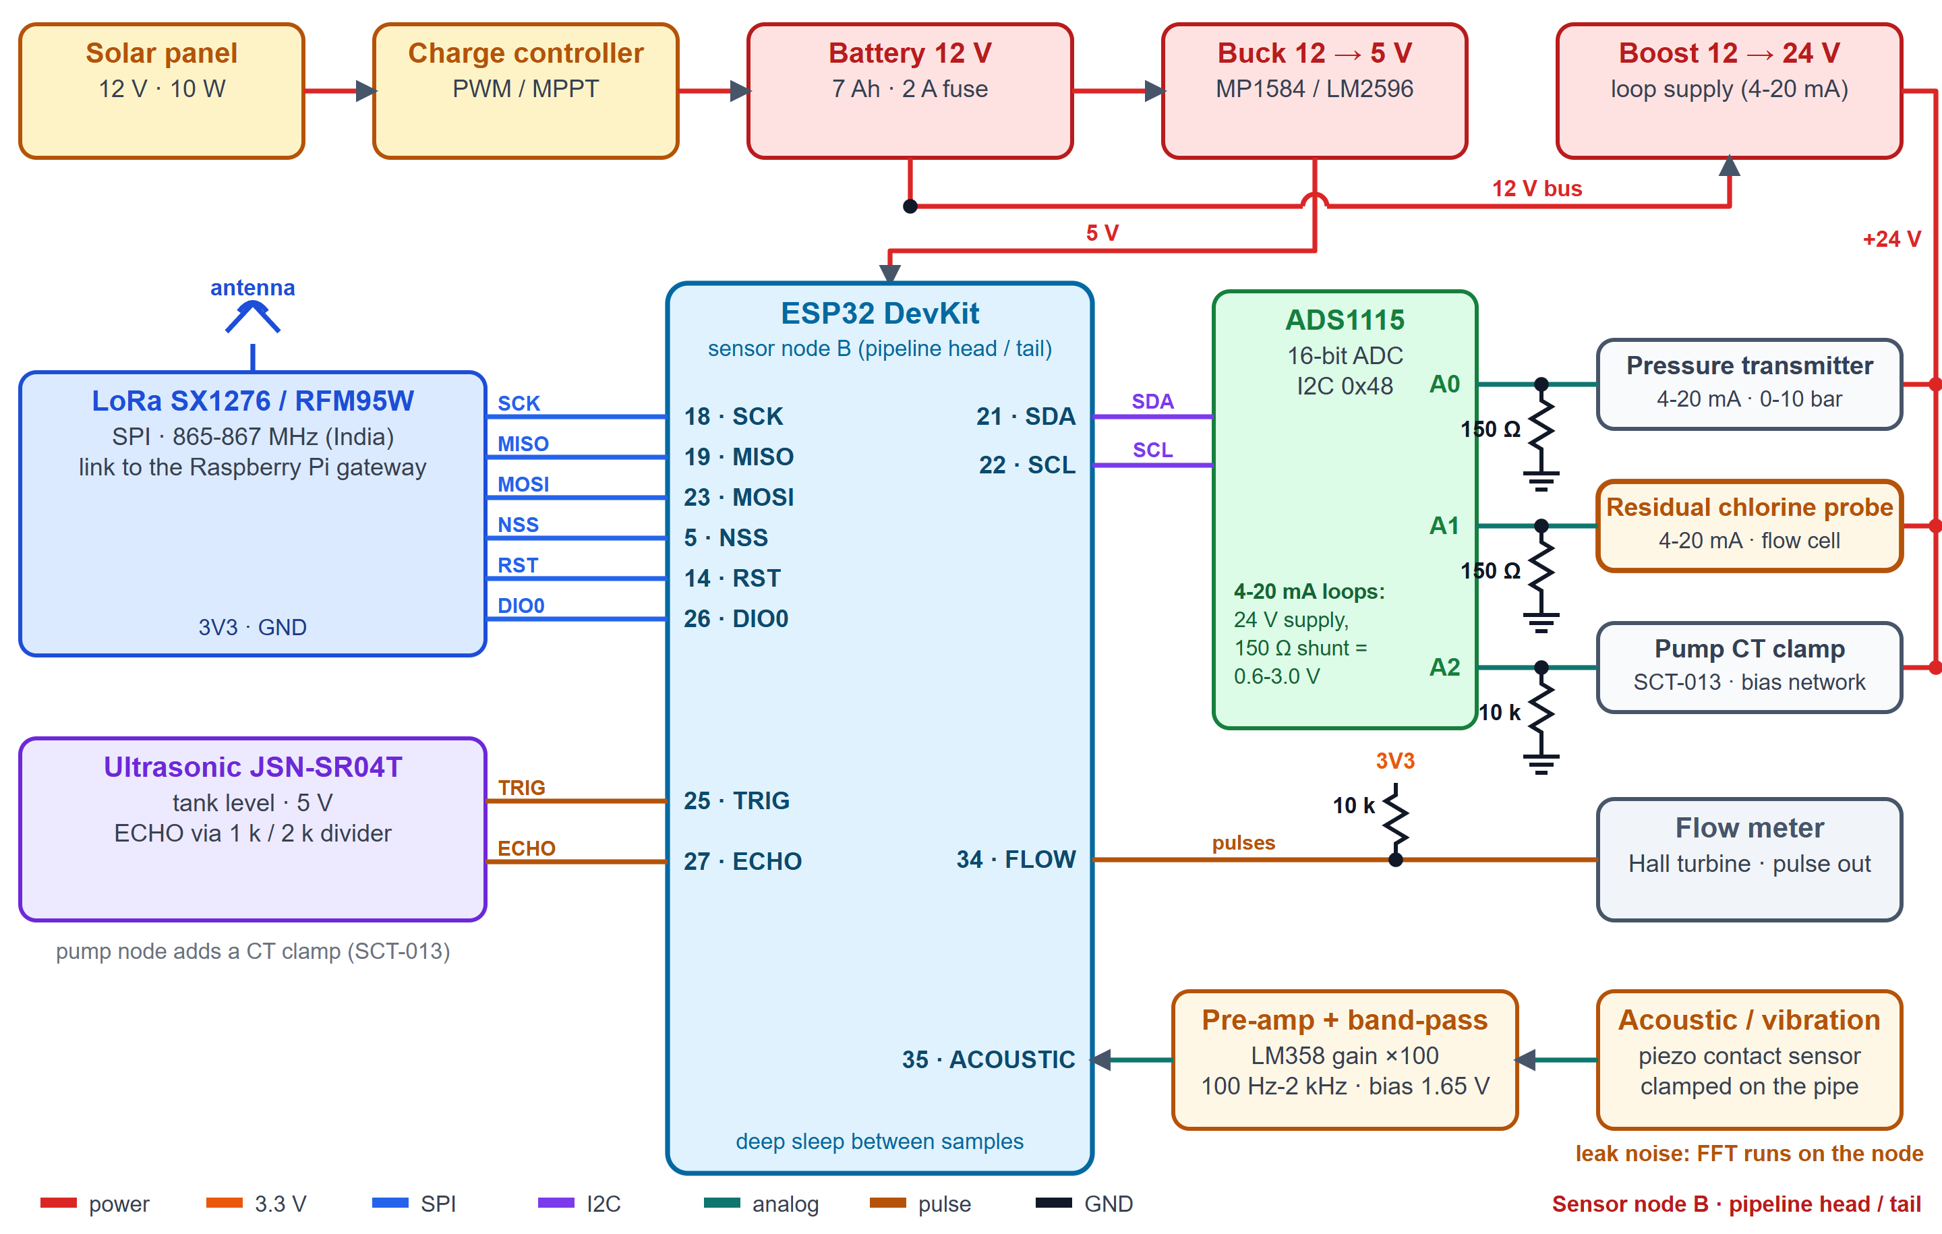

FEASIBILITY AND VIABILITY
Team Vistaar
Scalability
Interoperability
One village, then a cluster per gateway, block, district, state
Stateless APIs; PostgreSQL + PostGIS
Same node design in every village
Keyed to Sujal Gaon and Sujalam Bharat IDs
Sync with IMIS, JJM Dashboard, WQMIS
Open formats: REST/OpenAPI, GeoJSON, CSV
Data security
Ease of deployment
Role-based access by village; hashed passwords
Rate limits, audit log, GPS removed from photos
No personal data sent to other platforms
Solar node, plug-in LoRa gateway, no grid cabling
Mobile web app: nothing to install
Docker deployment, one configuration file
Node installation concept
Solar-powered pole node with an IP65 box
Clamp-on acoustic sensor: no digging
Chlorine flow cell at the tail end
LoRa to the Panchayat gateway
Circuit of sensor node B (pipeline head / tail): ESP32 with LoRa, ADS1115, 4-20 mA loops, flow, acoustic and tank-level inputs.
Feasibility analysis
Potential challenges and strategies to overcome them
Off-the-shelf sensors, ESP32, LoRa, Raspberry Pi
Node firmware and gateway written; 278 automated tests pass
Open-source software; rules work from day one, AI/ML improves with data
False alarms: persistence windows; HIGH needs two kinds of evidence
Sensor fault or drift: health gate; chlorine probe checked with a DPD kit
Rural network: gateway buffers readings, sends when online
Trust in AI: every score shows its reasons
Leak vs noise: per-pipe acoustic baseline plus flow gap
Platform access: adapters ready; official access and specifications needed

Slide 5
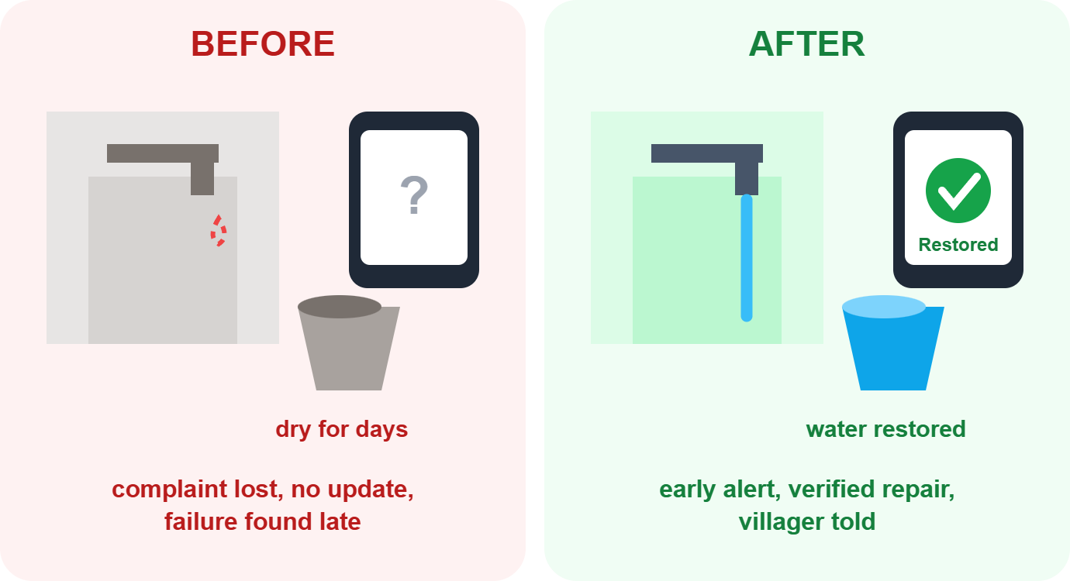
IMPACT AND BENEFITS
Team Vistaar
Expected outcomes
1
AI/ML-enabled platform: real-time monitoring of Functional Household Tap Connections and rural water supply service delivery
2
Early identification and prediction: of service disruptions, water quality issues and infrastructure failures, enabling timely corrective action
3
Community participation: mobile-based citizen feedback, grievance reporting and service validation
4
Automatic integration: of monitoring data with IMIS, Sujal Gaon IDs and other Jal Jeevan Mission digital platforms
5
Operational efficiency: preventive maintenance planning, transparency and evidence-based decision-making
6
Reliability, accountability, sustainability: of FHTCs through continuous AI-assisted monitoring and analytics
Who benefits: Village Water & Sanitation Committees, Gram Panchayats, implementing agencies, State authorities and villagers
VWSC / Gram Panchayat
Implementing agencies
State authorities
Villagers
Before: Learns of failures late; no priority order. Only 55.2% of villages had a VWSC [1]
After: Alert Center and a ranked inspection list; proof that a repair worked
Before: Periodic inspections and reactive repairs
After: Preventive maintenance plan with reasons; repeat-failure hotspots
Before: Coverage numbers, not service quality
After: Multi-level analytics and GIS maps; exports for evidence-based decisions
Before: Complaint disappears; the tap may be dry for days
After: Report in own language; told when water is truly restored; quality advisories
Roadmap
Idea submission
Working software platform
Bench rig with real nodes
Finale demo
Field pilot
Pilot will measure: time to detect, time to repair, share of taps working, complaints closed with verified restoration.

Slide 6




RESEARCH AND REFERENCES
Team Vistaar
Details / links of the reference and research work
Working platform screens
[1] DDWS, Functionality Assessment of Household Tap Connection, National Report 2024
jaljeevanmission.gov.in/sites/default/files/2025-12/FHTC_Na...
[2] PIB, 13 Aug 2026: 75% of rural habitations covered with Sujal Gaon IDs
pib.gov.in/PressReleasePage.aspx?PRID=2298959
[3] PIB, 30 Dec 2025: Jal Seva Aankalan launched
pib.gov.in/PressReleasePage.aspx?PRID=2209798
[4] Cabinet, Mar 2026: JJM extended to Dec 2028, service-delivery focus
pmindia.gov.in/en/news_updates/
[5] JJM Dashboard (coverage, GIS, IoT pilot view)
ejalshakti.gov.in/JJMReport/JJMIndia.aspx
[6] JJM-WQMIS (laboratory and FTK water-quality testing)
ejalshakti.gov.in/WQMIS/
[7] PIB, 31 Mar 2021: JJM deploys sensor-based IoT devices (off-grid pilot)
pib.gov.in/PressReleaseIframePage.aspx?PRID=1708701
Villager app: tap status and water quality (left); report a problem with photo and opt-in location (right)
[8] Jal Jeevan Samvad, Oct 2023: IoT water-quality monitoring with complaint tracking
jaljeevanmission.gov.in/sites/default/files/2025-05/JalJeev...
Gram Panchayat: AI Early Warning with measured chlorine (top right) and Water Status with acoustic leak alerts (bottom right).
Demo video: [add YouTube link]
Source code: private repository, access on request (includes node firmware, gateway and an ESP32 simulation project)
[9] Systematic review: ML for anomaly detection in smart water metering networks (2024)
sciencedirect.com/science/article/pii/S1474706524000160
[10] SIH 2026 problem statement SIH26255, Ministry of Jal Shakti
sih.gov.in/sih2026PS
pH, TDS and turbidity readings are screening indicators that trigger confirmatory laboratory or field-kit testing; they are not a safety certification.

