Slide 1




Slide 2
Team Name:
CLUSTERING CHAOS
Team Members:
Thrisha T Dass
Udaya Priya P
Madhu N
R Sneha

Slide 3
Track:
Open Innovation
Problem Statement:
Investors face challenges in comparing multiple stocks and identifying the best investment options due to the complexity and volume of available market data. This project aims to develop a stock prediction and analysis model that compares the historical performance of a primary stock (Apple) with competitors (Microsoft, Google, Adobe, Oracle, IBM) using technical indicators like SMA, Bollinger Bands, RSI, and Volatility. By providing clear visual insights and success rates, the model helps investors make informed decisions about stock investments.

Slide 4
Relevance
This project is focused on building a comprehensive stock prediction and analysis system that compares the performance of a primary stock (Apple) with its competitors (Microsoft, Google, Adobe, Oracle, and IBM) using historical data.
The system incorporates key technical indicators like Simple Moving Averages (SMA), Bollinger Bands, Relative Strength Index (RSI), and Volatility, which help provide insights into stock trends and market conditions.
By visualizing these indicators and calculating the success rates over a specified time period (2020-2023), the project empowers investors with data-driven insights to make informed decisions, ensuring a clear understanding of each stock’s potential performance relative to its peers.

Slide 5
Uniqueness
Comprehensive Competitor Analysis
Incorporation of Technical Indicators
Feature Engineering: Custom Lag Features
Volume Analysis
Data Visualization
Success Rate Calculation
Application to Real-World Problems
This project effectively combines multiple analytical techniques, advanced data handling, and visualization to create a robust framework for stock analysis. Its focus on technical indicators and comprehensive competitor analysis provides valuable insights for investors, setting it apart from more conventional stock prediction models.

Slide 6
Scalability
The project’s scalability lies in its modular design, allowing for easy integration of additional stock symbols, technical indicators, and analytical features.
Users can adapt the framework to analyze new stocks or extend the date range without significant reconfiguration, making it suitable for evolving market conditions and user requirements.
Furthermore, it can be enhanced with machine learning algorithms for predictive modeling, broadening its applicability in financial analysis.

Slide 7
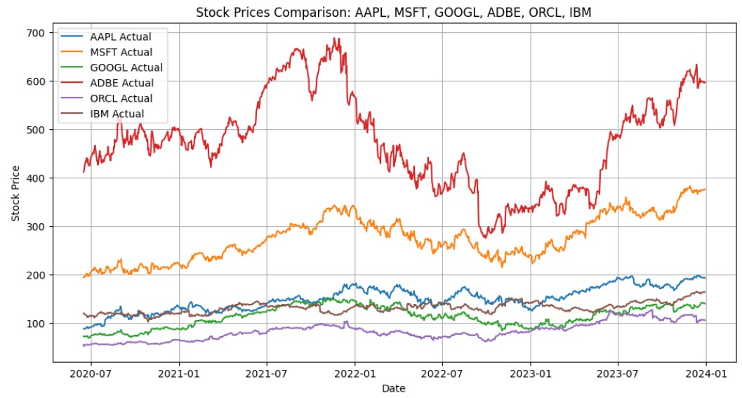
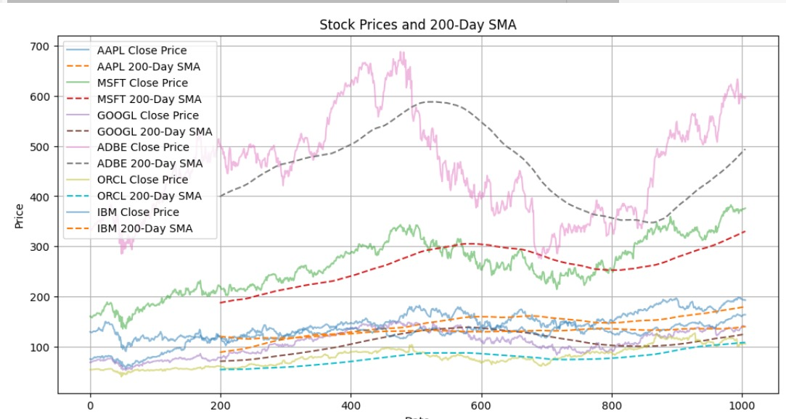
Interface

Slide 8
Conclusion
This stock prediction and analysis model offers a comprehensive approach to understanding the performance of Apple and its competitors through the integration of technical indicators, feature engineering, and comparative analysis. By leveraging historical price data and visualizing key metrics, the model not only aids in making informed investment decisions but also enhances the user's understanding of market dynamics. Its scalable and modular design allows for future enhancements, such as the inclusion of machine learning techniques, making it a valuable tool for both novice and experienced investors. Ultimately, this project bridges the gap between data analysis and practical investment strategies, providing insights that can lead to more informed and confident trading decisions.

