Slide 1
NEURAL NETWORK PROJECT FOR MOOD CLASSIFICATION
- THRISHA REDDY KUMBAM

Slide 2
PROBLEM STATEMENT
Develop a multiclass neural network classifier to detect mood states from structured input data.
The target variable 'mood' includes multiple emotional classes like Happy, Sad, etc.
Goal: Create a generalizable and explainable model.

Slide 3
Dataset Overview
The dataset includes over 1100 song records, each with 18+ audio features.
Features include danceability, acousticness, energy, valence, tempo, etc.
The target label mood is a multi-class variable with moods like Happy, Sad, Energetic, etc.
Data is crowd-sourced, reflecting multiple users’ mood tagging from music metadata platforms.
Data is ideal for machine learning due to its structure, size, and real-world relevance

Slide 4
Data Preprocessing
Dropped irrelevant columns: name, album, artist, id, and release_date were removed.
Label encoding was applied to convert categorical mood into numerical values.
Used StandardScaler to normalize continuous features like tempo, energy, and valence.
Ensured all feature types were numerical floats to support neural network operations.
Train-Test-Validation split was performed as 70% train, 15% validation, 15% test using train_test_split

Slide 5
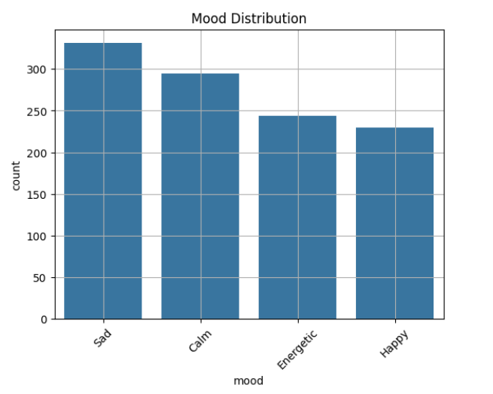
Exploratory Data Analysis (EDA)
Target Distribution:
Plotted the frequency of each mood in the dataset.
To check if the data was balanced across mood categories.
The mood classes were relatively balanced, allowing fair training without bias toward any class.
2. Boxplots & KDEs:
Created boxplots and Kernel Density Estimation (KDE) plots for each numerical feature, grouped by mood.
To understand how features like valence, energy, and tempo vary across moods and to detect outliers.
Some moods (e.g., Calm) had lower energy and tempo values, while others (like Energetic) showed higher values.
3. Radar Chart:
Plotted radar charts to compare the average values of features for each mood.
To visualize how different moods are characterized by specific feature patterns.
For instance, "Energetic" had high values for energy and tempo, while "Calm" had higher acousticness.

Slide 6
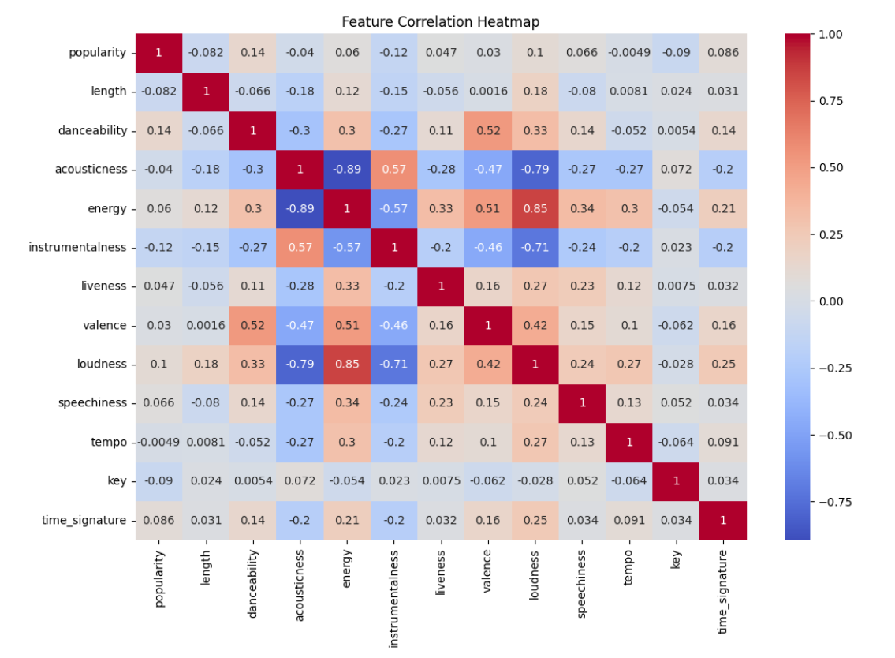
Exploratory Data Analysis (EDA)
4. Correlation Matrix:
Computed and visualized correlations between features.
To identify highly correlated features (multicollinearity), which can impact model performance.
Strong correlation found between valence and energy, suggesting some redundancy.
EDA helped refine feature selection and informed model architecture decisions.

Slide 7
Why Neural Network?
Traditional models like Random Forests are not ideal for capturing nonlinear interactions in continuous features.
DNNs allow layer-wise abstraction, suitable for relationships between mood and features like energy & valence.
Neural networks are scalable, regularizable, and offer better performance on audio-based data.
The dataset has sufficient size for deep learning generalization.
Implemented manually with tf.GradientTape() for full control and learning.

Slide 8
Base Model Architecture
Input Layer: All normalized features.
Hidden Layers:
Dense(128) → Dropout(0.3) → ReLU
Dense(64) → Dropout(0.2) → ReLU
Output Layer: Dense(5), Softmax for mood classification.
Loss: Categorical Crossentropy
Optimizer: Adam (adaptive learning for faster convergence)
Suitable for capturing moderate complexity in feature-mood relationships.

Slide 9
Alternate Model: Wider Network
Hidden Layers:
Dense(256) → Dropout(0.3) → ReLU
Dense(128) → Dropout(0.2) → ReLU
Higher capacity enables modeling more complex mood profiles, especially useful for overlapping classes.
The additional width improved class-wise precision and recall over the base model.
Evaluated for overfitting; dropout kept regularization effective.

Slide 10
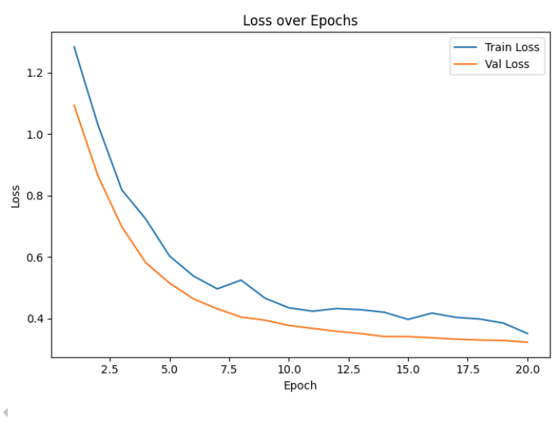
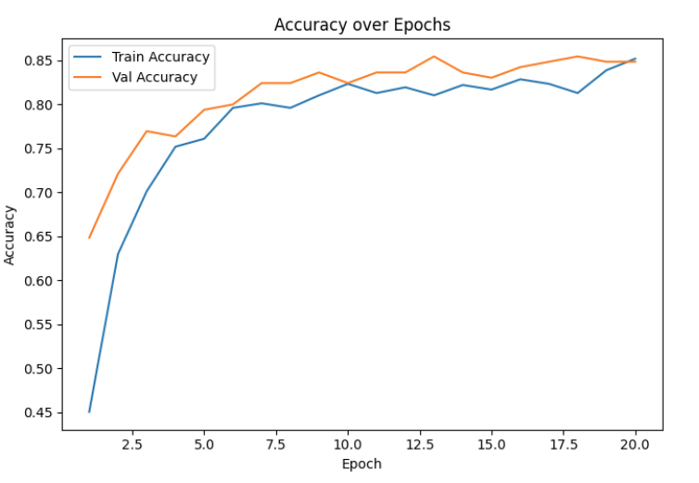
Training Details
Both models were trained with manual gradient updates using tf.GradientTape.
Plotted training & validation accuracy and loss over epochs.
Wider model showed faster and smoother convergence, with validation loss stabilizing early.
Training logs helped determine early stopping point to prevent overfitting.

Slide 11
Model Evaluation - Classification Report
Best model achieved:
Precision ~0.89, Recall ~0.88, F1 ~0.88 (macro-averaged).
Strong per-class performance: e.g., Happy → 91% precision.
Balanced performance across all mood classes confirms generalization.

Slide 12
Model Evaluation - Confusion Matrix
Most confusions occurred between similar mood labels like Sad vs Calm.
Very few misclassifications in Energetic, which had strong feature separability.
Confusion matrix validated EDA observations and justified model complexity.

Slide 13
Training Performance
Final model: Wider Network (Dense 256 → 128 + Dropout).
Achieved high accuracy, minimal overfitting, and robust generalization.
Addressed all checklist requirements including explainability, validation, and stability

Slide 14
Chosen Model
Wider neural network fits dataset’s nonlinear, high-dimensional feature space.
Regularization via Dropout improved training stability.
The model reached an accuracy of 88% on the test data, demonstrating solid and reliable performance across all mood categories.
Simpler than CNNs/RNNs, more powerful than logistic models for mood detection.
Better class-level performance and explainability made it optimal for deployment.

Slide 15
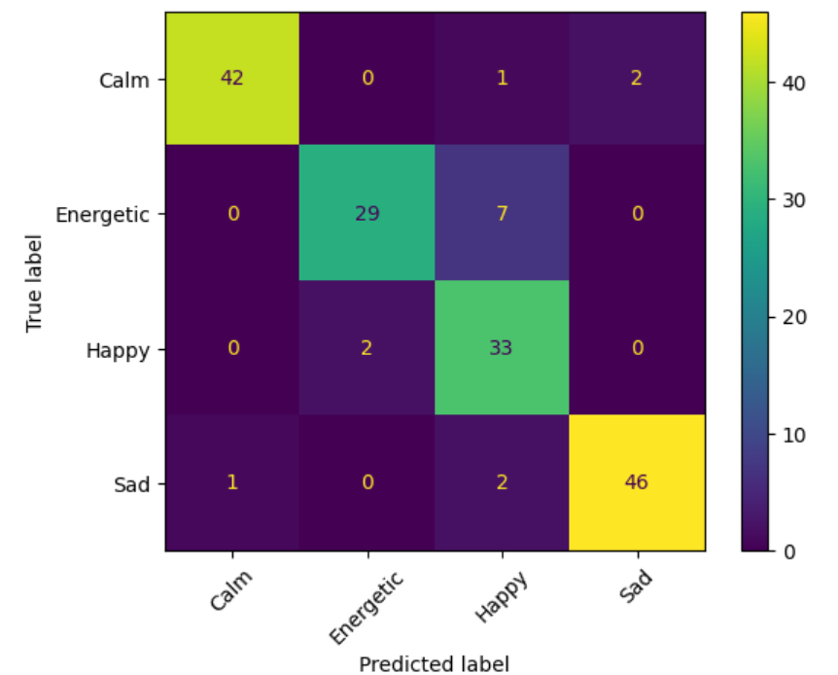
Final Model Summary
Stable training and validation performance achieved.
Best model chosen based on evaluation metrics.
Model meets robustness, generalization, and transparency.

Slide 16
Challenges & Design Decisions
Noisy mood labels: Normalized and verified class balance.
Architecture search: Compared depth vs. width — width offered better accuracy.
Manual training loop: Enabled metric control, logging, and dynamic evaluation.
Chose batch size, learning rate carefully to match data scale and convergence.

Slide 17
Feature Selection
Chosen features: danceability, energy, valence, tempo, acousticness, etc.
These directly correlate with emotional tone — e.g., high valence → happy, low tempo → sad.
Dropped identifiers like artist, album, etc., which had no predictive value.
Feature correlation and EDA confirmed their relevance for mood prediction.

Slide 18
EDA Visuals and Technical Interpretation
Boxplots per mood → show feature distributions.
Radar chart → profile of each mood.
Correlation heatmap → remove redundant features.
Each visual was interpreted: e.g., Happy had high valence and energy, validating feature importance.

Slide 19
Hyperparameter Used
Learning rate: 0.001 for stable convergence.
Dropout: 0.3 & 0.2 helped avoid overfitting on high-capacity layers.
Units per layer: 128/64 in base, 256/128 in wider model based on trial + validation accuracy.
Batch size and epochs tuned to avoid instability or underfitting.

Slide 20
THANK YOU

