Slide 1
Introduction to Machine Learning
Training Machine Learning Algorithms for Classification
Artificial neurons a brief glimpse into the early history of machine learning Implementing a perceptron learning algorithm in Python Training a perceptron model on the Iris dataset Adaptive linear neurons and the convergence of learning
Self Learning Exercise: Minimizing cost functions with gradient descent

Slide 2
Introduction to Machine Learning
Machine learning algorithms for classification - perceptron
Optimization using adaptive linear neurons

Slide 3
Introduction to Machine Learning
The topics that we will cover in this chapter are as follows:
Building an intuition for machine learning algorithms
Using pandas, NumPy, and matplotlib to read in, process, and visualize data
Implementing linear classification algorithms in Python

Slide 4
Introduction to Machine Learning
Artificial neurons – a brief glimpse into the early history of machine learning
Warren McCullock and Walter Pitts published the first concept of a simplified brain cell, the so-called McCullock-Pitts (MCP) neuron, in 1943 (W. S. McCulloch and W. Pitts. A Logical Calculus of the Ideas Immanent in Nervous Activity. The bulletin of mathematical biophysics, 5(4):115–133, 1943).
Neurons are interconnected nerve cells in the brain that are involved in the processing and transmitting of chemical and electrical signals, which is illustrated in the following figure:

Slide 5
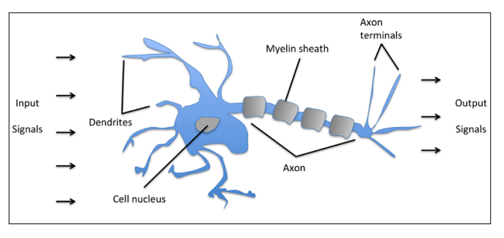
Introduction to Machine Learning
McCullock and Pitts described such a nerve cell as a simple logic gate with binary outputs; multiple signals arrive at the dendrites, are then integrated into the cell body, and, if the accumulated signal exceeds a certain threshold, an output signal is generated that will be passed on by the axon

Slide 6
Introduction to Machine Learning
Frank Rosenblatt published the first concept of the perceptron learning rule based on the MCP neuron model (F. Rosenblatt, The Perceptron, a Perceiving and Recognizing Automaton. Cornell Aeronautical Laboratory, 1957).
Algorithm that would automatically learn the optimal weight coefficients that are then multiplied with the input features in order to make the decision of whether a neuron fires or not..

Slide 7
Introduction to Machine Learning
In the context of supervised learning and classification, such an algorithm could then be used to predict if a sample belonged to one class or the other
binary classification task where we refer to our two classes as
1 (positive class)
-1 (negative class)

Slide 8
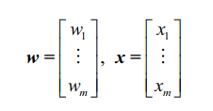
Introduction to Machine Learning
Activation function φ(z) that takes a linear combination of certain input values x and a corresponding weight vector w , where z is the so-called net input (z = w₁x₁ …+w_{m}x_{m} ):

Slide 9

Introduction to Machine Learning
If the activation of a particular sample x^{(i)} ,
Output of φ(z) is greater than a defined threshold θ , we predict class 1
otherwise we predict class -1
Perceptron algorithm, the activation function φ() is a simple unit step function (Heaviside step function),

Slide 10
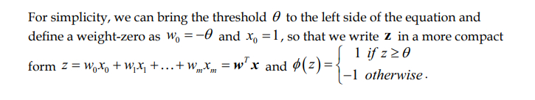
Introduction to Machine Learning

Slide 11
Introduction to Machine Learning
The following figure illustrates how the net input z = w^{T}x is squashed into a binary output (-1 or 1) by the activation function of the perceptron (left subfigure) and how it can be used to discriminate between two linearly separable classes (right subfigure):

Slide 12
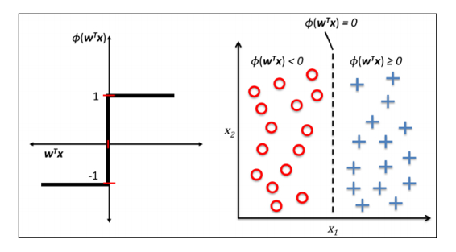
Introduction to Machine Learning

Slide 13
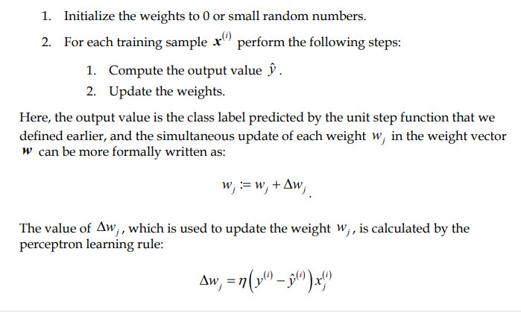
Introduction to Machine Learning

Slide 14

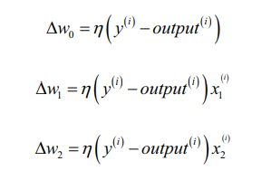
Introduction to Machine Learning
η -> learning rate [0.0 and 1.0]
y^{(i)} -> true class label of the i^{th} training sample,
-> is the predicted class label.
For a 2D dataset, we would write the update as follows:

Slide 15
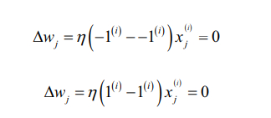
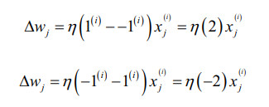
Introduction to Machine Learning
Two scenarios
Correct prediction
Wrong prediction

Slide 16


Introduction to Machine Learning
Example:
Assume x_{j}^{(i)} =0.5 and misclassify as -1, corresponding weight is

Slide 17

Introduction to Machine Learning
Example:
Assume x_{j}^{(i)} = 2 and misclassify as -1, corresponding weight is

Slide 18
Introduction to Machine Learning
NOTE:
Convergence of Perceptron is only guaranteed if:
Two classes are linearly separable
Learning rate is sufficiently small

Slide 19
Introduction to Machine Learning
NOTE:
Perceptron would never stop updating the weights if two classes can’t be separated by a linear decision boundary.
| Solution
^{V}
Set a maximum number of passes over the training dataset (epochs)
Threshold for the number of tolerated misclassification

Slide 20
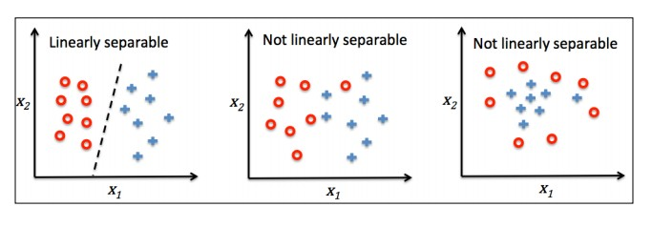
Introduction to Machine Learning

Slide 21
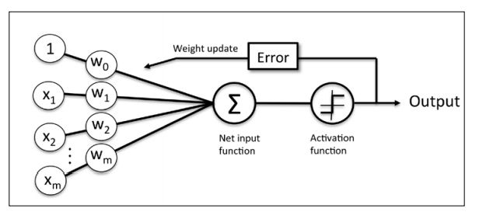
Introduction to Machine Learning
The figure illustrates how the perceptron receives the inputs of a sample x and combines them with the weights w to compute the net input. The net input is then passed on to the activation function (here: the unit step function), which generates a binary output -1 or +1—the predicted class label of the sample.
During the learning phase, this output is used to calculate the error of the prediction and update the weights.

Slide 22
Introduction to Machine Learning
Perceptron learning algorithm in Python using Iris dataset
We will take an objected-oriented approach to define the perceptron interface as a Python Class, which allows us to
initialize new perceptron objects that can learn from data via a fit method,
make predictions via a predict method.
As a convention, we add an underscore to attributes that are not being created upon the initialization of the object but by calling the object's other methods—for example, self.w_.

Slide 23
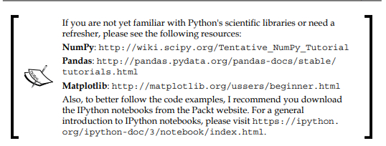
Introduction to Machine Learning

Slide 24
Introduction to Machine Learning
import numpy as np
class Perceptron(object):
"""Perceptron classifier.
Parameters
------------
eta : float
Learning rate (between 0.0 and 1.0)
n_iter : int
Passes over the training dataset.
Attributes
-----------
w_ : 1d-array
Weights after fitting.
errors_ : list
Number of misclassifications in every epoch.

Slide 25
Introduction to Machine Learning
"""
def __init__(self, eta=0.01, n_iter=10):
self.eta = eta
self.n_iter = n_iter

Slide 26
Introduction to Machine Learning
def fit(self, X, y):
"""Fit training data.
Parameters
----------
X : {array-like}, shape = [n_samples, n_features]
Training vectors, where n_samples is the number of samples and n_features is the number of features.
y : array-like, shape = [n_samples]
Target values.
Returns
-------
self : object

Slide 27
Introduction to Machine Learning
"""
self.w_ = np.zeros(1 + X.shape[1])
self.errors_ = []
for _ in range(self.n_iter):
errors = 0
for xi, target in zip(X, y):
update = self.eta * (target - self.predict(xi))
self.w_[1:] += update * xi
self.w_[0] += update
errors += int(update != 0.0) self.errors_.append(errors)
return self

Slide 28
Introduction to Machine Learning
def net_input(self, X):
"""Calculate net input"""
return np.dot(X, self.w_[1:]) + self.w_[0]
def predict(self, X):
"""Return class label after unit step""" return np.where(self.net_input(X) >= 0.0, 1, -1)

Slide 29
Introduction to Machine Learning
Demo on Jupyter Notebook

Slide 30
Introduction to Machine Learning (IS0321) (Module 2)
Machine learning algorithms for classification - perceptron
Optimization using adaptive linear neurons

Slide 31
Introduction to Machine Learning
The figure illustrates how the perceptron receives the inputs of a sample x and combines them with the weights w to compute the net input. The net input is then passed on to the activation function (here: the unit step function), which generates a binary output -1 or +1—the predicted class label of the sample.
During the learning phase, this output is used to calculate the error of the prediction and update the weights.

Slide 32
Introduction to Machine Learning
ADAptive LInear NEuron (Adaline)
By Bernard Widrow and his doctoral student Tedd Hoff
Single-layer neural network
Can be considered as an improvement on perceptron

Slide 33
Introduction to Machine Learning
The Adaline algorithm is particularly interesting because it illustrates the key concept of defining and minimizing cost functions, which will lay the groundwork for understanding more advanced machine learning algorithms for classification, such as
Logistic regression
Support vector machines
Regression models

Slide 34
Introduction to Machine Learning
The key difference between the Adaline rule (also known as the Widrow-Hoff rule) and Rosenblatt's perceptron is that the weights are updated based on a linear activation function rather than a unit step function like in the perceptron.

Slide 35
Introduction to Machine Learning
In Adaline, this linear activation function
φ(z) is simply the identity function of the net input so that φ(w^{T}x) = w^{T}x
While the linear activation function is used for learning the weights, a quantizer, which is similar to the unit step function that can be used to predict the class labels:

Slide 36
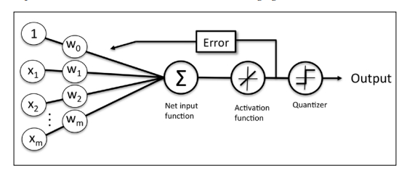
Introduction to Machine Learning

Slide 37
Introduction to Machine Learning
Weights are updated based on
Linear activation Unit Step
function function
(Adaline) (Perceptron)

Slide 38
Introduction to Machine Learning

Slide 39
Introduction to Machine Learning
One of the key ingredients of supervised machine learning algorithms is to define an objective function that is to be optimized during the learning process. This objective function is often a cost function that we want to minimize.

Slide 40

Introduction to Machine Learning
In the case of Adaline, we can define the cost function J to learn the weights as the Sum of Squared Errors (SSE) between the calculated outcome and the true class label
NOTE:
The term 1/2 is just added for convenience; it will make it easier to derive the gradient

Slide 41
Introduction to Machine Learning
NOTE:
Optimization algorithm called gradient descent is used to find the weights that minimize our cost function to classify the samples.
Principle behind gradient descent is climbing down a hill until a local or global cost minimum is reached. In each iteration, we take a step away from the gradient where the step size is determined by the value of the learning rate as well as the slope of the gradient

Slide 42
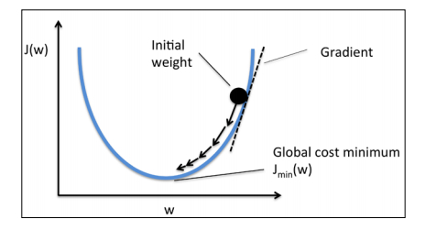
Introduction to Machine Learning

Slide 43
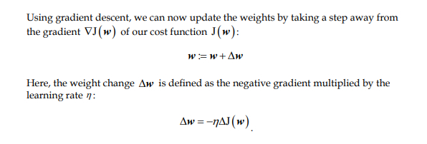
Introduction to Machine Learning

Slide 44
Introduction to Machine Learning
Adaptive Linear Neuron in Python
Since the perceptron rule and Adaline are very similar, we will take the perceptron implementation that we defined earlier and change the fit method so that the weights are updated by minimizing the cost function via gradient descent:

Slide 45
Introduction to Machine Learning
class AdalineGD(object):
"""ADAptive LInear NEuron classifier. Parameters
------------
eta : float Learning rate
(between 0.0 and 1.0)
n_iter : int
Passes over the training dataset.

Slide 46
Introduction to Machine Learning
Attributes
-----------
w_ : 1d-array
Weights after fitting.
errors_ : list
Number of misclassifications in every epoch.
"""

Slide 47
Introduction to Machine Learning
def __init__(self, eta=0.01, n_iter=50):
self.eta = eta
self.n_iter = n_iter

Slide 48
Introduction to Machine Learning
def fit(self, X, y):
""“ Fit training data.
Parameters
----------
X : {array-like}, shape = [n_samples, n_features] Training vectors, where n_samples is the number of samples and n_features is the number of features.
y : array-like, shape = [n_samples]
Target values.
Returns
-------
self : object
"""

Slide 49
Introduction to Machine Learning
self.w_ = np.zeros(1 + X.shape[1])
self.cost_ = []
for i in range(self.n_iter):
output = self.net_input(X)
errors = (y - output)
self.w_[1:] += self.eta * X.T.dot(errors) self.w_[0] += self.eta * errors.sum()
cost = (errors**2).sum() / 2.0 self.cost_.append(cost)
return self

Slide 50
Introduction to Machine Learning
def net_input(self, X):
"""Calculate net input"""
return np.dot(X, self.w_[1:]) + self.w_[0]
def activation(self, X):
"""Compute linear activation"""
return self.net_input(X)
def predict(self, X): """Return class label after unit step"""
return np.where(self.activation(X) >= 0.0, 1, -1)

