Slide 1
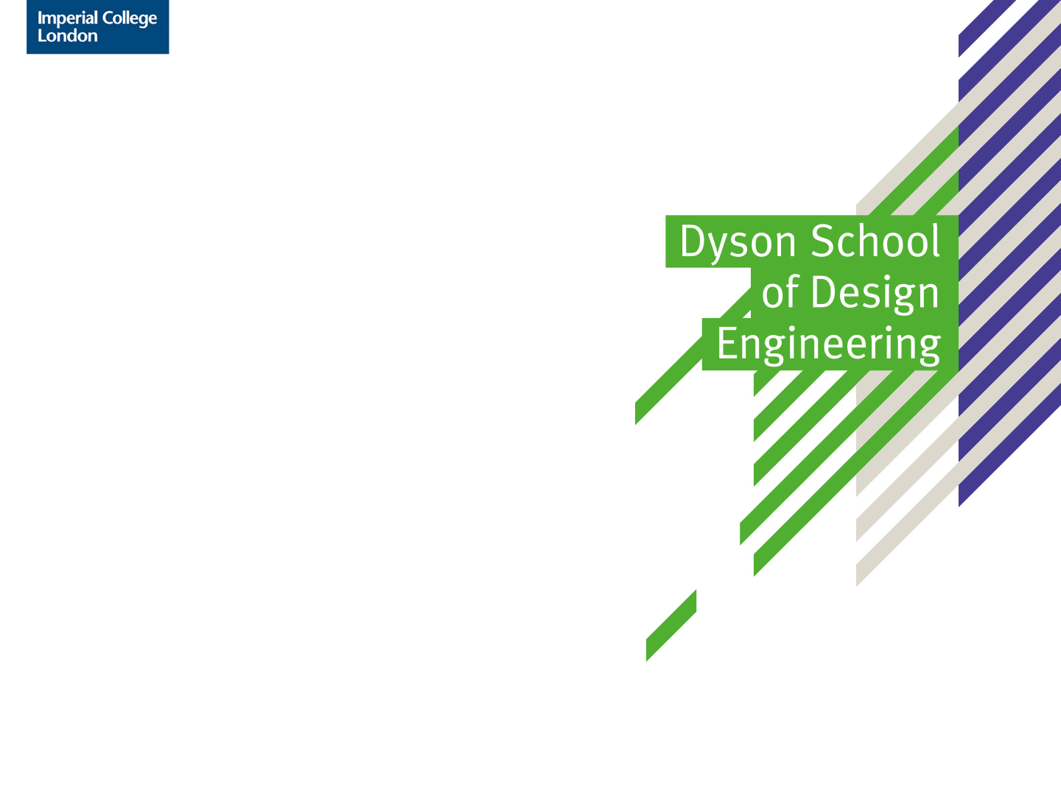
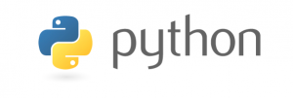
DE1-COM1 (Computing 1)
Introduction
Dr Thrishantha Nanayakkara
t.nanayakkara@imperial.ac.uk

Slide 2
What is the module about?
This module is designed to be a first introduction to computer programming to solve math problems.
You will learn the Python programming language.
We will be covering core concepts in programming which you will be able to reapply to any other programming language that you are likely to encounter in the future.

Slide 3
Why Python?
Python is a modern, general-purpose, high-level programming language.
It is one of the most popular introductory teaching languages.
Widely used in science and engineering
Main advantages:
Simple – It is easy to read and easy to learn.
Expressive – Fewer lines of code, fewer bugs and easy to maintain.
Python can be used for both small and large projects, Big Data, Physical/Embedded Computing, High Performance Computing applications, etc.

Slide 4
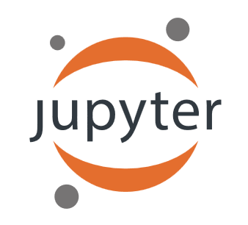
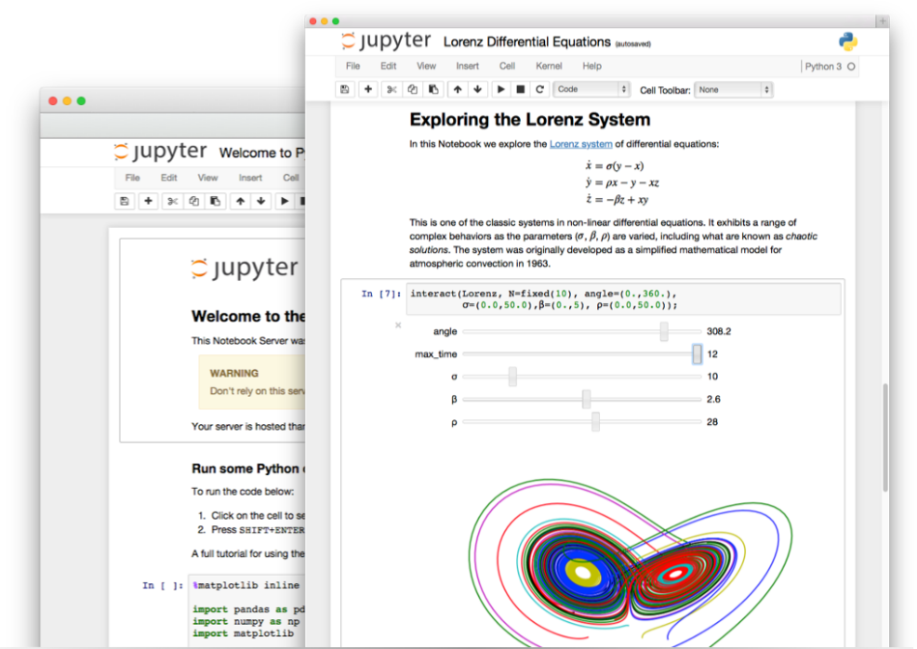
Programming Environment
The lectures notes are written in Jupyter Notebook (formerly known as IPython Notebook). File format: *.ipynb
This is a web-based interactive computational environment where you can combine code execution, text, mathematics, plots and rich media into a single document. It allows you to create documents that contain live code, equations, visualizations and explanatory text.
You can use your favourite web browser as a substitute for an Integrated Development Environment (IDE)
The Notebook has support for over 40 programming languages, including those popular in Data Science such as Python, R, Julia and Scala.

Slide 5
Grand plan – learning objectives and assessments
8/5/2019
9.00 – 12.00
Studio-3
Introduction
Learn program variable types like integer, float, Boolean, string, list, tuple, dictionary
Know how to perform basic math operations - add, subtract, multiply, power
15/5/2019
9.00 – 12.00
Studio-3
Know how to code a mathematical formula
Know how to use Python functions
Know how to use mathematical functions from a Python Math module
Know how to implement conditioned operations
22/5/2019
9.00 – 12.00
Studio-3
Be able to use numpy to compute with arrays (vectors and matrices)
Know how to use symbolic Python to solve equations
Know how to use two different forms of loops which are used to repeat operations on data
Know how to plot data

Slide 6
Grand plan – learning objectives and assessments
24/5/2019
15.00 – 17.30
Level-0 lecture theatre
Surgery session
5/6/2019
9.00 – 12.00
Studio-3
Know the basics of a class
Know what instances of a class mean
Know what encapsulation, abstraction, inheritance, and polymorphism of object oriented coding mean
Be able to use classes in a practical project
Know how to handle errors
29/5/2019
10.00 – 12.00
Studio-3
Assessment-1 under exam conditions (40% of marks)

Slide 7
Grand plan – learning objectives and assessments
12/6/2019
9.00 – 12.00
Studio-3
Be able to use classes in a practical project
Know how to handle errors
14/6/2019
15.00 – 17.00
102 – Library space
Drop in surgery
19/6/2019
9.00 – 12.00
Studio-3
Second Assessment under exam conditions (60% of marks)

Slide 8
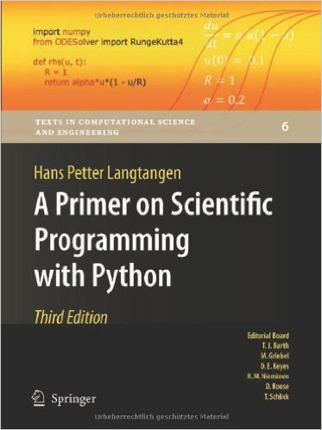
Supplementary material
This module loosely follows the text book:
A Primer on Scientific Programming with Python, by Hans Petter Langtangen
There are many copies in the library so do not feel that you have to buy it.
You do not have to read this book to excel in this course as the BlackBoard course material is self contained.
However, it is a good resource if you want to broaden your understanding of the subject.

Slide 9
Useful Resources
Codecademy – Free online Python course with many exercises
Python – The official Python web site
Python tutorials – The official Python tutorials
Think Python – A free book on Python
Software Carpentry - Python course
Khan Academy – Computer science course with videos
Learn Python the Hard Way – online book

Slide 10

Installation of Python and Jupyter Notebook
We will use Anaconda as a Python distribution.
To install it on your laptops, please follow the instructions given: http://jupyter.readthedocs.io/en/latest/install.html#id3

