Slide 1


NEXT GEN EMPLOYABILITY PROGRAM
CREATING A FUTURE-READY WORKFORCE
Student Name :
RAPARTHY THRISHA
Student ID :
College Name :
INTERNSHIP_173892172667a5d6fed4b6a
MALLA REDDY ENGINEERING COLLEGE FOR WOMEN

Slide 2
CAPSTONE PROJECT SHOWCASE
Project Title
FOOD ZONE
Abstract | Problem Statement | Project Overview | Proposed Solution | Technology Used | Modelling & Results | Conclusion | Q&A

Slide 3
Abstract
1
Food-Zone is a comprehensive web application designed to revolutionize the online food ordering experience. Built with the MERN stack (MongoDB, Express.js, React.js, Node.js), this platform offers a seamless interface for users to explore and order .
2
Food-Zone represents a state-of-the-art food ordering platform that transforms how people discover and order their favorite dishes. This innovative solution combines cutting-edge technology with an extensive culinary selection to create a seamless dish
3
Users can easily search through the menu, manage their shopping cart, and complete orders through a streamlined checkout process.
4
The application is designed with a responsive interface, ensuring a seamless experience across all devices, and utilizes environment-aware configurations for smooth deployment between development and production environments.

Slide 4


Problem Statement
The need for a secure, user-friendly online food ordering platform that can effectively present and manage a diverse international menu with detailed dish information.
The requirement for a robust authentication system and protected checkout process to ensure safe transactions and user data protection.
The demand for a responsive, high-performance application that can handle real-time search, dynamic menu updates, and seamless order processing across different devices.

Slide 5

Project Overview
1. Frontend (React.js)- Components Structure - Navigation & Authentication - Menu & Recipe Display - Cart Management - Search & Filtering - Order Processing - Protected Routes - Context Providers - Form Handling
2. Backend (Node.js/Express)- API Architecture - Authentication Endpoints - Menu Management - Order Processing - Cart Operations - Search Functionality - Data Validation
3.Database & Infrastructure- Data Management - MongoDB Collections - Users - Menu Items- Orders - Cart Data - Image Storage

Slide 6
Proposed Solution
Frontend Development:- React application with component-based architecture- Protected routing system with authentication checks- Context API for cart management and state handling.
Core Features:- International menu system with detailed item information- Real-time search functionality with name and description filtering- Secure checkout process with user authentication.
Deployment Structure:- Environment-aware configuration with dynamic API endpoints- Production deployment on Vercel(food-zone-mu.vercel.app/api)- Local development server ( localhost:5002/api ) for testing.

Slide 7
Technology used
Frontend: 1.React.js 2.React Router 3.Context API 4.React Hooks 5.JavaScript
Backend: 1.Node.js 2.Express.js 3.MongoDB 4.RESTful API

Slide 8
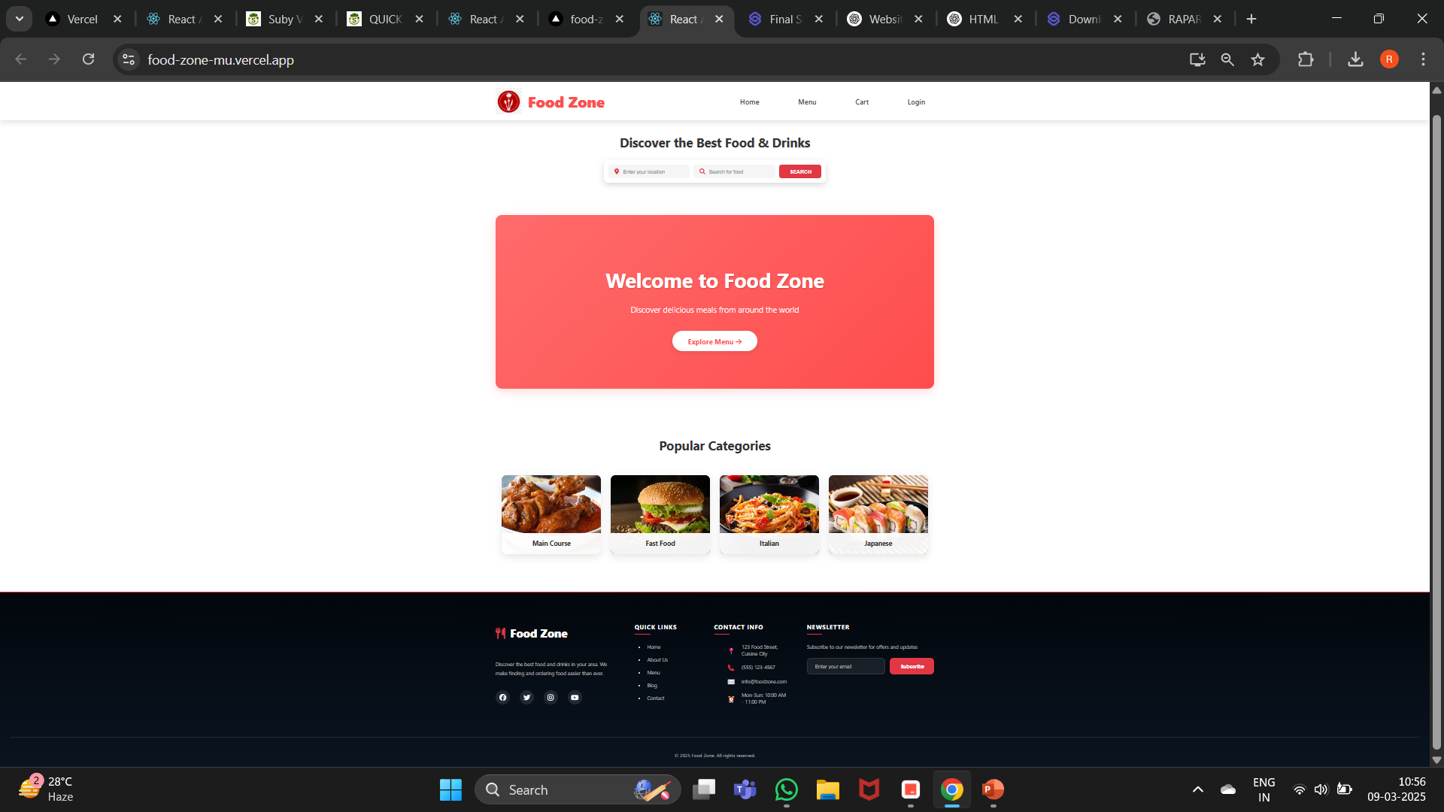
Modelling & Result

Slide 9
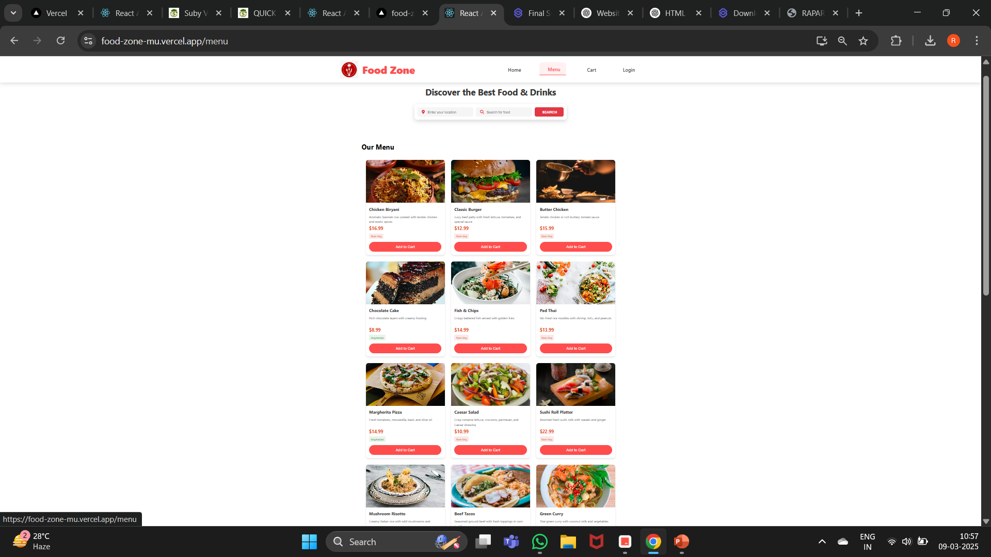
Modelling & Result

Slide 10
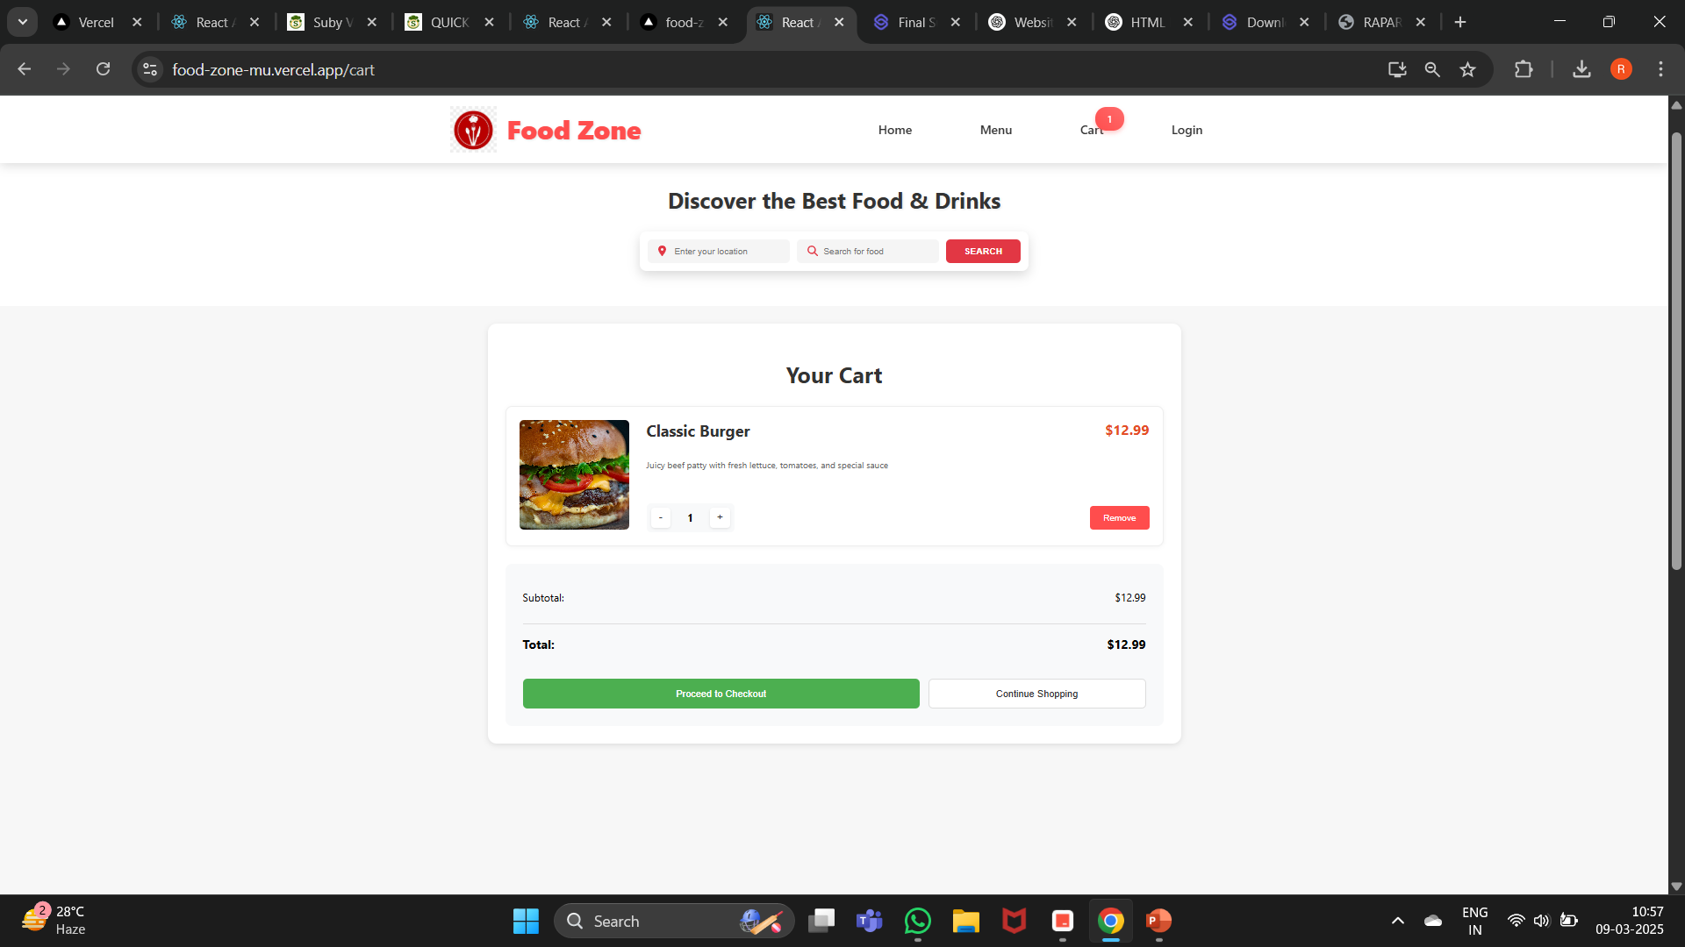
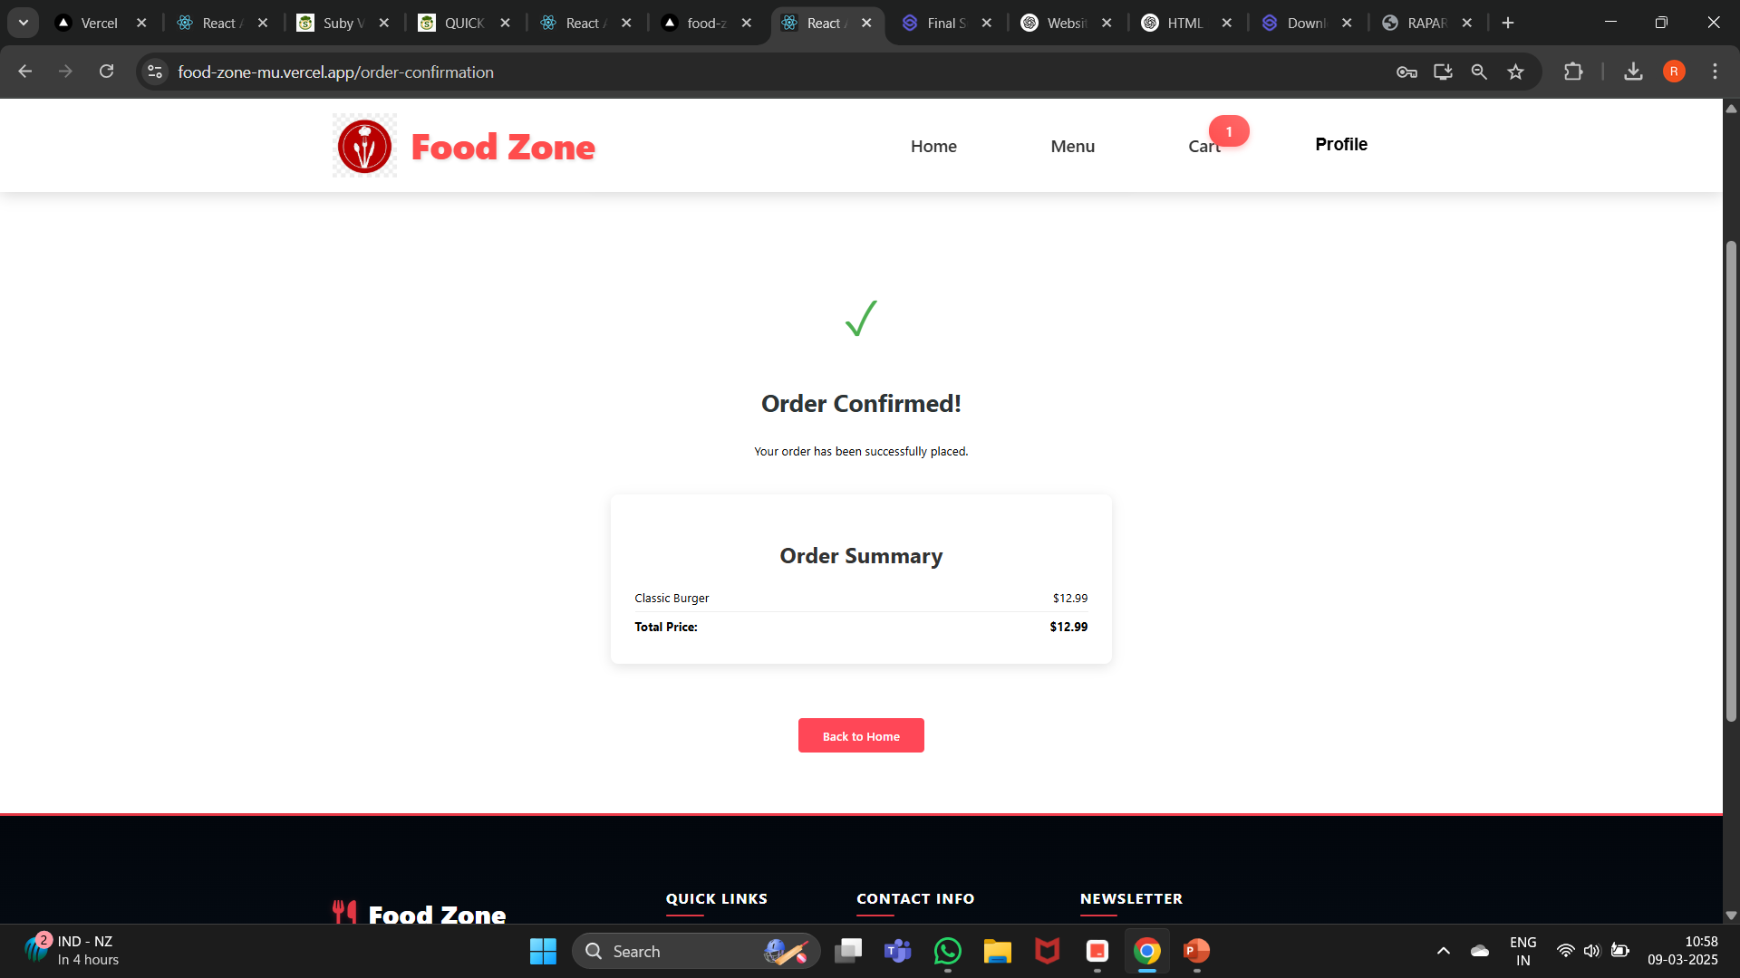
Modelling & Result

Slide 11

Conclusion
Food-Zone delivers an immersive culinary journey through its elegant interface, featuring high-quality food imagery, intuitive navigation, and real-time menu updates. The platform showcases diverse international cuisines with detailed dish information, making food discovery a delightful experience.
Built on the robust MERN stack, the application implements secure user authentication, environment-specific configurations, and optimized API endpoints. The platform ensures seamless performance across different environments, from development to production, with dedicated API URLs and protected routes.

Slide 12


Notes:
Thank You !!

