Slide 1


CHENNAI INSTITUTE OF TECHNOLOGY
INTERNSHIP REPORT
Project Name: CarbonOwl
Team Name: x_x
Team Members: Madhulekha R
Keerthana K V
Thrisha Vijayakumar

Slide 2
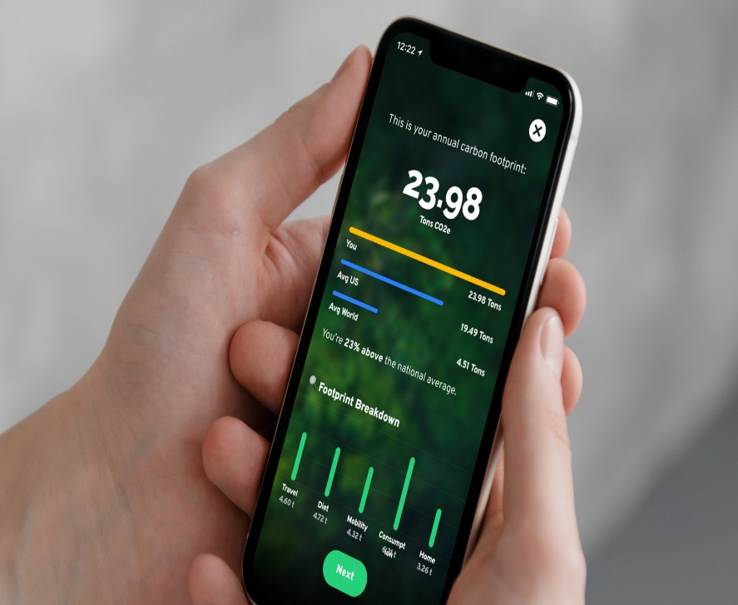
Problem Statement
Play store app for carbon footprint for products
Carbon Owl stands as a visionary force reshaping how we interact with sustainable shopping.
It encourages users to embrace green practices and actively contribute to a more sustainable future.
This app empowers individuals to make informed choices and offers a comprehensive solution that benefit both themselves and the planet.
It leverages various advanced features such as:
QR code scanning
Personalized recommendations
Climate-conscious rewards
Seamless bank account linking

Slide 3
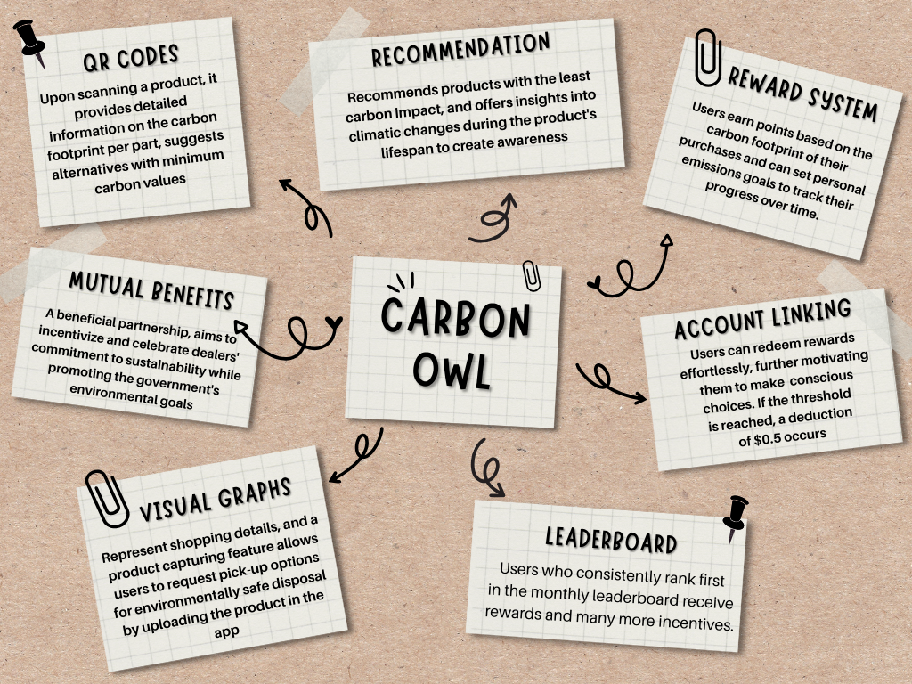

Concept of the solution

Slide 4
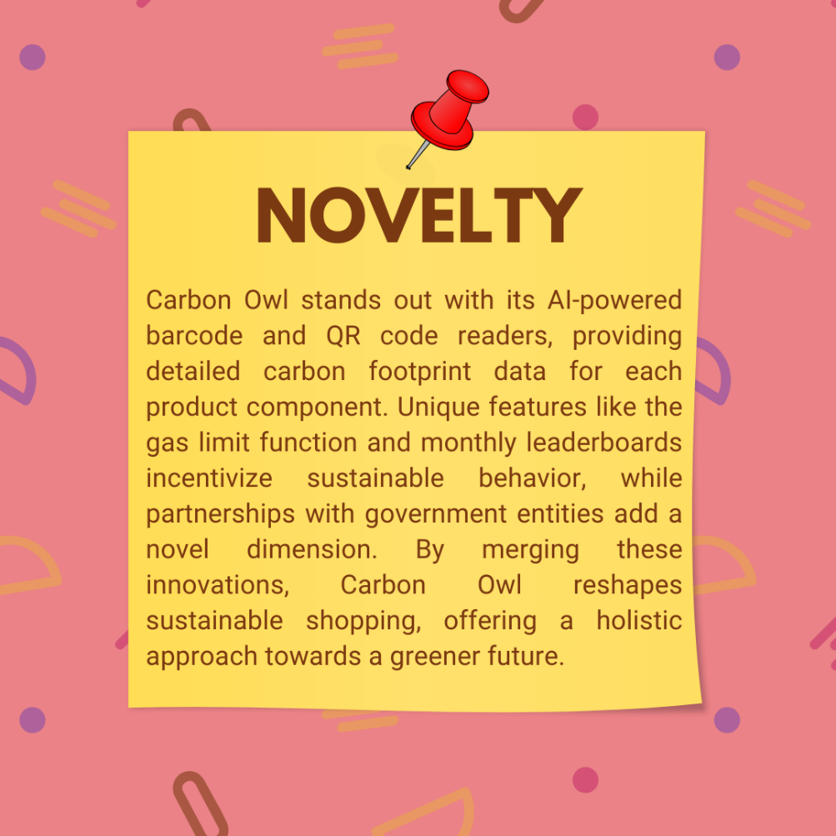
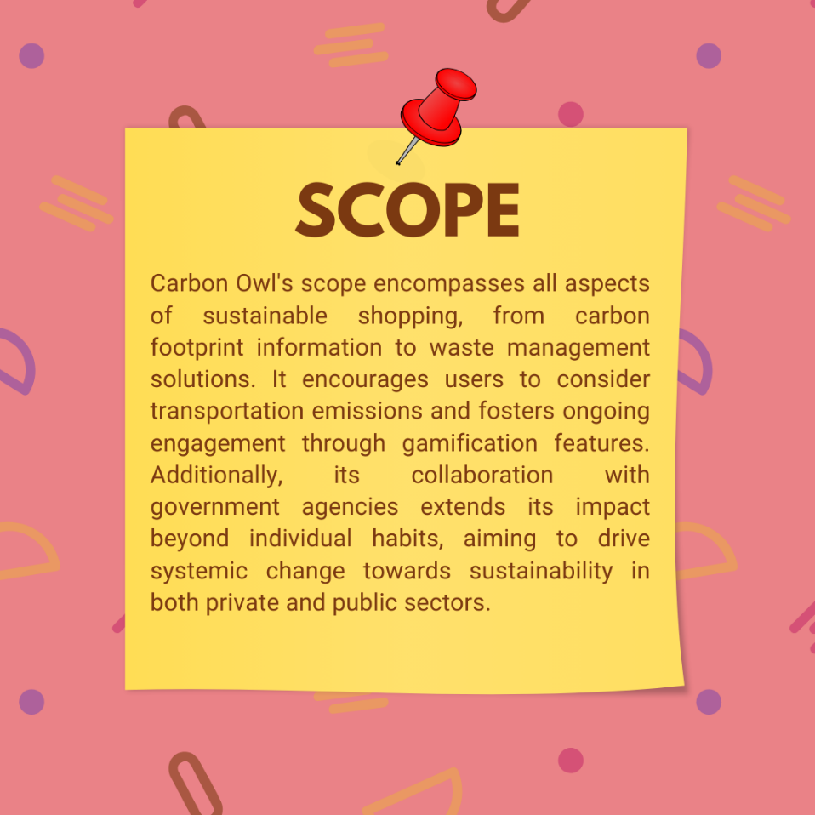
Novelty / Scope of Solution

Slide 5
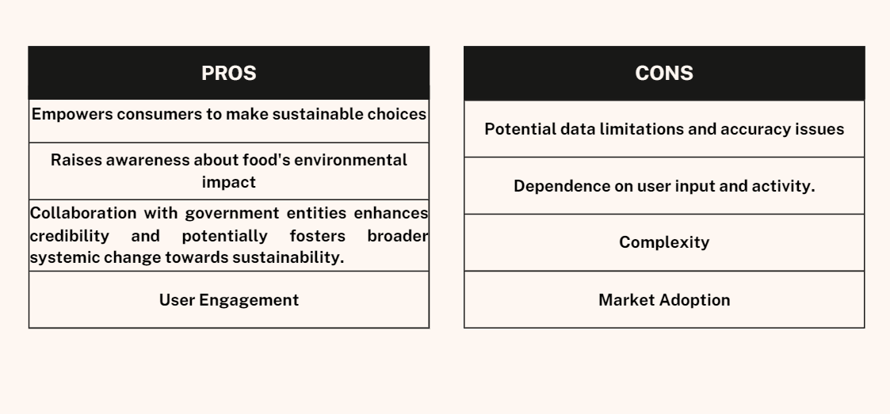

Pros and Cons of the solution

Slide 6
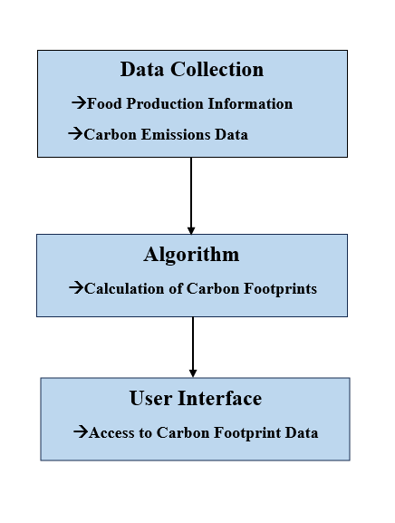
Technical Description
Data Collection:
The app will utilize a comprehensive database of food production information
and carbon emissions data to provide accurate carbon footprints.
Algorithm:
A sophisticated algorithm will calculate the carbon footprints based on various
factors, including food type, production method, and transportation distance.
User Interface:
Intuitive and engaging user interface design will enable users to easily access
and understand the carbon footprint data.

Slide 7
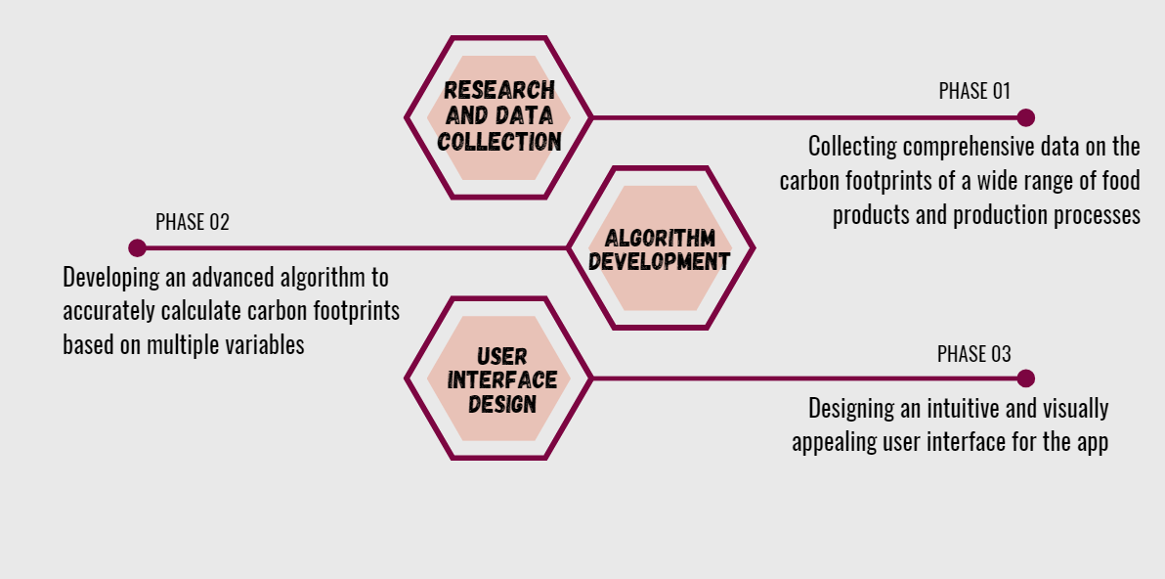
Implementation Plan/Working Model

Slide 8
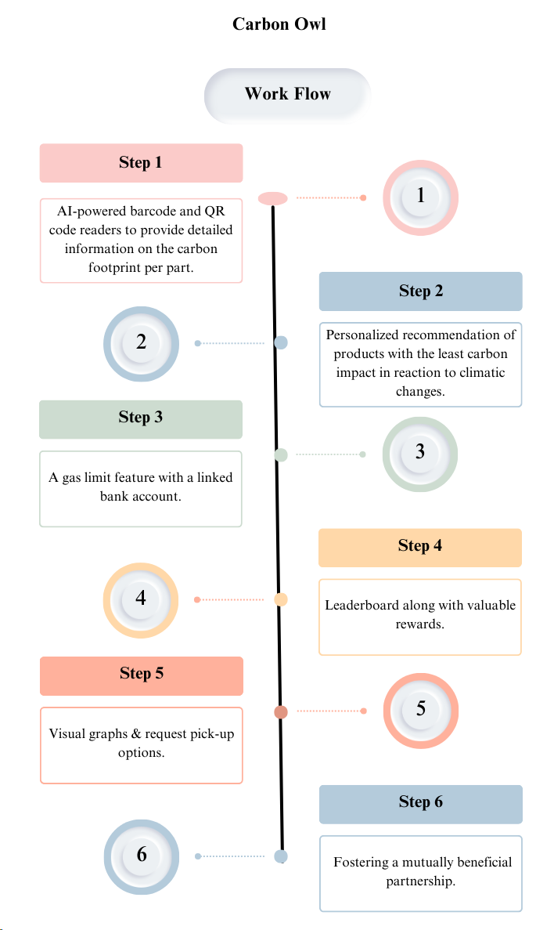
FLOW CHART:

Slide 9
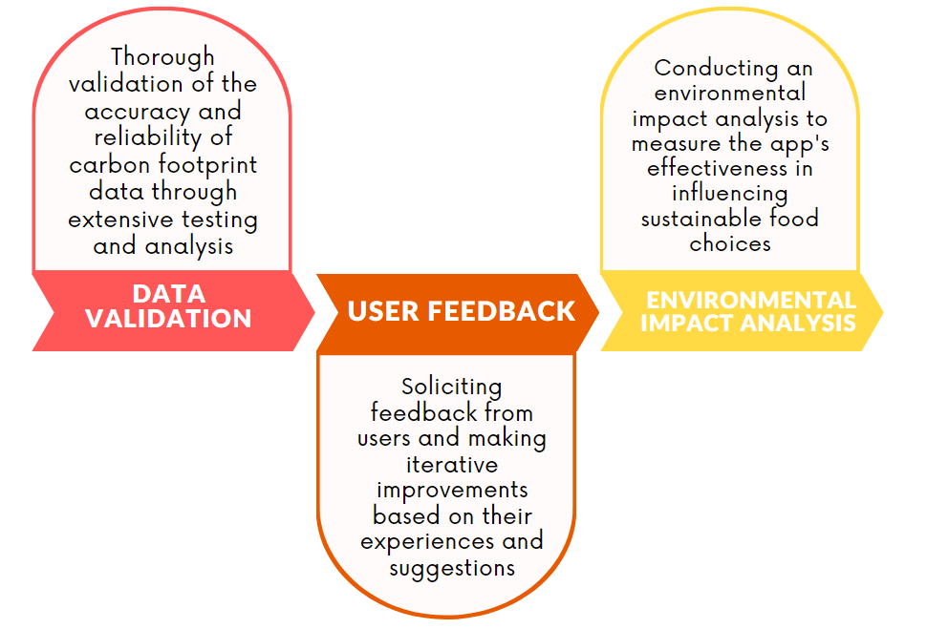

Validation / Testing / Analysis

Slide 10
THANK YOU

