Slide 1

By:
Nuthalapati.Akash
Sanjay M
Sai Srinivasan M
Ramana V
Thrisheiyan U K

Slide 2
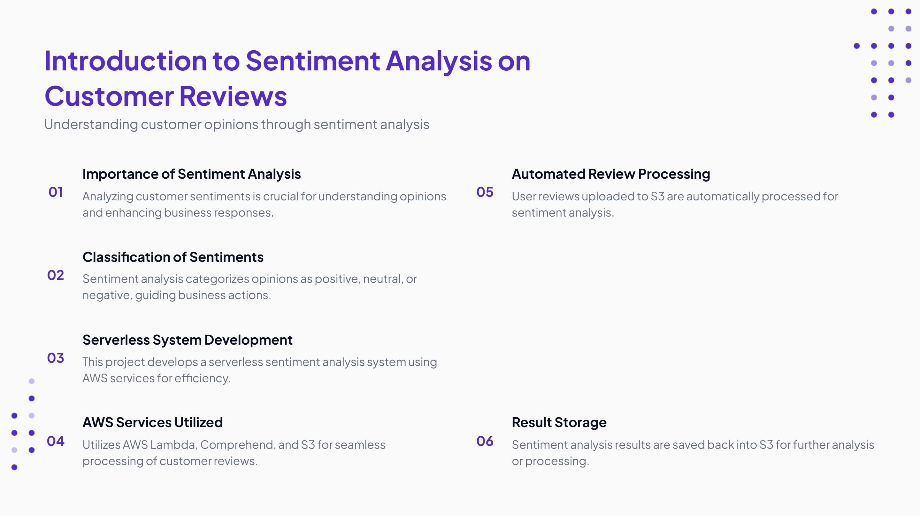

Slide 3
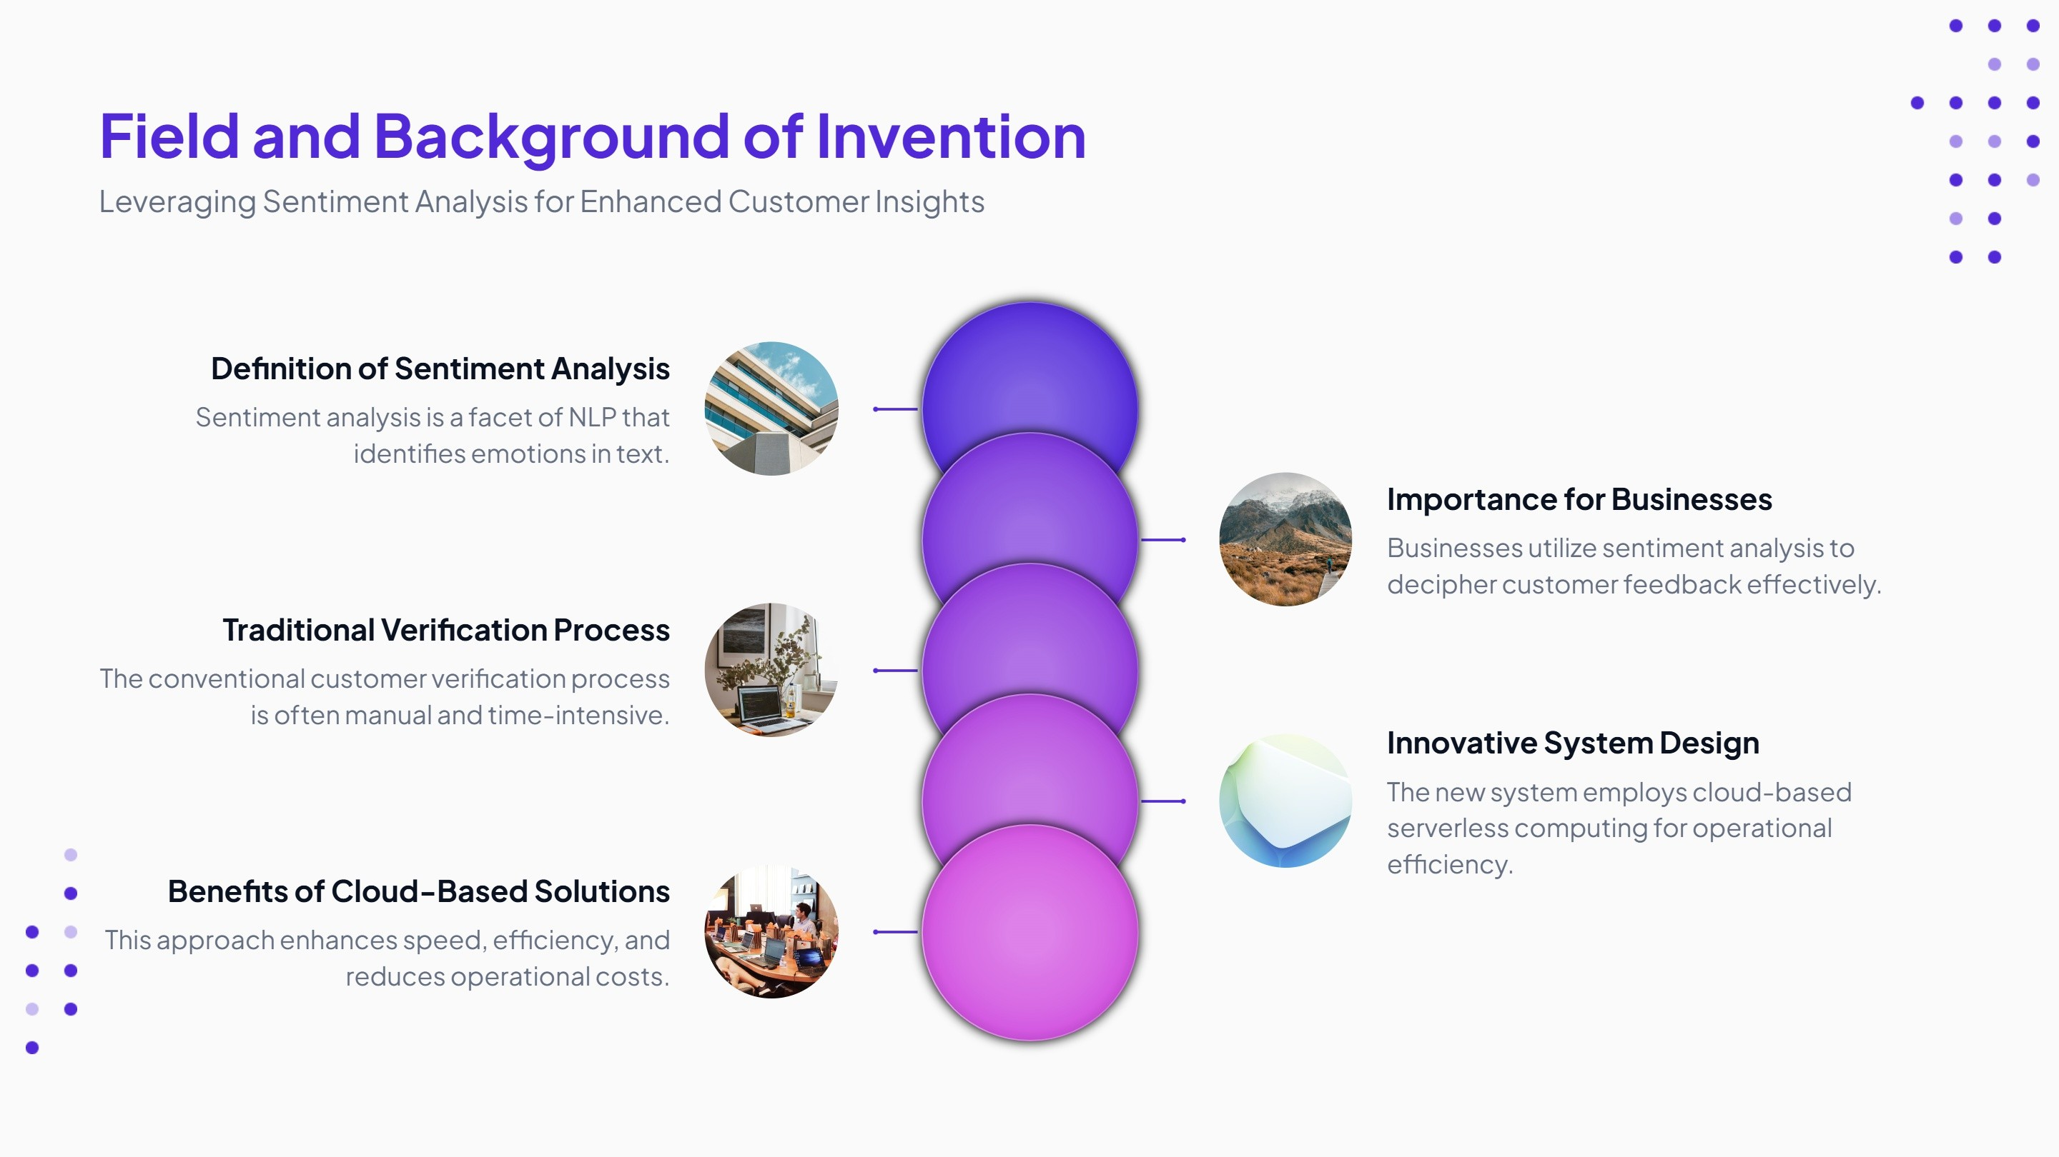

Slide 4
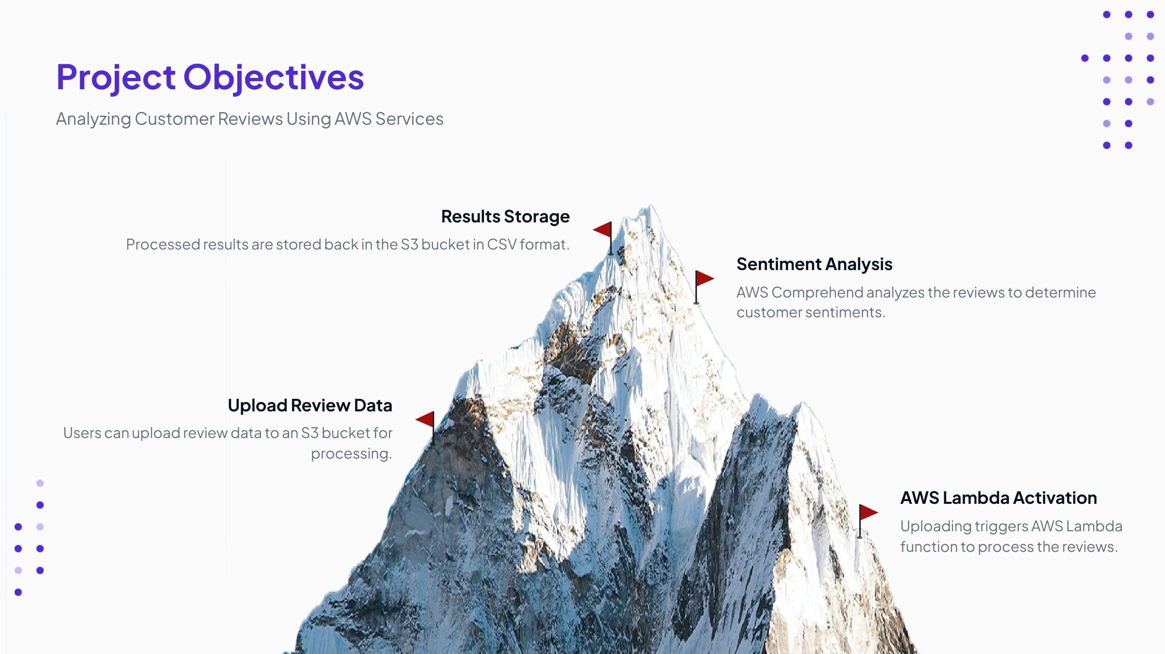

Slide 5
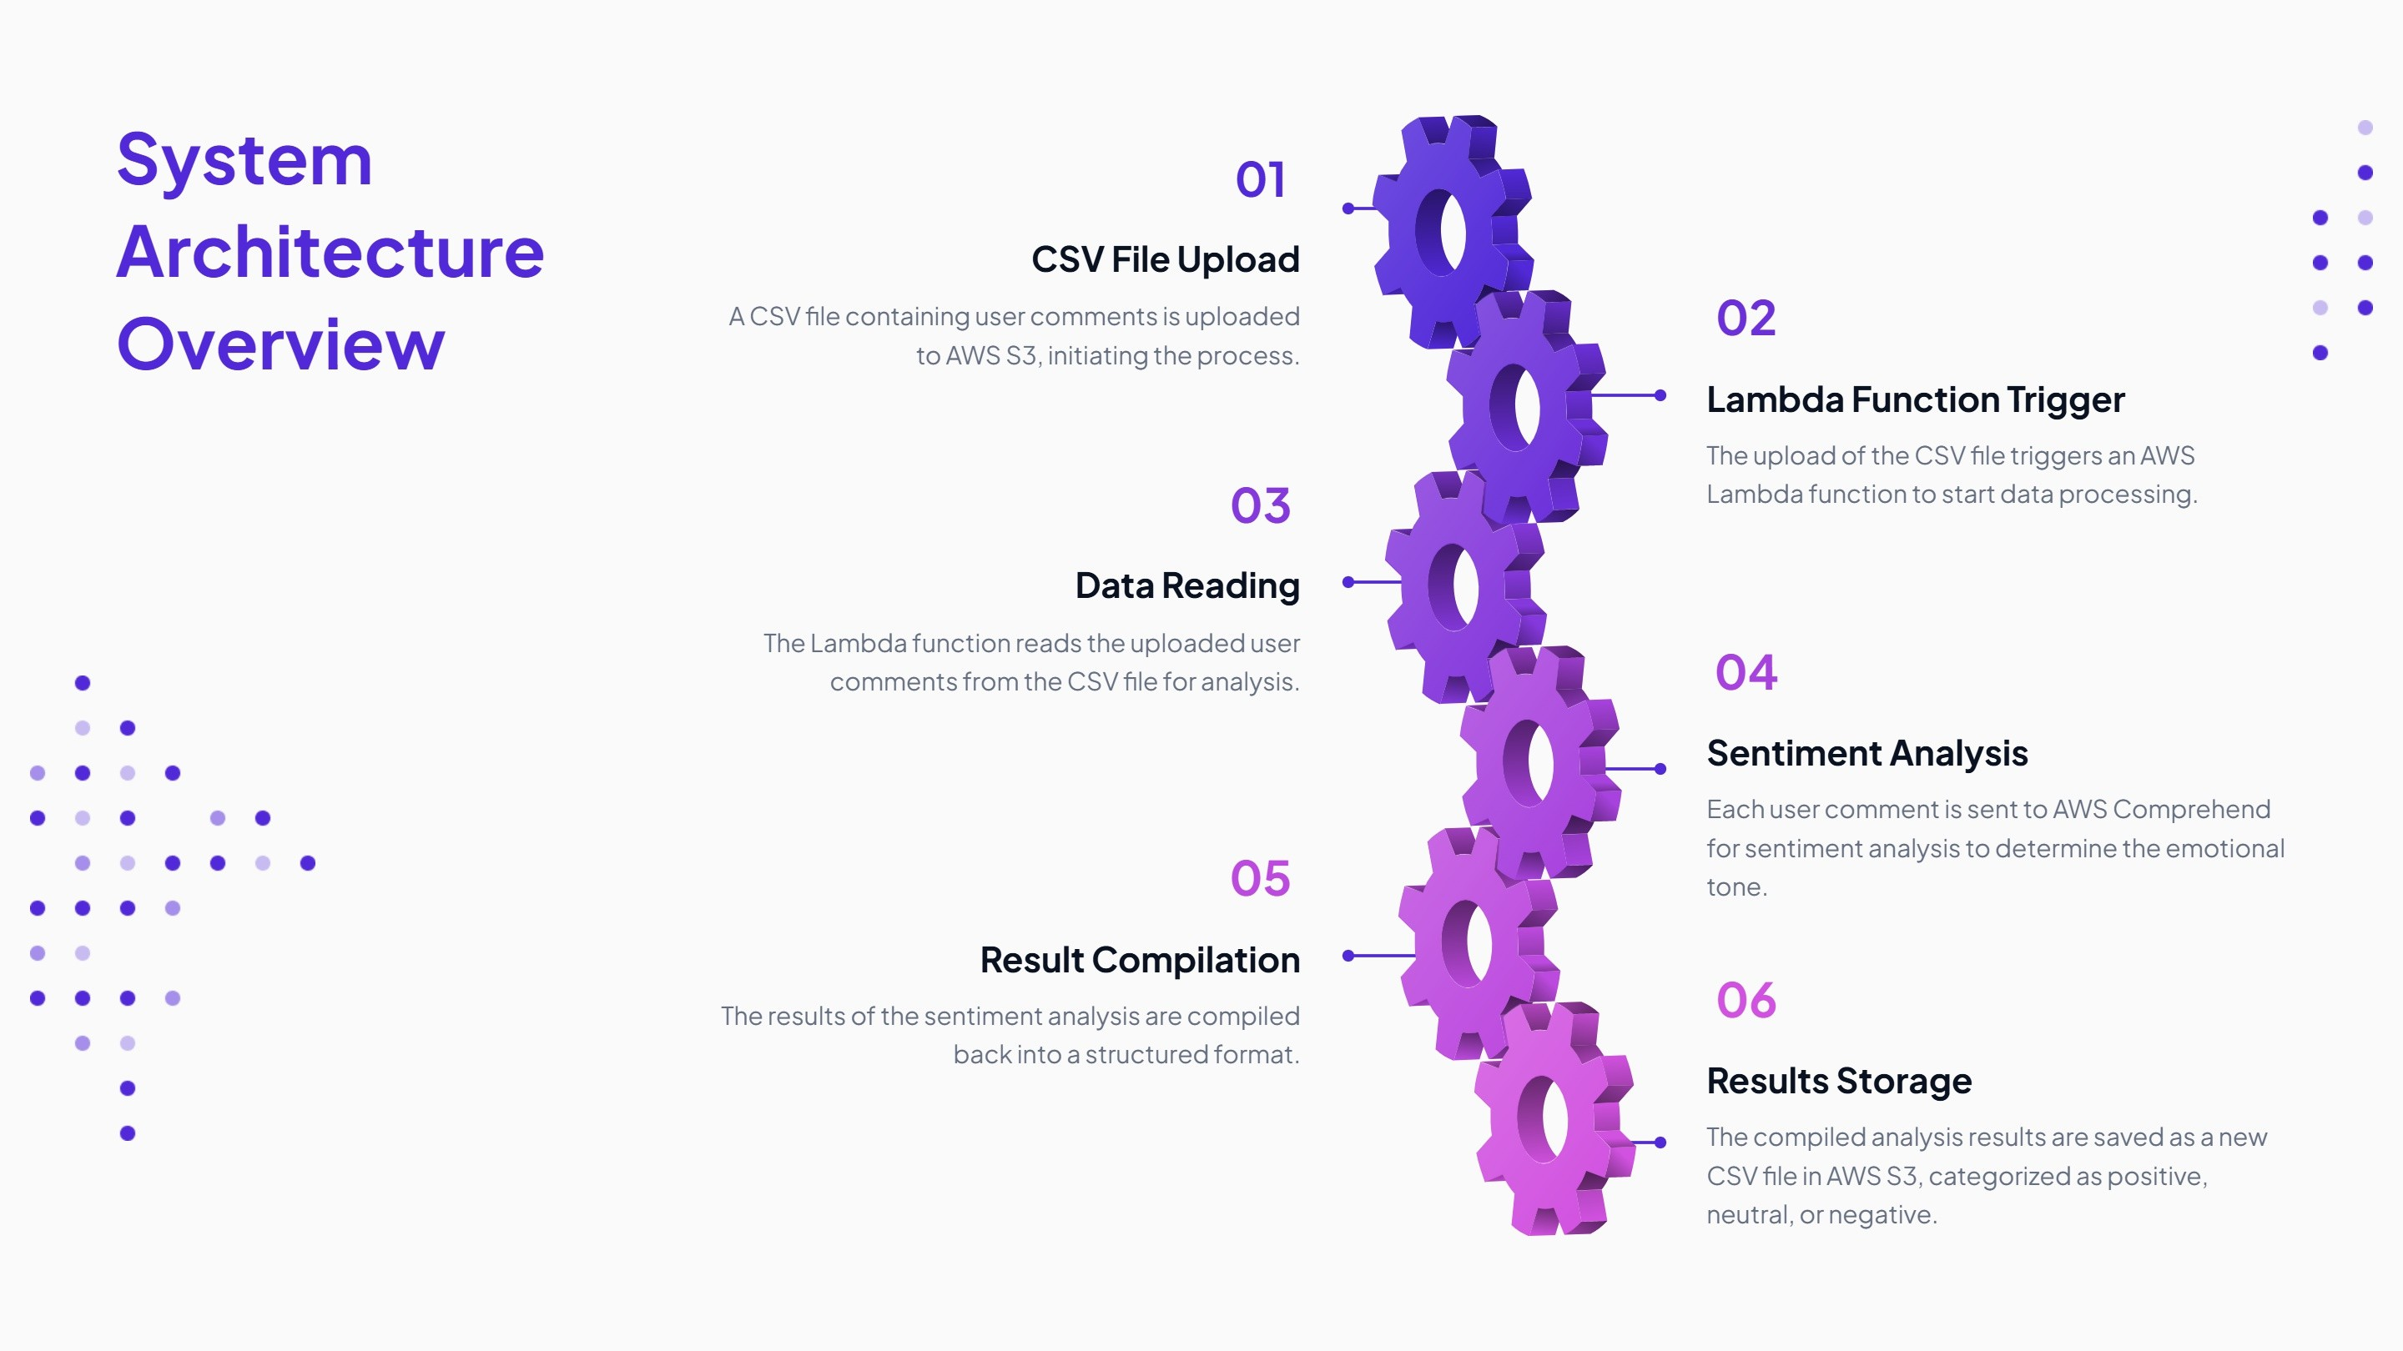

Slide 6
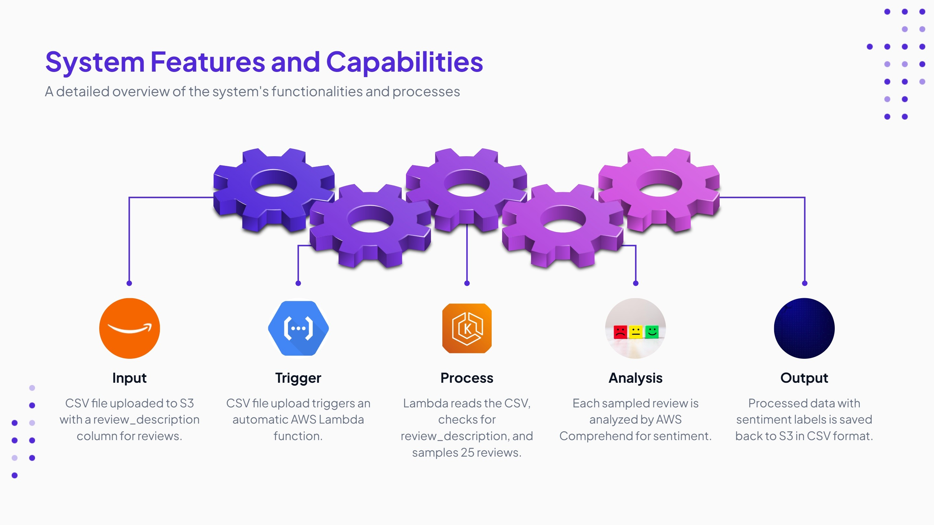

Slide 7
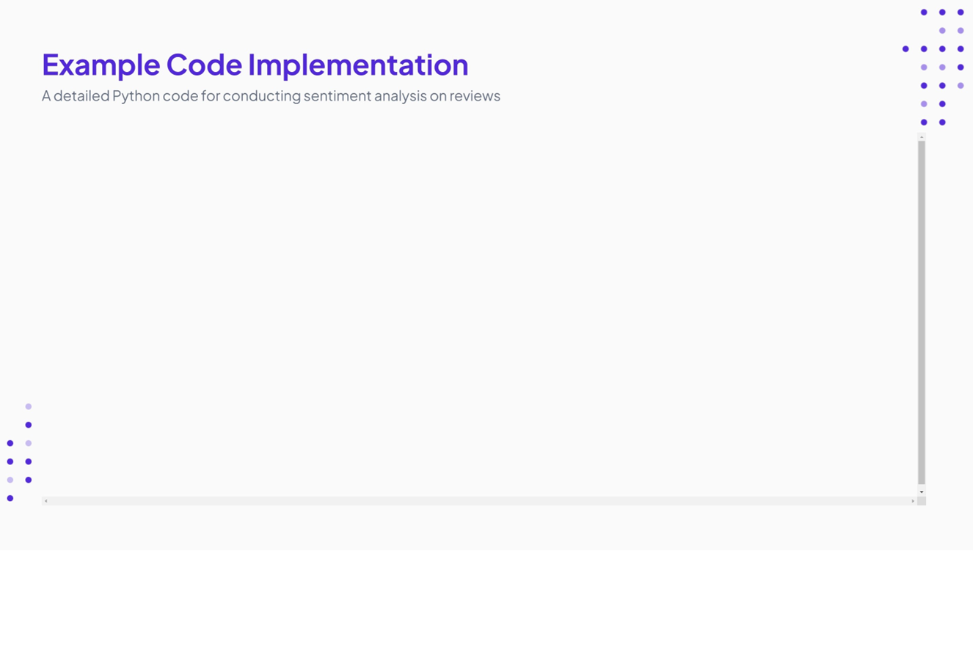
sentiment = comprehend.detect_sentiment(Text=review,
LanguageCode='en')
sentiments.append(sentiment['Sentiment'])
sample_df['Sentiment'] =
sentiments output_key = 'output/' + key.split('/')[-1]
output_csv = sample_df.to_csv(index=False)
s3.put_object(Bucket=bucket, Key=output_key, Body=output_csv)
return {
'statusCode': 200,
'body': json.dumps('Sentiment analysis completed successfully!')
}
except Exception as e:
print(f"Error: {str(e)}")
return {
'statusCode': 500,
'body': json.dumps(f"Error processing file: {str(e)}")
}
import json
import boto3
import pandas as pd
from io import StringIO
def lambda_handler(event, context): s3 = boto3.client('s3')
comprehend = boto3.client('comprehend')
try: bucket = event['Records'][0]['s3']['bucket']['name']
key = event['Records'][0]['s3']['object']['key’]
response = s3.get_object(Bucket=bucket, Key=key)
data = response['Body'].read().decode('utf-8’)
df = pd.read_csv(StringIO(data))
if 'review_description' not in df.columns:
return {
'statusCode': 400,
'body': json.dumps("Column 'review_description' not found.")
}
sample_df = df.sample(n=25, random_state=1) sentiments = []
for review in sample_df['review_description']:

Slide 8
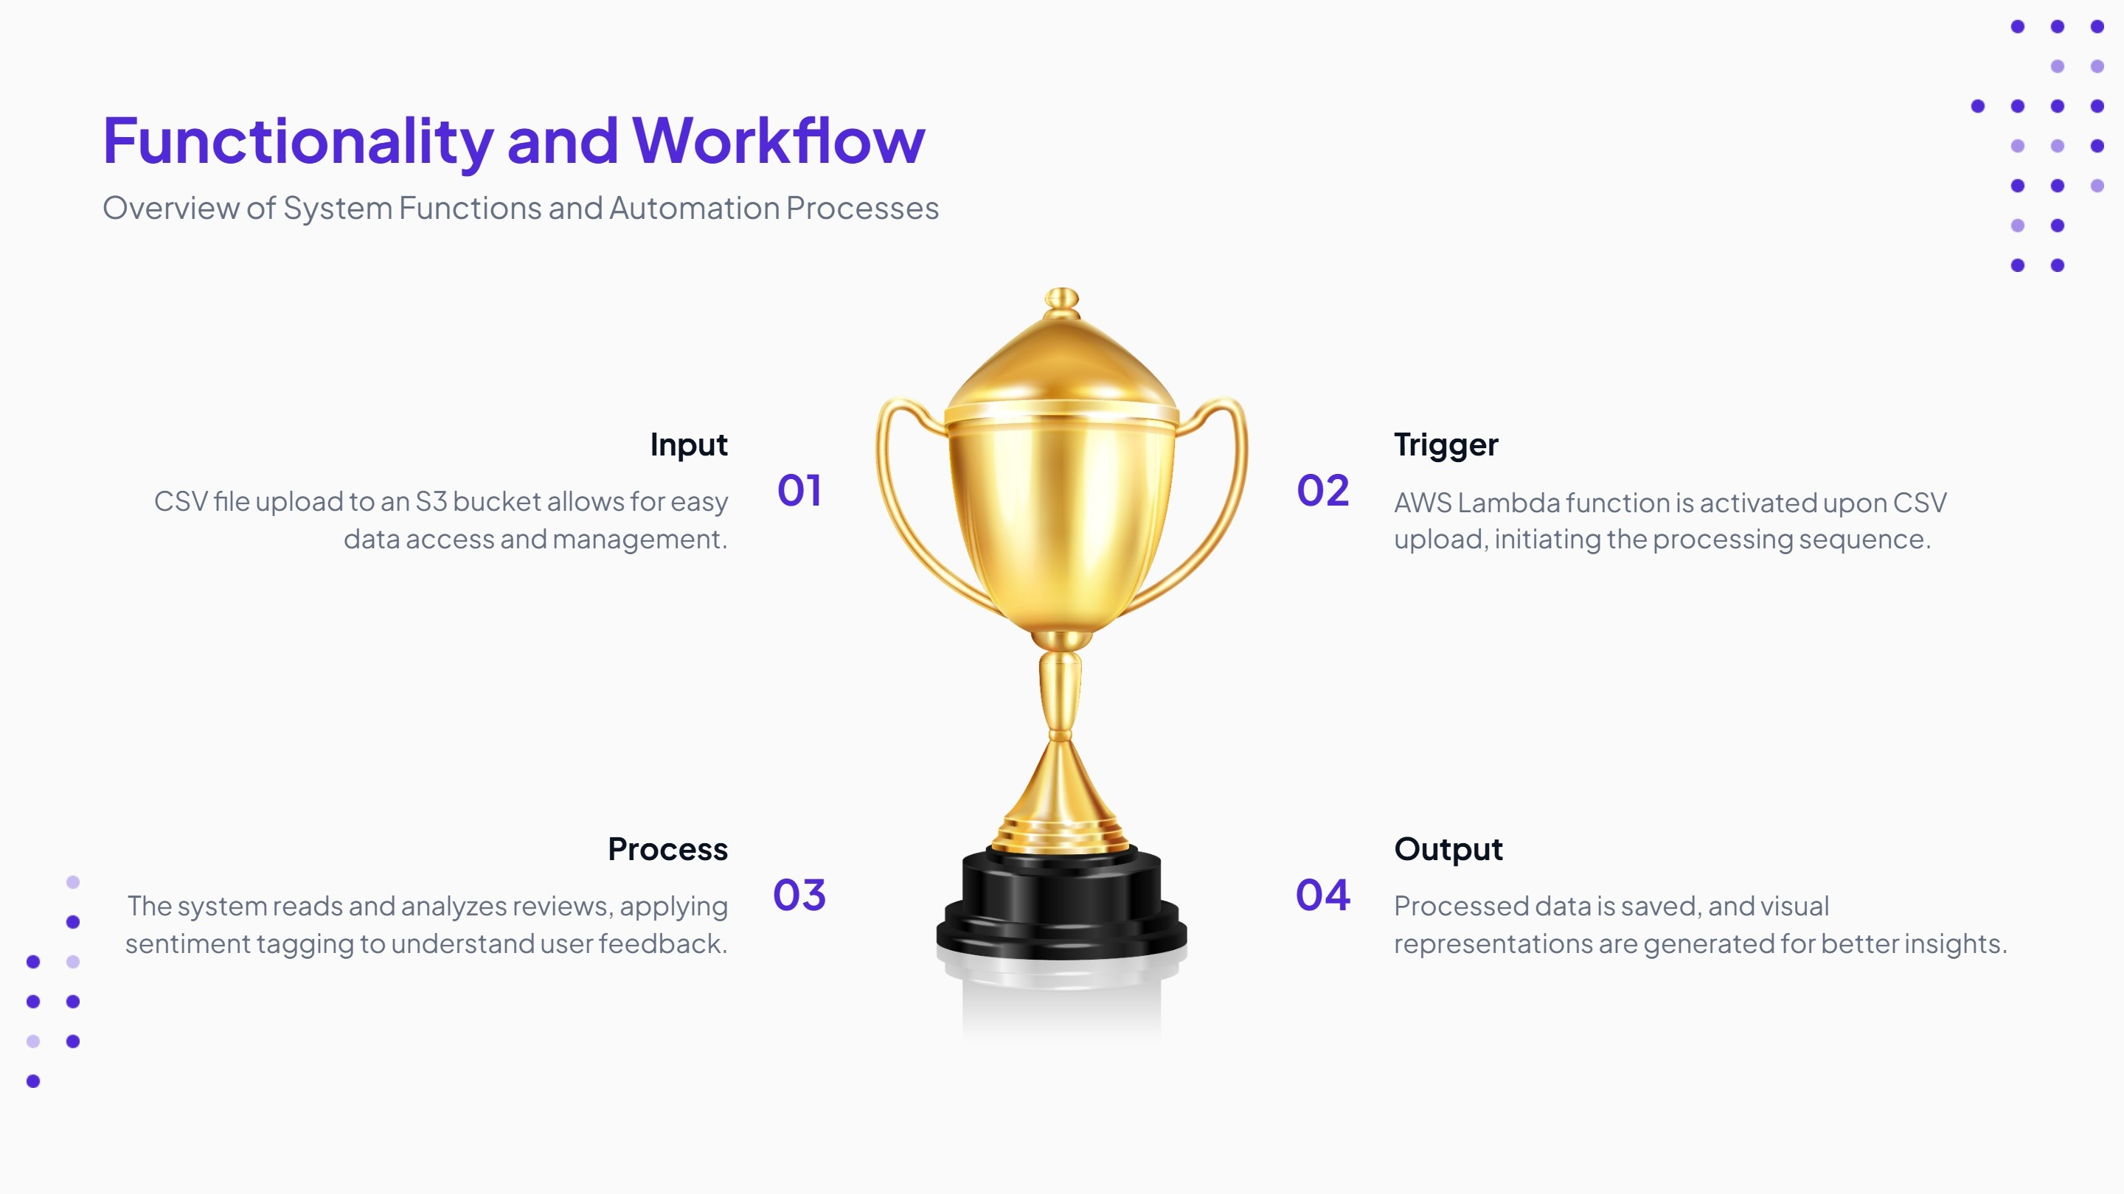

Slide 9


Slide 10
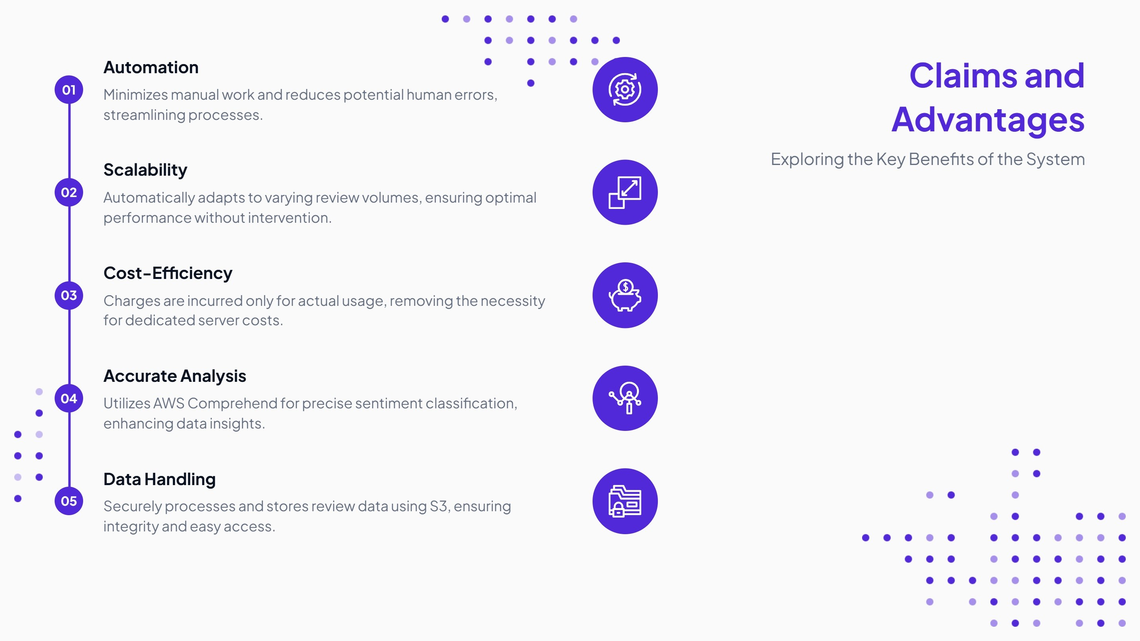

Slide 11
