Slide 1
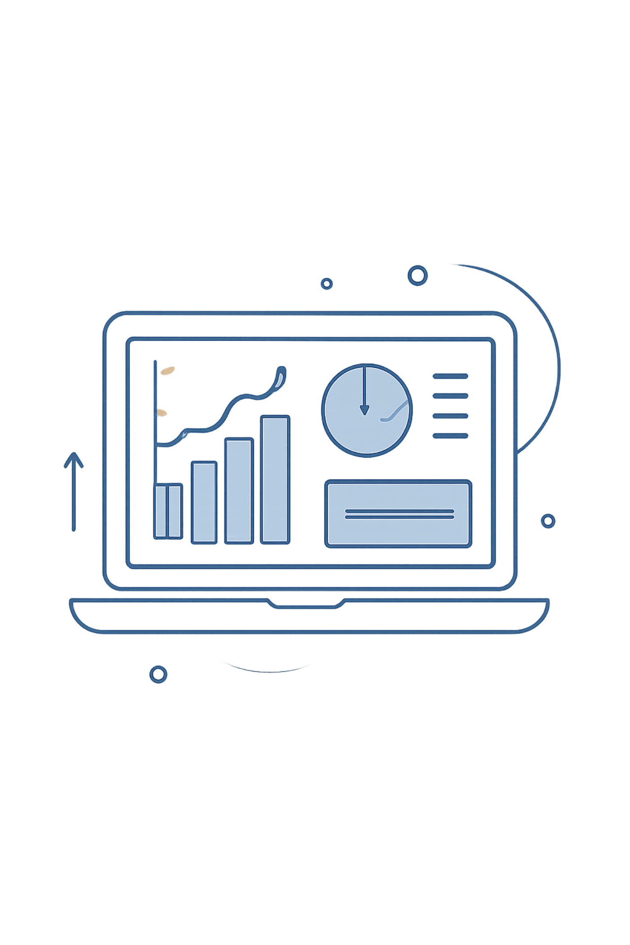
Customer Shopping Behavior Analysis
This project analyzes 3,900 purchases to reveal spending patterns, segments, product preferences, and subscription behavior to inform business strategy.

Slide 2
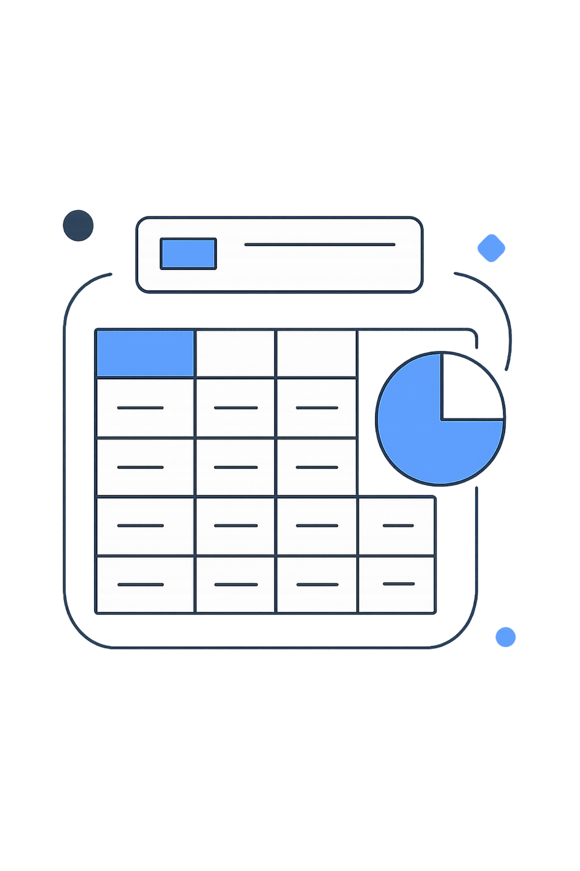
Dataset Summary
Scope
Key Features
3,900 rows · 18 columns: demographics, purchase details, behavior, and shipping.
Age, Gender, Location, Subscription, Item, Category, Amount, Season, Rating, Shipping.
Data Quality
37 missing values in Review Rating column.

Slide 3

Data Preparation & Feature Engineering
Loaded and explored data with pandas (df.info(), .describe()).
Imputed missing Review Ratings using category median.
Renamed columns to snake_case for consistency.
Engineered age_group and purchase_frequency_days.
Dropped redundant promo_code_used after checking discount_applied.

Slide 4

Database Integration
Connected cleaned DataFrame to PostgreSQL and loaded tables for SQL-based business analysis and reporting.

Slide 5
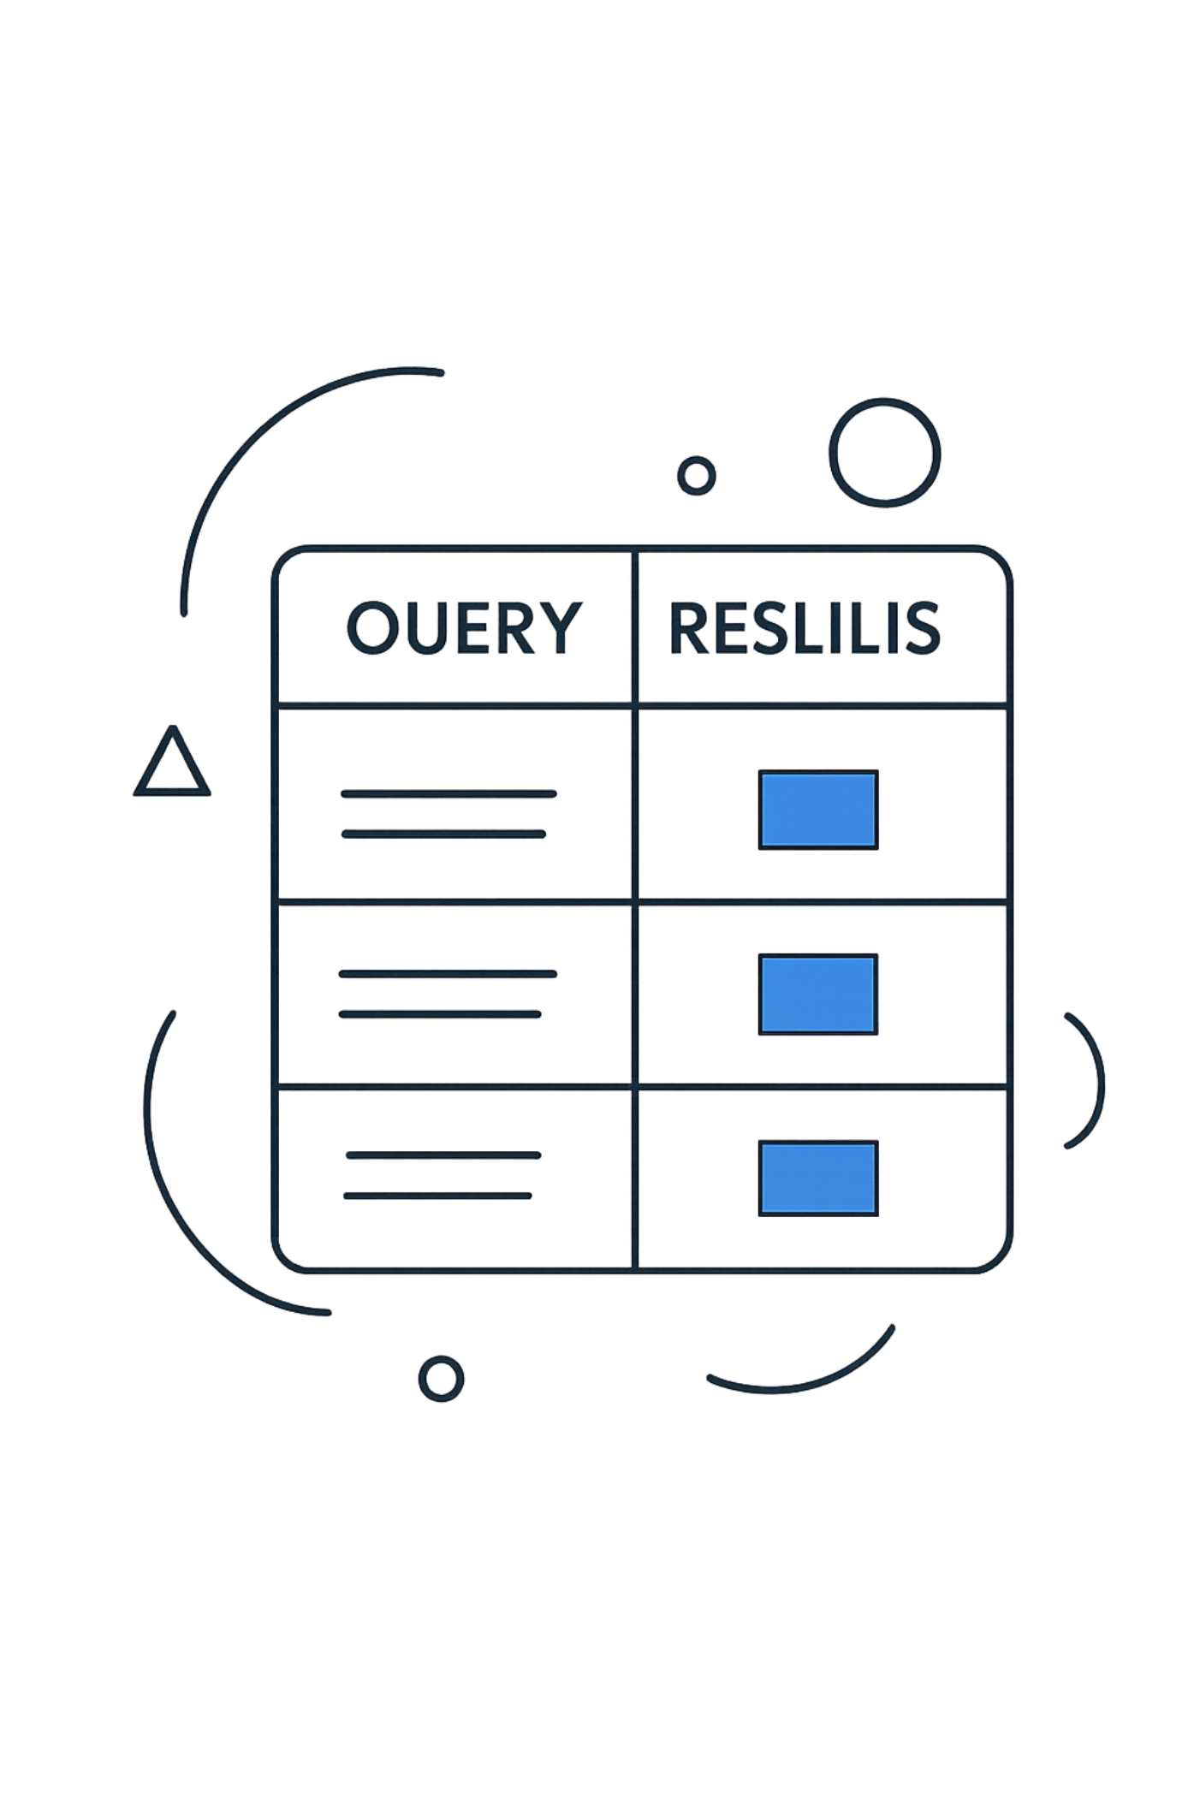



Revenue & Spending Insights (SQL)
Revenue by Gender
Female: 75,191 · Male: 157,890 (total revenue comparison).
High-Spending Discount Users
839 customers used discounts yet spent above average purchase amount.
Shipping Comparison
Average purchase: Standard $58.46 · Express $60.48.

Slide 6



Product Performance
Top Rated Items
Discount-Dependent
Top 5 by average rating:
Highest discount rates:
Gloves (3.86)
Sandals (3.84)
Boots (3.82)
Hat (3.80),
Skirt (3.78).
Hat 50%
Sneakers 49.66%
Coat 49.07%
Sweater 48.17%
Pants 47.37%.

Slide 7

Customer Segmentation & Loyalty
Segments based on purchase history:
Analysis checked whether customers with >5 purchases are likelier to subscribe.
Loyal
Returning
New
3,116 customers — largest group.
701 customers.
83 customers.

Slide 8
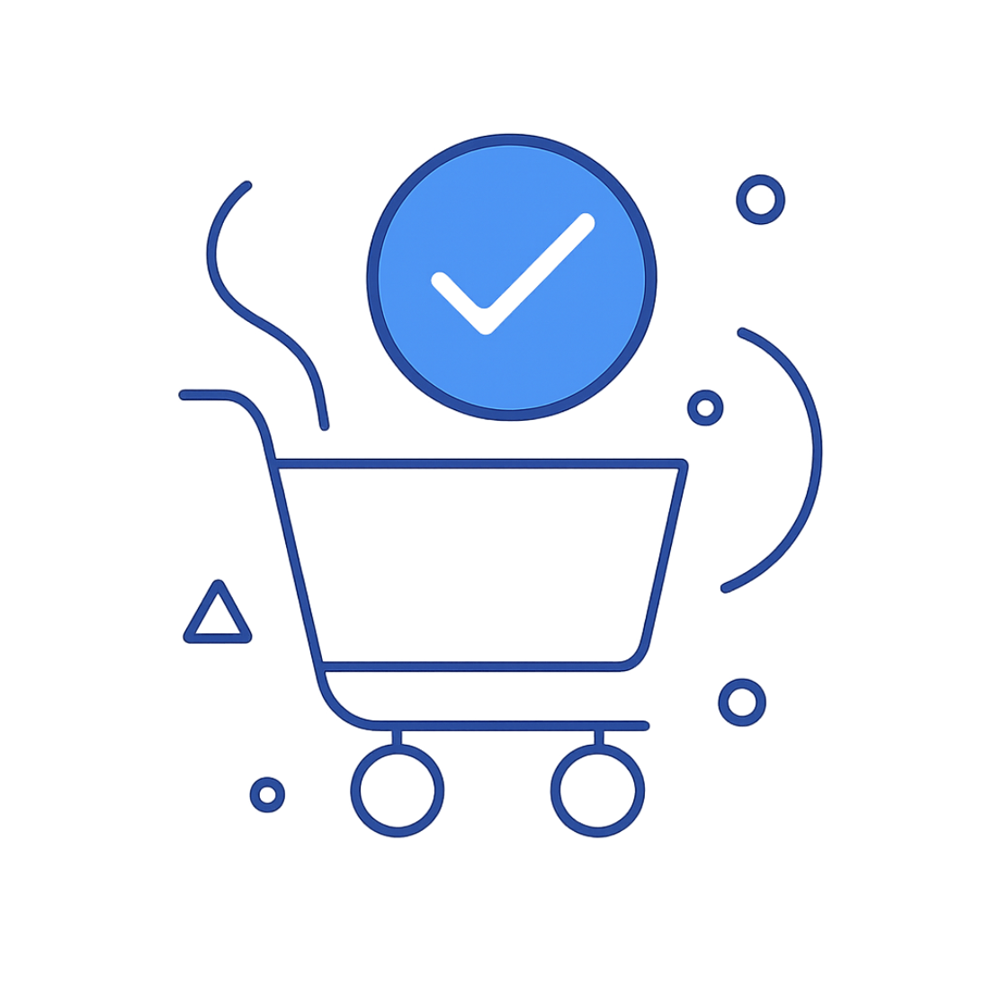
Subscriptions & Revenue Contribution
Subscribers vs Non-subscribers:
Subscribers
1,053 customers · Avg spend $59.49 · Total revenue $62,645.
Non-Subscribers
2,847 customers · Avg spend $59.87 · Total revenue $170,436.

Slide 9

Top Products & Revenue by Age
Top items by orders (examples): Jewelry, Sunglasses, Belt; Clothing: Blouse, Pants, Shirt; Footwear: Sandals, Shoes, Sneakers; Outerwear: Jacket, Coat.
Revenue by age group calculated to identify high-value cohorts for targeted marketing.

Slide 10
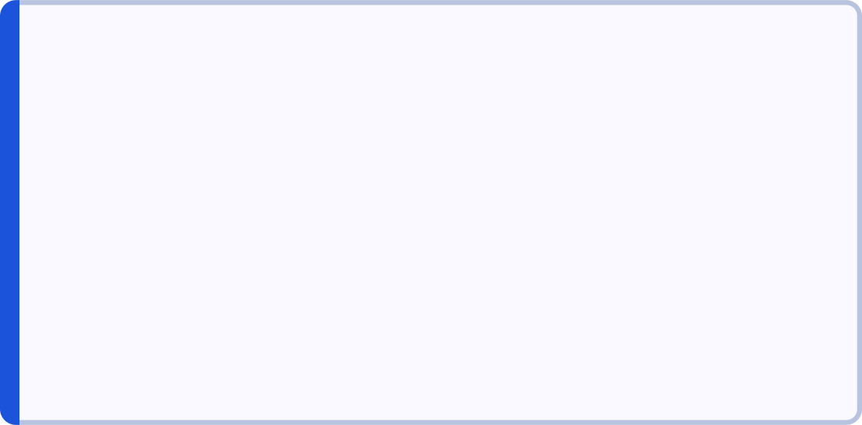
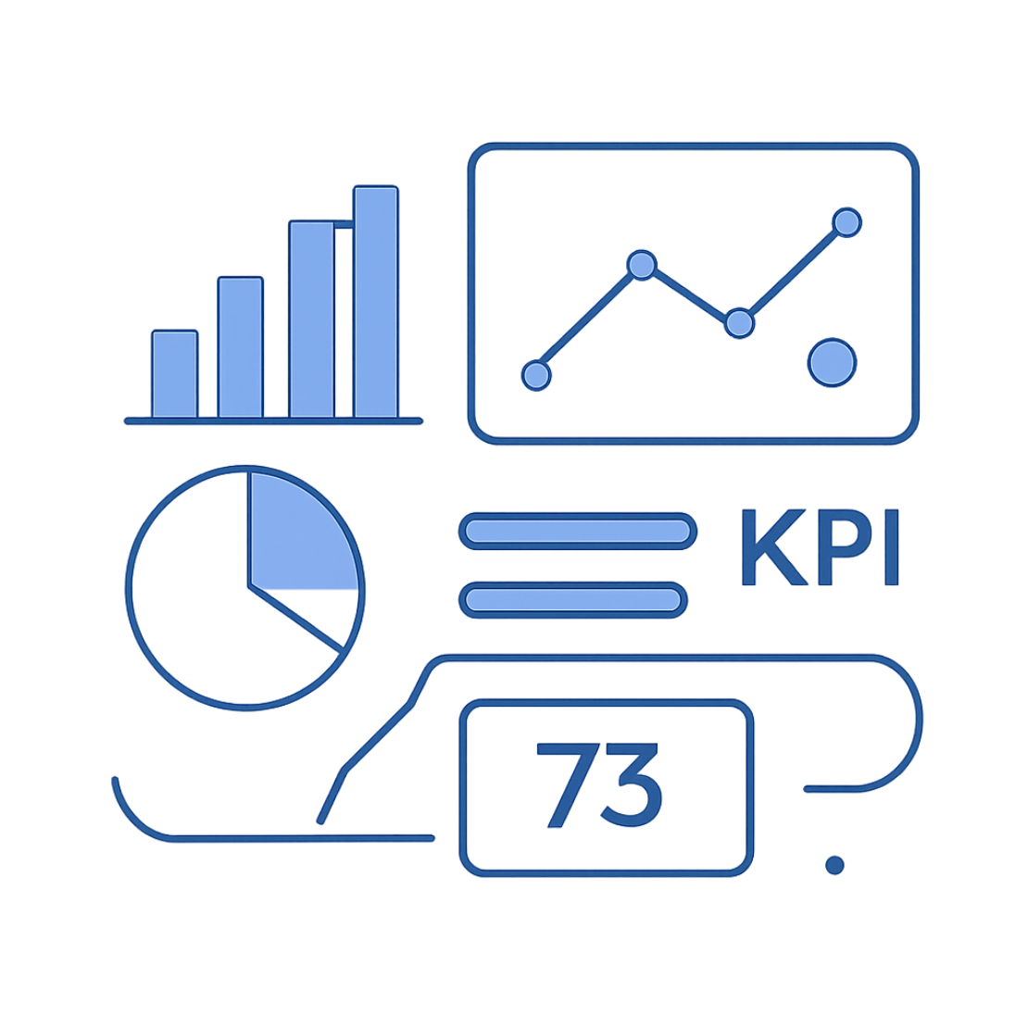

Dashboard & Recommendations
Boost Subscriptions
Customer Loyalty Programs
Promote exclusive subscriber benefits to increase retention.
Reward repeat buyers to move them into the Loyal segment.
Review Discount Policy
Product Positioning & Targeting
Balance sales lift with margin control; target discount-dependent items carefully.
Highlight top-rated, best-selling products and target high-revenue age groups and express-shipping users.
Interactive Power BI dashboard built to visualize these insights for stakeholders.

