Slide 1
IFM2B10 · GROUP PROJECT PROGRESS UPDATE · 26 AUGUST 2026
OPALÉRA
The House of Every Gem — a B2C fine-jewellery storefront
QUANTUM CODERS · 80 pieces · 92 pages · built, styled & working
Notes:
Good day, we are Quantum Coders. This is OPALÉRA — our fine-jewellery e-commerce project. Everything you are about to see on these slides is a real screenshot of the running site, and we will demo it live after the walkthrough.

Slide 2
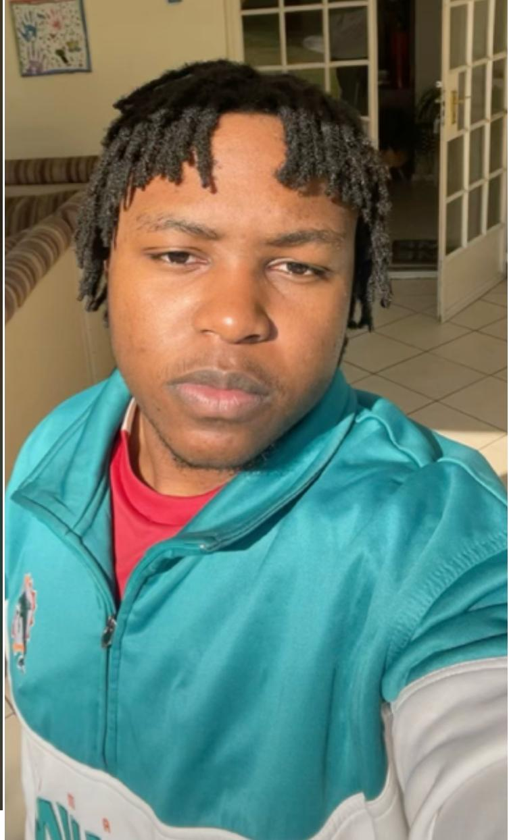
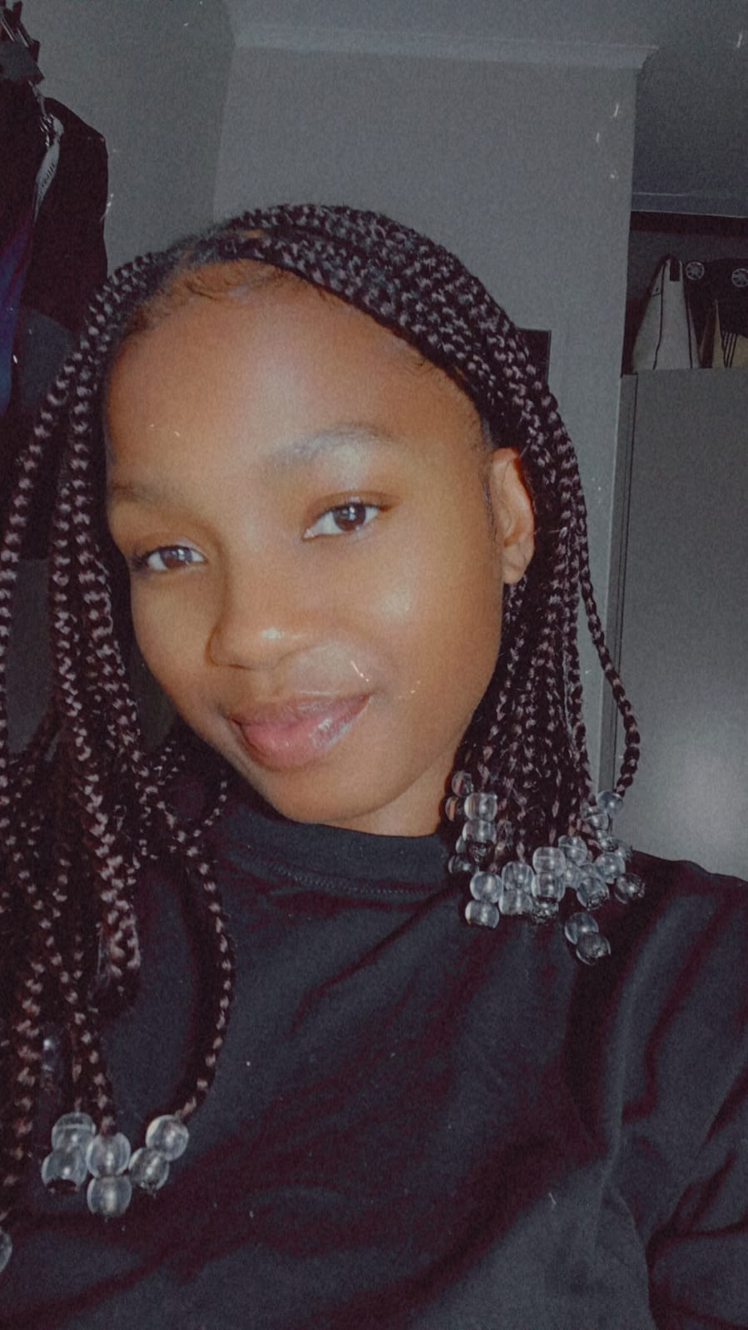

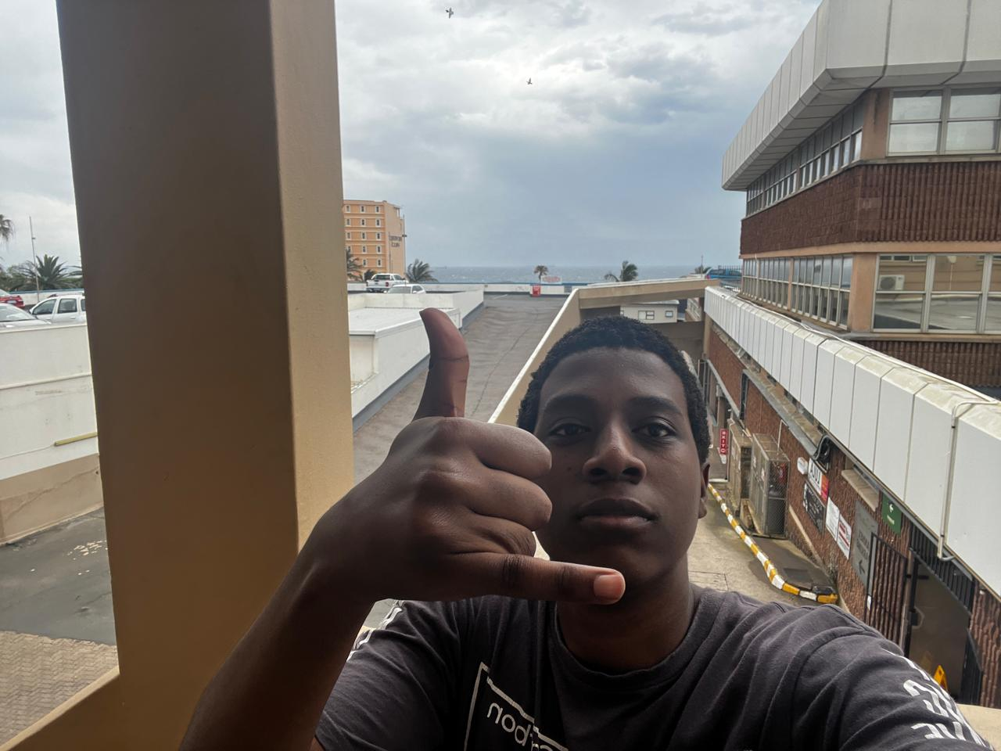
QUANTUM CODERS
The Team
Tsongorera RJN
Thedzisani KOP
Madhavan T
Mtshare B
225059699
224098795
225139703
225226751
Leader · Backend developer
Frontend developer
Backend developer · Database creator
Frontend developer
Notes:
Introduce each member by name and role: Tsongorera leads the team and builds the back-end with Madhavan, who also found and implements the database; Thedzisani and Mtshare build the front-end you are about to see.

Slide 3
FROM THE PROPOSAL
Why OPALÉRA Exists
Buying jewellery online is a gamble — fake stones, no recourse, and real pieces priced beyond a normal salary. OPALÉRA answers with a maison you can trust.
Certified authentic
Honest prices
The rating system
Every piece carries its own certificate of authenticity; the maison refunds in full if a stone is ever misrepresented.
Direct-from-atelier pricing from R 959, VAT included, with instalment framing on every piece.
The proposal's differentiator: star ratings, written patron reviews and thumbs votes on every piece — visible before you pay.
Catalogue: the 80-piece Kaggle jewellery dataset · necklaces, earrings & pendants · R 959 – R 6 799
Notes:
Our proposal made three promises: protection from fake-stone scams, honest prices on a real salary, and a rating system as the differentiator. Hold those three in mind — every screen that follows keeps one of them.

Slide 4
PROGRESS AGAINST THE MARKING SHEET
Where Every Feature Stands
DONE
Website design
DONE
Shopping cart
layout · styling · colour system
quantities · stock caps · persistent
DONE
Product catalog
DONE
Transaction processing
search · filter · sort · stock
discount · VAT 15% · checkout
IN PROGRESS
Database
IN PROGRESS
Invoices
schema mirrored; DB itself next
working draft — wiring continues
DONE
Products / test data
IN PROGRESS
User management
80 pieces · a page for each
3 roles live — deepening access
DONE
Product management
IN PROGRESS
Reports
manager adds · retires · restocks
charts live — more data views coming
Six features stand complete; four are in honest motion — each already working on screen, finishing as the back-end lands.
Notes:
Against the marking sheet: six features are done, four are in progress — and 'in progress' here means already working on screen, as the screenshots will show, with the remaining depth arriving with the back-end. We would rather under-claim and over-show.

Slide 5
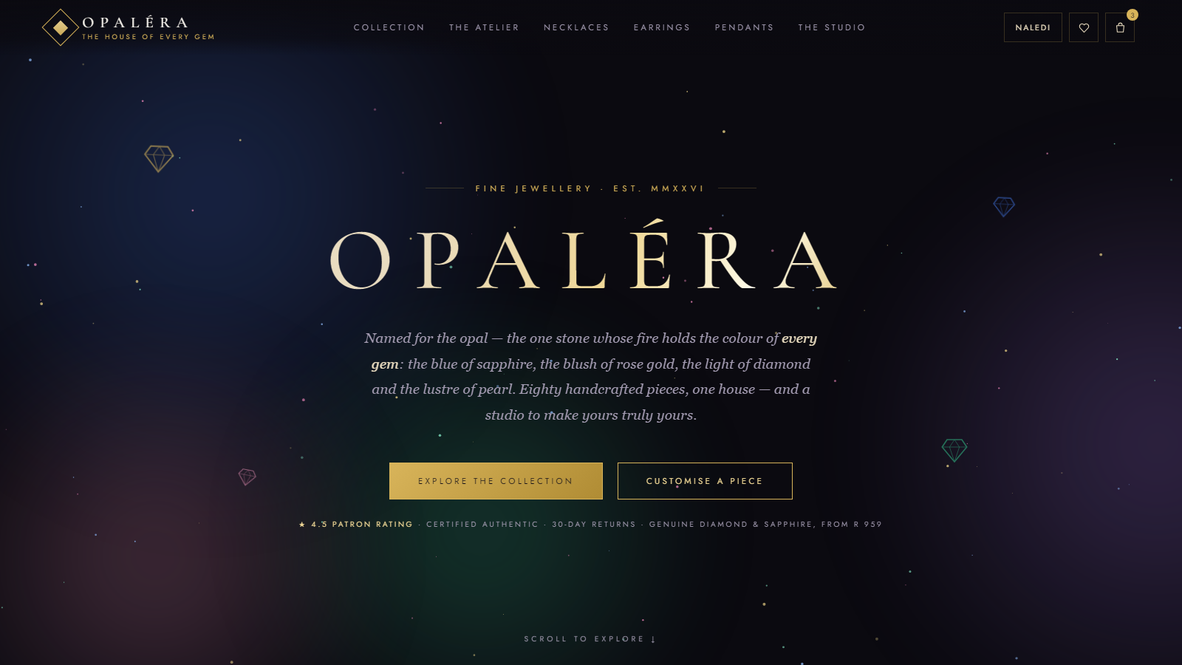
THE SITE TOUR · EVERY IMAGE IS A REAL SCREENSHOT
Arrival at the Maison
Animated aurora and sparkle field behind every page
One gold-on-midnight design system, 92 pages
Trust strip on arrival: rating · authenticity · returns
Signed-in patron, live wishlist & bag counts
WEBSITE DESIGN · DONE
Notes:
This is the home page as it renders today — the aurora background drifts slowly, the sparkles twinkle, and the trust strip answers the proposal's promises the moment you arrive.

Slide 6
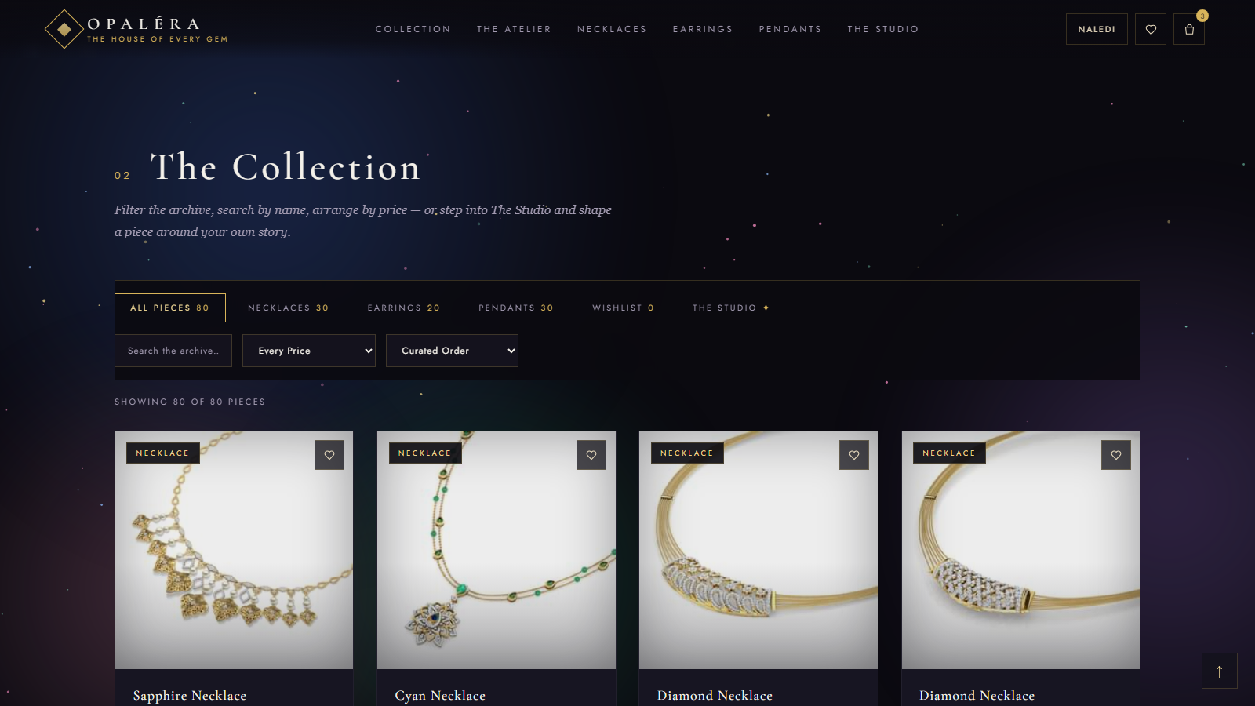
THE SITE TOUR · PRODUCT CATALOG + TEST DATA
The Collection — 80 Pieces, 80 Pages
Category tabs with live counts
Search, price bands and sorting combine
“Showing 80 of 80 pieces” honesty line
Wishlist hearts on every card
Each card opens the piece's own page
CATALOG · DONE
TEST DATA · DONE
Notes:
The catalogue: eighty pieces across three collections. The brief asked for ten products with description pages — we generated an individual HTML page for every one of the eighty.

Slide 7
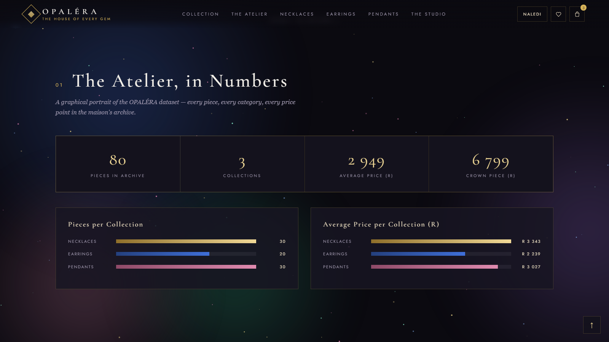
THE SITE TOUR · THE DATASET, VISUALISED
The Atelier, in Numbers
Live stat counters computed from the dataset
Pieces per collection, coloured by gem accent
Average price per collection in rand
Animates in as the visitor scrolls
WEBSITE DESIGN · DONE
Notes:
Between the hero and the shop sits a graphical portrait of the dataset itself — the counters count up and the bars grow as you scroll. Nothing is hard-coded.

Slide 8
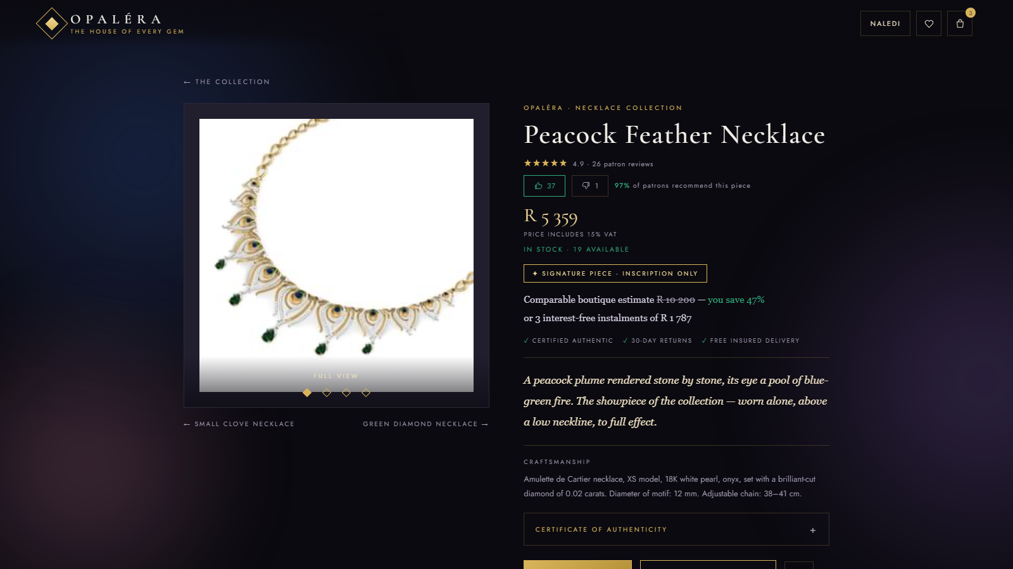
THE SITE TOUR · ONE PAGE PER PIECE
The Product Page
Hand-written description for all 80 pieces
4-view gallery with a follow-your-finger magnifier
Stars, thumbs votes and “97% recommend”
Stock level, VAT note, signature-piece rule
Certificate of authenticity on every piece
RATINGS · LIVE
Notes:
Every piece has this page: its own description, the magnifier gallery, the rating system from our proposal — stars, reviews and thumbs — plus stock, VAT and the certificate.

Slide 9
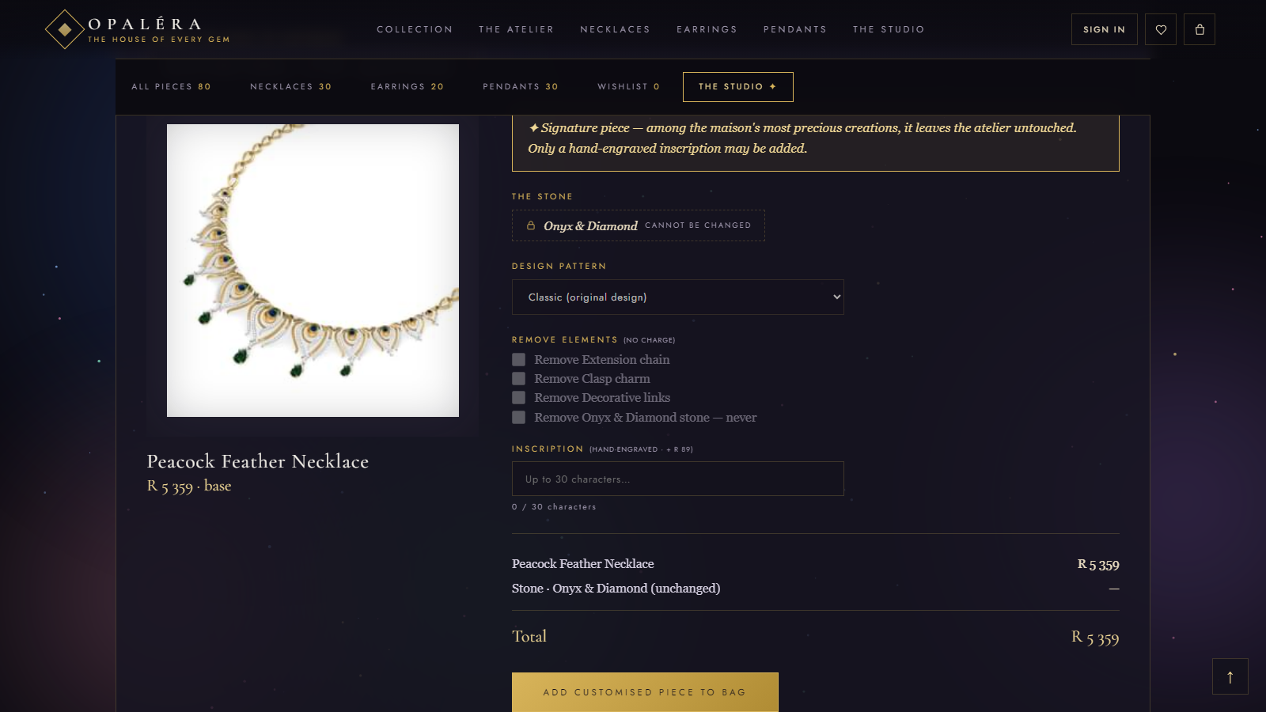
THE SITE TOUR · BEYOND THE BRIEF
The Studio — Customisation, With Rules
Patterns, removable elements, add-a-pendant
30-character inscription with a content filter
The stone is never changed — locked on screen
Signature pieces: inscription only
Priced live, carried to bag and invoice
PRODUCT MGMT · DONE
Notes:
The Studio is our feature beyond the brief. Watch the locked row — the stone cannot be changed, ever. Inscriptions are screened for offensive content because engraving is permanent.

Slide 10
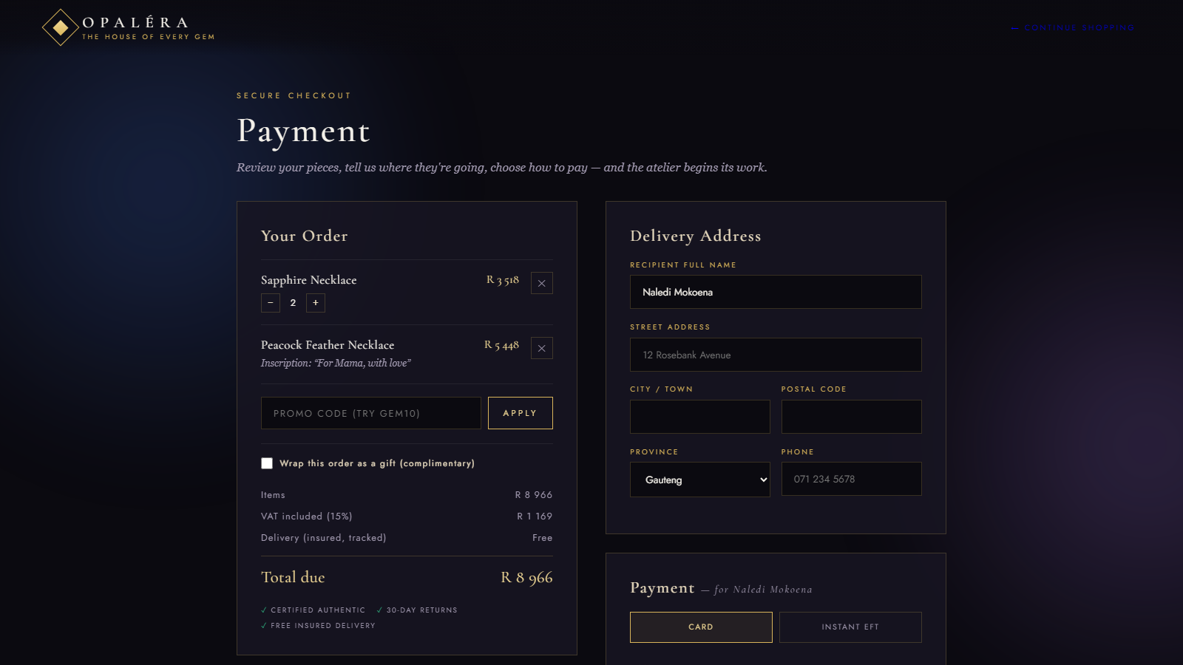
THE SITE TOUR · CART + TRANSACTION PROCESSING
Checkout: Quantities, VAT & Delivery
Bag with quantities, capped by real stock
Customisations itemised (see the inscription)
Promo codes — GEM10 takes 10% off
VAT at 15% shown inside every total
Delivery address with all nine provinces
CART · DONE
TRANSACTIONS · DONE
Notes:
Checkout: quantities capped by stock, the customised piece itemised with its inscription, the promo working, VAT broken out, and the delivery address feeding the province reports. Payment is clearly labelled simulated — the gateway is a back-end milestone.

Slide 11
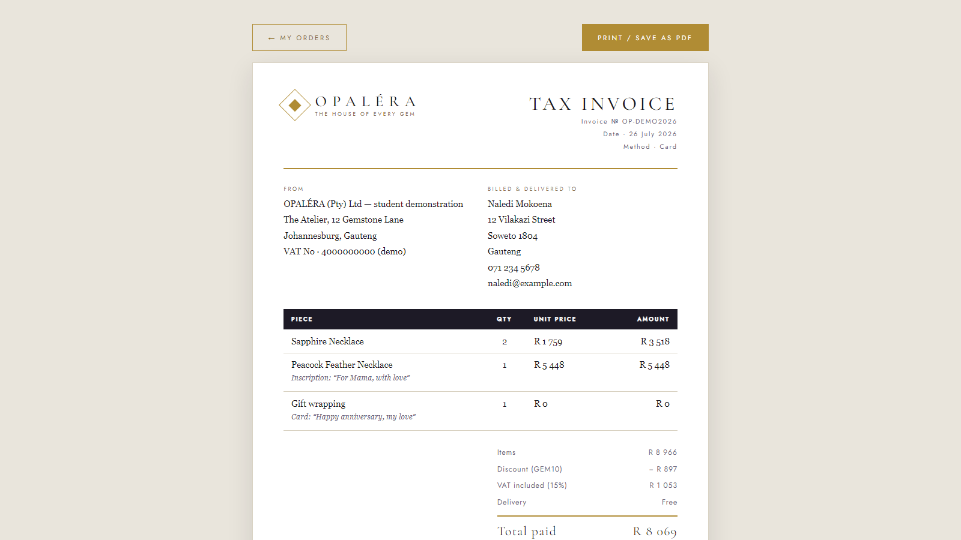
THE SITE TOUR · INVOICES
A Tax Invoice for Every Order
Generated the moment payment completes
Letterhead, invoice №, date and method
Line items with quantities and inscriptions
Discount and VAT broken out; print / save as PDF
INVOICES · IN PROGRESS
Next: sequential numbering &
server-side records (back-end).
Notes:
Every completed order already produces this printable tax invoice. We mark the feature in progress because sequential numbering and permanent server records arrive with the database.

Slide 12
USER MANAGEMENT · IN PROGRESS
Three Kinds of Visitor, Three Doors
GUEST
ACCOUNT
CONSOLE
Eye shopping
Registered customer
Manager
Browse all 80 pieces
Search, filter, galleries
Thumbs up / down votes
Reads reviews & certificates
Wishlist & persistent bag
Places orders & pays
Reviews with verified badge
Order history & invoices
Separate back-office site
Restocks, retires, adds pieces
Sales & engagement reports
Customer accounts refused
IN PROGRESS — REFRESH-TOKEN AUTH & PER-ROLE PERMISSIONS DEEPEN WITH THE BACK-END
Notes:
Three user types are already differentiated — guests browse and vote, customers transact and review, and the manager has a separate console that refuses customer accounts. It stays in progress because real session security belongs to the back-end.

Slide 13
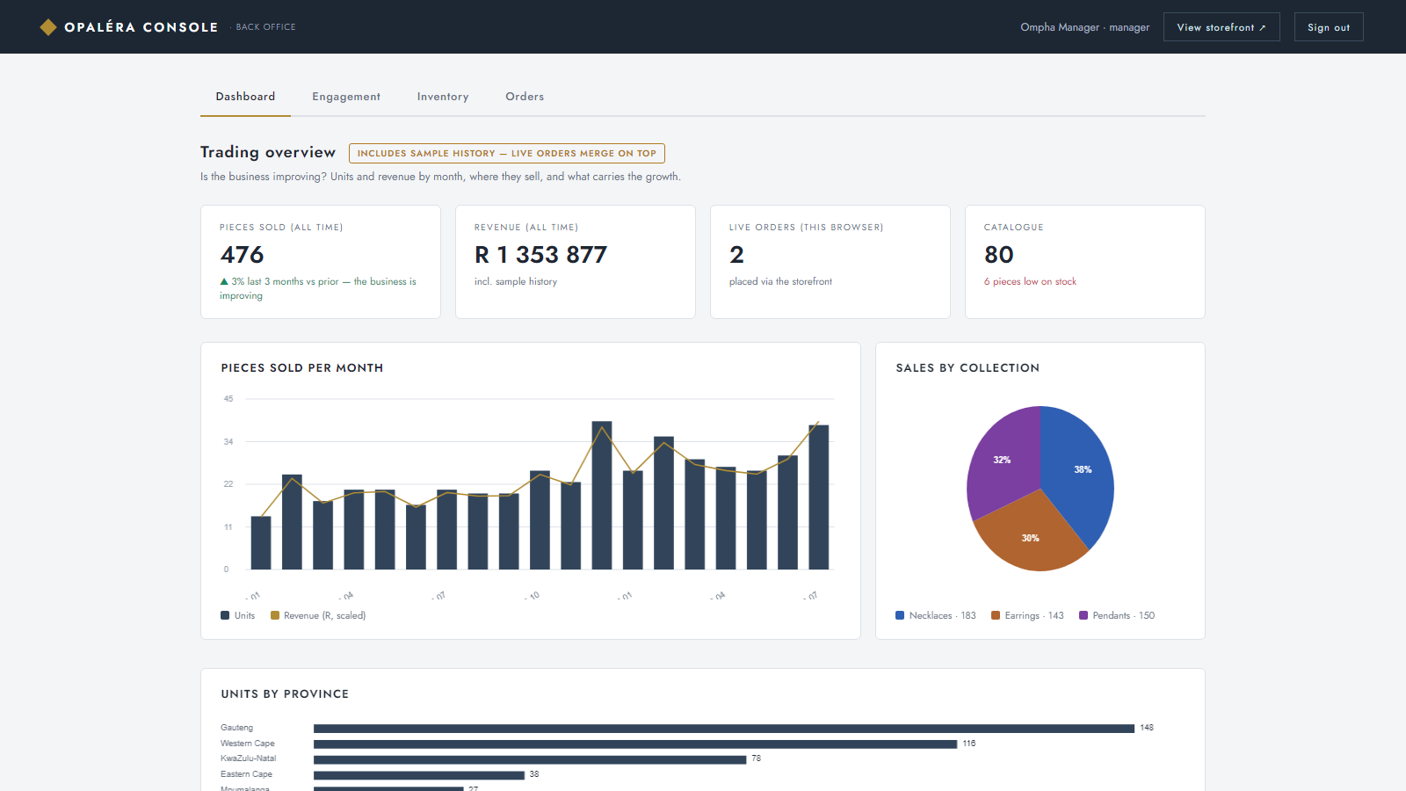
THE SITE TOUR · A DIFFERENT WORLD FOR THE MANAGER
The Manager's Console
Deliberately light & clinical — not the boutique
KPIs with an “improving / declining” verdict
Stock control: restock, retire, add pieces
Storefront reflects every change instantly
Manager login — customers are refused
PRODUCT MGMT · DONE
Notes:
The console is intentionally a different world — light, tabular, data-first. The verdict answers the lecturer's own question: is the business improving? Here, up three percent.

Slide 14
REPORTS · IN PROGRESS
Reports: Data Decides
By month
Pieces sold per month
Units and revenue across 19 months, with the improving / declining verdict.
By collection & province
Pie of sales by collection; bar chart of units across all nine provinces.
By affection
Thumbs votes ranked — the share of patrons who recommend each piece.
IN PROGRESS — SAMPLE HISTORY CLEARLY LABELLED; REAL ANALYTICS LAND WITH THE DATABASE
Notes:
Reports answer the lecturer's example questions directly: sales per province, and whether sales rise across the year — July closed at thirty-nine pieces. Sample months are honestly labelled; live orders merge on top.

Slide 15
CRAFT · THE LOOK IS A SYSTEM, NOT LUCK
One Palette, Two Worlds
Colour mapping
Gold voice on midnight ground, four gem accents rationed across all 92 pages.
The palette
Midnight — the ground
Typography
Gold — the voice
A display serif for romance, a spaced label face for order — safe fallbacks everywhere.
Champagne — display
Accessible by design
Sapphire accent
Keyboard operability, focus rings, reduced-motion support, POPIA privacy page.
Emerald accent
The manager's world
The console flips to light and clinical on purpose — two audiences, two moods.
Rose accent
Notes:
Design is graded first because it is felt first. One palette is mapped across every page — and the same discipline flips to a light, clinical mood for the manager.

Slide 16
WHERE WE STAND
Verified Today, Wired for Tomorrow
Proven now
Finishing next
47 / 47 automated end-to-end checks pass
Full journey: browse → customise → pay → invoice
Card details validated, never stored
POPIA-aware privacy, terms, returns & delivery pages
Database — our storage already mirrors its schema
Invoices: sequential numbering, server records
User management: real session security
Reports: live analytics replacing sample history
LIVE DEMO boutique → piece page → Studio → checkout with VAT → invoice → manager console manager@opalera.co.za · Opalera2026 · promo code GEM10
Notes:
Forty-seven automated end-to-end checks run the whole journey and pass. What finishes next is exactly the four in-progress features. Now the live demo, in this order.

Slide 17
Merci.
OPALÉRA — every promise from the proposal, visible on the page.
QUANTUM CODERS · IFM2B10 · PROGRESS UPDATE · 26 AUGUST 2026
Notes:
Thank you — we welcome questions after the demo.

