Slide 1

IFM2B10 · GROUP PROJECT · FINAL PRESENTATION · SEPTEMBER 2026
OPALÉRA — The House of Every Gem
A full-stack B2C fine-jewellery store · Quantum Coders · 80 pieces · 92 pages · Node.js backend · manager console · live at opalera.onrender.com
OPALÉRA · Quantum Coders · IFM2B10 · 1
Notes:
Open with the live site if the connection allows: opalera.onrender.com. The hero is animated — aurora, sparkles, floating gems.

Slide 2
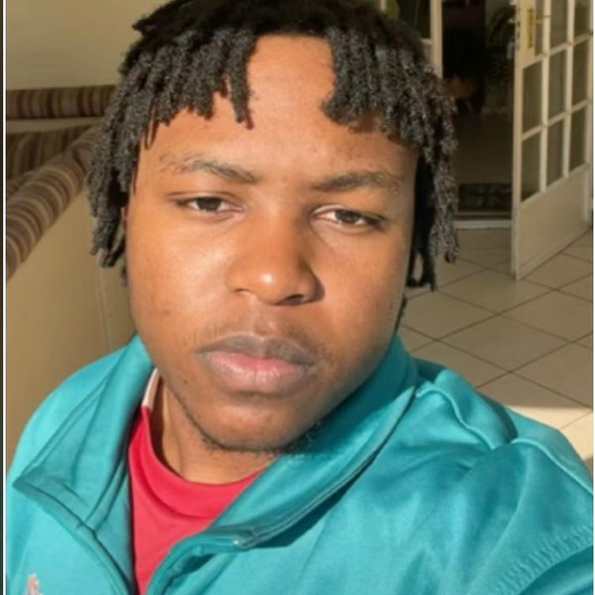


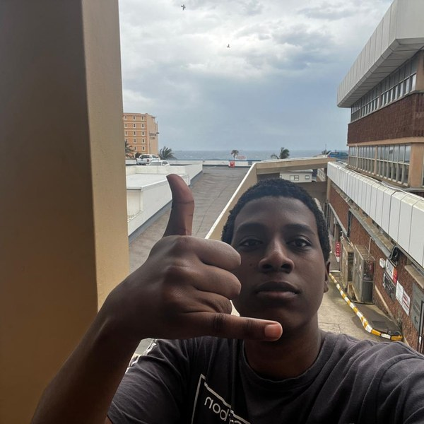
QUANTUM CODERS
The Team
Tsongorera RJN
Thedzisani KOP
Madhavan T
Mtshare B
225059699
224098795
225139703
225226751
Leader · Backend developer
Frontend developer
Backend developer · Database creator
Frontend developer
Dataset: the 80-piece Kaggle jewellery database · necklaces, earrings & pendants · R 959 – R 6 799 · Source: github.com/Thrivi17/Opalera
OPALÉRA · Quantum Coders · IFM2B10 · 2
Notes:
Four members. Everyone touched both sides; these were the primary roles.

Slide 3



FROM THE PROPOSAL
Why OPALÉRA Exists
Buying jewellery online is a gamble — fake stones, no recourse, real pieces priced beyond a normal salary. OPALÉRA answers with a maison you can trust.
Certified authentic
Honest prices
The rating system
Every piece carries its own certificate of authenticity; the maison refunds in full if a stone is ever misrepresented.
Direct-from-atelier pricing from R 959, VAT included, with the comparable boutique estimate and instalment framing on every piece.
Star ratings, written patron reviews with a verified-purchase badge, and thumbs votes — visible before you pay.
OPALÉRA · Quantum Coders · IFM2B10 · 3
Notes:
Recap the proposal in one breath: trust, honest prices, and the rating system as the differentiator.

Slide 4




SINCE THE PROGRESS UPDATE
What We Built
80
92
24
2
64
0
PIECES IN THE DATABASE
HTML PAGES
API ENDPOINTS
USER ROLES
AUTOMATED CHECKS
NPM DEPENDENCIES
Node.js server
JSON database
Shared JS layer
Deployed
server.js — routes, scrypt password hashing, httpOnly cookie sessions, server-side totals and stock rules, static hosting of the site
data/db.json — users, sessions, products, orders, reviews, wishlists, carts, resets; seeded on first run; DATA_DIR for a persistent disk
opalera-data.js — catalogue helpers, the API client, the live catalogue mirror, order tracking; one script for every page
GitHub → Render: every push to main redeploys opalera.onrender.com — the same server, site and API
OPALÉRA · Quantum Coders · IFM2B10 · 4
Notes:
The headline: since the progress update the whole back-end landed. One Node server hosts the site and the API; no frameworks, no npm installs.

Slide 5

AGAINST THE MARKING SHEET
Every Feature Stands Complete
Website design
one gold-on-midnight system, 92 pages
Product catalog
service-fed, search · price bands · sort · tabs
Database
8 collections, 80 seeded products
Web service
24 JSON endpoints, cookie sessions
Product management
add · edit · retire · delete, live on the storefront
Shopping cart
quantities, stock caps, saved per account
Transactions
promo codes, 15% VAT, stock rule, 3 pay methods
Invoices
tax invoice per order, QR code, printable
User management
register · login · reset · patron & manager roles
Reports
filters, distinct-products control, stock, users/day, 6 KPIs
BONUS · compare pieces side by side · live order-tracking timeline · QR code on every invoice · the Studio customiser
OPALÉRA · Quantum Coders · IFM2B10 · 5
Notes:
Every line of the marking sheet is done, plus three bonus features. Point at the four that were 'in progress' in August: database, invoices, user management, reports.

Slide 6


HOW IT WORKS · ARCHITECTURE
One Request, End to End
The pages
Shared layer
The web service
server.js
db.json
92 static HTML pages in pages/ — storefront, product pages, checkout, account, console. Plain HTML/CSS/JS, no framework.
opalera-data.js on every page: catalogue helpers, the api() client (fetch + cookies), the live catalogue mirror, tracking logic.
/api/… — 24 JSON endpoints. Cookies carry the session; the server decides who may do what (401 / 403).
Node's http module only. Validates every input, recomputes totals, applies stock rules, hashes passwords, serves the site.
Eight collections in one JSON file, saved with a debounce. Seeded on first run; migrated on start; DATA_DIR for a persistent disk.
A patron opens a product page the page paints from the bundled catalogue instantly, then GET /api/products patches live price, stock and retired flags in place
A patron checks out POST /api/orders — the server recomputes item totals, discount and VAT, refuses over-ordering, deducts stock, clears the cart, stores the order
A manager edits a piece PUT /api/products/:id (manager cookie) — saved to db.json; every storefront tab and product page shows the change on its next fetch
Deployment git push to main → Render rebuilds and restarts the same server; the database re-seeds from the repo's copy
OPALÉRA · Quantum Coders · IFM2B10 · 6
Notes:
Walk left to right: a page loads, the shared script asks the API, the server reads or writes the JSON database. Nothing sensitive ever leaves the server folder.

Slide 7








HOW IT WORKS · THE CUSTOMER JOURNEY
From Arrival to Delivered, in Eight Steps
1
2
3
4
Arrive & browse
Choose a piece
Customise (optional)
Bag
Tabs, search, price bands, sort by price or name; wishlist hearts and compare ticks on every card.
Its own page: photos, price, stock, rating, reviews, certificate, comparable boutique estimate.
The Studio: pattern, removable elements, add a pendant, a 30-character inscription — priced live.
Quantities capped by stock, customisations itemised; saved on the server once signed in.
5
6
7
8
Sign in / register
Checkout
Invoice
Track & account
Email + password (scrypt-hashed). Guest bag and wishlist merge into the account.
Delivery address (all nine provinces), promo code, gift wrap; Card, Instant EFT or pay-at-counter; 15% VAT shown inside the total.
A tax invoice is generated from the server's order record — printable, with a QR code.
Live timeline Placed → Paid → Packed → Shipped → Delivered; order history and invoices under My Account.
OPALÉRA · Quantum Coders · IFM2B10 · 7
Notes:
This is the demo script in one picture. Follow the numbers when you show the live site.

Slide 8
THE SITE TOUR · WEBSITE DESIGN
Arrival at the Maison
Animated aurora, sparkle field and floating gems behind every page
One gold-on-midnight design system across all 92 pages
Trust strip on arrival: rating · authenticity · returns · from R 959
Sign-in, wishlist and bag in the nav — the counts go live the moment a patron signs in
DESIGN · DONE
OPALÉRA · Quantum Coders · IFM2B10 · 8
Notes:
Every image in this deck is a real screenshot of the running site.

Slide 9
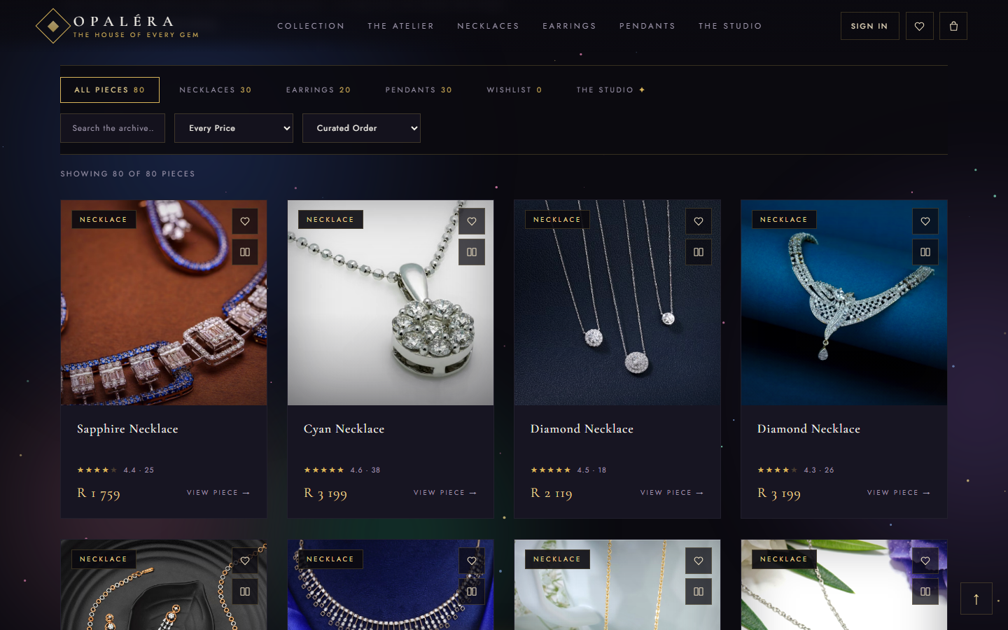
THE SITE TOUR · PRODUCT CATALOG + WEB SERVICE
The Collection — Fed by the Service
The catalogue is retrieved from the database through GET /api/products — prices, photos, stock and retired pieces update live
Category tabs with live counts, search, four price bands and sorting by price or name (the two sort criteria)
“Showing 80 of 80 pieces” honesty line; wishlist hearts and a compare tick on every card
Each card opens the piece's own page
CATALOG · DONE
SERVICE · DONE
OPALÉRA · Quantum Coders · IFM2B10 · 9
Notes:
Filters: category, search, price band. Sort: price and name.

Slide 10
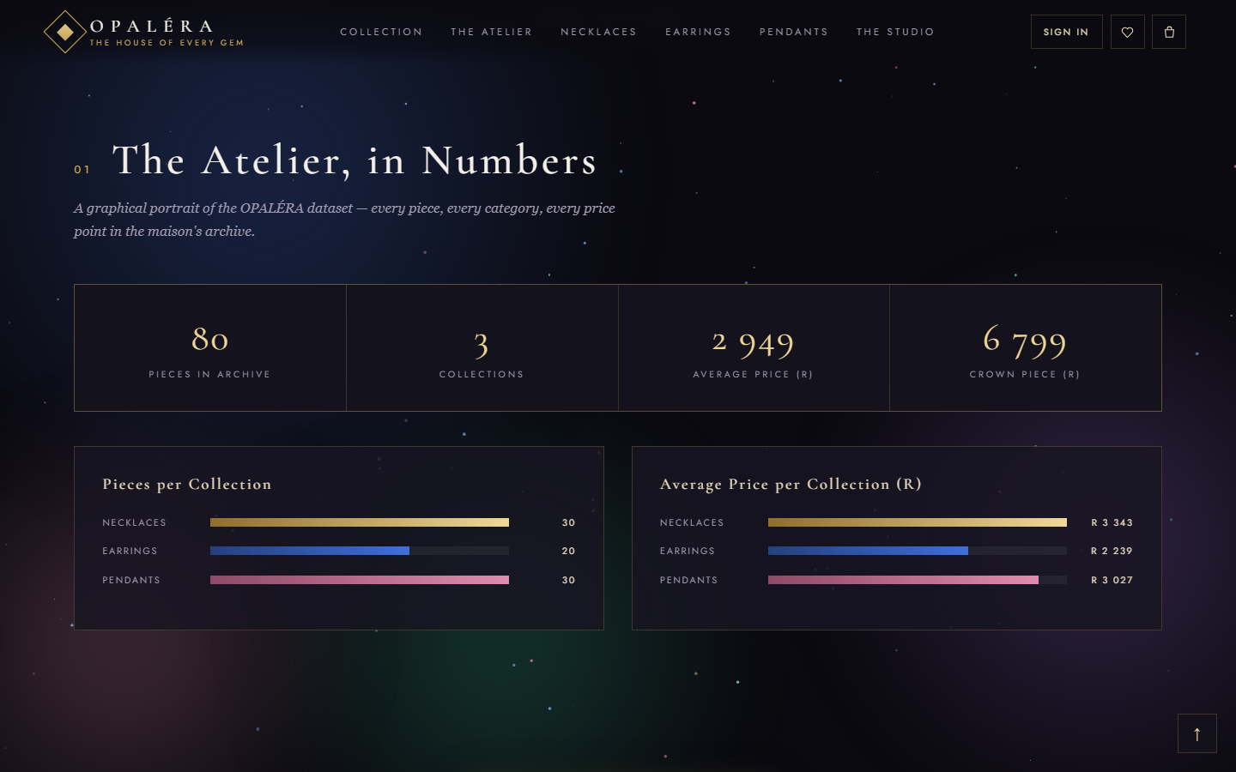
THE SITE TOUR · THE DATASET, VISUALISED
The Atelier, in Numbers
Live stat counters computed from the catalogue: 80 pieces, 3 collections, average price R 2 949, crown piece R 6 799
Pieces per collection and average price per collection, coloured by gem accent
Counts animate in as the visitor scrolls
Everything here recomputes if the manager adds or retires pieces
DESIGN · DONE
OPALÉRA · Quantum Coders · IFM2B10 · 10
Notes:
Shows the dataset requirement visually.

Slide 11
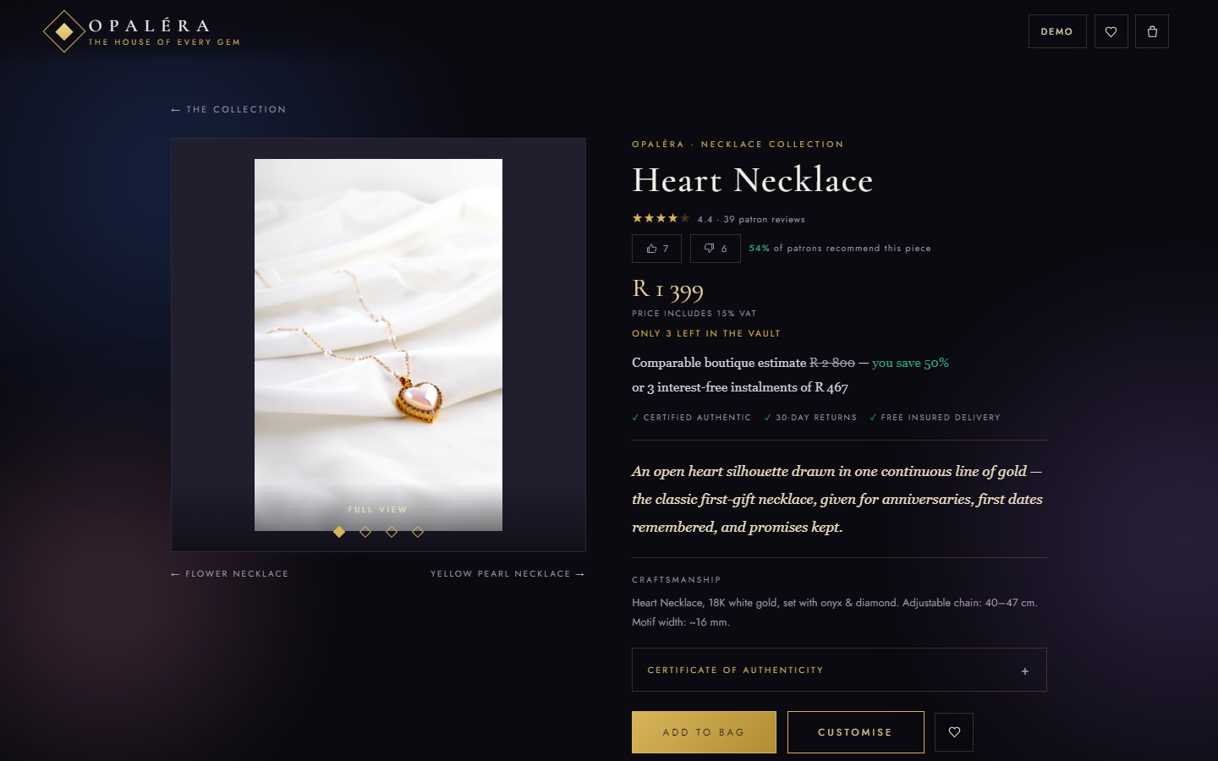
THE SITE TOUR · ONE PAGE PER PIECE
The Product Page
Hand-written description for all 80 pieces, plus craftsmanship specs
Live stock from the database — “Only 3 left in the vault”
Stars, thumbs votes and “% recommend”; reviews with the verified-purchase badge
Comparable boutique estimate, instalments, certificate of authenticity
Manager-added pieces get a page automatically (product.html?id=…)
INFORMATION · DONE
RATINGS · LIVE
OPALÉRA · Quantum Coders · IFM2B10 · 11
Notes:
Stock, price and description here come from the server — edit a piece in the console and this page changes.

Slide 12



HOW IT WORKS · THE RATING SYSTEM
Ratings You Can Trust
Star ratings
Written reviews
Every piece shows an average out of 5 and the review count. Patron reviews posted through the site are blended into the seeded baseline, so the number moves as real reviews arrive.
Signed-in patrons write a review (1–5 stars, up to 240 characters) on any piece — POST /api/reviews. A patron may delete their own; a manager may delete any.
Verified purchase
Thumbs & “% recommend”
When a review is posted the server looks through that patron's orders; if the piece is there the review is stamped VERIFIED. Nobody can fake the badge from the browser.
One vote per browser per piece, tap again to undo. The console's Engagement tab ranks pieces by recommend share and shows the split by collection.
OPALÉRA · Quantum Coders · IFM2B10 · 12
Notes:
The proposal's differentiator. Explain 'verified': the server checks the patron's own order history before stamping the badge.

Slide 13
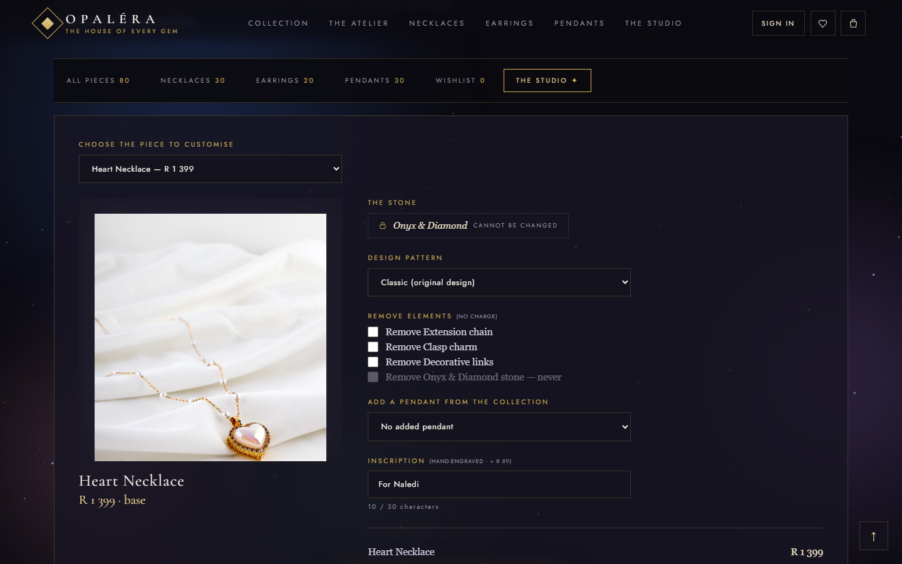
THE SITE TOUR · BEYOND THE BRIEF
The Studio — Customisation, With Rules
Choose any piece, then: design pattern, removable elements, add a pendant from the collection, a hand-engraved inscription (+ R 89)
The stone is never changed — locked on screen; signature pieces allow the inscription only
30-character inscription with a content filter
Priced live; the customised piece is carried to the bag, the invoice and the order record
BONUS
OPALÉRA · Quantum Coders · IFM2B10 · 13
Notes:
Made-to-order customisations are exempt from the stock rule — they are crafted on demand.

Slide 14
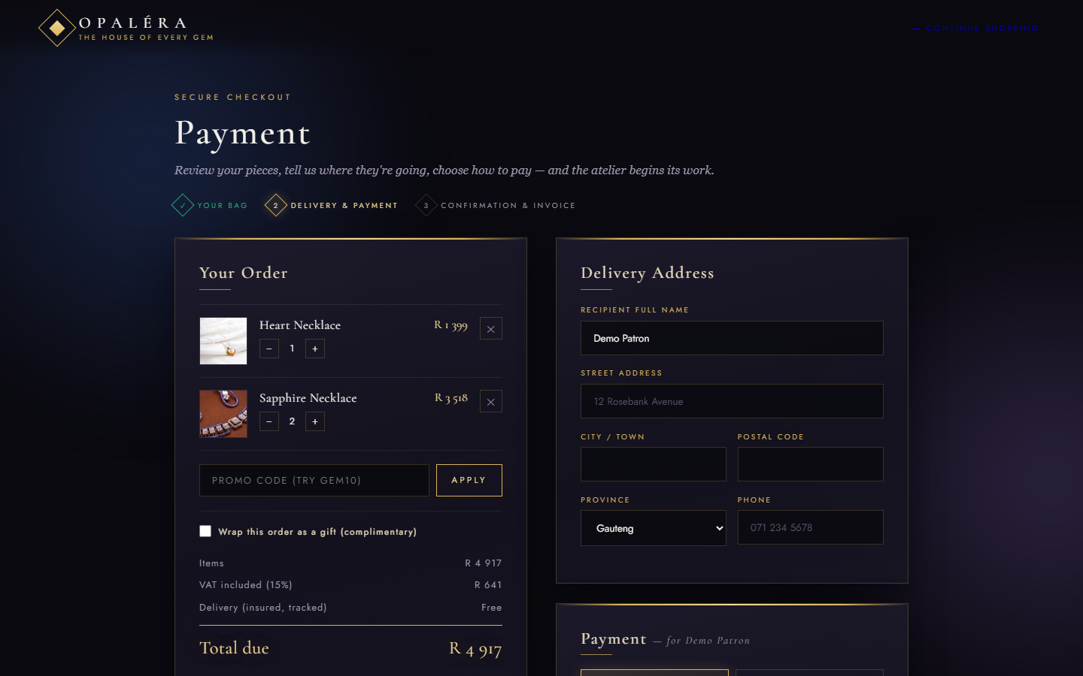
THE SITE TOUR · CART + TRANSACTION PROCESSING
Checkout: Quantities, Rules & VAT
Bag with quantities, capped by real stock; customisations itemised; saved per account on the server
Promo code (GEM10 / WELCOME10), complimentary gift wrap, delivery address with all nine provinces
Card (simulated, never stored), Instant EFT or pay-at-counter — totals recomputed on the server so the client can't tamper
Stock is deducted on the server the moment the order is placed
CART · DONE
TRANSACTIONS · DONE
OPALÉRA · Quantum Coders · IFM2B10 · 14
Notes:
Card details are only used client-side for the simulated portal; nothing sensitive reaches the server.

Slide 15






HOW IT WORKS · BUSINESS RULES
Eight Rules, Enforced Where It Counts
Promo codes
15% VAT inside the price
No over-ordering
Quantity capped by stock
GEM10 / WELCOME10 take 10% off the items. The discount is capped at the items total and re-applied server-side.
Prices are VAT-inclusive; VAT = total × 15 / 115 is shown on the bag, the checkout and the invoice.
Server rule: an order for more units than the vault holds is refused — “Only 18 of Sapphire Necklace left”. Retired pieces are refused too.
The bag's + button stops at the live stock figure; stock is deducted on the server at checkout.
Signature pieces
Inscription filter
Delivery & collection
Verified reviews
The stone is never customisable; signature pieces allow an inscription only.
30 characters, hand-engraved at + R 89, with a content filter on the text.
Delivery address requires one of the nine provinces; pay-at-counter orders skip the address and are reserved, not paid.
A review is marked verified only if the server finds the piece in that patron's own orders.
OPALÉRA · Quantum Coders · IFM2B10 · 15
Notes:
The sheet asks for at least three transaction rules; there are eight, and the important ones are enforced on the server, not just in the page.

Slide 16
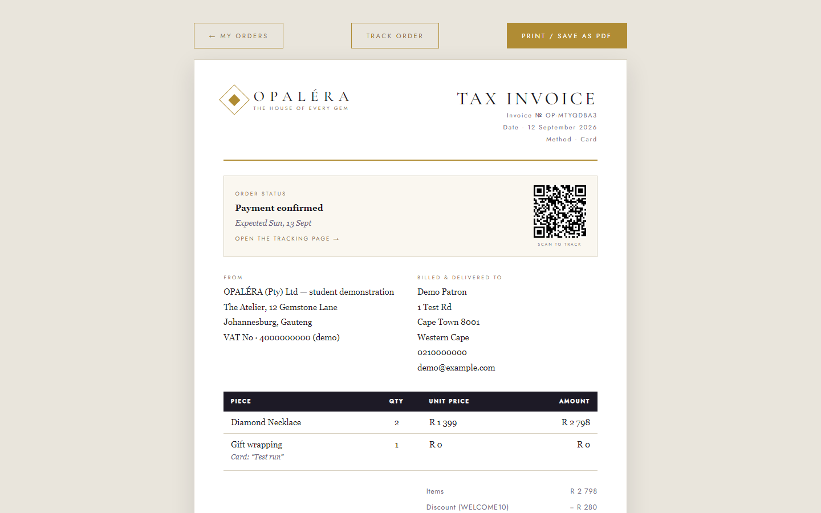
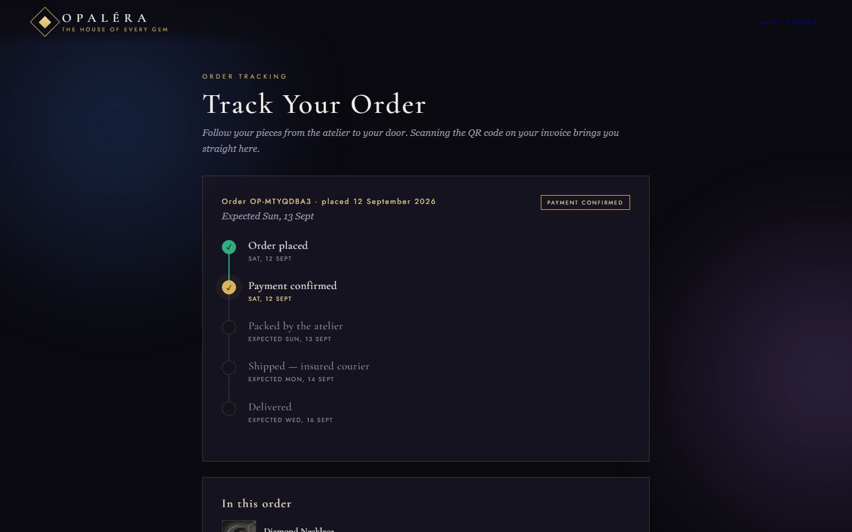
THE SITE TOUR · INVOICES + ORDER TRACKING
A Tax Invoice — and Where Your Order Is
Tax invoice · generated from the server's order record: letterhead, invoice №, date, method, line items with inscriptions, discount and VAT broken out, print / save as PDF.
Tracking timeline · Placed → Paid → Packed → Shipped → Delivered (a collection path for pay-at-counter), advancing with time; the QR on the invoice opens it.
INVOICES · DONE
BONUS
OPALÉRA · Quantum Coders · IFM2B10 · 16
Notes:
Two bonus features live here: the tracking timeline and the QR code that opens it from a printed invoice.

Slide 17
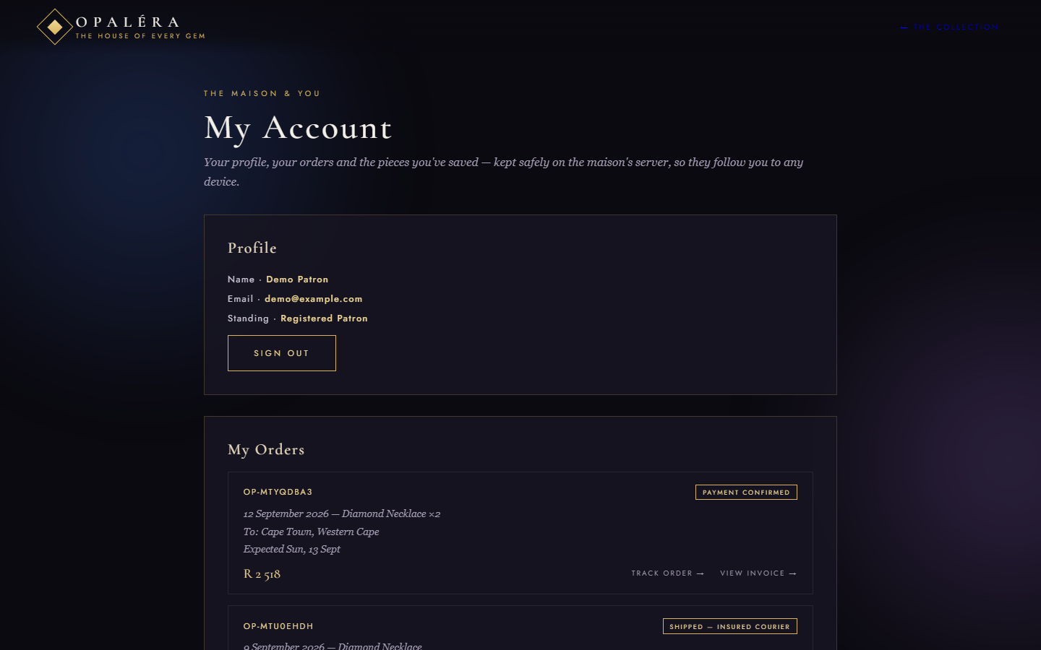
USER MANAGEMENT · ROLES
Three Kinds of Visitor, Three Doors
Guest — browses, searches, votes, reads reviews
Patron — registers (scrypt-hashed password, httpOnly cookie session); wishlist and bag saved on the server; orders, verified reviews, order history & invoices
Manager — a separate console session (role “manager” on the server); patron accounts are refused; managers can also remove a patron account
Forgot-password: one-time 6-digit code, single use, 15-minute expiry; show-password eye on every field
REGISTRATION · DONE
LOGIN · DONE
ROLES · DONE
OPALÉRA · Quantum Coders · IFM2B10 · 17
Notes:
Role checks are enforced by the server (401/403), not just hidden in the UI.

Slide 18




HOW IT WORKS · ACCOUNTS & SESSIONS
Sign In, Stay In, Reset Safely
Passwords are never stored
Cookie sessions
Two doors, two cookies
Each account keeps a random salt and an scrypt hash; sign-in compares hashes in constant time. Minimum 6 characters; emails validated and de-duplicated.
A random 32-byte token in an httpOnly, SameSite cookie — invisible to page scripts — valid 30 days. Log out destroys it on the server.
Patron sessions and manager sessions use different cookies, so a customer signed in on the storefront and the manager in the console never collide.
Forgot password
Bags that follow you
Roles on the server
Request a 6-digit code (email delivery is simulated for the demo), 15-minute expiry, 5 attempts, single use; every other session is signed out on reset.
A guest's bag and wishlist are merged into the account on sign-in and pushed to the server; the pages mirror the signed-in patron locally for instant paint.
patron / manager stored per account; manager-only routes answer 401 without a session and 403 to a patron. The backend folder is never served over HTTP.
OPALÉRA · Quantum Coders · IFM2B10 · 18
Notes:
Security in one slide. If asked 'where are passwords stored': never — only a salt and a scrypt hash.

Slide 19
DATABASE + WEB SERVICE
One Server, Eight Collections, 24 Endpoints
users
sessions
products
orders
email · names · scrypt salt+hash · role · createdAt
token → email · expiry (patron & manager scopes)
80 pieces: category · name · price · img · desc · stock · hidden
ref · items · totals · VAT · promo · gift · address · method · status
reviews
wishlists · carts
resets
Reset the demo: delete db.json — the catalogue re-seeds and the manager account is recreated on the next run.
pid · stars · text · verified · patron
per patron, merged on sign-in
one-time codes with expiry & attempt limit
AUTH
POST signup · login · forgot · reset · logout · GET me · admin/me
CATALOGUE
GET products · POST / PUT /:id / DELETE /:id (manager)
PATRON
GET/PUT cart · GET/PUT wishlist · GET/POST orders · GET reviews, reviews/:pid · POST / DELETE reviews
MANAGER
GET admin/orders · GET admin/users · DELETE admin/users/:email
OPALÉRA · Quantum Coders · IFM2B10 · 19
Notes:
Walk the data model left to right, then the endpoint list. Everything the pages show comes through these routes.

Slide 20
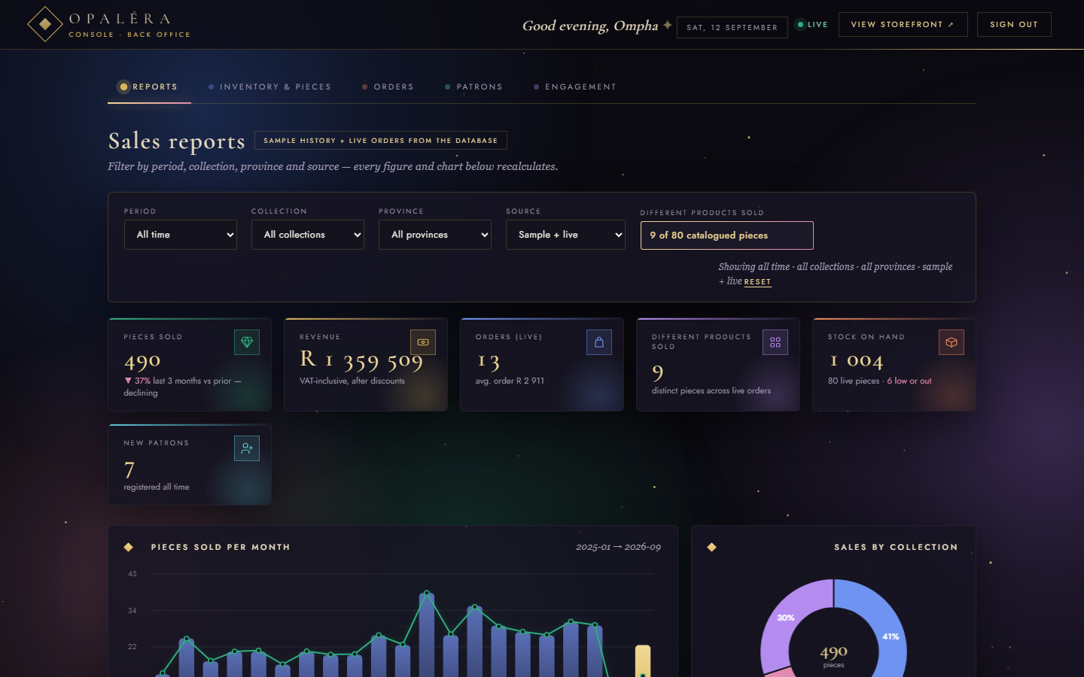
THE MANAGER'S CONSOLE
A Back Office in the Same World
Own manager sign-in — verified by the server; patrons are refused
Six KPI cards that count up: pieces sold with an improving / declining verdict, revenue, orders & average order, different products sold, stock on hand, new patrons
Charts grow into place: units per month with the revenue line, sales-by-collection donut, units by province, users per day
Live indicator, greeting and toasts — the same midnight-and-gold as the storefront; keyboard-navigable tabs
PRODUCT MGMT · DONE
REPORTS · DONE
OPALÉRA · Quantum Coders · IFM2B10 · 20
Notes:
Note the 'Different products sold' read-only text control in the filter bar — a specific marksheet item.

Slide 21
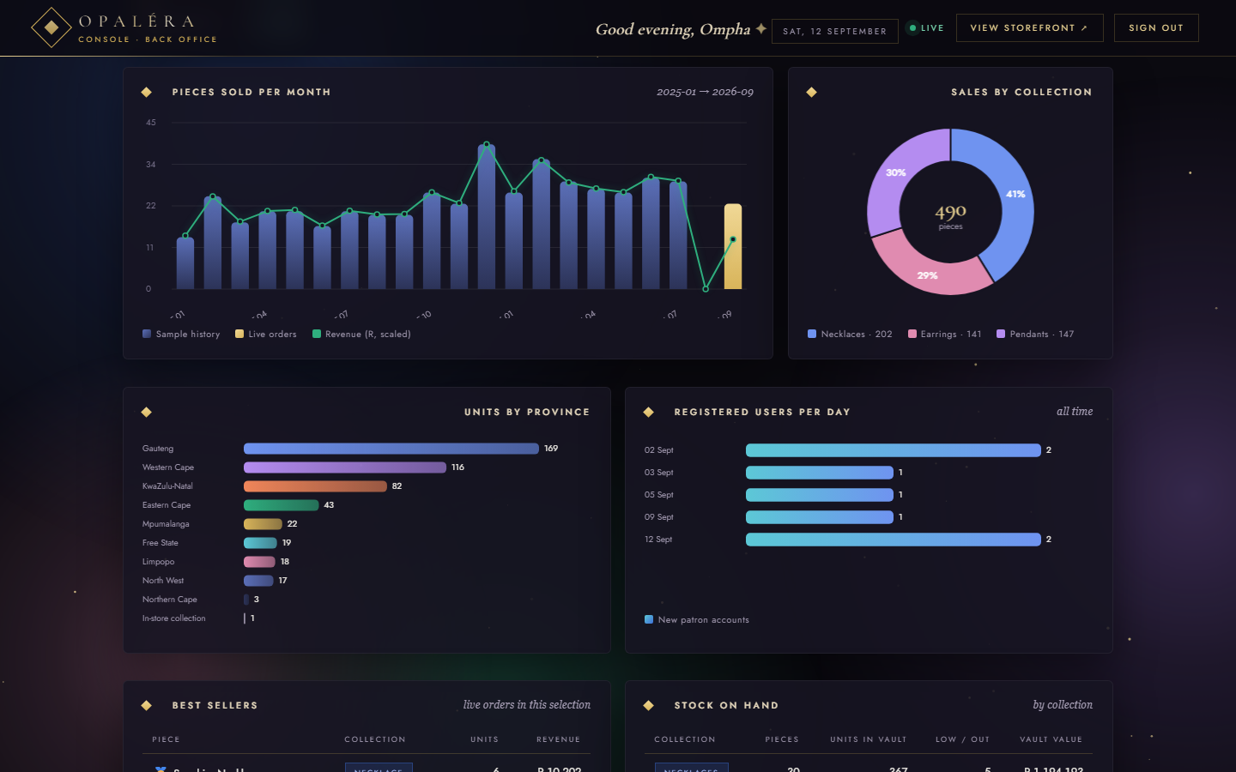
REPORTS · FILTERING
Reports: Data Decides
Filter by period (all time · 30 / 90 days · this year · custom months), collection, province and source — every figure recalculates
Values: pieces sold + growth verdict, revenue, orders & average order, different products sold (text control), stock on hand & vault value by collection, registered users per day, best sellers
Sample history is clearly labelled; live orders from the database merge on top
Every chart is drawn by hand on a canvas — no chart library
FILTERING
STOCK ON HAND
USERS / DAY
DISTINCT PRODUCTS
OPALÉRA · Quantum Coders · IFM2B10 · 21
Notes:
Show one filter change live if possible — the numbers animate from the old value to the new.

Slide 22
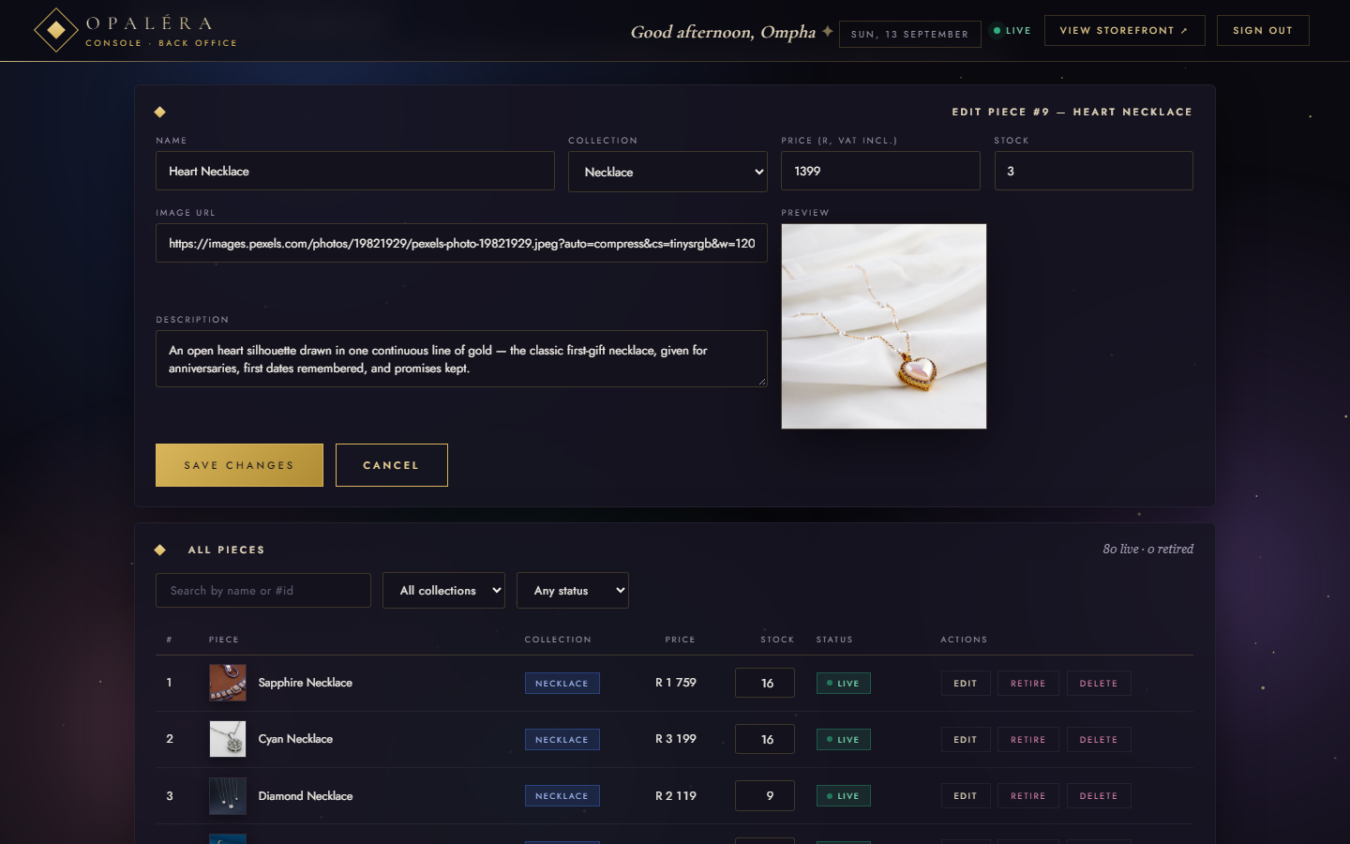
PRODUCT MANAGEMENT
Add, Edit, Retire, Delete
Add a piece: name, collection, price, stock, photo (with preview) and description → POST /api/products; it gets a product page automatically
Edit any piece in place (shown: Heart Necklace) → PUT /api/products/:id; the storefront and its product page update immediately
Inline stock control; low-stock and out-of-stock flags; retire hides a piece while keeping its history
Delete removes it from the database; search and status filters over all 80 pieces
ADD · 3
EDIT · 5
DELETE · 2
OPALÉRA · Quantum Coders · IFM2B10 · 22
Notes:
Demonstrate: change a price here, refresh the storefront tab, the card shows the new price.

Slide 23
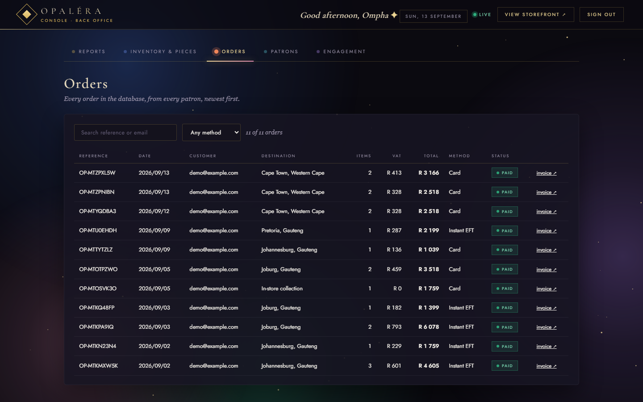
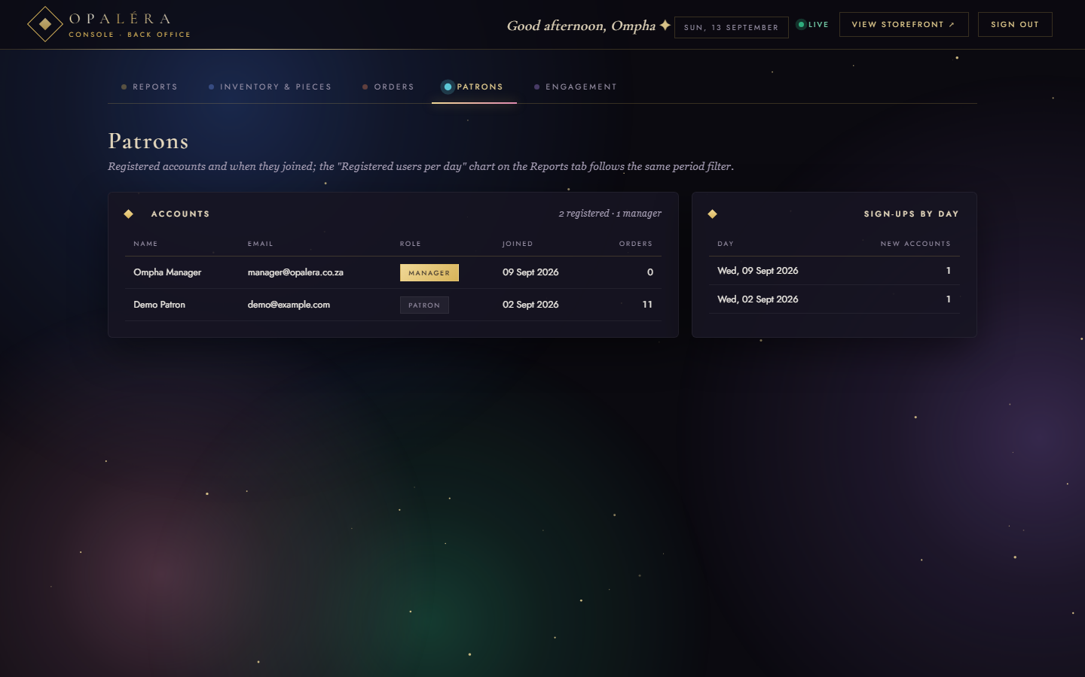
THE MANAGER'S CONSOLE · RECORDS
Every Order, Every Patron
Orders · every order from every patron, newest first: reference, date, customer, destination, items, VAT, total, method, status; search by reference or email, filter by method; open the invoice.
Patrons · every account with role, sign-up date and order count; sign-ups by day beside it. Managers can remove a patron account (managers are protected).
REPORTS · DONE
USER MGMT · DONE
OPALÉRA · Quantum Coders · IFM2B10 · 23
Notes:
The two record views managers use day to day.

Slide 24
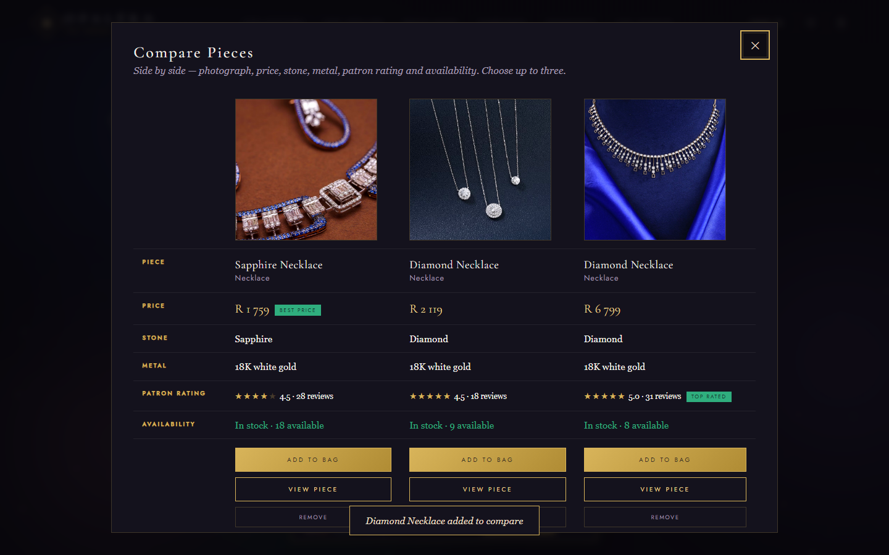
BONUS · BEYOND THE BRIEF
Compare, Track, Scan
Compare pieces — tick up to three; a side-by-side table of photo, price (“Best price”), stone, metal, rating (“Top rated”) and availability, with add-to-bag in place
Order tracking — a live timeline per order, with status chips and ETA on the account page
QR code on every invoice — printed invoices open the order's tracking page from a phone
Also: the Studio customiser, and a motion system that respects reduced-motion
BONUS
OPALÉRA · Quantum Coders · IFM2B10 · 24
Notes:
If time allows, tick two pieces on the live site and open the comparison.

Slide 25


TESTING, SECURITY & ACCESSIBILITY
Built to Be Trusted
64 automated checks — local and live
Browser-verified pages
Site & static blocking, sign-up / login / reset, cart, wishlist, orders with server-side totals, the stock rule, reviews, roles, product CRUD and validation, then cleanup of its own test data — all passing against localhost and against opalera.onrender.com.
Every page loaded with zero console errors; compare, tracking, invoice QR, account and the console exercised end to end; keyboard navigation checked.
Security by default
Accessible & considerate
scrypt password hashes with per-user salt, constant-time comparison, httpOnly SameSite cookies, server-recomputed totals and stock rules, the backend folder never served over HTTP, role checks on the server, a curated seed database with no tokens.
Reduced-motion switch, WAI-ARIA tabs with arrow keys, live regions, focus rings, colour contrast checked; a multi-agent review found and fixed 29 defects before release.
OPALÉRA · Quantum Coders · IFM2B10 · 25
Notes:
Quality was engineered, not hoped for. Mention the numbers.

Slide 26

DEPLOYMENT · HOW TO RUN · HOW WE SHIP
Live on Render, Runs Anywhere Node Does
RUN IT LOCALLY
Live site
node opalera-backend/server.js
opalera.onrender.com
Then open http://localhost:3000 — it redirects to the storefront
One server hosts the whole site and its API; no installs, no build step
Data lives in opalera-backend/data/db.json (or DATA_DIR), created on first run
Storefront /pages/jewellery_Html.html · Console /pages/admin.html
Source & workflow
github.com/Thrivi17/Opalera
DEMO ACCOUNTS
Both members commit to main as collaborators; every push redeploys the live site within minutes. The seed database, docs and presentation live in the repo.
Patron demo@example.com / demo123
Manager
manager@opalera.co.za / Opalera2026
OPALÉRA · Quantum Coders · IFM2B10 · 26
Notes:
Close the technical part with how to run it and how the team ships changes.

Slide 27
Merci.
OPALÉRA — every promise from the proposal, delivered on the page.
QUANTUM CODERS · IFM2B10 · FINAL PRESENTATION · SEPTEMBER 2026
Tsongorera RJN · Thedzisani KOP · Madhavan T · Mtshare B
OPALÉRA · Quantum Coders · IFM2B10 · 27
Notes:
Thank the panel; invite questions; offer the live demo.

