Slide 1
Abalone age prediction
-Nibir Talukdar (21370041)
-Samha oo Passah (21370049)

Slide 2
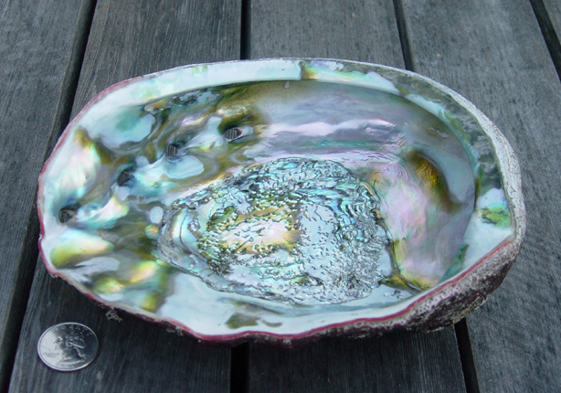
What is an abalone?
Abalone is a common name for any of a group of small to very large marine gastropod molluscs in the family Haliotidae.
In simpler terms, an abalone is a type of shellfish.
Abalone has been harvested worldwide for centuries as a source of food and decorative items.

Slide 3
Purpose of our project
The main purpose of our project is to predict the age of an abalone using certain measurements.
These measurements are
Sex: M, F, and I (infant)
Length: Longest shell measurement (mm)
Diameter: perpendicular to length (mm)
Height: with meat in shell (mm)
Whole weight: whole abalone (grams)
Shucked weight: weight of meat (grams)
Viscera weight: gut weight after bleeding (grams)
Shell weight: after being dried (grams)
Rings: +1.5 gives the age in years

Slide 4
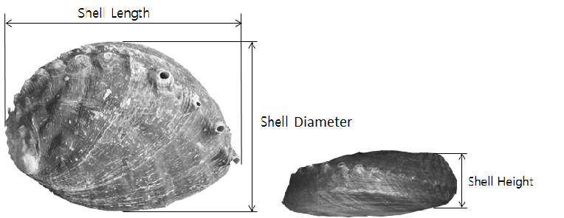
Dimensions of an abalone

Slide 5
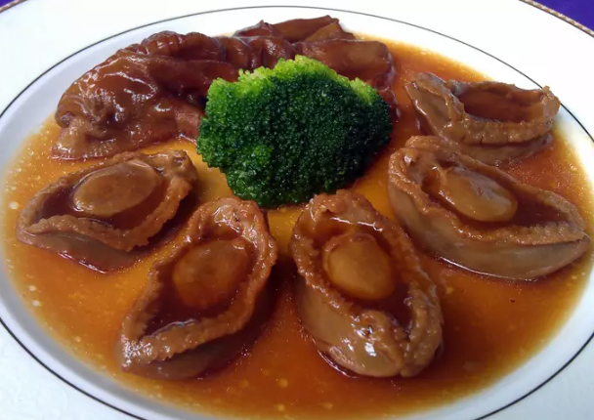
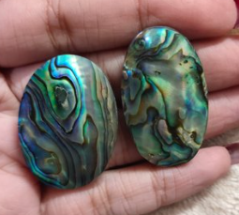
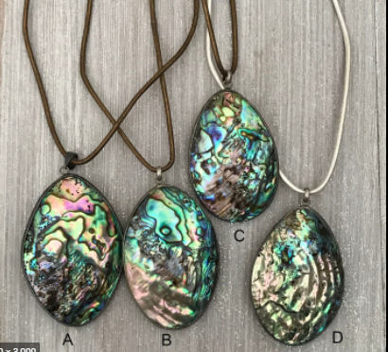
Need for a predictive method for the age of an abalone.
Abalones are rich in iron and pantothenic acid, so it a beneficial addition to the diet. It is farmed in many parts of the world. The meat of this mollusc is considered a delicacy in certain parts of the world. (France, Latin America, New Zealand, etc.)
The highly iridescent inner nacre layer of the shell of abalone has traditionally been used as a decorative item, in jewellery, buttons, and as inlay in furniture and musical instruments, such as on fret boards and binding of guitars.

Slide 6
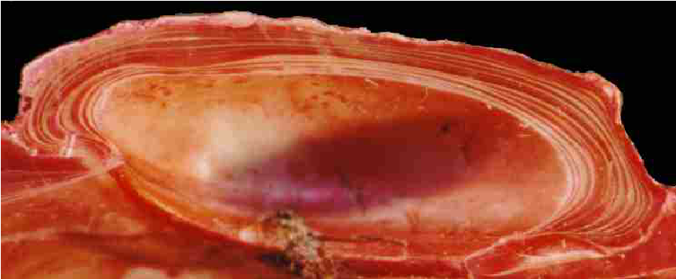
Need for a predictive method for the age of an abalone.
Judging the age of an abalone is essential to abalone farmers as the revenue earned from a single abalone is directly related to it’s age.
Determining the age of an abalone is similar to that of a tree. As an abalone grows rings are moulded onto its shell, generally at the rate of 1 ring per year. Doing it manually, with the use of a microscope and other such tools is a time consuming and inefficient process.
Predicting the age through the use of other measurements (as mentioned before) which are far easier to obtain is a more practical approach.

Slide 7
Dataset source
The data set is sourced from the UCI repository of machine learning databases. Which in turn obtained it from
Marine Resources Division
Marine Research Laboratories - Taroona
Department of Primary Industry and Fisheries, Tasmania
GPO Box 619F, Hobart, Tasmania 7001, Australia
(contact: Warwick Nash +61 02 277277, wnash '@' dpi.tas.gov.au)

Slide 8
Existing work done on this problem and dataset.
A New Method of Measuring the Age of Abalone Based on Data Visualization Analysis. -Runze Guo, Junmin Luo and Wuqi Gao
Machine Learning Project - Predict the Age of Abalone. -Yizhen Han
Sam Waugh (1995) "Extending and benchmarking Cascade-Correlation", PhD thesis, Computer Science Department, University of Tasmania.
David Clark, Zoltan Schreter, Anthony Adams "A Quantitative Comparison of Dystal and Backpropagation", submitted to the Australian Conference on Neural Networks (ACNN'96).

