Slide 1
Abalone Age prediction
Data mining project review, headed by Jayalakshmi S.L
-Nibir Talukdar (21370041)
-Samha oo Passah (21370049)

Slide 2
Purpose of our project
The main purpose of our project is to predict the age of an abalone using certain measurements.
The target is to predict the number of rings.
Another approach is to classify range of rings into age class and predict it.
These measurements are
Sex: M, F, and I (infant)
Length: Longest shell measurement (mm)
Diameter: perpendicular to length (mm)
Height: with meat in shell (mm)
Whole weight: whole abalone (grams)
Shucked weight: weight of meat (grams)
Viscera weight: gut weight after bleeding (grams)
Shell weight: after being dried (grams)

Slide 3
Dataset source
The data set is sourced from the UCI repository of machine learning databases. Which in turn obtained it from
Marine Resources Division
Marine Research Laboratories - Taroona
Department of Primary Industry and Fisheries, Tasmania
GPO Box 619F, Hobart, Tasmania 7001, Australia
(contact: Warwick Nash +61 02 277277, wnash '@' dpi.tas.gov.au)
Donated by
Sam Waugh (Sam.Waugh '@' cs.utas.edu.au)
Department of Computer Science, University of Tasmania
GPO Box 252C, Hobart, Tasmania 7001, Australia

Slide 4
Problem Statement
Aim is to create a classification model by generating a decision tree and to predict the number of rings

Slide 5
Approach 1:
By predicting the number of rings.
Done by Rapid Miner and WEKA

Slide 6
RapidMiner design phase
It uses a drag and drop interface.
Operators can be connected to get the desired result.

Slide 7
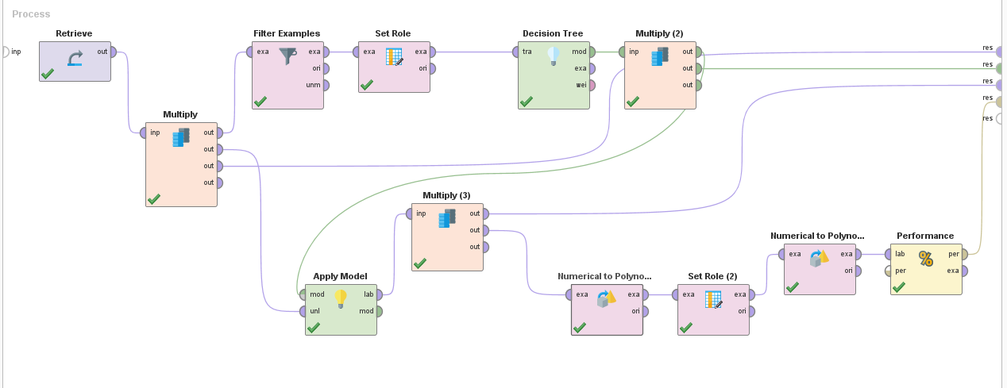
RapidMiner design phase
Design flow in rapid miner

Slide 8
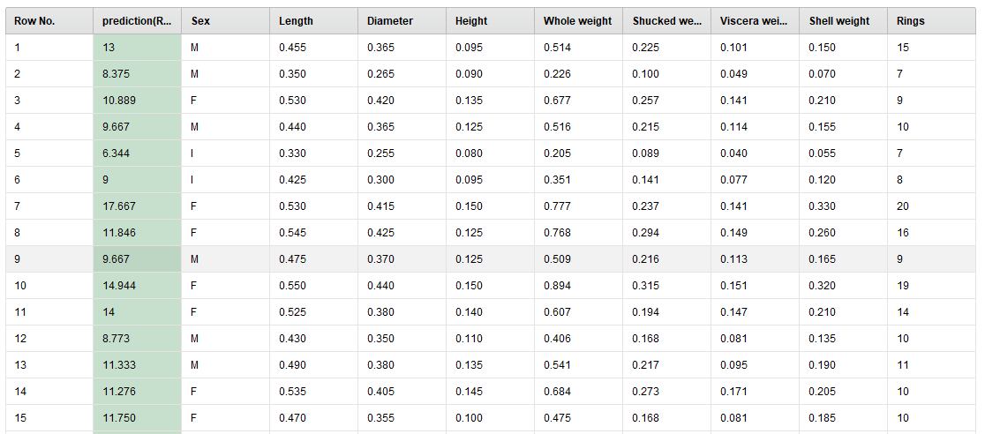
RapidMiner results
After applying the model (only a small subset of the result is shown as the actual result has a very large number of tuples, more than 4000)

Slide 9

RapidMiner results
Prediction accuracy as per the operator in rapid miner.
Note: checks for a 100% match only

Slide 10
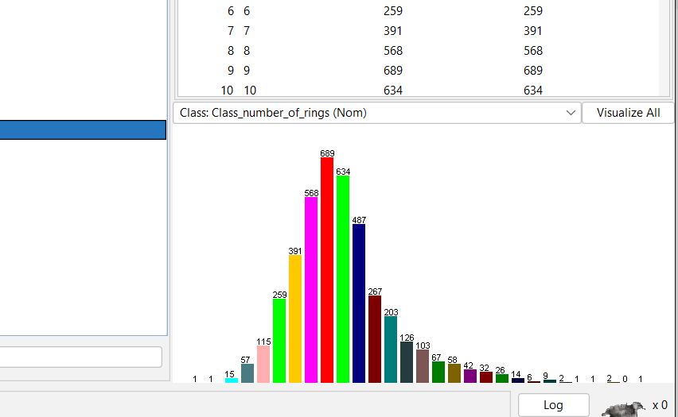
Using WEKA
Case 1:
Data Preprocessing
Conversion of Numerical Data to Nominal data
Converted the numerical data type to nominal data type using ‘NumerictoNominal’ filter to generate a J48 decision tree. It is also done to reduce the signal to noise ratio.
Number of instances = 4177

Slide 11
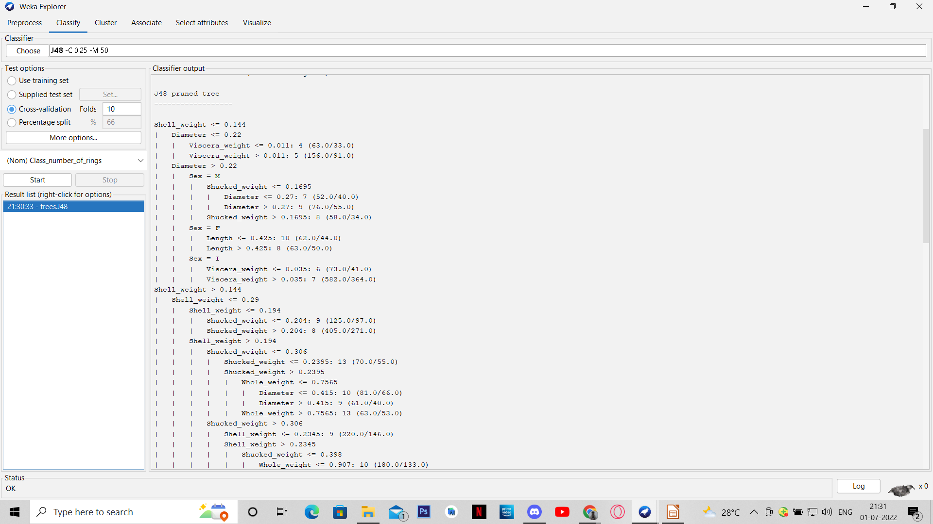
Using WEKA
Classification
Done using J48 Decision Tree
For Training Set
Confidence Level = 0.25
MinNumberObj = 50
Using 10 fold Cross Validation to produce
accurate output

Slide 12
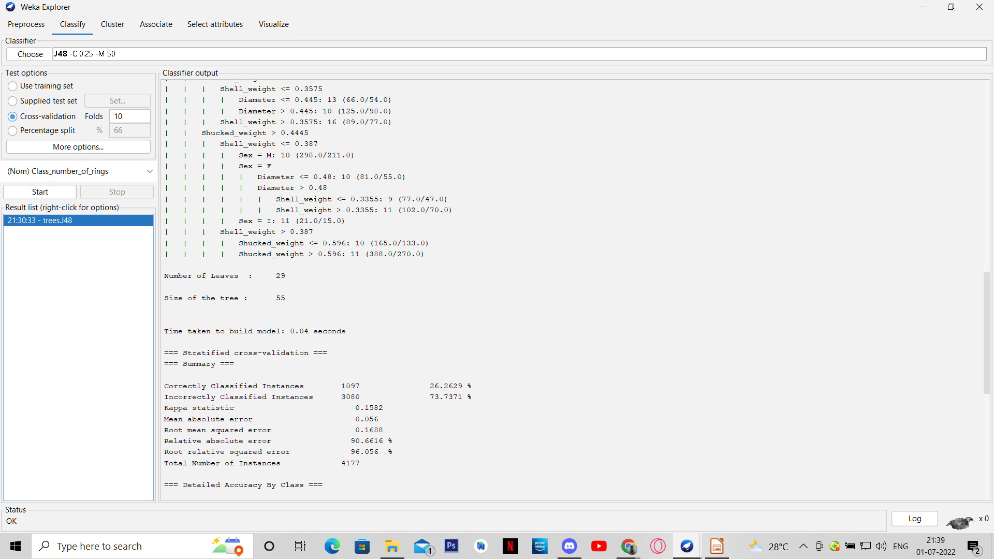
Using WEKA
Classification
Done using J48 Decision Tree
For Testing Set
Output accuracy = 26 .26 %

Slide 13
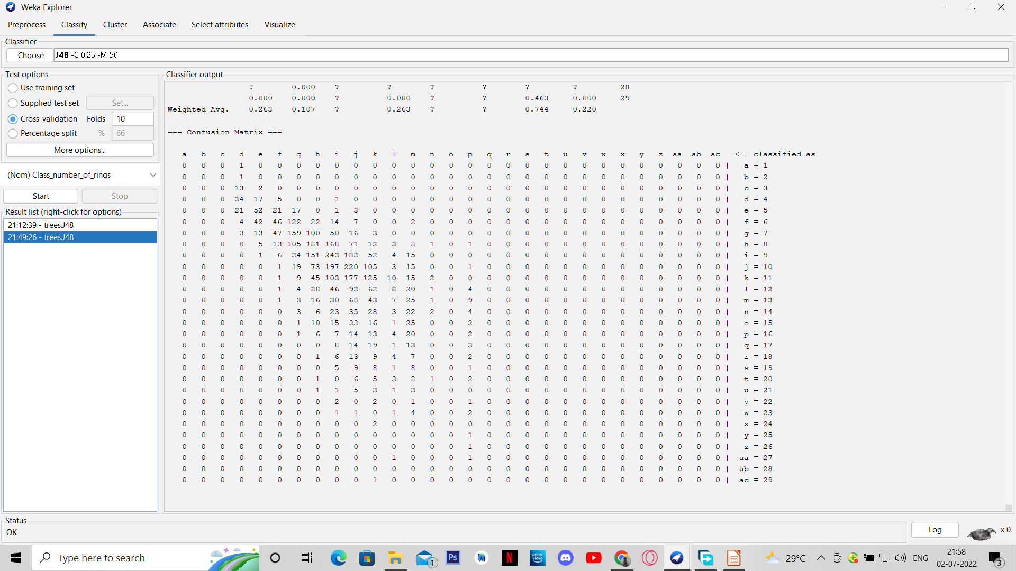
Using WEKA
Classification
Done using J48 Decision Tree
For Testing Set
Confusion matrix

Slide 14
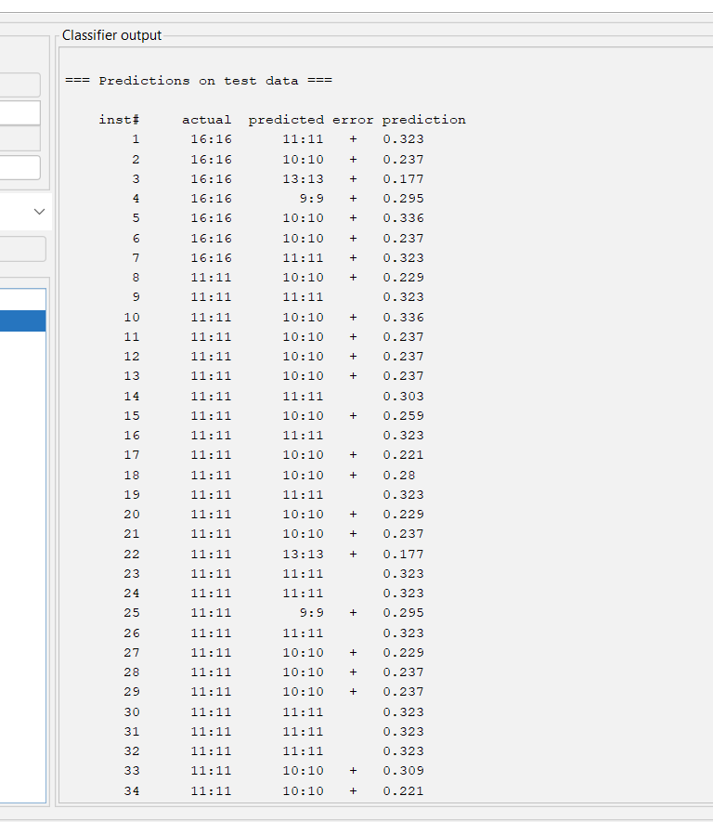
Using WEKA
Predicting the number of Rings
34 instances shown here

Slide 15
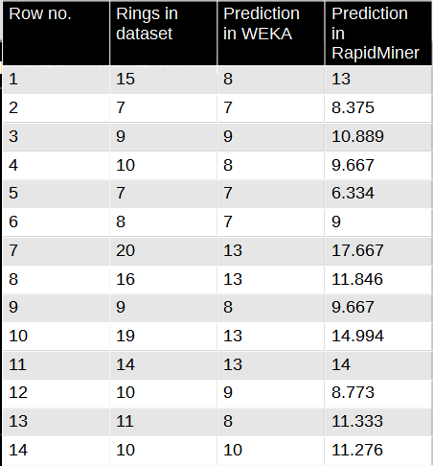
Comparison fo results between WEKA and RapidMiner
WEKA – done using j48 decision tree
RapidMiner – Done using decision tree operator

Slide 16
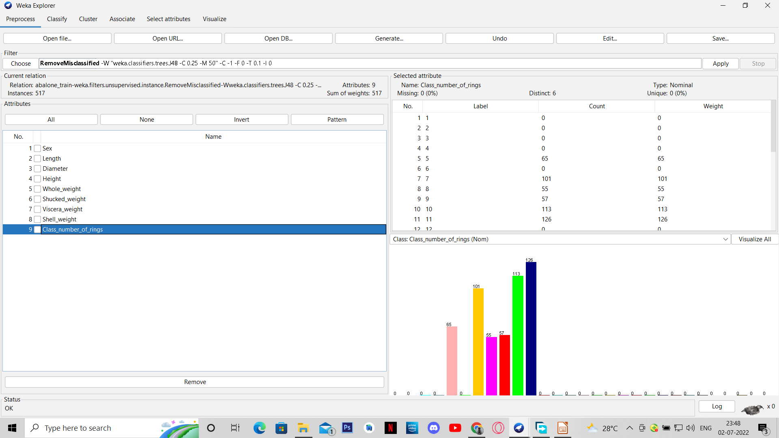
Using WEKA
Case 2:
Number of instances = 517
Data Preprocessing
Conversion of Numerical Data to Nominal data
Converted the numerical data type of ‘Class_number_of_rings’ attribute to nominal data type using ‘NumerictoNominal’ filter to generate a J48 decision tree. It is also done to reduce the signal to noise ratio.
Removal of mis-classified instances
Removed the mis-classified instances of ‘Class_number_of_rings’ attribute by using the ‘RemovedMisclassified’ filter with the classification method used is J48 decision tree

Slide 17
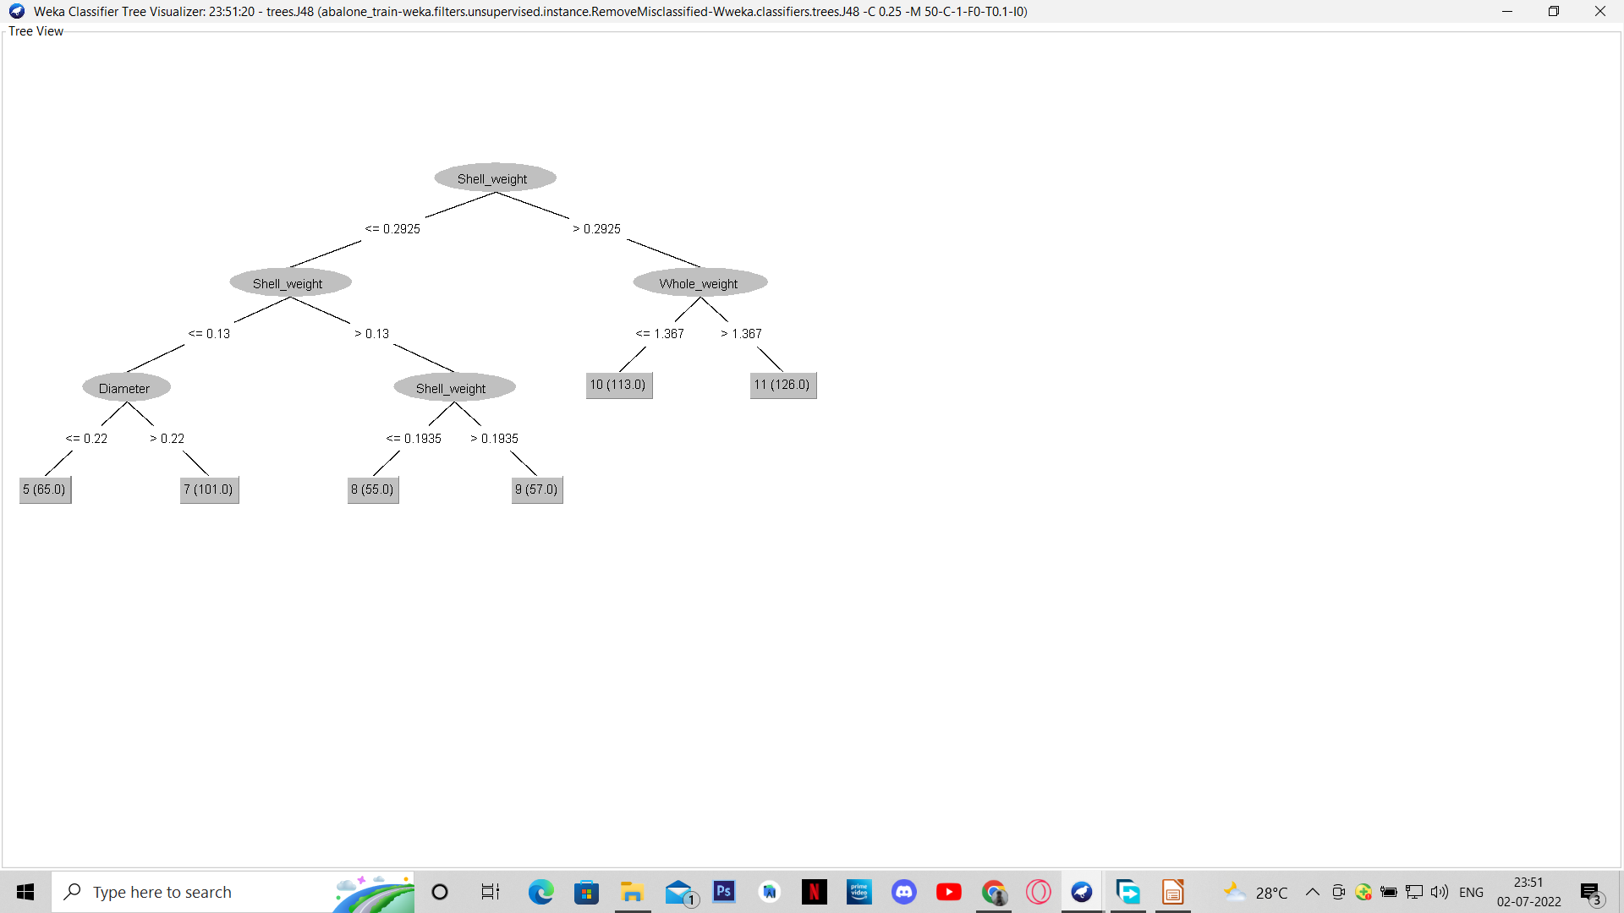
Using WEKA
Decision tree generated
Classification
Done using J48 Decision Tree
For Training Set
Confidence Level = 0.25
MinNumberObj = 50
Using 10 fold Cross Validation to produce
accurate output

Slide 18
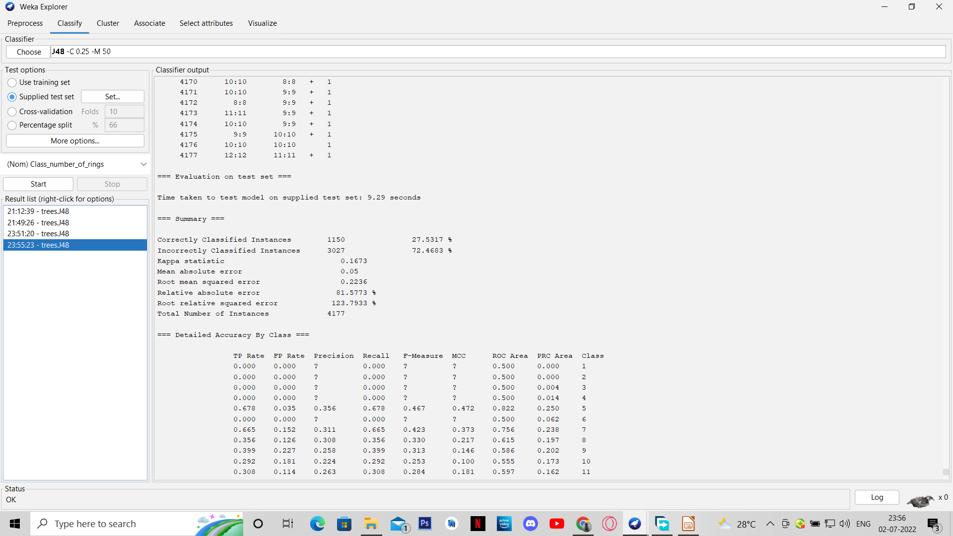
Using WEKA
Classification
Done using J48 Decision Tree
For Testing Set
Output accuracy = 27 .53 %

Slide 19
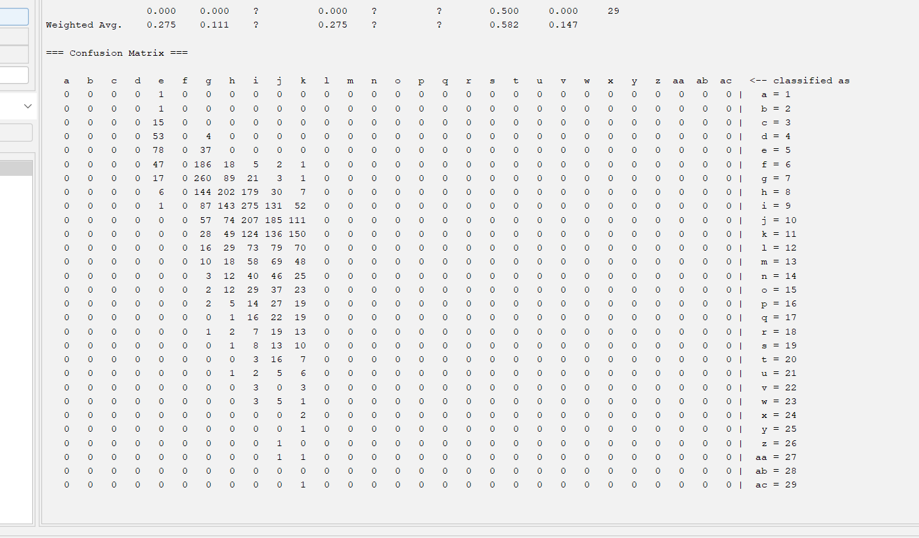
Using WEKA
Classification
Done using J48 Decision Tree
For Testing Set
Confusion matrix

Slide 20
Using WEKA
Predicting the number of Rings
34 instances shown here

Slide 21
Approach 2:
By predicting the age.
Done by WEKA

Slide 22
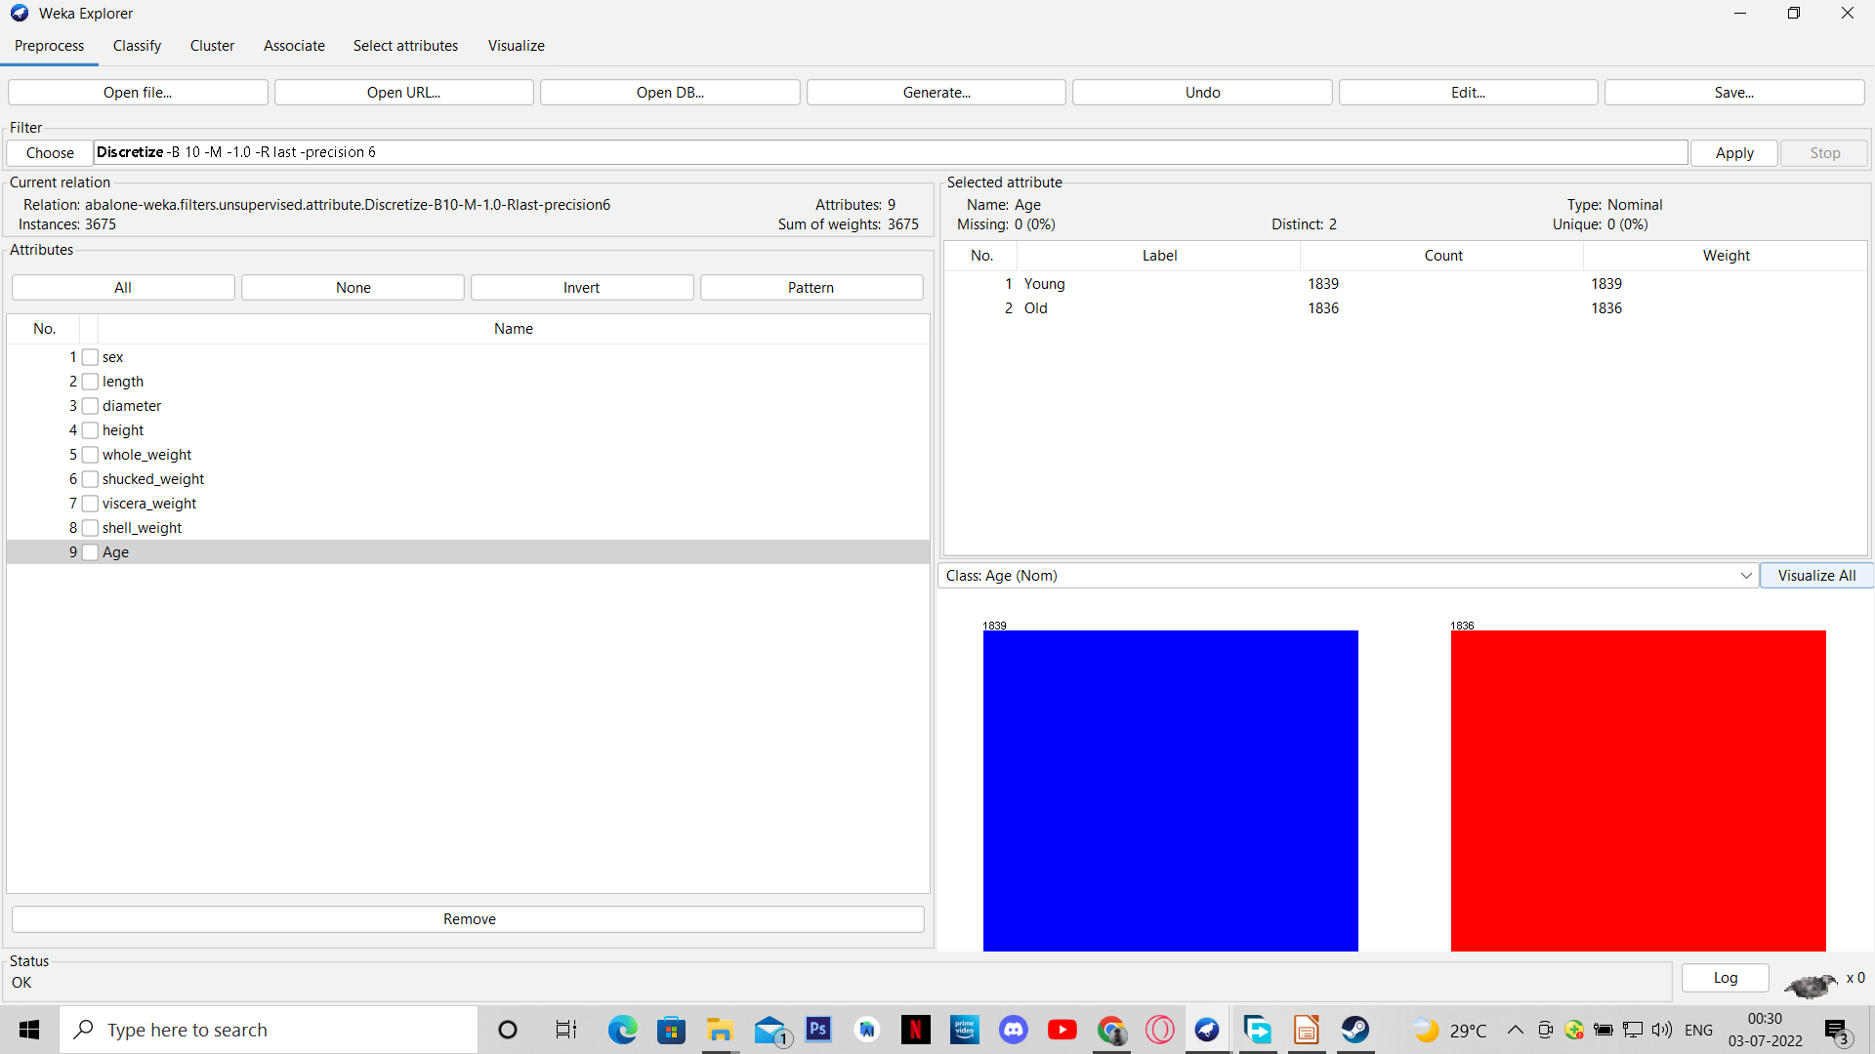
Using WEKA
Data Preprocessing
Discretization
The class data(Age attribute) had a range of 1 to 29 and for the decision tree algorithm to work it discretized the large range into a more acceptable number
Number of instances = 3675

Slide 23
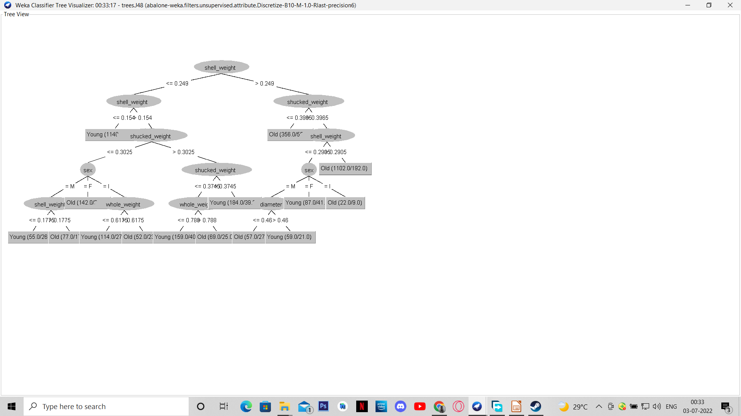
Using WEKA
Decision tree generated
Classification
Done using J48 Decision Tree
For Training Set
Confidence Level = 0.25
MinNumberObj = 50
Using 10 fold Cross Validation to produce
accurate output

Slide 24
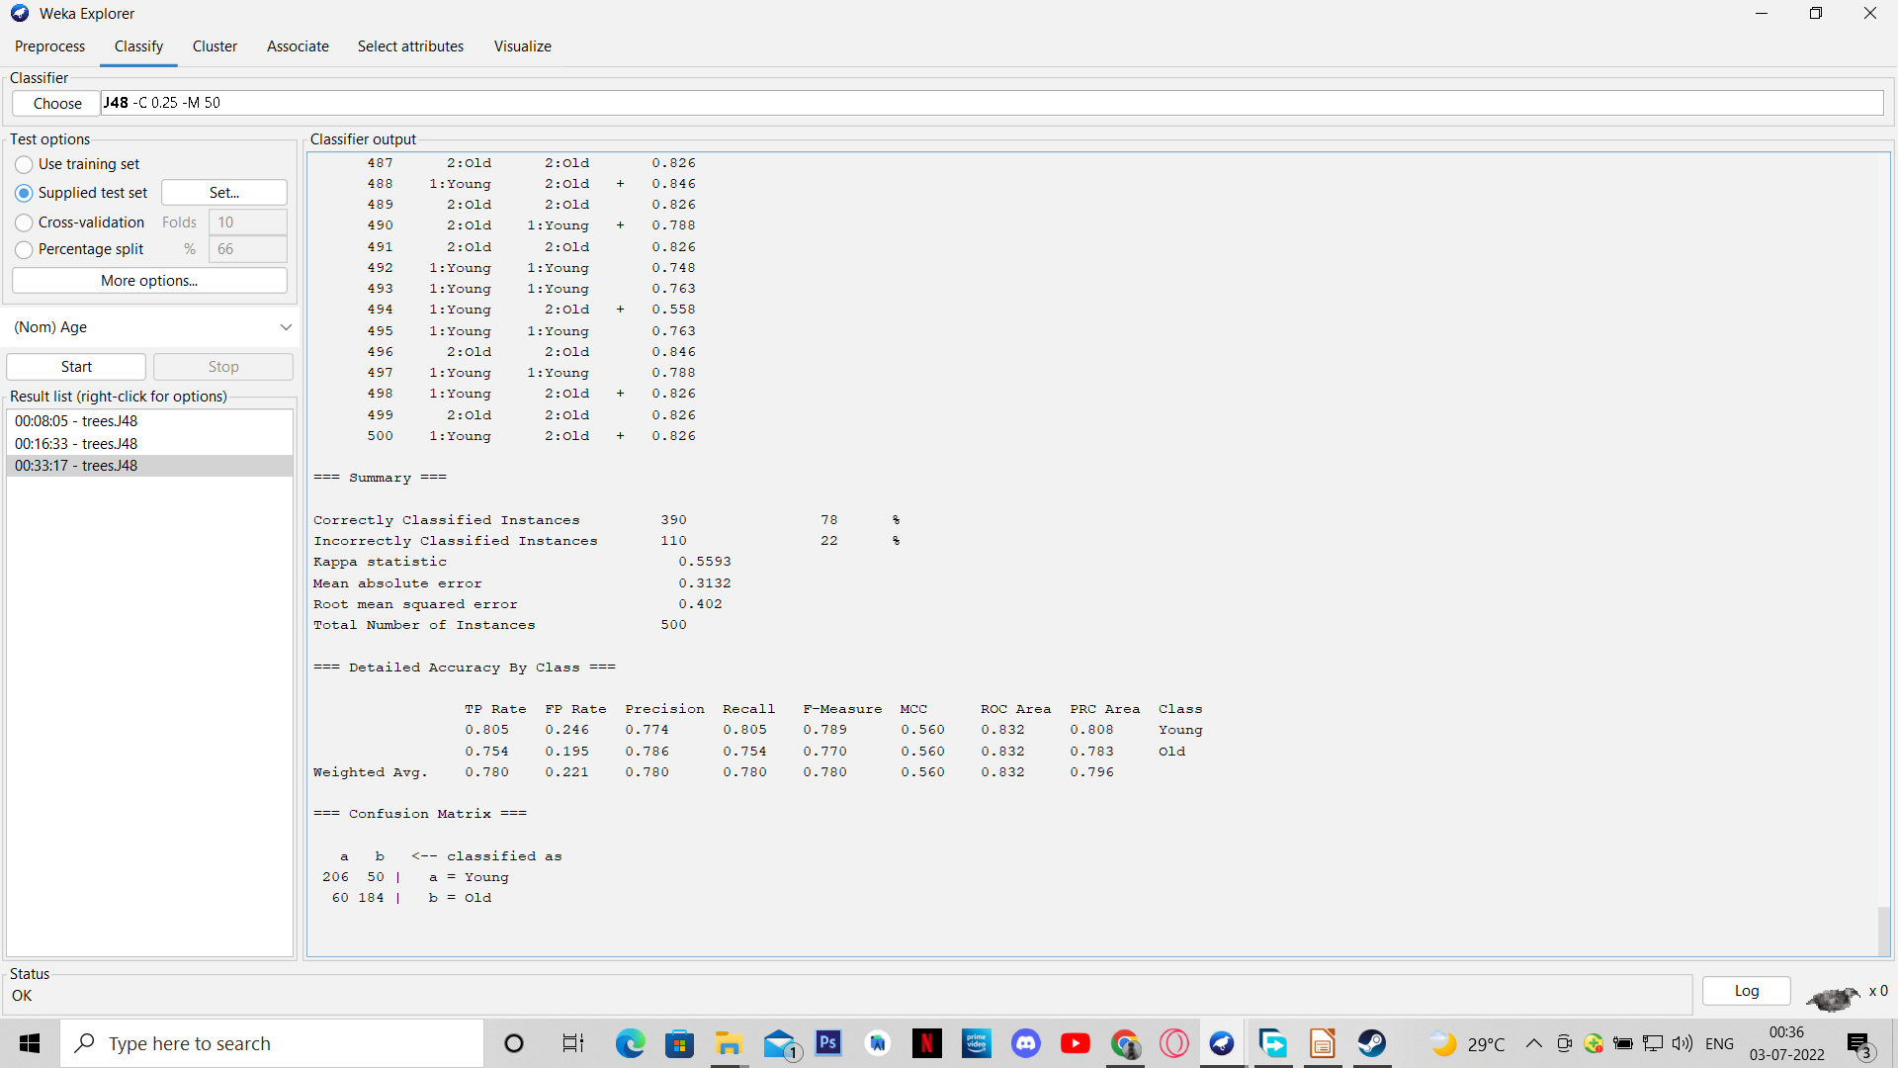
Using WEKA
Classification
Done using J48 Decision Tree
For Testing Set
Number of Instances = 500
Output accuracy = 78%

Slide 25

Using WEKA
Classification
Done using J48 Decision Tree
For Testing Set
Confusion matrix

Slide 26
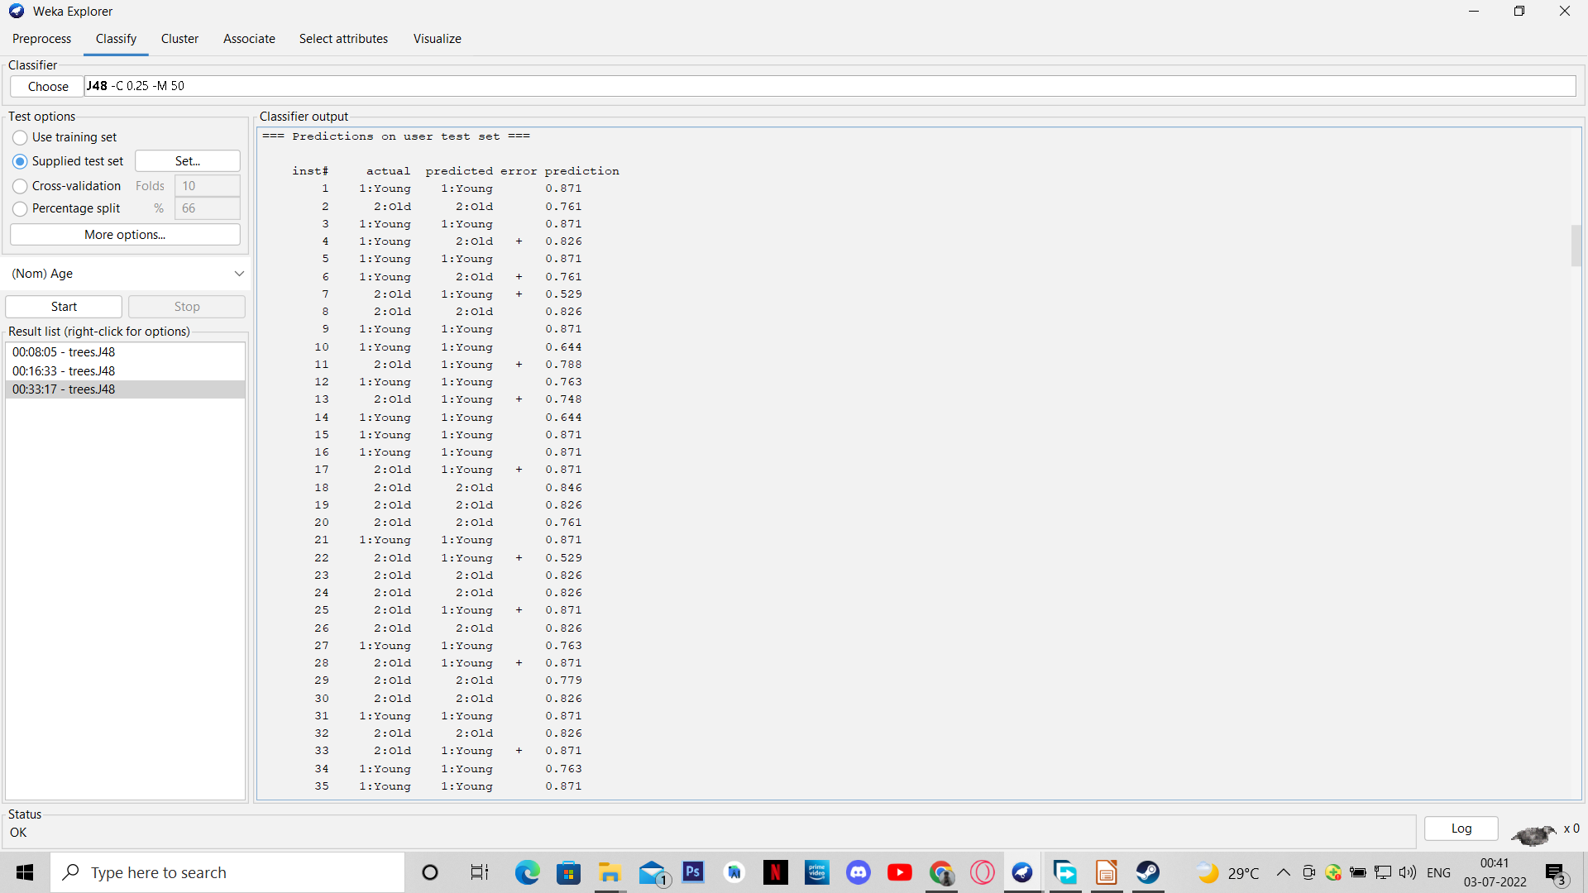
Using WEKA
Predicting the age
35 instances shown here

Slide 27
Conclusion
After comparing the two approaches, it is seen that the second approach to this problem statement that is prediction of the age (class) is better as it produces an accuracy percentage of 78 % than the first approach which just produces just 27.53 %.

