Slide 1
Yakup Koray Budanaz, Alexandru Calotoiu
SoftHier End-of-the-Year-Two Meeting

Slide 2



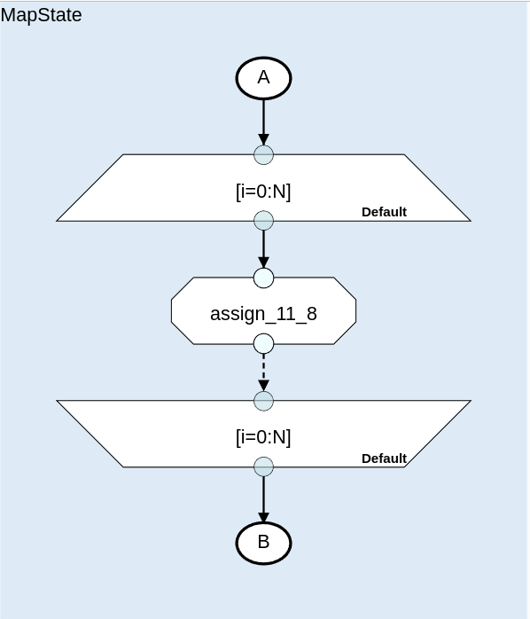


Absolute Performance For Weather Stencils
Can you directly apply scheduling transformations on a new accelerator?
Just run -
.offload() ?
.vectorize ?
Original Fortran Sources
Unoptimized DaCe SDFGs
Preprocessed Fortran Sources
(modules and functions inlined, macros expanded)
Optimized SDFG
Generated Source Code

Slide 3
Absolute Performance For Weather Stencils
No.
Can you directly apply scheduling transformations on a new accelerator?
Just run -
.offload() ?
.vectorize ?
Original Fortran Sources
Unoptimized DaCe SDFGs
Preprocessed Fortran Sources
(modules and functions inlined, macros expanded)
Optimized SDFG
Generated Source Code

Slide 4
Absolute Performance For Weather Stencils
Need to first prepare the SDFG for the Accelerator
With this approach we obtain ~1.5x speed-up over expert-tuned code
Original Fortran Sources
Optimized SDFG (for the target accelerator)
Unoptimized DaCe SDFGs
And then apply accelerator-specific optimizations
Preprocessed Fortran Sources
(modules and functions inlined, macros expanded)
SDFG Amenable to Accelerator Optimization
Generated Source Code

Slide 5
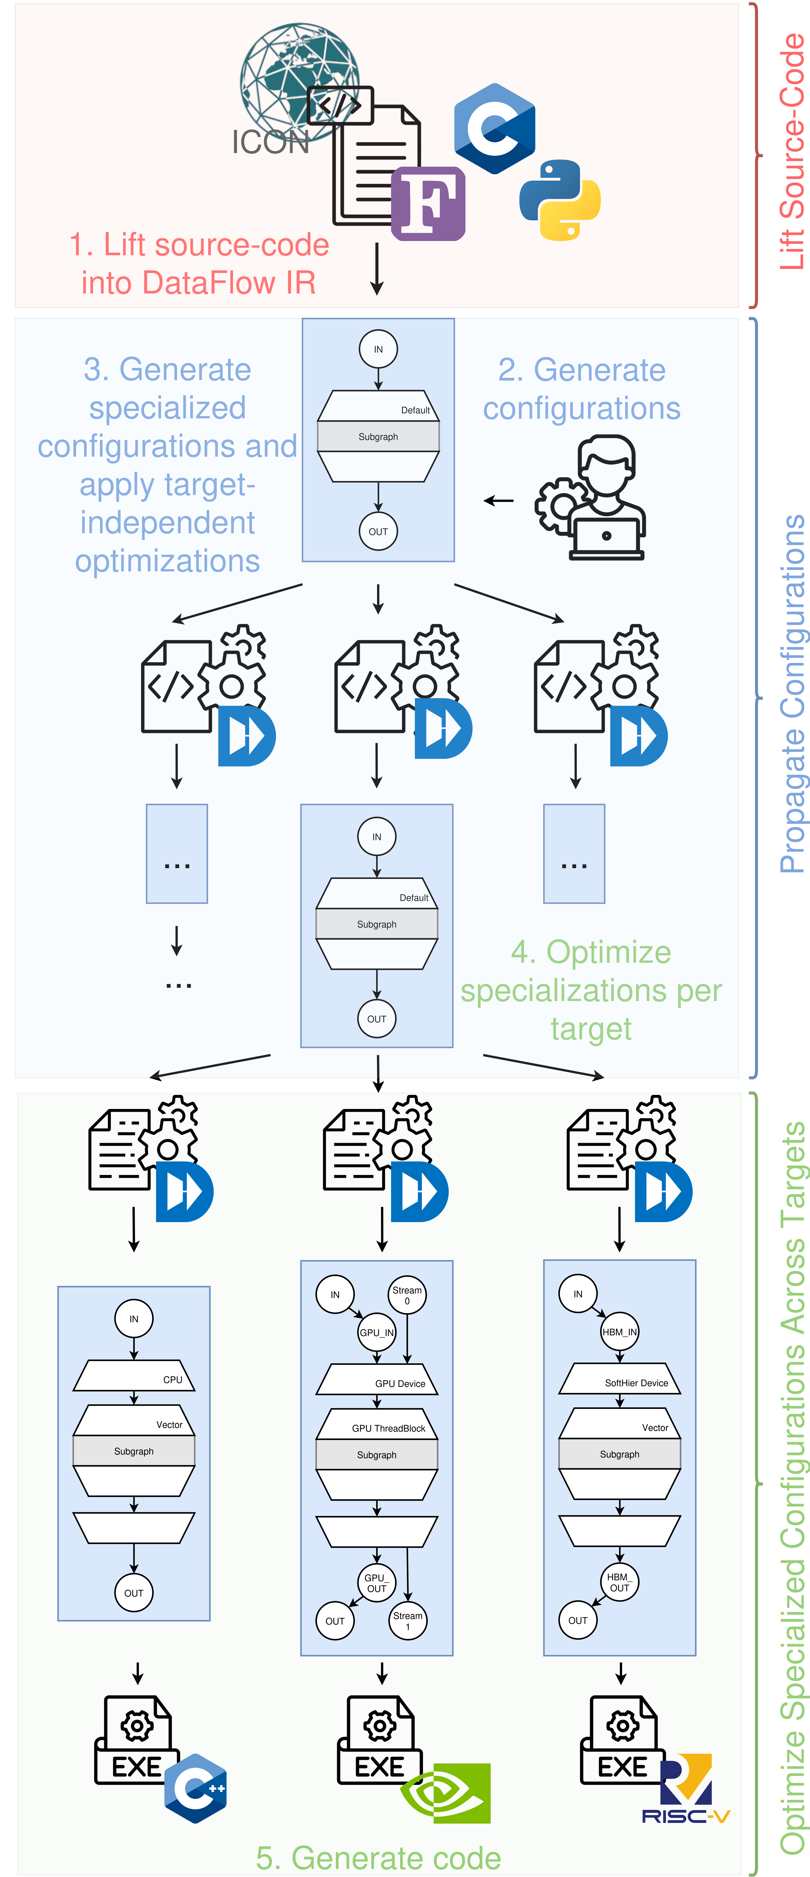
Optimizing ICON
First step to optimize ICON involves lifting ICON’s Fortran source code into the Stateful Dataflow MultiGraphs (SDFG) IR.

Slide 6
Optimizing ICON
In second step we collect the configuration-dependent constant and possible configurations necessary by the configurations used for the Gordon-Bell run and obtain a specialized SDFG per configuration.

Slide 7

Optimizing ICON
We optimize the specialized SDFGs depending on the target hardware

Slide 8
Optimizing ICON
The full optimization pipeline looks as follows:
  Lift control-flow centric IR into data-flow IR
  Automatically or manually collect configurations and generate specialized SDFGs.
  Optimize each specialized SDFG individually.
  → This automated pipeline also improves maintainability, while improving performance, by removing all pre-processor pragmas and decreasing LoC in Velocity Tendencies module of ICON by ~35%

Slide 9
How do we Decouple Optimizations from Source Code?
A Brief Introduction to the SDFG IR
AccessNode: Defines an access to a data container
Map: Defines a parallel region
Tasklet: Defines an operation on data

Slide 10
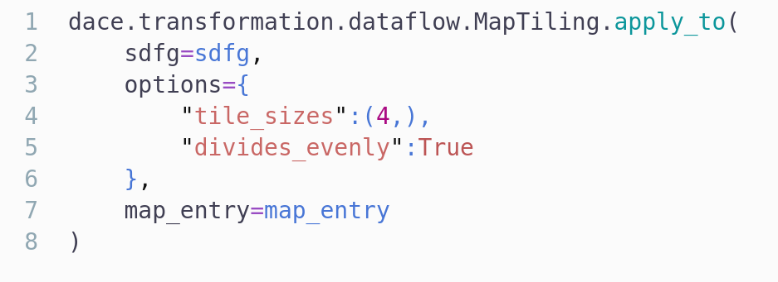
How do we Decouple Optimizations from Source Code?
A Brief Introduction to the SDFG IR

Slide 11
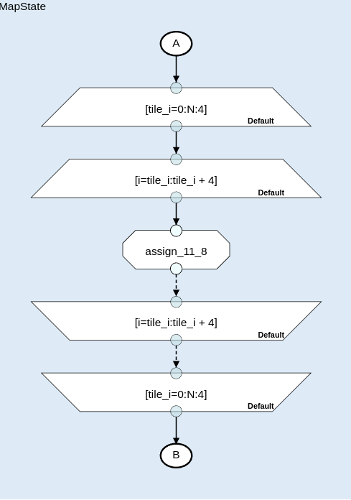
How do we Decouple Optimizations from Source Code?
A Brief Introduction to the SDFG IR
All operations are written as transformations on the IR

Slide 12
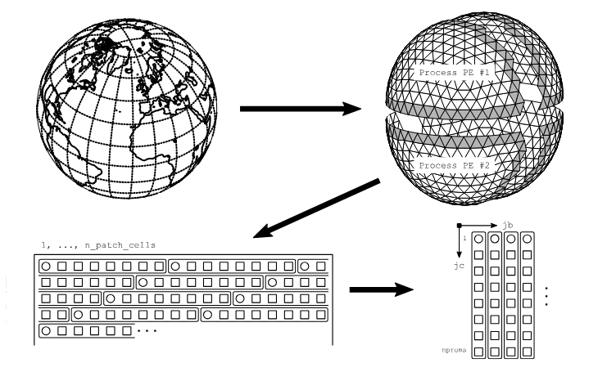
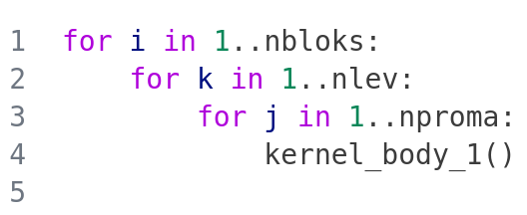
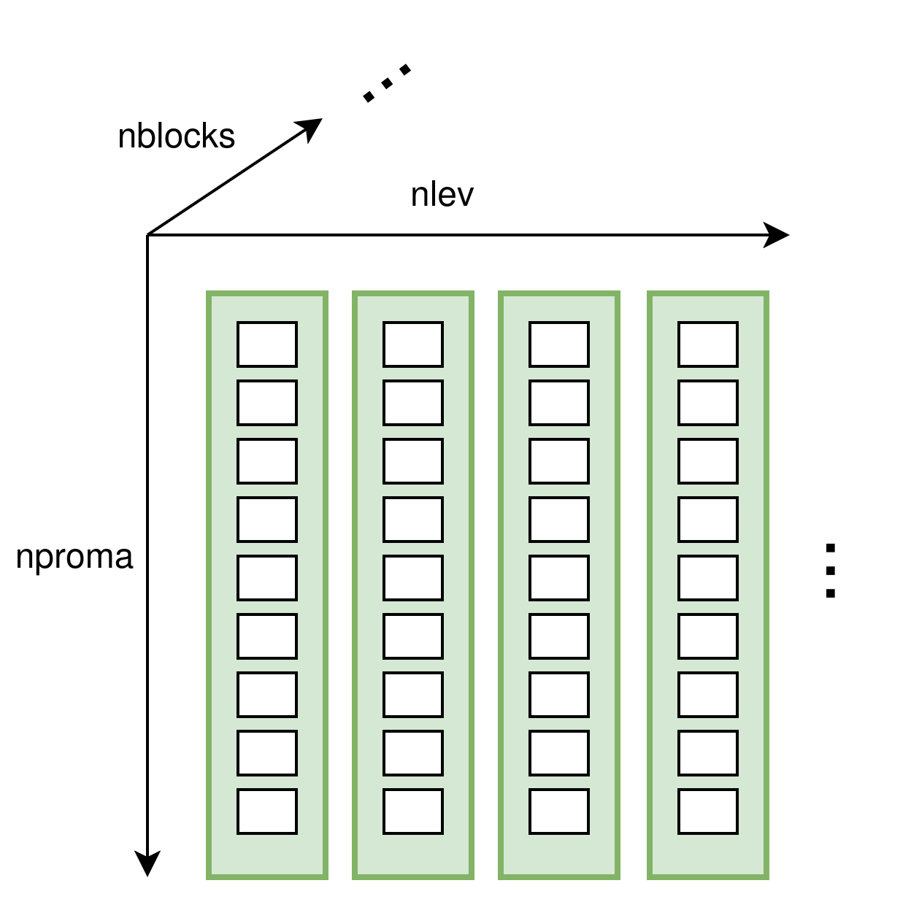
A Small Introduction to ICON’s Weather Stencils
Weather stencils are mostly semi-structured over two dimensions where the vertical dimension `nlev` is structured and `nproma * nbloks` domain is unstructured and blocked with the factor `nproma` for improved cache loaclity.
x
Grid Decomposition and Layout of ICON Grids*
*https://www.dwd.de/DE/leistungen/nwv_icon_tutorial/nwv_icon_tutorial.html (ICON Tutorial 2024)

Slide 13
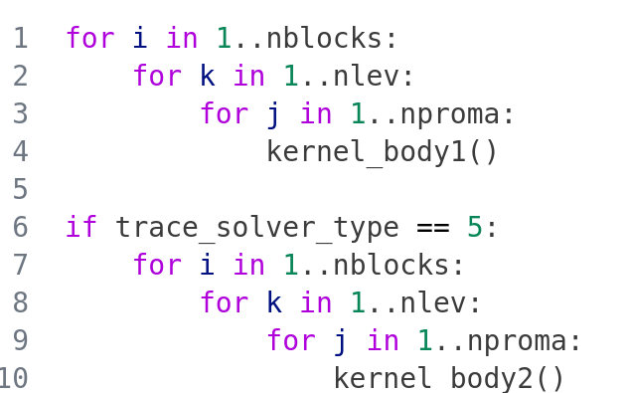
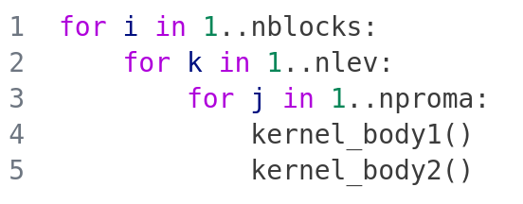
An Example for a Configuration Specific Optimization:
We propagate all known configuration dependent constants and aggressively fuse kernels.
The Gordon-Bell configuration uses `trave_solver_type = 5`

Slide 14
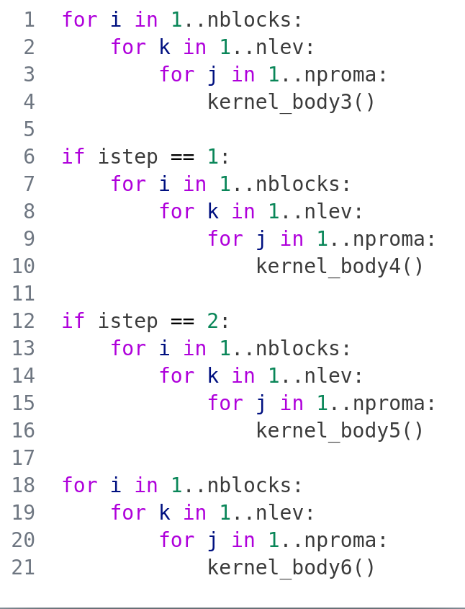
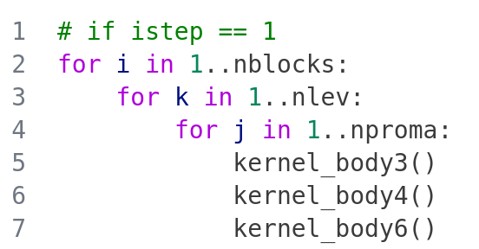

An Example for a Configuration Specific Optimization:
We propagate all known configuration dependent value sets and aggressively fuse kernels.
For example `istep` can have the values `{1, 2}`
Specialize for `istep == 1`
Specialize for `istep == 2`

Slide 15
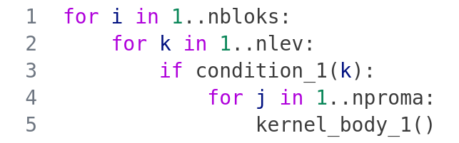
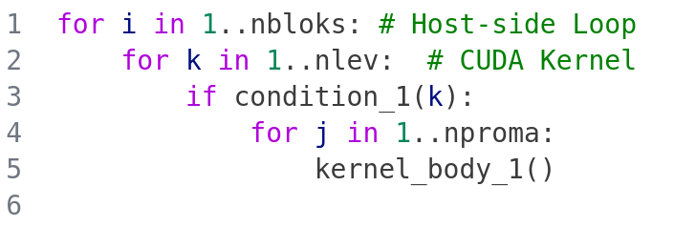
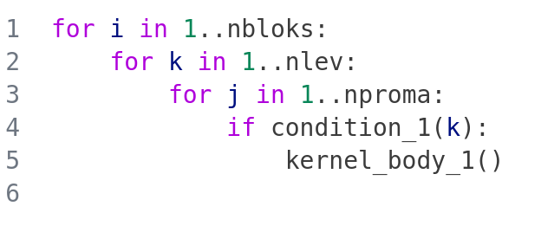
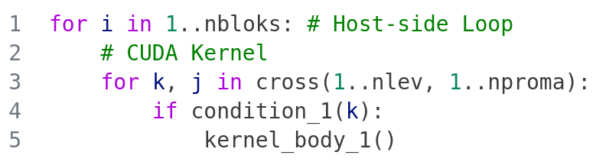
An Example For A Target-Specific Optimization:
We perform optimizations to increase the kernel dimension sizes even if it means we duplicate computation.
Schedule Kernels
Acc.
Move If Inside Loop
(to extend kernel dimensions)
Acc.
Schedule Kernels

Slide 16
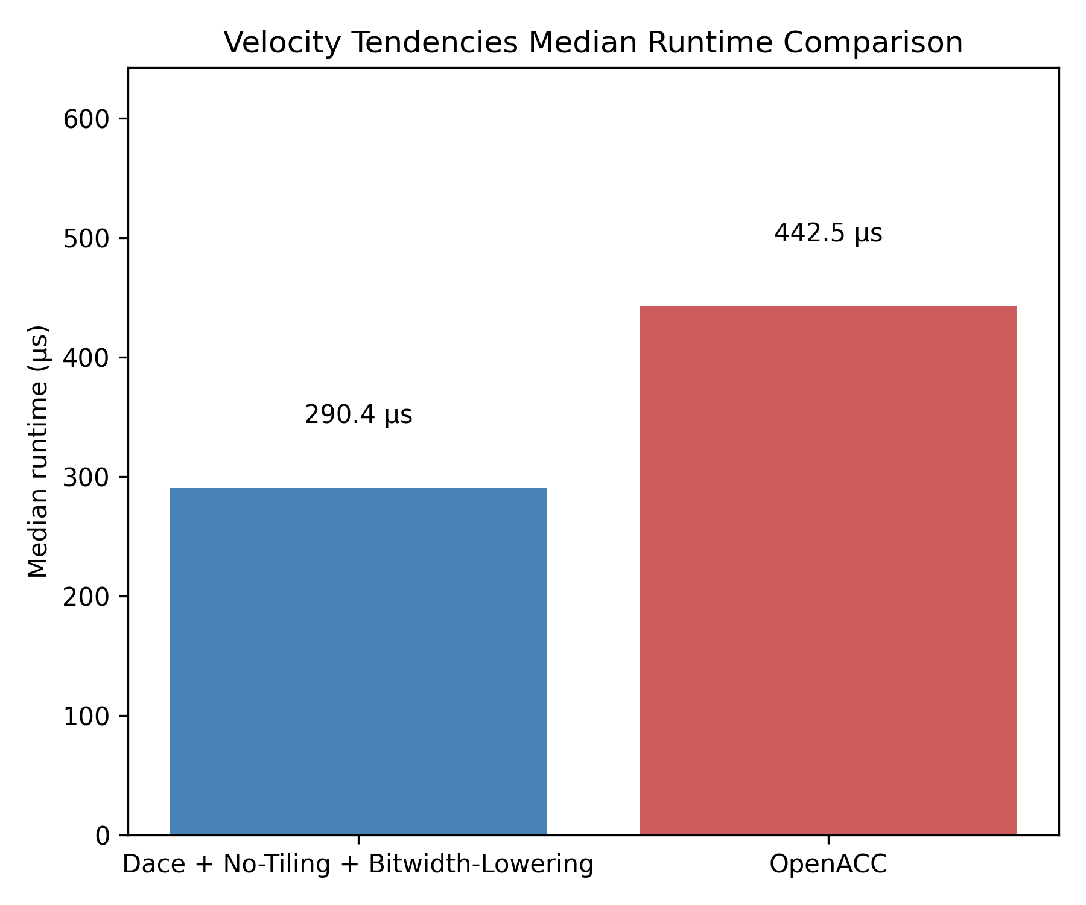
Impact of the Optimizations:
1.5x speedup by applying configuration-propagation

Slide 17
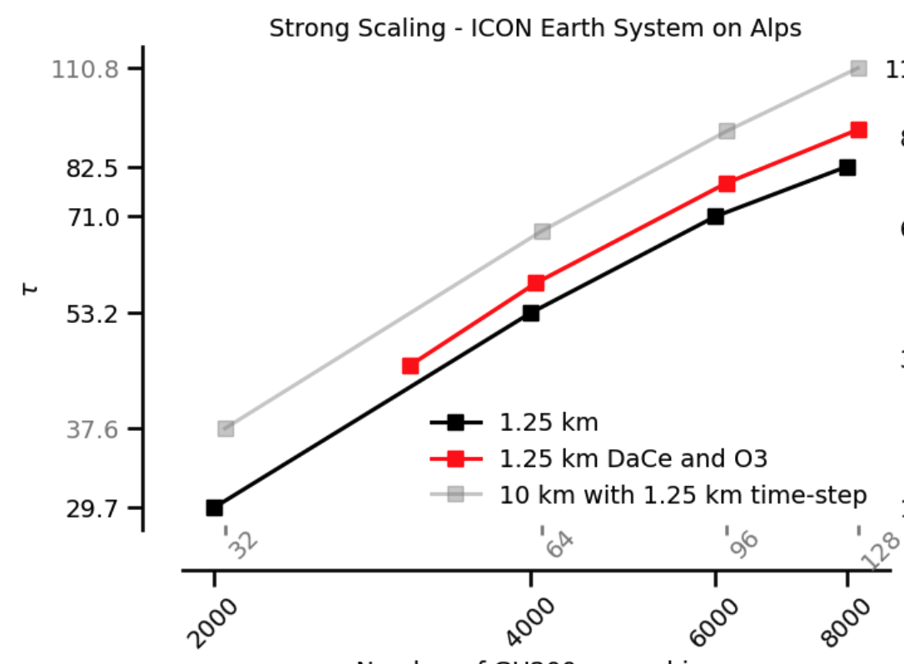
Impact of the Optimizations:
1.2x speedup on optimized section of ICON.
1.1x overall over expert-tuned OpenACC code, over complete ICON

Slide 18
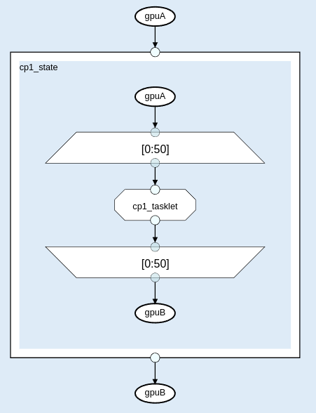
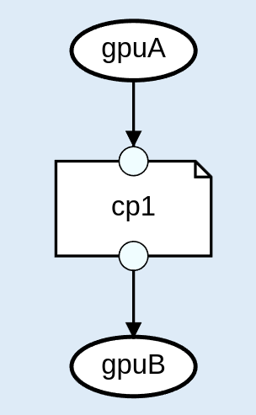
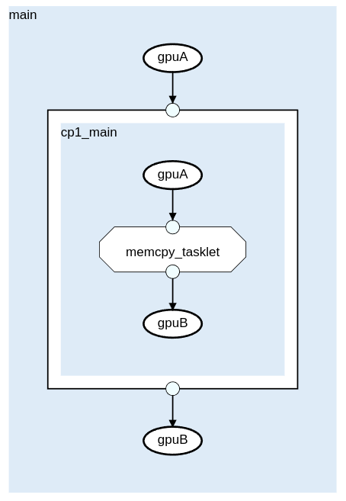
Specialization of Reductions, Copies and Memsets
Existing optimizations strategies rarely work out-of-the-box for new accelerators. Thus we specialize the reductions depending on the target.
.library.specialize(
Pure
)
CPU
.library.specialize(
Accelerator
)
Accelerator
.library.specialize(
SoftHier
)
SoftHier

Slide 19
Specialization of NeighborLists
Making all computation in FP64 and declaring everything in int64 is not always necessary
And weather stencils are memory bound!
Original execution path
int64_SDFG

Slide 20
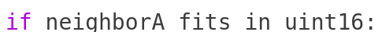

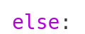
Specialization of NeighborLists
Making all computation in FP64 and declaring everything in int64 is not always necessary
And weather stencils are memory bound!
New execution paths
Original execution path
uint16_SDFG
uint32_SDFG
int64_SDFG

Slide 21
Gordon Bell
Extra slide if we get the GB award

Slide 22
SIMT vs SIMD
The Gordon-Bell run was performed on SIMT-model machines
We have worked on completing the transition from SIMT-model machine to a SIMD-only model and a machine.

Slide 23
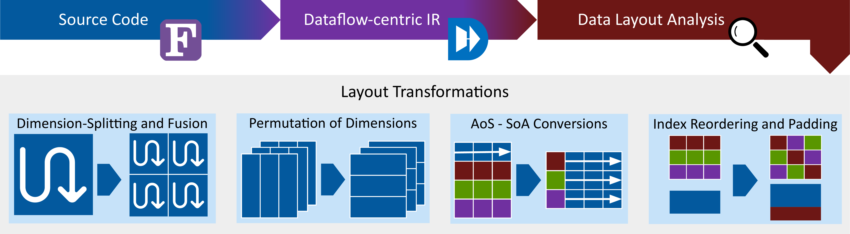
Layout Transformations
We also optimized layouts of transient data to improve access coalescing and enable transformations from the SIMT model to SIMD model.
Layout transformations and branch-elimination is necessary to enable a complete transition from SIMT to SIMD model.

Slide 24
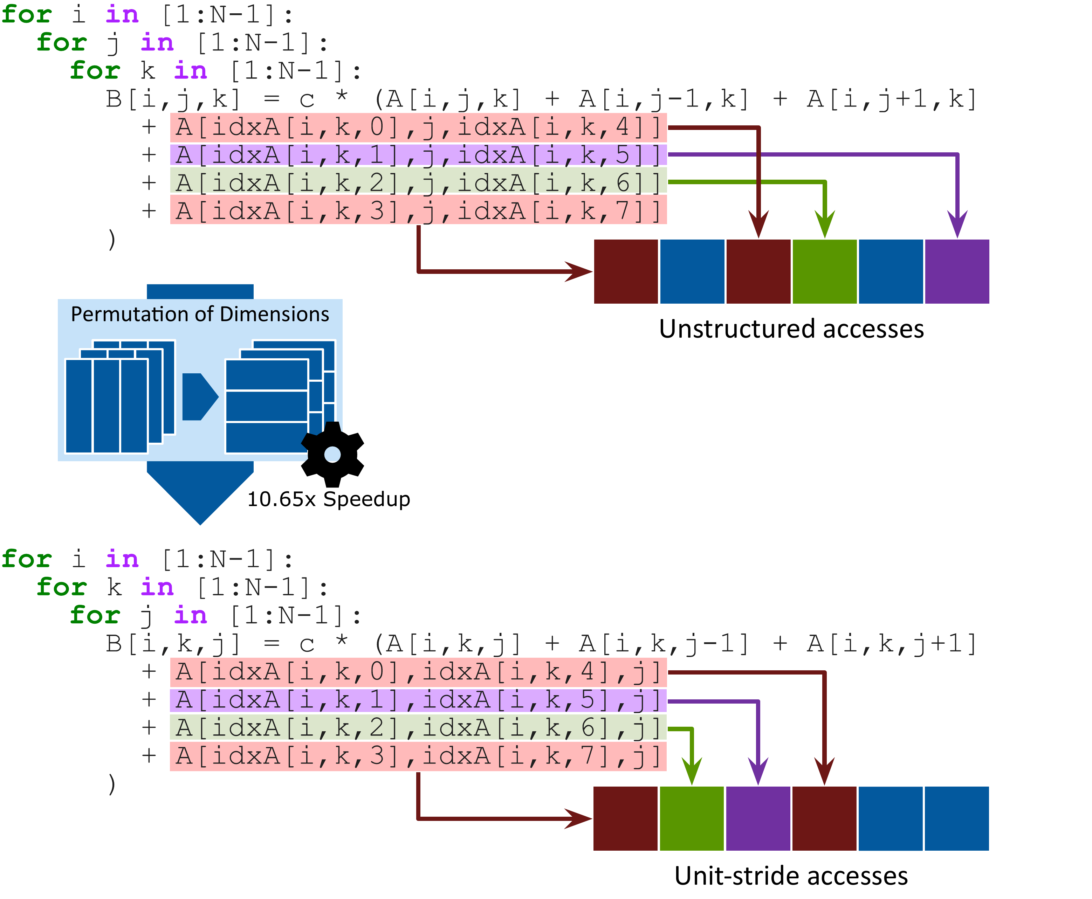
A Motivating Example for Layout Transformation from Weather Stencils
Layout transformation enable the use of SIMD instructions for semi-structured weather stencils

Slide 25
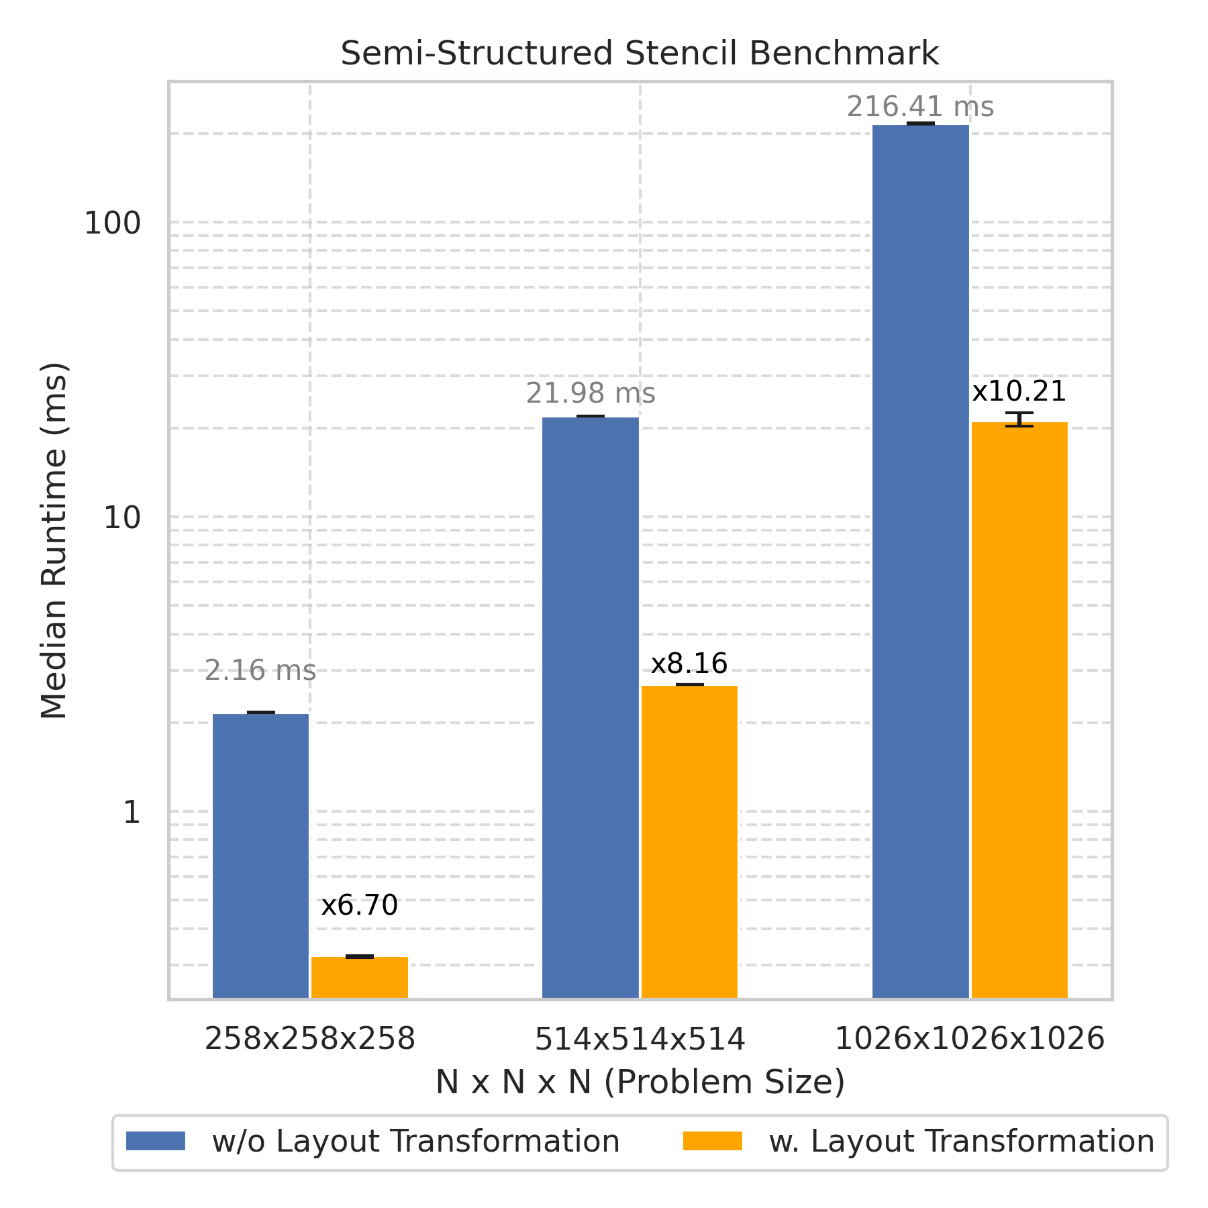
A Motivating Example for Layout Transformations from Weather Stencils

Slide 26
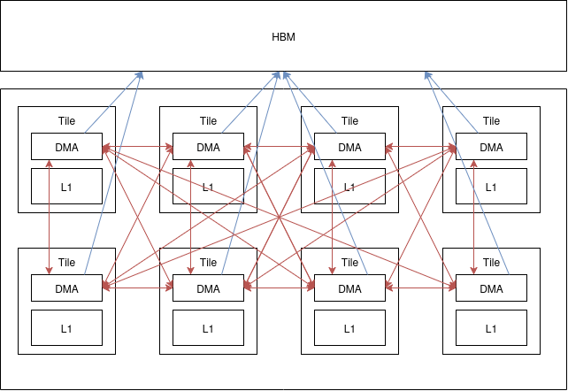
Layout Transformations On SoftHier
The layout transformations implemented in DaCe are also applicable to the SoftHier simulator, where it provides an all-to-all abstraction for both accesses over the NoC and the HBM

Slide 27
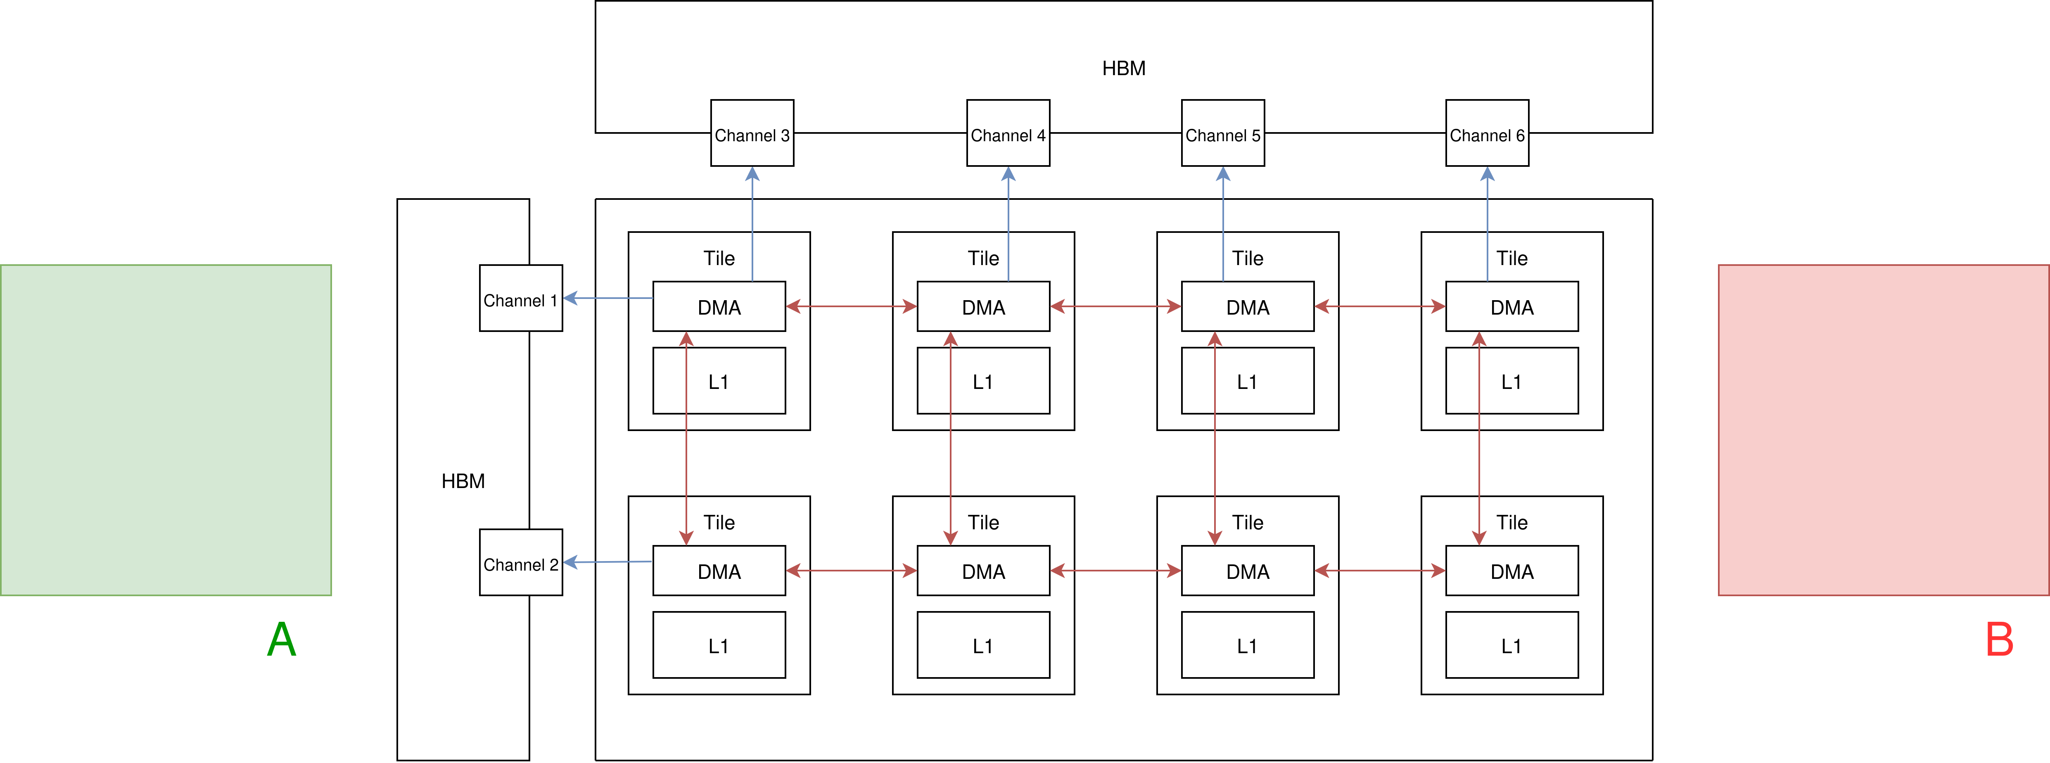
Layout Transformations On SoftHier
We have helped in applying layout transformations for the SoftHier simulator

Slide 28
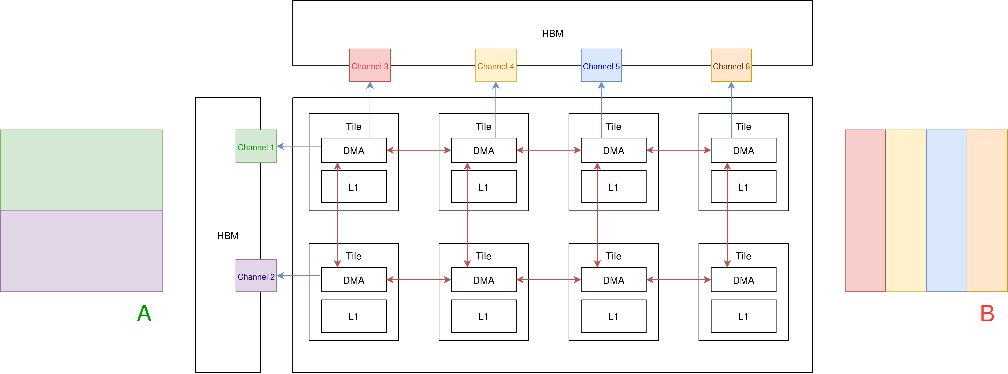
Layout Transformations On SoftHier
We identify the HBM-channel aware layout that depending on the computational kernel
We have helped in applying layout transformations for the SoftHier simulator

Slide 29
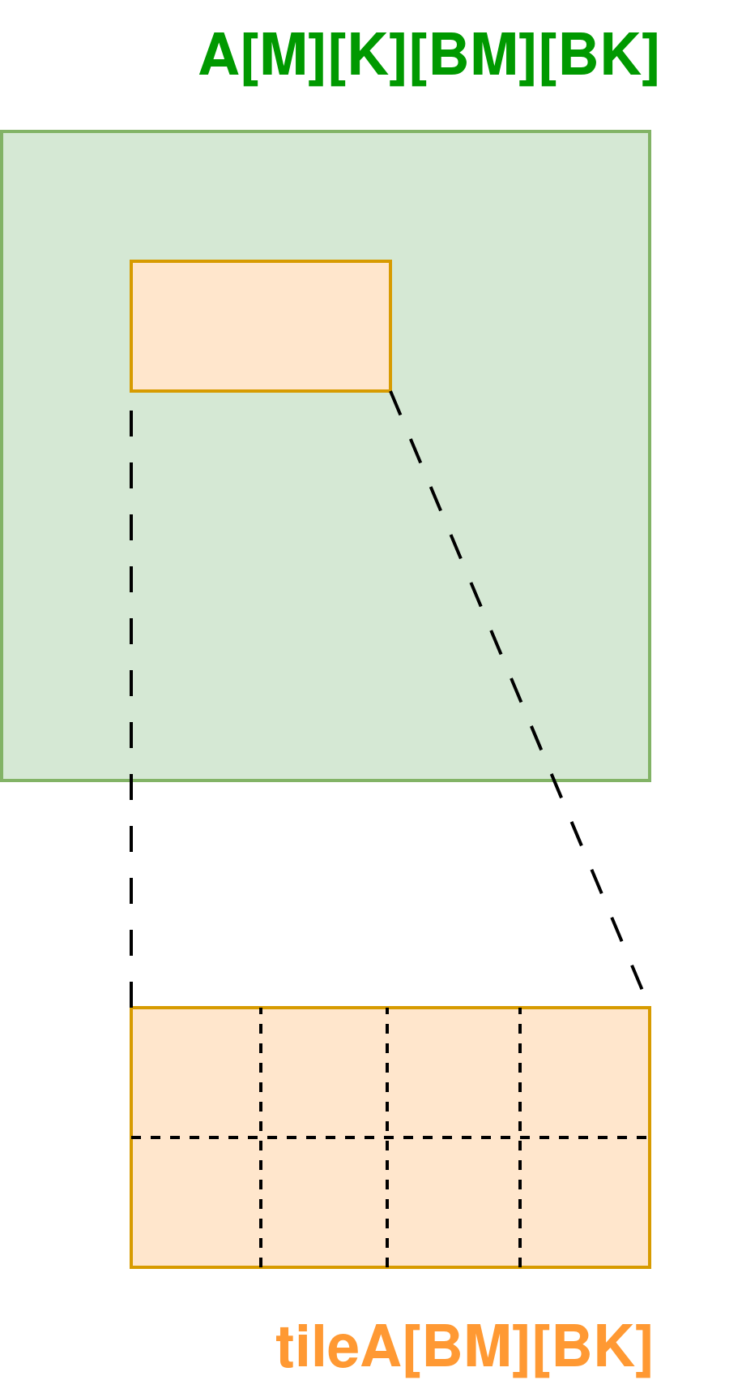
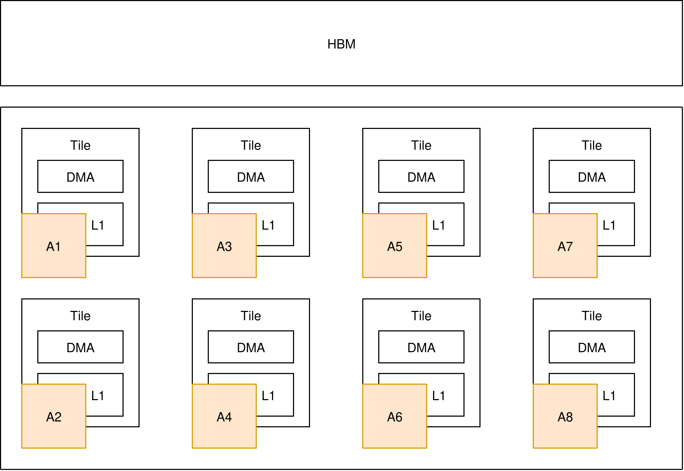
Layout Transformations On SoftHier
We have helped in applying layout transformations for the SoftHier simulator
A1
A3
A5
A7
A2
A4
A6
A8

Slide 30
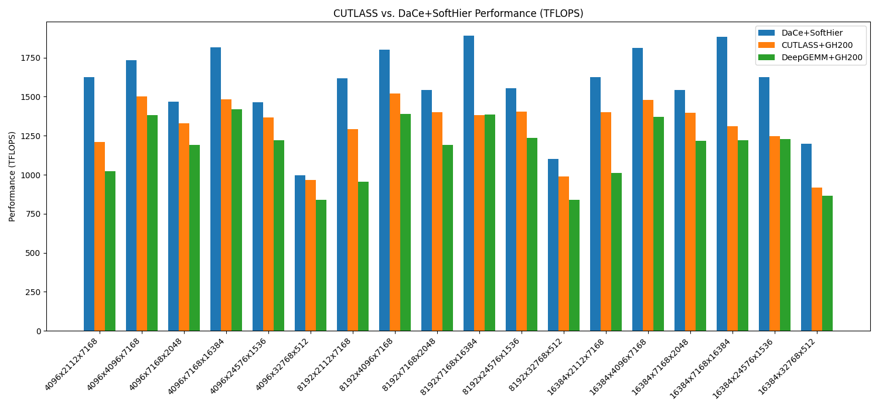
Layout Transformations On SoftHier
Results obtained by a student supervised by Chi and Yakup

Slide 31
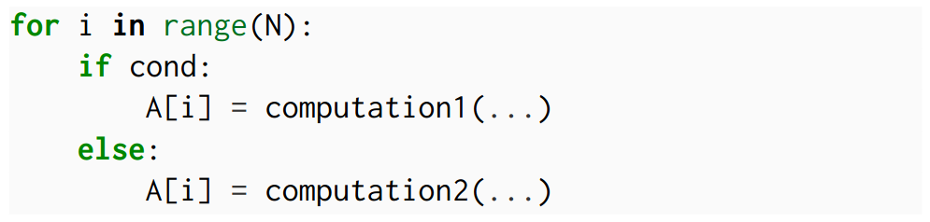
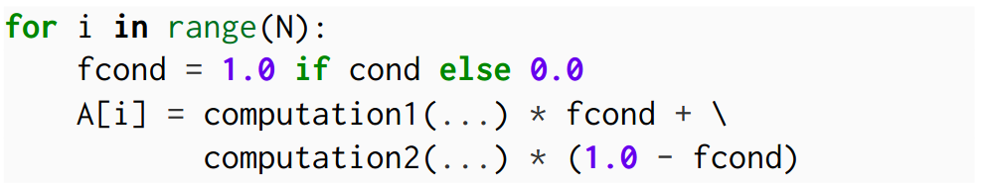
SoftHier on General Vectors: Auto-Vectorization
Vector-Processors and Branches are Natural Enemies!
Eliminating branches is necessary for vectorization

Slide 32
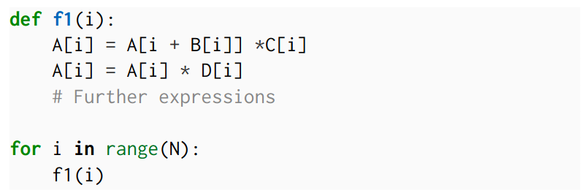
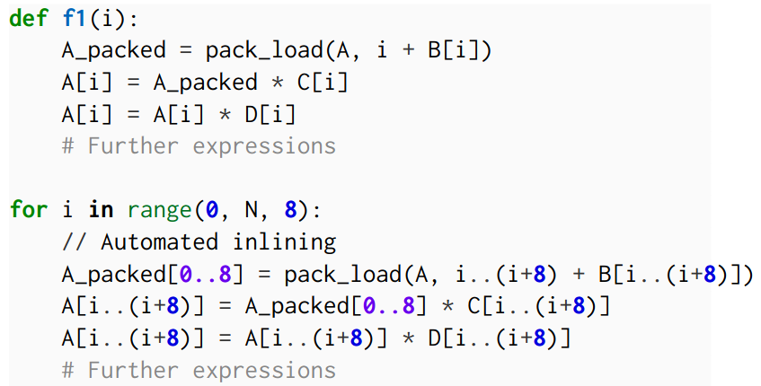
DaCe Vectorization
DataFlow IR and having the global-view of the program enables vectorization of patterns not vectorizable by traditional compilers such as LLVM:
Complete f1 can’t be vectorized by LLVM due to the indirect access!
We can vectorize the function f1 partially.

Slide 33
DaCe Vectorization
Performance results TODO

