Slide 1
WAREHOUSE INVENTORY SYSTEM

Slide 2
Contents:
• Introduction
• Problem Definition
• Objective
• Methodology
• Results
• Conclusion
• References

Slide 3
Introduction:
This project aims to develop a smart and efficient Warehouse Inventory Management System using Flask, MySQL, HTML, and CSS. The system is designed to simplify inventory operations such as adding, updating, deleting, and monitoring product records in an organized manner.
The application provides a user-friendly interface for managing warehouse products efficiently. It helps reduce manual work, improves data accuracy, and allows users to perform CRUD operations smoothly.
The project includes features such as product management, warehouse tracking, responsive user interface, and database connectivity. The system improves productivity and provides a simple solution for inventory management.

Slide 4
Problem Statement & Objective:
Problem Definition:
Managing warehouse inventory manually is a difficult and time-consuming process that may lead to errors, data redundancy, and improper stock management. Traditional methods make it difficult to track product availability, maintain accurate records, and monitor inventory status efficiently.
Objective:
The main objective of this project is to develop a smart and efficient Warehouse Inventory Management System for managing inventory records in an organized manner. The system aims to simplify inventory operations, reduce manual effort, and improve data accuracy through automation.

Slide 5
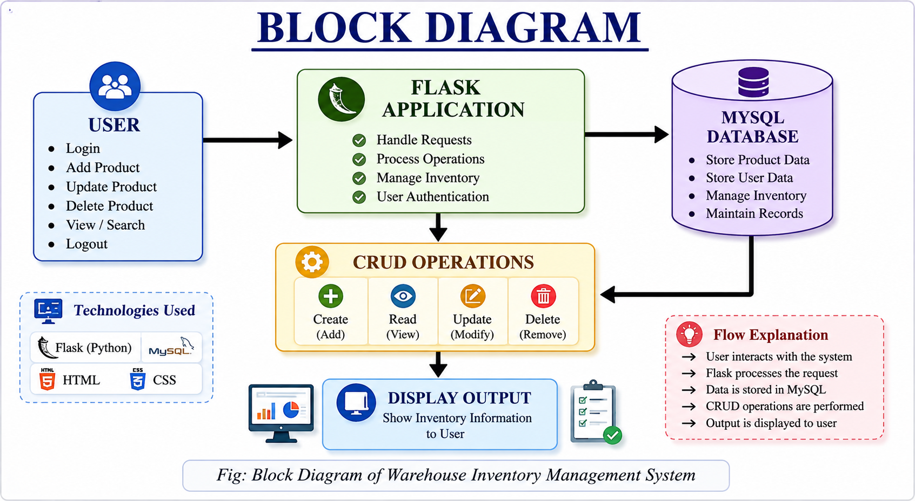
Block Diagram:

Slide 6
Methodology:
The development of the Warehouse Inventory Management System follows a systematic approach involving frontend development, backend implementation, and database management.
The frontend interface is developed using HTML and CSS to create a simple and user-friendly application interface. Flask is used as the backend framework to handle server-side operations and routing.
MySQL is used as the database system for storing and managing inventory records securely. The system allows users to perform CRUD operations such as adding, updating, deleting, and viewing product records efficiently.
The overall workflow of the system improves inventory management efficiency, reduces manual effort, and provides organized data handling.

Slide 7
Results:
The Warehouse Inventory Management System successfully combines frontend development, backend processing, and database management to create an efficient and user-friendly application.
The project simplifies inventory operations such as adding, updating, deleting, and monitoring product records through automation and organized data management. The developed system improves productivity, reduces manual effort, and provides accurate inventory tracking.
This project demonstrates the practical implementation of Flask, MySQL, HTML, and CSS technologies in developing a smart warehouse inventory management solution.

Slide 8
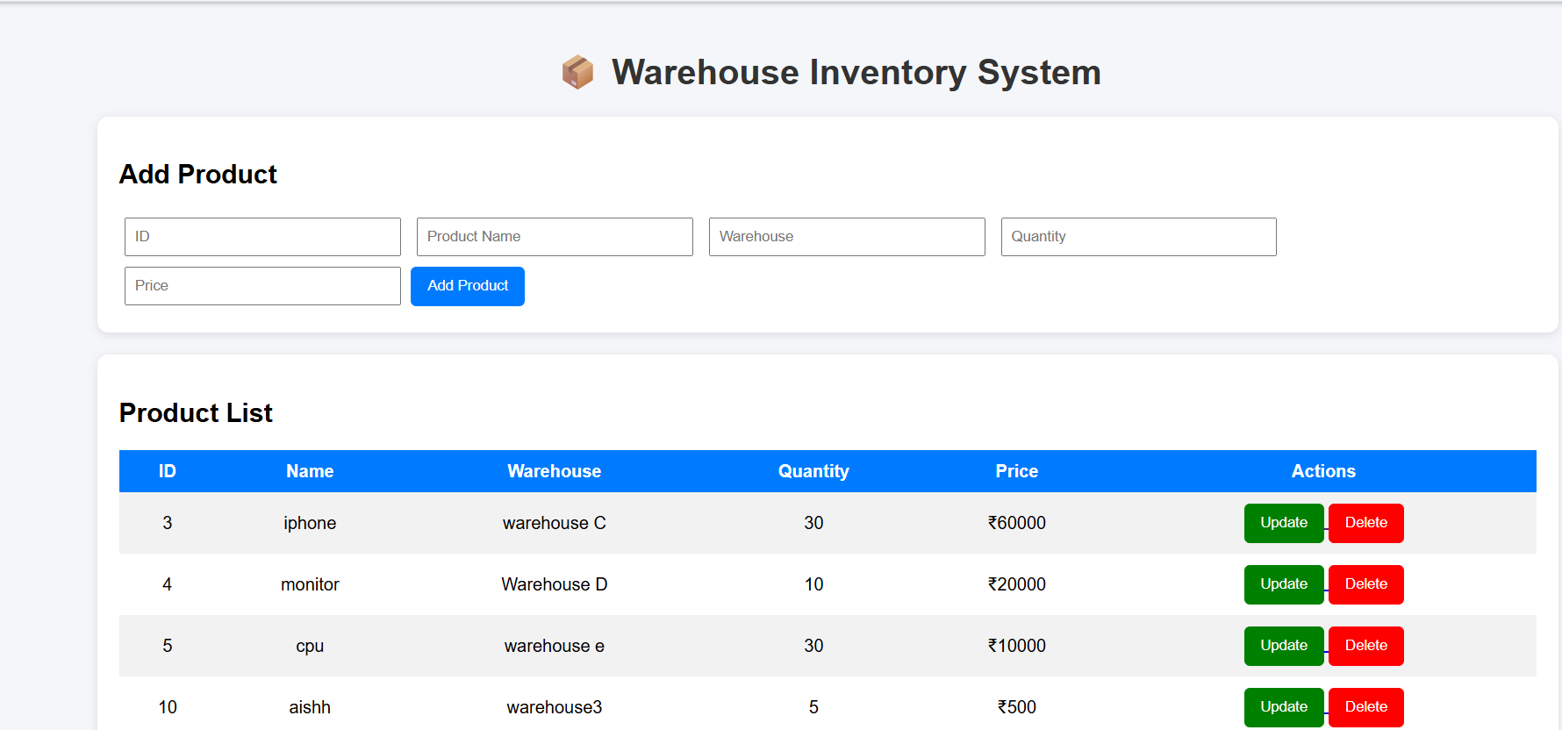
Snapshot
Fig 5.1: Home Page of Warehouse Inventory Management System

Slide 9
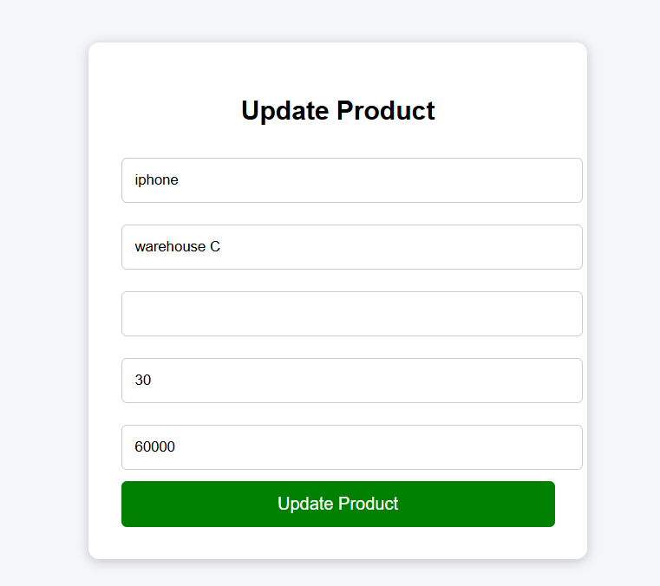
Snapshot
Fig 2: Update Product Module

Slide 10
Conclusion:
The Warehouse Inventory Management System successfully provides an efficient and user-friendly solution for managing warehouse inventory records. The system simplifies inventory operations such as adding, updating, deleting, and monitoring product details through an organized web application.
The project reduces manual effort, improves data accuracy, and enables efficient inventory tracking using Flask and MySQL technologies. The developed system is simple, reliable, and suitable for small and medium-scale warehouse management applications.

Slide 11
References
Flask Official Documentation – https://flask.palletsprojects.com/
MySQL Documentation – https://dev.mysql.com/doc/
HTML & CSS Tutorials – https://www.w3schools.com/
Python Documentation – https://docs.python.org/
Bootstrap Documentation – https://getbootstrap.com/

Slide 12
THANK YOU

