Slide 1
SENSOR YOURSELF

Slide 2
Where the idea came from?!!!

Slide 3
Hydrogen
Water Container
DRONE
Movement
Oxygen
Thrusters
AIR

Slide 4
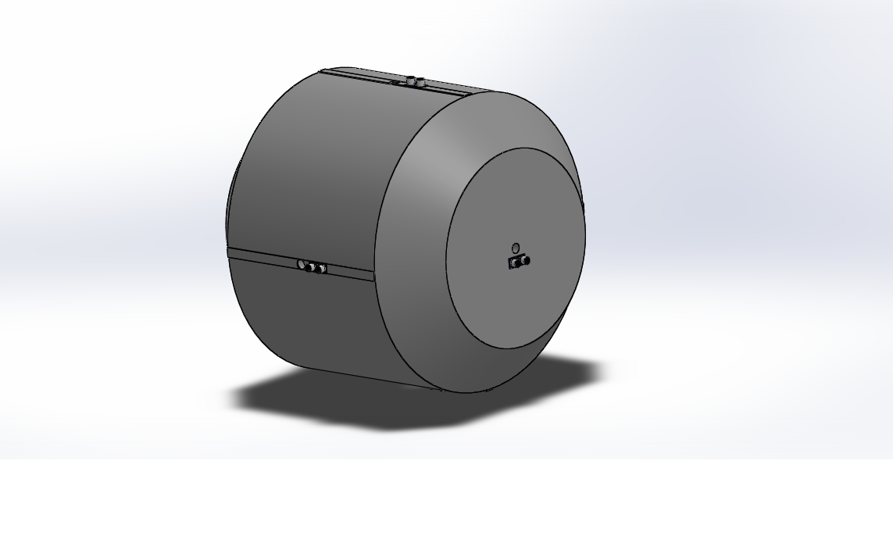

Slide 5
Drone sensors
Humidity
Temperature
Toxic
Dust
Movement
Ultrasonic
Gyroscope

Slide 6
Arduino
Sensor Data
PC
Charts
Temperature Alert
Toxic Procedures
Air Purify

Slide 7
OUTPUT Data from sensor to PC

Slide 8
HOW?!

Slide 9
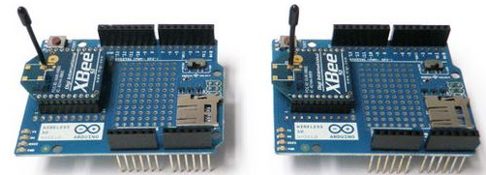

Slide 10
