Slide 1
Dengue in Vietnam: when and where does the season hit, and does rain warn us early?
A preparation plan for a pest-control client, from 17 years of provincial data
Google Data Analytics Capstone · Track B
Notes:
1 min. Introduce yourself, the client and the one-line question.

Slide 2
Context
Why it matters: dengue costs the client most when it arrives unprepared
Reported cases in Vietnam: 109,000 in a typical recent year, 367,729 in the record year 2022.
Aedes mosquitoes breed in standing water; control works best before cases rise (larval control, clean-ups, spraying).
The client needs to know which months and which provinces to staff, and how early it can see a season coming.
Data: OpenDengue V1.3.1 (Clarke et al. 2024, CC BY 4.0), 64 provinces 1994–2010 + national series to 2024; NASA POWER weather.
Notes:
2 min. Vietnam reports tens to hundreds of thousands of cases a year; 2022 set the record (367,729). Vector control works best before the peak: larval control and community clean-ups need weeks. Staff and insecticide bought in a hurry cost more.

Slide 3
Ask
Business task, stakeholders and metrics
Business task: identify when in the year and where reported dengue cases rise, and how strongly they follow rainfall and temperature in the preceding months, so the client can prepare one to two months before each regional peak.
Stakeholders: operations director, regional managers (North, Central coast, Central Highlands, South), finance, public-health partners.
Metrics: cases per month · peak month and season length · outbreak years (mean + 2 SD) · weather lead time (Spearman ρ, lag 0–3 months).
Data: OpenDengue V1.3.1 (Clarke et al. 2024, CC BY 4.0), 64 provinces 1994–2010 + national series to 2024; NASA POWER weather.
Notes:
2 min. Read the business task. Metrics: cases per month, peak month and season length, outbreak years (mean + 2 SD), Spearman correlation of weather k months earlier with cases.

Slide 4
Prepare
Data: 64 provinces × 17 years of monthly cases, plus weather for 11 provinces
OpenDengue V1.3.1 (CC BY 4.0): 12,273 province-months, 1994-02 → 2010-12, 1.38 million reported cases; national series 1960–2024.
NASA POWER: monthly rainfall, temperature and humidity, 1994–2024, at 11 provincial capitals in four regions.
Population by province (statistics office) for incidence; province boundaries from geoBoundaries.
Checks: no negative, missing or duplicate province-months; provinces sum exactly to the national monthly figures.
Limitations
• Province data ends in 2010
• Reported cases < real infections
• One weather point per province
• Incidence for 2004–2010 only
• Correlation is not causation
Data: OpenDengue V1.3.1 (Clarke et al. 2024, CC BY 4.0), 64 provinces 1994–2010 + national series to 2024; NASA POWER weather.
Notes:
2 min. OpenDengue compiles official reports; province data comes from Project Tycho. The sum of provinces matches the national monthly series exactly. ROCCC: weak on Current, so 2024 national data is used as a check.

Slide 5
Process
Process: clean, join and lag
Filtered the 503 MB global file to Vietnam with DuckDB (0.1 MB), parsed dates, added four regions.
Weather from wide to long; rainfall mm/day → mm/month; lags of 1–3 months for rain, temperature, humidity.
Joined cases and weather on province + year + month: 2,191 rows for 11 provinces.
National annual series: one complete total per year (57 years), no double counting, gaps left empty.
Data: OpenDengue V1.3.1 (Clarke et al. 2024, CC BY 4.0), 64 provinces 1994–2010 + national series to 2024; NASA POWER weather.
Notes:
2 min. Walk through the change log. Emphasise: no gaps filled with zero; one source per year in the national series; lags computed on the full weather series so the first months keep their lags.

Slide 6
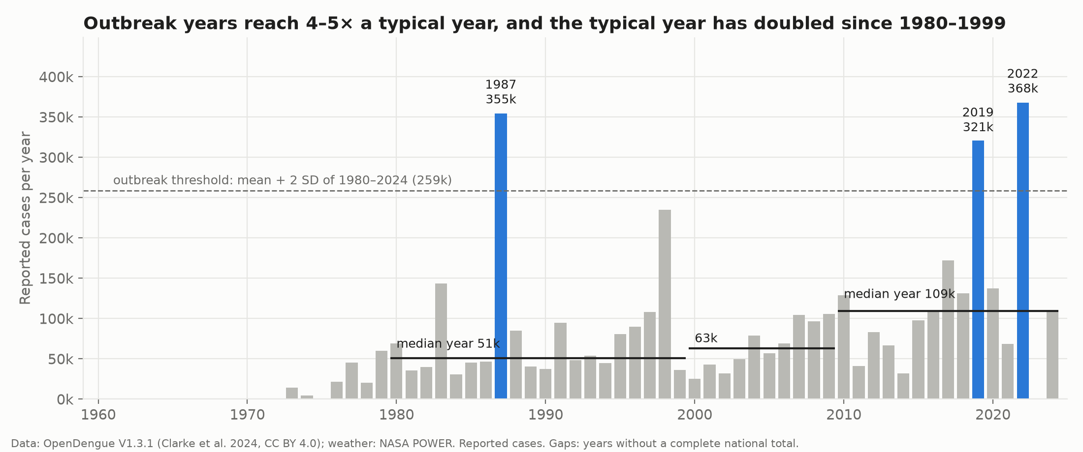
Finding 1
Outbreak years reach 4–5× a typical year, and the typical year has doubled
Data: OpenDengue V1.3.1 (Clarke et al. 2024, CC BY 4.0), 64 provinces 1994–2010 + national series to 2024; NASA POWER weather.
Notes:
~1.7 min. Median year 51k (1980–1999), 63k (2000–2009), 109k (2010–2024). Outbreak years above mean + 2 SD: 1987, 2019, 2022. 1998 (235k) came close. Implication: plan for a rising baseline and keep surge capacity.

Slide 7
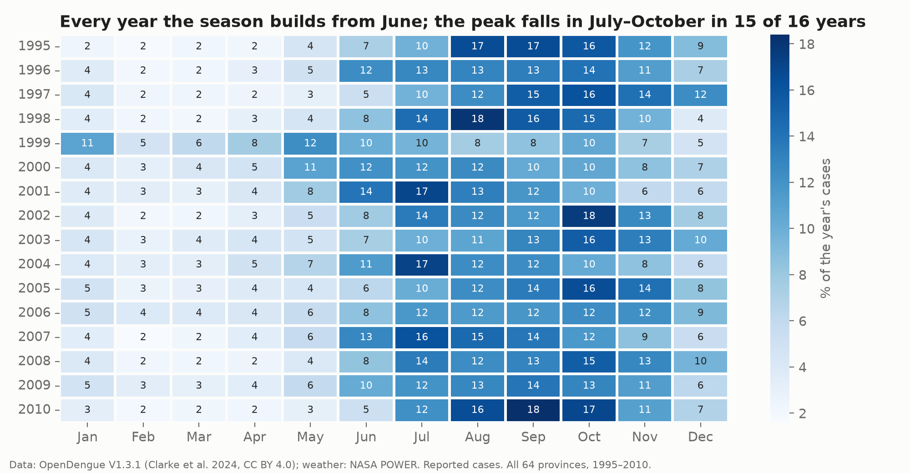
Finding 2
The season is regular: June–November holds 73% of cases
Data: OpenDengue V1.3.1 (Clarke et al. 2024, CC BY 4.0), 64 provinces 1994–2010 + national series to 2024; NASA POWER weather.
Notes:
~1.7 min. Every row shows the same band from June. Peak in July–October in 15 of 16 years; 1999 peaked in May. February–April holds only 9.5%: the quiet window for preparation.

Slide 8
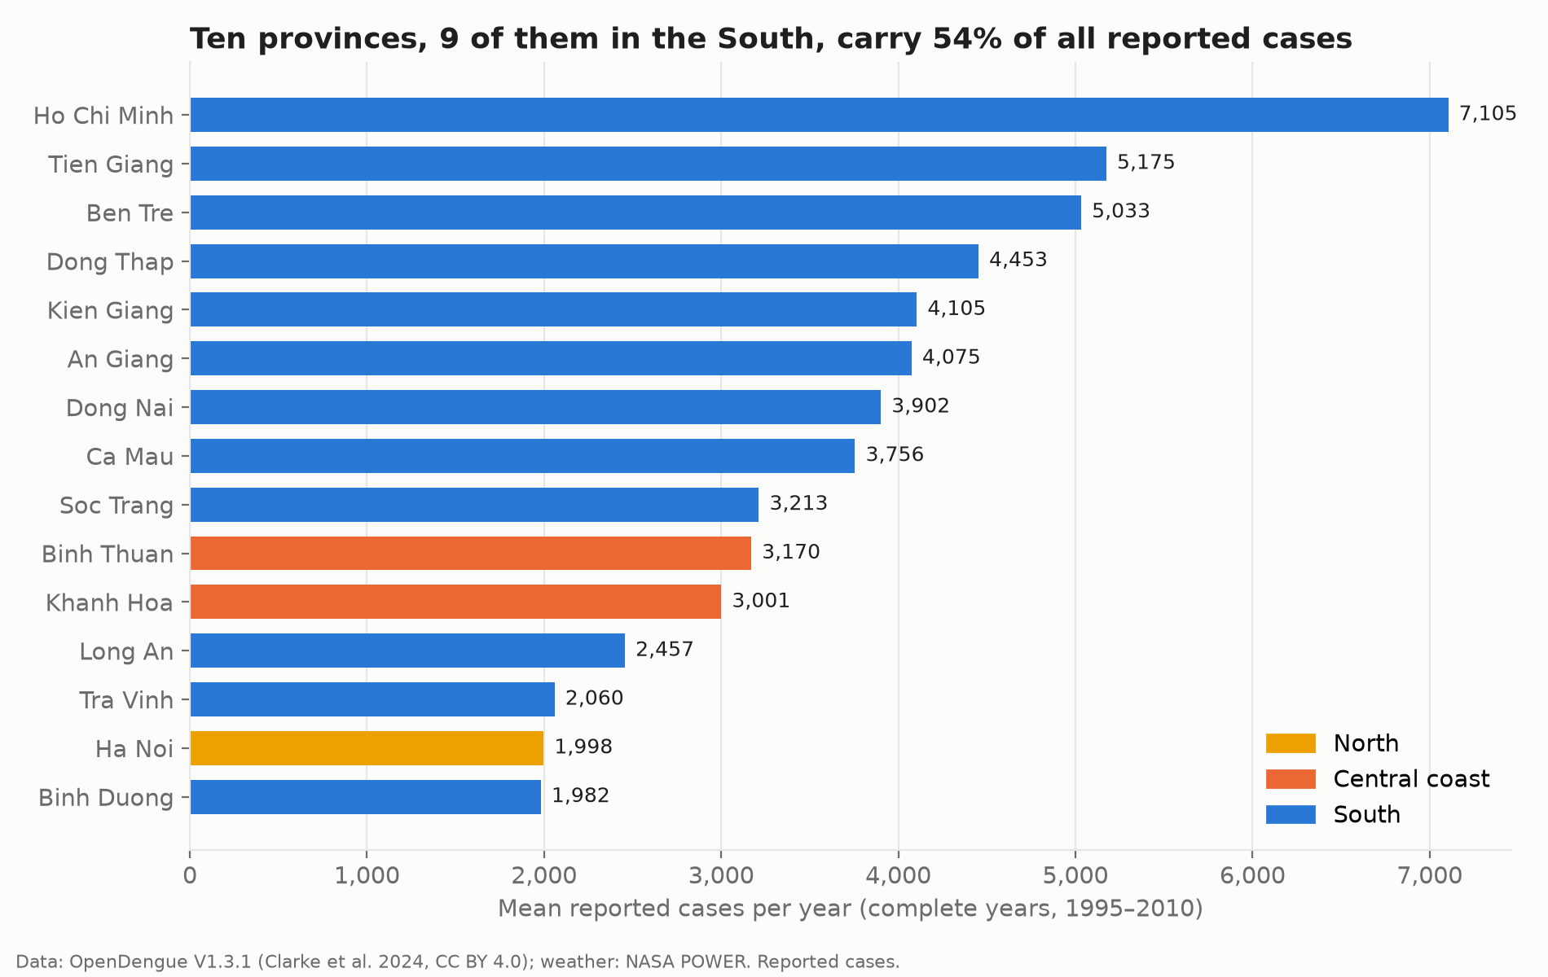
Finding 3
The South carries 68% of cases; ten provinces carry 54%
Data: OpenDengue V1.3.1 (Clarke et al. 2024, CC BY 4.0), 64 provinces 1994–2010 + national series to 2024; NASA POWER weather.
Notes:
~1.7 min. Ho Chi Minh City averages 7,105 cases a year, then the Mekong Delta. Binh Thuan and Khanh Hoa lead the Central coast. Counts, not incidence: small provinces with high risk can hide here.

Slide 9
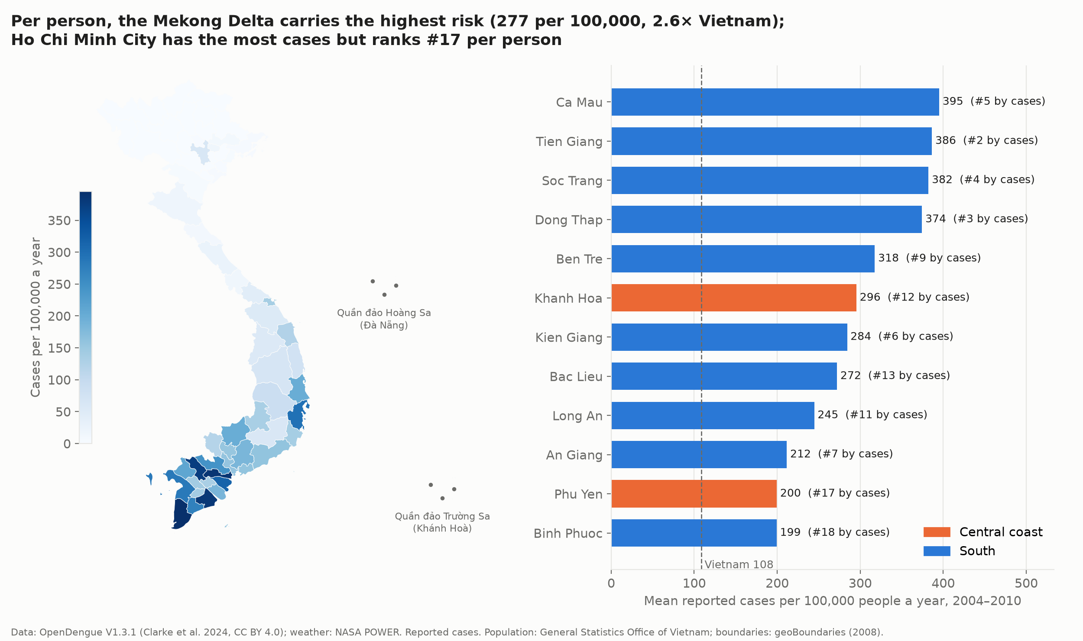
Finding 4
Per person, the Mekong Delta carries the highest risk
Data: OpenDengue V1.3.1 (Clarke et al. 2024, CC BY 4.0), 64 provinces 1994–2010 + national series to 2024; NASA POWER weather.
Notes:
~1.7 min. Incidence 2004–2010 with provincial population: Vietnam 108.5 per 100,000 a year, Mekong Delta 276.8 (2.6×). Ca Mau, Tien Giang, Soc Trang, Dong Thap at 375–395. Ho Chi Minh City is #1 by cases but #17 per person. Khanh Hoa is the only province outside the South at twice the national rate. Islands of Hoang Sa and Truong Sa marked.

Slide 10
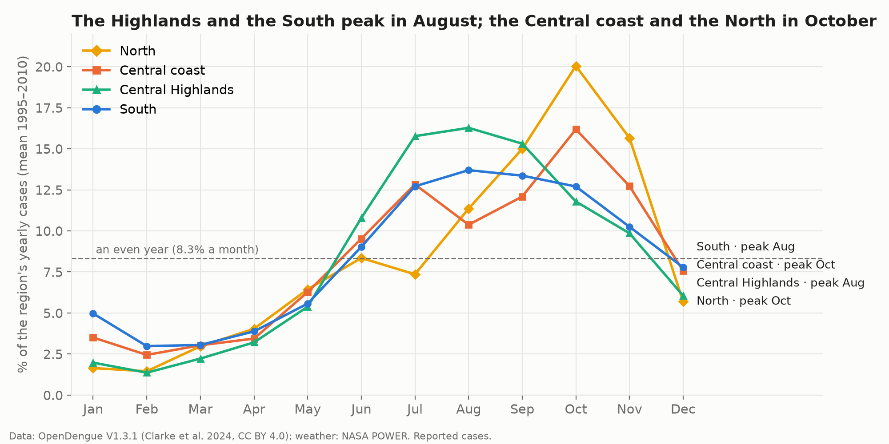
Finding 5
Regions are staggered: August peaks in the South, October in the North
Data: OpenDengue V1.3.1 (Clarke et al. 2024, CC BY 4.0), 64 provinces 1994–2010 + national series to 2024; NASA POWER weather.
Notes:
~1.7 min. Highlands and South climb fastest (by July) and peak in August; the Central coast has a July hump and peaks in October; the North climbs from August and has half of its cases in September–November. Ha Noi 2009: 16,175 cases.

Slide 11
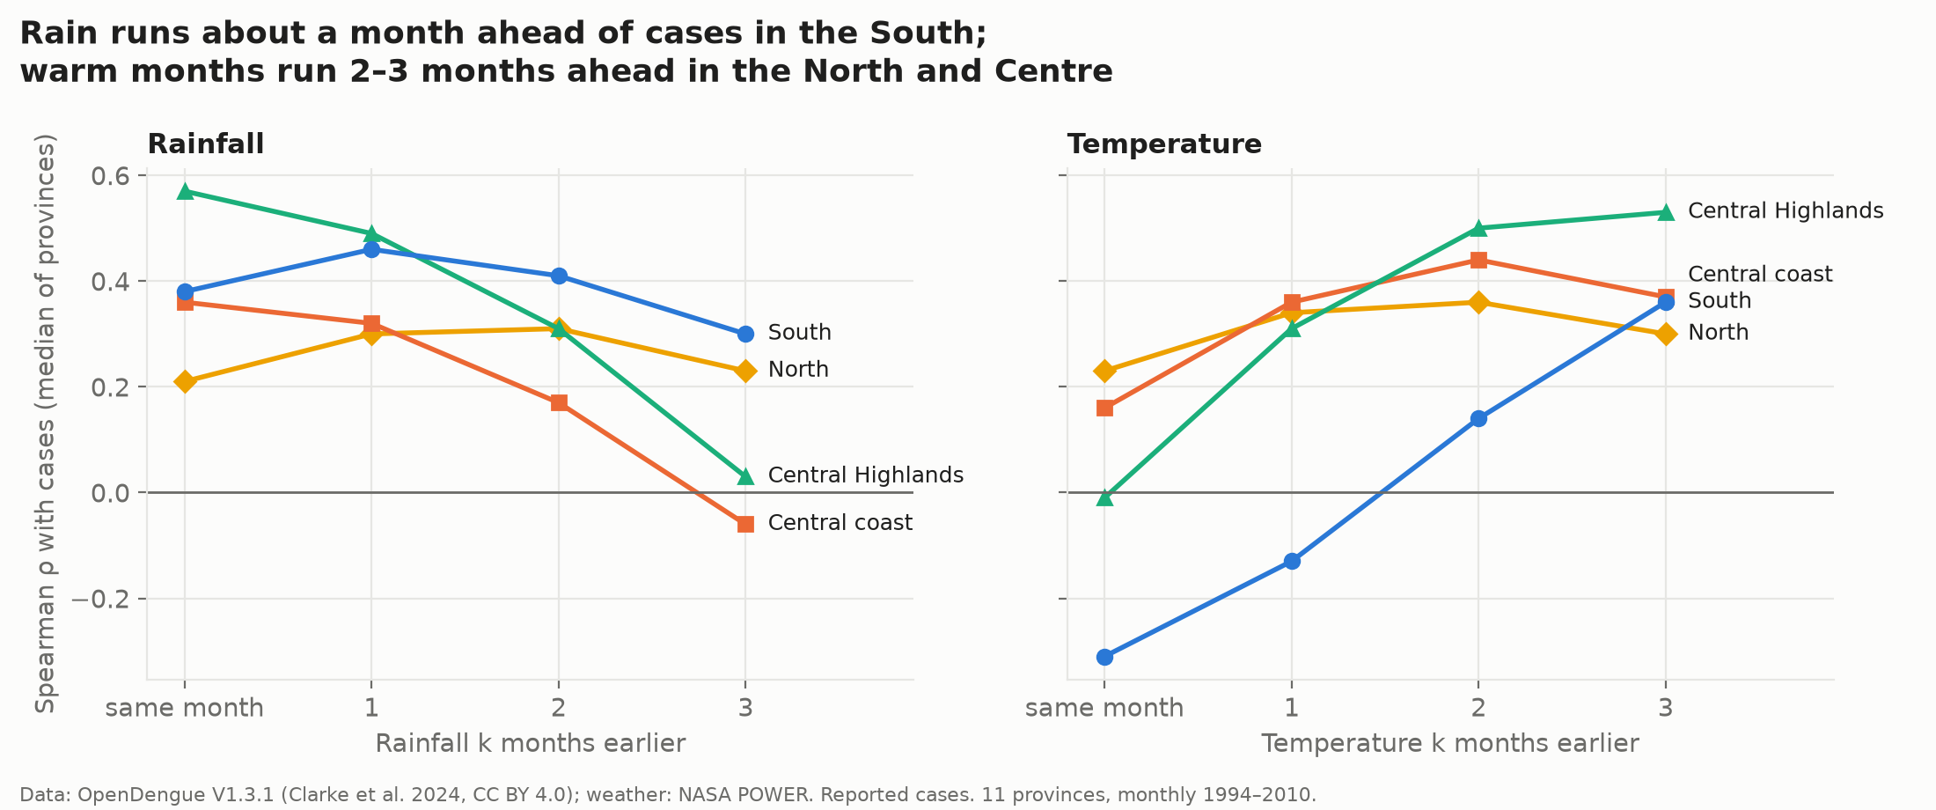
Finding 6
Weather runs ahead of the season
Data: OpenDengue V1.3.1 (Clarke et al. 2024, CC BY 4.0), 64 provinces 1994–2010 + national series to 2024; NASA POWER weather.
Notes:
~1.7 min. Rain leads cases by about a month in the Mekong Delta (An Giang 0.58). Temperature leads by 2–3 months in the North and Centre (Ha Noi 0.52, Da Nang 0.62). This mostly reflects the shared seasonal cycle.

Slide 12
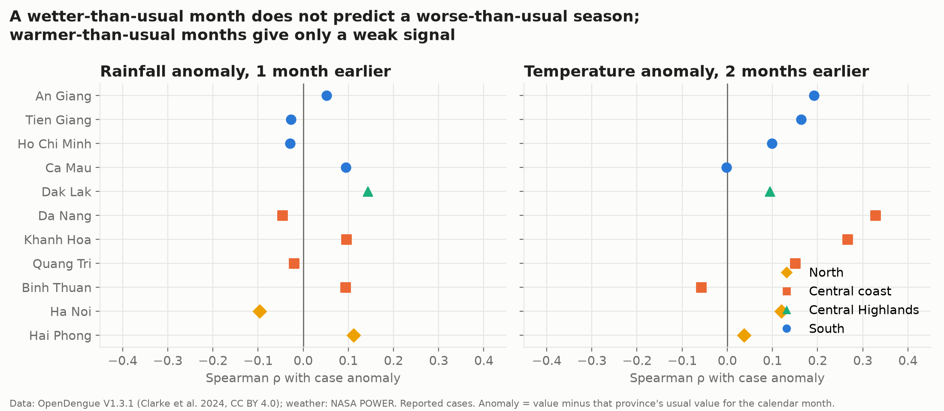
Finding 7
But a wetter-than-usual month does not predict a worse season
Data: OpenDengue V1.3.1 (Clarke et al. 2024, CC BY 4.0), 64 provinces 1994–2010 + national series to 2024; NASA POWER weather.
Notes:
~1.7 min. After removing the normal seasonal pattern, rain anomalies are unrelated to case anomalies (median ρ ~0). Warmer-than-usual months give a weak signal, clearest on the Central coast. So: plan by calendar, not by rain forecast.

Slide 13
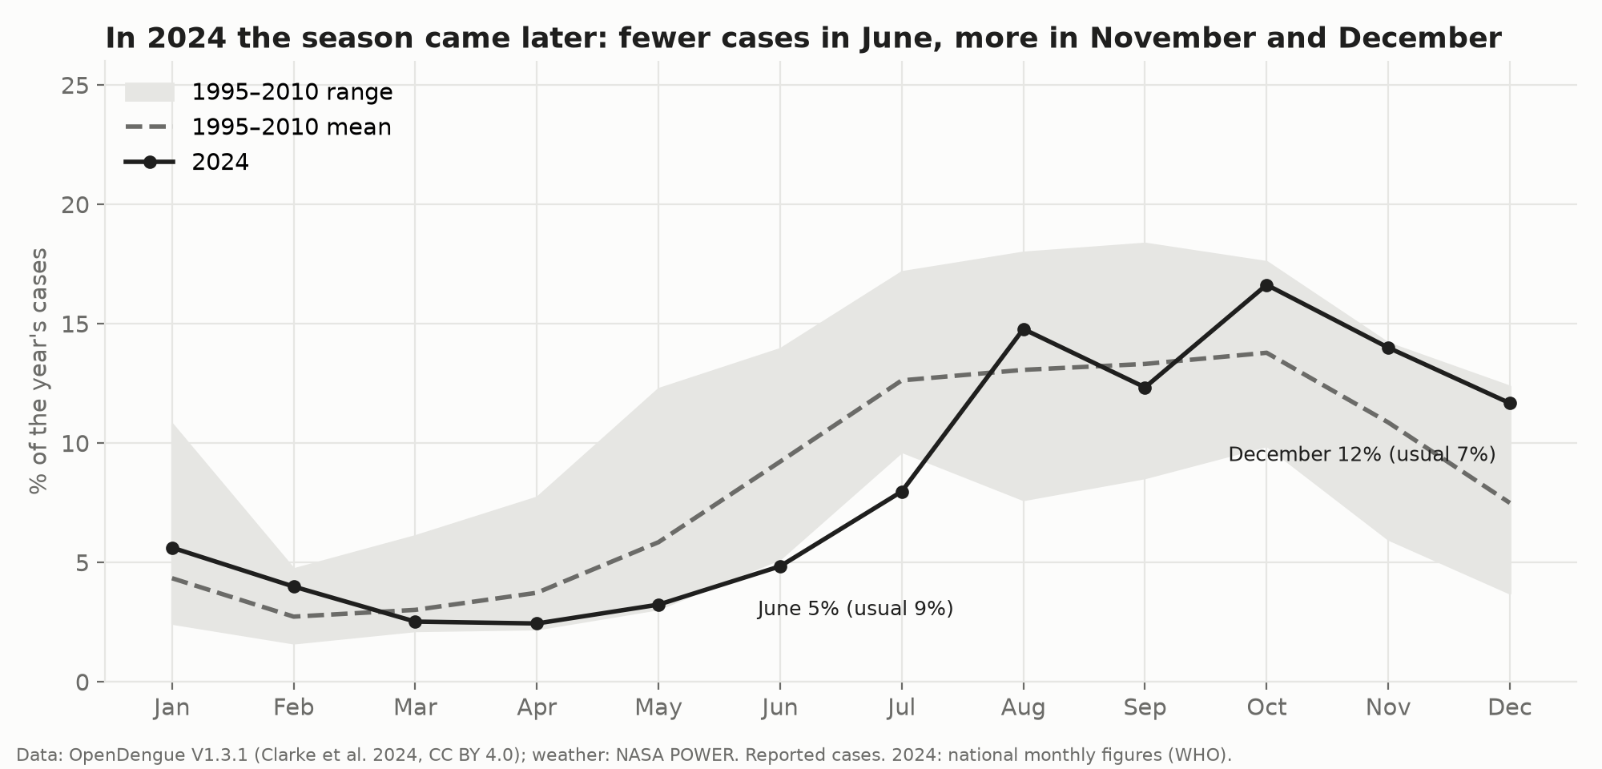
Finding 8
Recent seasons run later: 2024 stayed high into December
Data: OpenDengue V1.3.1 (Clarke et al. 2024, CC BY 4.0), 64 provinces 1994–2010 + national series to 2024; NASA POWER weather.
Notes:
~1.7 min. 2024 (WHO national monthly figures): June 4.8% of cases vs 9.2% before; December 11.7% vs 7.5%; peak in October. One year only, but it matches 2016. Keep crews until December.

Slide 14
Conclusion
Top insights
1. A predictable June–November season (73% of cases): the calendar tells you when to prepare.
2. Where matters more than when: the South has 68% of cases; per person the Mekong Delta runs at 2.6× the national rate.
3. Regions are staggered: August peaks in the South and Highlands, October on the Central coast and in the North.
4. Weather confirms timing but does not forecast severity; bad years (4–5×) need surge capacity.
5. The baseline doubled since the 1990s, and the 2024 season ran later, into December.
Data: OpenDengue V1.3.1 (Clarke et al. 2024, CC BY 4.0), 64 provinces 1994–2010 + national series to 2024; NASA POWER weather.
Notes:
2 min. One sentence each, with the number.

Slide 15
Act
Recommendations: a regional preparation calendar
1. Ready by May in the South, Central Highlands and Central coast; ready by July in the North; crews on until December (findings 2, 5, 8).
2. Allocate by burden two ways: crews by case counts (two thirds South, a quarter Central coast); larval-control intensity by incidence, highest in Ca Mau, Tien Giang, Soc Trang, Dong Thap, Ben Tre, Khanh Hoa; a reserve for the North (findings 3–5).
3. Use the onset of rains (May–June) as the trigger for larval-control campaigns in the South; sign a surge contract for outbreak years instead of scaling with rainfall (findings 1, 6, 7).
Data: OpenDengue V1.3.1 (Clarke et al. 2024, CC BY 4.0), 64 provinces 1994–2010 + national series to 2024; NASA POWER weather.
Notes:
2 min. Tie each recommendation to findings. Mention costs: earlier stocking vs emergency purchases.

Slide 16
Further work
Next deliverables, then questions
Province data after 2010, mapped to the 34 provinces created in 2025, to update incidence.
District-level cases inside Ho Chi Minh City and the Mekong Delta to find hotspots.
Early-warning model: lagged cases + temperature anomalies + El Niño, tested on held-out years.
Mosquito indices (Breteau, House index) and district-level cases from the client.
A monthly Tableau dashboard refreshed with new national figures.
Data: OpenDengue V1.3.1 (Clarke et al. 2024, CC BY 4.0), 64 provinces 1994–2010 + national series to 2024; NASA POWER weather.
Notes:
1 min, then Q&A for the rest of the 30 minutes. Likely questions: why data ends in 2010; why incidence only for 2004–2010; how strong is ρ 0.5; what about the 2025 province merger.

