Slide 1
Markov Models

Slide 2
Markov Chain
A sequence of states: X₁, X₂, X₃, …
  Usually over time
The transition from X_{t-1} to X_{t} depends only on X_{t-1} (Markov Property).
  A Bayesian network that forms a chain
  The transition probabilities are the same for any t (stationary process)
X1
X2
X3
X4

Slide 3
Example: Gambler’s Ruin
Courtsey of Michael Littman
Specification:
  Gambler has 3 dollars.
  Win a dollar with prob. 1/3.
  Lose a dollar with prob. 2/3.
  Fail: no dollars.
  Succeed: Have 5 dollars.
States: the amount of money
  0, 1, 2, 3, 4, 5
Transition Probabilities

Slide 4
Transition Probabilities
Suppose a state has N possible values
  X_{t}=s₁, X_{t}=s₂,….., X_{t}=s_{N}.
N² Transition Probabilities
  P(X_{t}=s_{i}|X_{t-1}=s_{j}), 1≤ i, j ≤N
The transition probabilities can be represented as a NxN matrix or a directed graph.
Example: Gambler’s Ruin

Slide 5
What can Markov Chains Do?
Example: Gambler’s Ruin
  The probability of a particular sequence
    3, 4, 3, 2, 3, 2, 1, 0
  The probability of success for the gambler
  The average number of bets the gambler will make.

Slide 6
Example: Academic Life
Courtsey of Michael Littman
Assistant
Prof.: 20
B. Associate
Prof.: 60
0.2
0.2
0.7
0.2
0.6
T. Tenured
Prof.: 90
0.2
0.6
S. Out on the
Street: 10
0.3
0.2
D. Dead: 0
0.8
1.0
What is the expected lifetime income of an academic?

Slide 7
Solving for Total Reward
L(i) is expected total reward received starting in state i.
How could we compute L(A)?
Would it help to compute L(B), L(T), L(S), and L(D) also?

Slide 8
Solving the Academic Life
The expected income at state D is 0
L(T)=90+0.7x90+0.7²x90+…
L(T)=90+0.7xL(T)
L(T)=300
0.7
T. Tenured
Prof.: 90
0.3
D. Dead: 0

Slide 9
Working Backwards
287.5
325
Assistant
Prof.: 20
B. Associate
Prof.: 60
0.2
0.2
0.7
0.2
0.6
300
0.2
0.6
T. Tenured
Prof.: 90
50
0.3
S. Out on the
Street: 10
0.2
D. Dead: 0
0
0.8
1.0
Another question: What is the life expectancy of professors?

Slide 10
Ruin Chain
2/3
1
0 | 1 | 2 | 3 | 4 | 5
+1
1
1
1/3

Slide 11
Gambling Time Chain
+1
2/3
1
0 | 1 | 2 | 3 | 4 | 5
1
1/3

Slide 12
Google’s Search Engine
Assumption: A link from page A to page B is a recommendation of page B by the author of A
(we say B is successor of A)
Quality of a page is related to its in-degree
Recursion: Quality of a page is related to
  its in-degree, and to
  the quality of pages linking to it
PageRank [Brin and Page ‘98]

Slide 13
Definition of PageRank
Consider the following infinite random walk (surf):
  Initially the surfer is at a random page
  At each step, the surfer proceeds
    to a randomly chosen web page with probability d
    to a randomly chosen successor of the current page with probability 1-d
The PageRank of a page p is the fraction of steps the surfer spends at p in the limit.

Slide 14
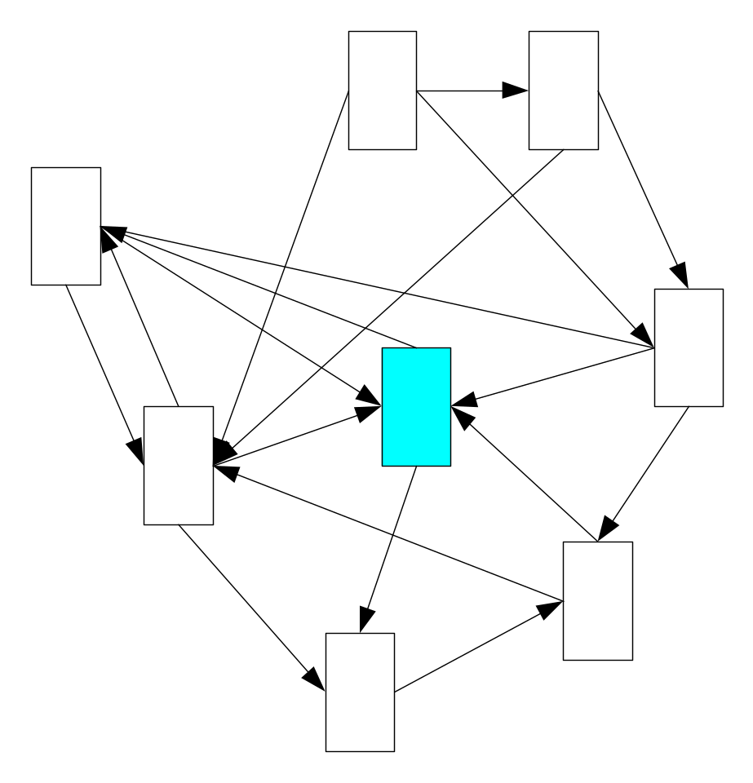
Random Web Surfer
What’s the probability of a page being visited?

Slide 15
Stationary Distributions
Let
  S is the set of states in a Markov Chain
  P is its transition probability matrix
The initial state chosen according to some probability distribution q⁽⁰⁾ over S
q^{(t)} = row vector whose i-th component is the probability that the chain is in state i at time t
q^{(t+1)} = q^{(t)} P ⇒ q^{(t)} = q⁽⁰⁾ P^{t}
A stationary distribution is a probability distribution q such that q = q P
(steady-state behavior)

Slide 16
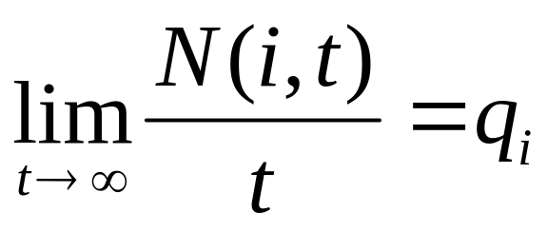
Markov Chains
Theorem: Under certain conditions:
  There exists a unique stationary distribution q with q_{i} > 0 for all i
  Let N(i,t) be the number of times the Markov chain visits state i in t steps. Then,

Slide 17
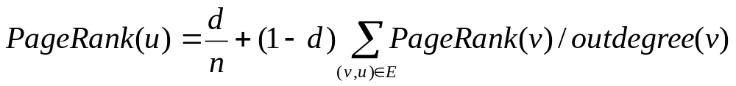
PageRank
PageRank = the probability for this Markov chain, i.e.
  where n is the total number of nodes in the graph
  d is the probability of making a random jump.
Query-independent
Summarizes the “web opinion” of the page importance

Slide 18
PageRank
A
B
P
PageRank of P is
(1-d)∗ ( 1/4th the PageRank of A + 1/3rd the PageRank of B ) +d/n

Slide 19
Kth-Order Markov Chain
What we have discussed so far is the first-order Markov Chain.
More generally, in kth-order Markov Chain, each state transition depends on previous k states.
  What’s the size of transition probability matrix?
X1
X2
X3
X4

Slide 20
Finite Markov Chain
An integer time stochastic process, consisting of a domain D of m>1 states {s₁,…,s_{m}} and
An m dimensional initial distribution vector ( p(s₁),.., p(s_{m})).
An m×m transition probabilities matrix M= (a_{sisj})

Slide 21

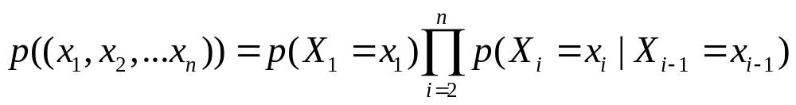
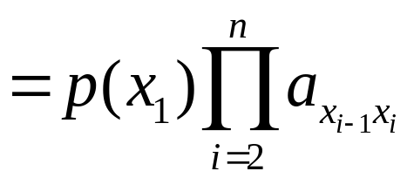
Markov Chain (cont.)
X₁
X₂
X_{n-1}
X_{n}
For each integer n, a Markov Chain assigns probability to sequences (x₁…x_{n}) over D (i.e, x_{i} D) as follows:

Slide 22
Markov Chain (cont.)
X₁
X₂
X_{n-1}
X_{n}
Similarly, each X_{i} is a probability distributions over D, which is determined by the initial distribution (p₁,..,p_{n}) and the transition matrix M.
There is a rich theory which studies the properties of such “Markov sequences” (X₁,…, X_{i} ,…). A bit of this theory is presented next.

Slide 23
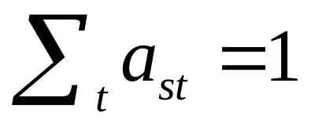
Matrix Representation
A
B
C
D
The transition probabilities Matrix M =(a_{st})
0.95
0
0.05
0
A
M is a stochastic Matrix:
B
0.2
0.5
0
0.3
0
0.2
0
0.8
C
The initial distribution vector (u₁…u_{m}) defines the distribution of X₁ (p(X₁=s_{i})=u_{i}) .
0
0
1
0
D
Then after one move, the distribution is changed to X₂ = X₁M

Slide 24
Matrix Representation
A
B
C
D
0.95
0
0.05
0
Example: if X₁=(0, 1, 0, 0)
then X₂=(0.2, 0.5, 0, 0.3)
And if X₁=(0, 0, 0.5, 0.5)
then X₂=(0, 0.1, 0.5, 0.4).
A
B
0.2
0.5
0
0.3
0
0.2
0
0.8
C
0
0
1
0
D
The i-th distribution is X_{i} = X₁M^{i-1}

Slide 25
Representation of a Markov Chain as a Digraph
0.95
A
B
C
D
0.95
0
0.05
0
A
0.2
0.5
0.2
0.5
0
0.3
A
B
B
0
0.2
0
0.8
0.05
0.2
0.3
C
0.8
0
0
1
0
D
C
D
1
Each directed edge A→B is associated with the positive transition probability from A to B.

Slide 26
Properties of Markov Chain states
States of Markov chains are classified by the digraph representation (omitting the actual probability values)
A, C and D are recurrent states: they are in strongly connected components which are sinks in the graph.
B is not recurrent – it is a transient state
A
B
Alternative definitions:
A state s is recurrent if it can be reached from any state reachable from s; otherwise it is transient.
C
D

Slide 27
Another example of Recurrent and Transient States
A
B
A and B are transient states, C and D are recurrent states.
Once the process moves from B to D, it will never come back.
C
D

Slide 28
Irreducible Markov Chains
A Markov Chain is irreducible if the corresponding graph is strongly connected (and thus all its states are recurrent).
A
B
E
A
B
C
D
C
D
1

Slide 29
Periodic States
A
B
E
A state s has a period k if k is the GCD of the lengths of all the cycles that pass via s. (in the shown graph the period of A is 2).
C
D
Exercise: All the states in the same strongly connected component have the same period
A Markov Chain is periodic if all the states in it have a period k >1. It is aperiodic otherwise.

Slide 30
Ergodic Markov Chains
A
B
A Markov chain is ergodic if :
the corresponding graph is strongly connected.
It is not peridoic
C
D
Ergodic Markov Chains are important since they guarantee the corresponding Markovian process converges to a unique distribution, in which all states have strictly positive probability.

Slide 31
Stationary Distributions for Markov Chains
Let M be a Markov Chain of m states, and let V = (v₁,…,v_{m}) be a probability distribution over the m states
V = (v₁,…,v_{m}) is stationary distribution for M if VM=V.
(ie, if one step of the process does not change the distribution).
V is a stationary distribution
V is a left (row) Eigenvector of M with Eigenvalue 1.

Slide 32
Stationary Distributions for a Markov Chain
Exercise: A stochastic matrix always has a real left Eigenvector with Eigenvalue 1 (hint: show that a stochastic matrix has a right Eigenvector with Eigenvalue 1. Note that the left Eigenvalues of a Matrix are the same as the right Eiganvlues).
[It can be shown that the above Eigenvector V can be non-negative. Hence each Markov Chain has a stationary distribution.]

Slide 33
“Good” Markov chains
A Markov Chains is good if the distributions X_{i} , as i→∞:
converge to a unique distribution, independent of the initial distribution.
(2) In that unique distribution, each state has a positive probability.
The Fundamental Theorem of Finite Markov Chains:
  A Markov Chain is good ⇔ the corresponding graph is ergodic.
  We will prove the ⇒ part, by showing that non-ergodic Markov Chains are not good.

Slide 34
Examples of “Bad” Markov Chains
A Markov chains is not “good” if either:
  It does not converge to a unique distribution.
  It does converge to u.d., but some states in this distribution have zero probability.

Slide 35
Bad case 1: Mutual Unreachabaility
Consider two initial distributions:
  p(X₁=A)=1 (p(X₁ = x)=0 if x≠A).
  p(X₁= C) = 1
In case a), the sequence will stay at A forever.
In case b), it will stay in {C,D} for ever.
A
B
C
D
Fact 1: If G has two states which are unreachable from each other, then {X_{i}} cannot converge to a distribution which is independent on the initial distribution.

Slide 36
Bad case 2: Transient States
A
B
C
D
Once the process moves from B to D, it will never come back.

Slide 37
Bad case 2: Transient States
Fact 2: For each initial distribution, with probability 1 a transient state will be visited only a finite number of times.
A
B
C
D
X
Proof: Let A be a transient state, and let X be the set of states from which A is unreachable. It is enough to show that, starting from any state, with probability 1 a state in X is reached after a finite number of steps (Exercise: complete the proof)

Slide 38
Corollary: A good Markov Chain is irreducible

Slide 39
Bad case 3: Periodic Markov Chains
A
B
E
C
D
Recall: A Markov Chain is periodic if all the states in it have a period k >1. The above chain has period 2.
In the above chain, consider the initial distribution p(B)=1.
Then states {B, C} are visited (with positive probability) only in odd steps, and states {A, D, E} are visited in only even steps.

Slide 40
Bad case 3: Periodic States
A
B
E
C
D
Fact 3: In a periodic Markov Chain (of period k >1) there are initial distributions under which the states are visited in a periodic manner. Under such initial distributions X_{i} does not converge as i→∞.
Corollary: A good Markov Chain is not periodic

Slide 41
The Fundamental Theorem of Finite Markov Chains:
We have proved that non-ergodic Markov Chains are not good
A proof of the other part (based on Perron-Frobenius theory) is beyond the scope of this course:
If a Markov Chain is ergodic, then
It has a unique stationary distribution vector V > 0, which is an Eigenvector of the transition matrix.
For any initial distribution, the distributions X_{i} , as i→∞, converges to V.

