Slide 1
Information Networks
Searching in P2P networks
Lecture 11

Slide 2
Unstructured vs Structured P2P
The systems we described do not offer any guarantees about their performance (or even correctness)
Structured P2P
Scalable guarantees on numbers of hops to answer a query
Maintain all other P2P properties (load balance, self-organization, dynamic nature)
Approach: Distributed Hash Tables (DHT)

Slide 3
Distributed Hash Tables (DHT)
Distributed version of a hash table data structure
Stores (key, value) pairs
The key is like a filename
The value can be file contents, or pointer to location
Goal: Efficiently insert/lookup/delete (key, value) pairs
Each peer stores a subset of (key, value) pairs in the system
Core operation: Find node responsible for a key
Map key to node
Efficiently route insert/lookup/delete request to this node
Allow for frequent node arrivals/departures

Slide 4
DHT Desirable Properties
Keys should mapped evenly to all nodes in the network (load balance)
Each node should maintain information about only a few other nodes (scalability, low update cost)
Messages should be routed to a node efficiently (small number of hops)
Node arrival/departures should only affect a few nodes

Slide 5
DHT Routing Protocols
DHT is a generic interface
There are several implementations of this interface
Chord [MIT]
Pastry [Microsoft Research UK, Rice University]
Tapestry [UC Berkeley]
Content Addressable Network (CAN) [UC Berkeley]
SkipNet [Microsoft Research US, Univ. of Washington]
Kademlia [New York University]
Viceroy [Israel, UC Berkeley]
P-Grid [EPFL Switzerland]
Freenet [Ian Clarke]
Notes:
Freenet more concerned with privacy/security, not as much on delivery guarantees.
Others: Farsite, SALAD (Douceur) are about file systems

Slide 6
Basic Approach
In all approaches:
keys are associated with globally unique IDs
integers of size m (for large m)
key ID space (search space) is uniformly populated - mapping of keys to IDs using (consistent) hashing
a node is responsible for indexing all the keys in a certain subspace (zone) of the ID space
nodes have only partial knowledge of other node’s responsibilities

Slide 7
Consistent Hashing
The main idea: map both keys and nodes (node IPs) to the same (metric) ID space

Slide 8
Consistent Hashing
The main idea: map both keys and nodes (node IPs) to the same (metric) ID space
The ring is just a possibility.
Any metric space will do

Slide 9
Consistent Hashing
The main idea: map both keys and nodes (node IPs) to the same (metric) ID space
Each key is assigned to the node with ID closest to the key ID
uniformly distributed
at most logarithmic number of keys assigned to each node
Problem: Starting from a node, how do we locate the node
responsible for a key, while maintaining as little information
about other nodes as possible

Slide 10
Basic Approach Differences
Different P2P systems differ in:
the choice of the ID space
the structure of their network of nodes (i.e. how each node chooses its neighbors)

Slide 11
Chord
Nodes organized in an identifier circle based on node identifiers
Keys assigned to their successor node in the identifier circle
Hash function ensures even distribution of nodes and keys on the circle
* All Chord figures from “Chord: A Scalable Peer-to-peer Lookup Protocol for Internet Applications”, Ion Stoica et al., IEEE/ACM Transactions on Networking, Feb. 2003.
Notes:
Each key stored on first node that follows k in identifier space

Slide 12
Chord Finger Table
O(logN) table size
i^{th} finger points to first node that succeeds n by at least 2^{i-1}
maintain also pointers to predecessors (for correctness)

Slide 13
Chord Key Location
Lookup in finger table the furthest node that precedes key
Query homes in on target in O(logN) hops
Notes:
N8 looks for a node with more “local” info about the nodes around K54
N8 looks in its finger table for closest node that precedes 54

Slide 14
Chord node insertion
Insert node N40:
Locate node
Add fingers
Update successor
pointers and other
node’s fingers
(max in-degree
O(log²n) whp)
Time O(log²n)
Stabilization protocol for
refreshing links
N40

Slide 15
Chord Properties
In a system with N nodes and K keys, with high probability…
each node receives at most K/N keys
each node maintains info. about O(logN) other nodes
lookups resolved with O(logN) hops
Insertions O(log²N)
In practice never stabilizes
No consistency among replicas
Hops have poor network locality

Slide 16
Network locality
Nodes close on ring can be far in the network.
N20
N40
N80
N41
* Figure from http://project-iris.net/talks/dht-toronto-03.ppt

Slide 17
Plaxton’s Mesh
map the nodes and keys to b-ary numbers of m digits
assign each key to the node with which it shares the largest prefix
e.g. b = 4 and m = 6
321002
321302
321333

Slide 18
Plaxton’s Mesh – Routing Table
for b = 4, m = 6, nodeID = 110223; routing table:
 | d = 0 | d = 1 | d = 2 | d = 3
p = 0 | 032130 | 1 | 210231 | 303213
p = 1 | 103002 | 1 | 123011 | 133233
p = 2 | 0 | 111210 | 112301 | 113331
p = 3 | 110031 | 110122 | 2 | 110310
p = 4 | 110200 | 110212 | 2 | 110232
p = 5 | 110220 | 110221 | 110222 | 3

Slide 19
Enforcing Network Locality
For the (i,j) entry of the table select the node that is geographically closer to the current node.
110223 | d = 0 | d = 1 | d = 2 | d = 3
p = 0 | 032130 | 1 | 210231 | 303213
p = 1 | 103002 | 1 | 123011 | 133233
p = 2 | 0 | 111210 | 112301 | 113331
p = 3 | 110031 | 110122 | 2 | 110310
p = 4 | 110200 | 110212 | 2 | 110232
p = 5 | 110220 | 110221 | 110222 | 3

Slide 20
Enforcing Network Locality
Critical property
for larger row numbers the number of possible choices decreases exponentially
in row i+1 we have 1/b the choices we had in row i
for larger row numbers the distance to the nearest neighbor increases exponentially
the distance of the source to the target is approximately equal to the distance in the last step – as a result it is well approximated

Slide 21
Enforcing Network Locality

Slide 22
Plaxton algorithm: routing
Move closer to the target one digit at the time
locate
322210
110223
 | d = 0 | d = 1 | d = 2 | d = 3
p = 0 | 032130 | 1 | 210231 | 303213
p = 1 | 103002 | 1 | 123011 | 133233
p = 2 | 0 | 111210 | 112301 | 113331
p = 3 | 110031 | 110122 | 2 | 110310
p = 4 | 110200 | 110212 | 2 | 110232
p = 5 | 110220 | 110221 | 110222 | 3
Notes:
The message is forwarded to a node that shares a prefix with the destination node that is longer than the prefix the message shares with the current node (simplification).
Object insertion is similar.

Slide 23
Plaxton algorithm: routing
Move closer to the target one digit at the time
locate
322210
110223
303213
 | d = 0 | d = 1 | d = 2 | d = 3
p = 0 | 032130 | 1 | 210231 | 303213
p = 1 | 103002 | 1 | 123011 | 133233
p = 2 | 0 | 111210 | 112301 | 113331
p = 3 | 110031 | 110122 | 2 | 110310
p = 4 | 110200 | 110212 | 2 | 110232
p = 5 | 110220 | 110221 | 110222 | 3
Notes:
The message is forwarded to a node that shares a prefix with the destination node that is longer than the prefix the message shares with the current node (simplification).
Object insertion is similar.

Slide 24
Plaxton algorithm: routing
Move closer to the target one digit at the time
locate
322210
110223
303213
322001
Notes:
The message is forwarded to a node that shares a prefix with the destination node that is longer than the prefix the message shares with the current node (simplification).
Object insertion is similar.

Slide 25
Plaxton algorithm: routing
Move closer to the target one digit at the time
locate
322210
110223
303213
322001
322200
Notes:
The message is forwarded to a node that shares a prefix with the destination node that is longer than the prefix the message shares with the current node (simplification).
Object insertion is similar.

Slide 26
Plaxton algorithm: routing
Move closer to the target one digit at the time
locate
322210
110223
303213
322001
322200
322213
Notes:
The message is forwarded to a node that shares a prefix with the destination node that is longer than the prefix the message shares with the current node (simplification).
Object insertion is similar.

Slide 27
Pastry: Node Joins
Node X finds the closest (in network proximity) node and makes a query with its own ID
Routing table of X
the i-th row of the routing table is the i-th row of the i-th node along the search path for X
locate
X
A
B
C
D

Slide 28
Network Proximity
The starting node A is the closest one to node X, so by triangular inequality the neighbors in first row of the starting node A will also be close to X
For the remaining entries of the table the same argument applies as before: the distance of the intermediate node Y to its neighbors dominates the distance from X to the intermediate node Y

Slide 29
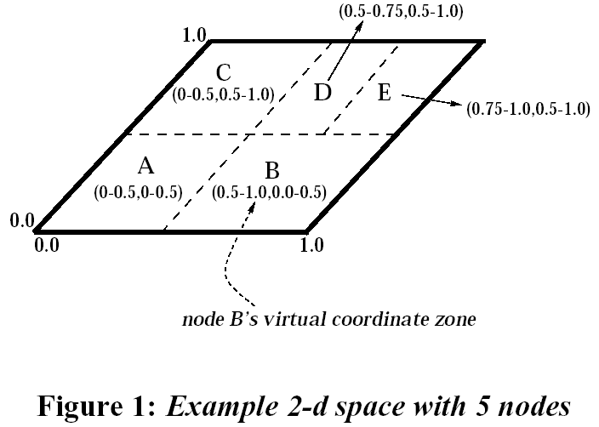
CAN
Search space: d-dimensional coordinate space (on a d-torus)
Each node owns a distinct zone in the space
Each node keeps links to the nodes responsible for zones adjacent to its zone (in the search space) – ~2d on avg
Each key hashes to a point in the space
* Figure from “A Scalable Content-Addressable Network”, S. Ratnasamy et al., In Proceedings of ACM SIGCOMM 2001.

Slide 30
CAN Lookup
Node x wants to
lookup key K
K→(a,b)
Move along neighbors
to the zone of the key
each time moving
closer to the key
x
expected time O(dn^{1/d})
can we do it in O(logn)?

Slide 31
CAN node insertion
Node y needs to be inserted
It has knowledge of node x
x
y
IP of y → (c,d)
zone belongs to z
z
Split z’s zone

Slide 32
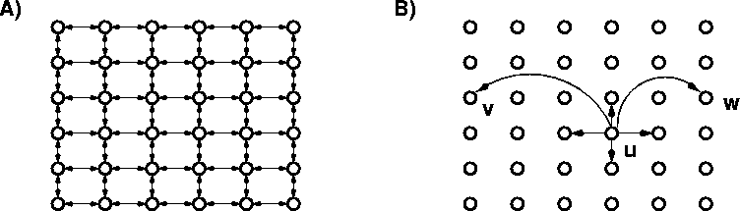
Kleinberg’s small world
Consider a 2-dimensional grid
For each node u add edge (u,v) to a vertex v selected with pb proportional to [d(u,v)]^{-r}
Simple Greedy routing
If r=2, expected lookup time is O(log²n)
If r≠2, expected lookup time is Ω(n^{ε}), ε depends on r
The theorem generalizes in d-dimensions for r=d

Slide 33
Routing in the Small World
logn regions of exponentially increasing size
the routing algorithm spends logn expected time in each region → log²n expected routing time
if logn long-range links are added, the expected time in each region becomes constant → logn expected routing time

Slide 34
Symphony
Map the nodes and keys to the ring
Link every node with its successor and predecessor
Add k random links with probability proportional to 1/(dlogn), where d is the distance on the ring
Lookup time O(log²n)
If k = logn lookup time O(logn)
Easy to insert and remove nodes (perform periodical refreshes for the links)

Slide 35
Viceroy
Emulating the butterfly network
level 1
level 2
level 3
level 4

Slide 36
Viceroy
Emulating the butterfly network
level 1
level 2
level 3
level 4

Slide 37
Viceroy
Emulating the butterfly network
level 1
level 2
level 3
level 4

Slide 38
Viceroy
Emulating the butterfly network
level 1
level 2
level 3
level 4

Slide 39
Viceroy
Emulating the butterfly network
level 1
level 2
level 3
level 4

Slide 40
Viceroy
Emulating the butterfly network
level 1
level 2
level 3
level 4

Slide 41
Viceroy
Emulating the butterfly network
level 1
level 2
level 3
level 4

Slide 42
Viceroy
Emulating the butterfly network
level 1
level 2
level 3
level 4

Slide 43
Viceroy
Emulating the butterfly network
Logarithmic path lengths between any two nodes in the network
level 1
level 2
level 3
level 4

Slide 44
Viceroy network
Arrange nodes and keys on a ring, like in Chord.

Slide 45
Viceroy network
Assign to each node a level value, chosen uniformly from the set {1,…,logn}
estimate n by taking the inverse of the distance of the node with its successor
easy to update

Slide 46
Viceroy network
Create a ring of nodes within the same level

Slide 47
Butterfly links
Each node x at level i has two downward links to level i+1
a left link to the first node of level i+1 after position x on the ring
a right link to the first node of level i+1 after position x + (½)^{i}

Slide 48
Downward links

Slide 49
Upward links
Each node x at level i has an upward link to the next node on the ring at level i-1

Slide 50
Upward links

Slide 51
Lookup
Lookup is performed in a similar fashion like the butterfly
expected time O(logn)
Viceroy was the first network with constant number of links and logarithmic lookup time

Slide 52
P2P Review
Two key functions of P2P systems
Sharing content
Finding content
Sharing content
Direct transfer between peers
All systems do this
Structured vs. unstructured placement of data
Automatic replication of data
Finding content
Centralized (Napster)
Decentralized (Gnutella)
Probabilistic guarantees (DHTs)

Slide 53
Issues with P2P
Free Riding (Free Loading)
Two types of free riding
Downloading but not sharing any data
Not sharing any interesting data
On Gnutella
15% of users contribute 94% of content
63% of users never responded to a query
Didn’t have “interesting” data
No ranking: what is a trusted source?
“spoofing”

Slide 54
Acknowledgements
Thanks to Vinod Muthusamy, George Giakkoupis, Jim Kurose, Brian, Levine, Don Towsley

Slide 55
References
D. Milojicic, V. Kalogeraki, R. Lukose, K. Nagaraja, J. Pruyne, B. Richard, S. Rollins, Z. Xu, Peer to Peer computing, HP technical report, 2002
G. Giakkoupis, Routing algorithms for Distributed Hash Tables, Technical Report, Univeristy of Toronto, 2003
Ian Clarke, Oskar Sandberg, Brandon Wiley, and Theodore W. Hong, "Freenet: A Distributed Anonymous Information Storage and Retrieval System," in Designing Privacy Enhancing Technologies: International Workshop on Design Issues in Anonymity and Unobservability, LNCS 2009
S. Ratnasamy, P. Francis, M. Handley, R. Karp, S. Shenker. A Scalable Content-Addressable Network. ACM SIGCOMM, 2001
I. Stoica, R. Morris, D. Karger, F. Kaashoek, H. Balakrishnan. Chord: A Scalable Peer-to-peer Lookup Service for Internet Applications. ACM SIGCOMM, 2001.
A. Rowstron, P. Druschel. Pastry: Scalable, distributed object location and routing for large-scale peer-to-peer systems. 18th IFIP/ACM International Conference on Distributed Systems Platforms (Middleware 2001).
Dalia Malkhi, Moni Naor, David Ratajczak. Viceroy: A Scalable and Dynamic Emulation of the Butterfly. ACM Symposium on Principles of Distributed Computing, 2002.
Manku, Gurmeet; Bawa, Mayank; Raghavan, Prabhakar, Symphony: Distributed Hashing in a Small World, USENIX Symposium on Internet Technologies and Systems (USITS), 2003

