Slide 1
The Small World Phenomenon:
An Algorithmic Perspective
Speaker: Bradford Greening, Jr.
Rutgers University – Camden

Slide 2
An Experiment by Milgram (1967)
Chose a target person
Asked randomly chosen “starters” to forward a letter to the target
  Name, address, and some personal information were provided for the target person
  The participants could only forward a letter to a single person that he/she knew on a first name basis
  Goal: To advance the letter to the target as quickly as possible

Slide 3
An Experiment by Milgram (1967)
Outcome revealed two fundamental components of a social network:
  Very short paths between arbitrary pairs of nodes
  Individuals operating with purely local information are very adept at finding these paths

Slide 4
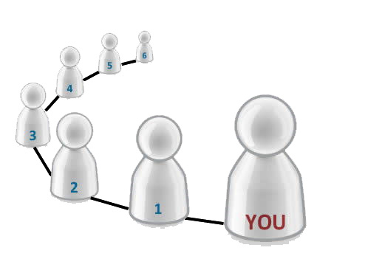
What is the “small world” phenomenon?
Principle that most people in a society are linked by short chains of acquaintances
Sometimes referred to as the “six degrees of separation” theory

Slide 5
Modeling a social network
Create a graph:
  node for every person in the world
  an edge between two people (nodes) if they know each other on a first name basis
If almost every pair of nodes have “short” paths between them, we say this is a small world

Slide 6
Modeling a social network
Watts – Strogatz (1998)
  Created a model for small-world networks
    Local contacts
    Long-range contacts
  Effectively incorporated closed triads and short paths into the same model

Slide 7
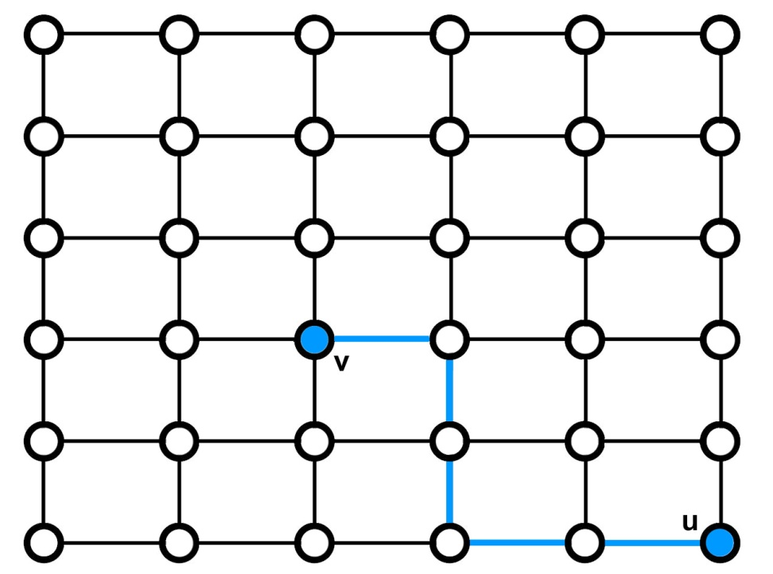
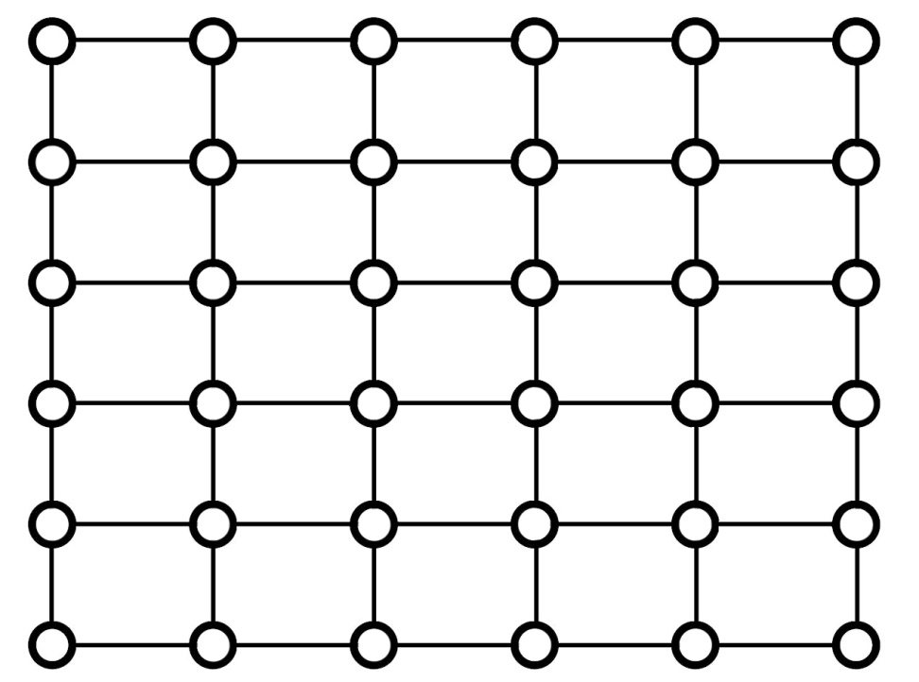
Modeling a social network
Imagine everyone lives on an n x n grid
“lattice distance” – number of lattice steps between two points
Constants p,q

Slide 8
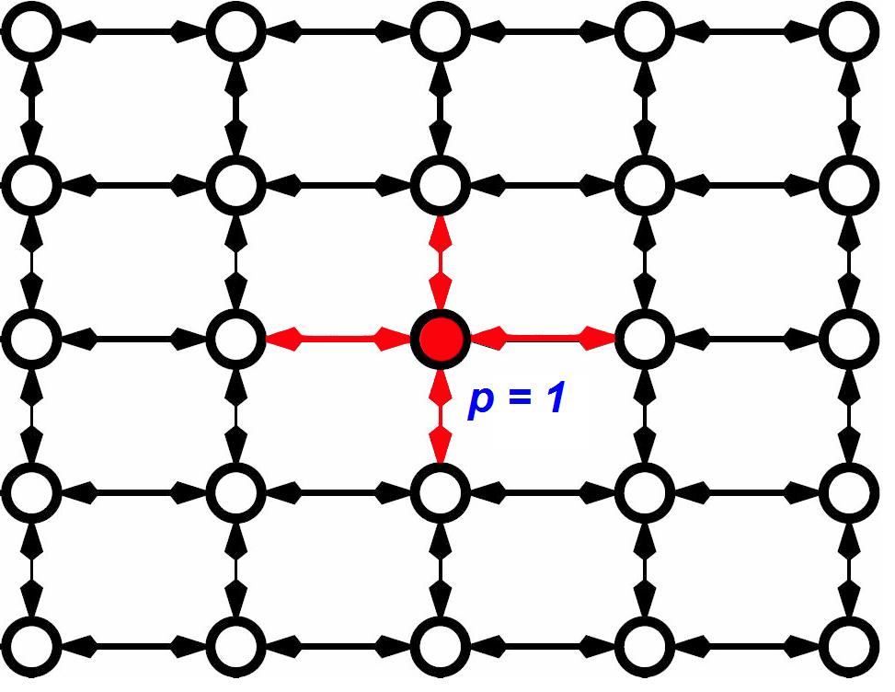
Modeling a social network
p: range of local contacts
  Nodes are connected to all other nodes within distance p.

Slide 9
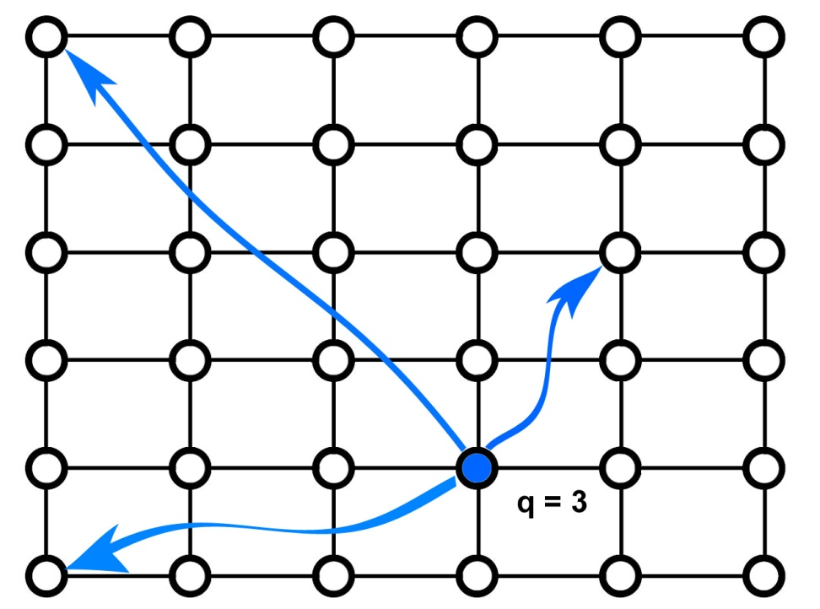
Modeling a social network
q: number of long-range contacts
  add directed edges from node u to q other nodes using independent random trials

Slide 10
Modeling a social network
Watts – Strogatz (1998)
  Found that injecting a small amount of randomness (i.e. even q = 1) into the world is enough to make it a small world.

Slide 11
Modeling a social network
Kleinberg (2000)
  Why should arbitrary pairs of strangers, using only locally available information, be able to find short chains of acquaintances that link them together?
  Does this occur in all small-world networks, or are there properties that must exist for this to happen?

Slide 12
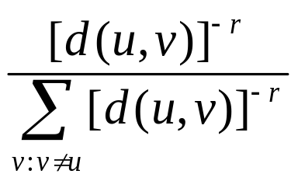
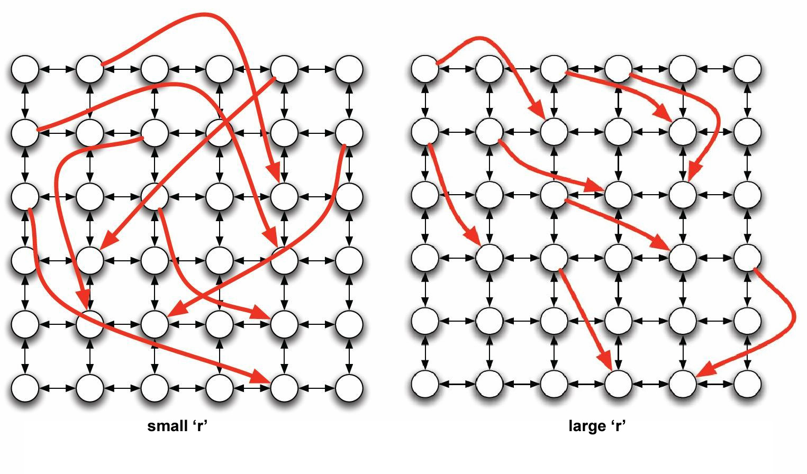
Modeling a social network
Pr [u has v as its long range contact] :
Infinite family of networks:
  r = 0: each node’s long-range contacts are chosen independently of its position on the grid
  As r increases, the long range contacts of a node become clustered in its vicinity on the grid.

Slide 13
The Algorithmic Side
Input:
  Grid G = (V,E)
  arbitrary nodes s, t
Goal: Transmit a message from s to t in as few steps as possible using only locally available information

Slide 14
The Algorithmic Side
Assumptions:
  In any step, the message holder u knows
    The range of local contacts of all nodes
    The location on the lattice of the target t
    The locations and long-range contacts of all nodes that have previously touched the message
  u does not know
    the long-range contacts of nodes that have not touched the message

Slide 15
r = 2

Slide 16
The Algorithm
In each step the current message holder passes the message to the contact that is as close to the target as possible.

Slide 17
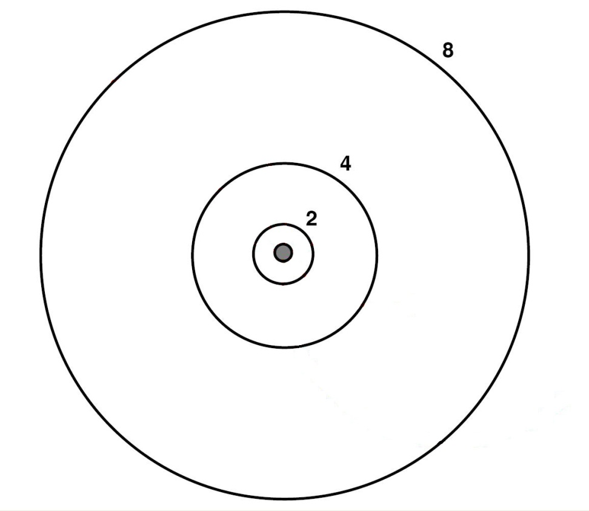
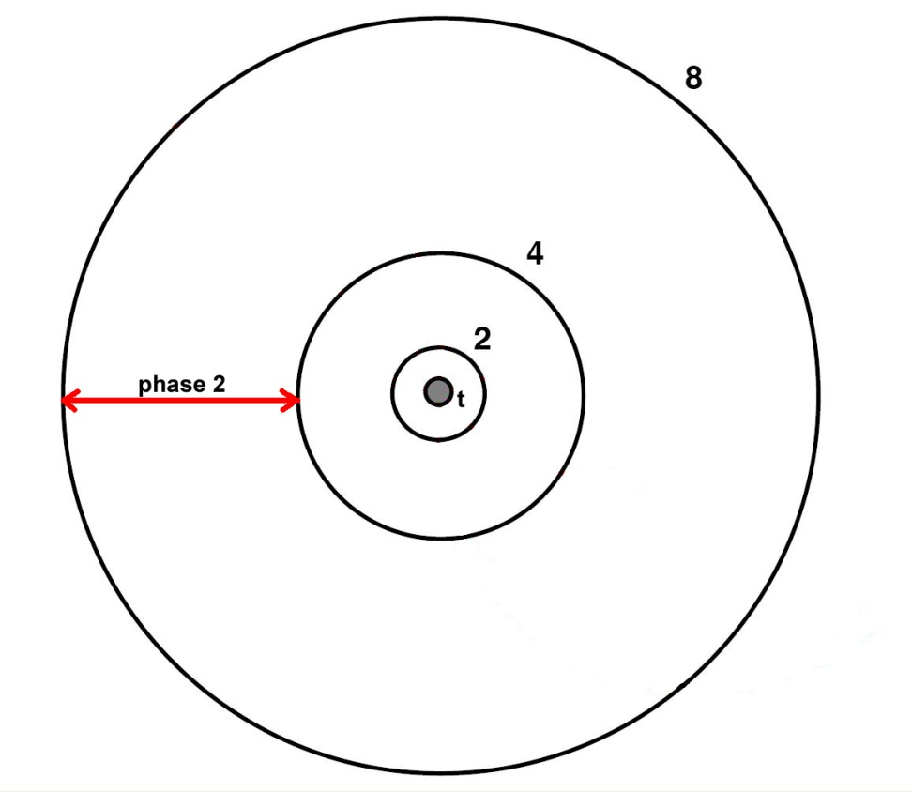
Analysis
Algorithm in phase j:
  At a given step,
  2^{j} < d(u,t) ≤ 2^{j+1}
  Αlg. is in phase 0 :
    message is no more than 2 lattice steps away from the target t.
  j ≤ log₂ n.

Slide 18
Analysis
Questions:
How many steps will the algorithm take?
How many steps will we spend in phase j?
In a given step, with what probability will phase j end in this step?
What is the probability that node u has a node v in the next phase as its long range contact?
Notes:
Rephrase first question so that we don’t imply run time of alg.

Slide 19
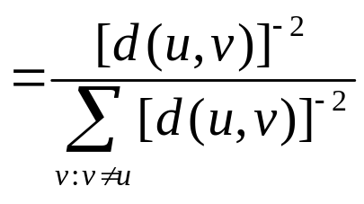
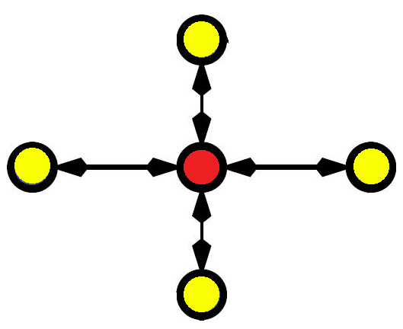
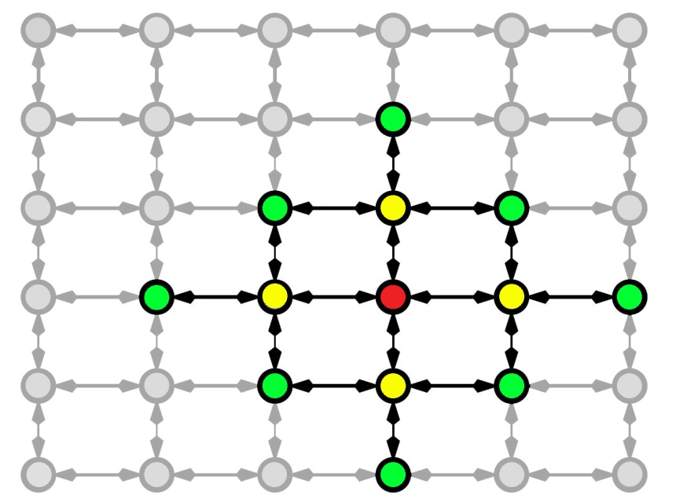
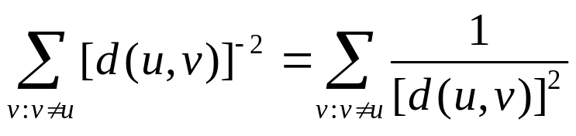
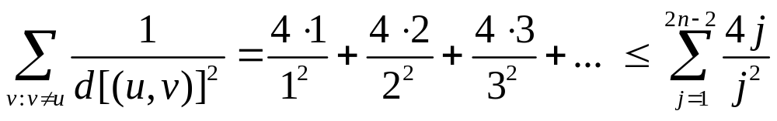
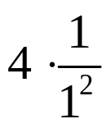
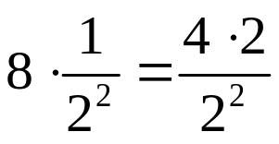
Analysis
Questions:
How many steps will the algorithm take?
How many steps will we spend in phase j?
In a given step, with what probability will phase j end in this step?
What is the probability that node u has a node v as its long range contact?
Pr [ u has v as its long range contact ] ?

Slide 20
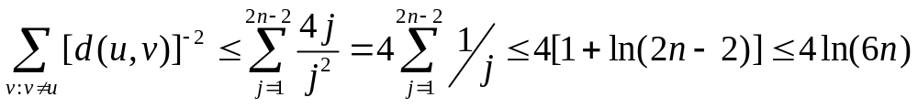
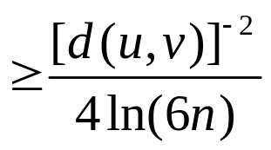
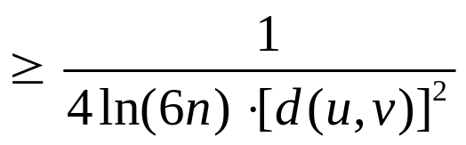
Analysis
Questions:
How many steps will the algorithm take?
How many steps will we spend in phase j?
In a given step, with what probability will phase j end in this step?
What is the probability that node u has a node v as its long range contact?
Pr[ u has v as its long range contact ]?
Thus u has v as its long-range contact with probability

Slide 21
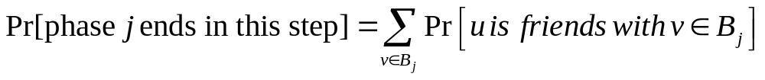

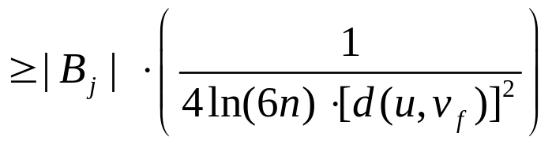
Analysis
Questions:
How many steps will the algorithm take?
How many steps will we spend in phase j?
In a given step, with what probability will phase j end in this step?
What is the probability that node u has a node v as its long range contact?
In any given step, Pr[ phase j ends in this step ]?
  Phase j ends in this step if the message enters the set B_{j} of nodes within distance 2^{j} of t. Let v_{f} be the node in B_{j} that is farthest from u.

Slide 22
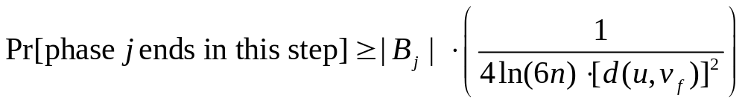
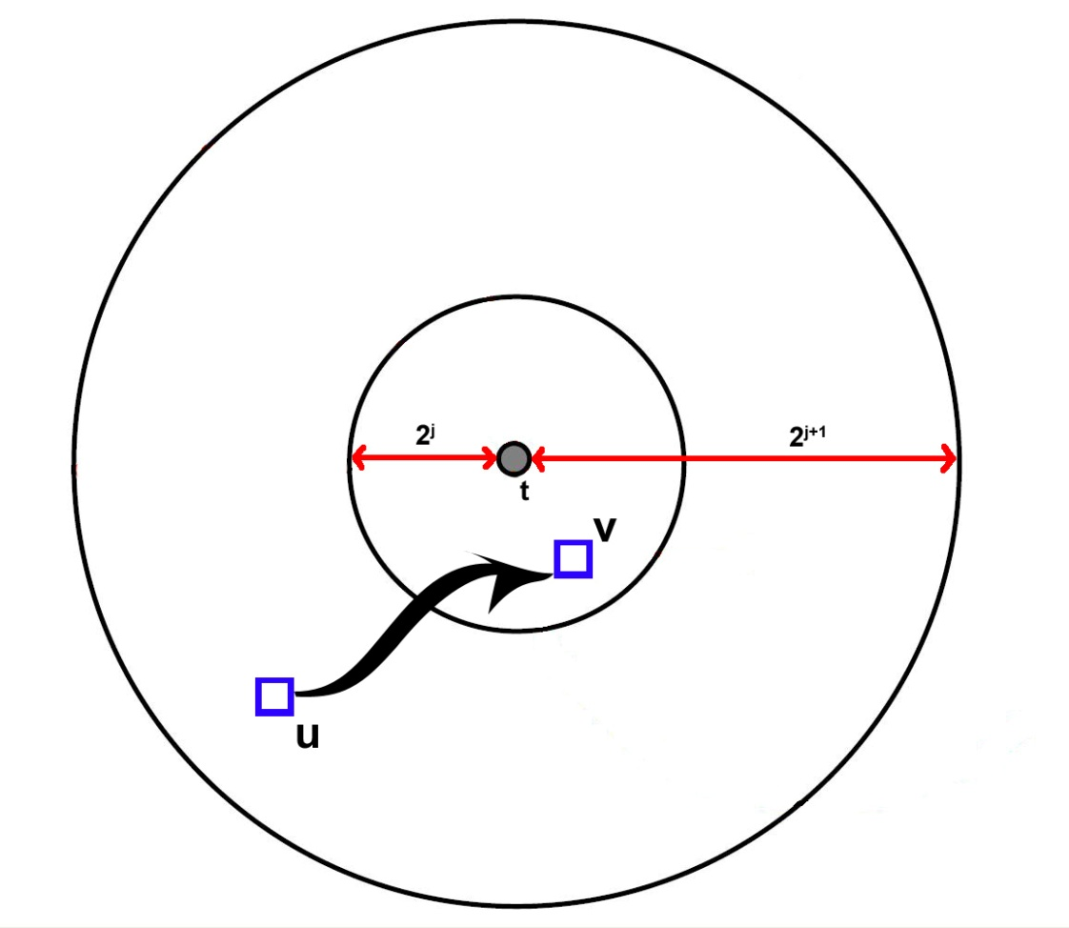
Analysis
Questions:
How many steps will the algorithm take?
How many steps will we spend in phase j?
In a given step, with what probability will phase j end in this step?
What is the probability that node u has a node v as its long range contact?
  What is d[(u,v_{f})]?
≤ 2^{j} + 2^{j+1} < 2^{j+2}

Slide 23
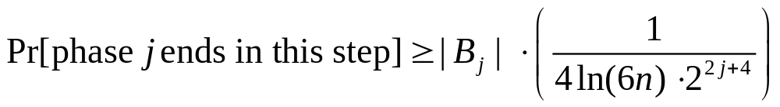
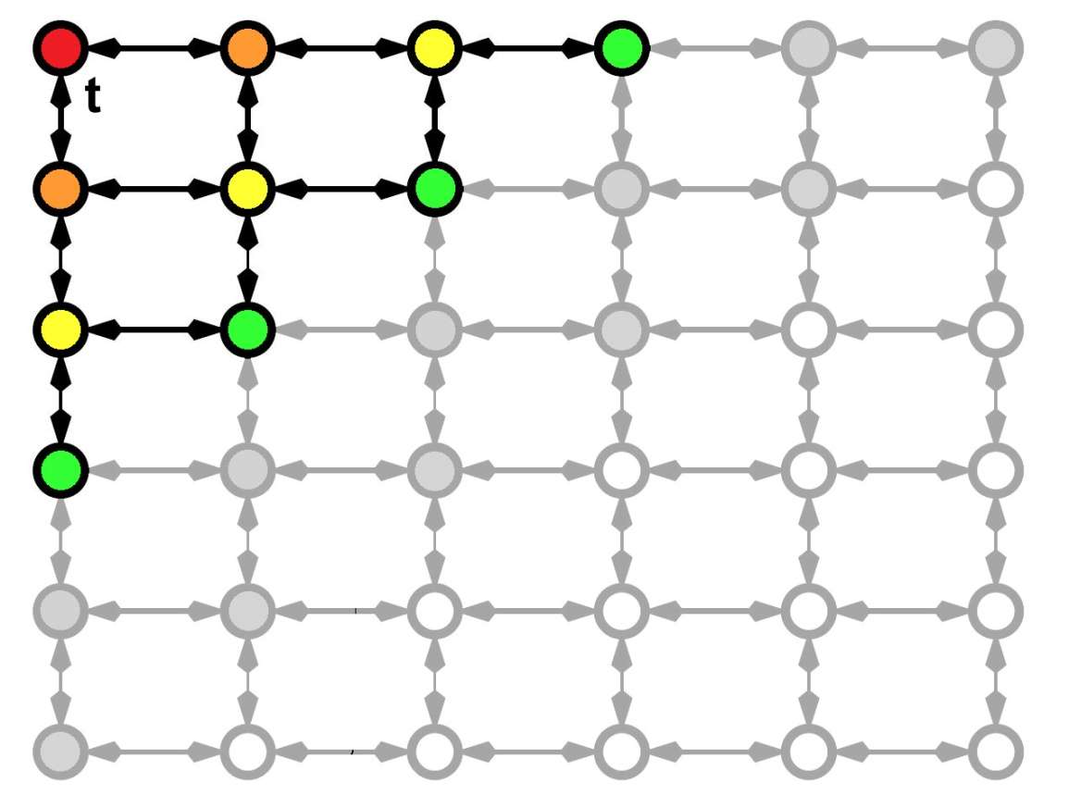
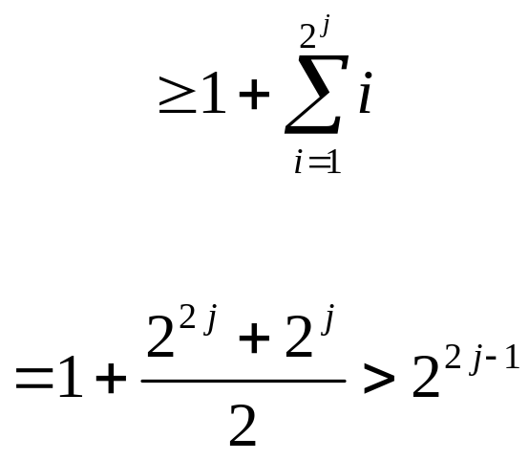
Analysis
Questions:
How many steps will the algorithm take?
How many steps will we spend in phase j?
In a given step, with what probability will phase j end in this step?
What is the probability that node u has a node v as its long range contact?
How many nodes are in B_{j}?

Slide 24
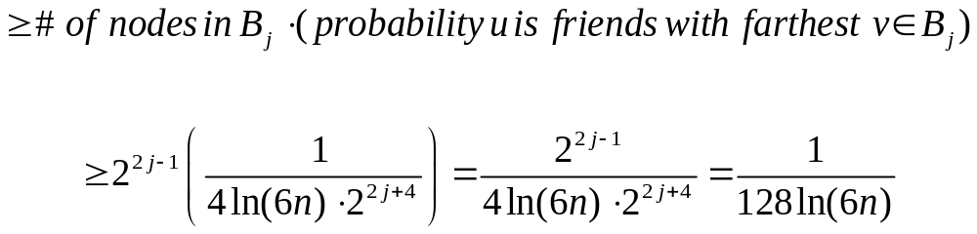
Analysis
Questions:
How many steps will the algorithm take?
How many steps will we spend in phase j?
In a given step, with what probability will phase j end in this step?
What is the probability that node u has a node v as its long range contact?
In any given step, Pr[ phase j ends in this step ]?
  Pr[ u has a long-range contact in B_{j} ]?

Slide 25

Analysis
Questions:
How many steps will the algorithm take?
How many steps will we spend in phase j?
In a given step, with what probability will phase j end in this step?
What is the probability that node u has a node v as its long range contact?
How many steps will we spend in phase j?
  Let X_{j} be a random variable denoting the number of steps spent in phase j.
    X_{j} is a geometric random variable with a probability of success at least

Slide 26
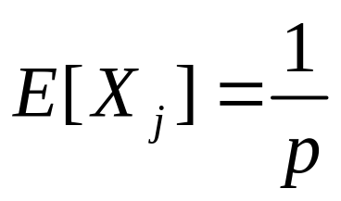
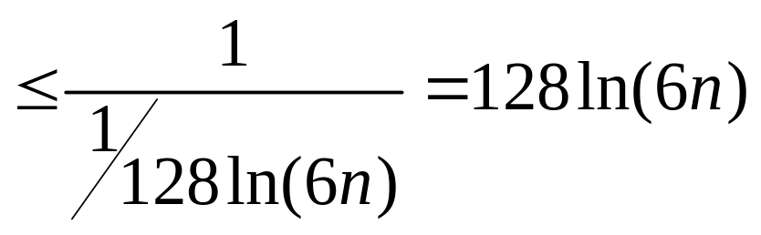
Analysis
Questions:
How many steps will the algorithm take?
How many steps will we spend in phase j?
In a given step, with what probability will phase j end in this step?
What is the probability that node u has a node v as its long range contact?
How many steps will we spend in phase j?
  Since X_{j} is a geometric random variable, we know that

Slide 27
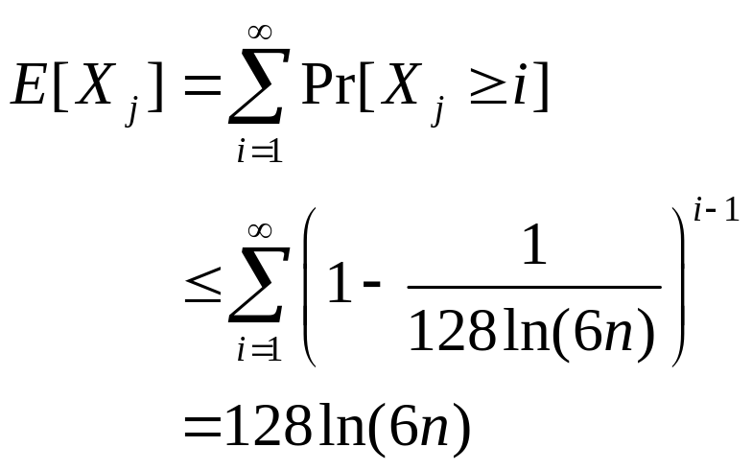
Analysis
Questions:
How many steps will the algorithm take?
How many steps will we spend in phase j?
In a given step, with what probability will phase j end in this step?
What is the probability that node u has a node v as its long range contact?
How many steps will we spend in phase j?
  Let X_{j} be a random variable denoting the number of steps spent in phase j.

Slide 28

Analysis
Questions:
How many steps will the algorithm take?
How many steps will we spend in phase j?
In a given step, with what probability will phase j end in this step?
What is the probability that node u has a node v as its long range contact?
How many steps does the algorithm take?
  Let X be a random variable denoting the number of steps taken by the algorithm.
  By Linearity of Expectation we have

Slide 29
Analysis
Questions:
How many steps will the algorithm take?
How many steps will we spend in phase j?
In a given step, with what probability will phase j end in this step?
What is the probability that node u has a node v as its long range contact?
When r = 2, expected delivery time is
O(log n)²

Slide 30
r ≠ 2

Slide 31
Summary of results
0 ≤ r < 2: The expected delivery time of any decentralized algorithm is Ω(n^{(2-r)/3}).
r > 2: The expected delivery time of any decentralized algorithm is Ω(n^{(r-2)/(r-1)}).

Slide 32
Revisiting Assumptions
Recall that in each step the message holder u knew
  the locations and long-range contacts of all nodes that have previously touched the message
Is knowledge of message’s history too much info?
Upper-bound on delivery time in the good case is proven without using this.
Lower-bound on delivery times for the bad cases still hold even when this knowledge is used.

Slide 33
The Intuition
For a changing value of r
  r = 0 provides no “geographical” clues that will assist in speeding up the delivery of the message.
  0 < r < 2: provides some clues, but not enough to sufficiently assist the message senders
  r > 2: as r grows, the network becomes more localized. This becomes a prohibitive factor.
  r = 2: provides a good mix of having relevant “geographical” information without too much localization.
Notes:
Add something here.

Slide 34
References
Kleinberg, J. The Small-World Phenomenon: An Algorithmic Perspective. Proc. 32nd ACM Symposium on Theory of Computing, 2000
Kleinberg, J. Navigation in a Small World. Nature 406(2000), 845.

