Slide 1
Chapter 4:
Requirements Determination

Slide 2
Objectives
Understand how to create a requirements definition.
Become familiar with requirements analysis techniques.
Understand when to use each requirements analysis technique.
Understand how to gather requirements using interviews, JAD sessions, questionnaires, document analysis, and observation.
Understand when to use each requirements-gathering technique.

Slide 3
The SDLC and Requirements
The SDLC transforms the existing (as is) system into the proposed (to be) system
Requirements determination step is the single most critical step of the entire SDLC
  Studies show that more than half of all system failures are due to problems with requirements

Slide 4
REQUIREMENTS DETERMINATION

Slide 5
Defining a Requirement
A statement of what the system must do or what characteristic it must have
During analysis, requirements are written from the perspective of the businessperson
Two kinds of requirements:
  Functional
  Nonfunctional

Slide 6
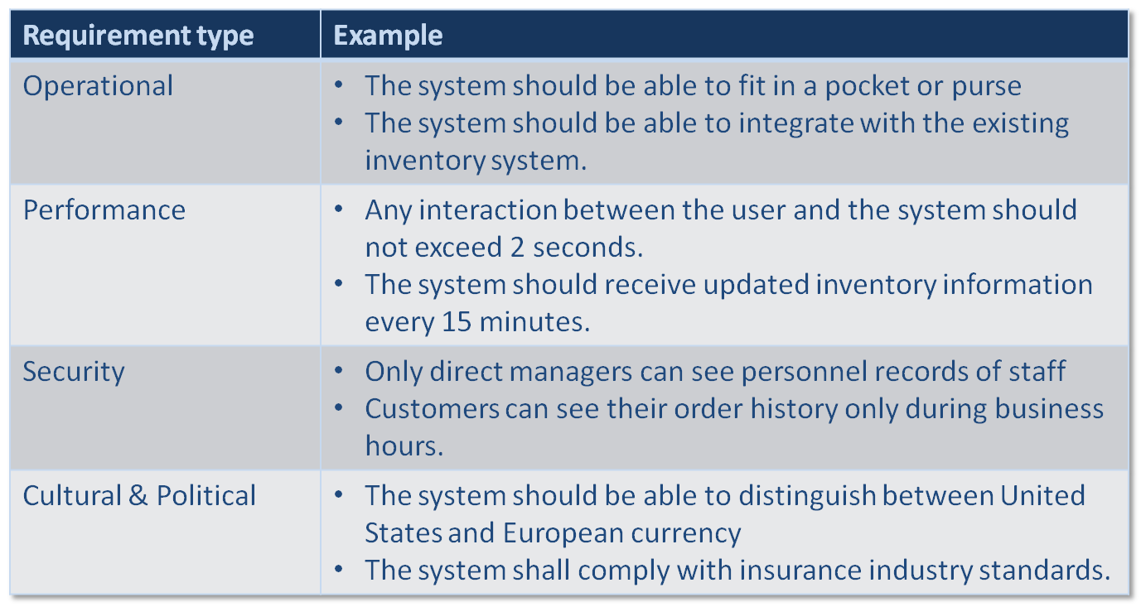
Nonfunctional Requirements

Slide 7
Requirements Definition Report
Correct
Unambiguous
Complete
Consistent
Verifiable
Modifiable
Traceable
Ranked for importance
Notes:
Source: IEEE Standard 830-1998: IEEE Recommended Practice For Software Requirements Specifications

Slide 8
A Bad Requirement
Initial Specification: Software will not be loaded from unknown sources onto the system without first having the software tested and approved.
Critique:
  Ambiguous – if the software is tested and approved, can it be loaded from unknown sources?
  (not) Testable – it is stated as a negative requirement making it difficult to verify.
  (not) Traceable – a unique identifier is missing.
Re-specification: 3.4.5.2 Software shall be loaded onto the operational system only after it has been tested and approved.

Slide 9
Determining Requirements
Requirements are best determined by systems analysts and business people together
Techniques available to the systems analyst:
  Interviews
  Questionnaires
  Observation
  Joint application development (JAD)
  Document analysis

Slide 10
REQUIREMENTS ANALYSIS STRATEGIES

Slide 11
Requirements Analysis Strategies
The basic process of analysis is divided into:
  Understanding the as-is system
  Identifying improvements
  Developing requirements for the to-be system
There are 3 requirements analysis strategies
  Business process automation
  Business process improvement
  Business process reengineering

Slide 12
Business Process Automation
BPA leaves the basic way in which the organization operates unchanged and uses computer technology to do some of the work
Low risk, but low payoff
Planners in BPA projects invest significant time in understanding the as-is system using:
  Problem analysis
  Root cause analysis

Slide 13
Problem Analysis
Users and managers identify problems with the as-is system and describe how to solve them in the to-be system
Tends to solve problems rather than capitalize on opportunities
Improvements tend to be small and incremental

Slide 14
Root Cause Analysis
Users are not asked for solutions, but for:
  A list of (prioritized) problems
  All possible root causes for those problems
Analysts investigate each root cause to find:
  Solutions for the highest priority problems
  Root causes that are common to multiple problems

Slide 15
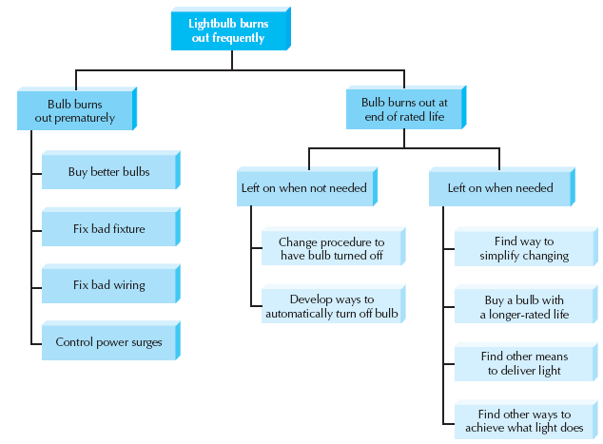
Root Cause Analysis Example

Slide 16
Business Process Improvement
BPI makes moderate changes to the way in which the organization operates to take advantage of new opportunities offered by technology or to copy what competitors are doing
Common activities:
  Duration analysis
  Activity-based costing
  Informal benchmarking

Slide 17
Business Process Reengineering
BPR changes the fundamental way in which the organization operates
Spends little time understanding the as-is, because their goal is to focus on new ideas and new ways of doing business
Popular activities:
  Outcome analysis
  Technology analysis
  Activity elimination

Slide 18
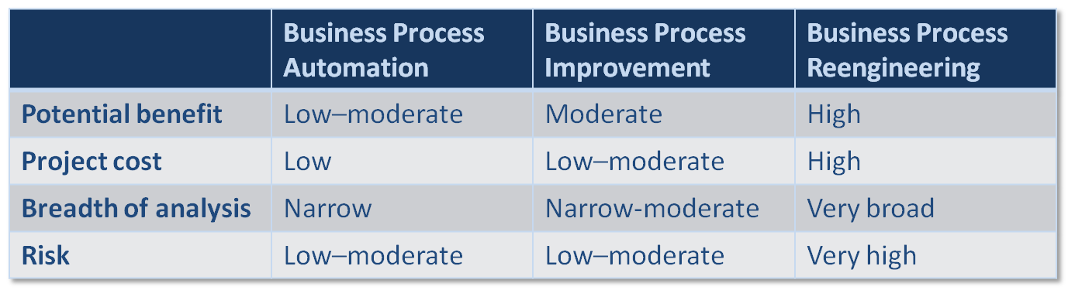
Selecting the Appropriate Strategies

Slide 19
REQUIREMENTS-GATHERING TECHNIQUES

Slide 20
Five Basic Steps of Interviews
Selecting interviewees
Designing interview questions
Preparing for the interview
Conducting the interview
Post-interview follow-up
Slide <number>

Slide 21
Selecting Interviewees
Based on information needed
Often good to get different perspectives
  Managers
  Users
  Ideally, all key stakeholders
Slide <number>

Slide 22
Interviewing Strategies
Top-down
How
can order
processing be
improved?
High-level:
Very general
Medium-level:
Moderately specific
How can we reduce the
number of times that customers
return ordered items?
Low-level:
Very specific
How can we reduce the number of
errors in order processing (e.g., shipping
the wrong products)?
Bottom-up

Slide 23
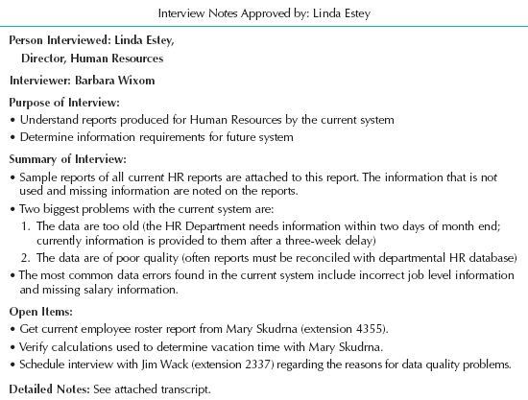
Post-Interview

Slide 24
Joint Application Development
Allows the project team, users, and management to work together to identify requirements for the system
Often the most useful method for collecting information from users
Key roles:
  Facilitator
  Scribe

Slide 25
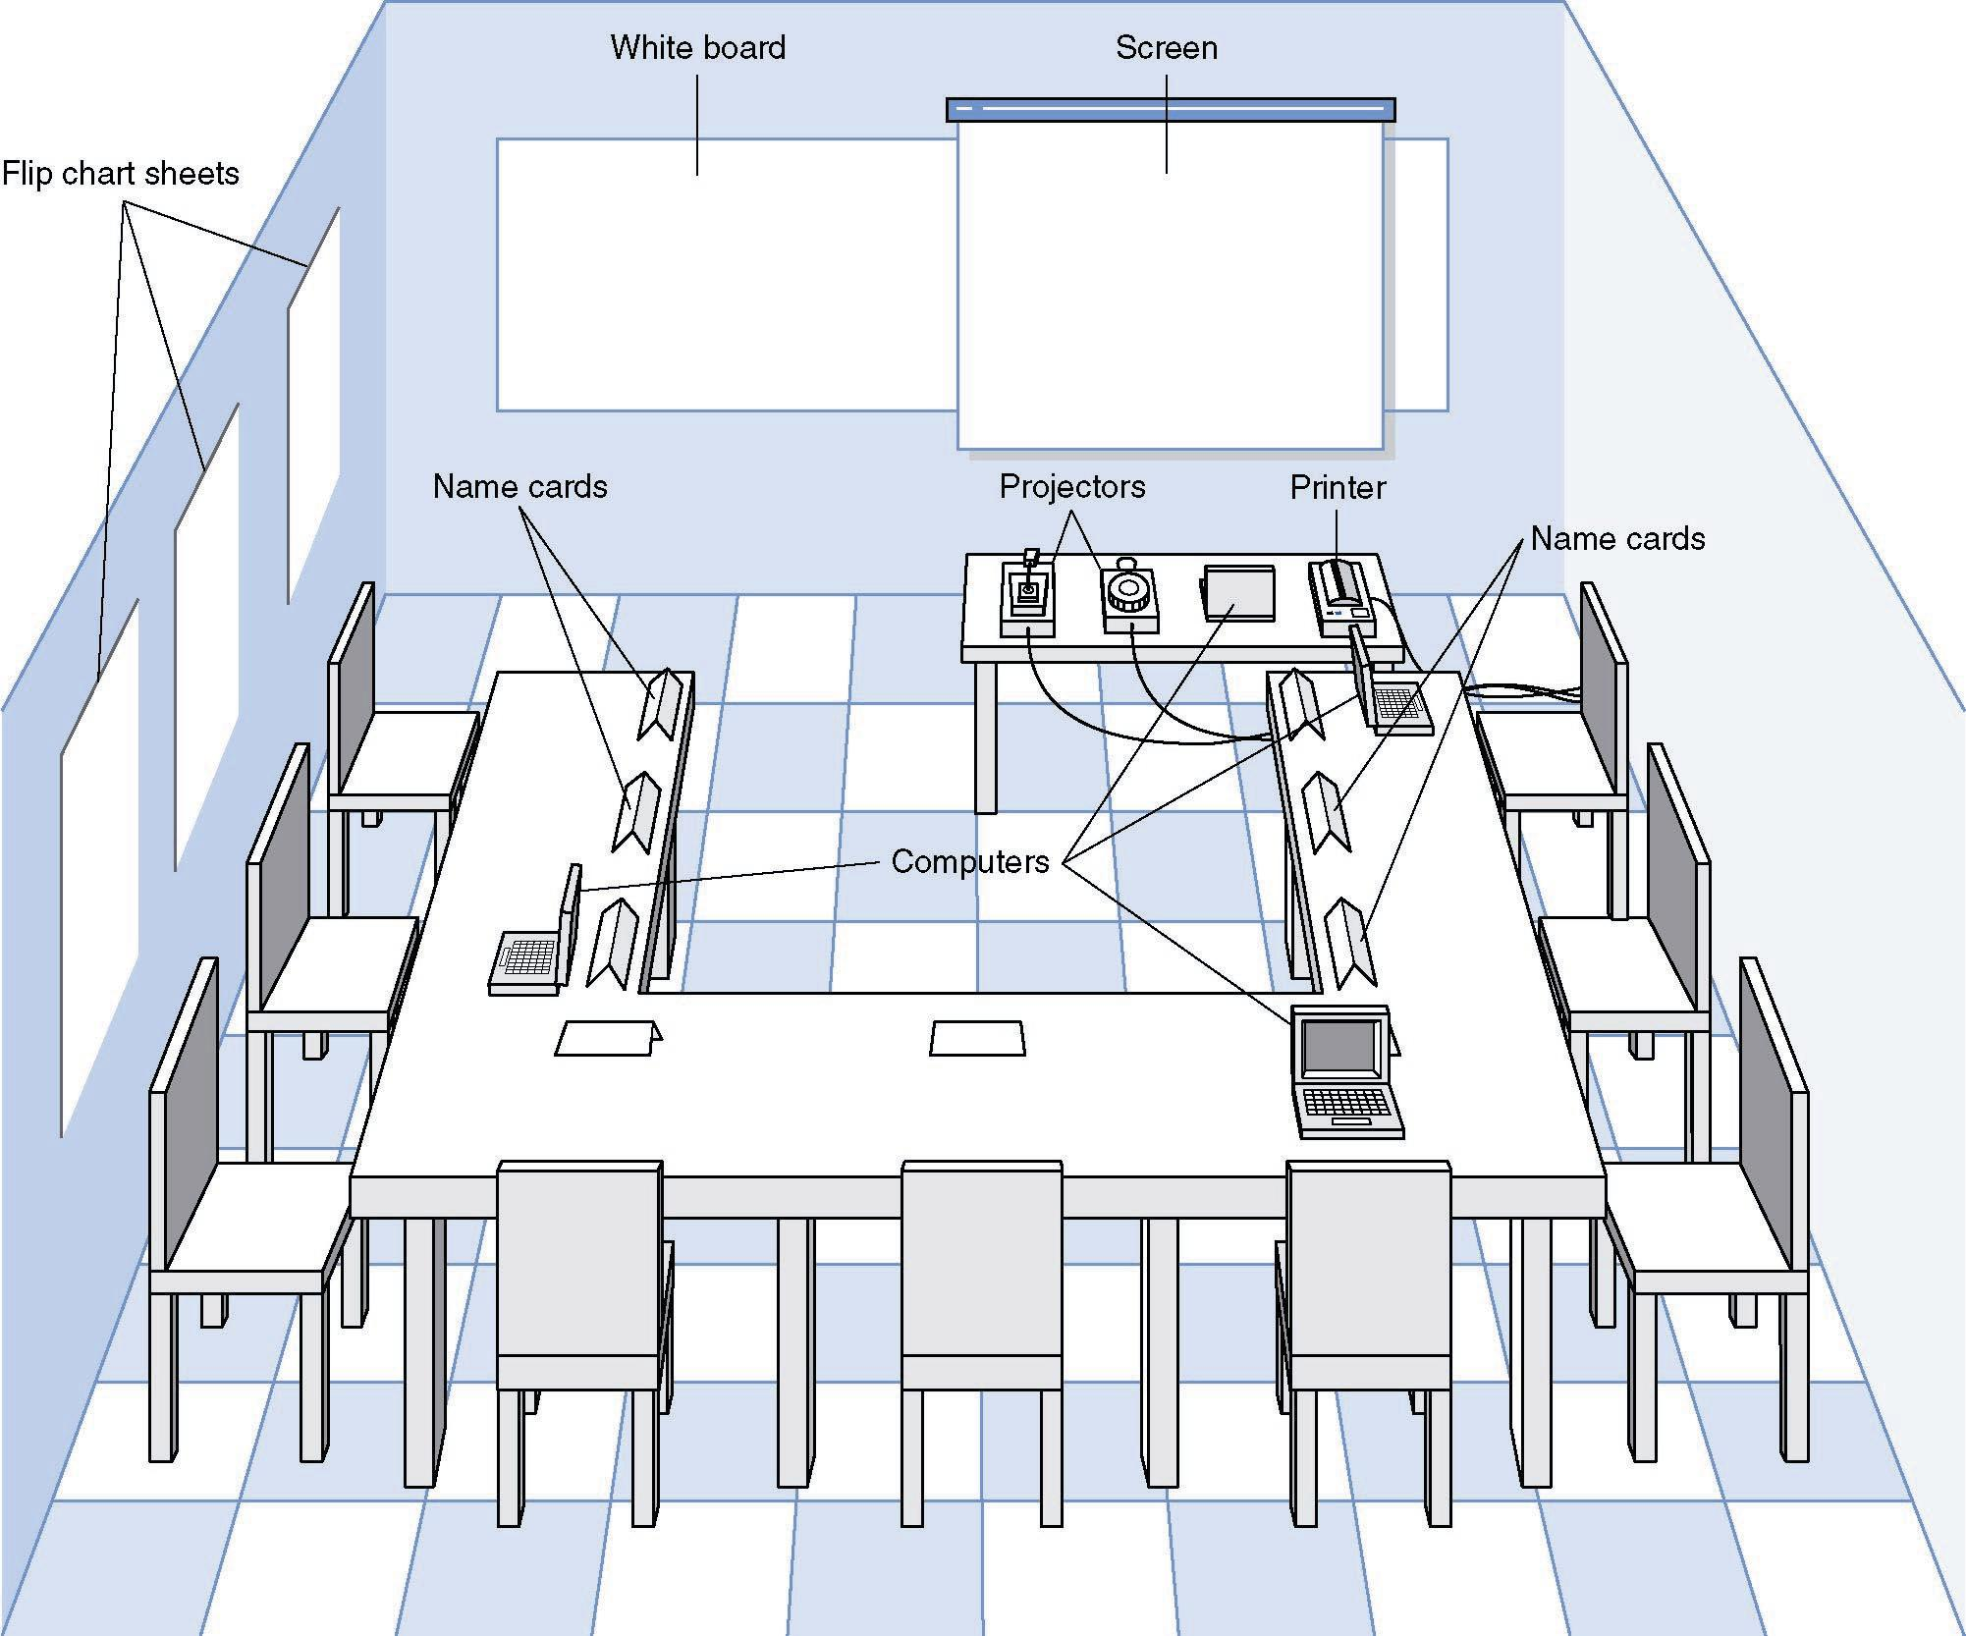
JAD Meeting Room
JPEG Figure 5-5 Goes Here

Slide 26
The JAD Session
Tend to last 5 to 10 days over a three week period
Prepare questions as with interviews
Formal agenda and ground rules
Facilitator activities
  Keep session on track
  Help with technical terms and jargon
  Record group input
  Help resolve issues
Post-session follow-up

Slide 27
Managing Problems in JAD Sessions
Reducing domination
Encouraging non-contributors
Side discussions
Agenda merry-go-round
Violent agreement
Unresolved conflict
True conflict
Use humor

Slide 28
Questionnaires
A set of written questions used to obtain information from individuals
Often used for large numbers of people from whom information and opinions are needed
Common technique with systems intended for use outside the organization
Response rates vary, but typically are significantly less than 50%

Slide 29
Questionnaire Steps
Selecting participants
  Using samples of the population
Designing the questionnaire
  Careful question selection
Administering the questionnaire
  Working to get good response rate
Questionnaire follow-up
  Send results to participants

Slide 30
Good Questionnaire Design
Begin with non-threatening and interesting questions
Group items into logically coherent sections
No important items at the very end
Do not crowd a page with too many items
Avoid abbreviations
Avoid biased or suggestive items or terms
Number questions to avoid confusion
Pretest to identify confusing questions
Provide anonymity to respondents

Slide 31
Document Analysis
Provides clues about existing “as-is” system
Typical documents
  Forms
  Reports
  Policy manuals
Look for user additions to forms
Look for unused form elements

Slide 32
Observation
Users/managers often don’t remember everything they do
Checks validity of information gathered other ways
Behaviors change when people are watched
Careful not to ignore periodic activities
  Weekly … Monthly … Annual

Slide 33
Other Techniques
Throw-away prototyping
Role playing CRC cards with use cases
Mind/concept mapping

Slide 34
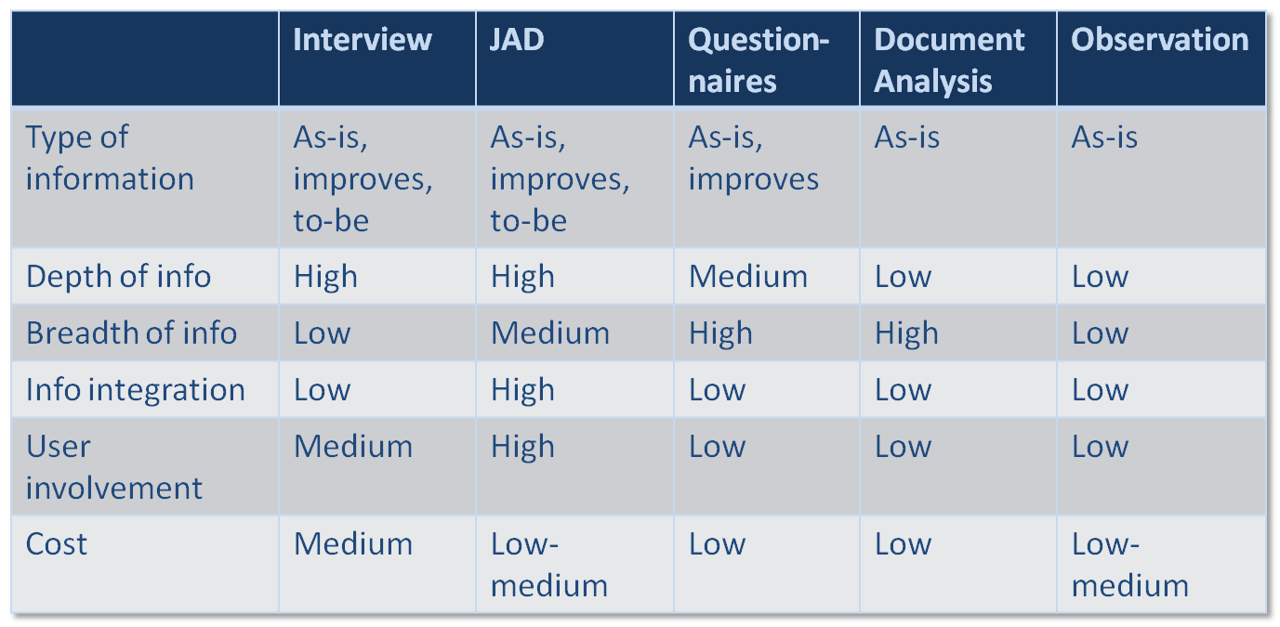
Selecting Appropriate Techniques

Slide 35
THE SYSTEM PROPOSAL

Slide 36
The System Proposal
The result of the planning and analysis phases
Typically includes:
  Executive summary
  System request
  Work plan
  Feasibility analysis
  Requirements definition
  Evolving system models

Slide 37
Summary
Requirements determination
Requirements analysis strategies
Requirements-gathering techniques
The system proposal

