Slide 1
Chapter 5:
Functional Modeling

Slide 2
Objectives
Understand the rules and style guidelines for activity diagrams.
Understand the rules and style guidelines for use cases and use-case diagrams.
Understand the process used to create use cases and use-case diagrams
Be able to create functional models using activity diagrams, use cases, and use-case diagrams.

Slide 3
BUSINESS PROCESS MODELING WITH
ACTIVITY DIAGRAMS

Slide 4
Business Process Modeling
Business process models describe the activities that collectively support a business process
A very powerful tool for communicating the analyst’s current understanding of the requirements with the user
Activity diagrams are used to model the behavior in a business process

Slide 5
Activity Diagram Syntax
Action or Activity
  Represents action or set of actions
Control Flow
  Shows sequence of execution
Initial Node
  The beginning of a set of actions
Final Node
  Stops all flows in an activity
Decision Node
  Represents a test condition

Slide 6
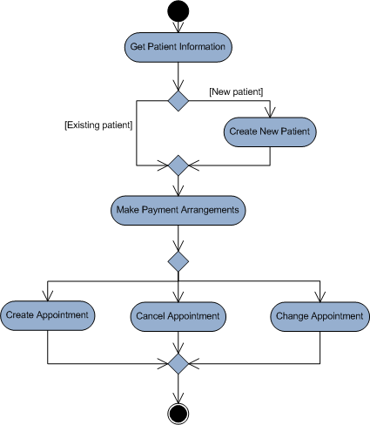
Sample Activity Diagram

Slide 7
Guidelines for Activity Diagrams
Set the scope of the activity being modeled
Identify the activities, control flows, and object flows that occur between the activities
Identify any decisions that are part of the process being modeled
Identify potential parallelism in the process
Draw the activity diagram

Slide 8
USE-CASE DESCRIPTIONS

Slide 9
Use Cases
A use case illustrates the activities that are performed by users of a system.
Describe basic functions of the system
  What the user can do
  How the system responds
Use cases are building blocks for continued design activities.

Slide 10
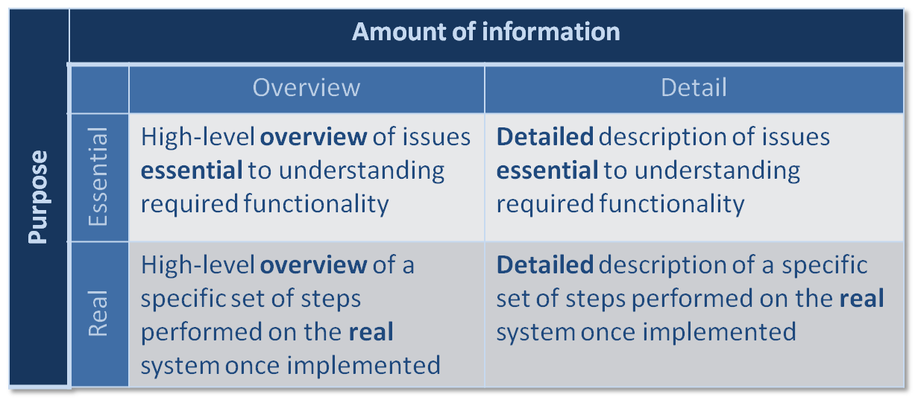
Types of Use Cases

Slide 11
Use Case Elements: Overview
Name
ID Number
Type
Primary Actor
Brief Description
Importance Level
Stakeholder(s)
Trigger(s)

Slide 12
Use Case Elements: Relationships
Association
  documents the communication between the use case and the actors that use the use case
Extend
  represents the extension of the functionality of the use case to incorporate optional behavior
Include
  shows the mandatory inclusion of another use case
Generalization
  allows use cases to support inheritance

Slide 13
Use Case Elements: Flows
Normal Flows
  include only those steps that normally are executed in a use case
Sub-Flows
  the normal flow of events decomposed to keep the normal flow of events as simple as possible
Alternate or Exceptional Flows
  flows that do happen but are not considered to be the norm

Slide 14
Use Case Writing Guidelines
Write in the form of subject-verb-direct object
Make sure it is clear who the initiator of the step is
Write from independent observer’s perspective
Write at about the same level of abstraction
Ensure the use case has a sensible set of steps
Apply the KISS principle liberally.
Write repeating instructions after the set of steps to be repeated

Slide 15
USE-CASE DIAGRAMS

Slide 16
Use Case Diagram Syntax
Actor
  person or system that derives benefit from and is external to the subject
Use Case
  Represents a major piece of system functionality
Association Relationship
Include Relationship
Extend Relationship
Generalization Relationship
<<includes>>
<<extends>>

Slide 17
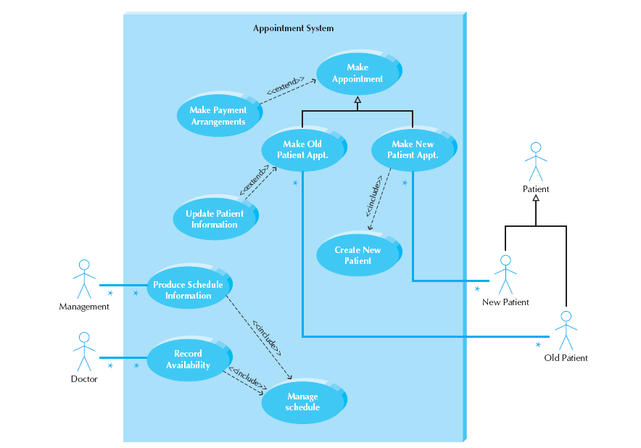
Sample Use Case

Slide 18
CREATING USE-CASE DESCRIPTIONS
AND USE-CASE DIAGRAMS

Slide 19
Identify the Major Use Cases
Review the activity diagram
Find the subject’s boundaries
Identify the primary actors and their goals
Identify and write the overviews of the major use cases for the above
Carefully review the current use cases. Revise as needed

Slide 20
Extend the Major Use Cases
Choose one of the use cases to expand
Start filling in the details of the chosen use case
Write the normal flow of events of the use case
If the normal flow of events is too complex or long, decompose into sub flows
List the possible alternate or exceptional flows
For each alternate or exceptional flow, list how the actor and/or system should react

Slide 21
Confirm the Major Use Cases
Carefully review the current set of use cases. Revise as needed
Start at the top again

Slide 22
Create the Use Case Diagram
Draw the subject boundary
Place the use cases on the diagram
Place the actors on the diagram
Draw the associations

Slide 23
REFINING PROJECT SIZE AND EFFORT
ESTIMATION USING USE-CASE POINTS

Slide 24
Use-Case Points
A size and effort estimation technique that was developed around use cases
  Better for OOSAD projects than function points
Requires at a minimum:
  The set of essential use cases
  The use case diagram
  All actors and use cases classified as simple, average, or complex

Slide 25
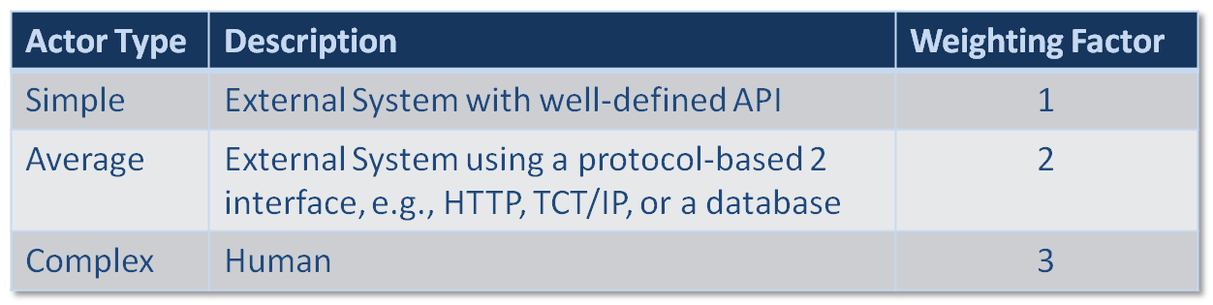
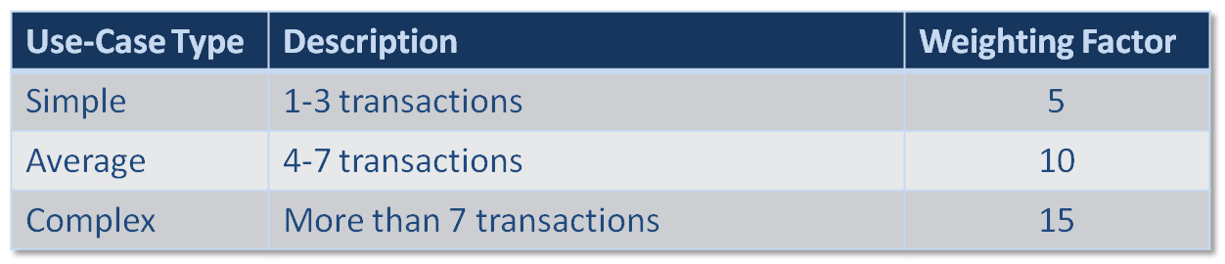
Actor & Use Case Weighting Tables
Unadjusted Actor Weighting (UAW)
Unadjusted Use Case Weighting (UUCW)
Unadjusted Use Case Points (UUCP) = UAW + UUCW

Slide 26
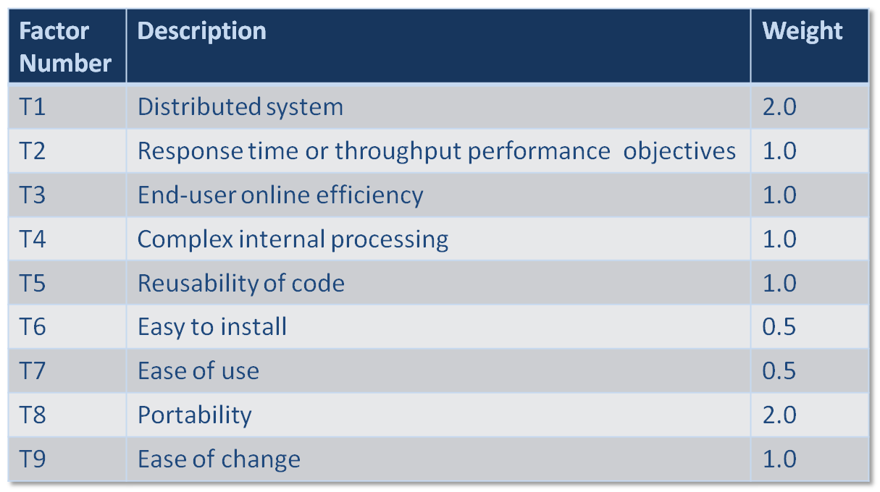
Technical Complexity Factors
Technical Complexity Factor (TCF) = 0.6 + (0.01 * TFactor)

Slide 27
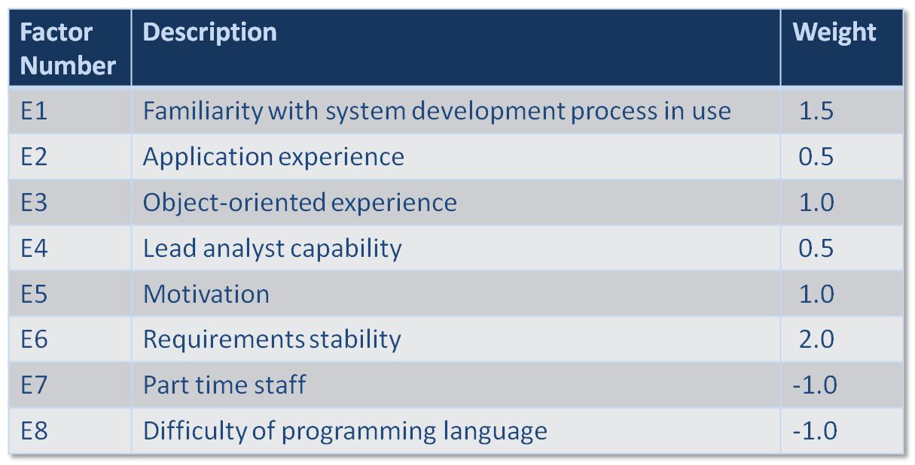
Environmental Factors
Environmental Factor (EF) = 1.4 + (-0.03 * EFactor)

Slide 28
Person-Hours Multiplier
If the sum of (number of Efactors E1 through E6 assigned value < 3) and (number of Efactors E7 and E8 assigned value > 3) ≤ 2
PHM = 20
Else If the sum of (number of Efactors E1 through E6 assigned value < 3) and (number of Efactors E7 and E8 assigned value > 3) = 3 or 4
PHM 28
Else
Rethink project; it has too high of a risk for failure

Slide 29
Computing Use-Case Points
Adjusted Use Case Points (UCP) =
UUCP * TCF * ECF
Effort in Person Hours =
UCP * PHM

Slide 30
Summary
Business Process Modeling with Activity Diagrams
Use-Case Descriptions
Use-Case Diagrams
Refining Project Size and Effort Estimation with Use-Case Points

