Slide 1
Chapter 8:
Moving on to Design

Slide 2
Objectives
Understand the verification and validation of the analysis models.
Understand the transition from analysis to design.
Understand the use of factoring, partitions, and layers.
Be able to create package diagrams.
Be familiar with the custom, packaged, and outsource design alternatives.
Be able to create an alternative matrix.

Slide 3
Key Ideas
The purpose of the analysis phase is to figure out what the business needs. The purpose of the design phase is to figure out how to provide it.
The steps in both analysis and design phases are highly interrelated and may require much “going back and forth”

Slide 4
Avoiding Classic Design Mistakes
Reducing design time
Feature creep
Silver bullet syndrome
Switching tools in mid-project

Slide 5
VERIFYING AND VALIDATING (V&V) THE ANALYSIS MODELS

Slide 6
Walkthroughs
Peer reviews of models and diagrams created during analysis
  Conducted by teams of analysts, designers, and clients
  Main purposes:
    Test the fidelity of the models
    Uncover errors or faults
Potential danger is that analysts be punished for errors uncovered

Slide 7
Functional Model V&V
Events in Use Case descriptions should map to activities in the Activity Diagram
Object node in an activity diagram must be mentioned in Use Case descriptions
Sequential ordering within the Use Cases should match ordering in Activity Diagram
There must be a one-to-one correspondence of Use Cases in the Use Case Diagram and Use Case descriptions.

Slide 8
Functional Model V&V (cont’d)
All actors listed in a use case description must be portrayed on the use-case diagram
Include stakeholders listed in the use case description as actors in the use-case diagram
All relationships listed in a use-case description must be portrayed on a use-case diagram

Slide 9
Structural Model V&V
Every CRC card should be associated with a class on the class diagram
Responsibilities listed on the CRC card must be operations in a class on a class diagram
Collaborators on the CRC card imply some type of association on the class diagram
Attributes listed on CRC cards must be attributes in a class on a class diagram

Slide 10
Structural Model V&V (cont’d)
Class attributes with a type that is another class imply a relationship between classes
Relationships on the CRC cards must show up on the class diagram
Use association classes only if the association has unique attributes not on either class

Slide 11
Behavioral Model V&V
Actors & objects on sequence diagrams must be included on communication diagrams
Messages on sequence diagrams require associations on communications diagrams
Every message on a sequence diagram must appear as a message on an association in the corresponding communication diagram
Guard conditions messages in sequence diagrams require equivalent guard conditions on the corresponding communication diagrams

Slide 12
Structural Model V&V (cont’d)
The sequence number on message labels in communications diagrams must correspond to the top-down ordering of the messages being sent on the sequence diagram
State machine transitions must be associated with a messages on sequence & communication diagrams
All entries in a CRUD matrix imply a message being sent between an actor or object and another

Slide 13
EVOLVING THE ANALYSIS MODELS INTO DESIGN MODELS

Slide 14
Factoring
Creating modules that account for similarities and differences between units of interest
New classes
  Generalization
  Aggregation
Abstracting
Refinement

Slide 15
Partitions and Collaborations
Creating “subsystems” or larger units
Grouping units that collaborate
May have collaboration among units or partitions
The more messages or contracts between objects, the more likely they are in the same partition

Slide 16
Layers
Consider system environment information to help evolve the analysis model
Model-view-controller (MVC) architecture
Separating application logic from user interface logic

Slide 17
5 Layers
Foundation
Problem Domain
Data Management
Human-Computer Interaction
Physical Architecture

Slide 18
PACKAGES AND PACKAGE DIAGRAMS

Slide 19
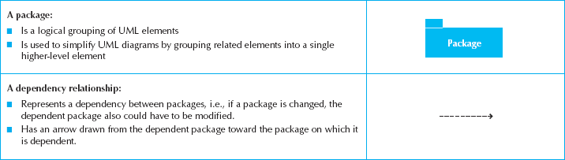
Package
A general construct that groups units together
Used to reduce complexity of models
A package diagram shows packages only

Slide 20
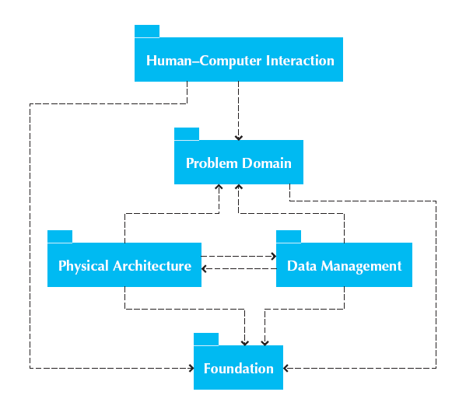
Package Diagram for 5 Layers

Slide 21
Building Package Diagrams
Set the context
Cluster classes together based on shared relationships
Model clustered classes as a package
Identify dependency relationships among packages
Place dependency relationships between packages

Slide 22
DESIGN STRATEGIES

Slide 23
Custom Development
Allows for meeting highly specialized requirements
Allows flexibility and creativity in solving problems
Easier to change components
Builds personnel skills
May tax firm’s resources
May add significant risk

Slide 24
Packaged Software
Software already written
May be more efficient
May be more thoroughly tested and proven
May range from components to tools to whole enterprise systems
Must accept functionality provided
May require change in how the firm does business
May require significant “customization” or “workarounds”

Slide 25
System Integration
The process of combining packages, legacy systems, and new software
Key challenge is integrating data
Write data in the same format
Revise existing data formats
Develop “object wrappers”

Slide 26
Outsourcing
Hire external firm to create system
May have more skills
May extend existing resources
Never outsource what you don’t understand
Carefully choose vendor
Prepare contract and payment style carefully

Slide 27
Selecting a Design Strategy
Business need
In-house experience
Project skills
Project management
Time frame

Slide 28
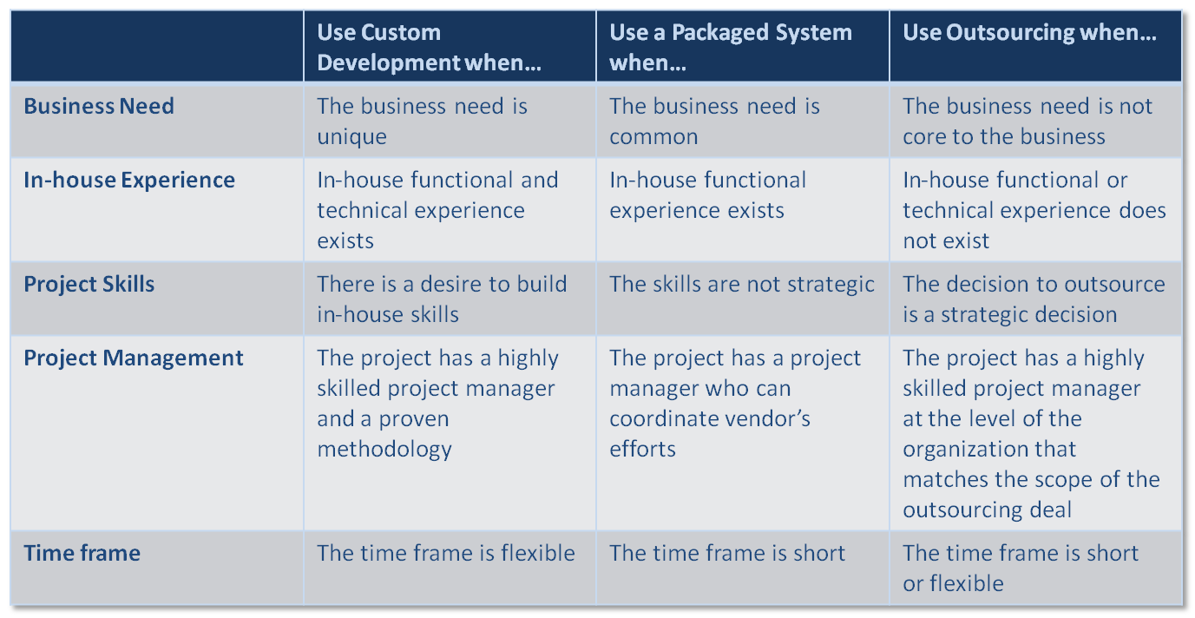
Selecting a Design Strategy

Slide 29
DEVELOPING THE ACTUAL DESIGN

Slide 30
The Alternative Matrix
Combines several feasibility analyses into one grid
Revisits technical, economic, and organizational feasibility

Slide 31
Request for Proposals
Description of the system you propose to be built
Vendors, developers, service providers respond with proposals including how they will address needs as well as stating cost and time requirements.

Slide 32
Summary
Verifying and Validating the Analysis Models
Evolving the Analysis Models into Design Models
Packages and Package Diagrams
Design Strategies
Developing the Actual Design

